Slide 1
cvmfs for LBNE Stu Fuess Fermilab 1/31/2014

Slide 2
Outline
Overview of cvmfs elements
Intro to FNAL and OSG Oasis implementations
High level view of “How it works”
What’s been created (so far) for LBNE
Configuring a client
FNAL and Oasis differences – reprise
Some final details
References

Slide 3
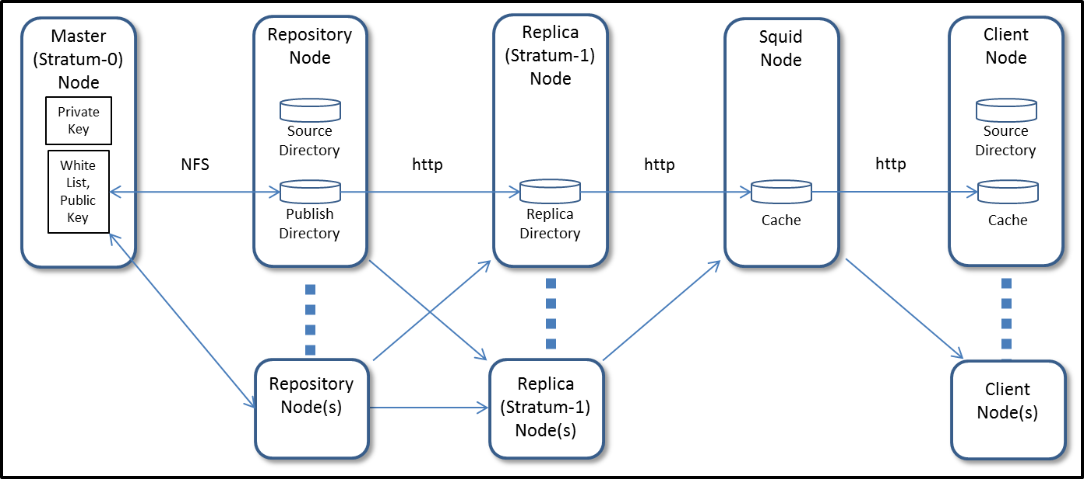
Overview of cvmfs elements
Purpose is to “distribute” one definitive read-only Repository Source directory to copies on many Clients
Distribution via http of compressed/encrypted/cached files

Slide 4
Intro to FNAL and OSG Oasis implementations
FNAL implementation
OSG Oasis implementation
Single Master, then Repository for each experiment (VO)
Release manager(s) directly access Repositories
“Publish” steps are independent
Keys, configs manually distributed
(Currently) only accessible within fnal.gov domain
Master and VO Repositories all on single “Stratum-0” node
All VO Release managers utilize single login node (not shown) which exports VO areas to Stratum-0
“Publish” steps are serialized among VOs
Keys, configs part of OSG distribution

Slide 5
“How it works” (1)
Release manager places distribution files (source, binaries, whatever) in Source area of Repository node
A daemon is watching and logging all changes
Upon a “publish” command, the log is unwound and all changes are reflected in compressed, encrypted files in the Publish directory
A catalog, part of this directory, maintains the relations between the Source files and the created/modified Published files
Source files are identified by their SHA-1 hash. Files with the same hash, independent of directory location, are stored only once in the Publish directory (this is a principal advantage of cvmfs)

Slide 6
“How it works” (2)
Replica (aka Stratum-1) node(s) periodically (cron job) maintain full Replicas of the Publish directories
The intent is for a Replica node to be located in each geographical / site / network / logical area
The Replica also maintains snapshots of prior catalogs
On a Client node, a user accesses the Source directory
This initiates an automount of a FUSE file system
A source file is located in the published catalog, then extracted from a compressed file in a cached copy of the Replica directory.

Slide 7
“How it works” (3)
If the required compressed file is not in the local cache, an http call to (optionally) a Squid server or a Replica server is made to fetch the file
If a Squid server is utilized, it will fetch, via http, and cache the contents of the Replica server(s)
Aside: The Replica server must have the full distribution. The Squid server should have as much as possible. The Client will likely have a much smaller local cache.

Slide 8
What’s been created (so far) for LBNE
All work to date has been done within the FNAL implementation. LBNE is not yet in Oasis.
A Repository node has been configured for LBNE
Node: lbnecfs.fnal.gov
Only a single “cvmfs” user exists; .k5login lists authorized people
~200 GB working space to transfer files, etc
~2 TB disk to contain “source” and “publish” directories
References give Client node configuration instructions
SL/SLF centric
Can easily do on laptop/VM
But (currently) limited to fnal.gov (ref Oasis discussion…)
LBNE VMs (lbnegpvm*.fnal.gov) are configured as Client nodes, pointing to both FNAL and Oasis repos

Slide 9
Configuring a client
Get cvmfs client package (as RPM, whatever)
Get public key(s), either/both from FNAL Master or Oasis Stratrum-0
Configure cvmfs to define repositories (Names! Nodes are not needed), Squid servers, Replica servers, etc
Can access multiple repositories, each with its own (set of) Replica servers
Configure fuse, autofs. Need sizable (~10+ GB for local cache)
Access your files! For example:
ls /cvmfs/lbnecfs.fnal.gov/

Slide 10
FNAL and Oasis differences – reprise
In the long run, we don’t want to have multiple “definitive sources”
OSG Oasis distribution is meant to be the solution for the Grid
We (FNAL system managers) weren’t particularly impressed with the way Oasis was configured
There have been operational problems, now addressed
We hope there can be some convergence of the methods
In the interim, direct access to the Repository along with an independent implementation allows for a better understanding of operation

Slide 11
Some final details
Effective operation of cvmfs depends upon efficient use of the cache layers.
cvmfs is not meant to distribute large files, eg calibration sets, template background events, etc – there needs to be a separate method for that function.
In the current cvmfs implementation, files are effectively never deleted. Catalog entries may be cleaned up, but because of both compression (multiple source files may be compressed into single published files) and the use of single published files to represent multiple directory entries, the published area is persistent.
All users on a Client share the local cache (either fenced or segregated – but still sharing the disk), and can potentially conflict.

Slide 12
References
Document on FNAL cvmfs installation
http://cd-docdb.fnal.gov/cgi-bin/ShowDocument?docid=5150
OSG Document on installing cvmfs clients
https://twiki.opensciencegrid.org/bin/view/Documentation/Release3/InstallCvmfs
OSG Document on updating Oasis repository
https://twiki.grid.iu.edu/bin/view/Documentation/Release3/UpdateOasis
CERN cvmfs home page
http://cernvm.cern.ch/portal/filesystem

