Slide 1
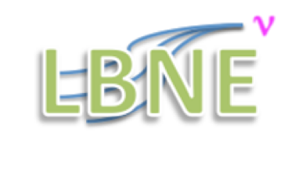
Status and Plans Deliverables for FD
Simulation and Reconstruction
Tom Junk
Fermilab
Simulation Jobs Left To Do
Reconstruction
Documentation and Timescales
Quite a lot
of work has been
done! Thanks!

Slide 2
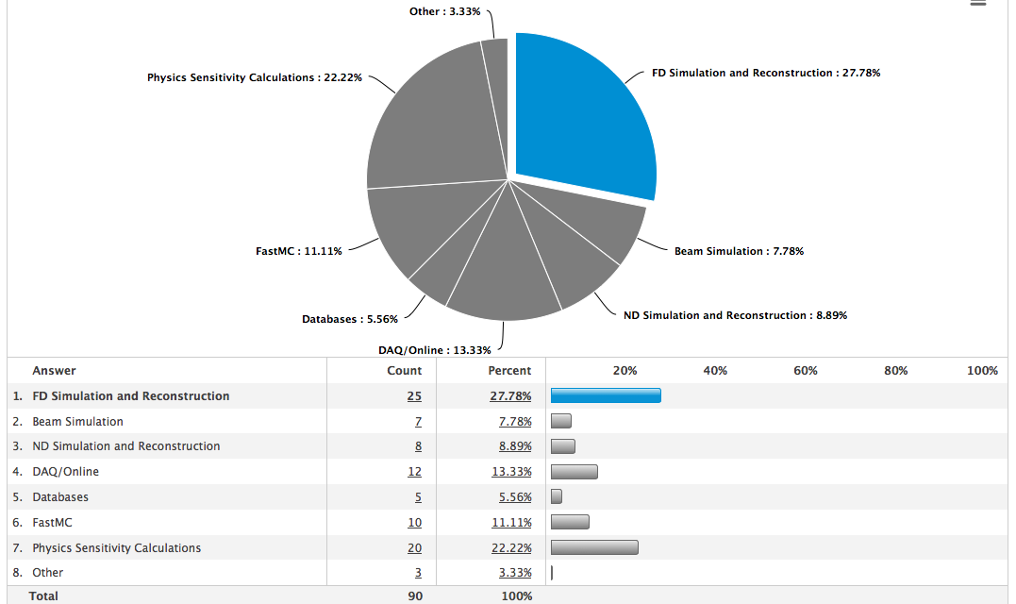
Which Components of LBNE Software Would Your Group Like to Get Involved in Over the
Next Two Years? -- Survey as of September 2013

Slide 3
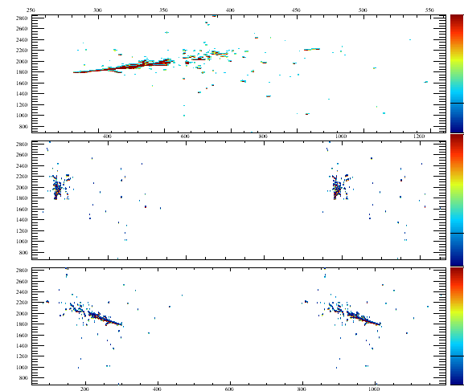
A CC nue Event in the 10 kt FD Simulation – No cosmics. Cryostat 1. TPC 54

Slide 4
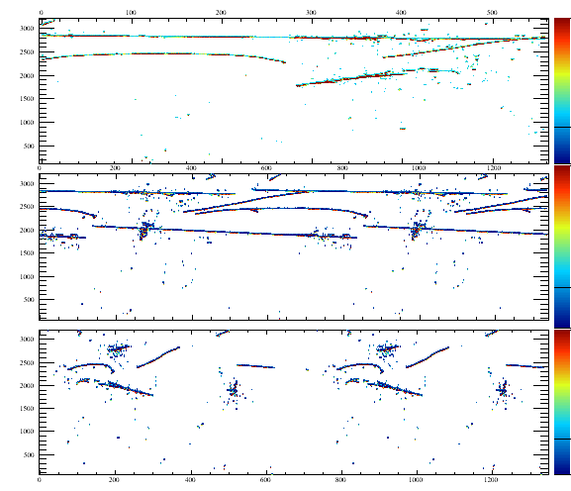
The Same Event, Re-Simulated, with Surface Cosmic-Ray Overlay
Collection
V
U

Slide 5
Simulation TODO List
Finish Validating NEST photon and electron production modeling
Compare predictions of NEST with LArSoft’s current parameterization
Seek ways to reduce memory consumption:
Can we use GEANT4’s geometry replica mechanism to our advantage?
Many samples we need to simulate
GENIE neutrino interactions – already have some at
https://cdcvs.fnal.gov/redmine/projects/lbne-fd-sim/wiki
Simulated from Dan Cherdack’s GENIE files produced for FastMC tasks
To do (or only partially done):
Cosmic rays (underground and 35t surface)
Proton Decay, in several modes
Atmospheric Neutrinos
Supernova interactions
Rock interactions
Interactions of atmospheric and beam neutrinos with detector material
(APA frames, etc).
Simulate ICARUS events? Reconstruct some we get from ICARUS?

Slide 6
LArSoft FD Reconstruction Chain
As used by ArgoNeuT and MicroBooNE
Deconvolution
LBNE Modifications:
Raw Data are zero-suppressed,
and likely other compression
algorithms applied. Cannot unpack
it all at once.
One wire at a time, and apply
deconvolution and hit reco
on blocks of nonzero data
LBNE Modifications:
Ambiguity breaking for
induction-plant hits.
Reconstruct one APA at a time
vs. global tracking and shower finding.
Cosmic-ray rejection may be done at a
faster, more approximate level and events
selected for further processing
Need
a fast
version
for
software
triggering

Slide 7
Deliverables for FD Reconstruction:
Physics Performance: Single Particles in the TPC
Monte Carlo predictions of, and systematic uncertainties on the following:
Efficiency for detecting muons, electrons, protons, pions, and kaons as functions of
Energy
Whether they exit or not (and how much is detected)
Angle
Whether they cross a gap or cross the APA
Energy Resolution for muons, electrons, protons, pions, and kaons as functions of
Energy
Whether they exit or not (and how much is detected)
Energy resolution for exiting muons and electrons is
difficult – scattering angles
and extrapolations needed. Extended readout window helps for some tracks.
Angle
Whether they cross a gap or cross the APA
PID fake-rate matrices for each of the particles
dE/dx performance plot
Functions of energy, angle, and position.
Optimize cuts on PID MVA’s and fiducial cuts on events

Slide 8
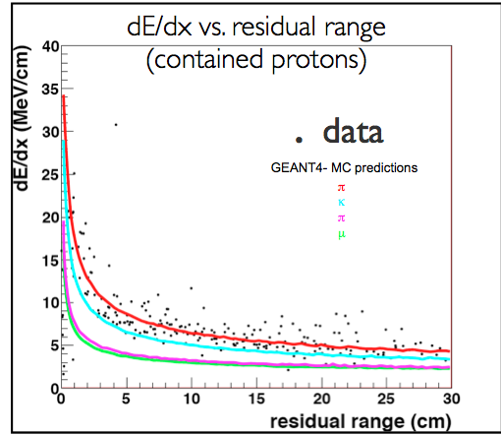
Examples of Delivered Performance Plots (ArgoNeuT)

Slide 9
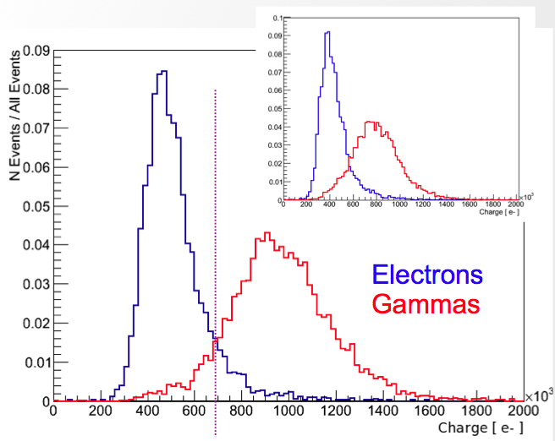
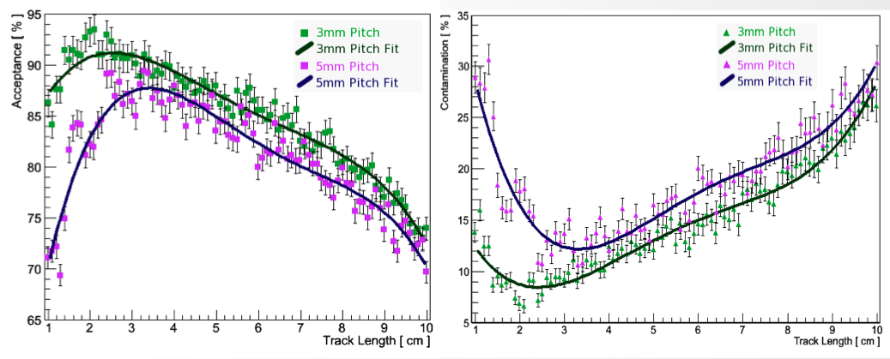
e/γ Separation
Matthew Szydagis, Daniel Coelho
Measured charge in the first part of an EM
shower used to tell one MIP from two
Consulting with ICARUS colleagues to
optimize performance
Acceptance for selecting electrons
Fraction of selected events that are misID
Recent update – Negligible impact on the performance of this metric if we use
36 degree induction-plane wires instead of 45-degree induction-plane wires

Slide 10
Deliverables for FD Reconstruction:
Physics Performance: Neutrino Events
Event Detection Efficiency as a function of incident neutrino energy
CCv_{μ}, CCv_{e}, CCv_{τ}
Separately for QE, Resonant, and DIS interactions
NC interactions
Energy Resolution for
CCv_{μ}, CCv_{e}, CCv_{τ}
Separately for QE, Resonant, and DIS interactions
-- or better yet, parameterized as functions of observable
quantities like reconstructed hadronic recoil particles
Separately for contained and non-contained events
Energy transfer function for NC interactions

Slide 11
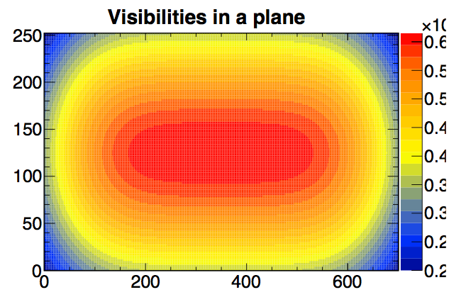
Parameterized Photon Simulation – 10 kt
Just visibilities to the bars, no
attenuation function in the bars
on this page.
Visibilities within
an APA. Pattern
continues for
many APA’s and
fills in edges.
200 cm
from APA

Slide 12
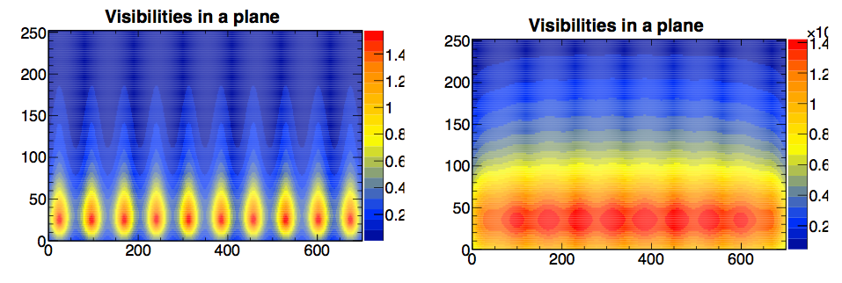
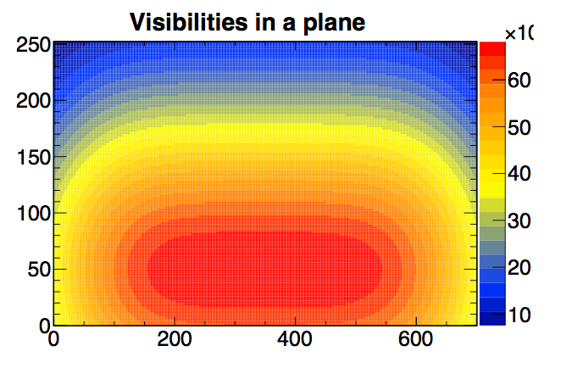
Parameterized Photon Simulation – 10 kt
Including effects of attenuation in the
acrylic bars
Need measured
efficiencies and
attenuation
functions. These
are placeholders.
z
y

Slide 13
Deliverables for FD Reconstruction:
Physics Performance: Photon Detectors
Efficiency for triggering
Beam Neutrino Events
Atmospherics
Supernova neutrino events
Proton Decay
Timing Resolution
Does it depend on energy?
Performance in the presence of backgrounds
Photon Detector Spatial Resolution
Energy Resolution
Association efficiency and purity between PD data and TPC data
Under what circumstances is the association ambiguous?
Norm Buchanan
has started up a
PD Simulation/Reconstruction
Group – Meets Tuesdays
at 1:00 PM Central Time
Mailing list:
lbne-ephxportsim@fnal.gov

Slide 14
Analysis Strategy: Using Data to
Control Backgrounds and Efficiencies
We also need to develop tools for measuring, or at least
constraining, using control samples,
reconstruction efficiency
PID fake rates
backgrounds
for the different particle types as functions of energy, angle, and position,
using the FD data.
Backgrounds: Lots of beam-off data to
constrain cosmics. Non-fiducial events to help
constrain rock events. Instrument the volume
outside the field cage with photon detectors?

Slide 15
FD MC Challenge Proposal
Shown at
September DOE Briefing
MC Files produced for:
(10 kt + 35t) x (With and Without MC Truth info) x (GENIE and GENIE+CRY)
LBNE nominal spectrum for CC nue+nuebar+numu+numubar unoscillated
(and fully oscillated for nue(bar)). NC events from unoscillated numu spectrum.
Without MC truth info – true input vectors hidden from users but kept around for
scoring the results.
Tasks:
1) Identify primary neutrino vertex and give location
2) Identify type of neutrino event – CC nue, numu, or NC
3) Measure energy of primary lepton in CC event candidates
4) Count and identify additional particles produced at the primary vertex
5) Estimate neutrino energy

Slide 16
Questions from the Project – They Need Our Guidance
45-degree or 36-degree induction-plane wires?
Different impact on our physics groups:
Underground beam physics – probalby small impact
Surface beam physics – will be easier with 36 degrees
Atmospheric neutrinos Nucleon decay – background
rejection is easier with 36 degrees
Supernova physics – probably little to no impact
Deeper question – do we need to eliminate wire wrapping
entirely?
What physics do we give up with wrapped wires?
(they cannot be good!)

Slide 17
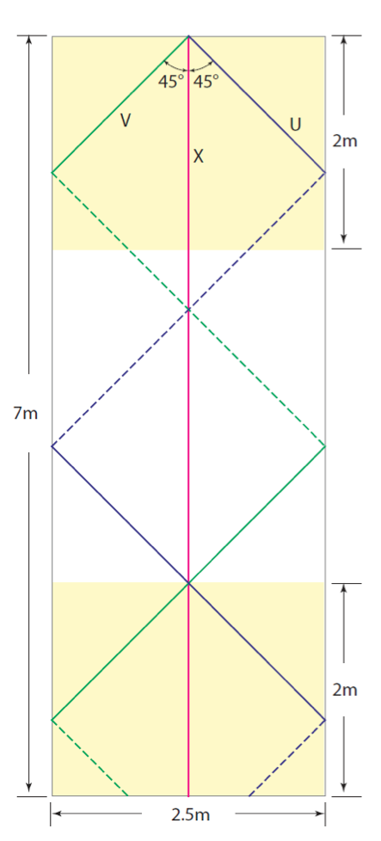
Induction-Plane Wire Wrapping Geometries
45º
Bo Yu
DocDB 6464
36º
They still
wrap,
but they
do not
wrap twice
on the same
side, intersecting
the same
collection
wire

Slide 18
More Questions from the Project
What are the requirements on calibration?
This is also a question for the physics groups as it affects them differently
What are the requirements on radiological purity?
What are the requirements on the detector orientation? And its uncertainty?
What is the wire pitch uniformity tolerance?
What is the impact of <100% transparency in the induction planes?
Impact of gaps between active TPC volumes
Horizontal, vertical, and dead space inside the APA frames
Impact of frame material interactions
Photon detector performance – is this better with transparent or opaque CPA’s?
Requirement on defective wire/channel count and grouping
Photon yield requirements
Physics analysis dependent
Impact of different zero suppression strategies and thresholds
expand windows in time – how about in wire number too?
Data compression studies. Lossless: OK – how much loss are we willing to endure?

Slide 19
People Working on Far Detector Simulation Tasks
FD Simulation
Geometry
Tyler Alion (SC)
Xinchun Tian (SC)
Sanjib Mishra (SC)
Mike Kirby (FNAL)
Tom Junk (FNAL)
Brian Rebel (FNAL)
Zepeng Li (Duke)
Electron Drift
Brian Rebel (FNAL)
Eric Church (FNAL)
Matthew Szydagis (UC Davis)
Jonathan Insler (LSU)
Tom Junk (FNAL)
From meetings and DocDB entries
Photon Production and
Detector Simulation
Zepeng Li (Duke)
Kate Scholberg (Duke)
Dave Muller (SLAC)
Ben Jones (MIT)
Matt Szydagis (UC Davis)
Eric Church (Yale)
Brian Rebel (FNAL)
Alex Himmel (CIT)
Craig Thorn (BNL)
Stan Seibert (Penn, moved on)
Josh Klein (Penn)
Stuart Mufson (Indiana)
Radiologicals
Tom Junk (FNAL)
Vic Gehman (LBNL)
Xinhua Bai (SDSMT)
Emily Dvorak (SDSMT)
Douglas Tiedt (SDSMT)
Luke Corwin (SDSMT)
Electric/Magnetic Field tools
David McKee (moved on)
Producing Samples
Tom Junk (FNAL)
Zepeng Li (Duke)

Slide 20
People Working on Far Detector Reconstruction Tasks
Clustering
Andy Blake (Cambridge)
Mark Thompson (Cambridge)
John Marshall (Cambridge)
Ben Carls (FNAL) (MicroBooNE,
plays an advisory role)
Andrzej Szelc (Yale)
Calorimetry
Andrzej Szelc (Yale)
Kevin Wood (SC)
Sanjib Mishra (SC)
Tracking
Andy Blake (Cambridge)
Mark Thompson (Cambridge)
John Marshall (Cambridge)
Herb Greenlee (FNAL) (MicroBooNE)
Eric Church (Yale)
FD Event Display
Brian Rebel (FNAL)
Zepeng Li (Duke)
Seongtae Park (UTA)
FD Event Scanning
Sanjib Mishra (SC)
Libo Jiang (SC)
Tyler Alion (SC)
Andrzej Szelc (Yale)
Kayla Hasbrouck (SC)
Andrew Svenson
Jae Kim (SC)
Xinchun Tian (SC)
Hit Processing
Jonathan Insler (LSU)
Amir Farbin (UTA)
Hit-finding Characterization
Jonathan Insler (LSU)
Kevin Wood (SC)
Tyler Alion (SC)
Disambiguation Algorithms
Tyler Alion (SC)
Jae Kim (SC)

Slide 21
FD Reconstruction (cont’d)
Photon detector reconstruction
Zepeng Li (Duke)
Kate Scholberg (Duke)
Stan Seibert (Penn)
Low-Energy Reco & nuclear de-excitation gammas
Kate Scholberg (Duke)
Zepeng Li (Duke)
Mike Smy (UC Irvina)
Bob Svoboda (UC Davis)
Reconstructing ICARUS Events
Need person(s). And events.
dE/dx reconstruction/PID
J. Insler (LSU)
Bruce Baller's the expert on ArgoNeuT
Muon charge sign from absorption
Richard Imlay (LSU)
Energy Calibration -- electrons
Kevin Wood (SC)
Sanjib Mishra (SC)
Energy Calibration -- muons
No one specific to LBNE yet -- range and multiple scattering techniques
Energy Calibration -- other particles
Protons, pions, kaons – need personnel
Energy Calibration -- reconstruction of neutrino energy
Needed. But this is down the road from the above tasks. Maybe it can
be worked on making assumptions on the reco of the particles. FastMC does this.

Slide 22
Timescales
January 31 – February 1: FD Workshop/Hackathon @Fermilab
February 2—4: LBNE Collaboration meeting @Fermilab
February 5: Far Detector Engineering meeting @Fermilab
March 20 – 22: R&D and Software & Computing & Physics Tools Internal Review
@Argonne
May 12 – 16: DOE Review of R&D, Software & Computing, Physics Tools

Slide 23
Documentation
Jim Stewart would like us to justify a change request for
moving the wire angle from 45º to 36º on a short timescale (~week)
Documentation for May DOE Review
Physics Tools Status Document, including FD Sim/Reco
Computing Requirements Document (see Maxim’s talk in the collab meeting)
Software and Computing plans document
R&D group document
The first of those, Physics Tools Status, we will have to write/contribute to,
and the others we should review as we are clients and/or participants

