Slide 1
LBNE FD Rawdata Event Display
Seongtae Park
University of Texas at Arlington
Tom Junk
Fermilab
LBNE collaboration meeting
Jan. 31, 2014
Fermilab, Batavia, IL

Slide 2
Outline
How rawdata event display works
10kt FD event display
35t event display
Examples of 35t rawdata display
Summary

Slide 3
Channel comparison between 10kt and 35t detectors
10kt Far detector (120 APA)
Nchannels = 305,760 (=2548x120APA)
All APAs are identical:
Number of channels per APA = 2548
U channels per APA = 714
V channels per APA = 716
Z channels per APA side = 559
TPC: 0~119 in Cryostat 0
TPC: 120~239 in Cryostat 1
35t detector (4APA)
Nchannels = 1992
U channels per APA = 138
V channels per APA = 138
Z channels per APA side = 111
One cryostat and different APA size

Slide 4
Procedure to view raw data
Data File (Simulation, DAQ data)
LarSoft Module
(RawEVD_module.cc, RawEVD35t_module.cc)
rawevd.fcl
rawevd35t.fcl
Uncompressing
Histogram Data File
Root Script
(rawEVD10ktFD.C, rawEVD35tFD.C, interactive)
Display
Time vs channel
ADC vs time

Slide 5
Histogram files
10kt FD
120 time(ticks) vs. channel histograms for U plane(APA)+120 Thumbnail histograms
120 time(ticks) vs. channel histograms for V plane(APA) )+120 Thumbnail histograms
240 time(ticks) vs. channel histograms for Z plane(TPC) )+240 Thumbnail histograms
3 TH2D histogram of sum charge plot for U,V,Z planes
35t detector
4 time(ticks) vs. channel histograms for U plane(APA)+4 Thumbnail histograms
4 time(ticks) vs. channel histograms for V plane(APA) )+4 Thumbnail histograms
8 time(ticks) vs. channel histograms for Z plane(TPC) )+8 Thumbnail histograms
3 TH2D histogram of sum charge plot for U,V,Z planes
Strategy for memory saving
Leaves all the histograms on the disk and only thumbnail histograms are loaded.
Every time you click one of the thumbnails on the main display, automatically load the original version of the histograms into the memory and display on the event display window(time vs channel)
When next click occurs, the previous histograms are removed from the memory and new histograms are loaded.

Slide 6
Samples and histogram generation time
Particle | Generater (Detector) | Energy (MeV) | # of Events | Data file size | Histogram file size | Process Time
Electron | Babu Bhandari (35 t) | 100 | 1000 | 640M | 1.3M | 7:00
Proton |  | 30 | 1000 | 8.7M | 0.1M | 6:00
Muon |  | 500 | 1000 | 471M | 1.2M | 8:00
Pion+ |  | 30 | 1000 | 47M | 0.7M | 6:10
Cosmic |  | - | 1000 | 336M | 8.4M | 7:30
Genie-Cry | Tom Junk (10 kt) | - | 1 | 259M | 33M | 3:30
Atmospheric Neutrinos |  | - | 10(100) | 150M | 18M | 9:00
*No histograms from proton data?
35T 4APA sample:
https://cdcvs.fnal.gov/redmine/projects/lbne-fd-sim/wiki/LBNE35T4APASamples
Particles injected at (100,50,0) cm along +z axis.
10kt Sample:
https://cdcvs.fnal.gov/redmine/projects/lbne-fd-sim/wiki/LBNE10KTSamples

Slide 7
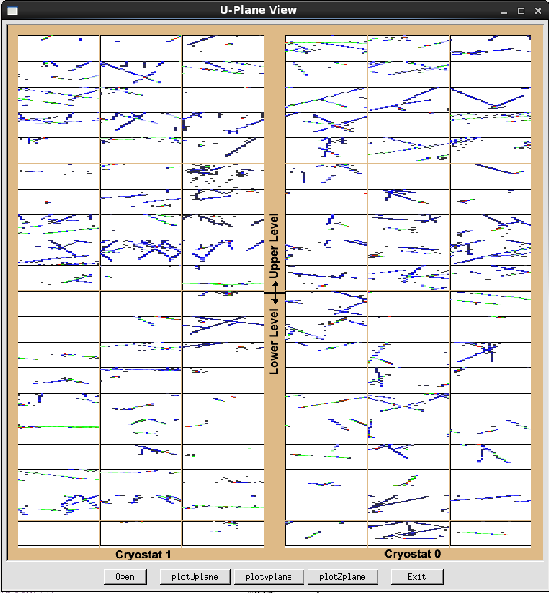
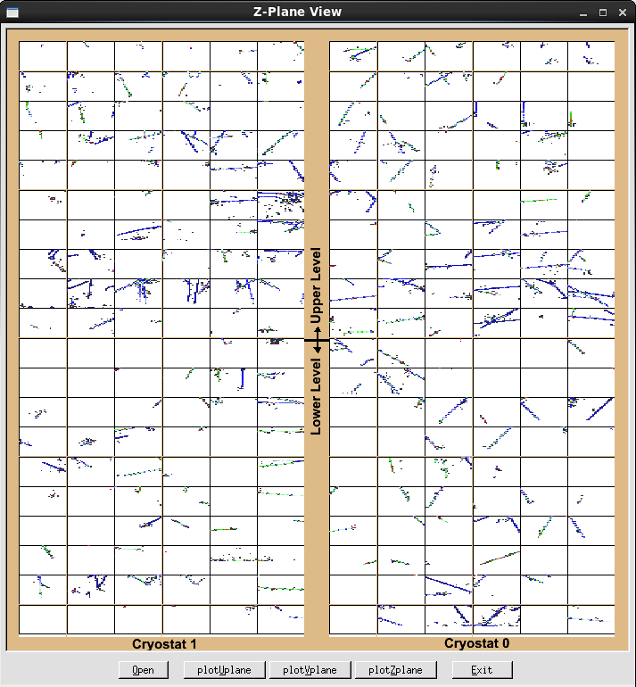
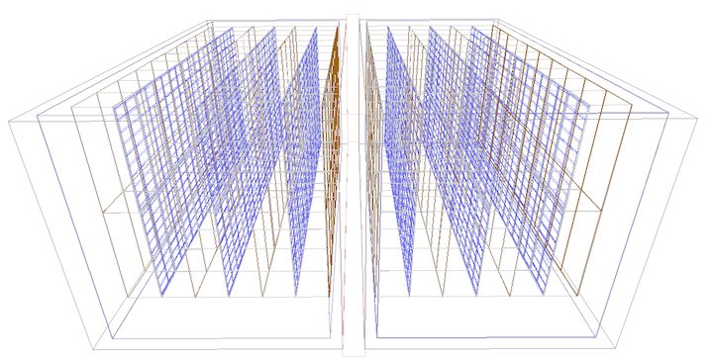
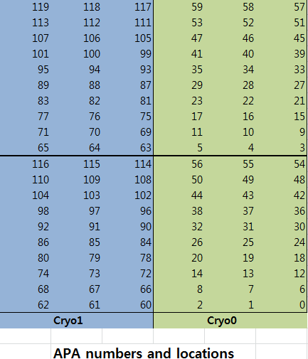
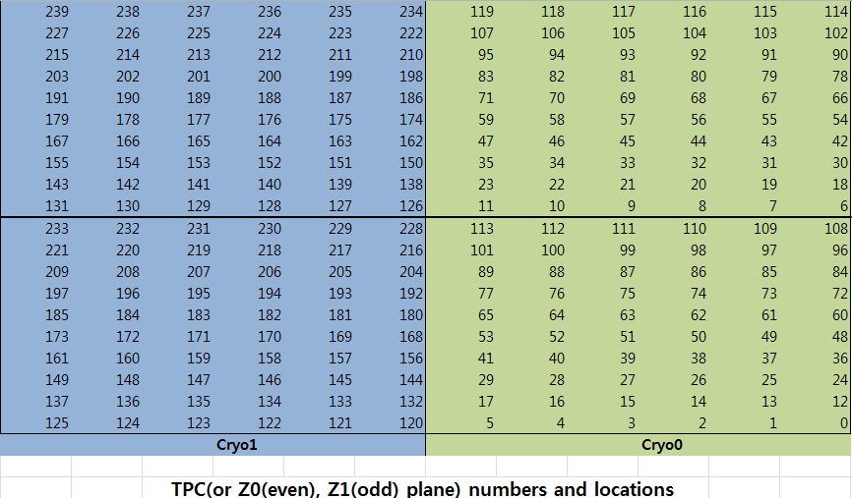
10kt FD APA(U,V planes) and TPC(Z-plane) locations
https://cdcvs.fnal.gov/redmine/projects/lbne-fd-sim/wiki/LBNE_Geometries
U,V plane
Z plane
(Tyler Alion)

Slide 8
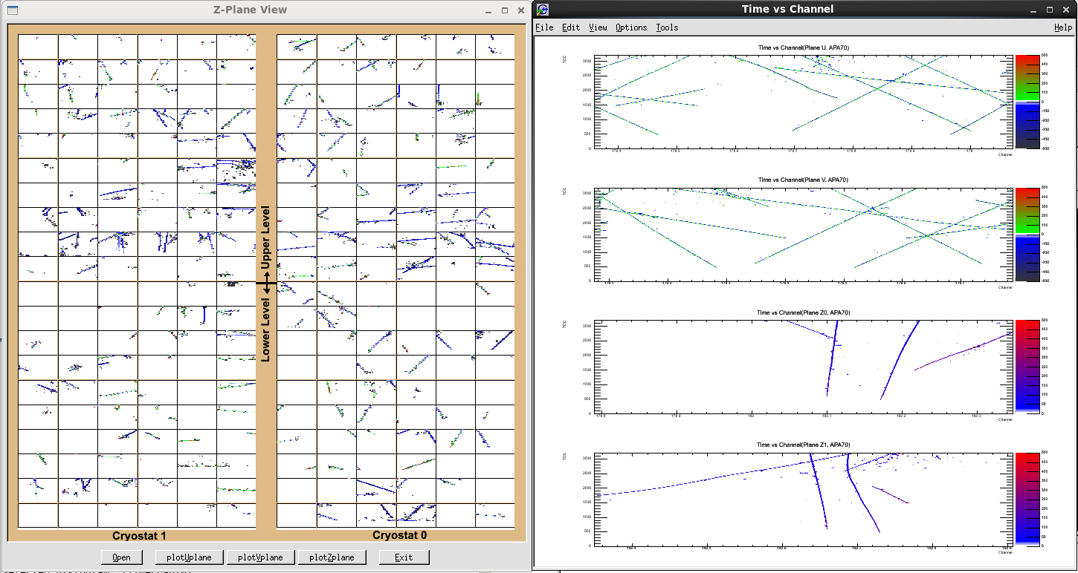
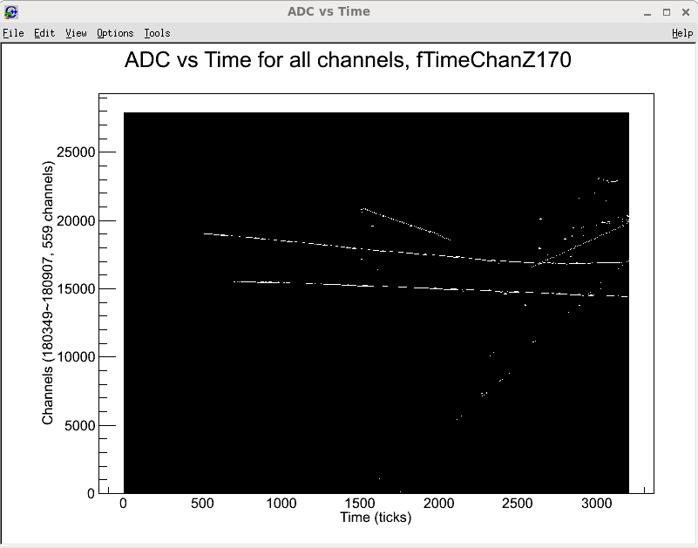
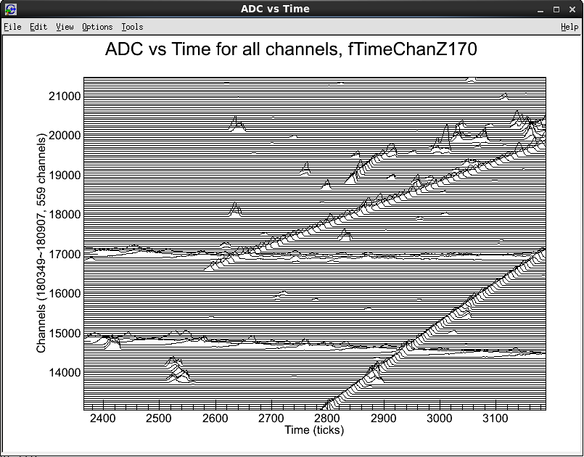
Snap shot of 10kt FD event display
Mouse left click!
Z-plane view: 240 TPCs
GENIE + CRY samples: 10 kT CDR geometry
Mouse wheel click!
Zoom in

Slide 9
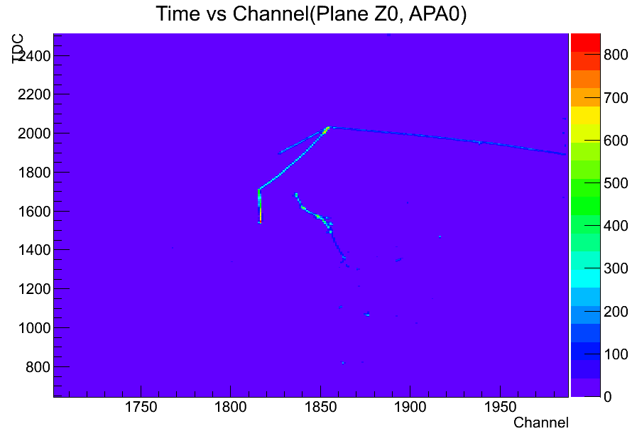
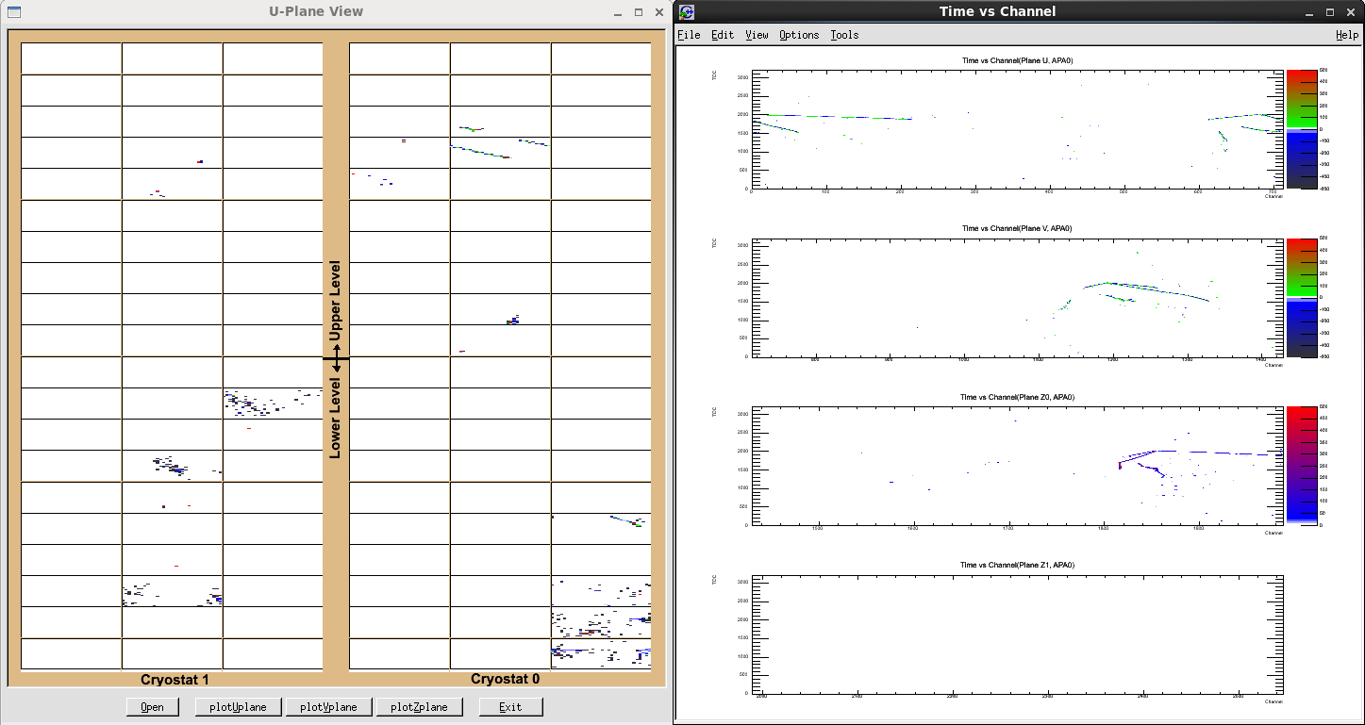
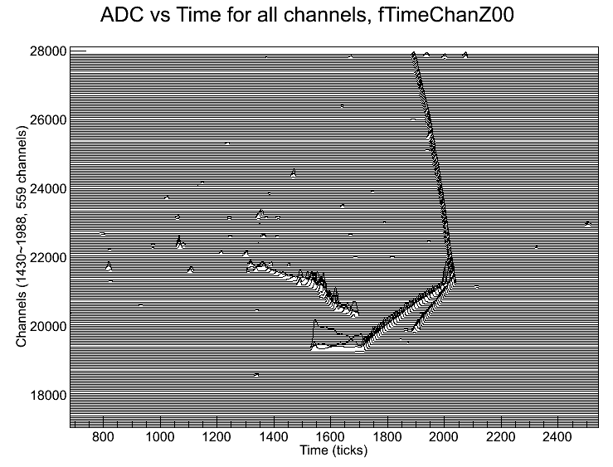
Atmospheric Neutrinos
10 neutrino events
primary vertex X is uniform from -1722 cm to +1722 cm, except for -150 cm to +150 cm which is skipped (the septum).
primary vertex Y is uniform from -879 cm to +879 cm. Z is uniform from 0 cm to 3016 cm
noise simulation is off
zero suppression is on

Slide 10
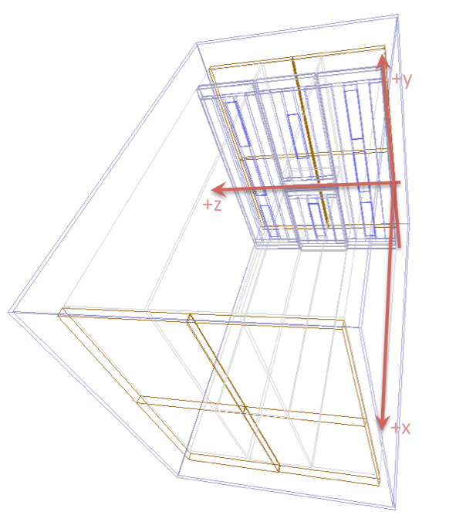
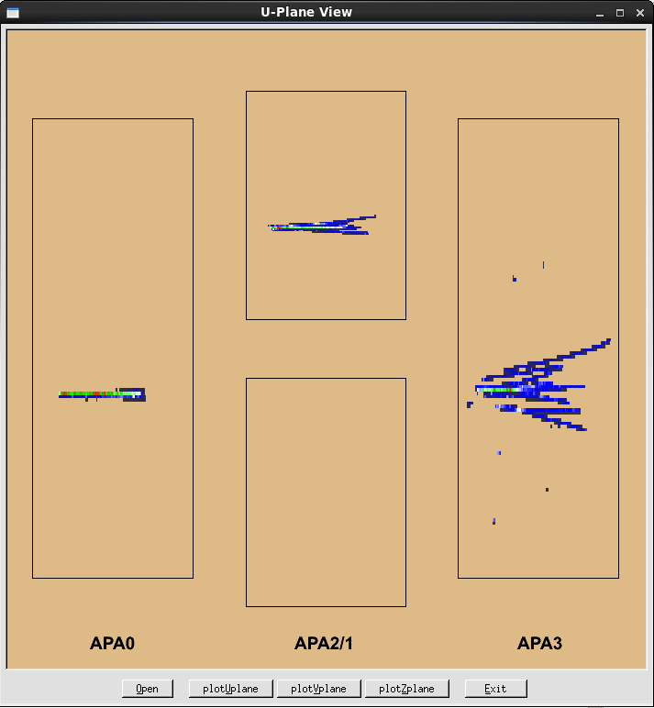
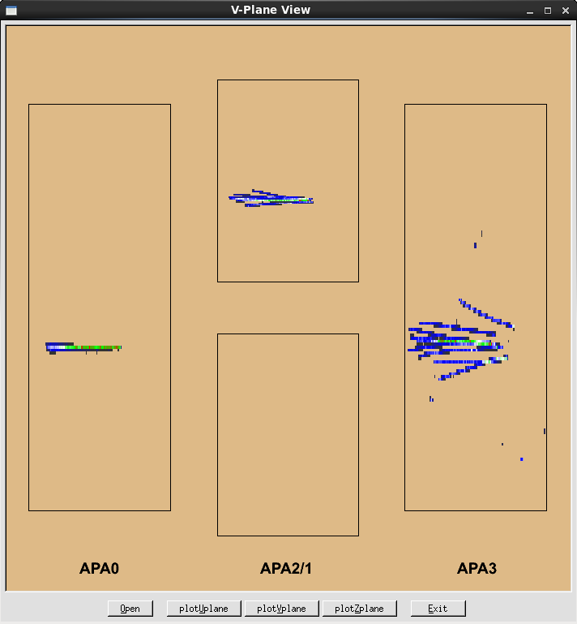
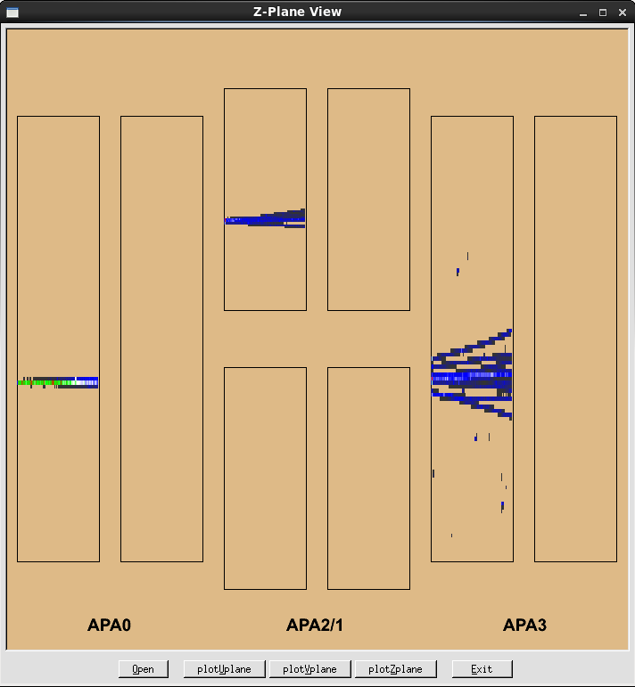
35t detector geometry and main view of event display
APA2
APA3
APA0
35t detector
4 APAs, 8 TPCs
Number of channels = 1992
U channels per APA = 138
V channels per APA = 138
Z channels per APA = 111
Time ticks: 3200
APA1
V-plane wire ordering reversed?

Slide 11
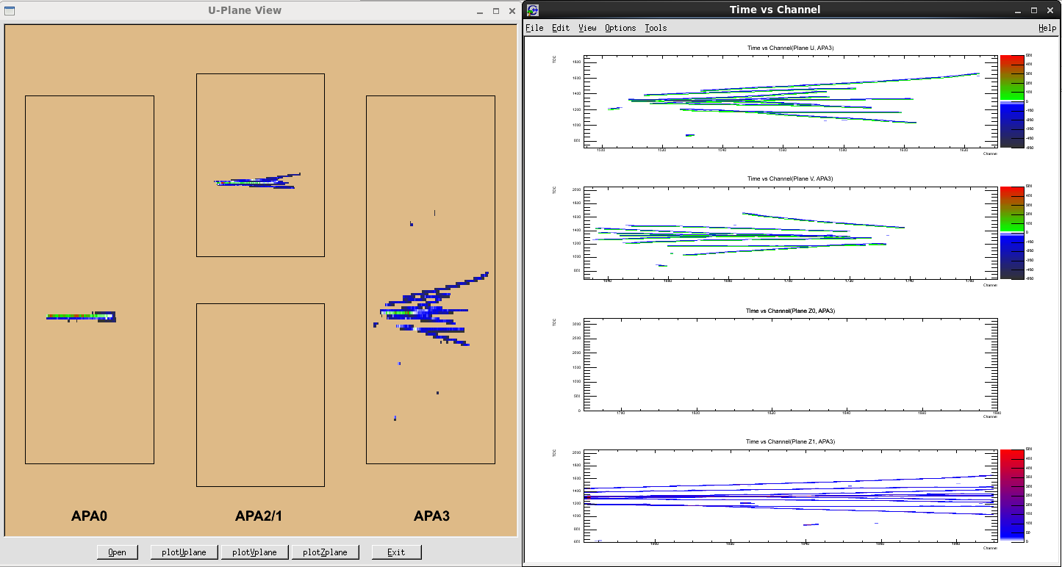
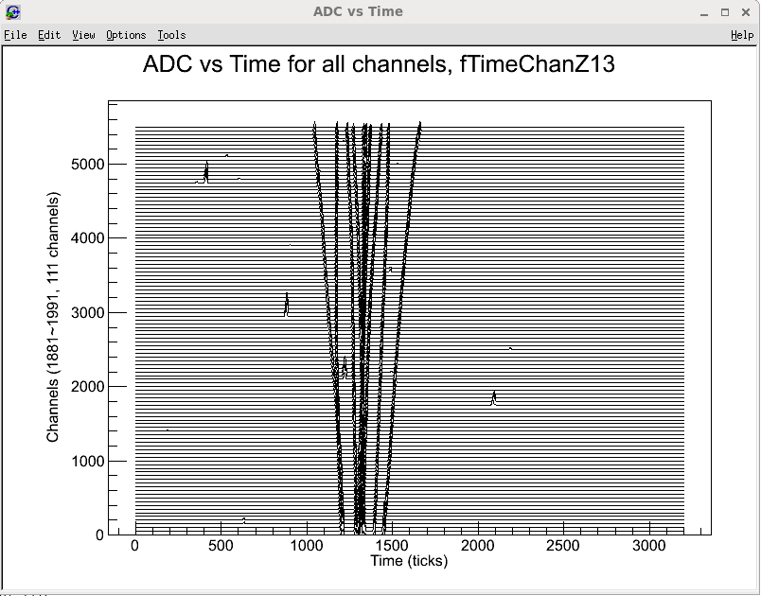
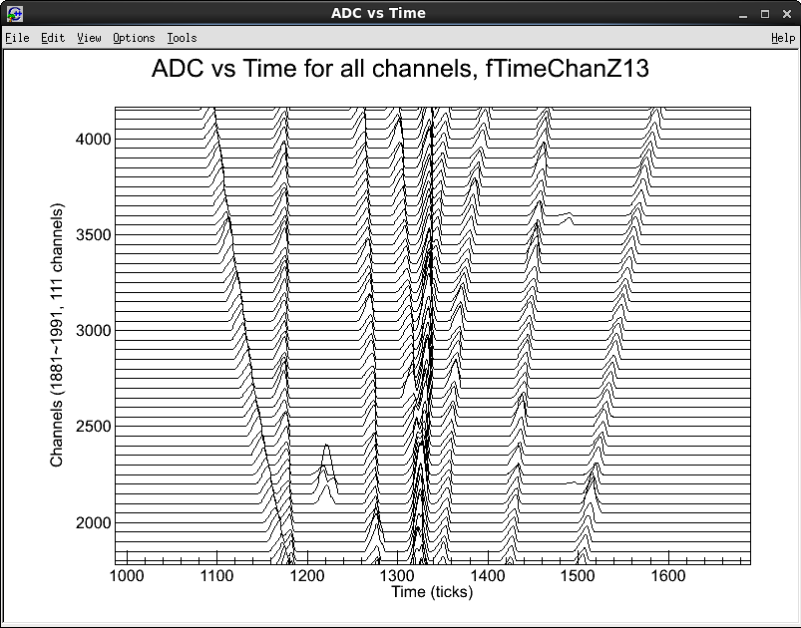
Snap shot of 35t detector event display
Example of 10 μ (500 MeV) events
Particles are generated at the position (100,50,0)cm and beam is along the z axis.
Particles with momentum of 0.5 GeV.
Noise simulation is off.
Zero suppression is on.
zoom
Wave forms on each channel

Slide 12
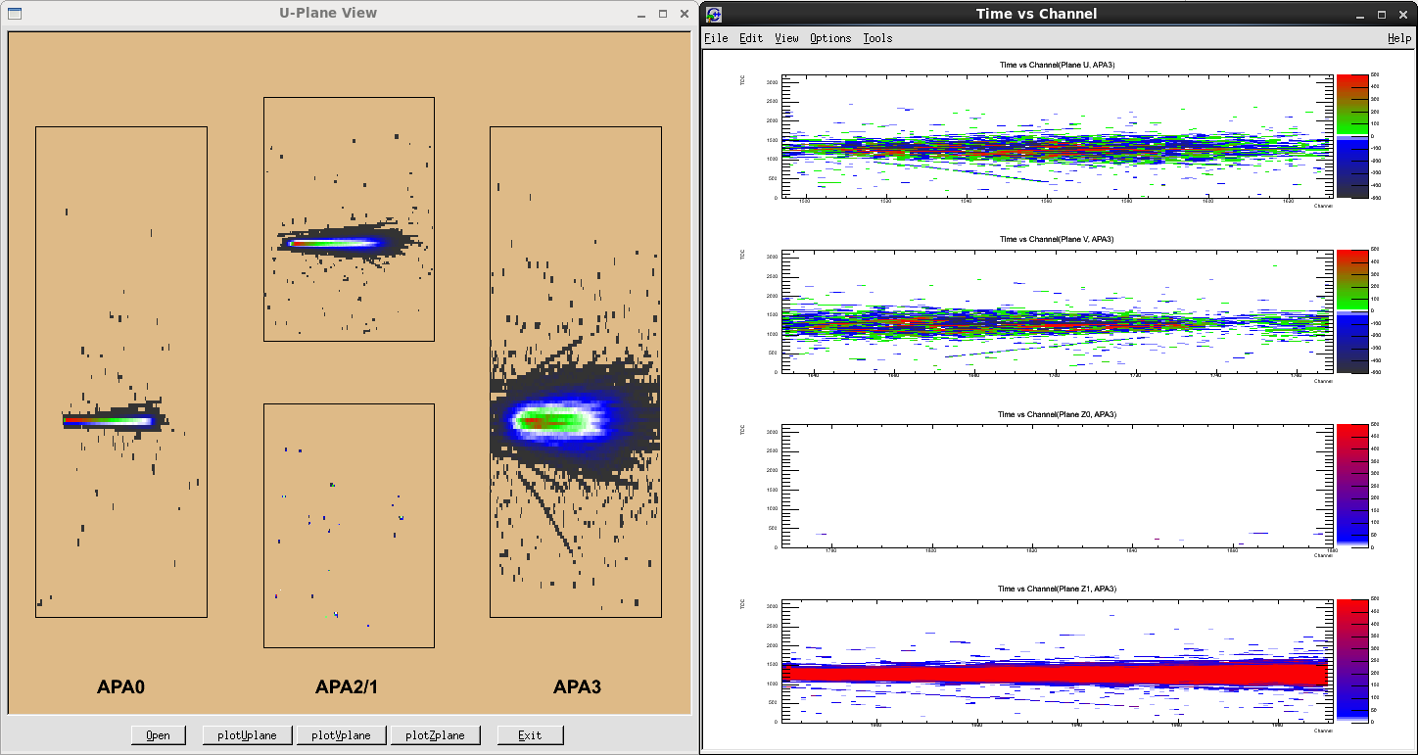
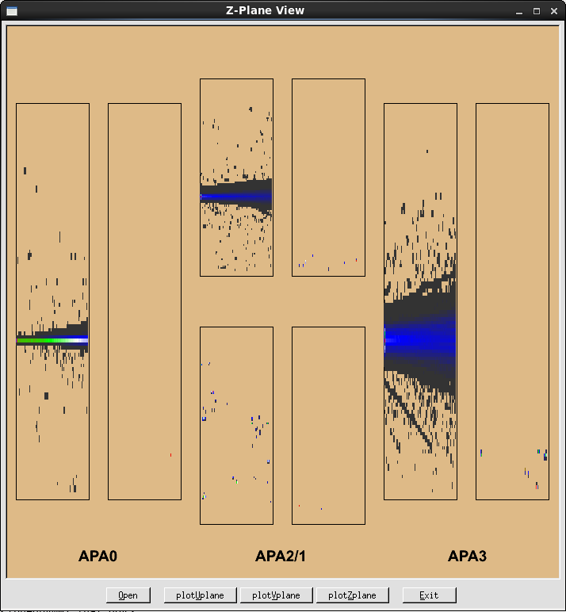
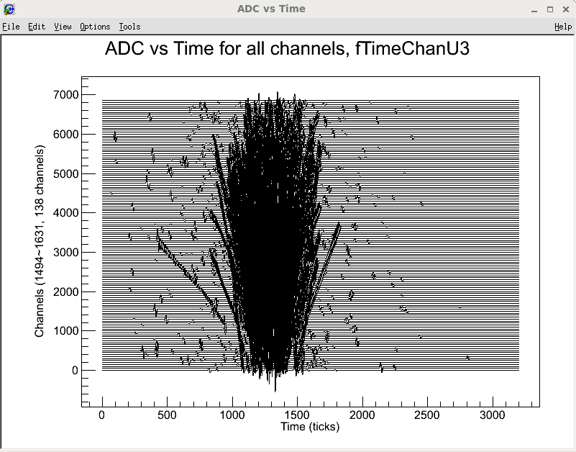
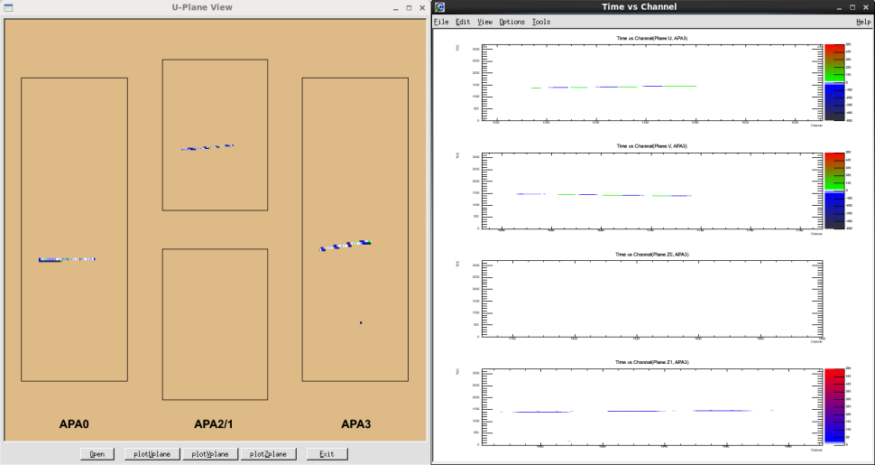
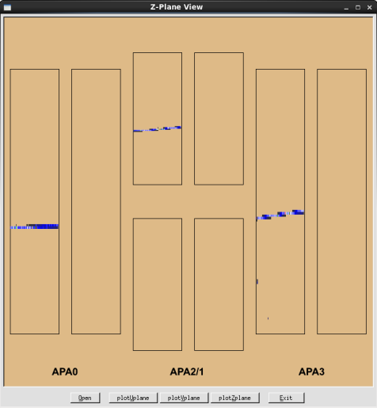
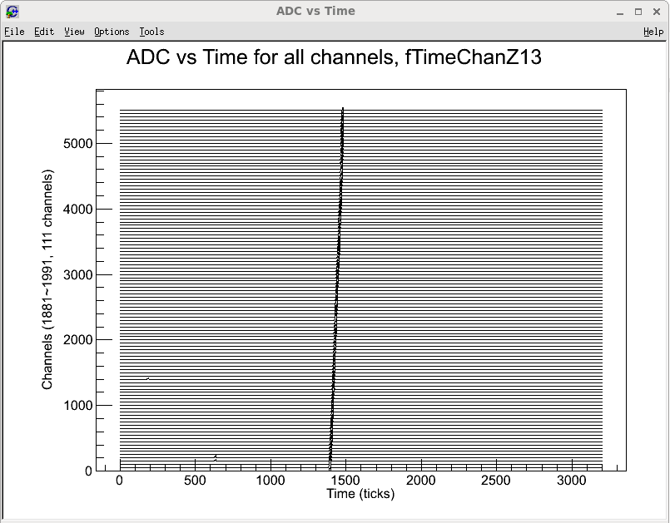
35t μ⁻ events
1000 events overlapped
First event

Slide 13
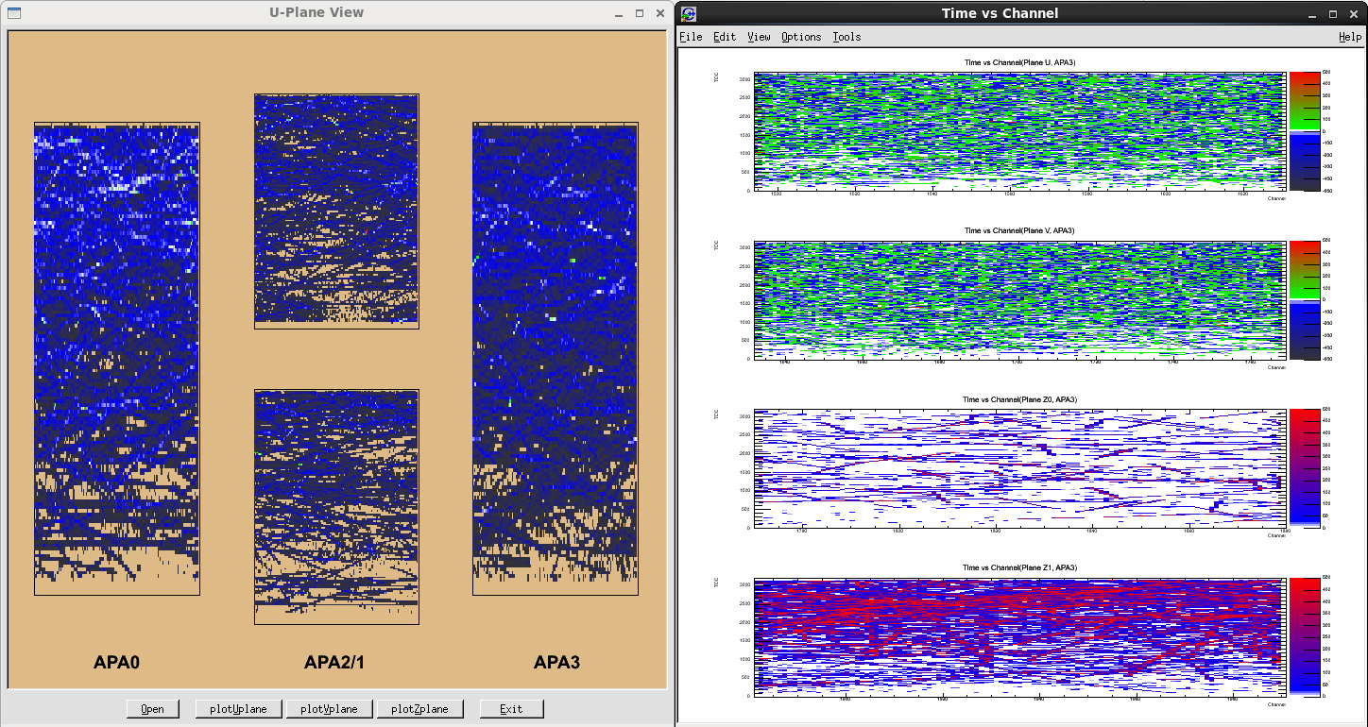
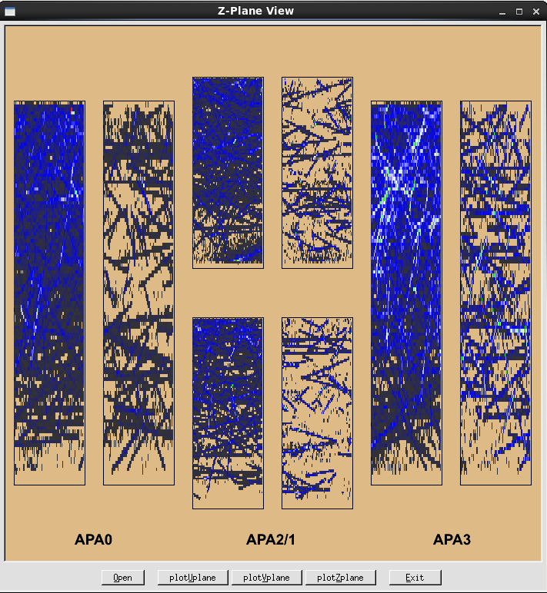
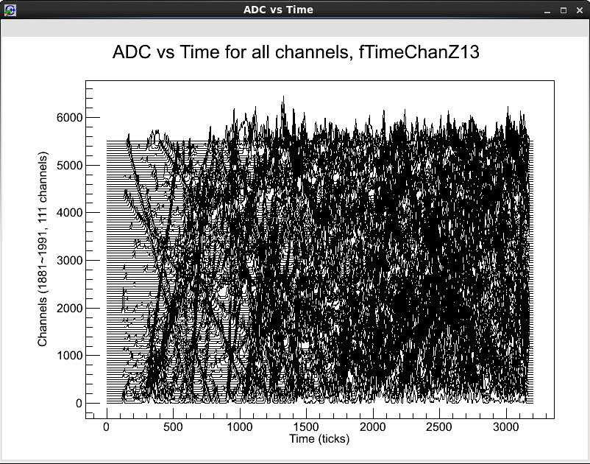
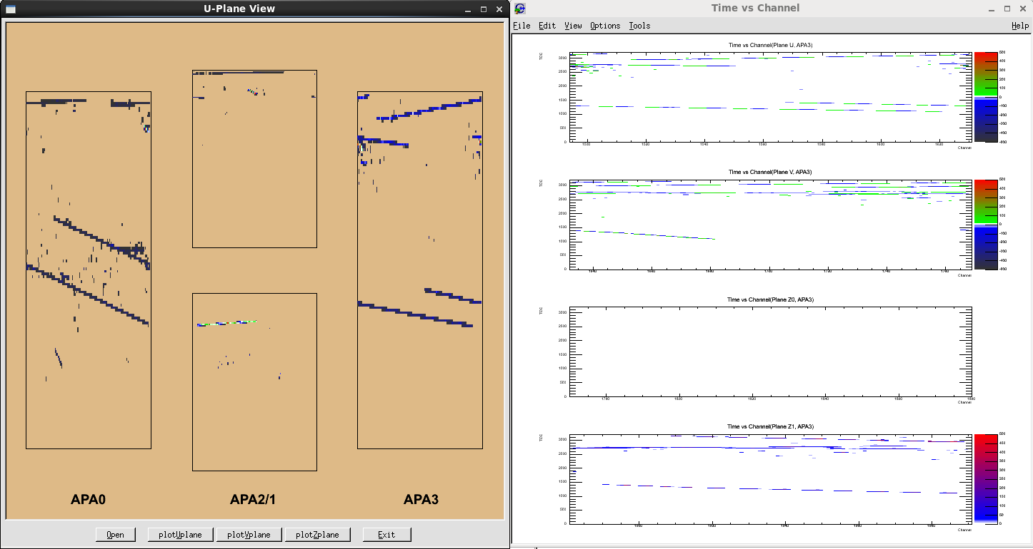
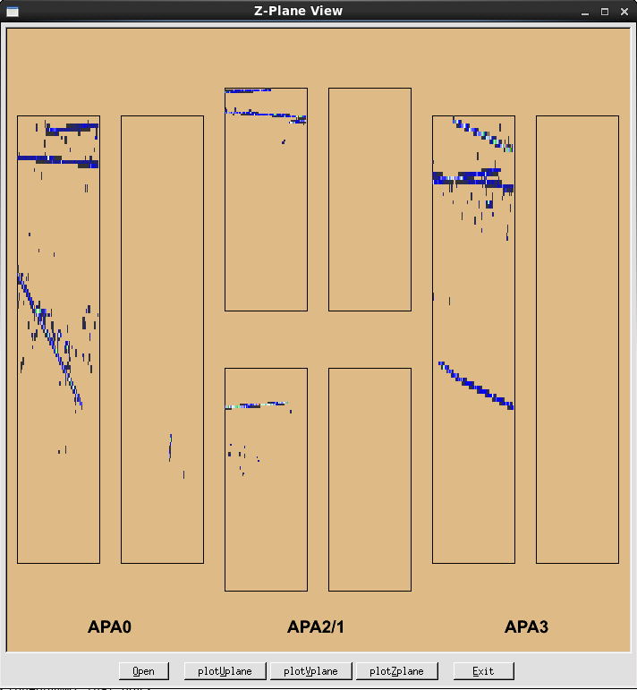
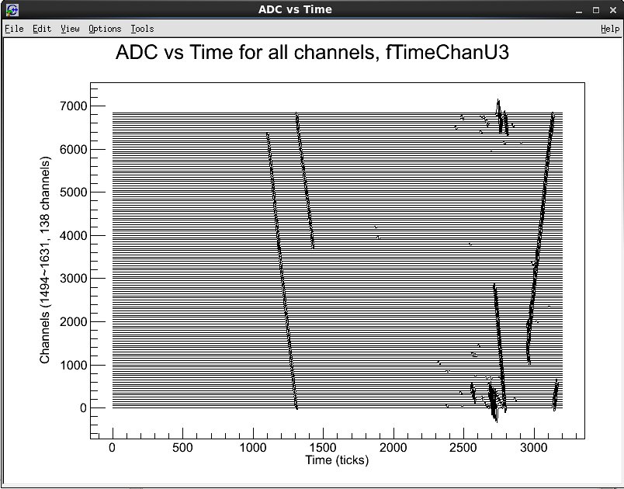
35t cosmic events
1000 events overlapped
Early time zone=near APA plane
Why low rate in this area?
First 10 events overlapped

Slide 14
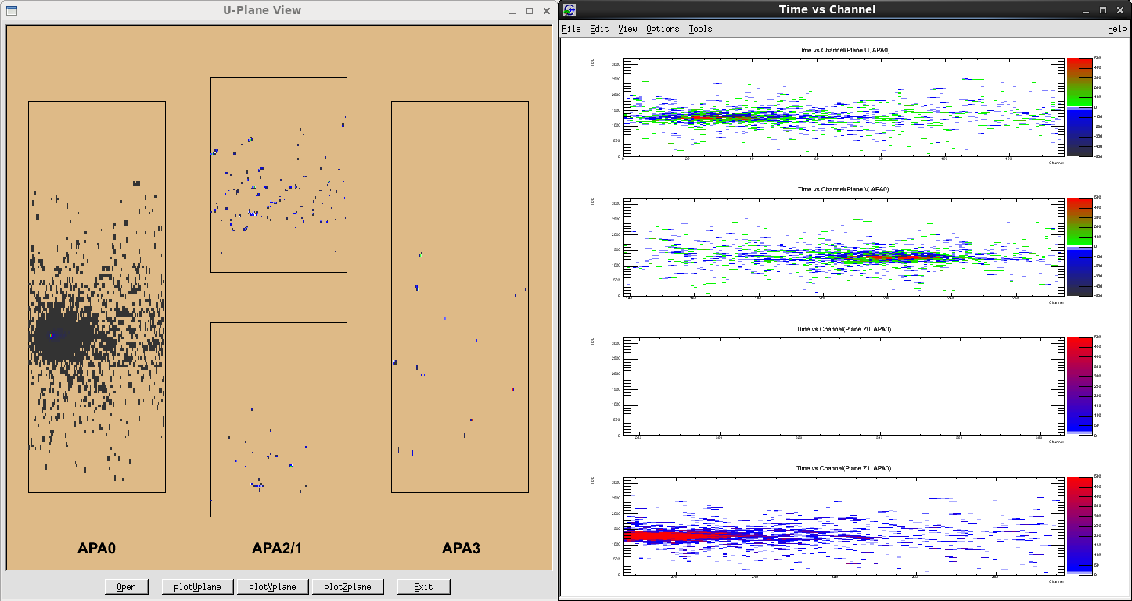
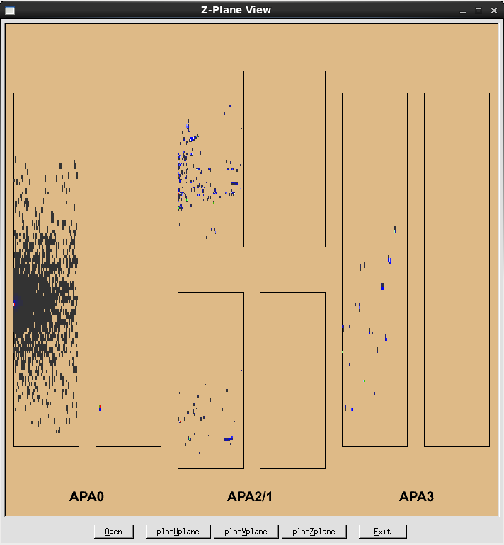
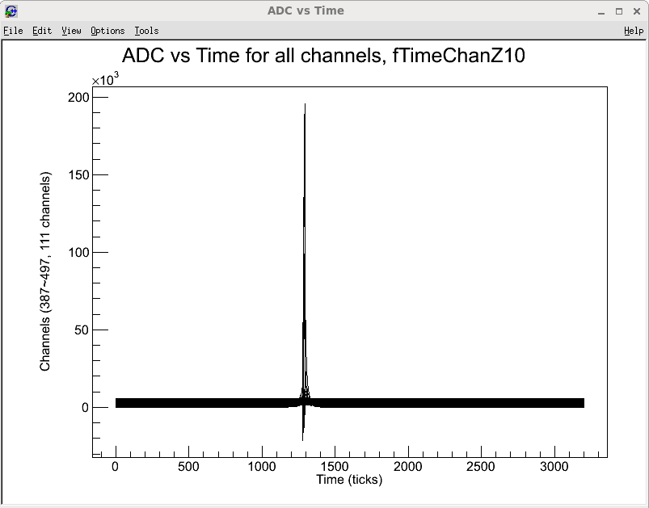
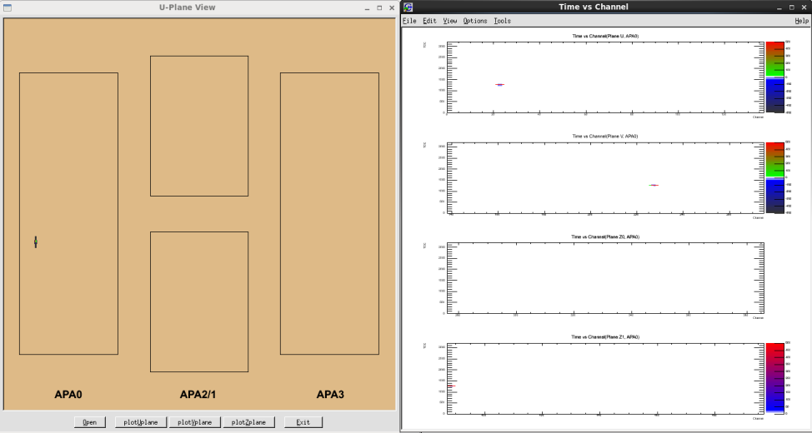
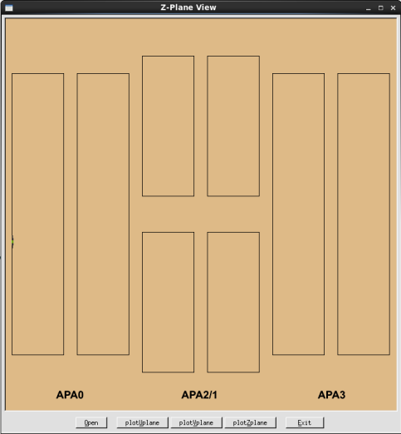
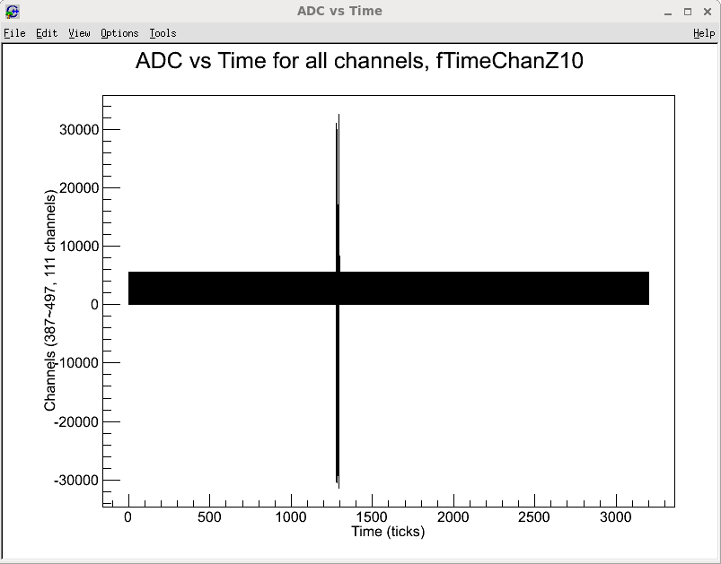
35t π⁺ (30 MeV)events
1000 events overlapped
First event
Why bipolar signals on collection channels?

Slide 15
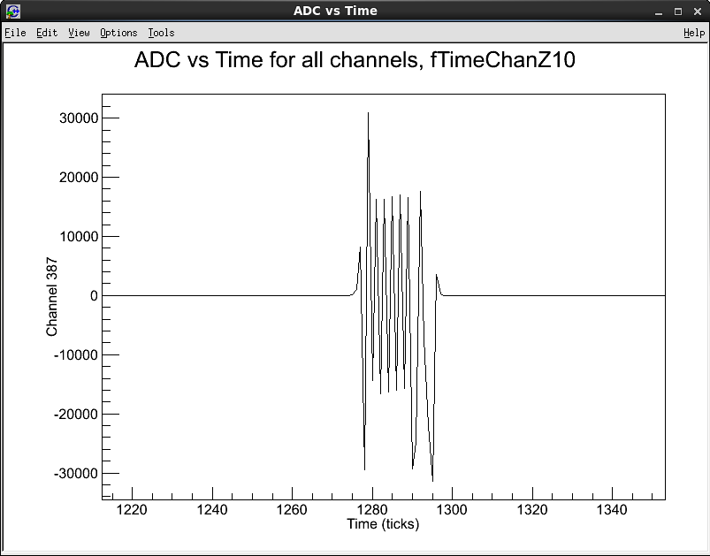
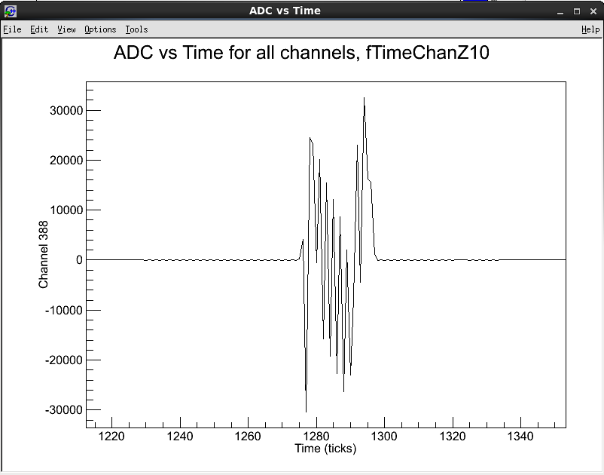
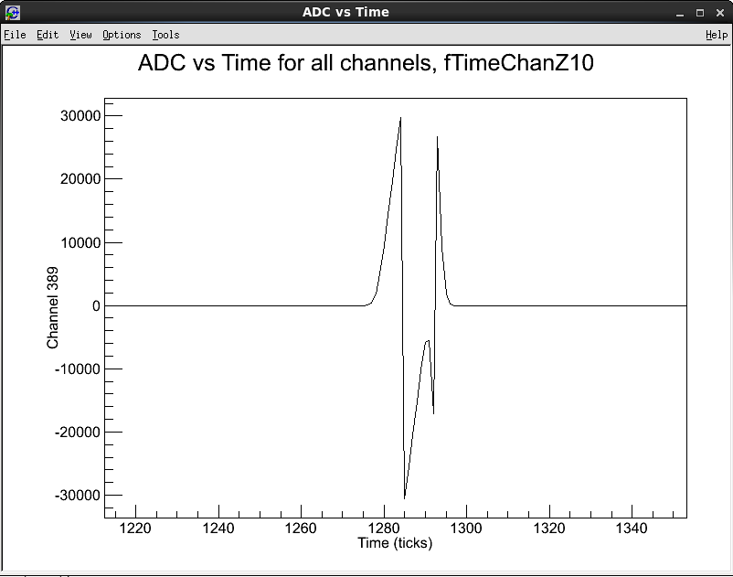
Bad signals?
The first three collection channels show peculiar waveforms.
This is observed only in the Pion+ data.
Ch 387,388,389

Slide 16
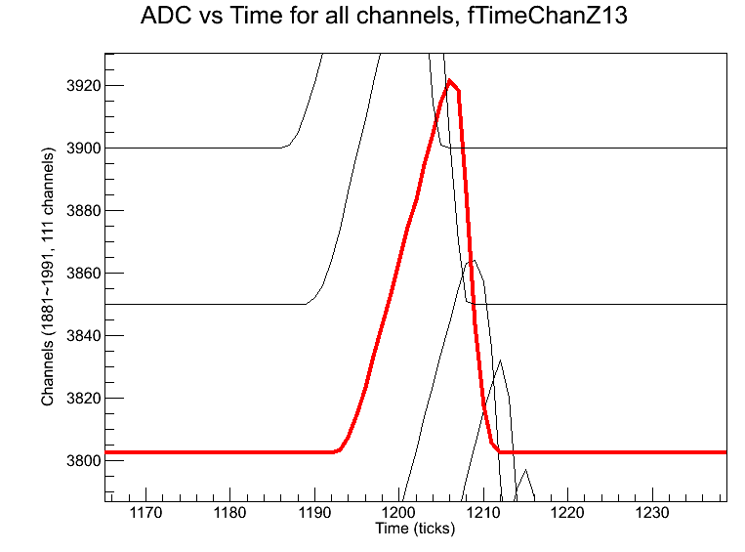
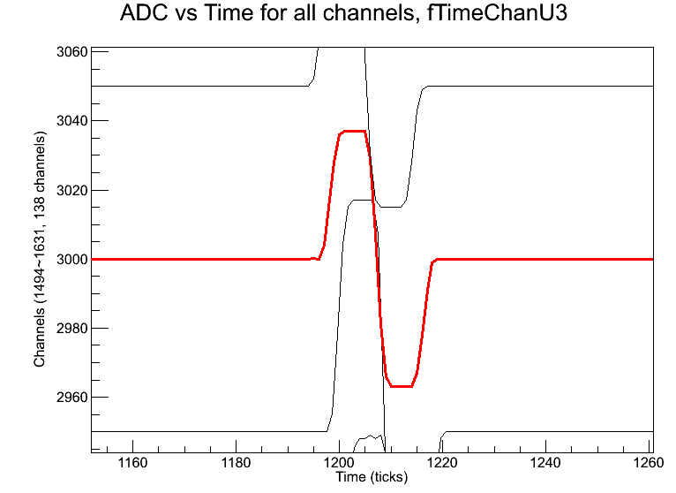
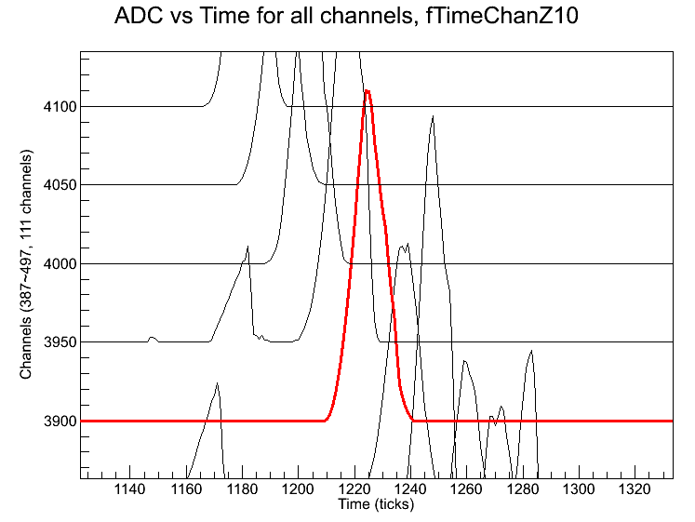
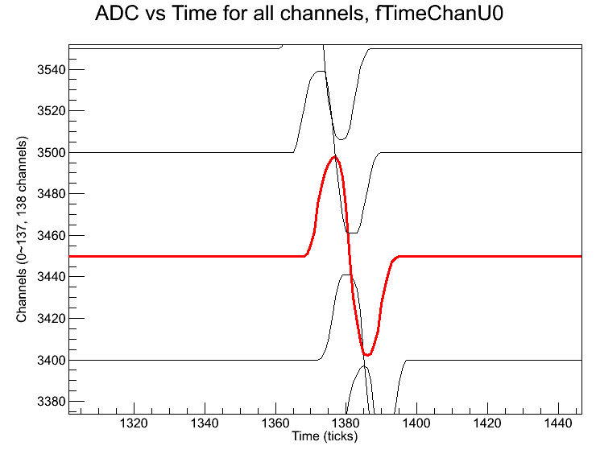
Typical wave forms on wire
35t Muon, Z-plane
35t Muon, U-plane
35t Cosmic, Z-plane
35t Cosmic, Z-plane
Waveform shapes are not always the same.

Slide 17
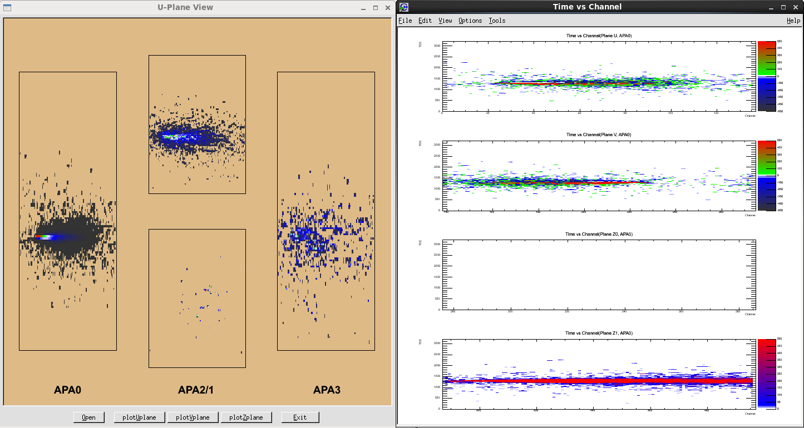
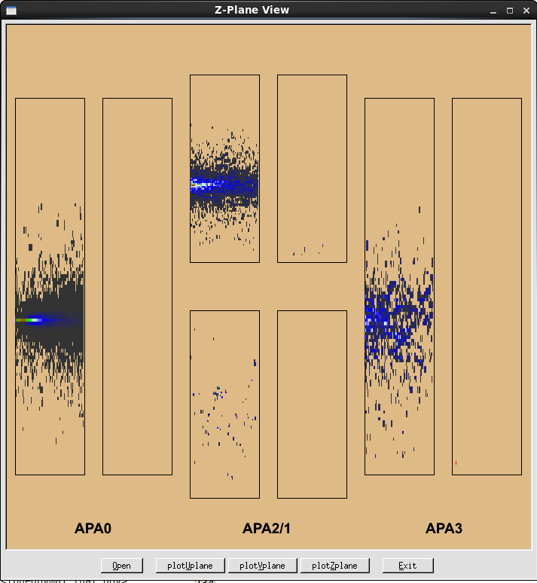
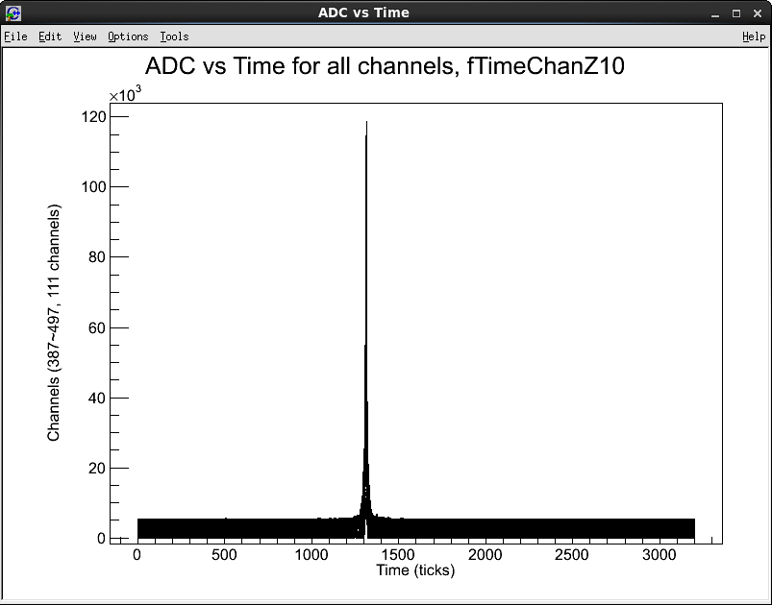
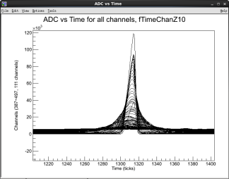
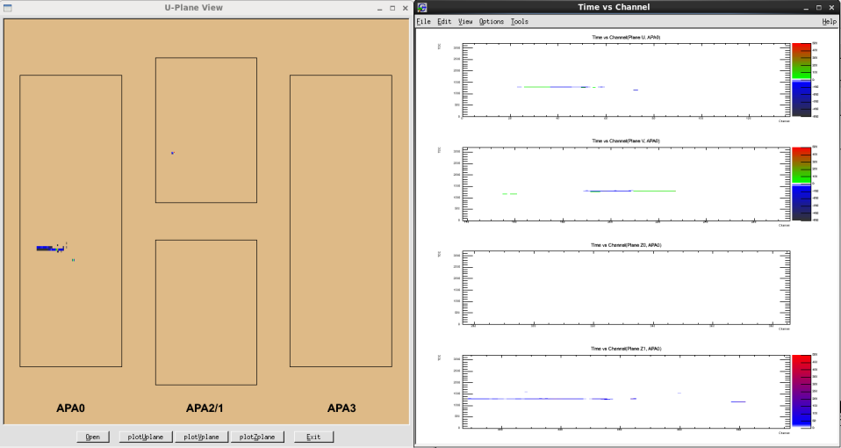
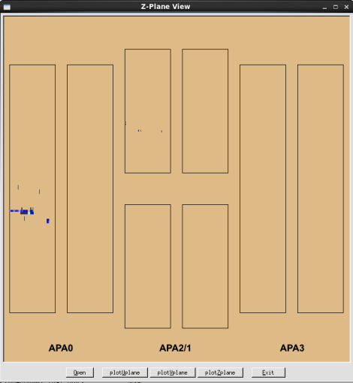
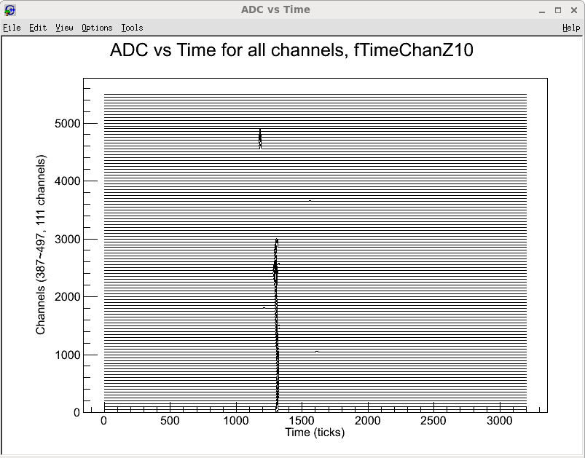
35t e⁻ (100 MeV) events
1000 events overlapped
First event

Slide 18
Summary
The main purpose of this work was to get a fast, light, portable event display which is independent of LarSoft.
This raw data event display is composed of two programs, A LarSoft module for histogram generation and a ROOT script for data display.
Two separate programs for 10kt FD and 35t detector, respectively
These modules and ROOT scripts are checked in to the new lbnecode repository (git/mrb/usb). The package name is ‘RawdataDisplay’. Feel free to use them.

