Slide 1
HOMs for the Future
High Intensity and
CW Superconducting Accelerators
Hasan Padamsee
July 14, 2014

Slide 2
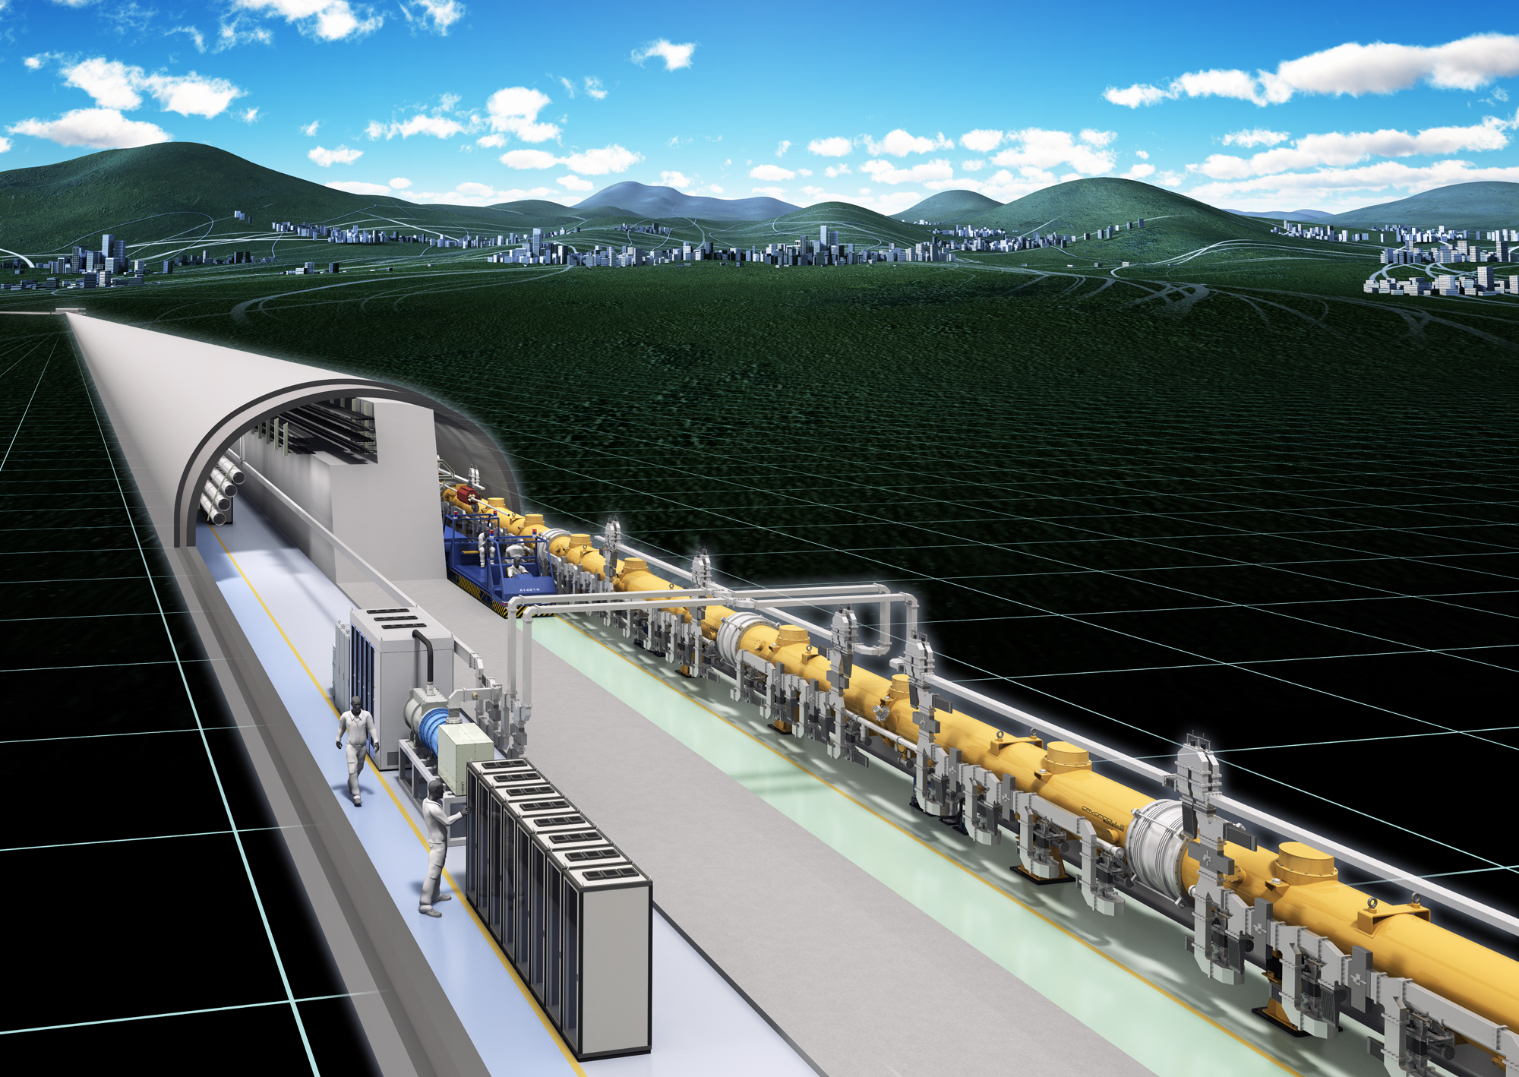

Themes for the HOM Workshop
Now that XFEL is in the bag!
  Thanks to the world-wide effort of the TTC collaboration
  Thanks to DESY
We are waiting eagerly for the ILC to TAKE THE PLUNGE!
  Japan ….We are all behind you
  P5 is behind you…
  It’s only another step forward, and you’re off!

Slide 3

We are now in the “Golden Age of SRF”

Slide 4
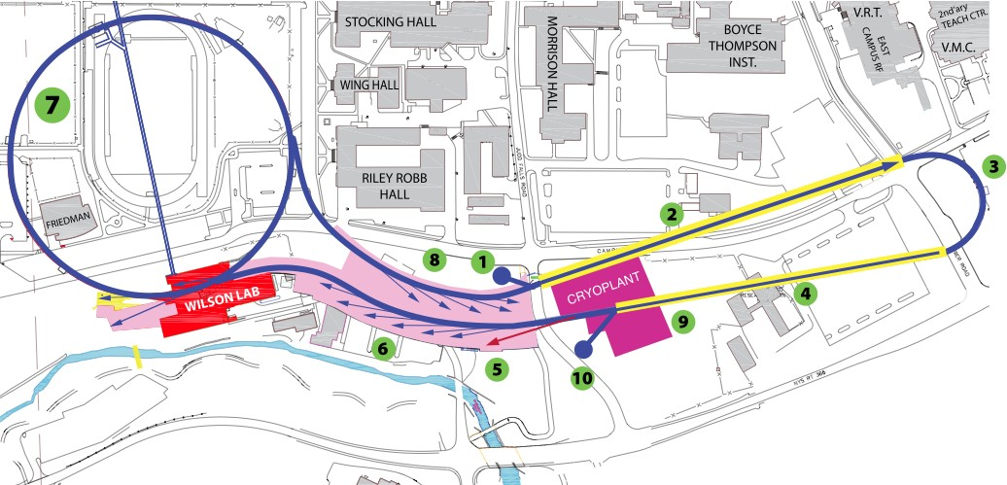
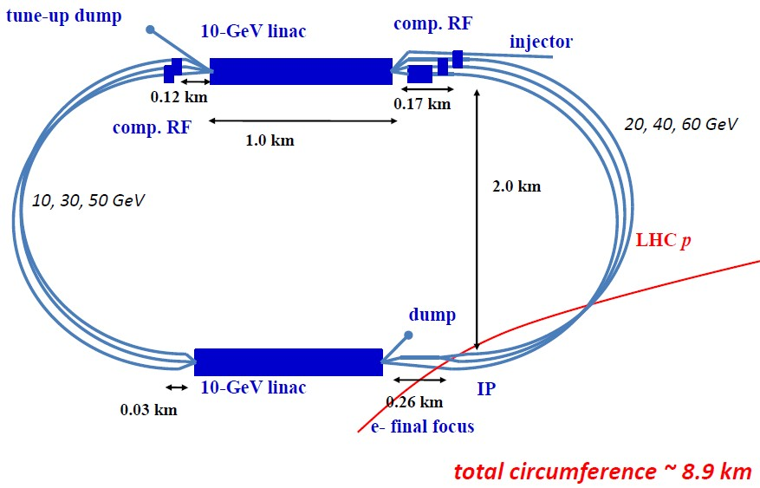
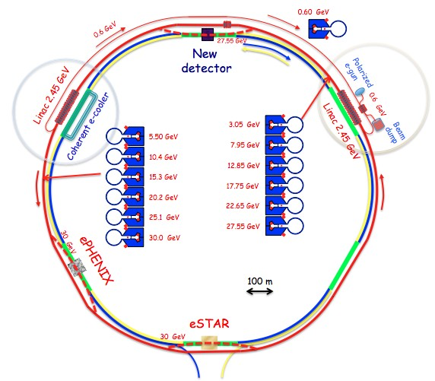
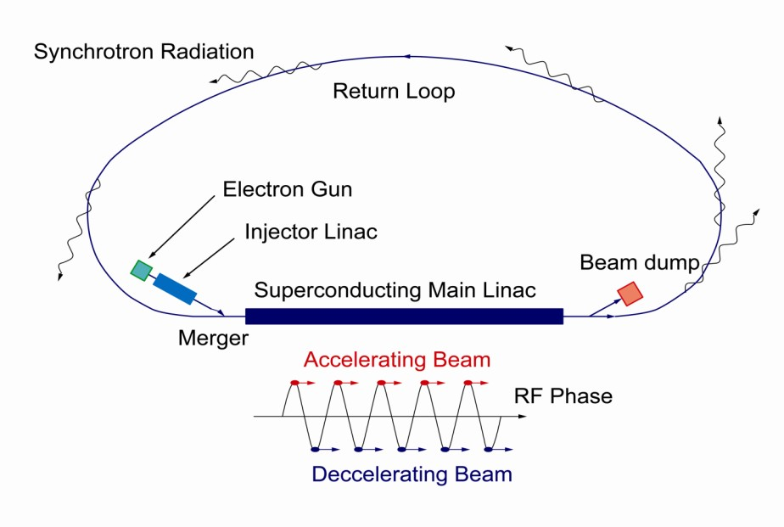
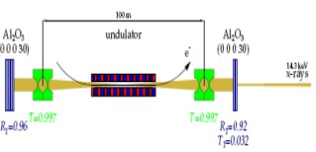
Future ERLs
ERLs
“Big” Machines
Cornell 5 GeV
LHeC 60 GeV
X-ray Light Sources
Electron Ion colliders
7GeV
Double Ac
c.
3GeV ERL
First Stage
XFEL-O Second Phase
eRHIC
5-30 GeV
KEK 3 GeV

Slide 5
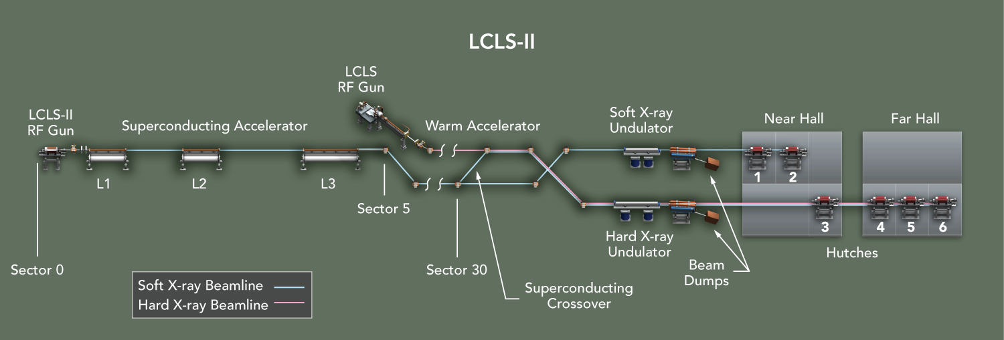
SLAC is funded to build an SRF based Linac
Linac Coherent Light Source –II
  Fermilab and Jlab will build the cavities and cryomodules

Slide 6
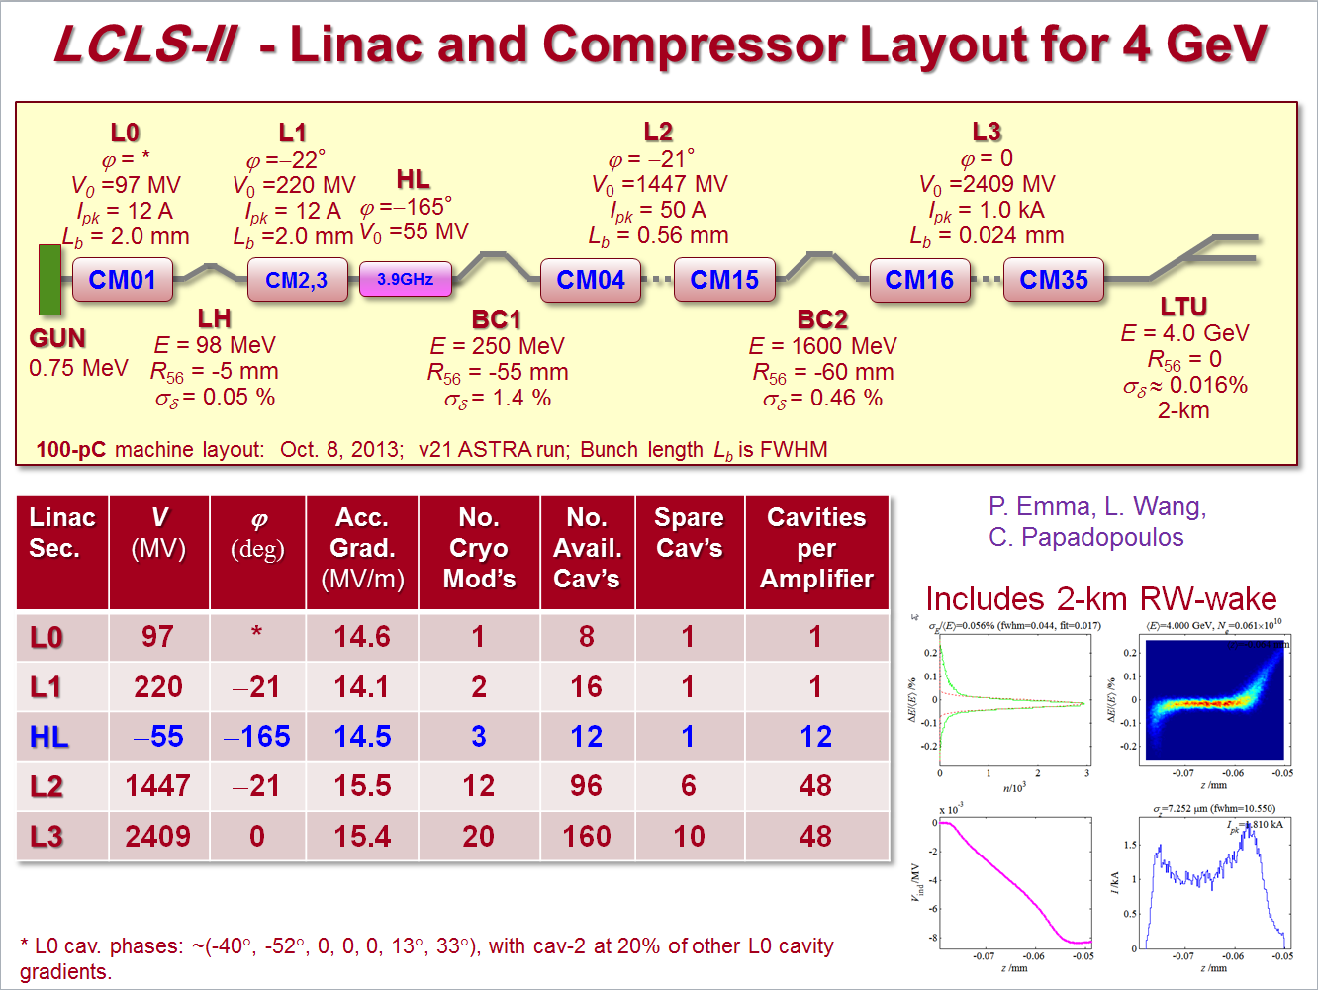
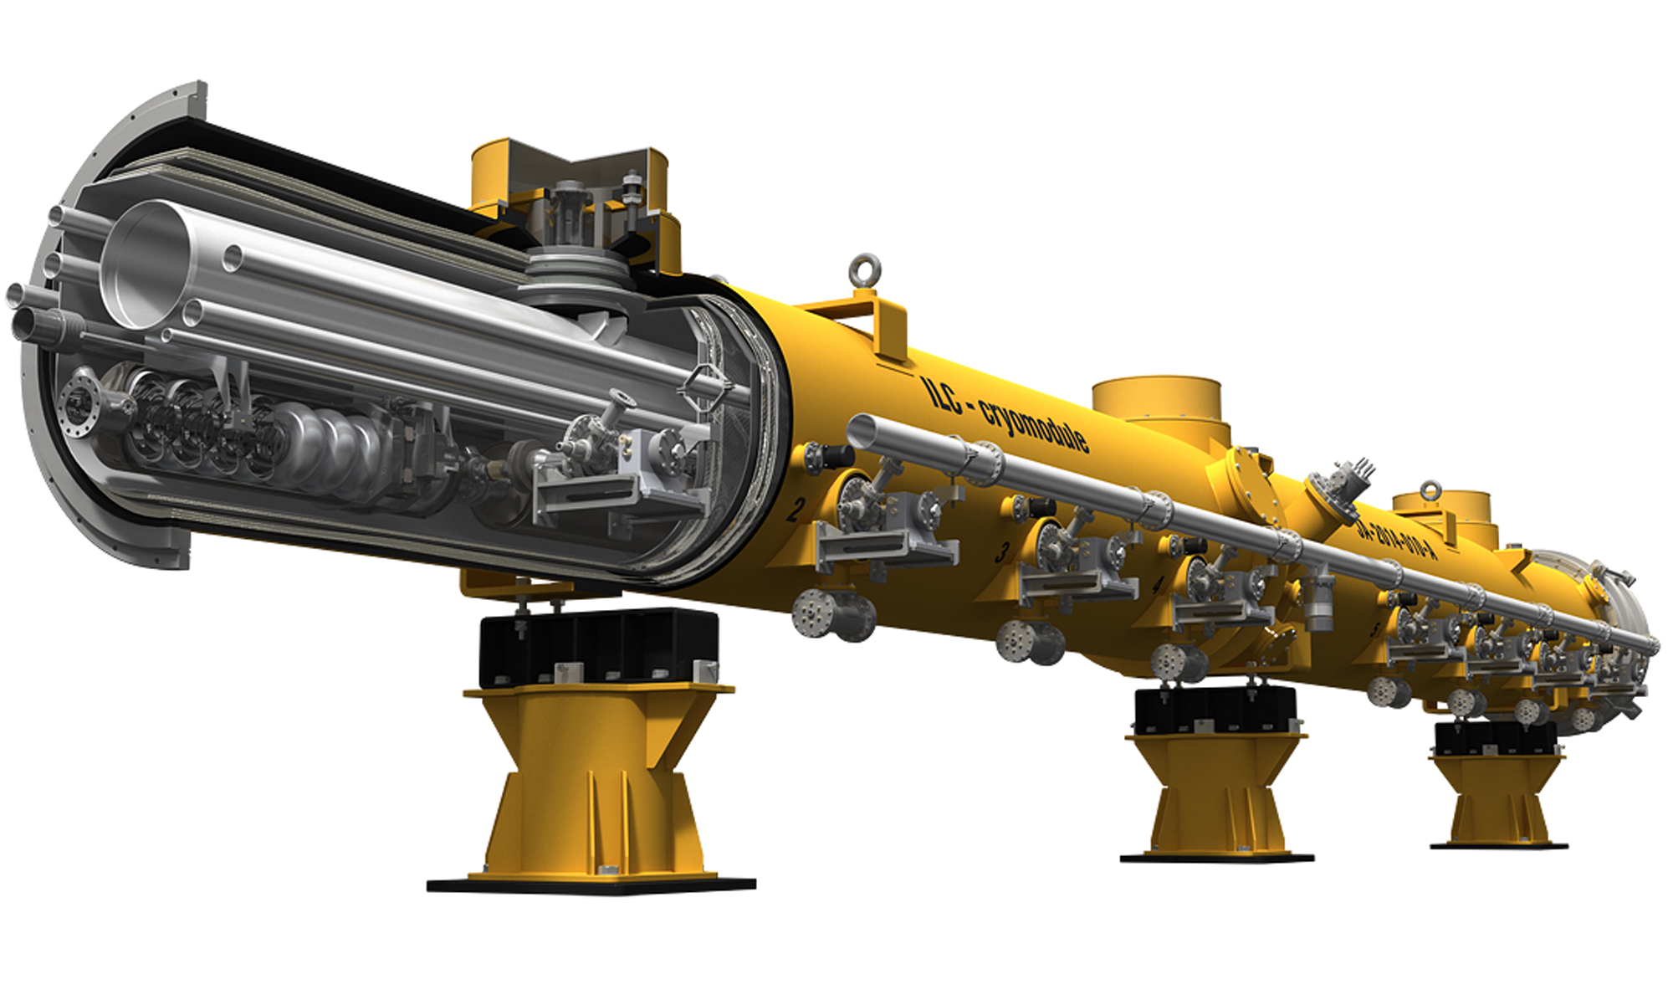
High Performance Cryomodules for LCLS-II
36 Cryomodules
with ~300 cavities

Slide 7
High Intensity Proton Accelerators Everywhere
Fermilab – Proton Improvement Plan –II – 1 MWatt
European Spallation Source (ESS) - 5 MW
Superconducting Proton Linac (SPS) CERN : 2 – 4 MW
ADS

Slide 8
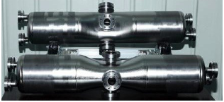
Fermilab Proton Improvement Plan-II - 1 MW beam
Linac Technology Map
IS
LEBT
RFQ
MEBT
β=0.11
β=0.22
β=0.51
β=0.61
β=0.9
RT
SC
162.5 MHz
0.03-11 MeV
325 MHz
11-177 MeV
650 MHz
177-800 MeV
Medium-Beta Elliptical Cavities
Half Wave
Spokes

Slide 9

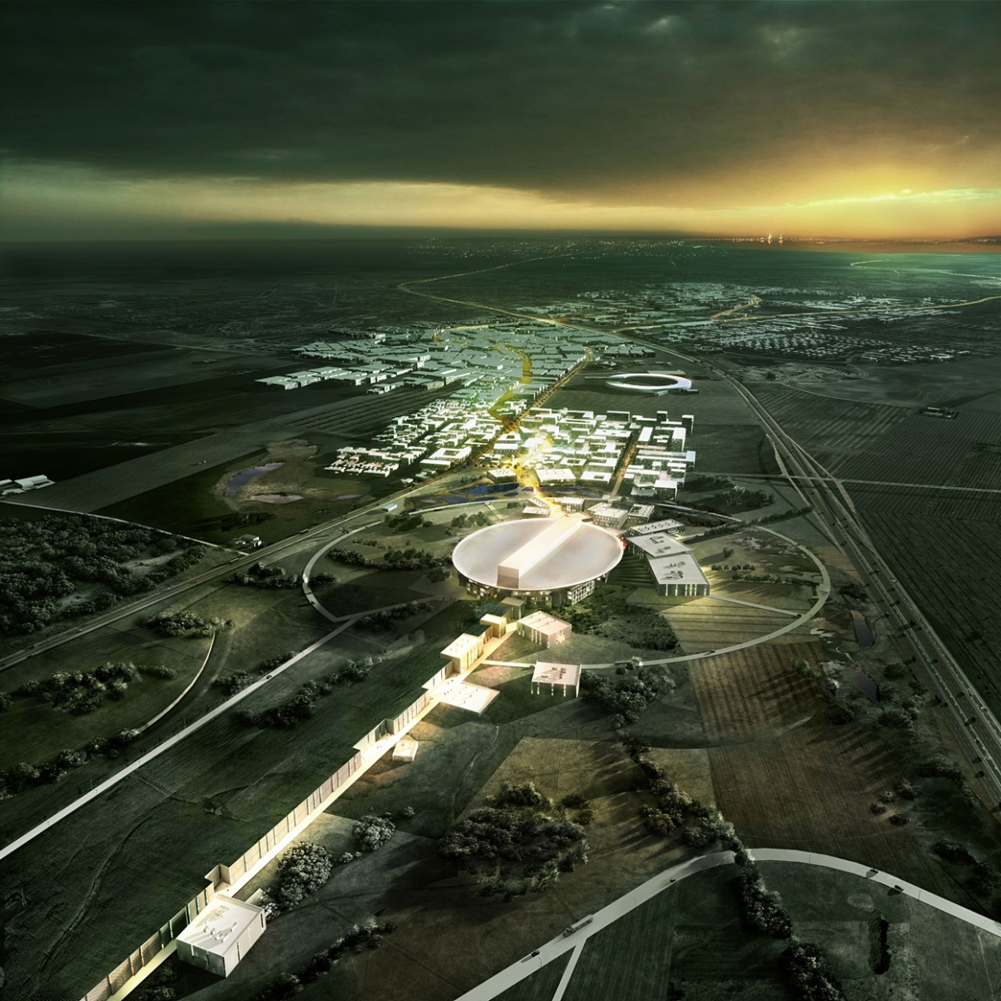

Slide 10
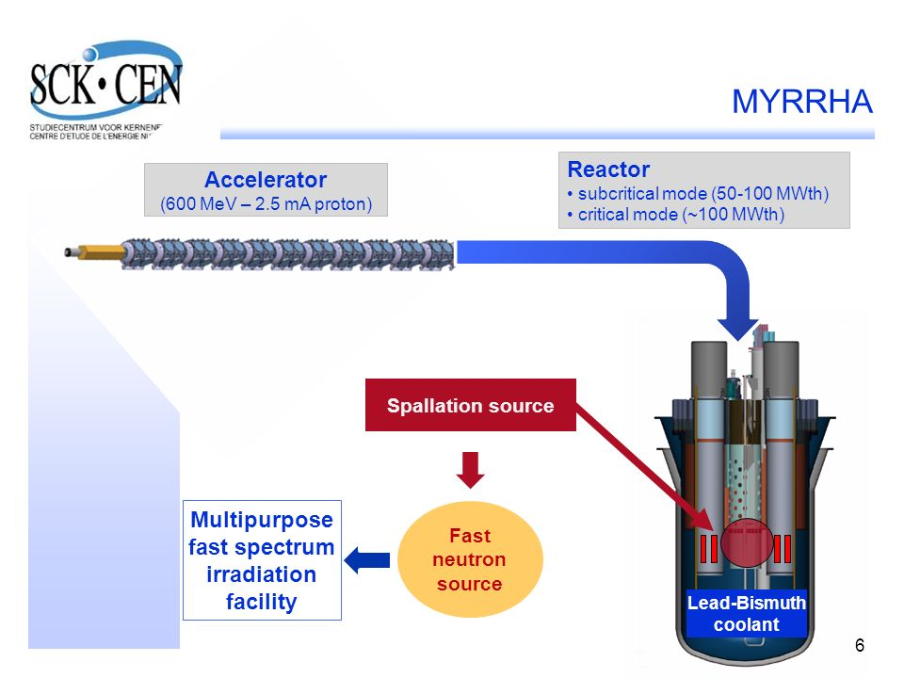

Slide 11
237 Cavities by
2030- 2040

Slide 12
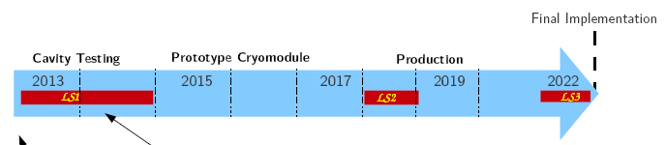
SRF Crab Cavity Candidates Under Development
3 MV Kick Voltage Demonstrated

Slide 13
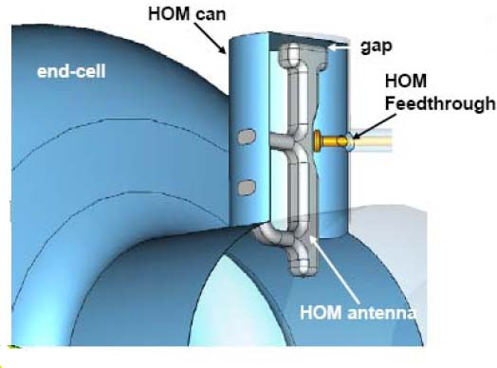
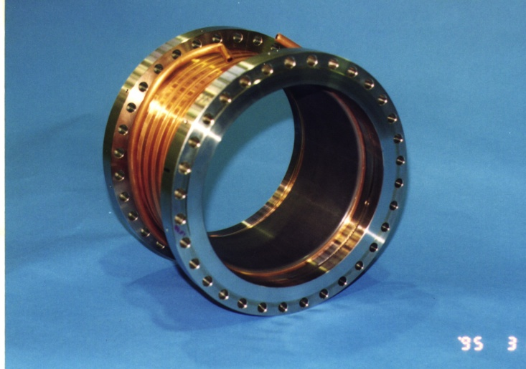
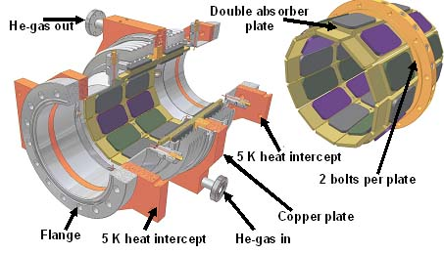
All These Accelerators Will Need HOM Analysis, HOM Couplers and Absorbers

Slide 14

We Are Here to Share Advances in
HOM Assessment
  Find the HOMs, frequencies, R/Qs, propagation properties
How much damping?
  For the bunch charge, beam current, bunch spacing
  Avoid power deposition at low temperatures
  Preserve beam quality
  Avoid beam instabilities from HOMs
Develop devices to damp dangerous modes
Extract the HOM power to high temperature
Materials to absorb HOM power
Materials with acceptable properties
  Vacuum, dust, charging…

Slide 15
Best Wishes for a Succesful Workshop!

