Slide 1

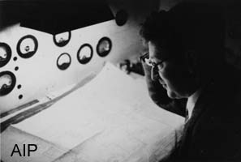
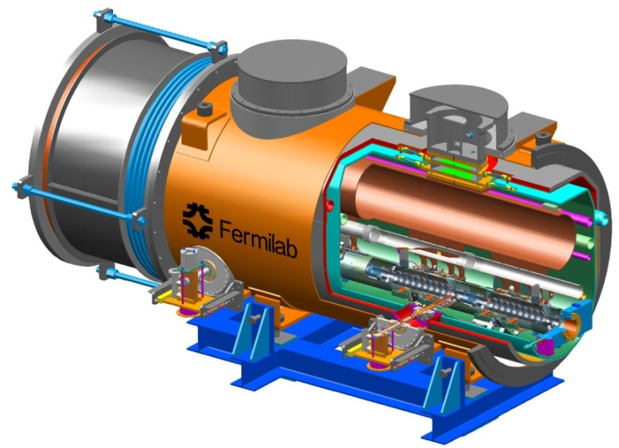
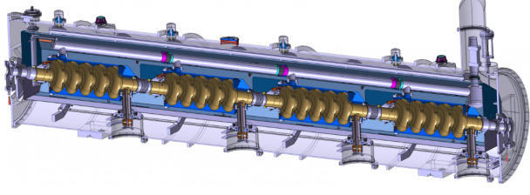
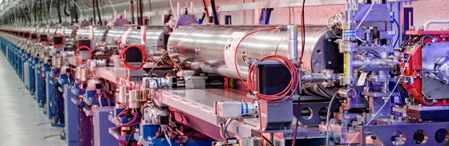
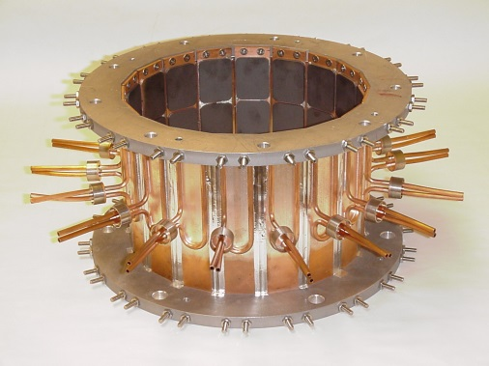
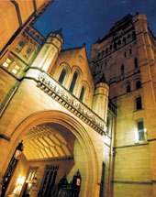

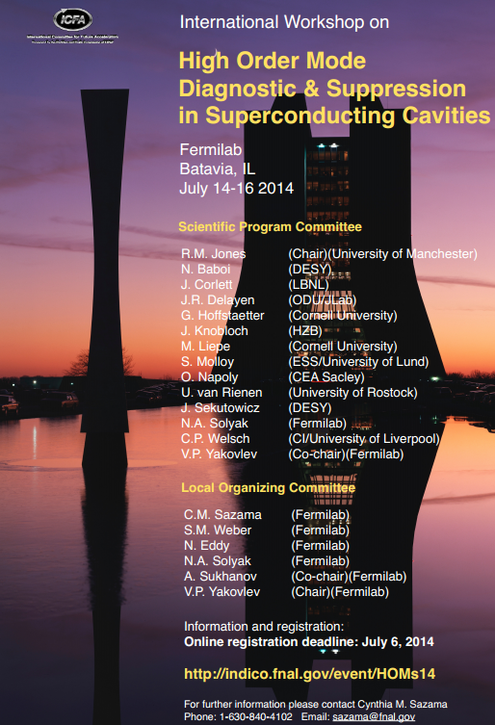
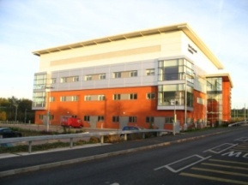

Overview of HOMs and Wakefield Issues in SC Cavities and Systems
-Roger M. Jones
https://indico.fnal.gov/event/HOMs14

Slide 2
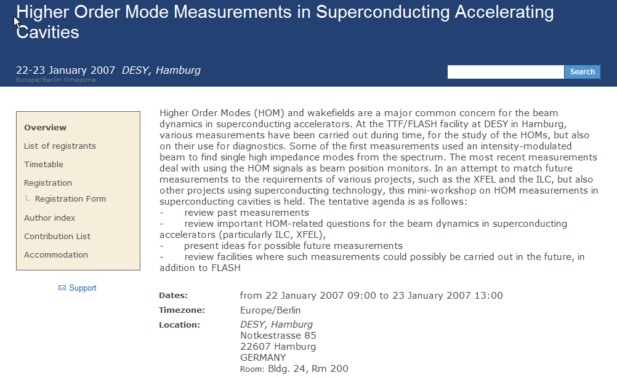

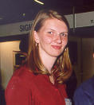

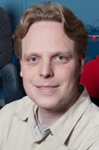
Inaugural & Continuing…
Builds on success of DESY workshop:
1. Higher Order Mode Measurements in Superconducting Accelerating Cavities (Jan 2007) hosted by Nicoleta Baboi, and 2. HOM Damping in SCRF Cavities hosted by Matthias Liepe (Oct 2010)
37 registered -by invitation only
HOMSC14 publication in Physics Procedia. Deadline for receipt of paper: October 16th 2014.
58 registered –open registration
(26 UK, 14 Europe, 11 USA, 3 Asia)
HOMSC12 NIMA Special Issue Published

Slide 3
HOMSC14 Workshop –Broad Overview
Facilities, Planned Light Sources, ERLs, and Specialised Cavities: XFEL, FLASH, NGLS, Project-X, Novel Crab Cavities, LL Cavities for ILC, ESS, LCLS-II
Diagnostics: FLASH/XFEL
Simulations on HOMS, Beam Dynamics (Emittance Preservation), and Simulations of RF Loads

Slide 4
HOMSC14 Workshop -Overview
Light Sources & ERL
Spallation Sources
HOM BPM diagnostics and measurement methods
HOM couplers and influence of FP couplers
Novel HOM suppression in TEM and other cavity shapes
Special considerations in third harmonic, deflecting and crab cavities
RF absorbing materials
Antenna HOM absorbers
Beam-pipe HOM absorbers
Waveguide HOM absorbers
Advanced HOM simulation tools and models

Slide 5
Selected Highlights
XFEL/FLASH (HOM Diagnostics & Simulation, Beam Dynamics)
ILC
LCLS-II (Wakefield Losses Into Load)
NGLS & Project-X
ESS (HOMs and Beam Dynamics)
Couplers in Damping in Crab & Quarter Wave Cavities
HOM Damping Materials (Measurements and Simulation)

Slide 6
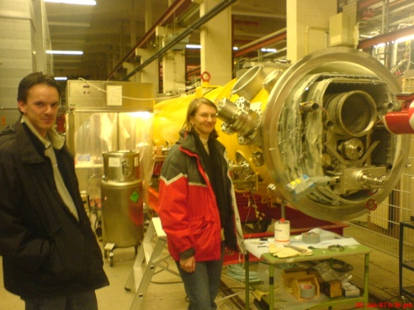
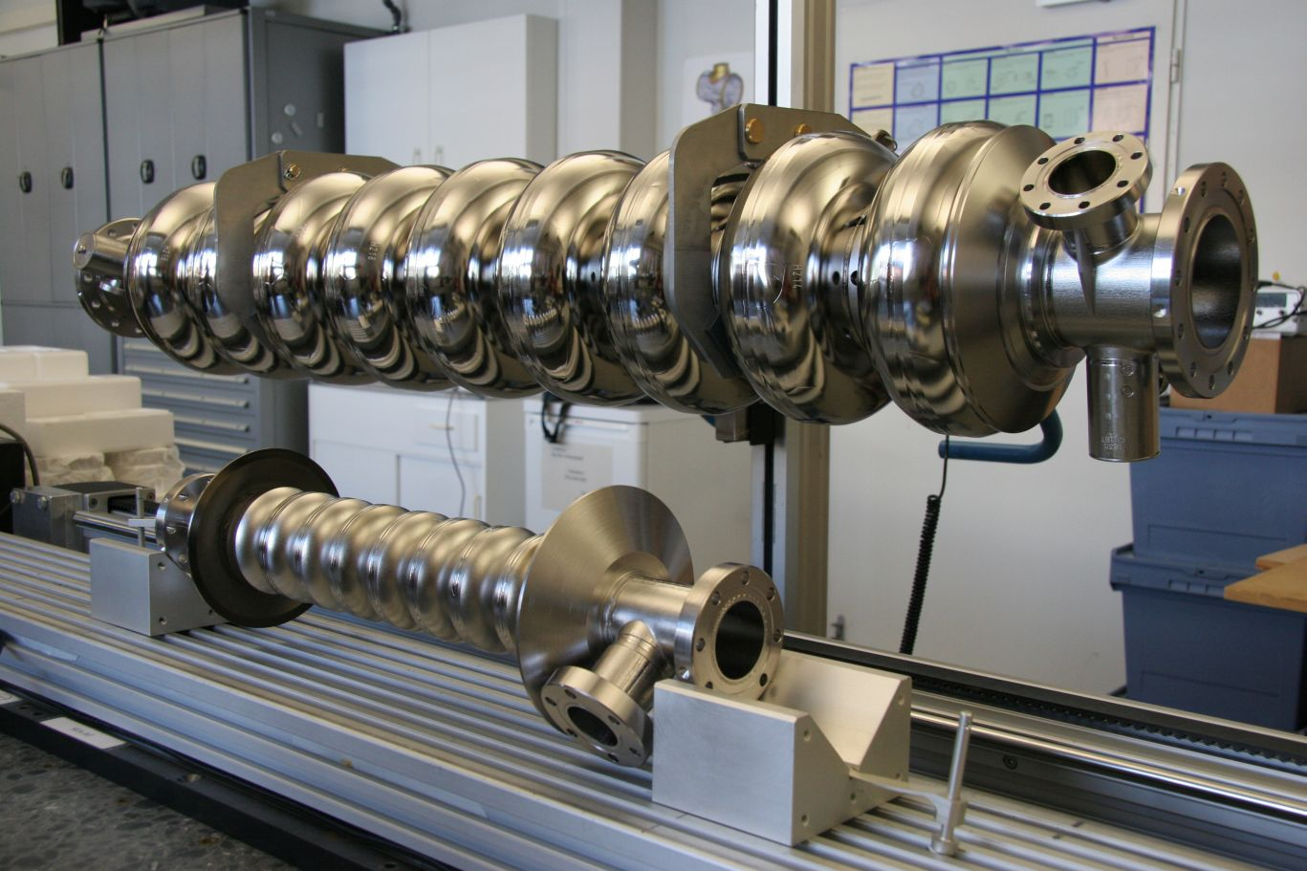
1. XFEL/FLASH
FLASH HOM-Based Beam Diagnostics -3rd Harmonic
Beam Dynamics in XFEL and Damping Requirements

Slide 7

1.I HOM Diagnostic in 3rd Harmonic Cavities at FLASH
Fermilab has constructed a third harmonic accelerating (3.9GHz) superconducting module and cryostat for a new generation high brightness photo-injector.
This system compensates the nonlinear distortion of the longitudinal phase space due to the RF curvature of the 1.3 GHz TESLA cavities prior to bunch compression.
The cryomodule, consisting of four 3.9GHz cavities, have been installed in the FLASH photoinjector downstream, of the first 1.3 GHz cryomodule (consisting of 8 cavities).
Four 3.9 GHz cavities provide the energy modulation, ~20 MV, needed for compensation.

Slide 8
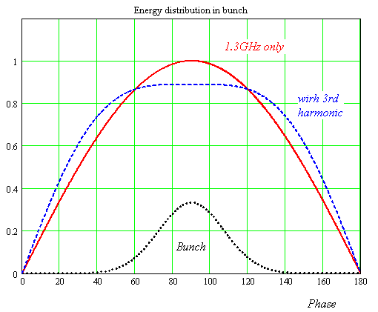
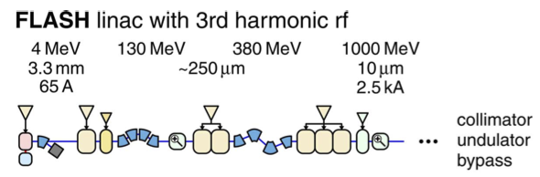
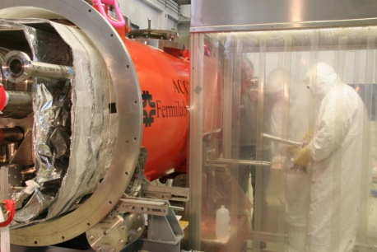
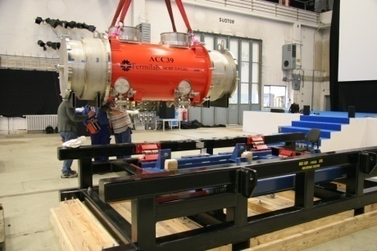
1.I Third Harmonic (3.9 GHz) Parameters
Illustrative energy (not to scale)
Number of Cavities | 4
Active Length | 0.346 meter
Gradient | 14 MV/m
Phase | -179º
R/Q [=U²/(wW)] | 750 Ω
E_{peak}/E_{acc} | 2.26
B_{peak} (E_{acc} = 14 MV/m) | 68 mT
Q_{ext} | 1.3 X 10⁶
BBU Limit for HOM, Q | <1 X 10⁵
Total Energy | 20 MeV
Beam Current | 9 mA
Forward Power, per cavity | 9 kW
Coupler Power, per coupler | 45 kW
Adding harmonic ensures the 2nd derivative at the max is zero for total field (could use other harmonics in the expansion, but using the lowest freq. ensures the transverse wakefields ~ ω³ are minimised).
The third harmonic system (3.9GHz) compensates nonlinear distortion of the longitudinal phase space due to cosine-like voltage curvature of 1.3 GHz cavities.
It linearises the energy distribution upstream of the bunch compressor thus facilitating a small normalized emittance ~1.10⁻⁶ m*rad.
See talk by N. Baboi et al.

Slide 9
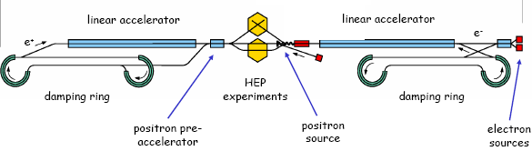
1.I HOMs in SCRF Cavities
Schematic of International Linear Collider (ILC)
~11km
~11km
http://www.linearcollider.org
Used at XFEL and FLASH. Baseline design for main accelerators in ILC.
TESLA cavity (1.3 GHz)
FPC Coupler
~1m
Used at XFEL and FLASH in order to flatten the field profile and reduce energy spread.
HOM Coupler
3rd harmonic cavity (3.9 GHz)

Slide 10
1.I Minimising Emittance Dilution and HOMBPMs
Source of Emittance Dilution
W_{t} , transverse wakefields for radial offset r :W_{t} ~ (r/a)³ (a iris aperture)
Stronger in 3.9 GHz than in 1.3 GHz cavities (each iris is a ~ 15 mm compared to 35 mm for TESLA).
Utilise Wakefields as Diagnostic
Sample HOMs to ascertain beam position (HOMBPM).
Move beam to minimise impact on itself and to align to electrical axis.
  Can also be used for measuring beam charge, phase etc.
See talk by N. Baboi et al.
Notes:
~ eight times larger…

Slide 11
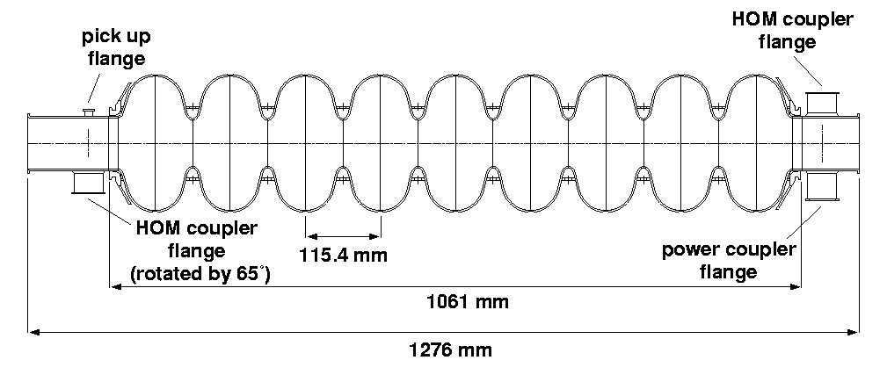
1.I XFEL/FLASH HOMs in SCRF Cavities
Task:
  Develop, build, test electronics for 3.9 GHz cavities
  Interpret signals and integrate in control system
  Measure cavity alignment
HOM-couplers
  At end of each cavity
  Enable monitoring the
  HOMs excited by beam
HOM-couplers (pick-ups)
TESLA cavity Illustrated
(similar features present in 3.9 GHz cavity)
See talk by N. Baboi et al.

Slide 12
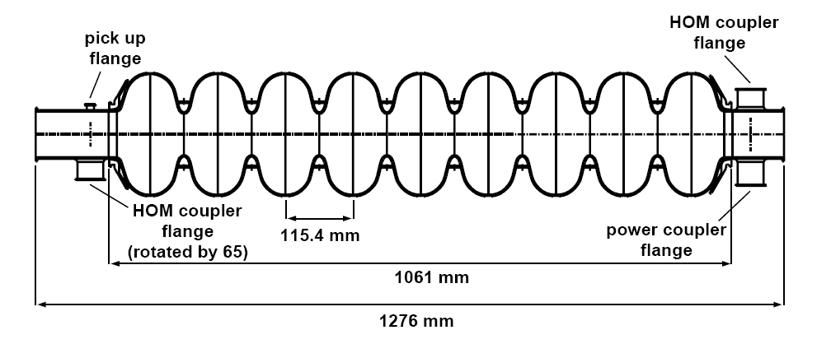
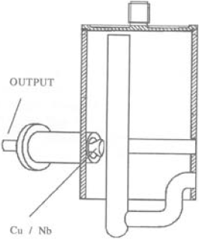
bunch compressors
bypass line
gun
undulators
FEL beam
ACC39
4 cavities within
3.9GHz Module
collimator section
dump
5 accelerating modules
with 8 cavities each
1.3GHz SC, typically 450-700MeV, 1 nC charge for FLASH/XFEL
HOMs generated in accelerating cavities must be damped.
Monitored HOMs facilitate beam/cavity info
Forty cavities exist at FLASH.
-Couplers/cables already exist.
-Electronics enable monitoring of HOMs (wideband and narrowband response).
Based on 1.3 GHz (CEA/SLAC/FNAL/DESY) Diagnostics –redesigned for ACC39 as part of EuCARD
See talk by N. Baboi et al.

Slide 13
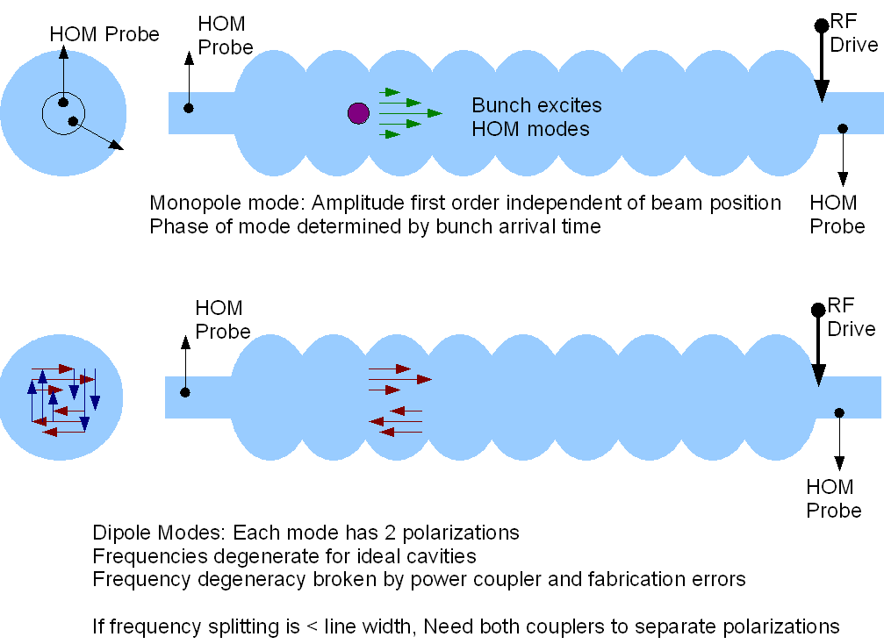
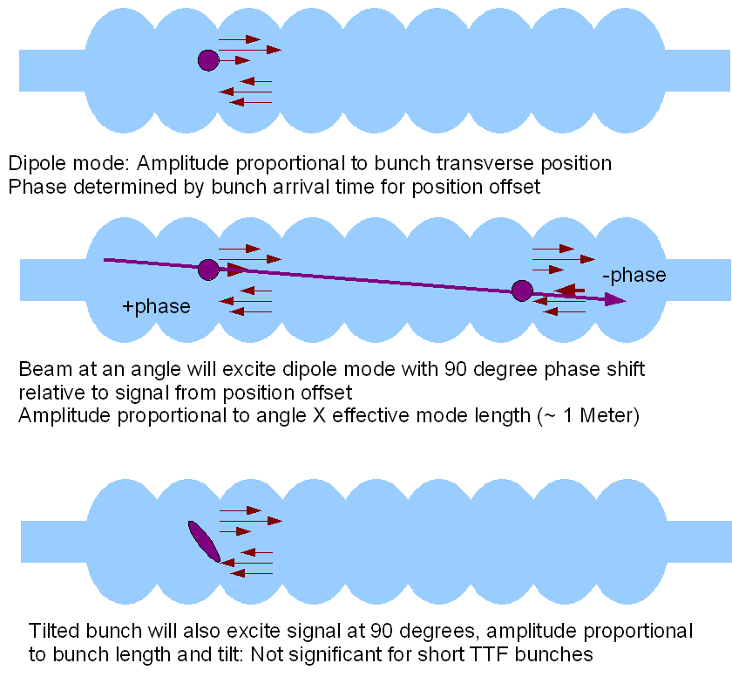
1.I Response of HOM Modes to Beam
See talk by N. Baboi et al.

Slide 14
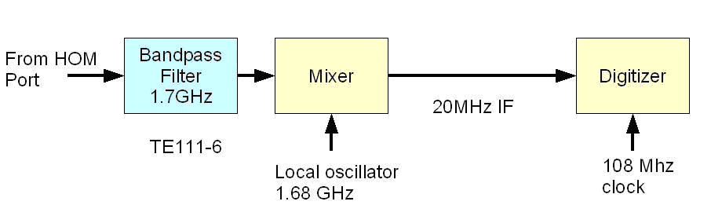
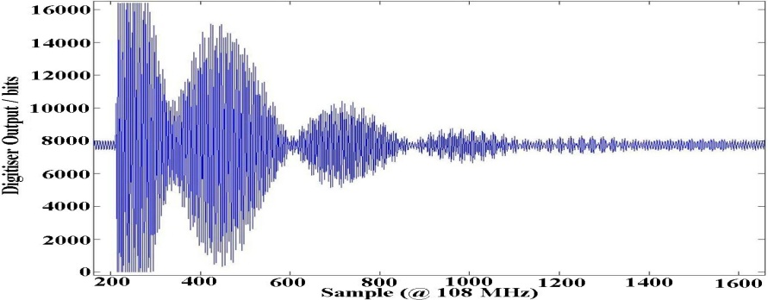
1.I Extant Work at 1.3 GHz:
HOM-BPMs in TESLA Cavities
HOM-BPMs at 1.3GHz cavities
  Use dipole mode at 1.7 GHz
  Installed in 5 accelerating
  modules (40 cavities)
  Calibration: with SVD technique
    problem: unstable in time
Beam Alignment in Modules
  Now routinely used in FLASH
Other studies
  Cavity alignment in cryo-module
  Beam phase measurement with monopole modes at ~2.4GHz
XFEL Plans:
  Install in some 1.3 GHz and in all 3.9 GHz cavities (8 per module)
See talk by N. Baboi et al.

Slide 15
1.I Analysis of Narrowband Signals –
Beam Position (Previous 1.3 GHz Study)
Resolution of position measurement.
  Predict the position at cavity 5 from the measurements at cavities 4 and 6.
  Compare with the measured value.
X resolution
  ~9 μm
Y resolution
  ~4 μm
See talk by N. Baboi et al.

Slide 16
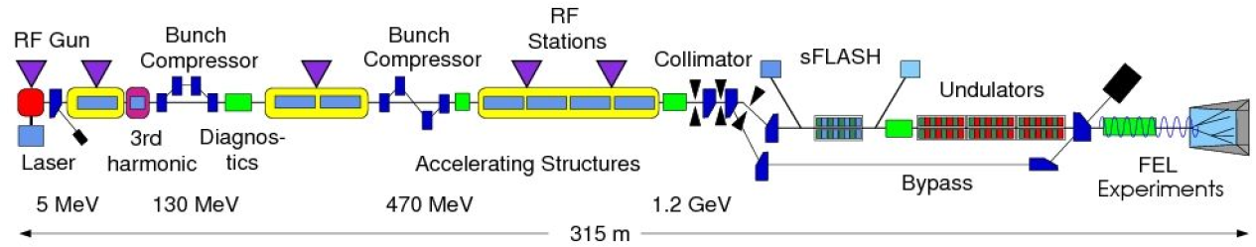
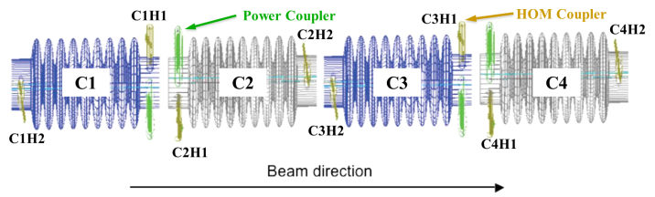
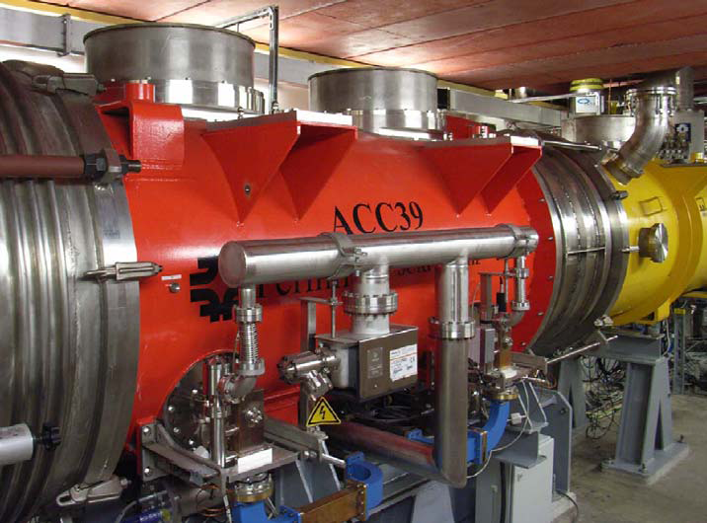
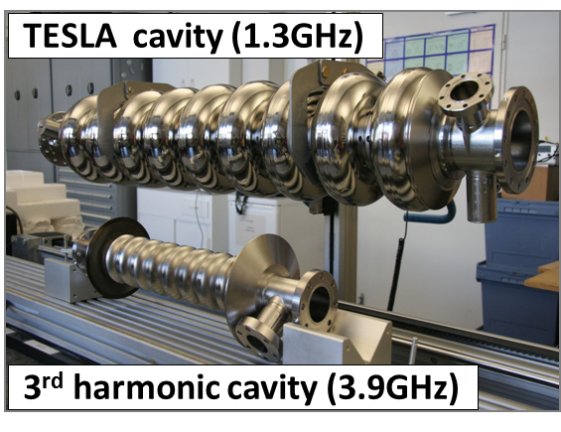
1.I FLASH and ACC39
Free-electron LASer in Hamburg (FLASH)
Photo courtesy E. Vogel & DESY
See talk by N. Baboi et al.
Page 16

Slide 17
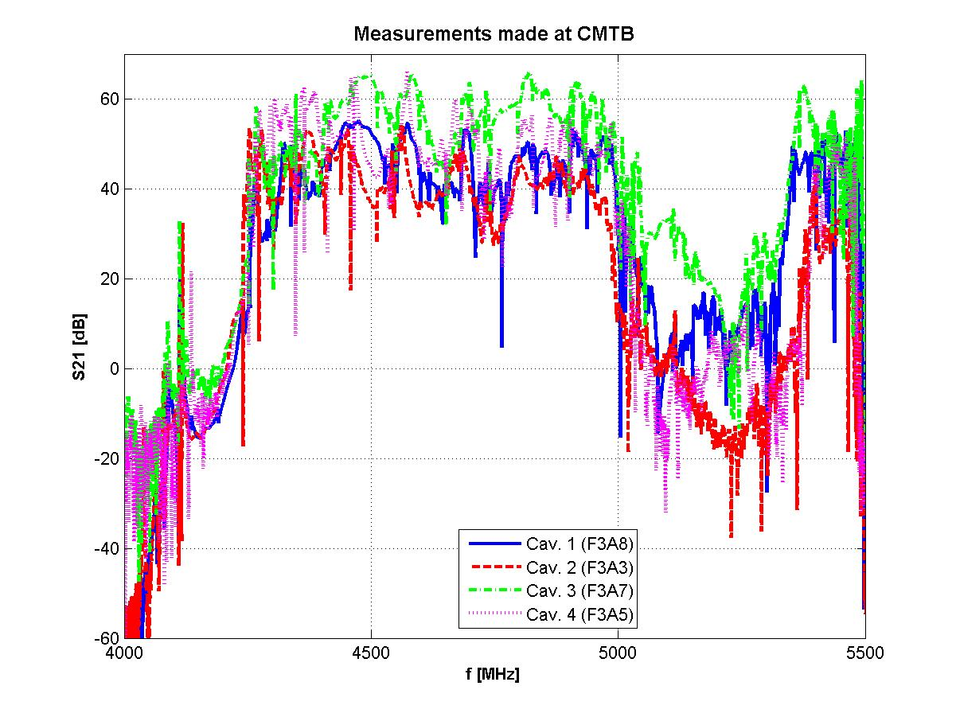
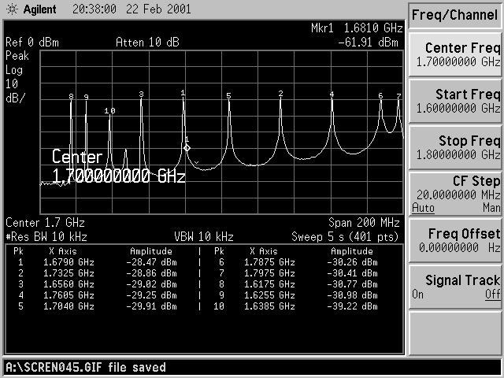
1.I ACC39 Spectra Measured in CMTB:
Focused on Dipole and Other Bands
For comparison: dipole band in TESLA cavity
Transmission matrix measurements made on all 4 cavities within ACC39.
See talk by N. Baboi et al.

Slide 18
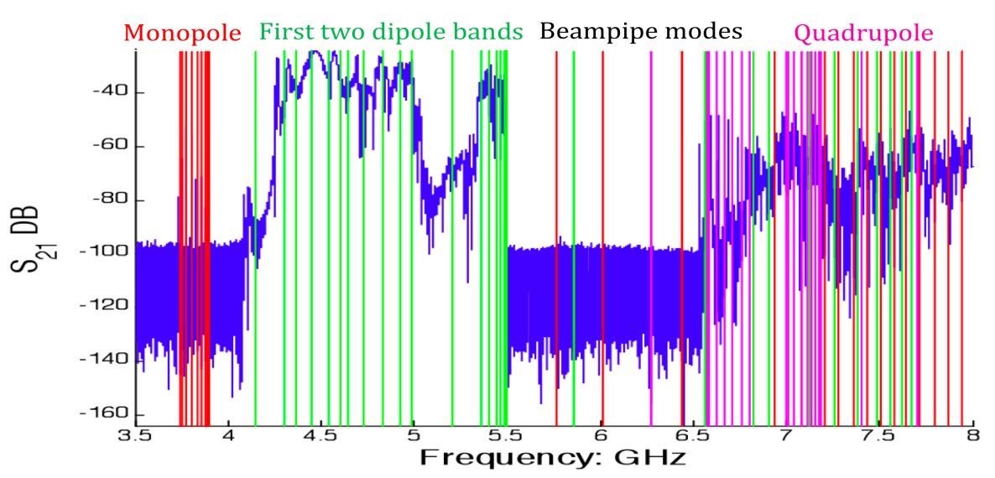
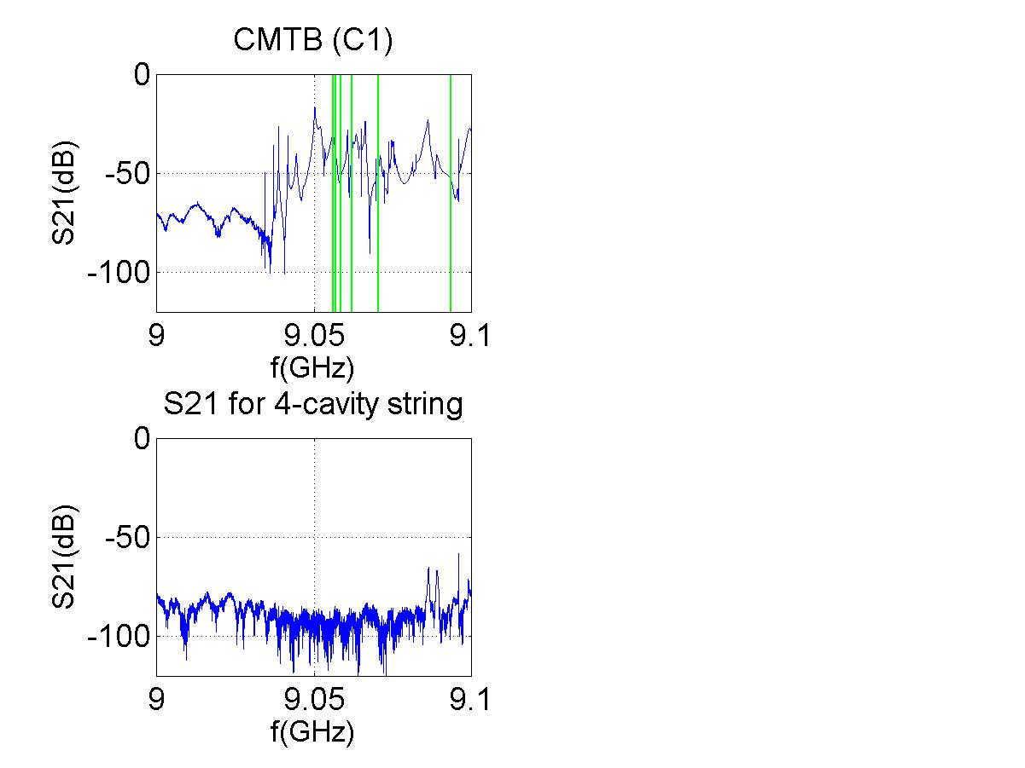
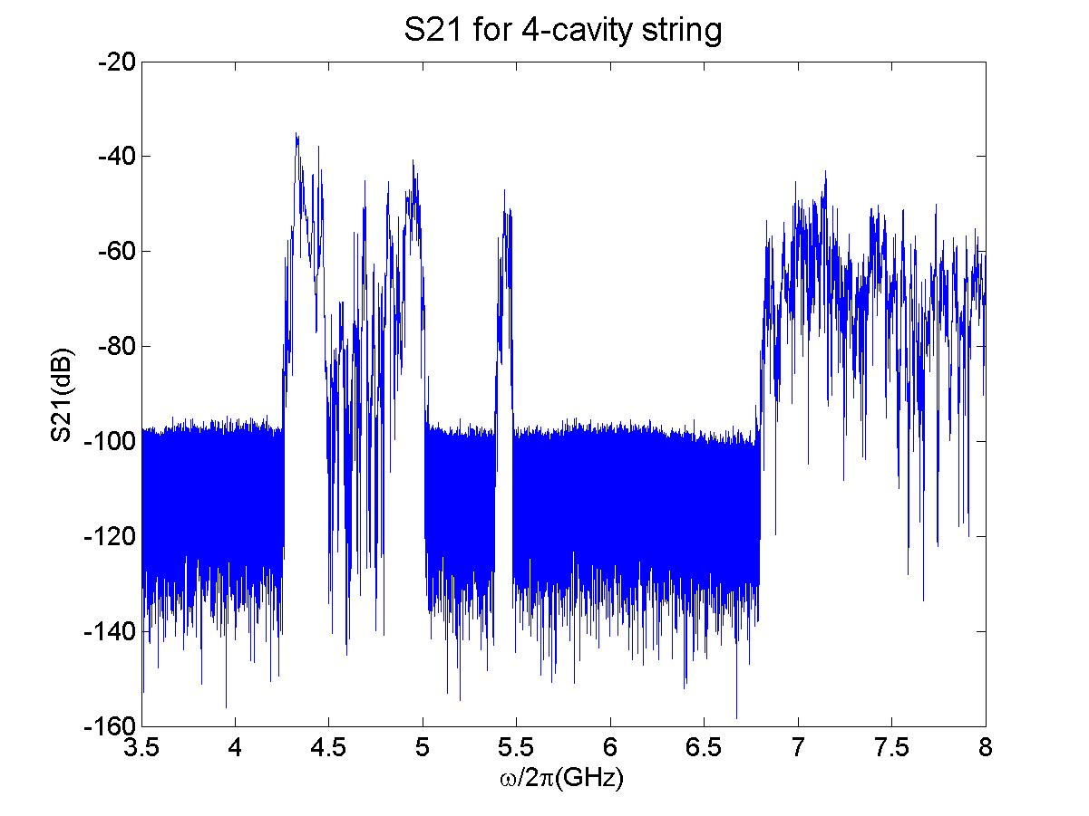
1.I Band Structure
5th dipole band
Potential HOM Diagnostic Candidates (2nd band)
Potential HOM Diagnostic Candidates (5th band)
Resolution Issues
2nd Band consists of multi-cavity modes – provides resolution along module
5th Band modes are trapped – provides resolution along cavity (but with reduced overall resolution ~ R/Q)
See talk by N. Baboi et al.
Page 18

Slide 19
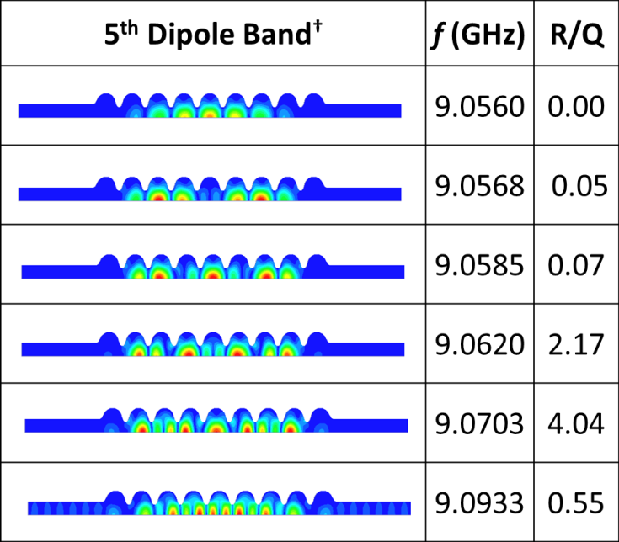
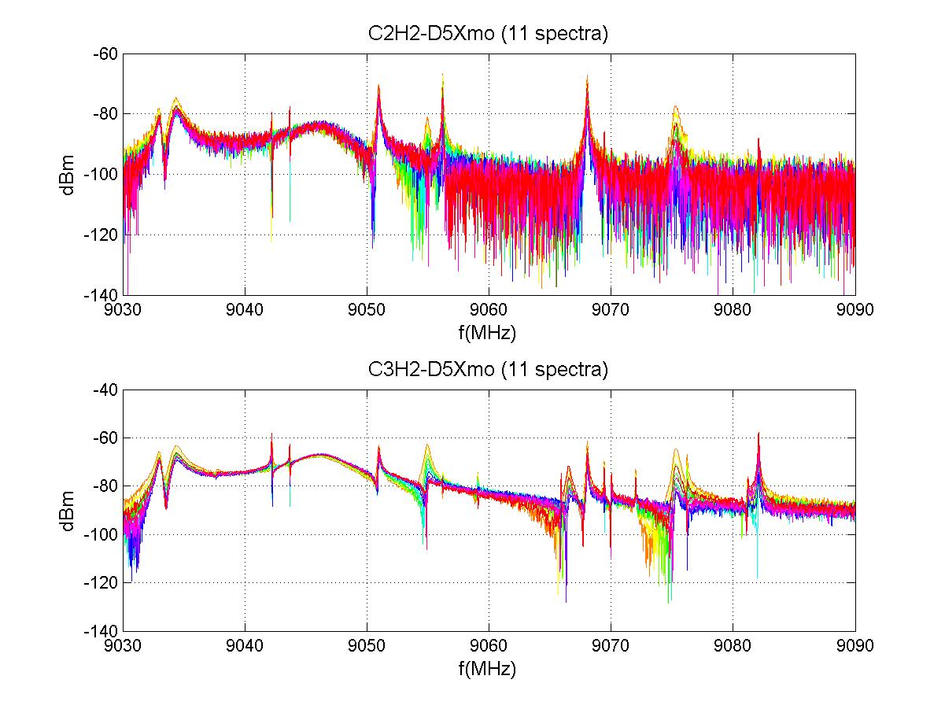
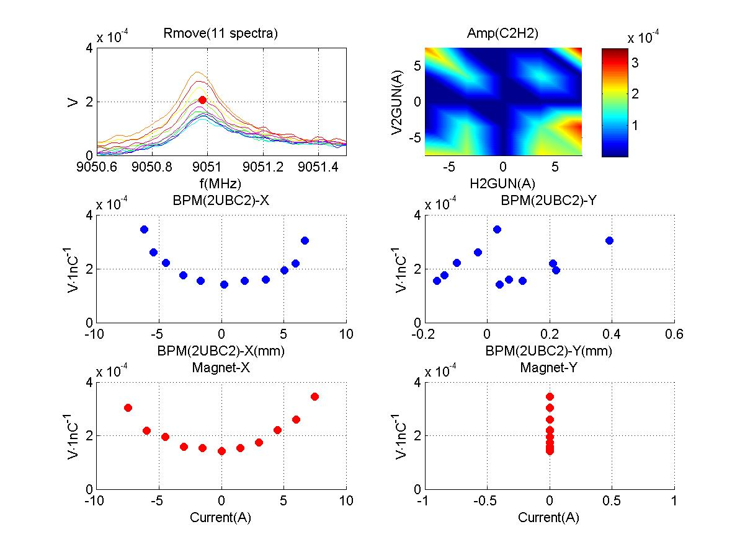
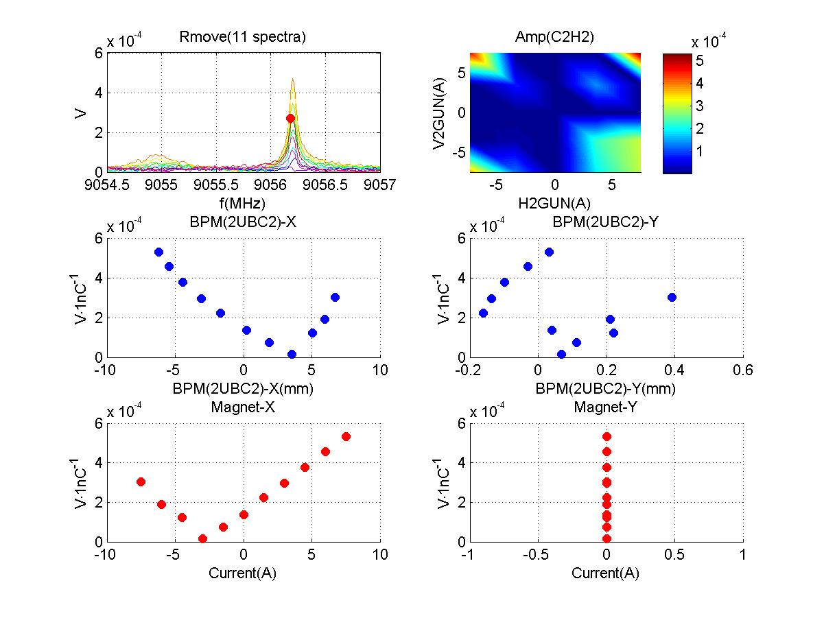
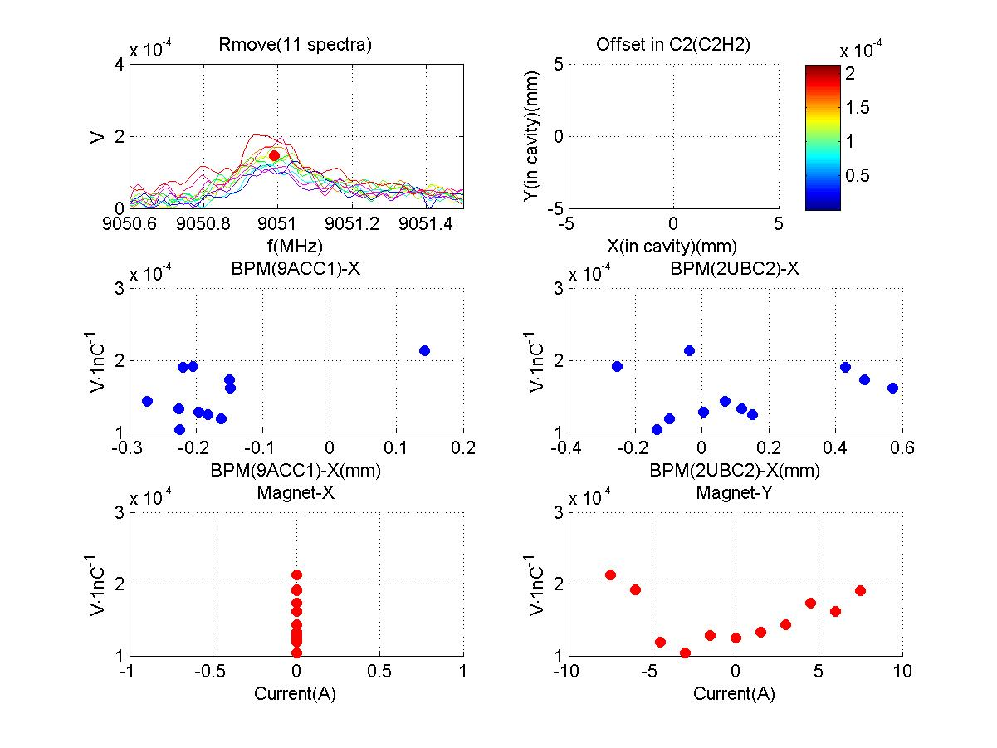
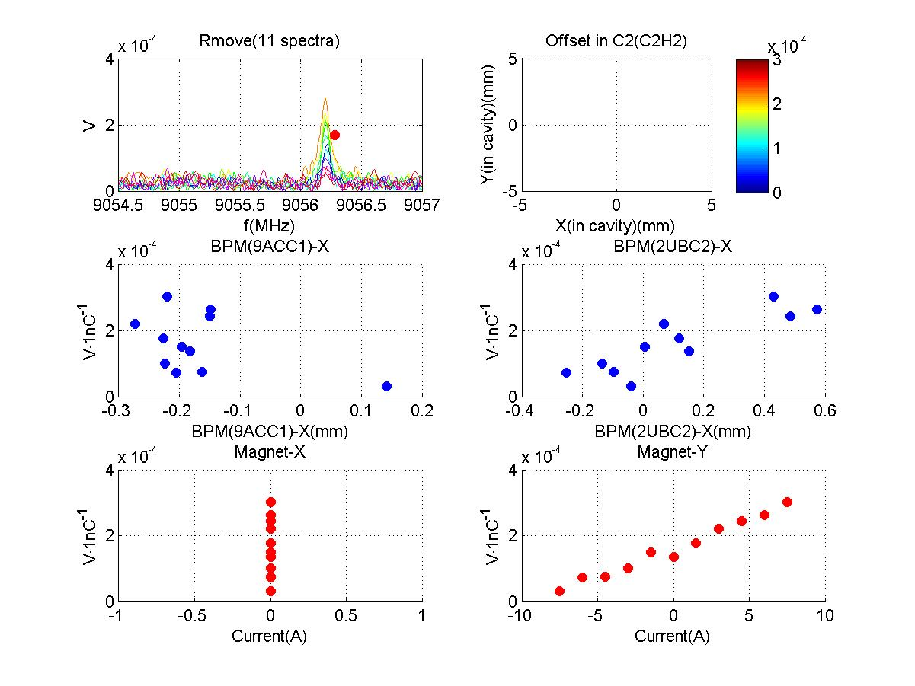
5th Dipole Cavity Band
1.I 5th Dipole Cavity Band
localized!
hor. move
hor. move
vert. move
vert. move
† I.R.R. Shinton, et al., “Mode Distribution …”, CI Internal Note
See talk by N. Baboi et al.

Slide 20
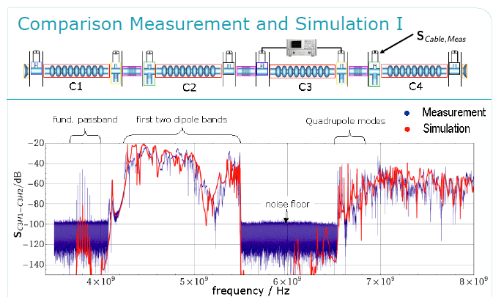
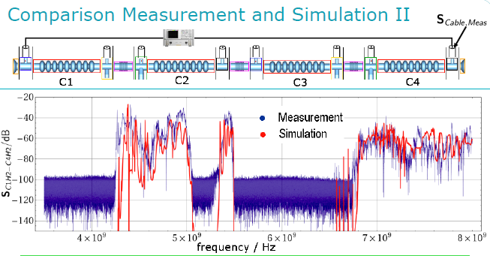
1.I S₂₁ Exp vs Simulations
Transmission through single cavity in chain.
Transmission through complete chain.
See talk by T. Flisgen & U. Van Rienen

Slide 21
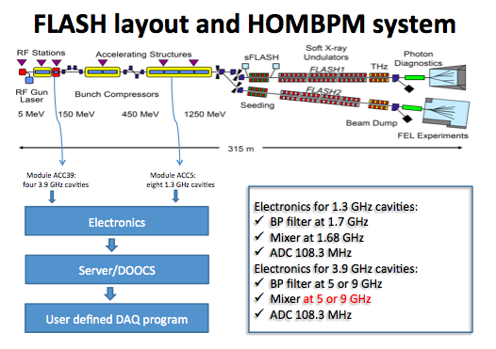
1.I Impetus From HOMSC12
The LLRF discussions in HOMSC12 prompted investigations on mode stability –the predictive capacity of HOMBPMS changes from day-to-day and sometimes on an hourly basis.
Calibration mode shift over time as machine is operated or a calibration issue?
See talk by L. Shi

Slide 22
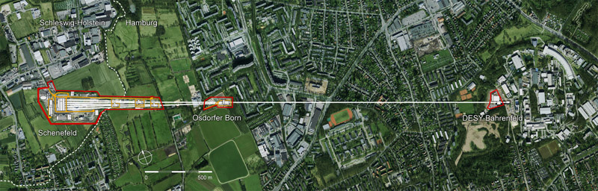
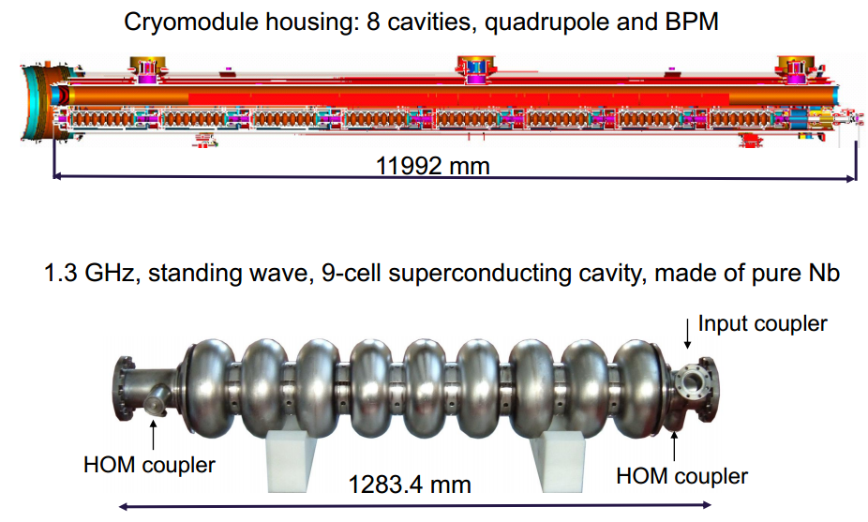
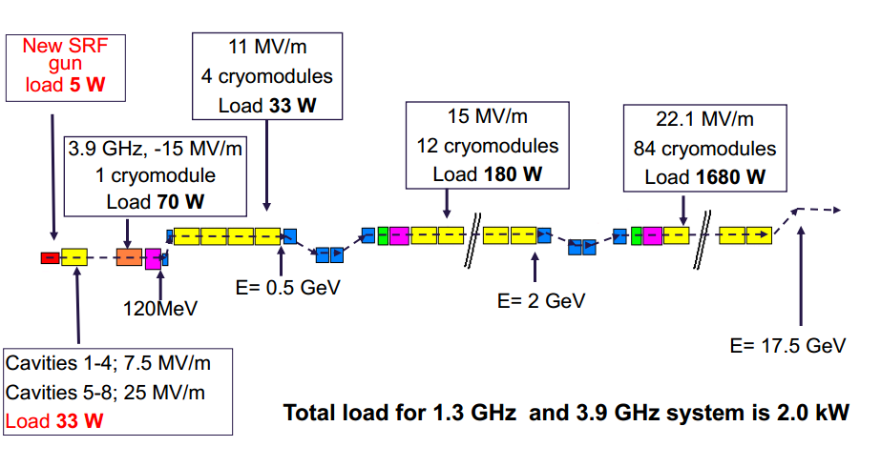
1.II XFEL

Slide 23
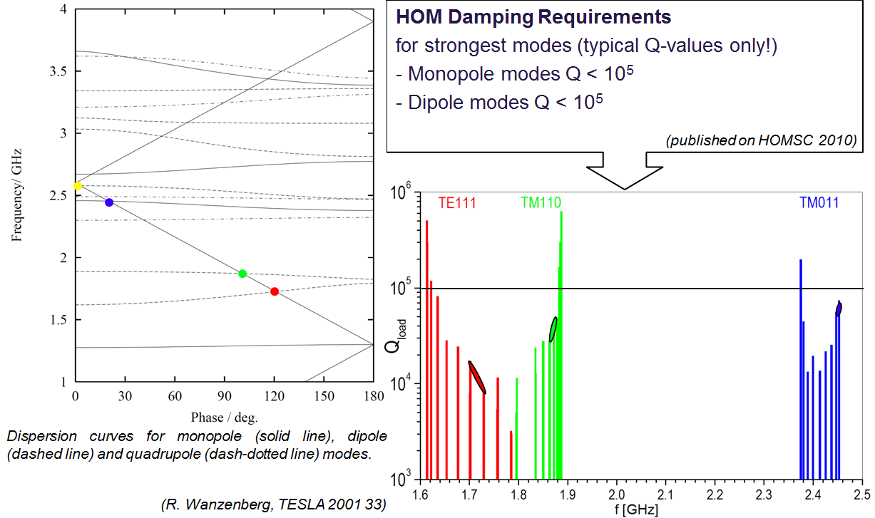
1.II XFEL –Beam Dynamics Requirements and Measurements on HOM Damping
HOM Prescription
or Requirement: Q<10⁵
See talk by A. Sulimov

Slide 24
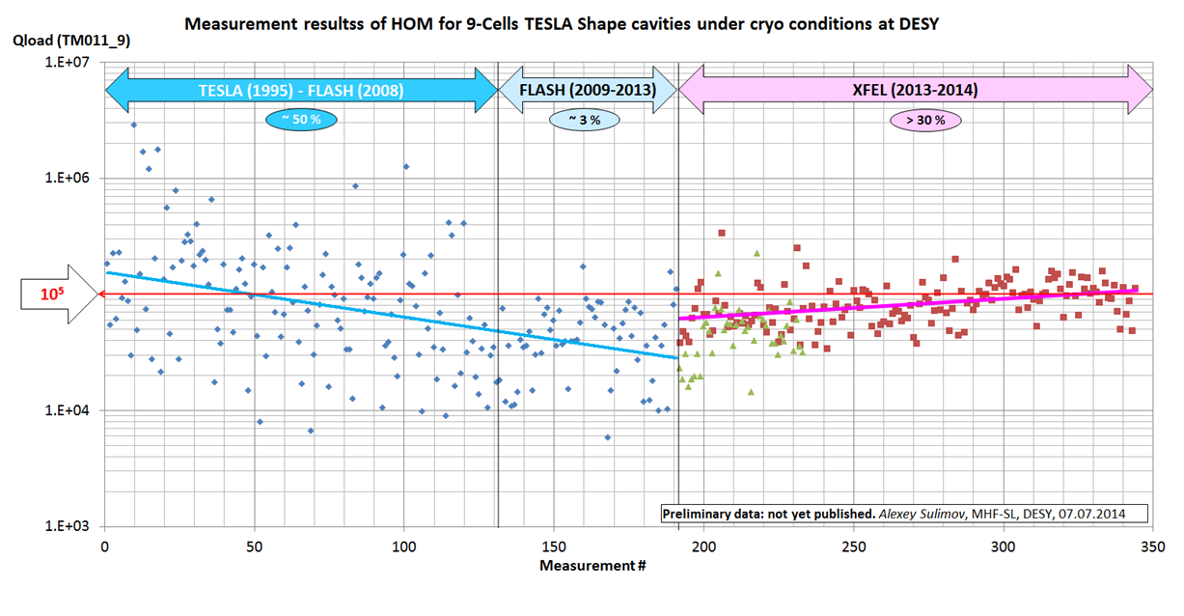
1.II XFEL –Beam Dynamics Requirements and Measurements on HOM Damping
HOM Prescription
or Requirement: Q<10⁵
Measurements Indicate Various Manufacturing Errors May Cause Deviation From Specs.

Slide 25
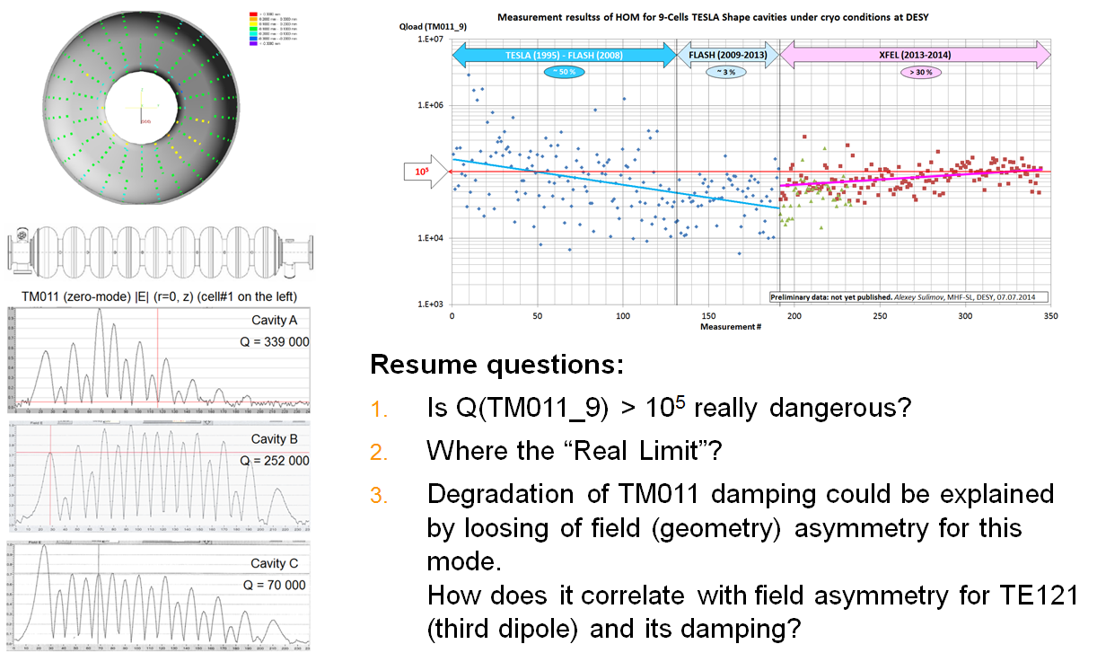
1.II XFEL –Is HOM Damping Spec Too Stringent?
See talk by A. Sulimov

Slide 26
1. XFEL/FLASH Remarks on HOMs
ACC1 HOM diagnostics successful & ACC39 linearises beam –HOM diagnostics ongoing as part of EuCARD2 (DESY, Univ. Rostock, Univ Manchester, Cockcroft Inst.). Stability and assessing the tendancy of mode drifts is an important consideration for robust system –experiments continue.
Third harmonic ACC39 module at FLASH consists of 4 coupled cavities (XFEL 8) within a module. Many of these modes propagate through the modules –a suite of simulations is being used to characterise the coupling and sensitivity to geometrical perturbations. Challenging to simulate accurately. Nonetheless, simulations of transmission is in good agreement with measurement (see U. Van Rienen/T. Flisgen talk).
HOM electronics continue tests in 3.9 GHz cavities 2014.
There are potential questions on XFEL HOM damping specifications (see A. Sulimov’s talk).

Slide 27
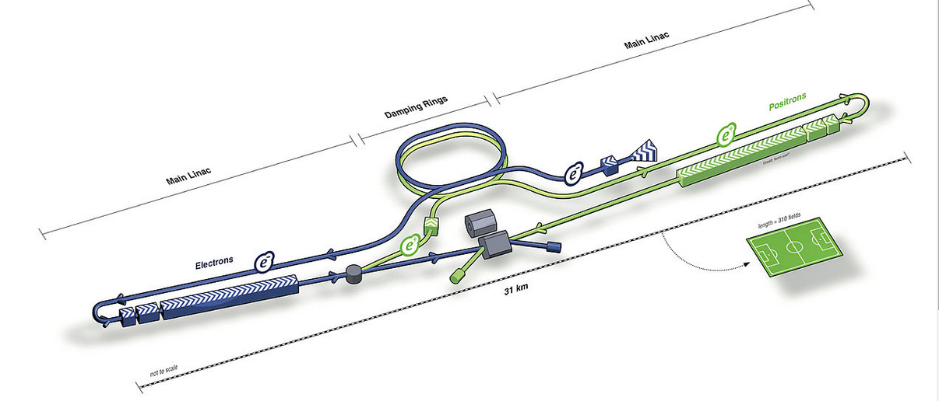

2. ILC
The ILC will collide electrons with positrons.
It will be between 30 km and 50 km (19–31 mi) long, more than 10 times as long as the 50 GeV Stanford Linear Accelerator –initially at an energy of 0.5 TeV and with a later upgrade to 1 TeV

Slide 28


2. ILC –Various Optimised Cavities
Low-Loss (and Reentrant) cell shapes more susceptible to geometrical variations – change in HOM behaviour
Band frequency shifts
Qext values differ only a little between cavities with 3 (diamonds), 4 (crosses), 5 (circles), 6 (asterisks) and 7 (squares)
Some pass-bands have relatively higher Qext values (2 orders of magnitude) for cavities with Low-Loss shapes (NLSF and Ichiro) than for TESLA like shapes (Cornell and TESLA)
U. Van Rienen, T. Galek

Slide 29




2. ILC –Low Loss (LL) Design
Powerful & efficient simulations with the SLAC in-house suite of codes: ACE3P provides confidence in design
See talk by Z. Li

Slide 30




3. LCLS-II
Replaces first part of NC S-band with SC L-band linacs
Driven by a 4 GeV SRF linac – based on XFEL / ILC technology

Slide 31



3. Power Losses Due To Wakefields in LCLS-II
Third Harmonic Bunch Linearizing Cavities
Overall power losses appear minimal for both third harmonic and main accelerating cavities and have little impact on breaking cooper pairs [1]
Main 1.3 GHz SC Accelerating Cavities
See talk by K.L.F Bane and [1] LCLSII-TN-13-01

Slide 32





4. Next Generation Light Source (NGLS) & Project-X
See talk by A. Sukhanov, A. Vostrikov & V. Yakovlev

Slide 33


4. NGLS & Project-X
Monopole Energy Loss Characterised by k_{loss}
Incoherent losses cause minimal losses for NGLS and is an order of magnitude less for Project-X

Slide 34

4. NGLS & Project-X
Dipole HOMs and Beam Break Up Instability (BBU)
Monopole & Dipole HOMs have little impact on beam
Small effect Dispense with HOM couplers

Slide 35



5. ESS
European Spallation Source (ESS) is a collaboration of more than 17 countries
Experiment is based in Lund Sweden –2 GeV, 5 MW beam
At the forefront of neutron flux
Anticipated first beam in 2019
ESS is planned to be “green” - the energy used to power the machine will be recovered using on-site renewable energy sources

Slide 36


5. ESS –HOM Dispersion Curves and k_{loss}
β= 0.86 Elliptical Cavities (86 in Linac)
First 6 Monopole
Dispersion Curves
Banded Modal Loss Factors
In dispersion curves (left): blue points correspond to full cavity (model), and red to infinite periodic results (single cell)
Loss factor (right) are modal values
Focus on the 2 modes close to the synchronous point
These have the potential to be resonantly excited from random errors in fabrication -as they are within 2 MHz of the bunch frequency
See talk by A. Faricker

Slide 37


5. ESS –Beam Dynamics Simulations
Q=10⁸
Q=10⁸
Utilising R. Ainsworth python code, subject the cavities to an RMS error of 2 MHz (expected from manufacturing) and track beam down complete linac whilst monitoring the emittance dilution (%) due to a single monopole HOM (1.410 GHz left, 2.465 GHz)
A single modal component is included in one cavity along the linac
Its frequency is shifted to be a multiple of the bunch frequency
Worst case regime –at present damping provided by fundamental mode couplers is not determined.
See talk by A. Farricker

Slide 38


5. ESS –Beam Dynamics Simulations
R/Q
Q=10⁸
R/Q
Q=10⁸
Q=10⁶
Q=10⁶
Utilising R. Ainsworth python code, subject the cavities to an RMS error of 2 MHz (expected from manufacturing) and track beam down complete linac whilst monitoring the emittance dilution (%) due to a single monopole HOM (1.410 GHz left, 2.465 GHz)
A single modal component is included in one cavity along the linac
Its frequency is shifted to be a multiple of the bunch frequency
Worst case regime –at present damping provided by fundamental mode couplers is not determined.
Adding further damping manages the dilution but it is still significant –suggesting that cavities must be tuned to better than 2 MHz

Slide 39






6. Couplers and Damping in Crab and Quarter Wave Cavities
E Field
Surface
E Field
B Field
Surface B Field

Slide 40




6. Couplers and Damping in Crab and Quarter Wave Cavities
RHIC is equipped with a 56 MHz SC quarter wave cavity
HOM damper includes a loop coupler and a high-pass filter.
High-pass filter has been designed and measured with more than 90 dB attenuation difference between the fundamental mode and the first HOM.
Prototype HOM Damper
3D Model of
HOM Damper
RLC Cct
3D
Model
See talk by Q. Wu

Slide 41

6. Couplers and Damping in Crab and Quarter Wave Cavities
Double Quarter Wave Crab HOM Coupler
Compact in size to fit into the cryomodule
Cooling channel big enough
Band stop structure to provide minimum loss on Cu gasket (mW range RF loss)
Loss on Cu pin is negligible (much less than that on gasket)
Coupling to 400MHz: 7.9x10⁹ (1.1W each port to outside load)
Designed to handle kW range HOM power
Cross-checking the R/Q and Qext calculations between BNL and CI/Univ. Lancs, UK.
See talk by B. Xiao

Slide 42



6. Couplers and Damping in Crab and Quarter Wave Cavities
Compact deflecting mode, crab cavity –generates dipole mode
No lower order modes
Wealth of designs at ODU
The 400 MHz cavity (below) indicates all modes damped to 10⁵ or better
RT
Q_{ext}
See talk by S. De Silva

Slide 43

7. HOM Damping Materials

Slide 44


7. HOM Damping Materials
Frequency dependent properties of ferrites and dielectrics important for proper implementation in HOM damping system –should damp as anticipated!
Measurement of complex permittivity and permeability showed some discrepancies in earlier workshops
A campaign of improved simulations, (MWS, S3P) together analytical work leads to better interpretation of experiment measurements
See talk by V. Shemelin

Slide 45
7. HOM Damping Materials
Ferrite covered ceramic break
discovered in BNL ERL Gun
S₁₁ and Q measurements performed
Dipole modes are well damped, Q << 100
in part by the ferrite absorber and also by the dual-feed fundamental mode coupler (FPC).
Monopole mode damping is restricted by 10 cm cutoff tube to Q < 10⁶
The concept of an absorber over a ceramic break has been demonstrated.
See talk by H. Hahn

Slide 46
Final Remarks
HOMs in SC cavities is an active and vibrant field!
Based on earlier HOM-based measurements at FLASH (now routinely used as HOM diagnostics by operators), there is potential for implementation at XFEL –3rd harmonic cavities coupled in ACC39 module but well-simulated!
Beam dynamics may indicate lose damping on HOMs for XFEL?
Simulations LCLS-II, NGLS pose no problems in terms of heat load and emittance dilution due to HOMs generated
ESS operation close to harmonic of HOM bunch prompts attention to tuning and manufacturing tolerances.
Improved understanding of HOM damping materials –both simulation & measurement

Slide 47
Acknowledgments
In addition to several ongoing collaborations on HOM damping and HOM-based diagnostics (in the context of EuCARD2 and ESS in particular), I am also pleased to acknowledge direct contributions from K.L.F. Bane, U. Van Rienen, V. Shemlin, Z. Li, N. Baboi, S. Belomestnykh, A. Sukhanov, A. Sulimov, W. Xu, B. Xiao, Q. Wu, H. Hahn, S. De Silva.

Slide 48

Thank you for your attention!

Slide 49
Extra Slides

Slide 50




Direct Linear Regression
Direct Linear Regression
RSA
2nd dipole cavity band
Direct Linear Regression (DLR)
A: spectra matrix
B: beam position matrix
See talk by N. Baboi et al.

Slide 51




Singular Value Decompostion
RSA
Calib.
2nd dipole cavity band
Two steps
Valid.
See talk by N. Baboi et al.

Slide 52


