Slide 1












Overview of HOM-based Diagnostics at FLASH and the European XFEL
N. Baboi, DESY
HOMSC 14, WG 2 HOM-based Diagnostics
Fermilab, 14 July 2014

Slide 2
Contents
Principle, benefits
HOMBPMs for 1.3 GHz cavities
  FLASH
  E-XFEL
HOMBPMs for 3.9 GHz cavities
  FLASH
  E-XFEL
HOM-based beam phase
Measurement of cavity alignment at FLASH
Summary

Slide 3
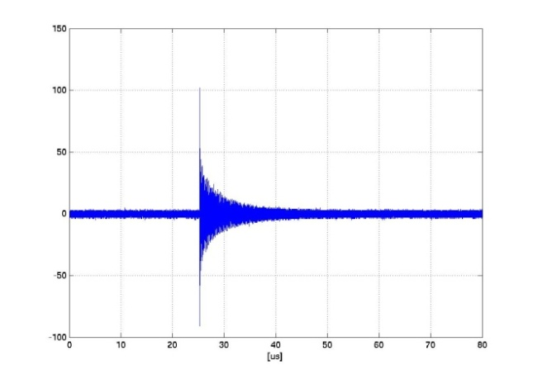
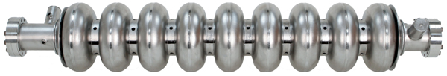
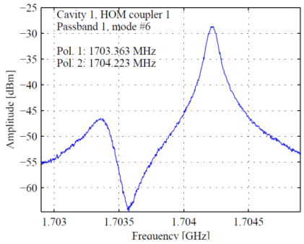
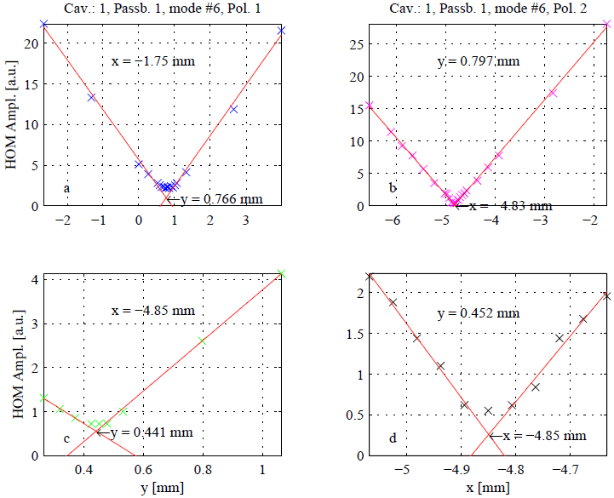
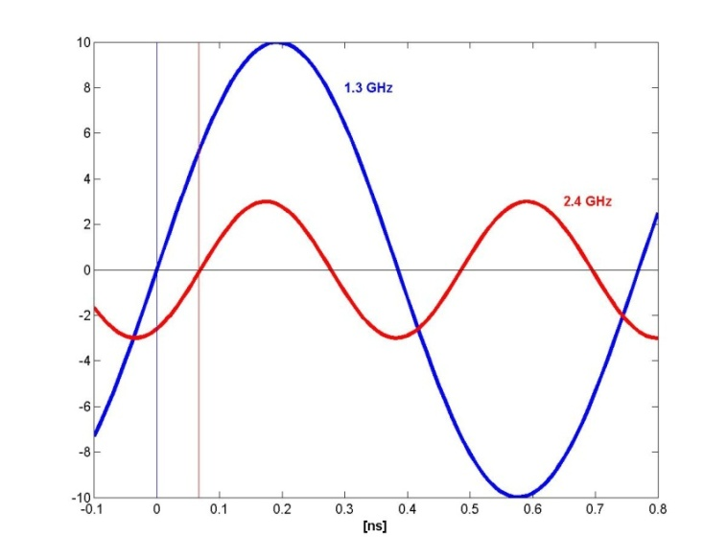
Principle
e⁻
Filter higher dipole mode for
beam position
Filter higher monopole mode for beam phase
×
Phase difference
Beam offset [mm]

Slide 4
Benefits
Additional beam diagnostics without additional vacuum component
  Beam alignment
  Additional information on cavity alignment
Reduction in emittance dilution from transverse wakefields by
centering beam in accelerating cavities
Direct, on-line measurement of beam phase wrt RF phase

Slide 5
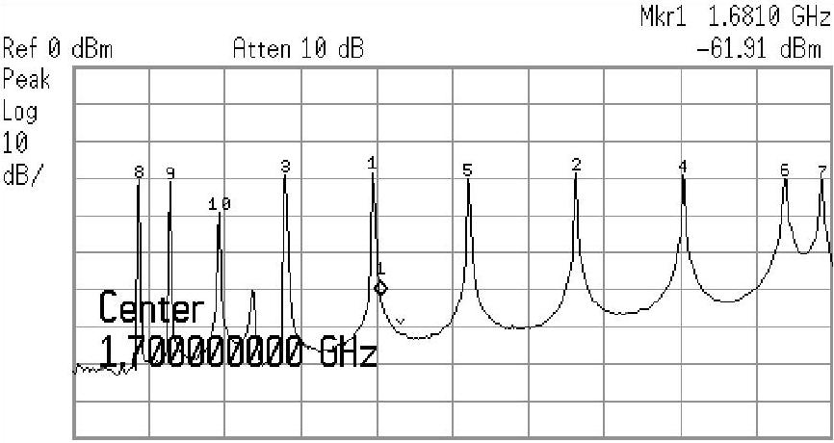
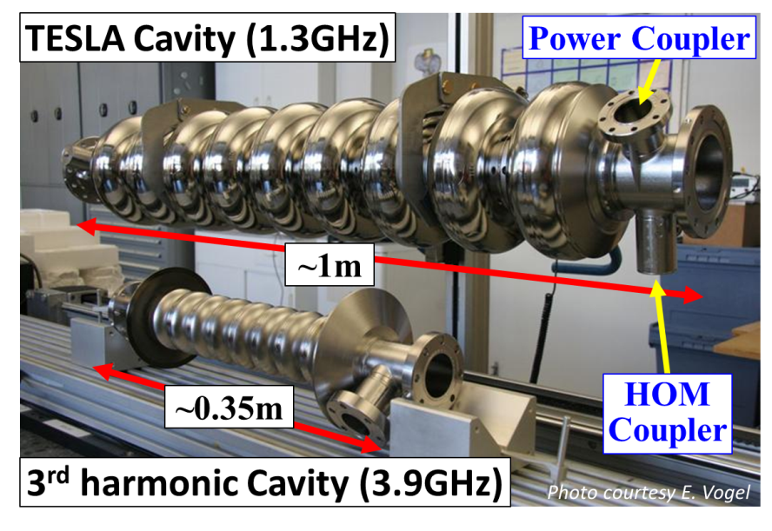
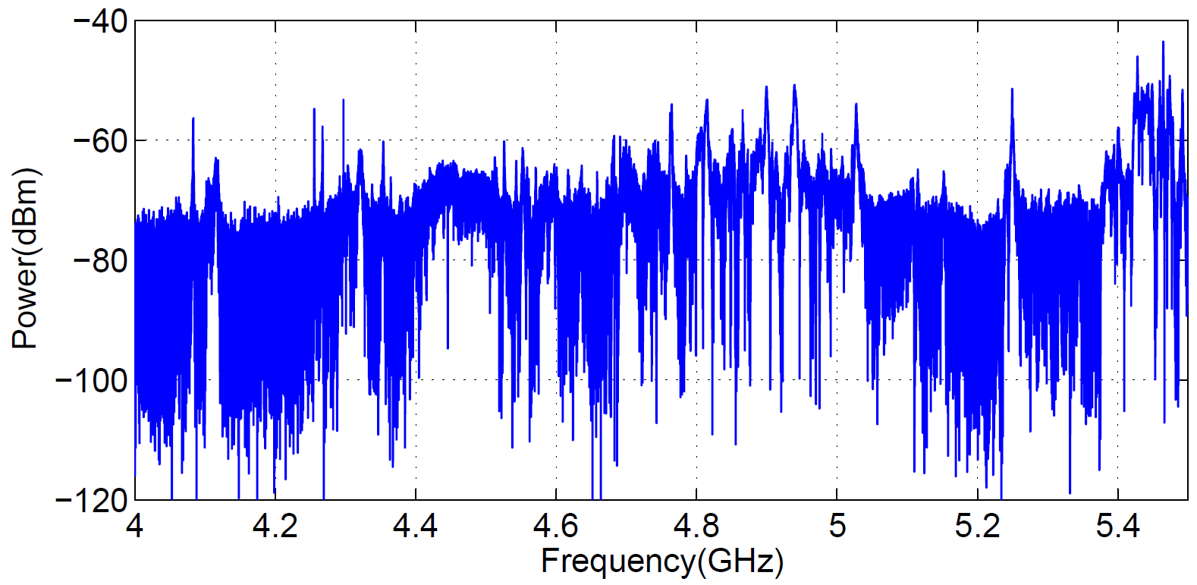
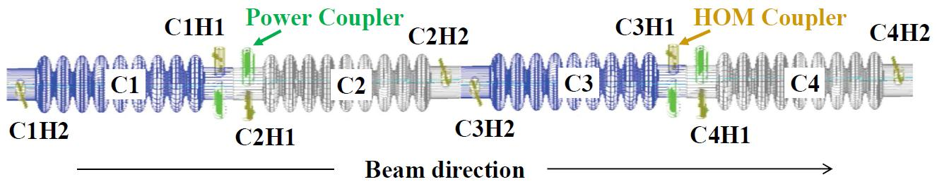
Accelerating Cavities in the E-XFEL and FLASH
The 1st dipole band
The 2nd dipole band
The 1st dipole band
Coupled cavities

Slide 6
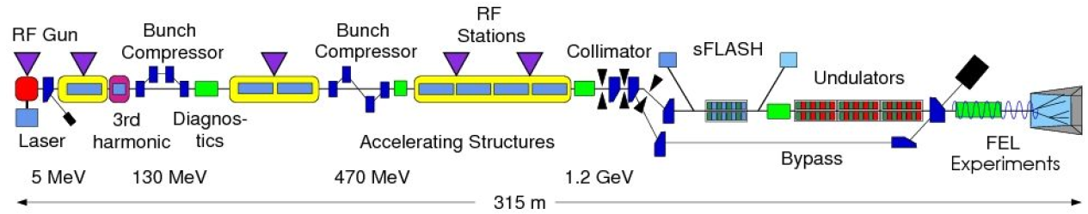
FLASH
 | European XFEL | FLASH
1.3 GHz cavities | 100 x 8 cavities | 7 x 8 cavities
3.9 GHz cavities | 1 x 8 cavities | 1 x 4 cavities
Charge | 0.02-1 nC | 0.2 – 1 nC
Energy | Up to 17.5 GeV | Up to ~1.2 GeV
Bunch frequency | Up to 4.5 GHz | Up to 1 MHz
Macro-pulse frequency | 10 Hz | 10 Hz
Macro-pulse length | ≤ 650 μs | ≤ 800 μs
Tests for
E-XFEL made at FLASH

Slide 7
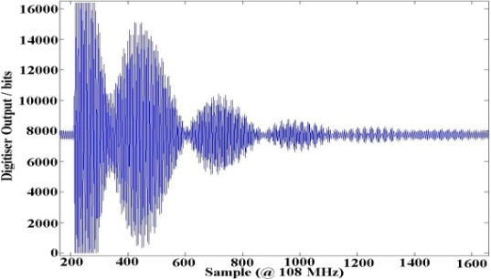
HOMBPMs at FLASH:
1.3 GHz Cavities
Electronics built by SLAC
HOMBPM-electronics installed
in 40 cavities in FLASH
  Use 1 dipole mode at 1.7 GHz
  Used as operator tool for beam alignment
  Used for measurement of cavity alignment
  Demonstrated use as BPM
  10 μm rms resolution
Presently
  Study stability of calibration into BPM-signals
The 1st dipole band
Joe Frisch et al., SLAC
Bandpass
Filter
1.7 GHz
20 MHz BW
Mixer
Digitizer
LO 1.68 GHz
Clock 108 MHz

Slide 8
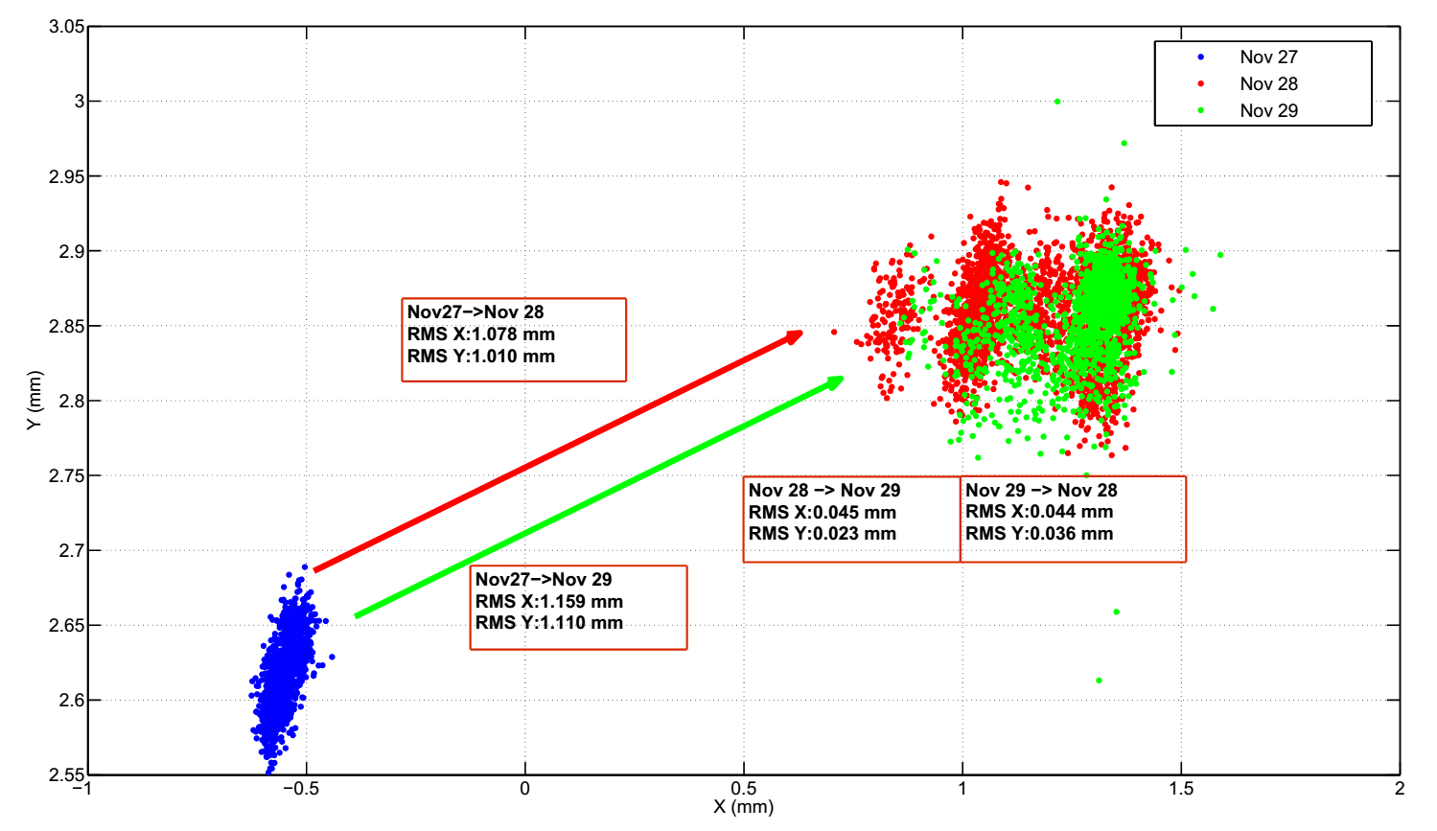
HOMBPMs at FLASH:
1.3 GHz Cavities (cont. 1)
Preliminary stability study
  Mostly parasitical measurements
  It seems that there is a strong correlation between calibration
  stability and
  the data position
Relevant for
the E-XFEL
as well
Liangliang Shi, DESY, UNIMAN

Slide 9
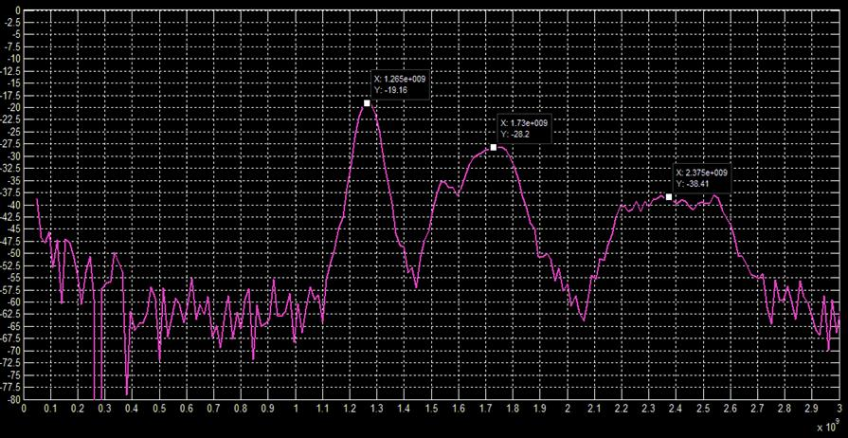
HOMBPMs at the E-XFEL:
1.3 GHz Cavities
Electronics Design
  Direct sampling of all three
  frequencies without any DCW
  MTCA standard
  Multiple filtering
Samer Bou-Habib, WUT, DESY

Slide 10
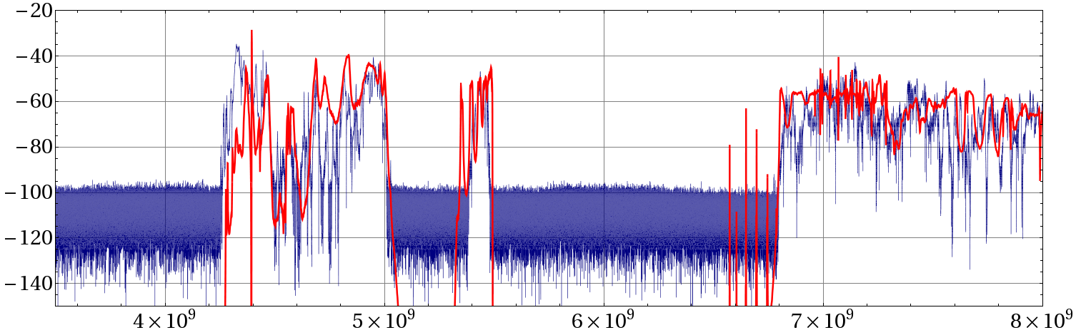
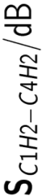
HOMBPMs at FLASH:
3.9 GHz Cavities
Theoretical studies made within EuCARD
  4 coupled cavities
Measurement
Simulation
frequency / Hz
T. Flisgen et al., Phys. Rev. ST Accel. Beams, 17:022003, February 2014
Thomas Flisgen, UROS

Slide 11
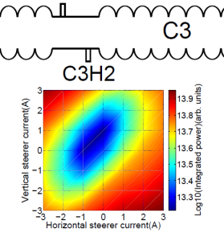
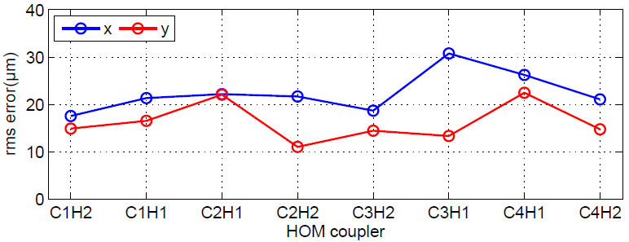
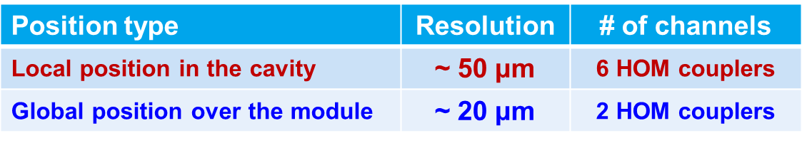
HOMBPMs at FLASH:
3.9 GHz Cavities (cont. 1)
Experimental studies made within EuCARD
  Specs for FLASH and E-XFEL
Presently: stability study
(Liangliang Shi)
Coupled modes 5.437 MHz
RMS Error at Module Center
Integrated
power
Pei Zhang,
ex-DESY
(now CERN)

Slide 12
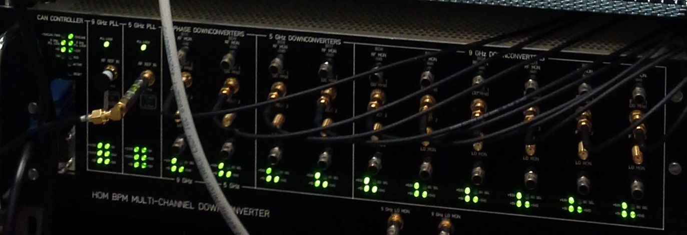
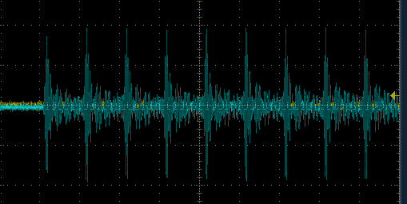
HOMBPMs at FLASH:
3.9 GHz Cavities (cont. 2)
Electronics built at FNAL
  Now under commissioning
  Will serve as prototype for the E-XFEL
Nathan Eddy, FNAL
30 MHz IF
LO
Bandpass
Filter
~5.43 GHz or 9.06 GHz
100 MHz BW
Mixer
uTCA Digitizer
SIS8300
(108MS/sec)

Slide 13
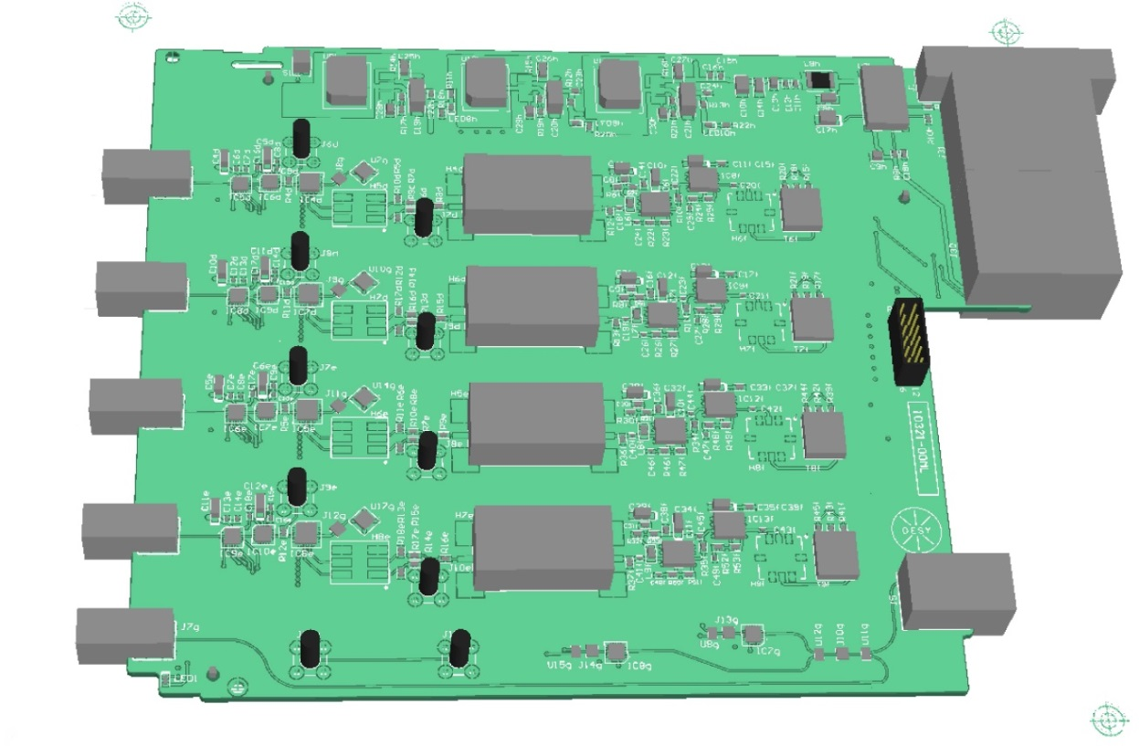
HOMBPMs at the E-XFEL:
3.9 GHz Cavities
Electronics under design, based on same specifications as for FLASH
  Designed at DESY
  Design of 5GHz DCW and PLL ready
LO
30 MHz IF
Bandpass
Filter
~5.43 GHz or 9.06 GHz
100 MHz BW
Mixer
uTCA Digitizer
SIS8300
(108MS/sec)
Thomas Wamsat, DESY

Slide 14
HOMBPMs at the E-XFEL:
3.9 GHz Cavities (cont. 1)
But much more challenging:
  8 coupled cavities cf. 4
  4.5 cf 1 MHz bunch frequency
  Different orientation of cavities
Presently: Need significant theoretical and experimental studies
  Prototype cavity arrived at DESY
  SSC (State Space Concatenations) approach developed at Uni Rostock and ready for simulation of 8-cavity simulations
  Direct simulations of full module started at Uni Manchester

Slide 15
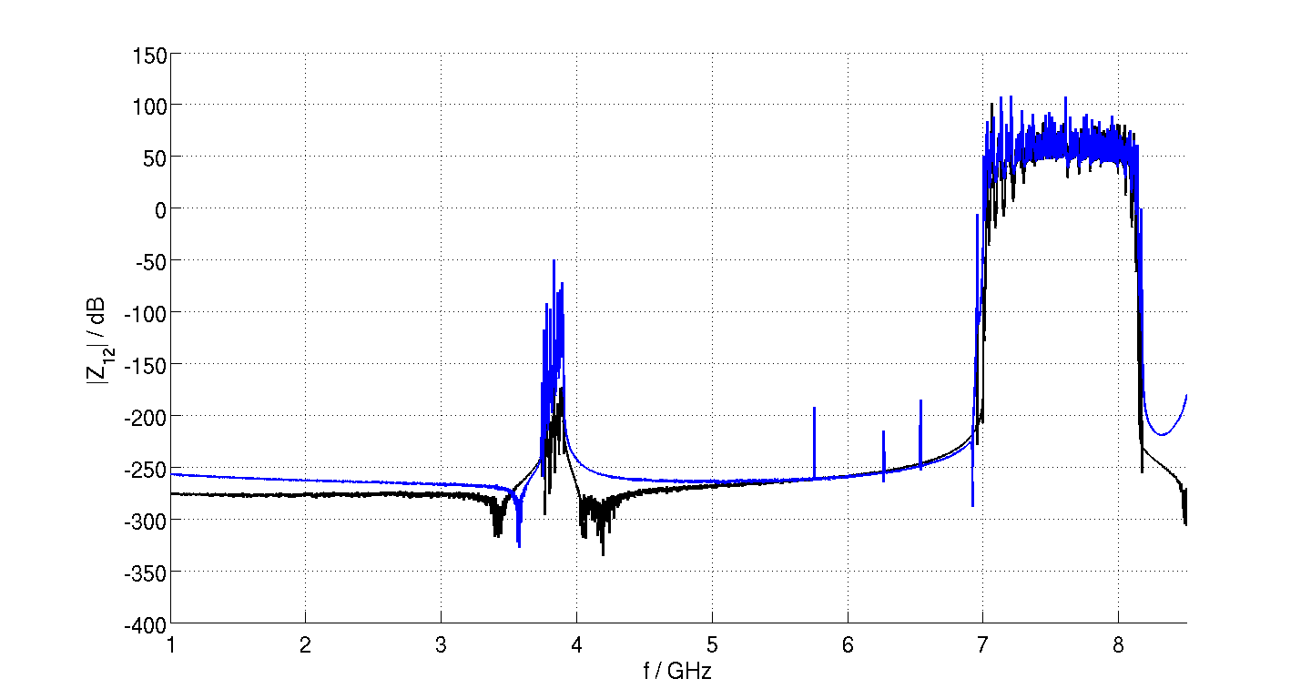
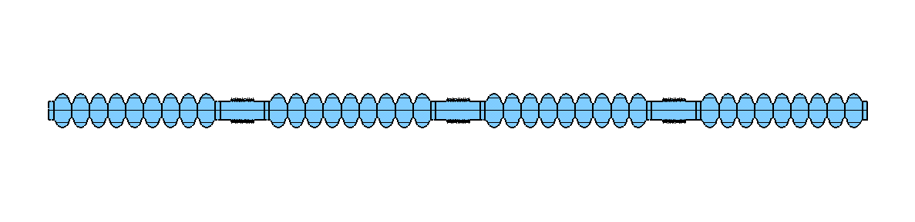
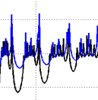
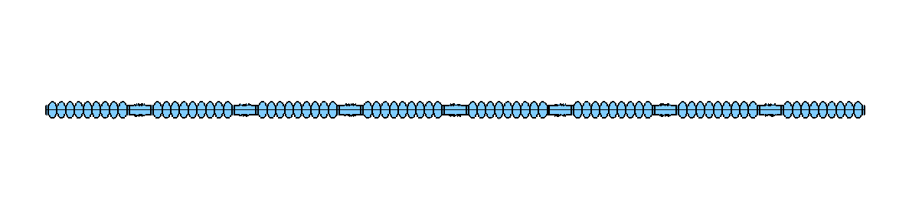
HOMBPMs at the E-XFEL:
3.9 GHz Cavities (cont. 2)
Impedance Parameter Comparison with SSC
Thomas Flisgen,
UROS

Slide 16

HOM-based Beam Phase Measurement wrt RF
1.3 GHz
(leaking through HOM-coupler)
~2.4 GHz
Phase difference
Joe
Frisch,
SLAC
Proof-of-principle made at FLASH
Presently:
  Phase monitors for 1.3 GHz cavities
  No nice monopole mode found for 3.9 GHz cavities
~0.1 deg
noise
(at 1.3 GHz)

Slide 17
HOM-based Beam Phase Measurement wrt RF (cont)
Same electronics as for HOMBPMs / 1.3GHz / E-XFEL
  Prototype under construction
  First beam tests expected in the next few months
Samer Bou-Habib, WUT, DESY

Slide 18
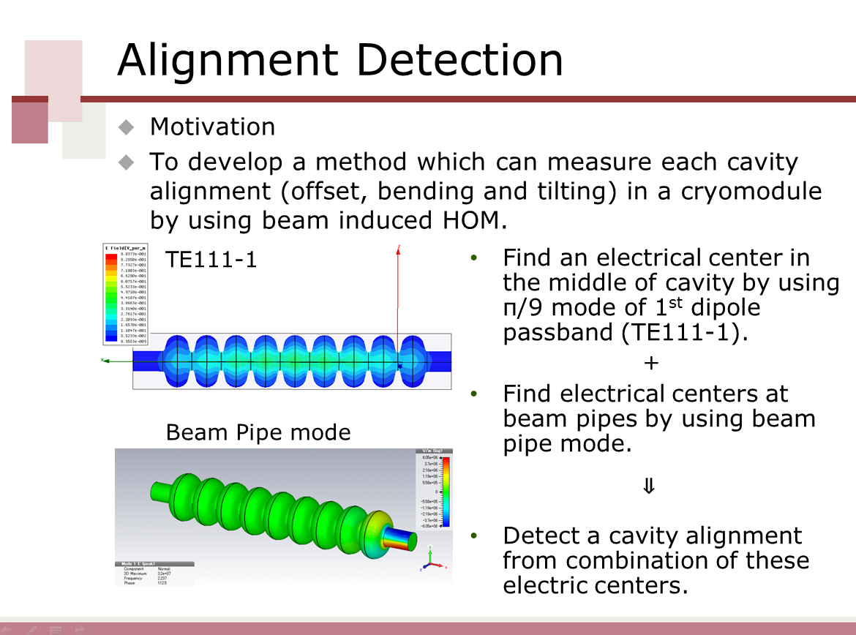
Measurement of Cavity Alignment at FLASH
Ayaka Kuramoto, KEK

Slide 19
Summary
Aim: HOM-based beam diagnostics for the E-XFEL
Based on large previous experience at FLASH
  1.3 GHz cavities: same specs as FLASH
  New concept for electronics, no DCW, multiple filter
  New: beam phase
  3.9 GHz cavities: same specs as in FLASH, but much more challenging:
    8 coupling cavities instead of 4
    different orientation of cavities
    4.5 MHz beam instead of 1 MHz
    Simulations being made
Tests on cavity alignments at FLASH
    Ayaka Kuramoto’s talk

