Slide 1
HOM-Based Diagnostics for 3.9GHz Cavities
Nathan Eddy
HOM Workshop
July 14, 2014

Slide 2
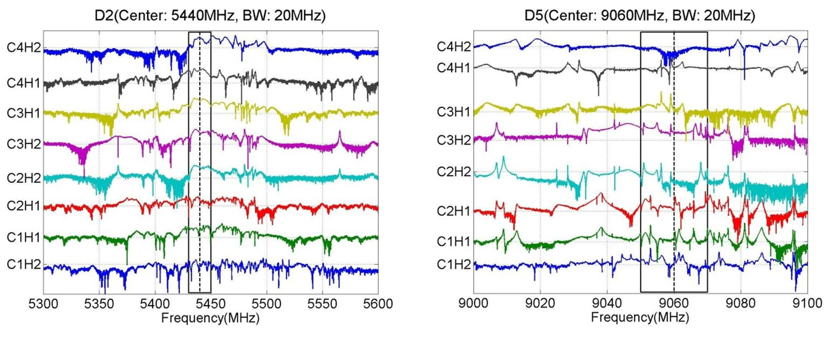
Specifications for Dedicated Electronics for FLASH
Based upon analysis of DESY data by P. Zhang, N. Baboi

Slide 3
HOM Downmix Electronics
From HOM
Port
RF Section
SSB
Mixer
IF Section
ADC
LO
Clock
RF Section
Bandpass filter and optimize signal power to mixer for signal of interest
IF Section
Image rejection, anti-alias
30MHz CF, 20MHz BW
ADC Input
Nyquist bands, Bandwidth
Mixer LO & ADC Clock
Locked and synchronous with RF & Trigger
Require integer multiple of 9MHz

Slide 4
All Timing Phase Synchronous with Beam
ADC Trigger Jitter
Fixed

Slide 5
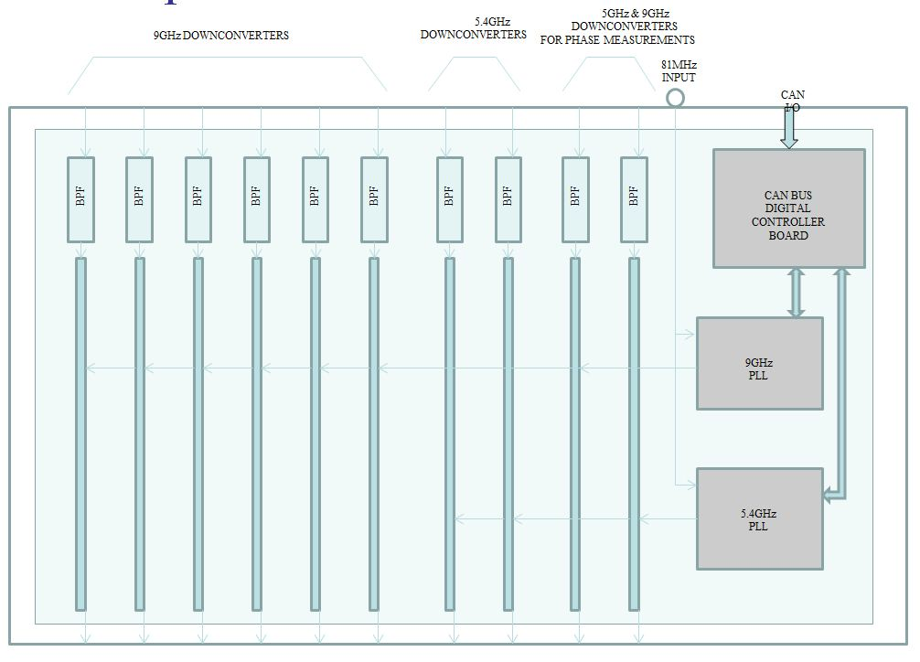
Final HOM Multi-Channel Downmix Electronics
Seven 9GHz downmix channels (6 hom, 1 phase)
Three 5 GHz downmix channels (2 hom, 1 phase)
LO programmable in 9MHz steps over 100MHz, locked to LLRF

Slide 6
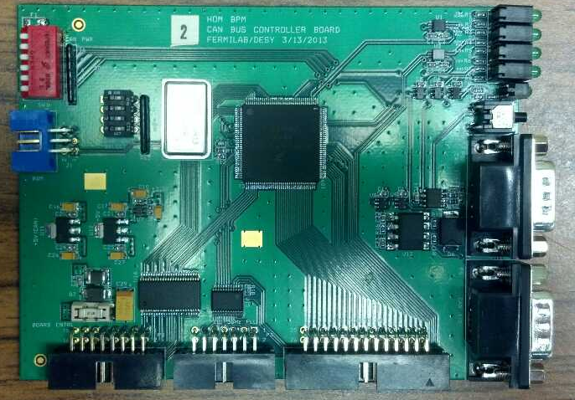
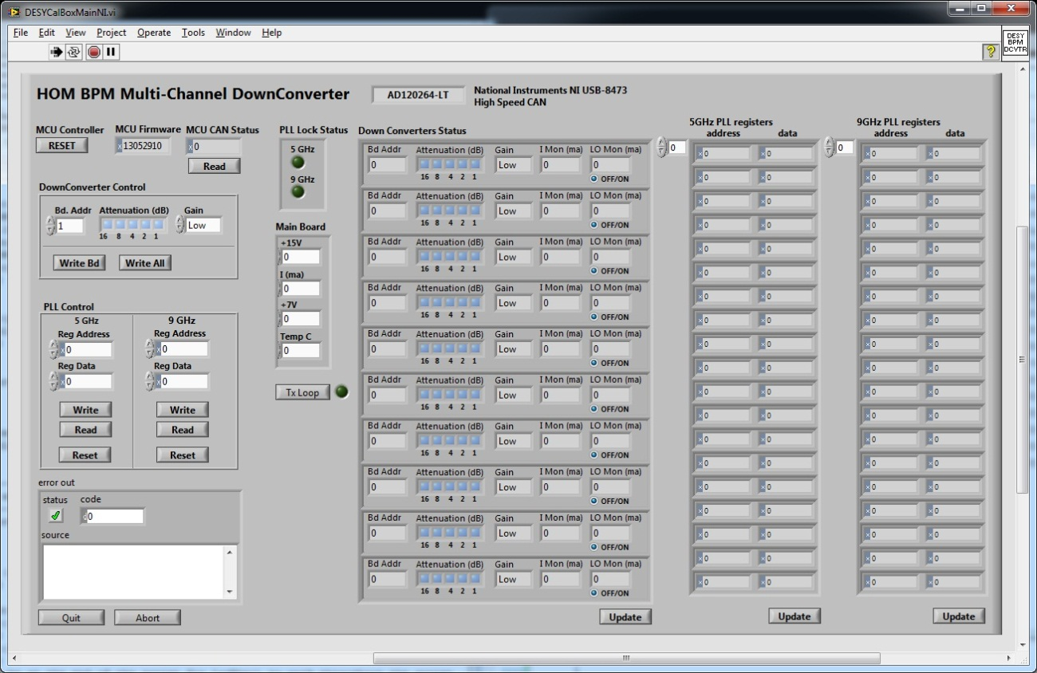
CAN-Control Interface Labview Test App
Use CAN to USB connector (PC/laptop)
Provide Control for each LO via PLL, gain & attenuation settings for each channel
Monitoring of voltages and signal levels

Slide 7
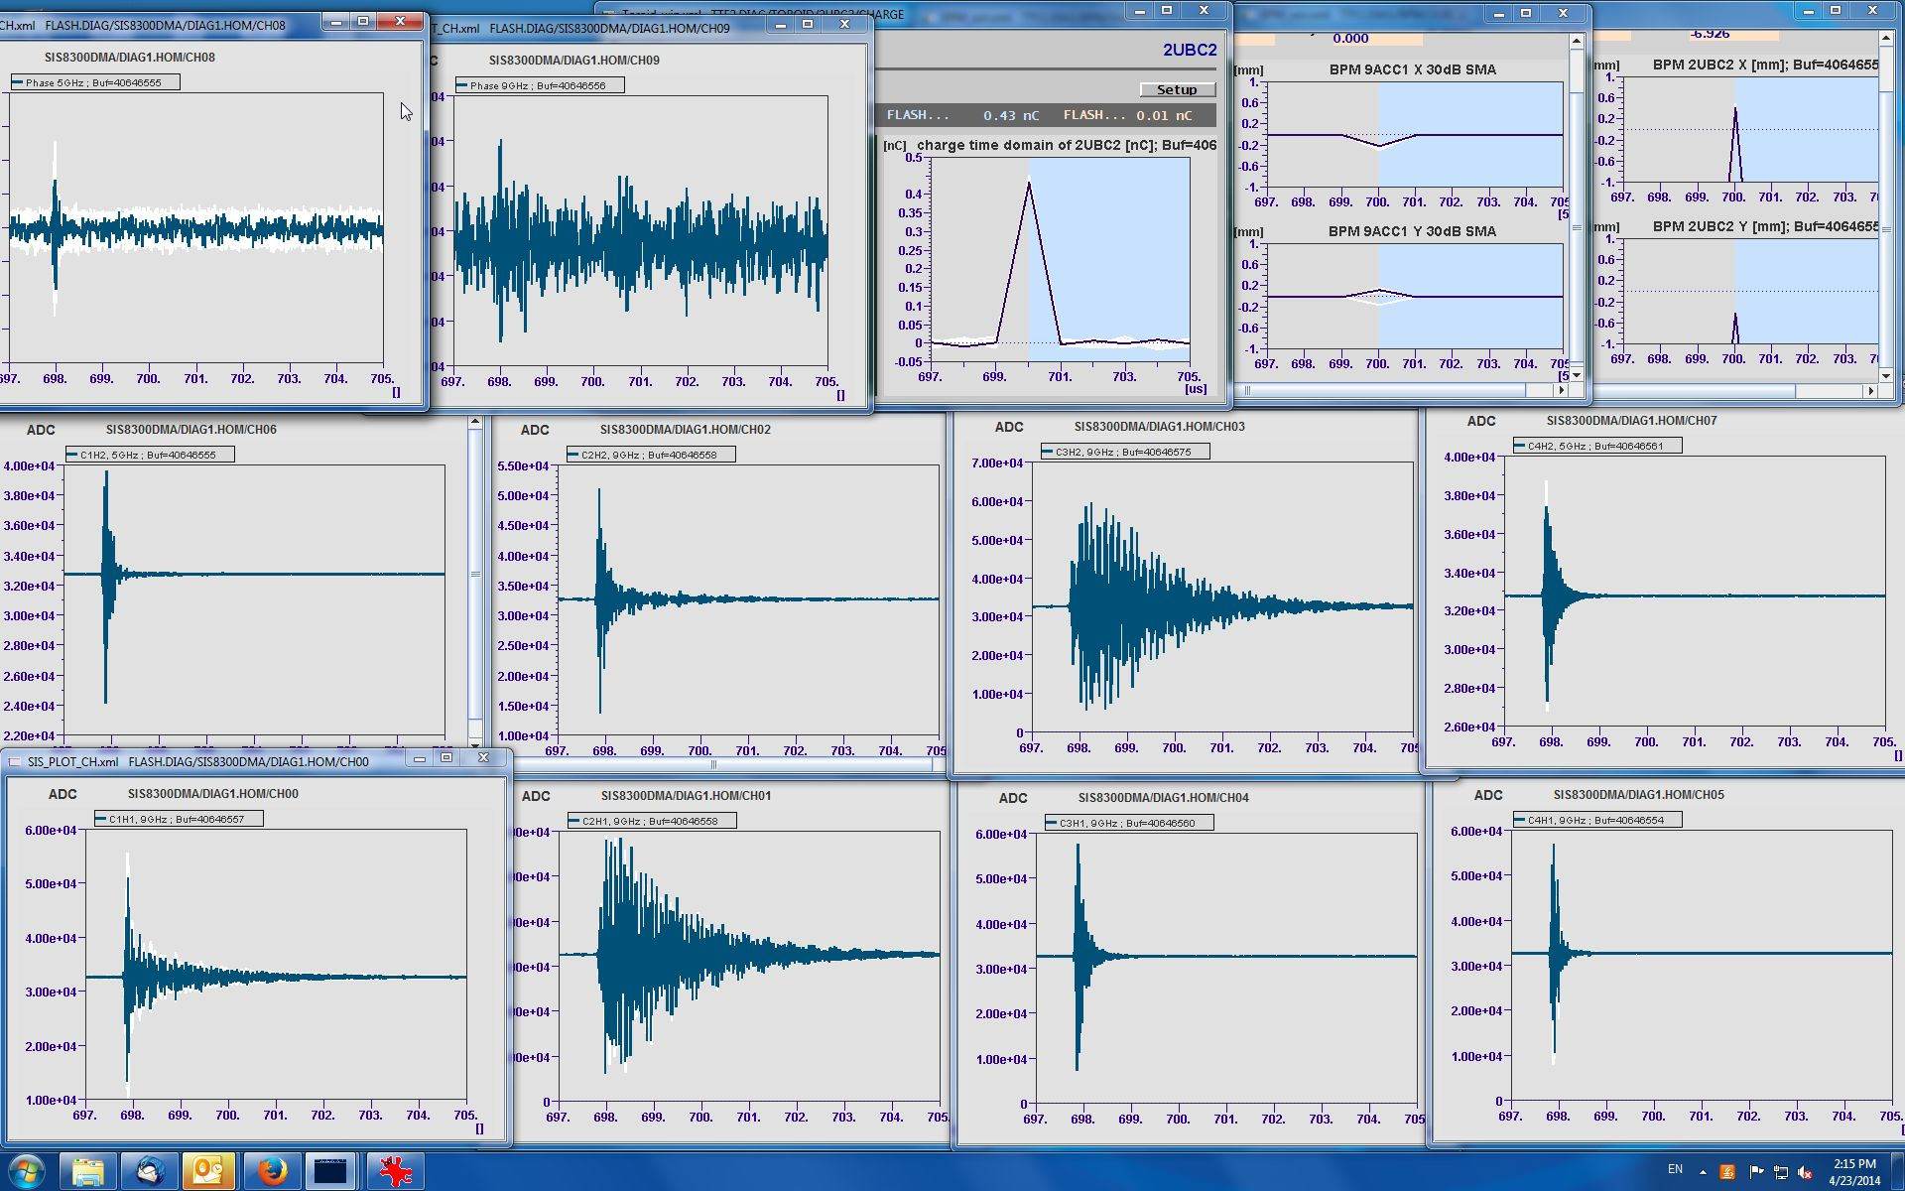
Raw Signals from DOOCs at FLASH
Toroid 2UBC2:
BPM 9ACC1
BPM 2UBC2
PhMon: 5GHz
PhMon: 9GHz
HOM: 5GHz
HOM: 5GHz
Courtesy of Thomas Wamsat, DESY

Slide 8
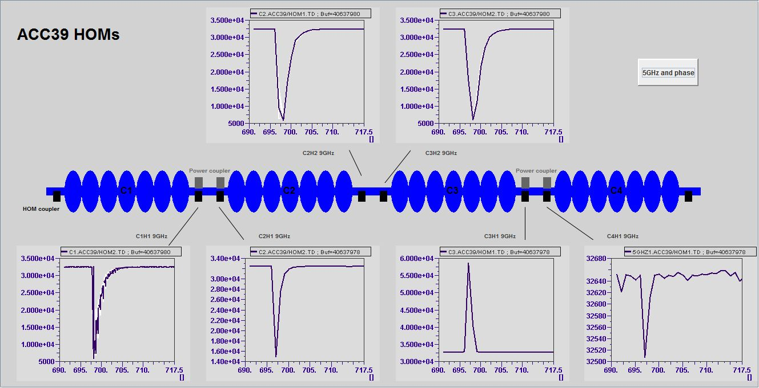
Signals in DOOCs (9GHz - “Envelope”)
Courtesy of Thomas Wamsat, DESY

Slide 9
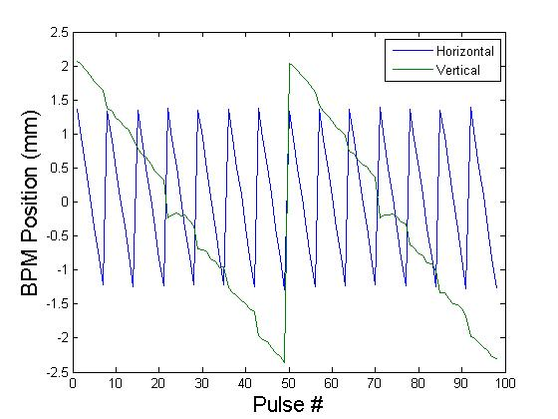
Beam Position: Looking for Dipoles
Polarizations get mixed

Slide 10
Beam Position: Understanding the Calibration
Singular Value Decomposition (SVD) analysis has been very successful at providing calibrations cable of achieving 10’s of micron position resolution on shift time scale
Unfortunately, calibrations become invalid quickly – often by the next day - 10’s of micron resolution becomes 100’s microns
Initial suspect has been phase drift within the electronics
The current downmix electronics provide dedicated phase channels for each PLL to monitor this effect
I expect we will be able to put the nail in this coffin
Next suspect, changes in HOM modes due to cavity tuning
Can we overcome this?

Slide 11
Summary
Dedicated multi-channel downmix electronics have been developed for the 3.9GHz module installed in FLASH
Provide simultaneous HOM data for 2nd and 5th Dipole Passbands
Monitor and minimize HOM power
Provide means to monitor LO phase with respect to beam
The issue of calibration stability remains an issue for all HOM based Beam Position Monitors
Changes due to cavity tuning looking like a strong suspect
Can this be accounted for in the calibration…
Beam jitter based correction?

