Slide 1
Measuring HOM parameters with beam for Cornell’s ERL cavities
Daniel Hall
Notes:
I will be talking about Higher Order Mode measurements in the Horizontal test cryomodule, using a beam-based probing method
The project is supervised by Matthias Liepe, data taking was performed by Adam Bartnik and myself

Slide 2
Talk Outline
Introduction and motivation
  BBU in ERLs and the design of the ERL 7-cell
The Horizontal Test Cryomodule
  Introducing the device-under-test and the ERL injector prototype
HOM load heating with beam
  Measuring temperature rise in the HOM cooling system
HOM detection and measurement with beam
  Using beam deflection to identify and characterise HOMs in the cavity

Slide 3
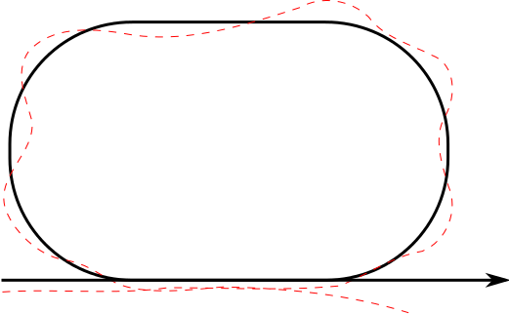
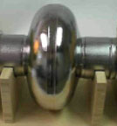
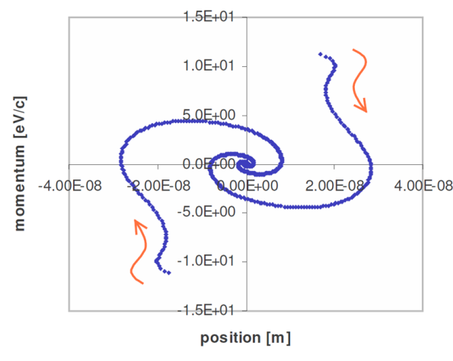
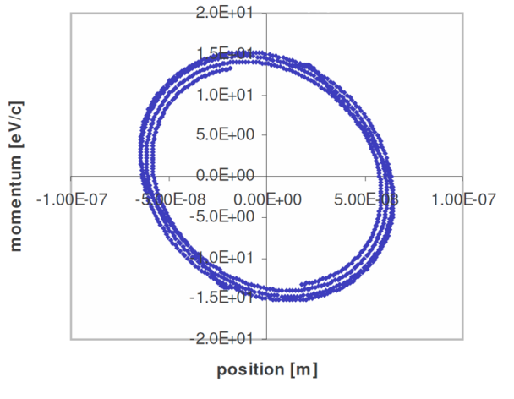
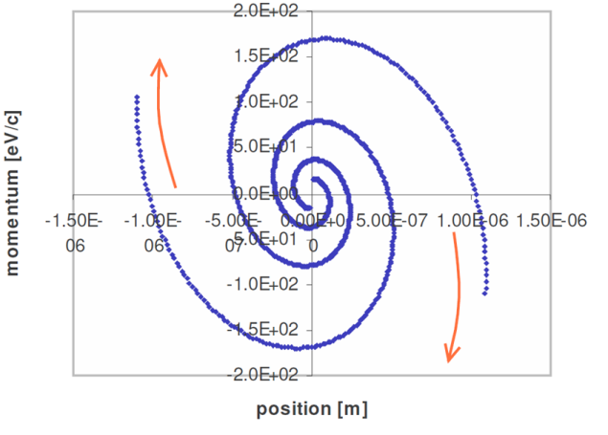
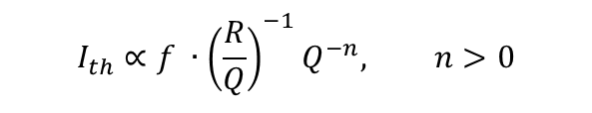
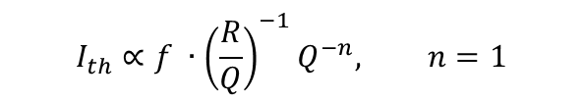
Beam Break-Up (BBU) in ERLs
BBU due to HOMs is a danger for ERLs
BBU occurs when the threshold current is reached
$$I_{th}∝f ∙{\left(\frac{R}{Q}\right)}^{−1}Q^{−n}, n=1$$
$$I_{th}∝f ∙{\left(\frac{R}{Q}\right)}^{−1}Q^{−n}, n>0$$
Below I_{th}
Near I_{th}
Above I_{th}
Notes:
Beam breakup due to the presence of a high impedance HOM is a particular danger for ERLs since the bunch train is effectively infinite.
It only really takes one dipole with a high enough impedance to cause BBU. However, the scaling relation of the threshold current is known.
The onset of this threshold current can be easily seen in the phase space of particle simulations for a single-cavity ERL, in which the scaling term n is 1.
(Animate) At currents below the threshold, the phase space has a stable, attractive centre. Nearing the threshold, we see the onset of stable phase space orbits. Above the threshold, beam breakup occurs as the phase space path diverges.

Slide 4
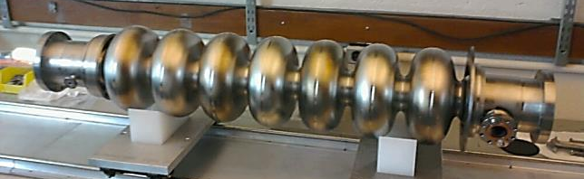
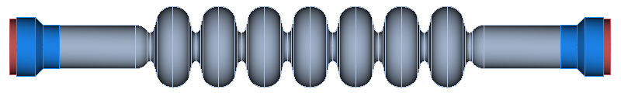
The Main Linac Cavity
Developed from the ILC TESLA design
Solid niobium cavity – operating at 1.3 GHz
4 sectors of the cavity were optimised to maximise the current at which BBU onsets
Cavity parameter | Specification
Gradient (MV/m) | 16.2
Q0 at 1.8 K | > 2 × 10¹⁰
Beam current in ERL mode (mA) | 100
Beam
pipe
Centre cells
End cells
HOM load
Notes:
The 7-cell ERL cavity is based upon the ILC TESLA design.
It is a solid niobium cavity, with an operating mode frequency of 1.3 GHz.
To optimise the beam for operation at 100 mA operation, and to maximise the threshold current at which BBU onsets, we consider the geometry of 4 (animate) different sectors of the cavity:
The HOM loads, which determine specific mode losses,
The beam pipe, which determines the linac fill factor and fundamental mode losses,
The centre cells, which determine the general properties of the HOM spectrum,
The assymetric end cells, which are responsible for coupling HOMs to the HOM absorber as well as preventing trapped modes.
Here is what the cavity looks like once fabricated.

Slide 5
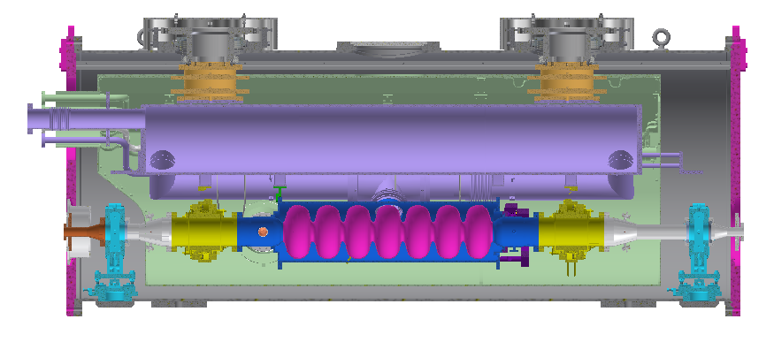
Horizontal Test Cryomodule (HTC)
Cryomodule is assembled in a fashion almost identical to that of a Main Linac Cryomodule
Fully equipped for operation with beam
ERL Cavity
HOM Load
HOM Load
RF Input Coupler
RF Field Probe
Notes:
The cavity is mounted inside our Horizontal Test Cryomodule.
The fabrication and assembly process of this cryomodule is as close as possible to the procedure expected to be used in the fabrication of the Main Linac Cryomodules.
It is fully equipped with everything needed for operation with beam.
(Animate)
At the centre is the 7-cell main linac cavity.
On the left is the input RF high current coupler.
On the right is an RF field probe for HOM diagnostics.
On either end are the two HOM loads.

Slide 6
Testing the HTC
3 major avenues for testing:
  Cavity quality factor measurements
  HOM load heating under beam loading
  Beam deflection due to HOM excitation

Slide 7
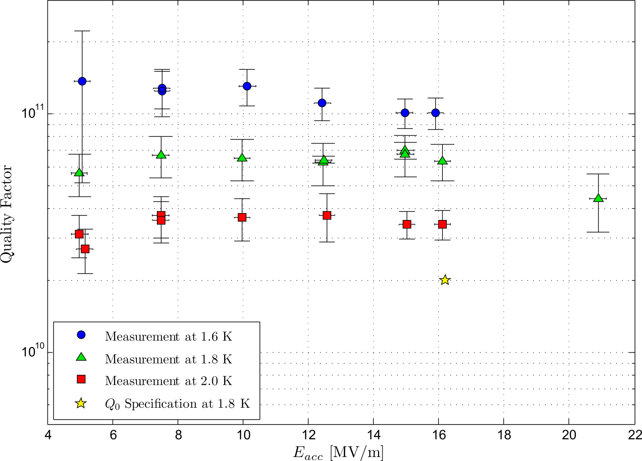
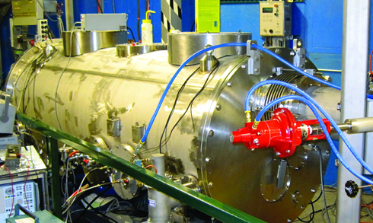
The Quality Factor
The cavity exceeded its specification by a factor of 3 – a new world record for a cavity in a test cryomodule!
Quality factor vs Accelerating field of HTC-3
× 3
The HTC at Wilson Lab
Graph credit: N.R.A. Valles
Photo credit: LEPP SRF newsletter
Notes:
Our first major defining characteristic is our operating efficiency at the operating gradient – i.e. the Quality factor.
The cavity Q is 6x10^10 at our specified gradients of 16 MV/m – 3 times greater than our specification!
Having such a high Q increases the cryogenic efficiency and slashes costs in our cooling system.

Slide 8
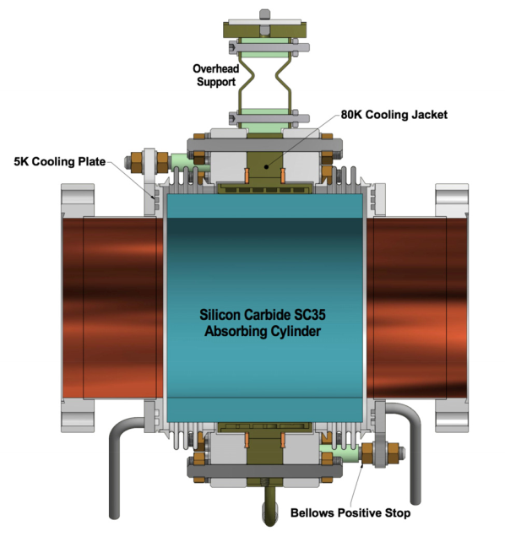
HOM load heating
Pass a beam through the cavity, measure the increase in temperature of the HOM loads
Loss factor and power dissipation are measured and compared to expected values
Notes:
The first experiment to be run is very simple in concept – we pass a beam through the HTC, and observe the increase in temperature of the HOM load cooling system. We can determine the power dissipation and longitudinal loss factor from these measurements and then extrapolate them to what we would see if the HTC were to be operated at 100 mA in an ERL configuration.

Slide 9
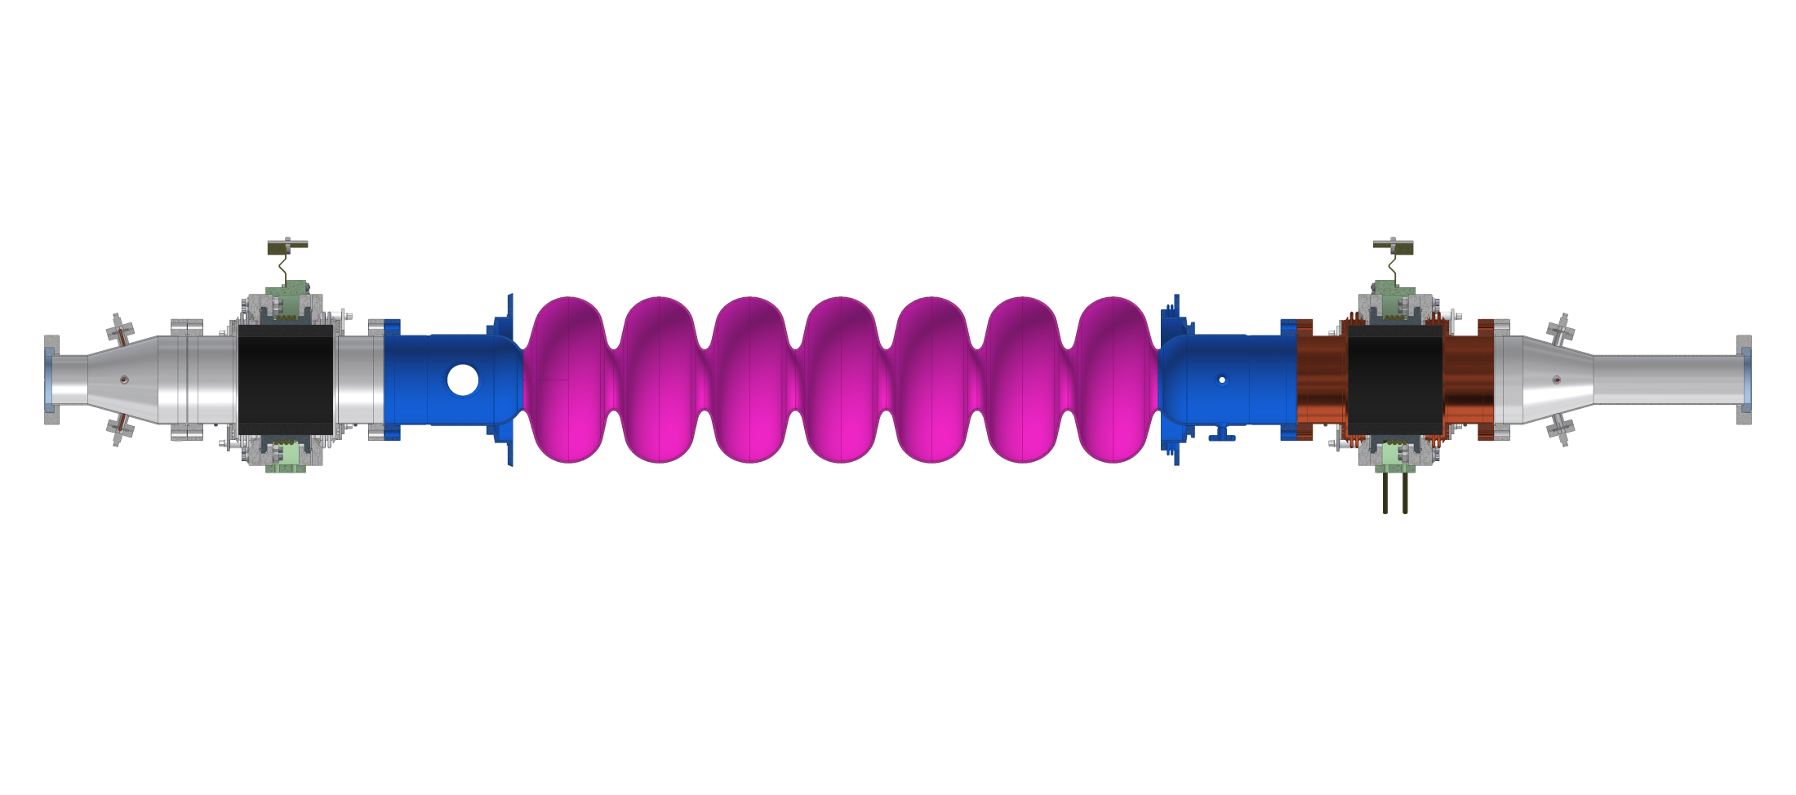
HOM load copper coating
Reduce losses, and hence heating, in the stainless steel walls of the beam pipe.
Heating could potentially spread to the cavity beampipe
HOM beampipe heating
80 K cooling system
Location of Cu plating
Notes:
One contentious issue in the design was whether or not to coat the stainless steel beampipe around the HOM load with a thin layer of copper. Being more conductive, this would drastically lower the resistive wall losses, and with it the dynamic load, but it also increases static load from the 5K cooling ring. A consensus as to which design was better could not be reached, so one of the HOM loads was copper coated and the other was not.

Slide 10
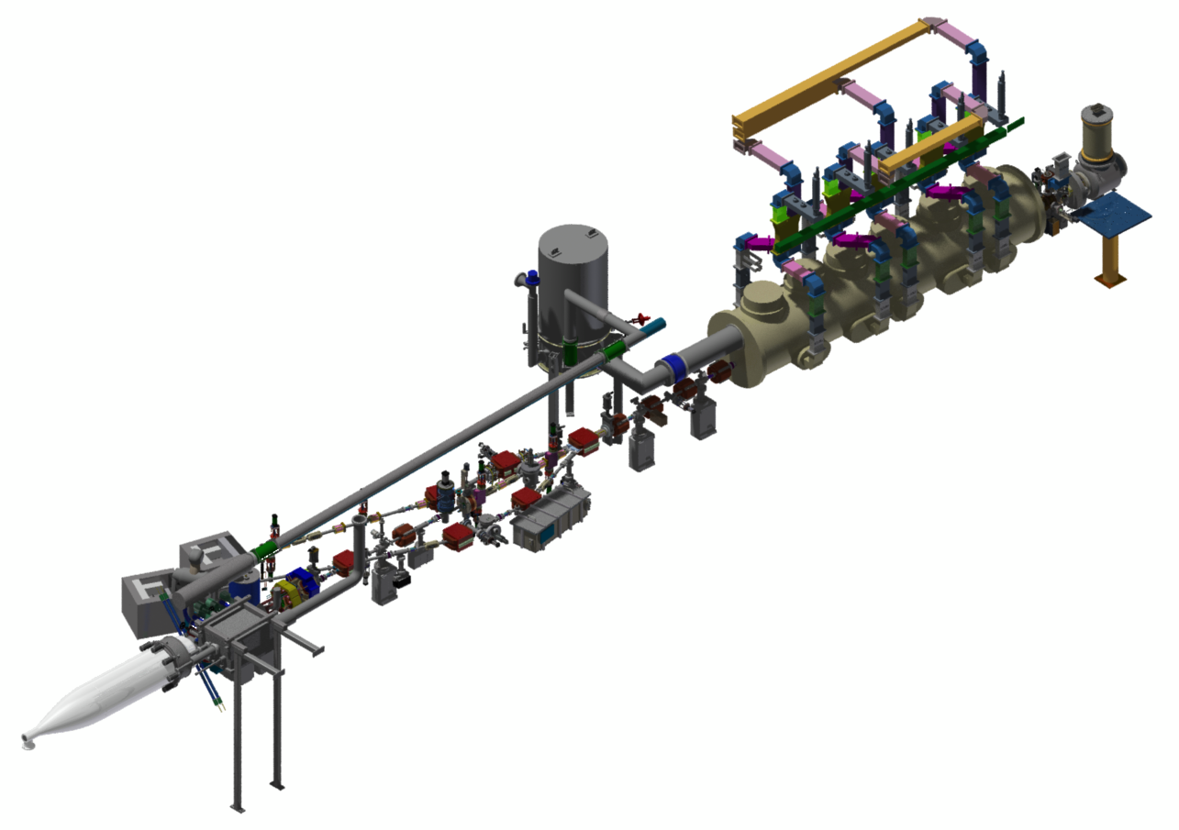
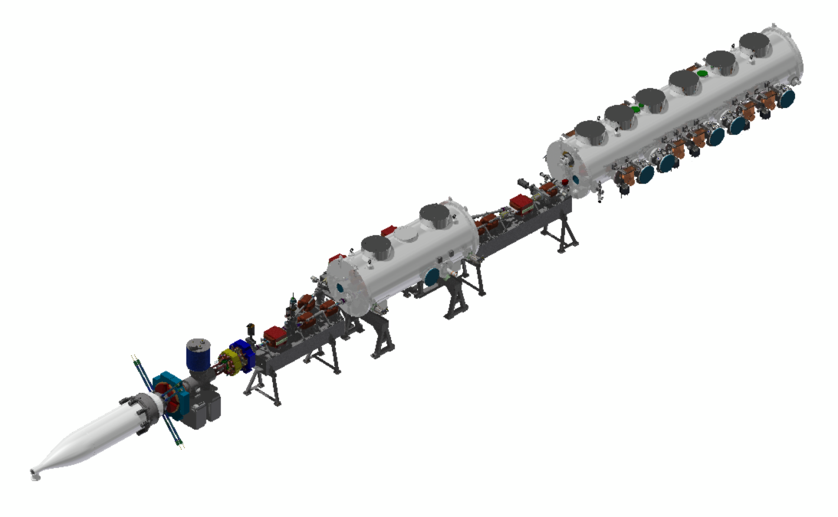
ERL Injector prototype
DC Gun
Beam energy : 5 MeV
Maximum current : 75 mA CW
HTC
Injector cryomodule
Beam stop
HTC location
Notes:
To supply the HTC with beam, we use the ERL injector prototype. This is a small accelerator that consists of essentially the first 20 metres of the actual ERL. It is capable of accelerating a beam of electrons to 5 MeV at up to 75 mA of continuous beam current. The device consists of (animate) the DC gun, from where the beam originates, the injector cryomodule, which accelerates the electrons to 5 MeV, the beamline where the HTC will be installed, and the beam stop where the beam terminates. (Animate) Here is the ERL, zoomed in slightly, with the HTC now integrated into the beamline after the injector.

Slide 11
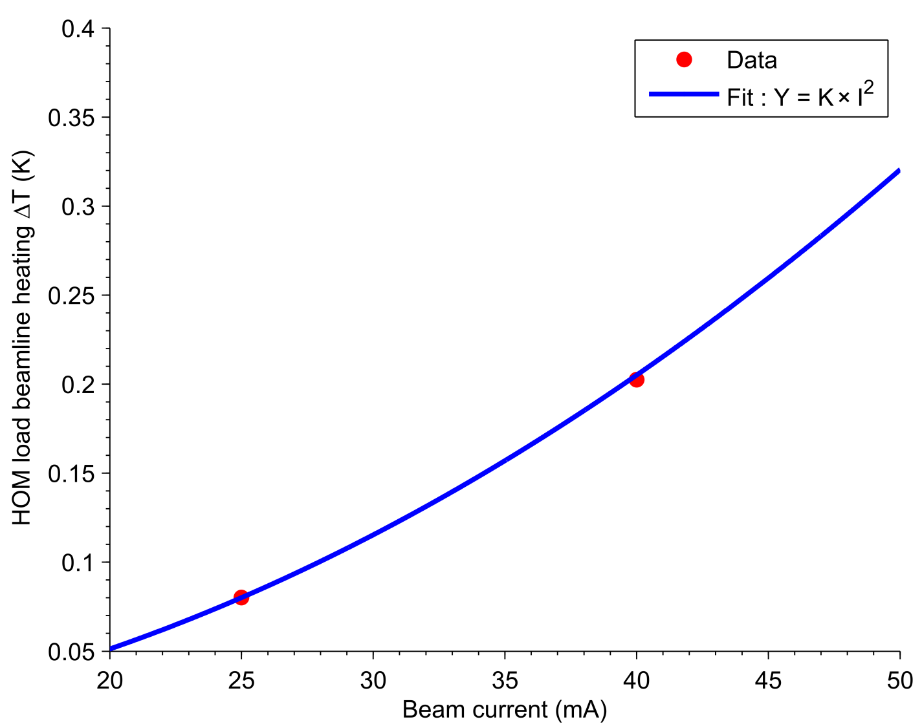
HOM heating results
At 100 mA in an ERL configuration, ΔT = 3 K

Slide 12
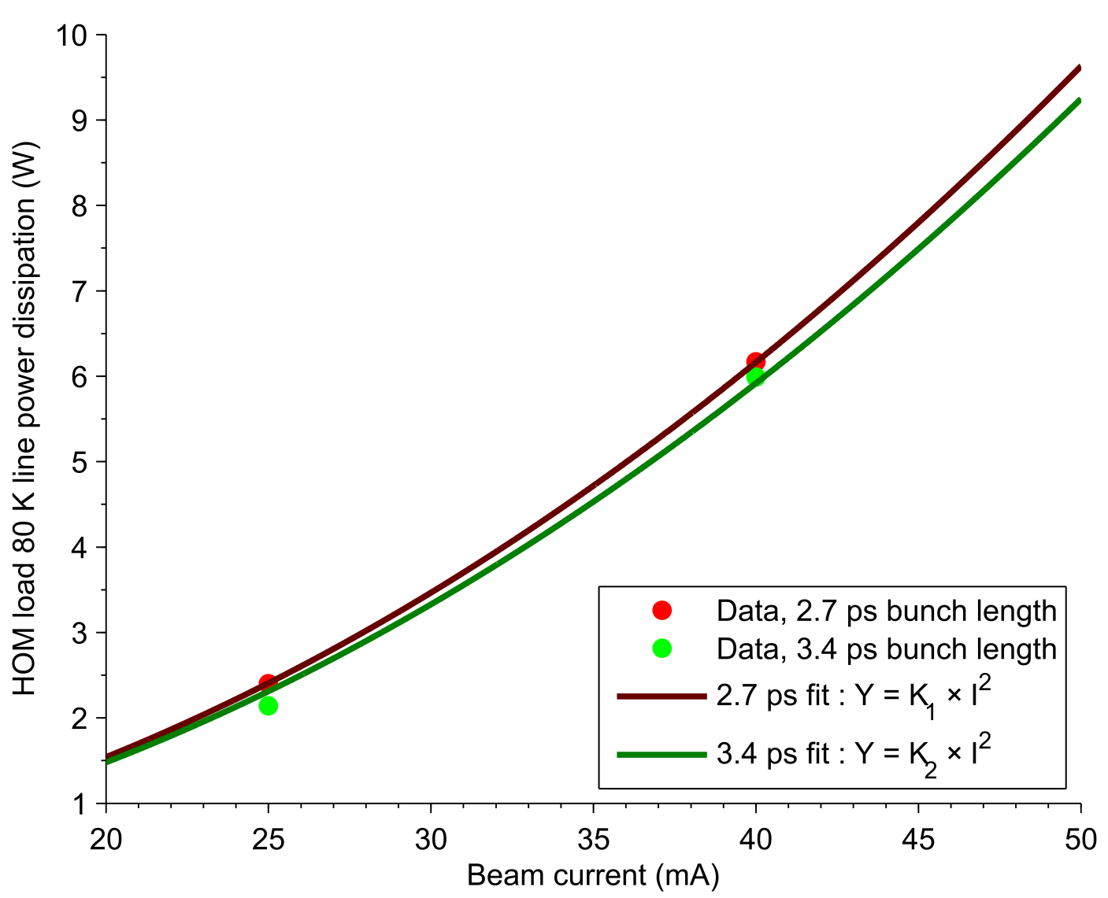
HOM heating results
At 100 mA in an ERL configuration, P_{diss} = 90 W

Slide 13
HOM heating conclusions
The heating of the steel beampipe at 100 mA would be borderline acceptable – copper coated beampipes are a better alternative
At 100 mA, the projected dissipated power is 90 W, lower than our expected value of 200 W
Projected value is lower than realistic value, due to very high frequency HOMs – however, the worst case scenario is P_{diss} = 180 W

Slide 14
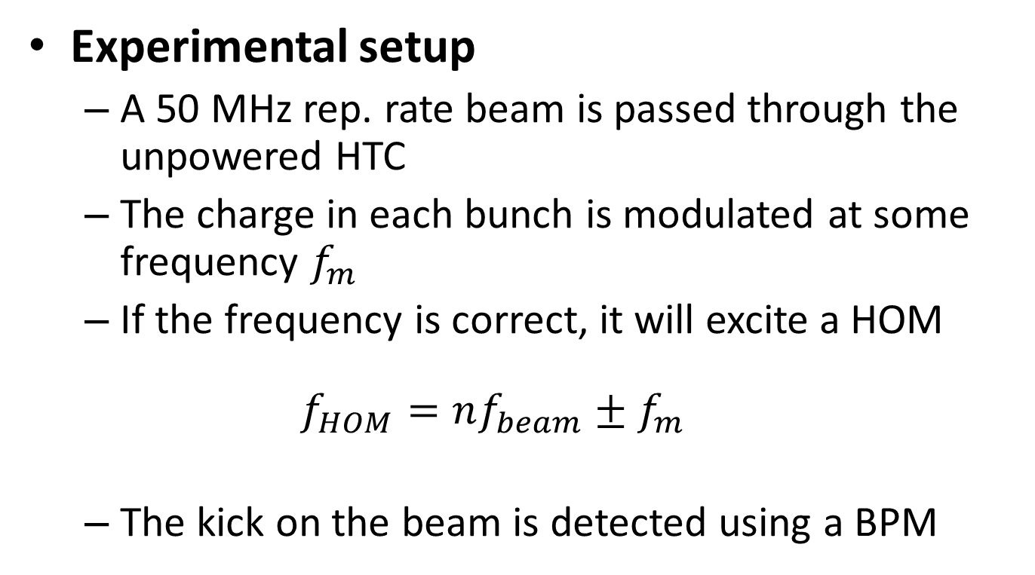
HOM detection with beam
Experimental setup
  A 50 MHz rep. rate beam is passed through the unpowered HTC
  The charge in each bunch is modulated at some frequency $f_{m}$
  If the frequency is correct, it will excite a HOM
  $$f_{HOM}=nf_{beam}±f_{m }$$
  The kick on the beam is detected using a BPM
Notes:
We installed the HTC into the beamline of the ERL. It’s unpowered, but any beam going through it will excite modes in the cavity
We hooked up the 50 MHz laser to the ERL. We can modulate the amount of charge in each bunch by some frequency
If this frequency is correct, you’ll excite a higher order mode

Slide 15
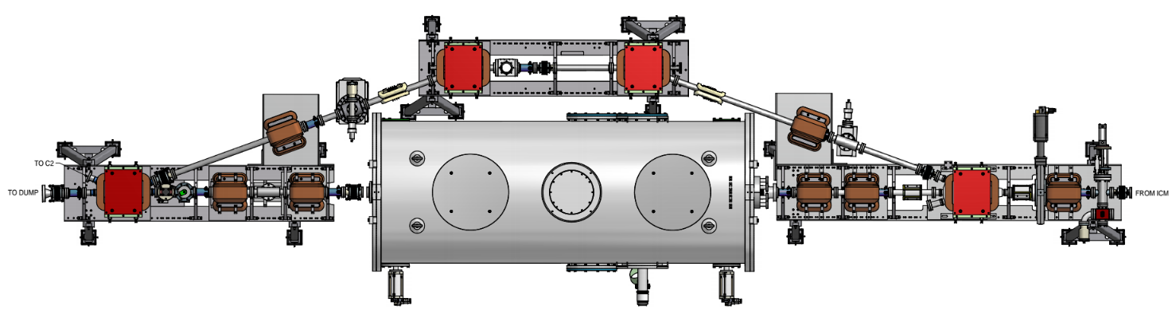
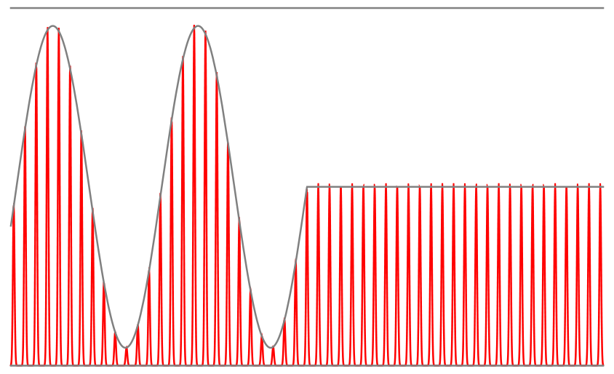
Experimental setup
Beam direction
Dump 1° dipole magnet
BPM2
BPM1
Bunch charge:
Bunch charge:
HOM excited: beam kicked
Decay gives loaded Q
BPM used to look for kicks, connected to spectrum analyzer
Bunch charge
On resonance:
SA Signal
Off resonance:
SA Signal
Time
Time
Notes:
Here’s a bird’s eye view of the HTC in the beamline. The beam goes from right to left. We deflect the beam using scanner dipoles in the quads here, and (animate) monitor the transverse offset of the beam with these BPMs. We monitor the kick of the beam using this BPM further downstream, which is located just behind the 1 degree dipole that takes the beam into the beam stop. To induce the kick, we modulate the bunch charge and then monitor the beam motion immediately after we turn it off. (Animate) If you’re off resonance, when you turn the modulation off, you see nothing. (Animate) But if you’re on resonance, when you turn the modulation off you see a decay, which gives you the loaded Q of the mode.

Slide 16
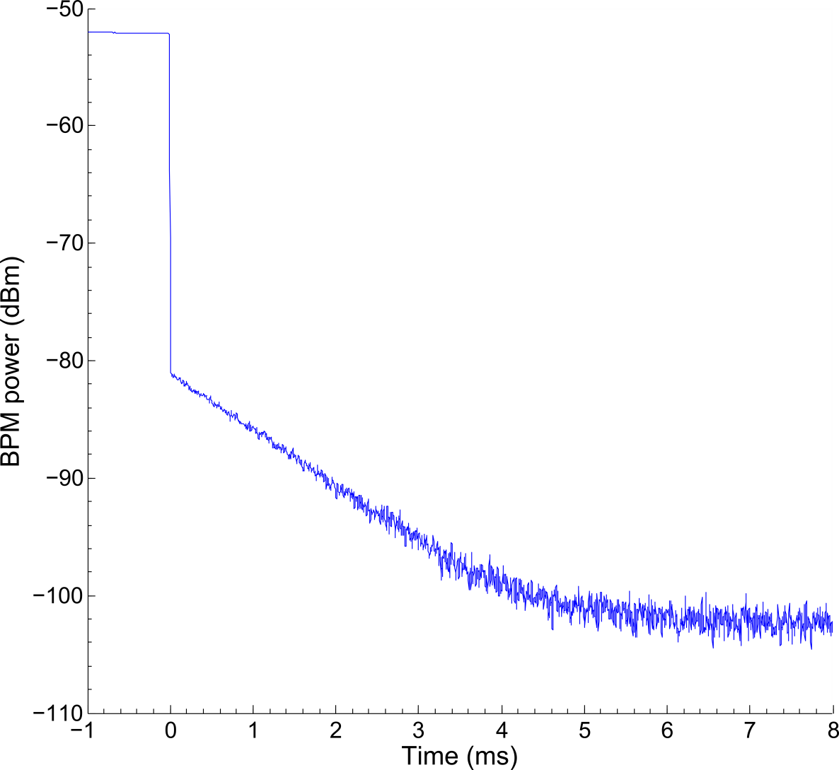
Example decay
Modulation frequency = 10.03 MHz
Loaded Q/f ≈ 5 × 10⁶ GHz⁻¹
Notes:
Here is an example of a decay seen on the spectrum analyser connected to the BPM. When the modulation is turned off, the power drops suddenly but does not reach the noise floor. Instead it stops at a peak power and then decays with a characteristic time factor.

Slide 17
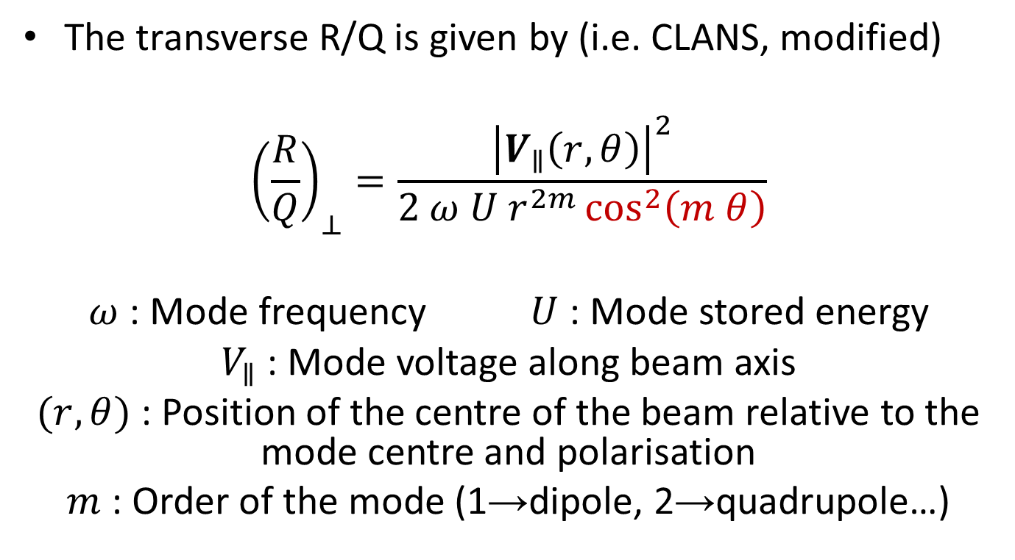
Characteristic factor: the R/Q
The transverse R/Q is given by (i.e. CLANS, modified)
$${\left(\frac{R}{Q}\right)}_{⊥}=\frac{{\left|V_{∥}\left(r,θ\right)\right|}^{2}}{2 ω U r^{2m}\cos^{2}\left(m θ\right)}$$
$ω$ : Mode frequency $U$ : Mode stored energy
$V_{∥}$ : Mode voltage along beam axis
$(r,θ)$ : Position of the centre of the beam relative to the mode centre and polarisation
$m$ : Order of the mode (1→dipole, 2→quadrupole…)
Notes:
Here is the circuit definition of R/Q, as used in the code CLANS, modified to take into account that the mode might not necessarily be polarised in the same angle as the beam.
This definition of R/Q, which uses the circuit definition and hence includes a factor of 2, is normalised to the distance from the centre of the mode.
On top of this, we have to also normalised for the polarisation of the mode relative to the beam.

Slide 18
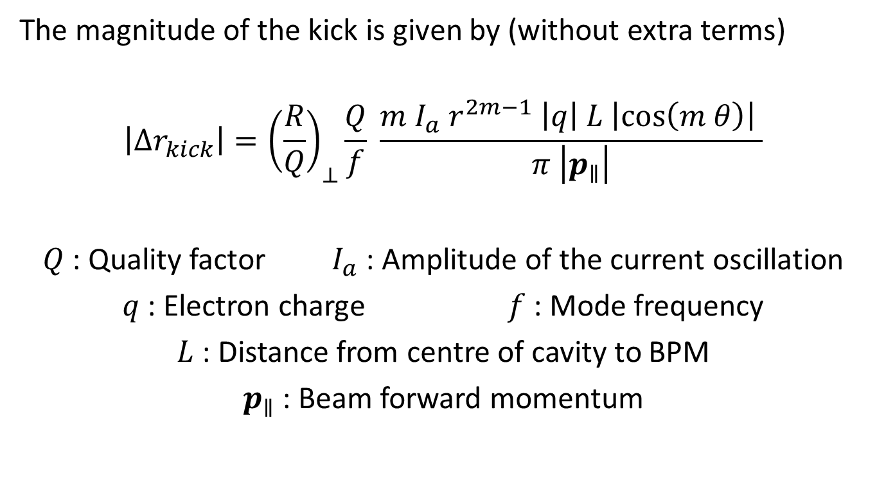
Magnitude of the HOM kick
The magnitude of the kick is given by (without extra terms)
$$\left|{Δr}_{kick}\right|={\left(\frac{R}{Q}\right)}_{⊥}\frac{Q}{f} \frac{m I_{a} r^{2m−1} \left|q\right| L \left|\cos\left(m θ\right)\right| }{π \left|p_{∥}\right|}$$
$Q$ : Quality factor $I_{a}$ : Amplitude of the current oscillation
$q$ : Electron charge $f$ : Mode frequency
$L$ : Distance from centre of cavity to BPM
$p_{∥}$ : Beam forward momentum
Notes:
It is possibly, in theory, to use the magnitude of the kick as a function of the position of the beam in the cavity to determine the nature and R/Q of the mode excited.
From the Panofsky-Wenzel theorem we can obtain a formula that tells us how we expect the mode to kick
This formula gives the magnitude of the peak kick from a mode.
We see that as we increase the amplitude of the driving current, this kick increases – of course, we’re putting more energy into the mode.
We have an L term – the further we are from the cavity, the bigger this kick will look.
The further we get from the centre of the mode, the greater the kick
If we go bang through the centre of the mode, or along one of it’s azimuthal zeroes, we will get no kick whatsoever. Since the cavity is not perfectly axially symmetric, we can expect this to happen since the polarisations will be frozen.

Slide 19
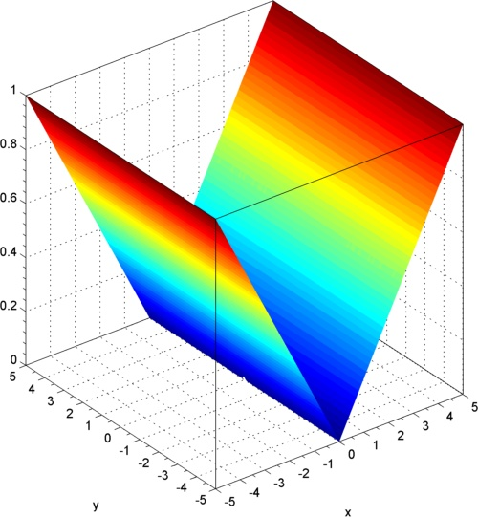
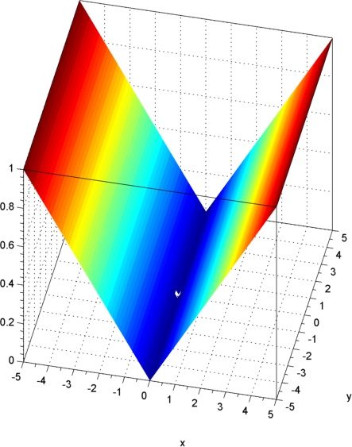

Expected kick landscape
Dipole:
$$\left|{Δr}_{kick}\right|∝r \left|\cos\left( θ\right)\right|$$
Kick (A.U.)
Kick (A.U.)
y
x
y
x
Notes:
Here’s what a dipole should look like. We see the linear dependence, and one azimuthal zero. The x and the y axes give the distance from the centre of the mode, and the magnitude of the kick is given on the z axis

Slide 20
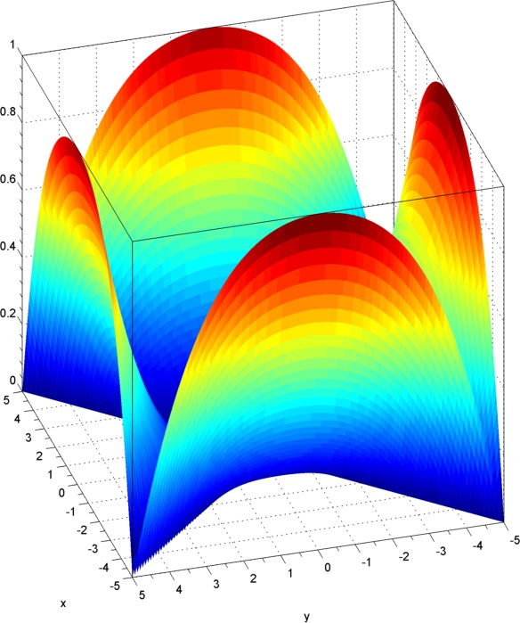
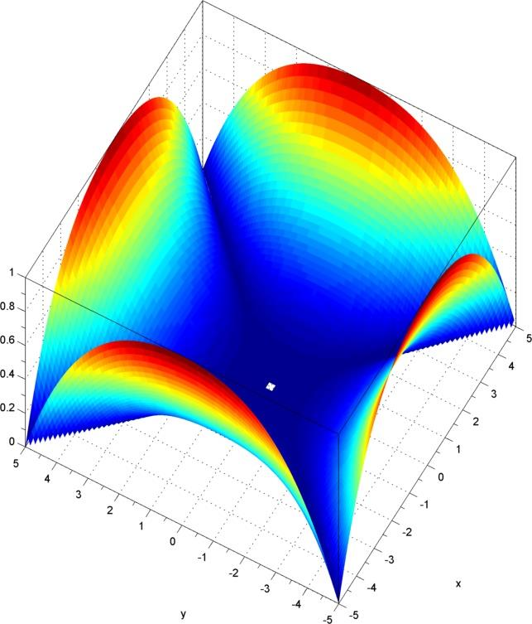

Expected kick landscape
Quadrupole:
$$\left|{Δr}_{kick}\right|∝r^{3} \left|\cos\left( 2 θ\right)\right|$$
Kick (A.U.)
Kick (A.U.)
x
x
y
y
Notes:
Here’s what we expect for a quadrupole. Note we now have a cubic dependence, as well as two azimuthal zero lines.

Slide 21
List of modes found in the ERL 7-cell
Modulation frequency f_{mod} (Mhz) | Mode frequency f (GHz) | Quality factor Q | Mode width ∆f (KHz)
5.27 | 1.295 | 4.3x10⁷ | 0.030
10.03 | 2.290 | 1.3x10⁷ | 0.18
3.36 | 2.303 | 8.3x10⁶ | 0.28
24.30 | 2.476 | 4.7x10⁶ | 0.12
10.70 | 2.489 | 1.7x10⁶ | 1.5
5.52 | 2.494 | 2.0x10⁷ | 0.12
5.11 | 2.495 | 1.1x10⁷ | 0.22
8.86 | ? Not found | 1.5x10⁴ (GHz⁻¹) | 70
M
A
B
?
Notes:
Here’s the grand list. We can divide these into four groups.
The first is our one lonely monopole mode.
The second two lie within the first quadrupole passband
The third group lies in the second quadrupole passband. Our two strongest modes are also found here, at 5.52 and 5.11 MHz modulation frequency
And finally, our mystery mode. This is also our weakest mode, which might be why we can’t find it on the HOM coupler.

Slide 22
The mode landscape
Where our modes lie amongst simulation and data from HTC-1 (no HOM loads present)
Notes:
This plot shows the expected Qs of the modes (and their nature) in HTC-1
It also shows the location of modes found using the NA. Their nature is unknown.
6 of the 8 modes could be placed on this plot.
Two lie within the first quadrupole passband. One is highly likely to be a quadrupole, although the second could be an enhanced dipole.
The other four lie inside or within reach of the second quadrupole passband. However, almost all of these have a chance of being either an enhanced dipole or a quadrupole.

Slide 23
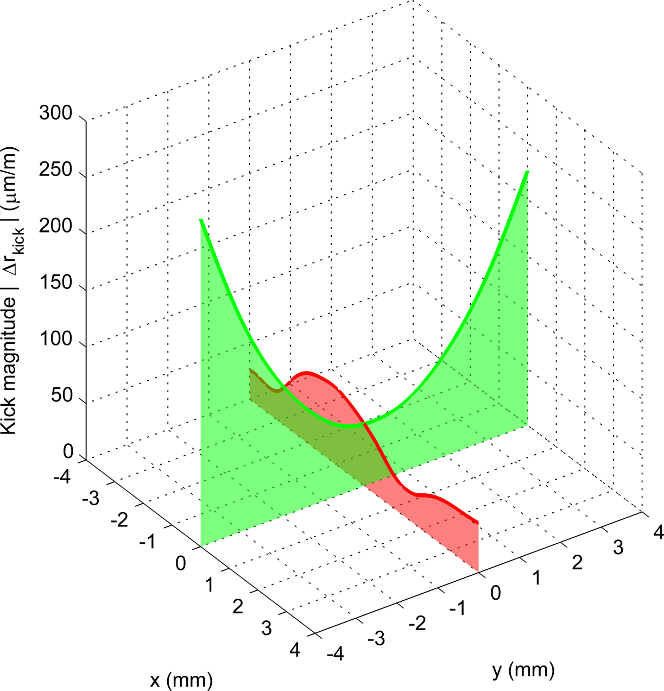

Mode at 2.494 GHz, second Quadrupole passband
Kick (A.U.)
x
y
Beam position in cavity
Notes:
Here’s an example. This mode is pretty likely a quadrupole mode.
In fact, the x-axis has an almost perfect cubic dependence.
The directions indicate that this should likely be a quadrupole mode.
But! 1) Why doesn’t the kick go to zero at the centre?
2) Why doesn’t the kick go down to the noise floor?
3) Where are the azimuthal zeroes we were promised?

Slide 24
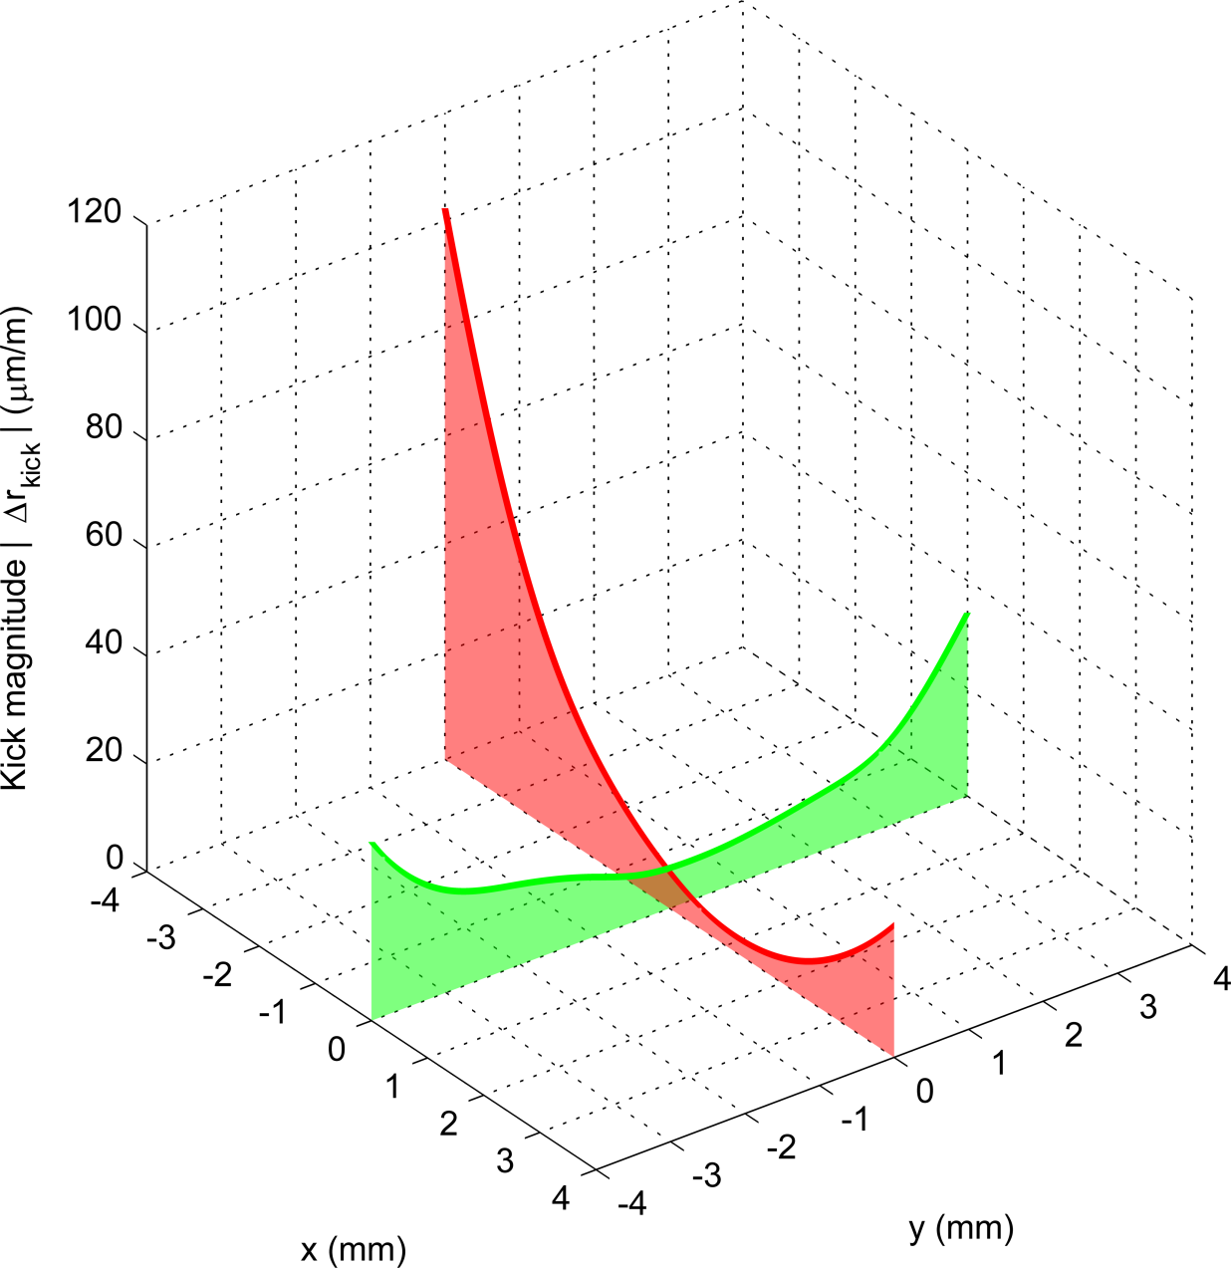
Mode at 2.290 GHz, first Quadrupole passband
Kick (A.U.)
x
y
Beam position in cavity
Notes:
Here’s an example. This mode is pretty likely a quadrupole mode.
In fact, the x-axis has an almost perfect cubic dependence.
The directions indicate that this should likely be a quadrupole mode.
But! 1) Why doesn’t the kick go to zero at the centre?
2) Why doesn’t the kick go down to the noise floor?
3) Where are the azimuthal zeroes we were promised?

Slide 25
Dipole conclusions
The fact that all non-monopole modes are relegated to the first two quadrupole passbands, as well as their high Q, strongly suggests that these are all quadrupoles
However, fitting is inconclusive
  Next step : delve through the cavity 3D mode simulations to better determine the likelihood of any of these modes being dipoles

Slide 26
Overall conclusions
Scaling the HOM load heating with current results in a power dissipation at 100 mA that is in agreement with expectations
A HOM search with beam revealed the presence of only 6 non-monopole modes in the ERL 7-cell cavity with a Q > 10⁵
All non-monopole modes were relegated to the first two quadrupole passbands
  However, identification via an expected fit of the kick magnitude is as of yet inconclusive

Slide 27
Thank you for listening
Acknowledgements
Adam Bartnik
Matthias Liepe
Mike Billing
John Dobbins
Ivan Bazarov
Georg Hoffsteatter
Nicholas Valles
Ralf Eichhorn

Slide 28
Slides for answering questions
Preparation, preparation, preparation…

Slide 29
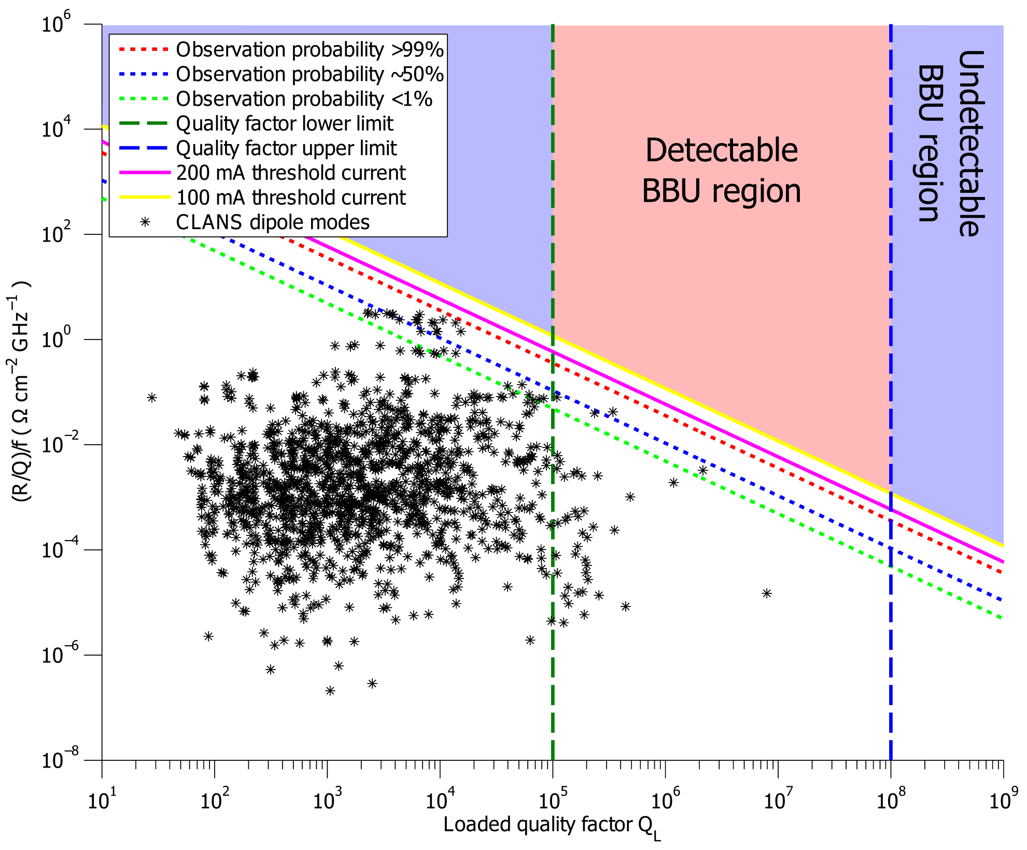
Experiment resolution

Slide 30
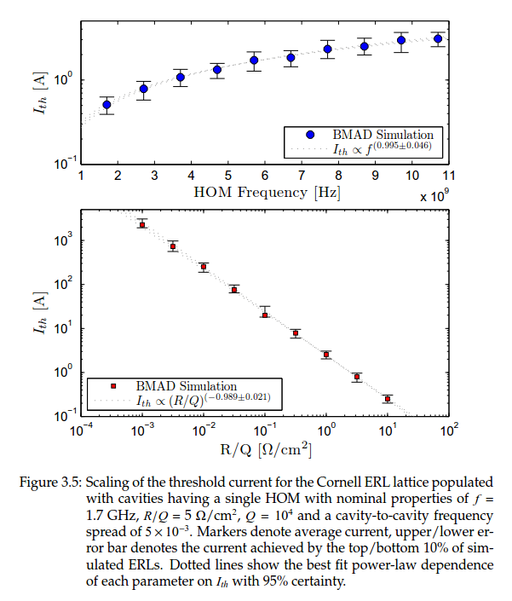
Current scaling
Smallest kick detectable is approximately 5 μm at 1 MHz RBW
Current modulation is a weak function of frequency
Choice of scan step size dictates maximum Q that can be detected
Minimum Q detectable by experiment is approximately 1e5
BBU for a single cavity is dictated by a maximum (R/Q)Q/f
This BBU limit is taken from data in Nick Valles’ thesis

Slide 31
Introduction
Introduction – what is going on?
  ERL 7-cell cavity design, courtesy of Nick Valles
  Optimized for performance in an ERL
  The design must be capable of sustaining 100 mA beam current CW without BBU
  The design must be resistant to small defects in machining
  Higher Order Modes (HOMs) could ruin our day
Notes:
So we want to build an ERL. A crucial part of this is the superconducting cavity that we use for our meat-and-potatoes acceleration.
The design was adopted from the TESLA design
Nick Valles, a recently graduated student, performed simulations to optimise the cavity for use in an ERL
Why? Well, the cavity must be capable of sustaining 100 mA sustained current in an ERL configuration. That is not easy.
We need a design that is resistant to small defects in machining.
Even if the accelerating mode does perform to your specifications, HOMs could ruin your day by causing BBU

Slide 32
Bunch charge:
Bunch charge:
On resonance:
SA Signal
Off resonance:
SA Signal
Time

Slide 33
Theory
Theory – what do we expect to see?
Bunch charge:
HOM excited; beam kicked
Decay gives loaded Q
On resonance:
SA Signal
Otherwise:
SA Signal
Time
Image credit: Adam Bartnik
Notes:
We have the BPM hooked up to a spectrum analyzer. As the bunch charge is modulated, the signal is dominated by this charge modulation.
When the modulation is turned off, if a HOM has been excited, we should see a decay. We can use this decay to get the loaded Q of the mode, as well as details regarding how much kick it has given the beam

Slide 34
Anatomy of a decay curve
Charge modulation dominates signal
Beginning of the decay corresponds to the greatest kick
Spectrum Analyzer Signal (dBm)
Measured peak power
Noise floor
Fitting region
Notes:
Here is a more detailed look at the decay we expect to see.
While the modulation is turned on, the spectrum analyzer signal is dominated by the charge modulation.
When the modulation is turned off, if a HOM has been excited, we will see a decay in the power.
In reality this decay is actually an exponentially decaying oscillation, but due to the smoothing at the input we see a flat decay.
We fit to the decaying region to get the loaded Q of the mode.
We have a noise floor and response time that is dependent upon the bandwidth setting upon the spectrum analyzer. There is a trade off between having a low noise floor and a fast response time.

Slide 35
Motivation
Motivation – why are we doing it?
  Our simulations say that this cavity can do the job; but do experiments agree?
  Does our HOM damping quash HOMs sufficiently to be able to run at 100 mA?
  Are there HOMs with a high enough R/Q to cause beam breakup?
  Are there any trapped modes?
Notes:
So we’ve built a car that can do 240mph. But if it can’t turn, the first corner is a doozy.
Our simulations tell us that this cavity has been optimised to avoid trapping any dangerous HOMs – they should all be sucked dry by the HOM loads
But is this really the case?
Are there any dangerous HOMs? A useful characteristic value is the R/Q
What about trapped modes? Searches using a NA won’t see those!

Slide 36
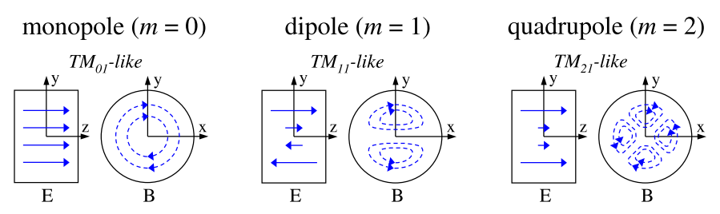
How do we expect the mode to kick?
The direction of the kick is given by the field pattern of the mode
Kick is perpendicular to the magnetic field at that point, with a magnitude determined by the coupling
Notes:
So long as there are no longitudinal zeroes in the mode, the kick should be predominantly due to the magnetic field.
To first order, monopoles do not kick.
Dipoles are particularly dangerous since they have a kick even on axis, although there is no coupling there.
The direction of the kick is perpendicular to the magnetic field, as given by the Lorentz force.

Slide 37
Breaking symmetry
If the cavity has perfect symmetry, the mode can have any polarisation and the kick is always inward/outward for any m > 0
But the couplers break symmetry!
We can expect to see azimuthal zeroes as we move our beam
Knowing the polarisation of the mode is crucial in getting the correct R/Q
Notes:
If a cavity has perfect symmetry – as it would do in CLANS – then the mode can have any polarisation, and will always angle itself for strongest coupling.
However, the presence of couplers and machining defects will break this symmetry
Dipoles, Quadrupoles, will now split into their various polarisations. For modes with frequencies in the GHz region, this splitting can be anything up to a few 10s of KHz.
This means that we can excite each polarisation independently. We should now expect to see azimuthal zeroes in our modes.
Knowing the polarisation of the mode is now crucial for obtaining the R/Q of the mode

Slide 38
Data
Data – what do we actually see?
  At the end of the test, we found 8 modes
  This was whittled down from a larger list, many of which were found to actually be in the ICM
  Out of these, 7 were found to couple to the HOM pickup probe, allowing us to obtain their real frequency
Notes:
So what do we actually see? Well, the decays were there.
We stepped through the 25 MHz of parameter space available in steps of 10 KHz and found about 15 modes.
Most of these were actually found to be in the ICM.
After whittling all these down, we were left with 8 modes that were actually in the HTC.
Of these 8, we could pick up 7 on the HOM coupler and so obtain their real frequency.

Slide 39
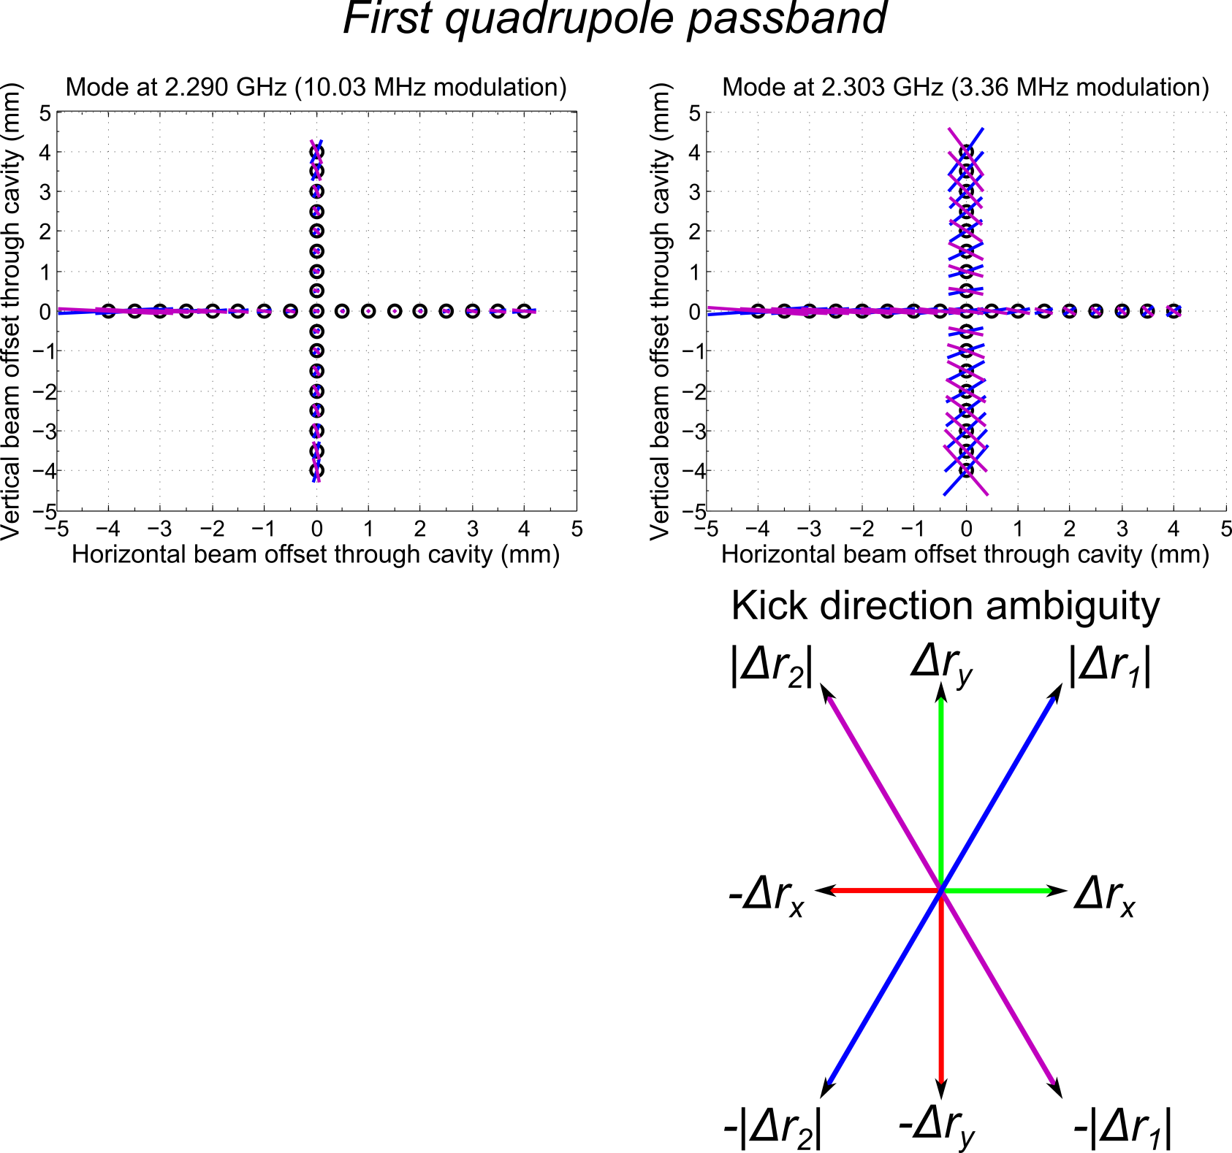
The direction in which the mode kicks gives some clue as to its nature.
We would expect a dipole mode to always kick in the same direction.
There is an ambiguity in the direction due to the relative sign between the components.
Notes:
The first thing we can plot is the direction in which the modes are kicking.
This is the purpose of the plots above.
We have the horizontal component and the vertical component of each mode.
However, there is an ambiguity as to the sign of the two.
Hence, they could be kick along either the purple line or the blue line.
The direction of the kick is the first clue as to the nature of the mode.
Dipole mode should always kick in the same direction (near the mode axis).

Slide 40
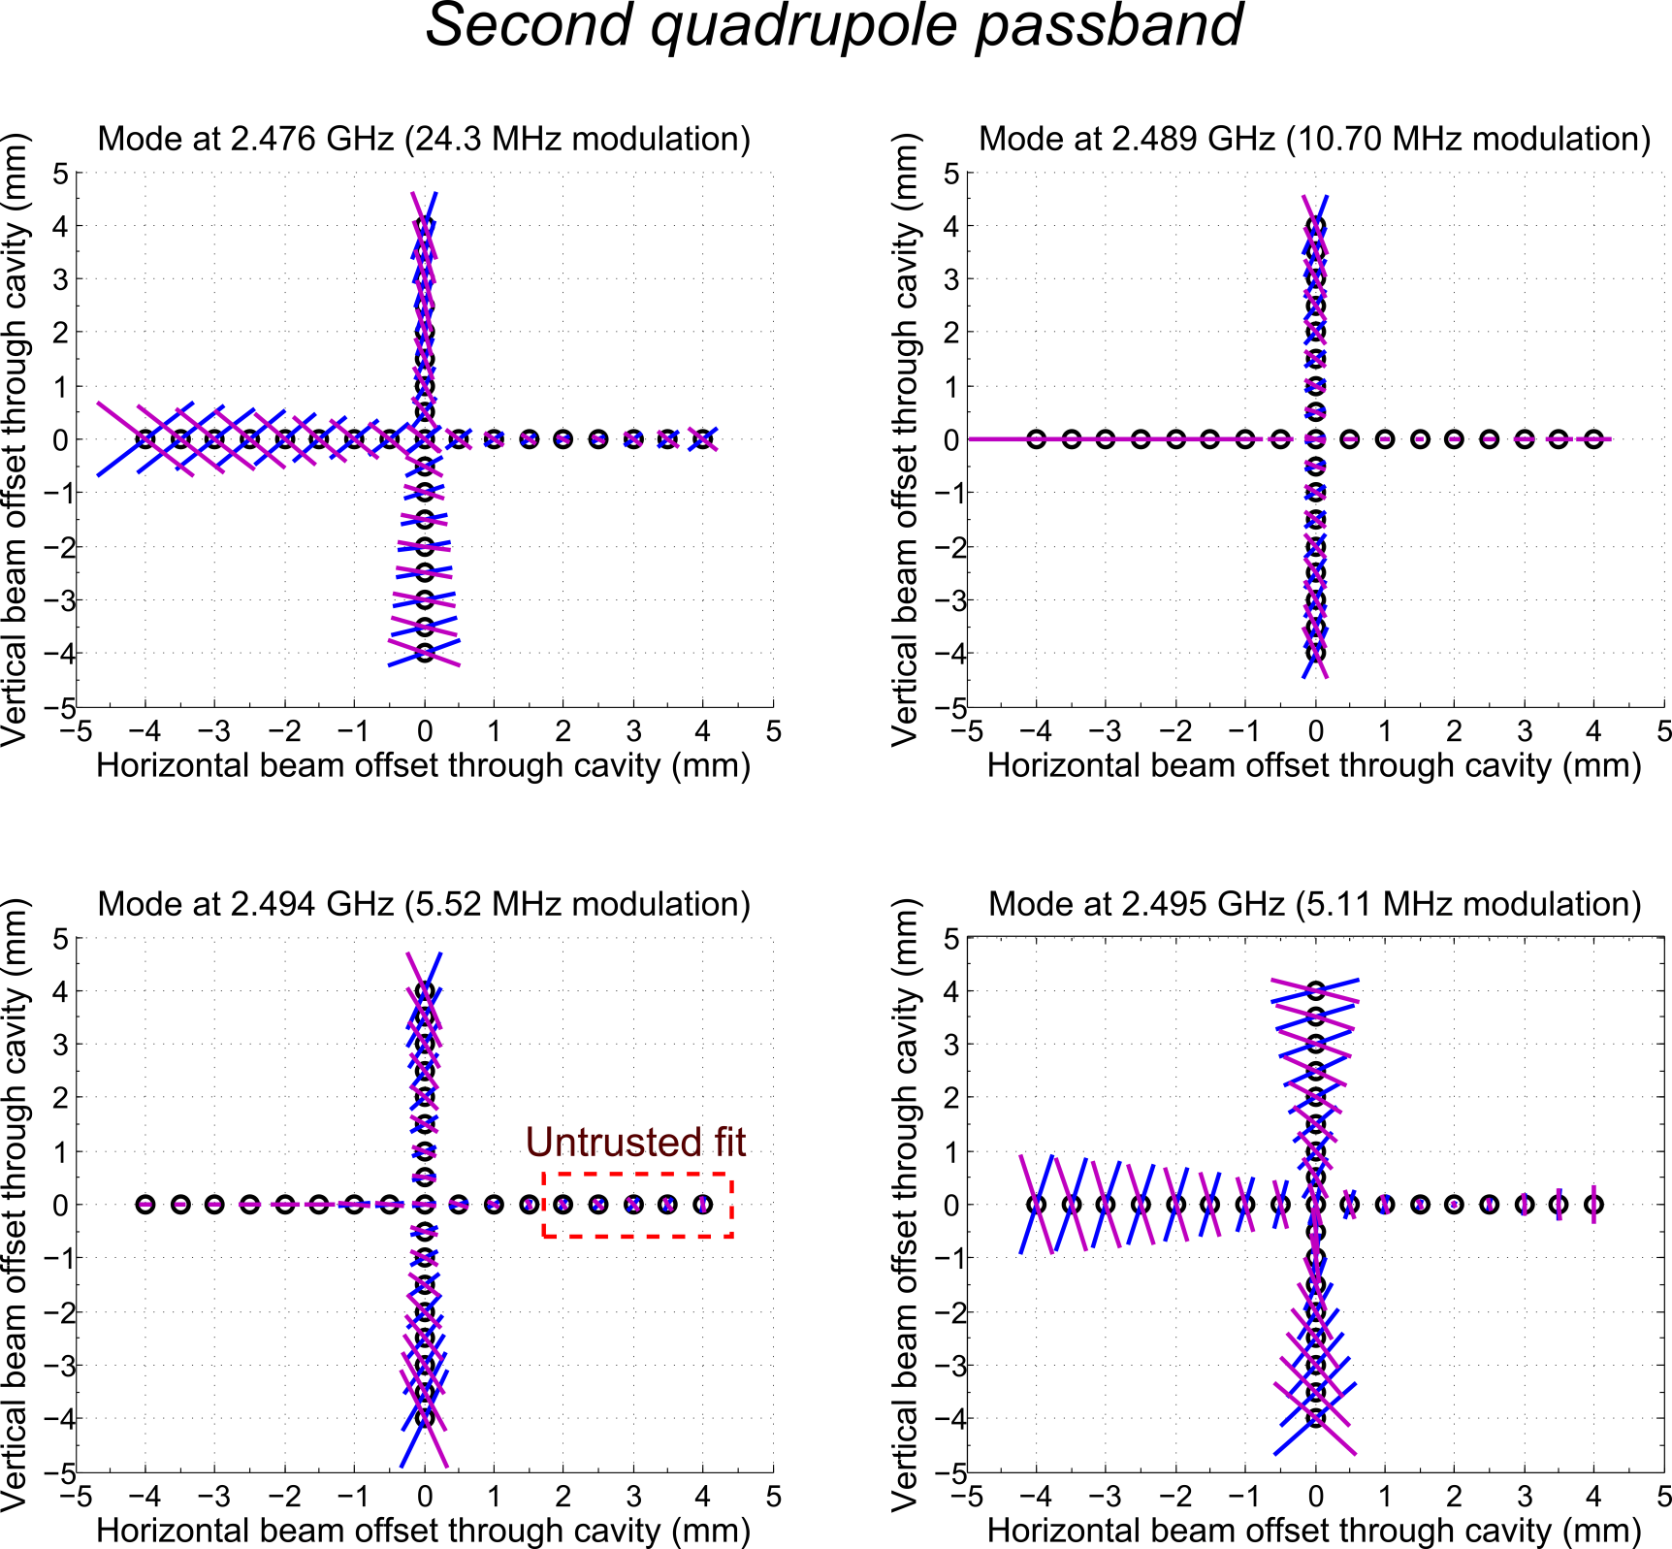
Notes:
Here’s the same set of plots, this time for the second quadrupole passband.
Note that these directions are not perfect. Note for example the plot in the bottom left.
Here we had no data for one of the components in the region around x-2 to x=5, and hence the spline fit that is used to get the direction is not trustworthy.

Slide 41
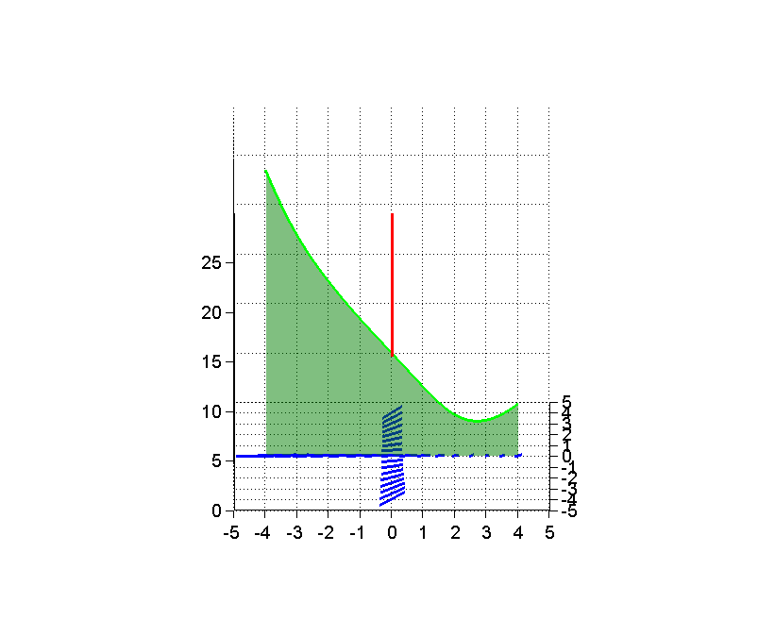
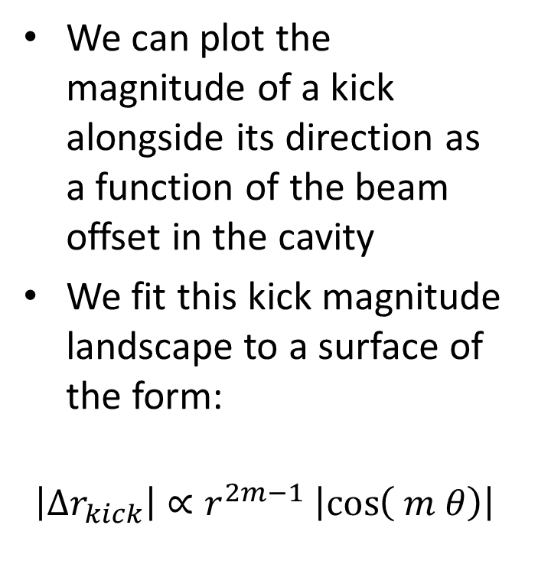
Plotting for the sake of analysis
We can plot the magnitude of a kick alongside its direction as a function of the beam offset in the cavity
We fit this kick magnitude landscape to a surface of the form:
$$\left|{Δr}_{kick}\right|∝r^{2m−1} \left|\cos\left( m θ\right)\right|$$
Notes:
The direction gives us a hint to the nature of the mode (dipole, quadrupole, etc.)
But to get the R/Q, we need to fit to the magnitude of the kick
To do this, we plot the magnitude of the kick, on top of the direction so that we can keep both in view at the same time.
We then perform a surface fit.

Slide 42

Analysis feedback loop
Obtain the polarisation of this functional form
Compare the expected kick directions of this functional form to the data
Do they match to within reasonable limits?
Fit the kick magnitude surface to some functional form
Start here
No
$$\left|{Δr}_{kick}\right|=A r^{2m−1} \left|\cos\left( m θ\right)\right|$$
Yes
Obtain R/Q
Notes:
The analysis consists of one feedback loop for each mode. We first fit the mode to some functional form, and use that to obtain the polarisation and nature of the mode.
We compare the directions of the expected kick to the real thing
If they match within limits, the fit is good and we can obtain the R/Q.
Otherwise, we start over.

Slide 43
Conundrums
Why doesn’t the kick go all the way to the noise floor, at 0.5 mum/m?
  Is something else kicking the beam?
Why doesn’t the kick go to zero when we centre the beam through the BPMs?
  Is the cavity truly centred to the BPMs?
Why are no azimuthal zeroes evident in the kick landscape?
  Are we seeing a summation of modes?

Slide 44
Conundrums
It is unlikely that the BPMs are perfectly aligned to the centre of the cavity.
BPM2
BPM1
Notes:
Well, it’s unlikely that the BPMs are perfectly aligned to the centre of the cavity. Being 3mm off is really quite likely. This means that even if we centre directly through these two BPMs, we’re still going to excite HOMs.

Slide 45
Conundrums
That’s fine – but why don’t we go to zero elsewhere then?
Dump 4° dipole magnet
BPM used to look for kicks
Notes:
Even so – where are our azimuthal zeros? Is there something else that’s kicking the beam?
Well, there is a dipole magnet that bends the beam just before the BPM. This dipole is necessary to send the beam into the dump.
Dipoles can turn a longitudinal momentum spread into a kick.
But at least to my estimate, this kick should be only on the order of 1-2 microns. We see offsets that are even 10s of microns.
Is the polarisation of our mode rotating as we go cell to cell?

Slide 46
Current focus
Look for sources of kick other than the excited mode
Investigate whether we may or may not be seeing a summation of modes
Extend the kick derivation to include other sources of kick
Fit the kick landscape to these new functional forms
Notes:
This is where we are now. Until we understand why the kick landscape doesn’t match to the original expectation, we cannot obtain the R/Q. We need the R/Q to be able to tell if the cavity will scale to higher currents.
Firstly, we’re scouring the experiment for other possible sources of kick.
It is possible (although we deem it unlikely) that we’re seeing some summation of modes
The next stage is to extend the original derivation to include these extra kick sources

Slide 47
Conclusions
Conclusions – can we draw any (yet)?
  Unfortunately, no concrete ones yet
Devise experiment
Take data
Perform preliminary analysis
Derive theoretical expectations
Fit expectations to data
Obtain final result
Finish
Start
Notes:
Which brings us to our conclusions. Can we draw any yet? Unfortunately, until we obtain the R/Qs, we cannot state with certainty that these modes won’t be a problem. The preliminary analysis gives some useful information – number of modes, Qs, etc. – but we’re stuck in this little loop here.
However, hopefully we’ll break out of this loop in the next couple of weeks and we’ll have an R/Q for these modes very soon.

Slide 48
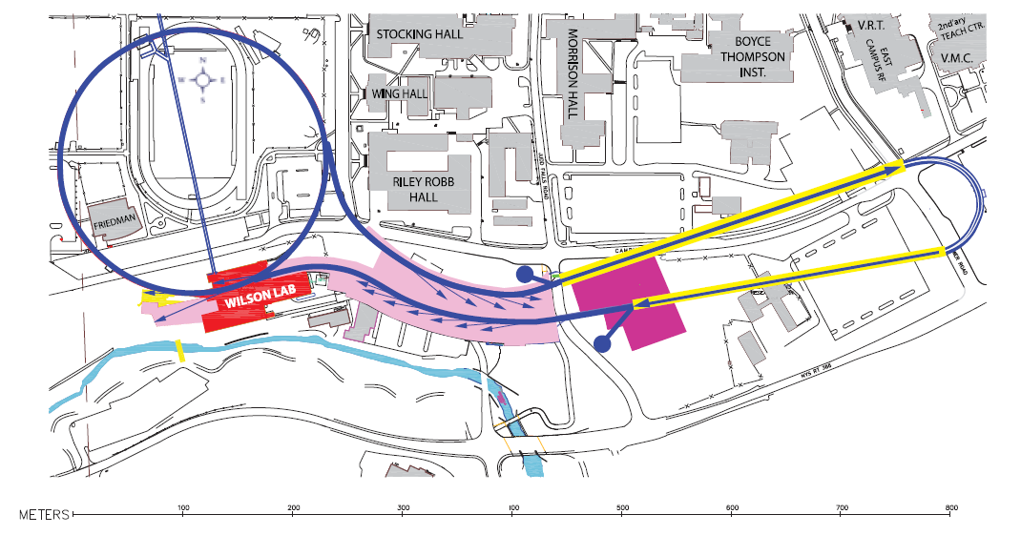
The Cornell ERL
LINAC-A
CESR
Injector
LINAC-B
Experimental
Stations
Beam Stop
 | Main Linac
Energy gain [GeV] | 5 GeV
CW beam current [mA] | 2x100
Gradient [MV/m] | 16.2
Cavity intrinsic Q₀ | >2 x 10¹⁰
Animation credit: N.R.A. Valles
Layout diagram from ERL PDDR
Notes:
Here is a layout and brief animation that outlines the function of the proposed ERL.
The beam is injected, accelerated through the two linac stretches, passed through the experimental stations and the modified storage ring, decelerated in the linacs, and finally brought a stop.
What is particularly challenging regarding this design is that it requires storage ring levels of continuous current in a linac-based design. Only SRF cavities can fulfil this requirement.

