Slide 1
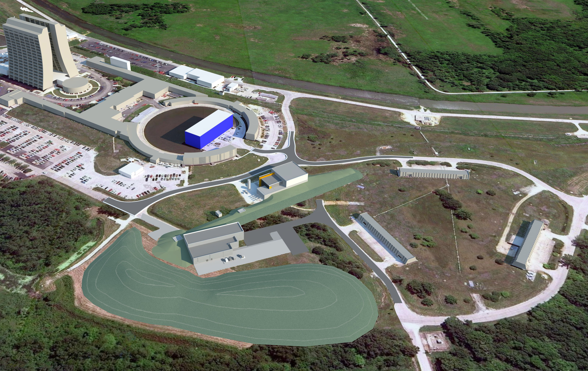
Muon Campus Program RR to P1 Transfer Line Cons Gattuso 8/28/13

Slide 2
RR to P1 Transfer Line
2014 shutdown will only deal with the Recycler
portion of the beam line

Slide 3
RR to P1 line update
Stand Modification
Lambertson stands
Drawings are complete
Assembly/installation drawing underway
Kicker stands
Drawing are underway
Vacuum Rework
General layout sketches complete
Drafting switching over form IDEALS to VX
Issues not resolved
Pump placement, Beam box, Beam Pipe supports
Cable pulls
Preliminary list generated
Interferences mitigation
looking for MI access time to identify issues
Lattice updates
Correction elements added
Beam line instrumentation updated

Slide 4
Mile Stones
Task codes open 10/1/2013
Vacuum design should be finalized by 11/4/13
Pumps/Gauges/valves order should be placed by 12/2/13
EE support should receive the vacuum layout/configure at this time to layout the CIA crate
Stand Designs
Lambertson/Kickers/Differential pumping should be done by 12/9/13
Stand parts should be ordered by 12/16/13
Shut down Readiness (Last Week of May)
ALL stand components in hand and staged at MI-60
Installation drawings/procedures ready and signed off
ALL Vacuum Components ready for installation
ALL Cabling in hand and ready for installation
Shutdown Begins ( 4th Qtr.. of 2014 FY, July/Aug/Sept)
2/9/14
2/15/14
2/12/14
2/7/14
9/1/14

Slide 5
Schedule for the Fall 2014 shutdown
Start of the shut down September 1 2014 (tentative)
Driven by Com Ed
Main 345KV line maintenance
Duration
6-8 Weeks Driven by the RR to P1 line Recycler modification
Other shutdown Work
MI/RR
Replace 3 sets of Lambertson flanges
Install 3rd RF cavity
Install 2 IPMS
Remove 201 electron cloud experiment
Open up aperture in the RR to MI extraction line
Techs will be a premium
May not get much done during this time period in Muon rings

Slide 6
First Access Monday/Tuesday access period
Mech Support Tunnel
Prepping Storage areas
Converting over the E760 pit
General house keeping
Procedures requested from Mechanical support
Beam pipe processing
Water system
Stand inspections
Magnet inspections
Alignment
Network
Ceiling monuments installed (~100 monuments installed)
Floor monuments(~45 of the 110 installed)
Wall monuments
Delivery Ring Referencing and As-founds

Slide 7
Weeks to Come……..
Tunnel clean up
Prepping Storage areas
Lots of misc cables/ pipe and other hardware in the tunnel
Some in short straight section
Some in storage bins/fenced in areas
Alignment
Network
Ceiling monuments installed
Floor monuments
Wall monuments
Delivery Ring Referencing and As-founds
Tunnel component tagging
What stays
What goes
Storage
New location
Waste

Slide 8
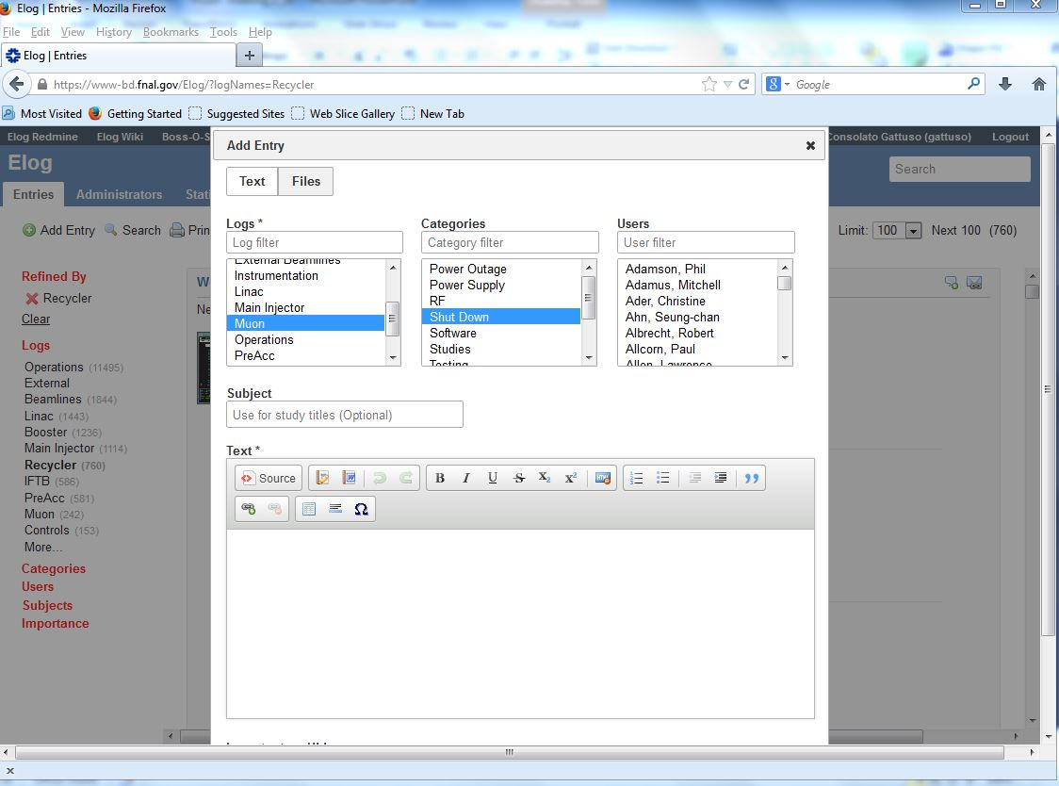
Documenting Our access period work
We will be tagging our entries using the ”Subject” (studies title page).
Looking for suggest as to how to title them…

