Slide 1
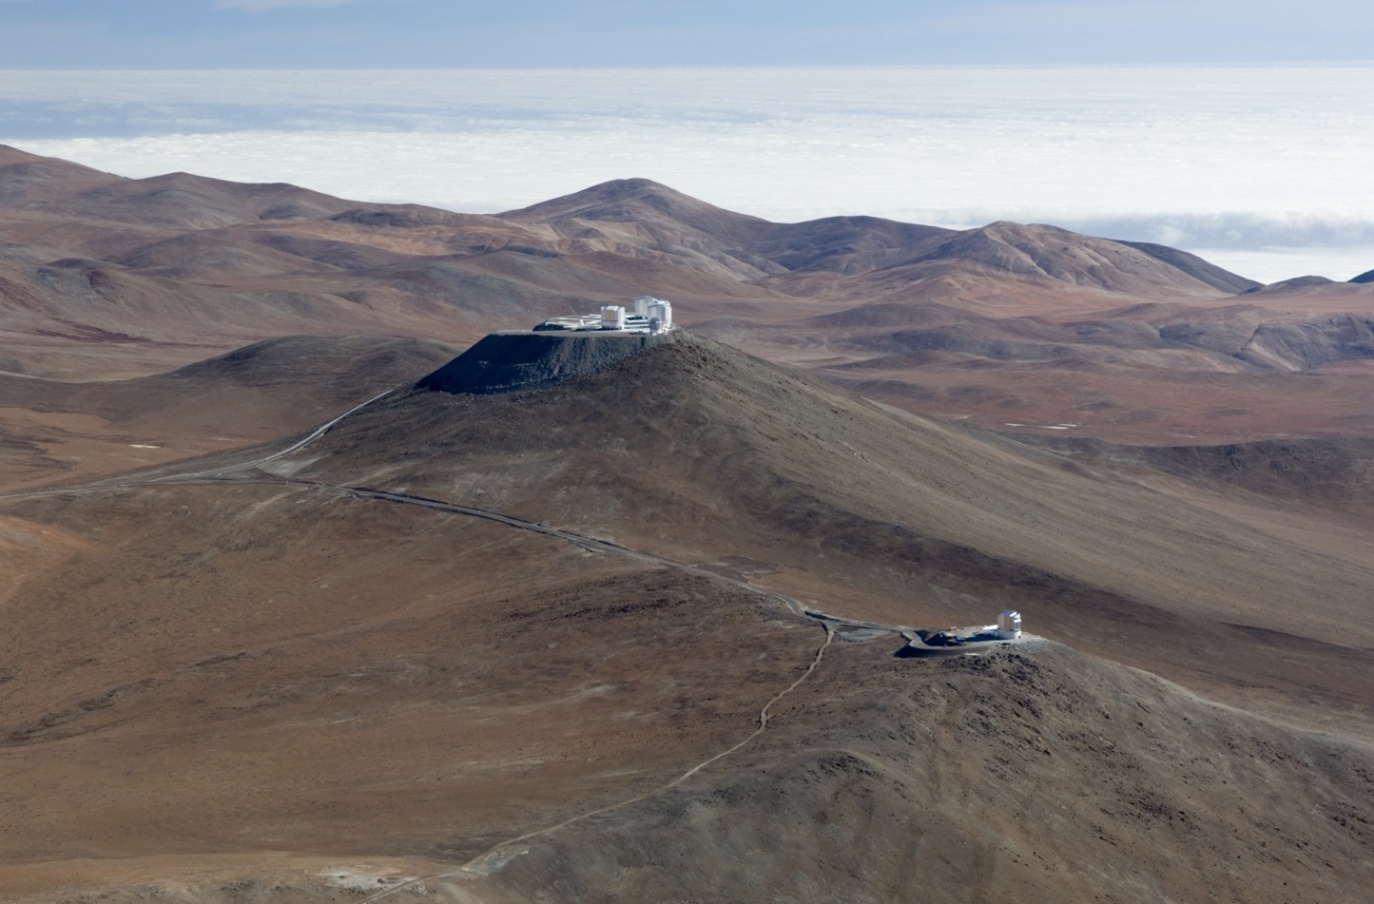




VISTA near IR survey data and DES
Richard McMahon,
Manda Banerj (UCL), Mike Irwin
Eduardo Gonzalez, Jim Lewis

Slide 2
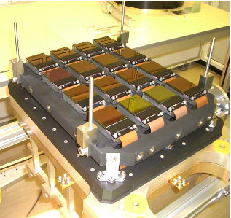
VISTA Summary
Visible and Infrared Survey Telescope for Astronomy (VISTA)
Location: ESO, Paranal, Chile
Aperture: 4.1 m diameter f/1 primary
Field of view: 1.65 degree diameter
Instrumentation: VIRCAM ― 8k x 8k sparse filled mosaic near-infrared camera
Detectors: 16 x 2k x 2k pixel (Raytheon VIRGO HgCdTe); 67 megapixels
Wavelength range: 0.84–2.5 microns
Pixel scale: 0.34 arcseconds/pixel
Filled field of view: 0.60 deg²
Surveys started: April 2010

Slide 3
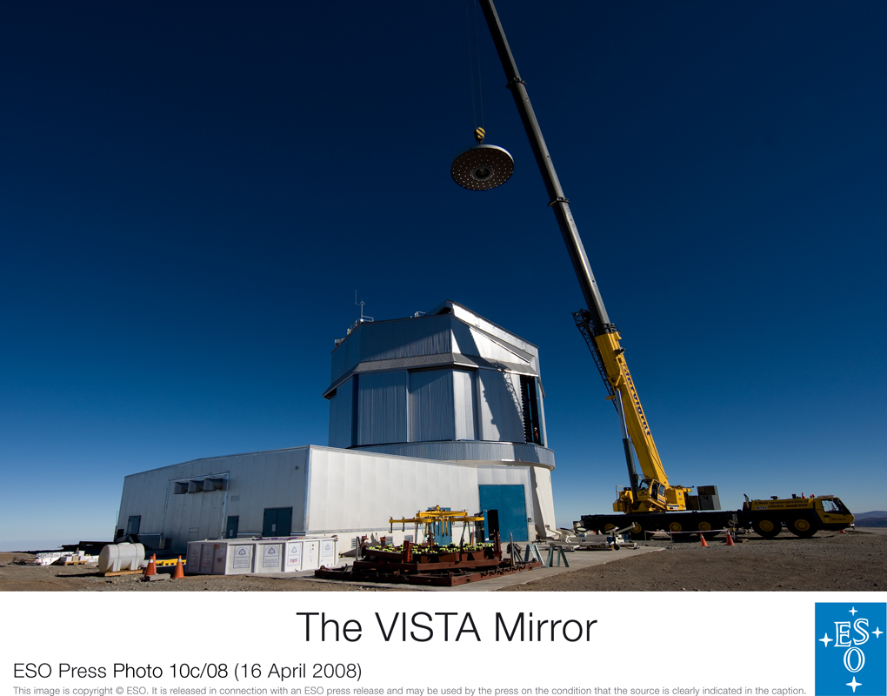
4.1 m diameter f/1 primary

Slide 4
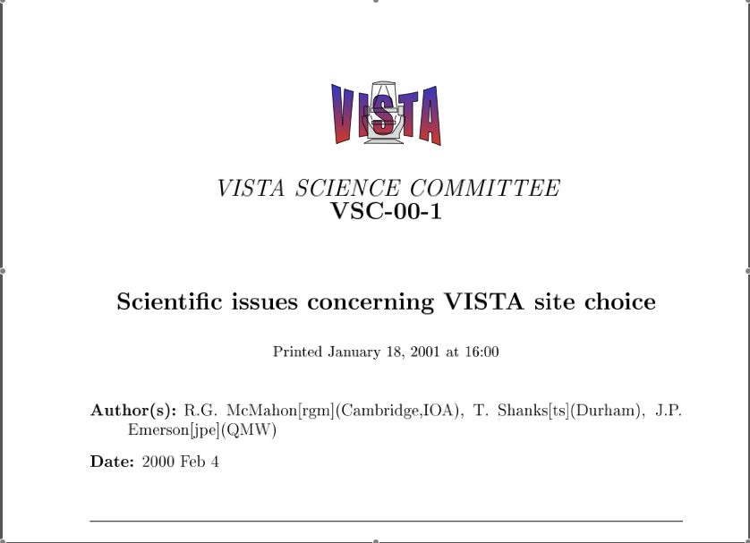
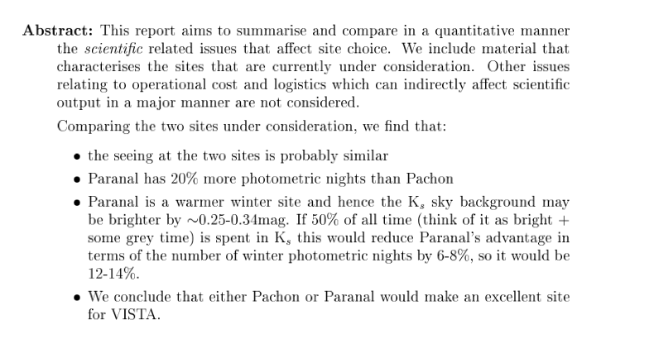
VISTA site choice: Cerro Paranal (ESO) or Cerro Pachon (Gemini)

Slide 5
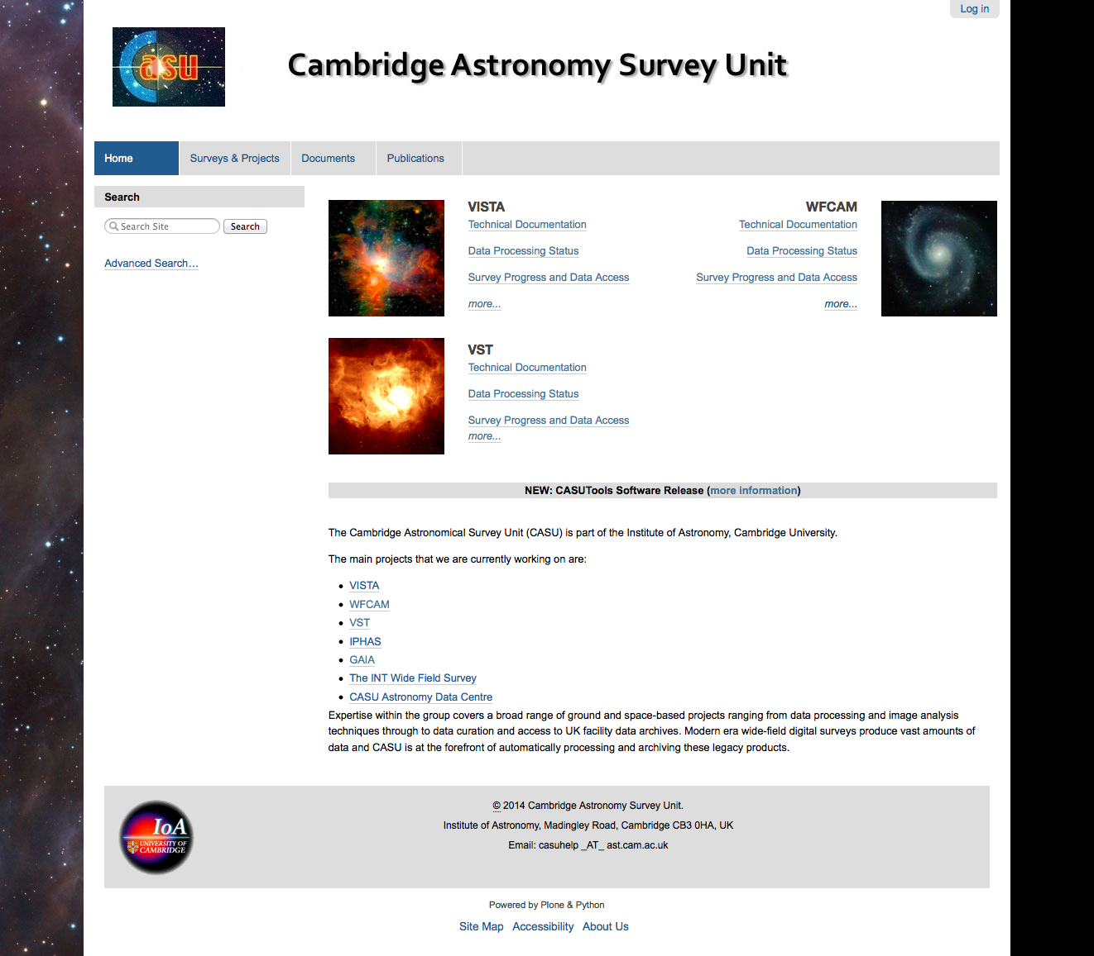
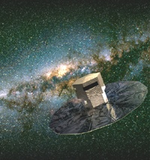
http://casu.ast.cam.ac.uk/
Group is led by Mike Irwin
UKIRT
VLT Survey Telescope
http://casu.ast.cam.ac.uk/surveys-projects/software-release
Gaia/Euclid

Slide 6
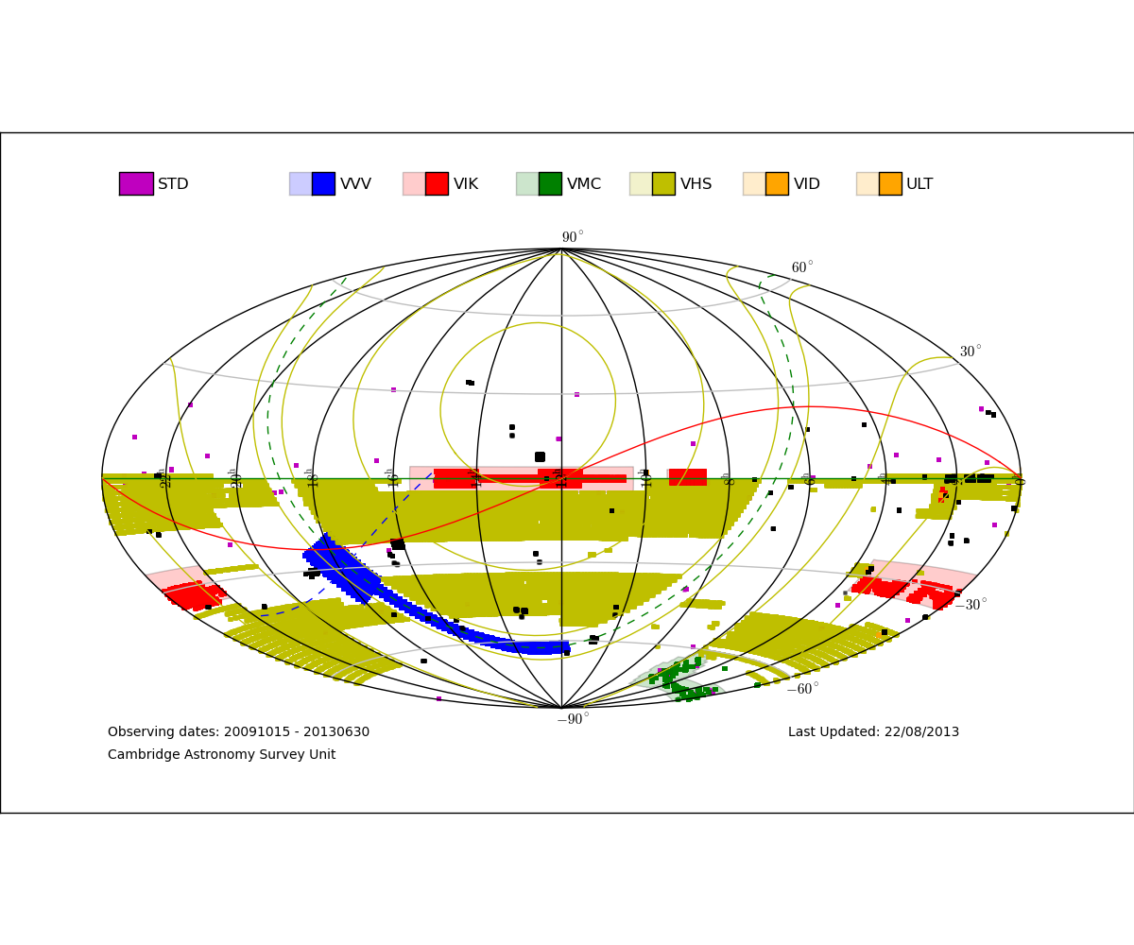
VISTA Surveys Processing Status

Slide 7
VHS and other DES-centric VISTA Surveys
Survey | Area (deg²) | Depths | Nominal Depth (mag)
VHS (PI: Richard McMahon) | 18, 000 | 5σ, AB | J=21.2 Ks=20.0
1. VHS-DES | 4500 | 5σ, AB | J=21.6 (H=21.0)* Ks=20.4
2. VHS ATLAS | 5000 | 5σ, AB | Y=21.2 J=21.2 (H=20.6) Ks=20.0
3. VHS-GPS | 8000 | 5σ, AB | J=21.2 Ks=20.0
VIKING (PI: Alistair Edge | 1,500 (450 250 deg² in DES) | 5α, AB | Z=23.1 Y=22.3 J=22.1 H=21.5 K_{s}=21.2
VIDEO (PI: Matt Jarvis) | 15 (DES SN fields) | 5σ, AB | Z=25.7 Y=24.6 J=24.5 H=24.0 K_{s}=23.5
Note: since April 2012, VHS H-band has been dropped to increase J-band exposure time and meet nominal J-band depth requirement.

Slide 8
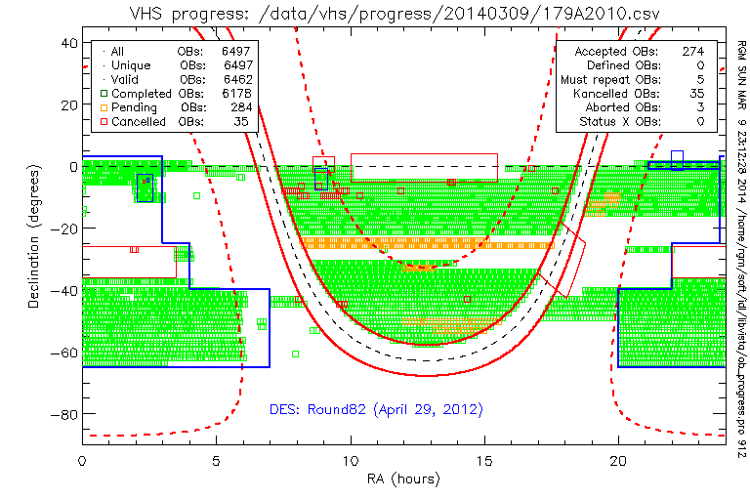
around 10,000 deg² observed

Slide 9
VHS Components
VHS-Dark Energy Survey (VHS-DES)
  4500deg² ( excludes 500deg² from VIKING footprint)
  J (120sec), H(120sec), K(120sec)
    Changed April 2012 to J(240sec), H(0sec), K(120sec)
VHS-ATLAS (VST-ATLAS PI: Shanks):
  Non-DES High Galactic latitude including NGP
  5000deg²
  Y(60sec), J(60sec), H(60sec), K(60sec)
    Changed April 2012 to Y(120sec), J(60sec), H(0sec), K(60sec)
VHS Galactic Plane (VHS-GP)
  5< |b| <30
  8200deg²
  J(60sec); K(60sec)

Slide 10
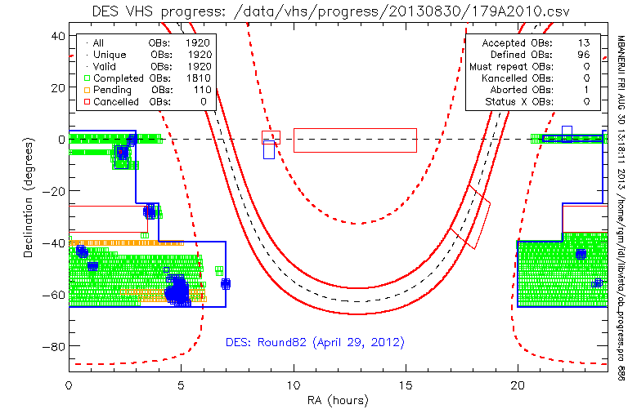
VHS observations status on 2013, Sep 1st
Observing Block(OB);
Tile = 1.5deg²
VIKING
VIKING
VIKING
VHS-DES currently completed ~2900 sq deg: ~250 sq deg overlapping DES SVA1

Slide 11
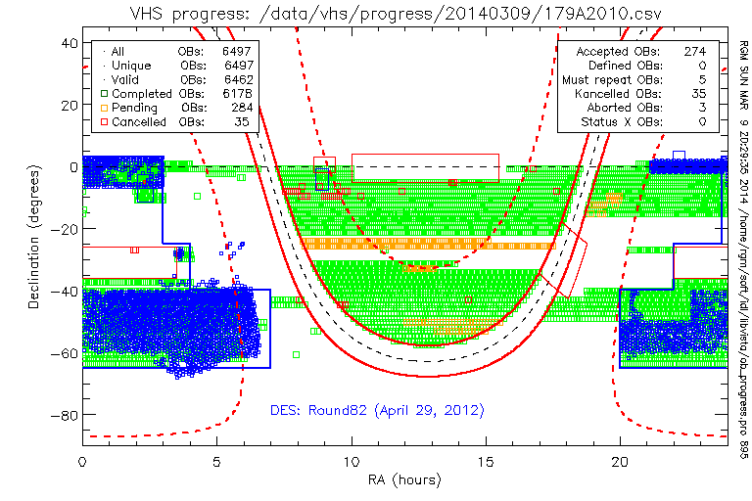

Slide 12
CASU processing for VISTA
Mike Irwin
Jim Lewis
Eduardo Gonzalez-Solares
Simon Hodgkin
Aybuke Kupcu Yoldas
Eduardo Gonzalez-Solares
CASU responsible for all NIR processing for VISTA and WFCAM as part of the VISTA Data Flow System(VDFS)
VISTA pipelines run: Paranal; Garching; Cambridge

Slide 13
CASU mantra
MEFs as container -> simplifies bookkeeping
use lossless Rice-compression -> (x 2-4 less space)
FITS images and catalogue binary tables (CFITSIO)
FITS headers record processing details
  derived data quality control (QC) parameters
  WCS astrometric calibration
  photometric calibration
  versioning and software details
modular software -> C & perl/python scripts
minimise external software dependencies

Slide 14
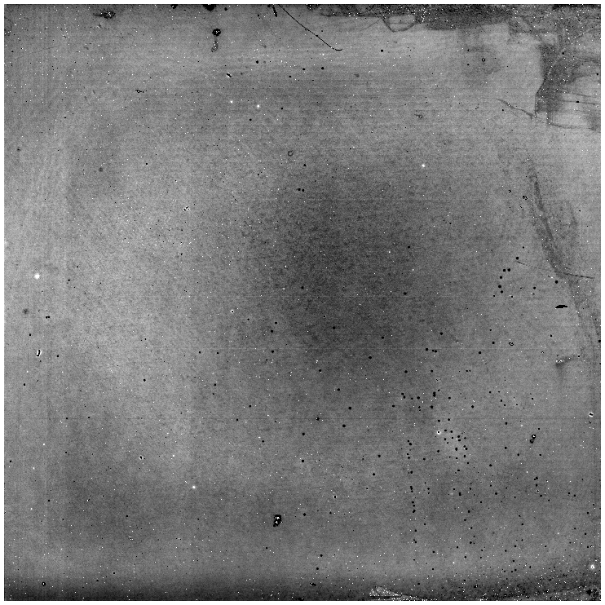
IR Data Reduction Issues
IR detectors are inherently more unstable than optical CCDS
  some odd electronic effects
  not as good cosmetically as CCDs
Sky background >100x brighter than most objects of interest
Sky background is variable temporally and spatially
Exposure times are short, so nightly data rates for VISTA are (~250-500GB)

Slide 15
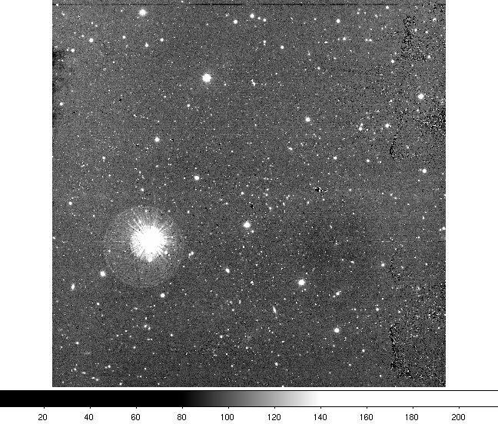
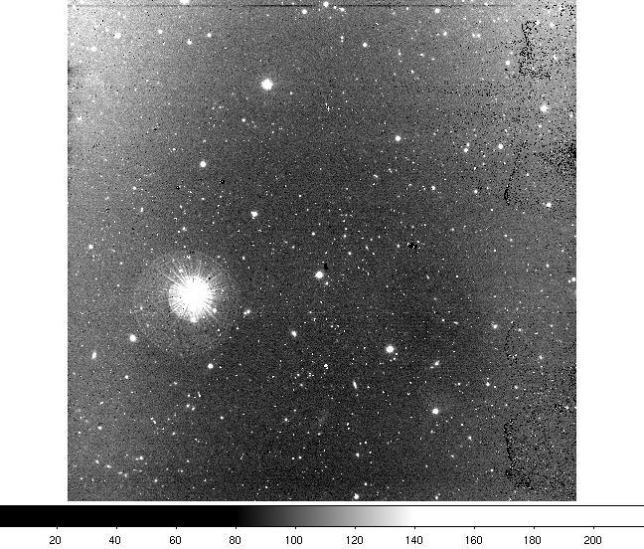
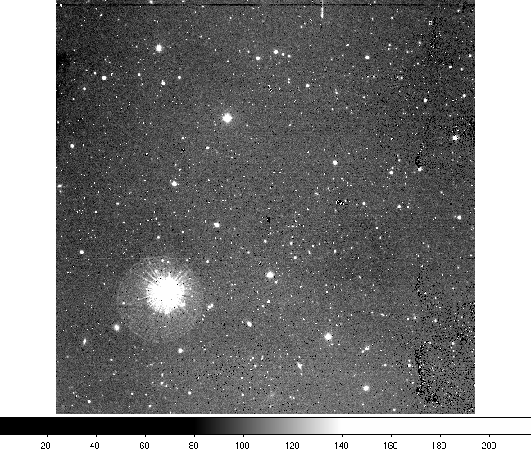
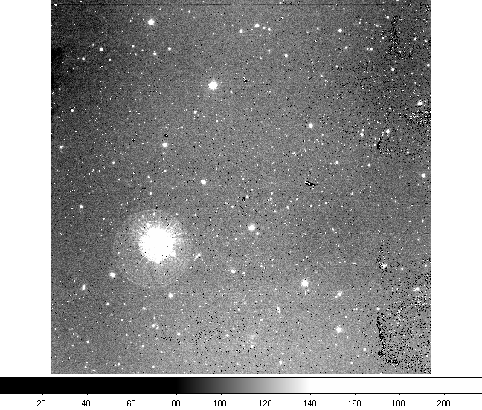
Time Variable Sky

Slide 16
Image processing Steps
Raw data transfer, ingest and organisation
Monthly calibration updates (flats, linearity, masks)
Nightly processing:
  reset correction (debias)
  dark correction
  linearity correction
  flat field correction
  sky background correction *****
  destripe - controller level pickup
Crosstalk, persistence, no fringing corrections needed for VISTA

Slide 17
Software Solutions
nebuliser
  removes complex background variations
  enhanced object detection & parameterisation
despiker
  removes diffaction spikes, charge bleeding artefacts, and satuarated stellar cores
mosaicer
  CASU tiling software developed for VISTA
psf’ers
  automatically generates detector-level PSFs
  and performs PSF photometry

Slide 18
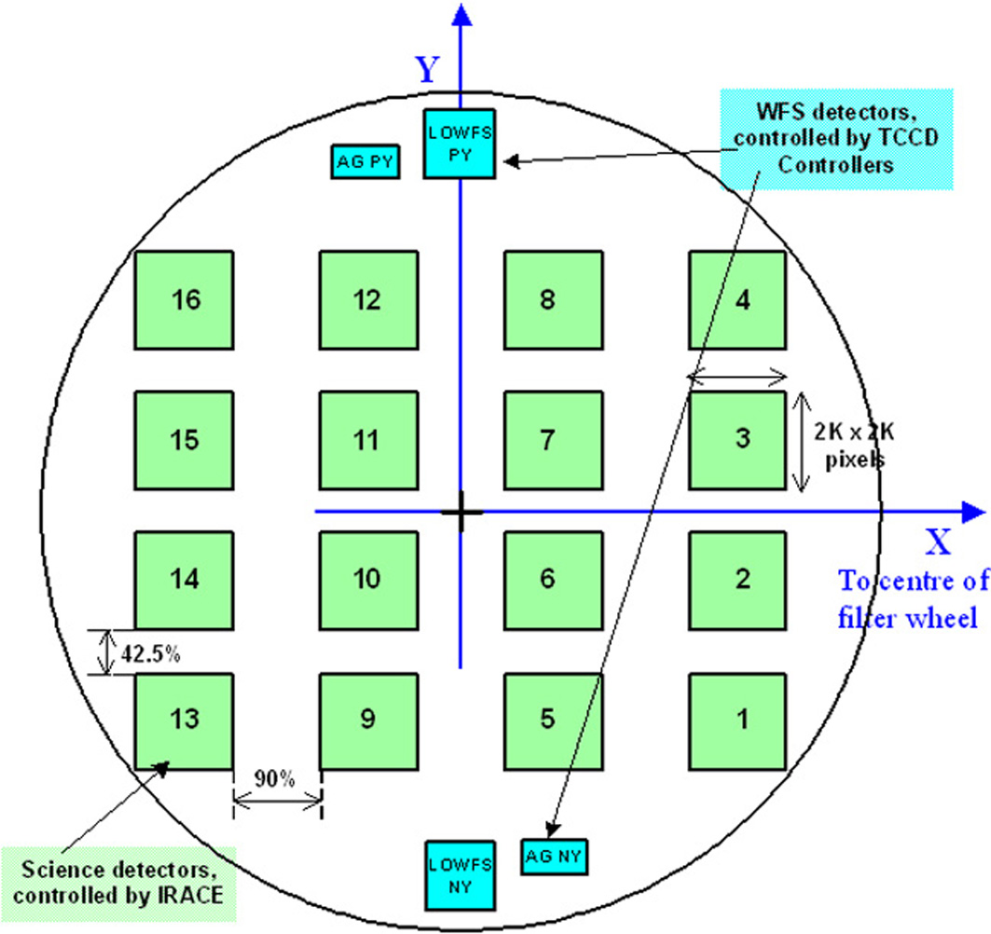
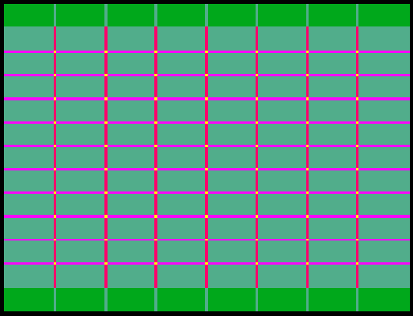
VISTA IR focal plane
16 arrays, 64 Mpix = 0.60 deg² on-pixels , 0.34 arcsec/pix.
  - 6 offset pawprints gives 1.5 x 1.0 deg² “tile”, every pixel covered by at least 2 pawprints.
Completed Tile
Relative Exposure Time
dark green = 1, light green = 2, magenta = 3
red = 4, yellow = 6

Slide 19
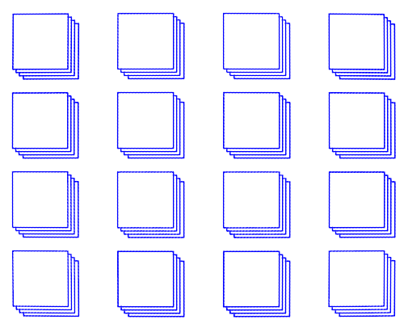
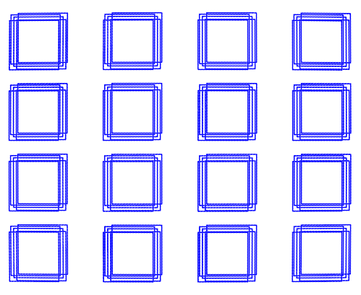
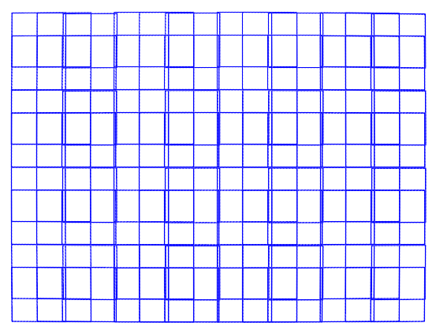
VISTA
pawprints
x6
......
+ confidence map
dither
stacked
+ catalogue
96 chips
mosaic
tile
+ confidence map
+ catalogue

Slide 20
Challenges when dealing with tiles
imperfect sky subtraction pawprint matching + artefacts
variable PSF across pawprint detectors
variable seeing conditions for entire pawprint
variable saturation levels of each detector
variable extinction (ZP) during tile observations
astrometric distortion = photometric distortion
interpolation = varying correlated noise patterns

Slide 21
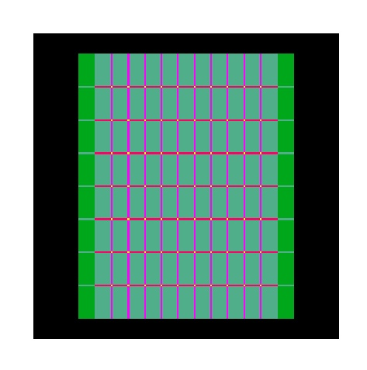
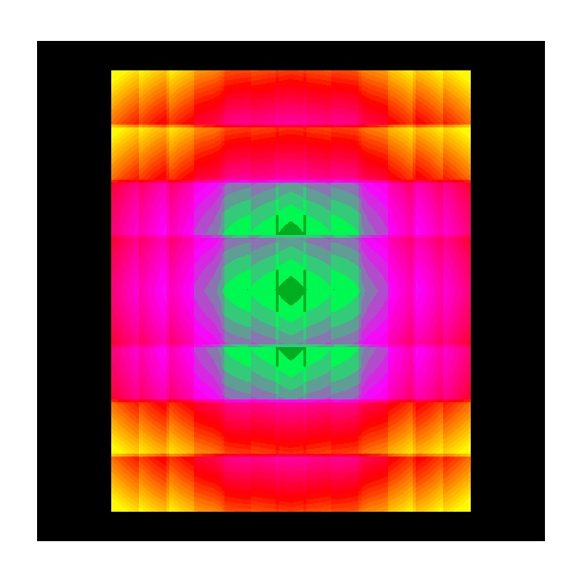
Tile photometric distortion
Inherent illumination correction
Tile exposure map

Slide 22
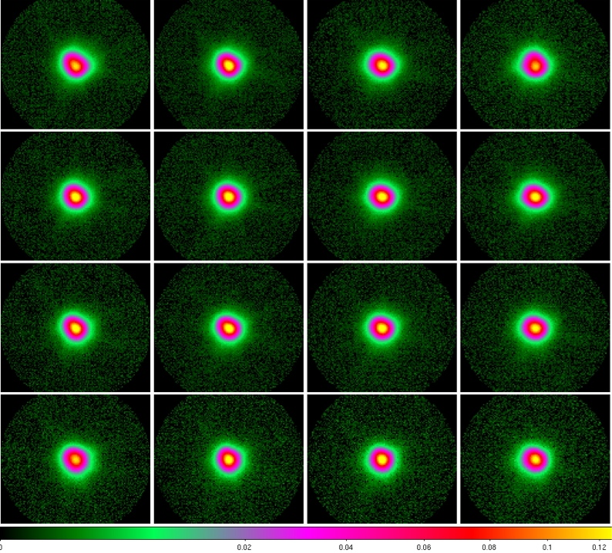
Detector PSF variations

Slide 23
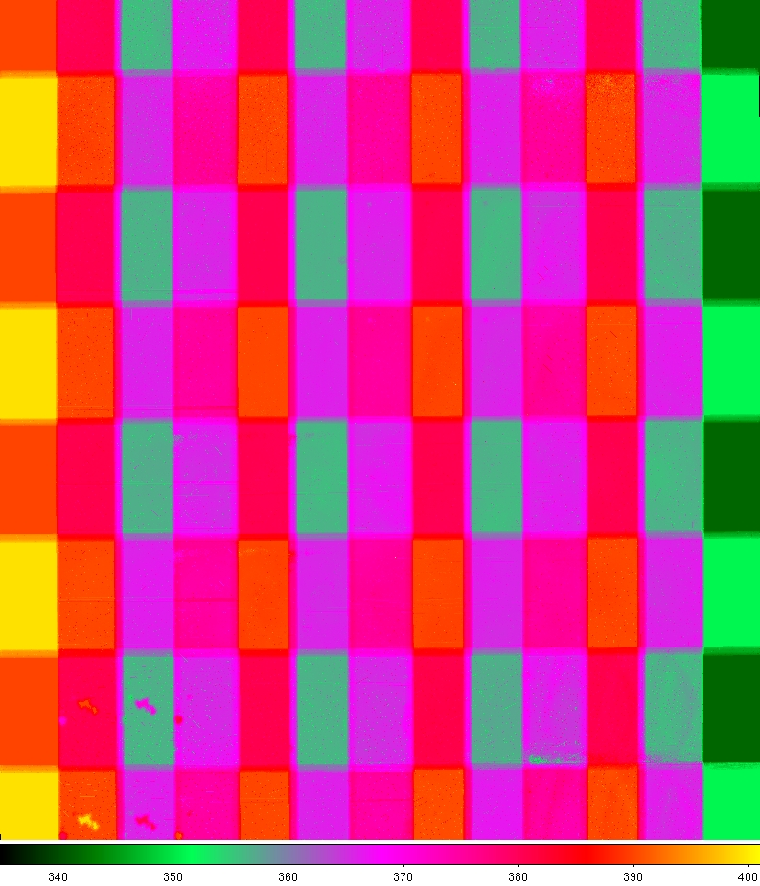
MJD variation across tiles

Slide 24
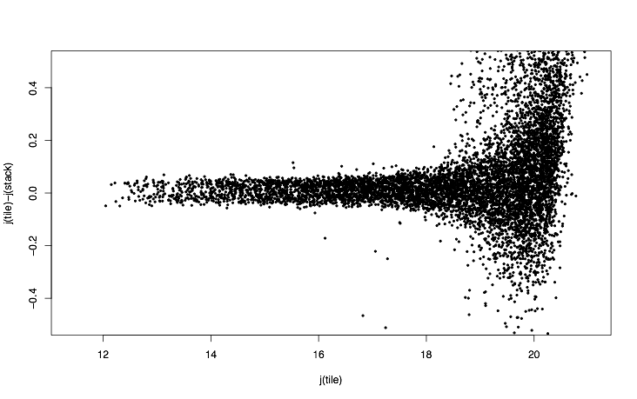
Tile vs Stack photometry (before grouting)
∆j = 0.05

Slide 25
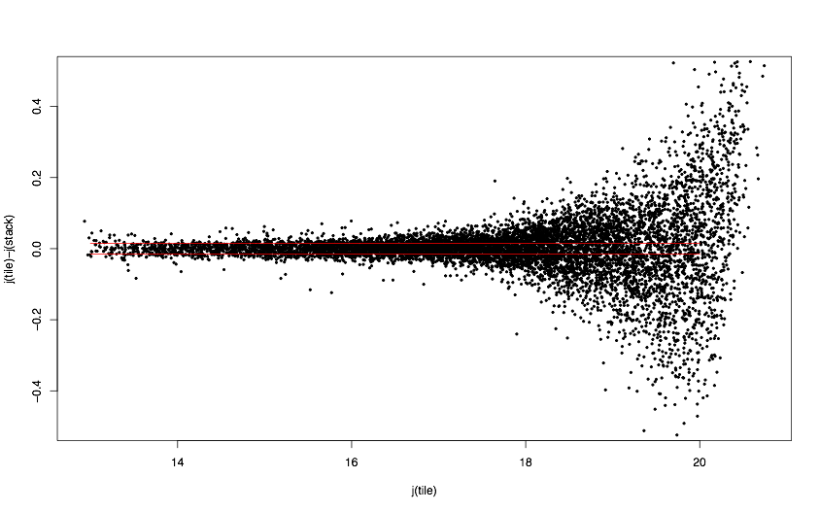
Tile vs Stack Photometry (after grouting)
∆j = 0.015

Slide 26
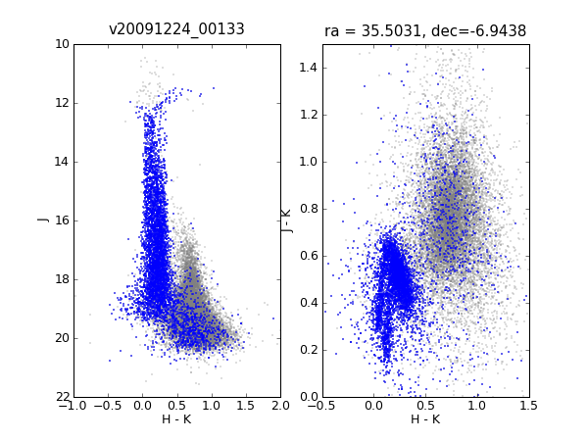
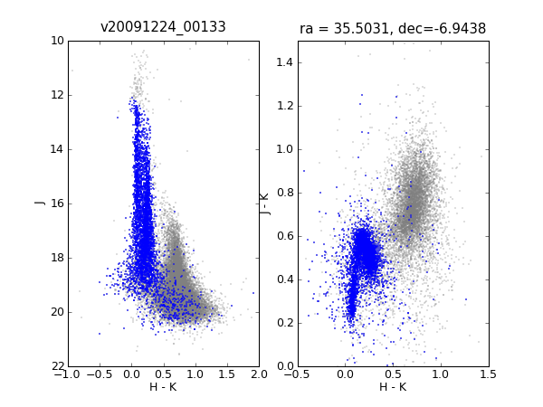
Tile grouting
Before
After

Slide 27
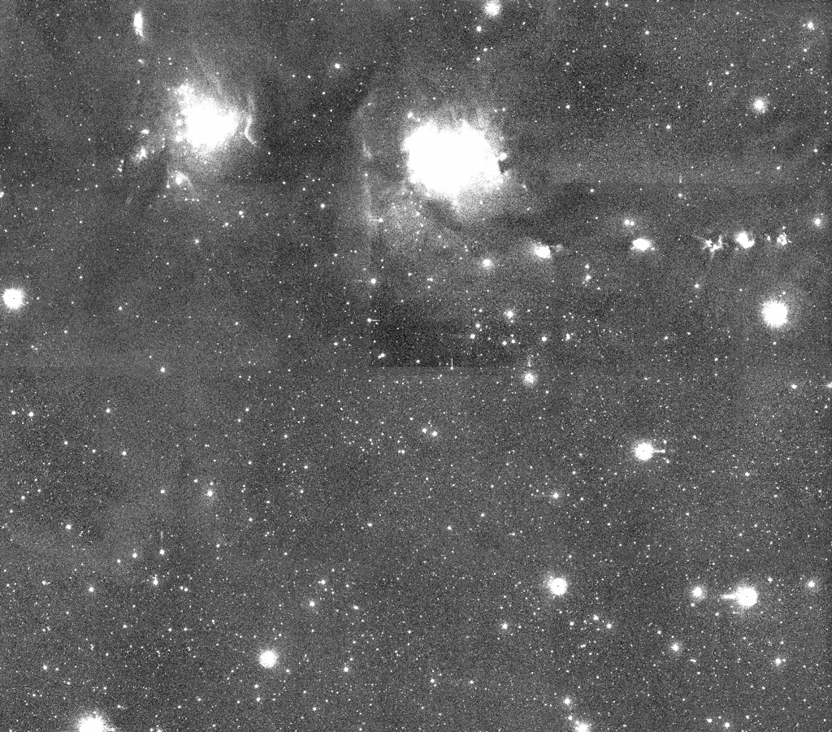
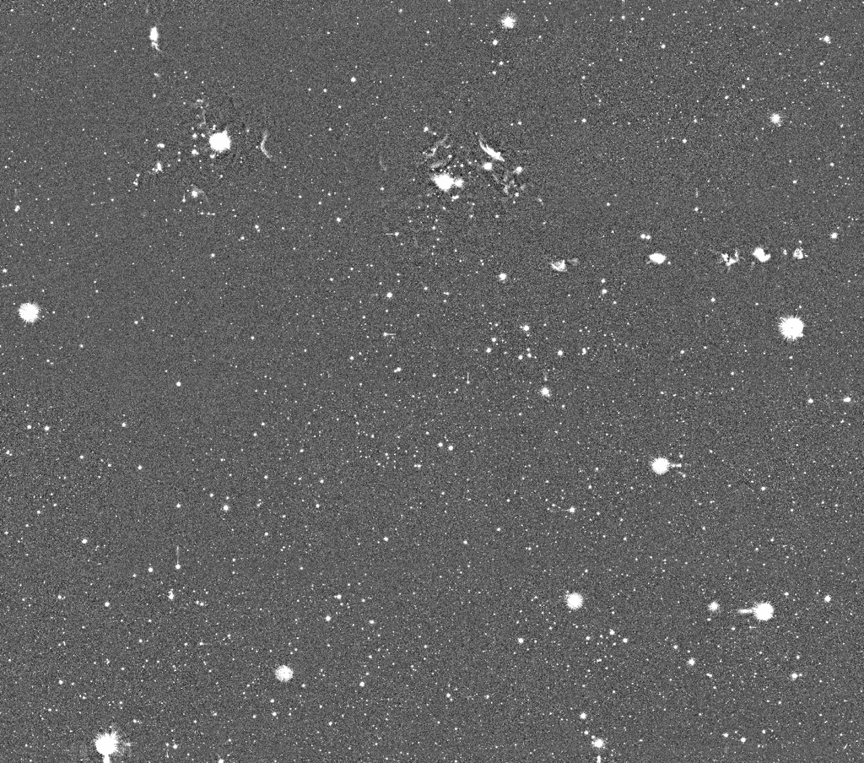
Nebulised pawprints and tiles
Nebulosity filter applied to stacks before mosaicing

Slide 28
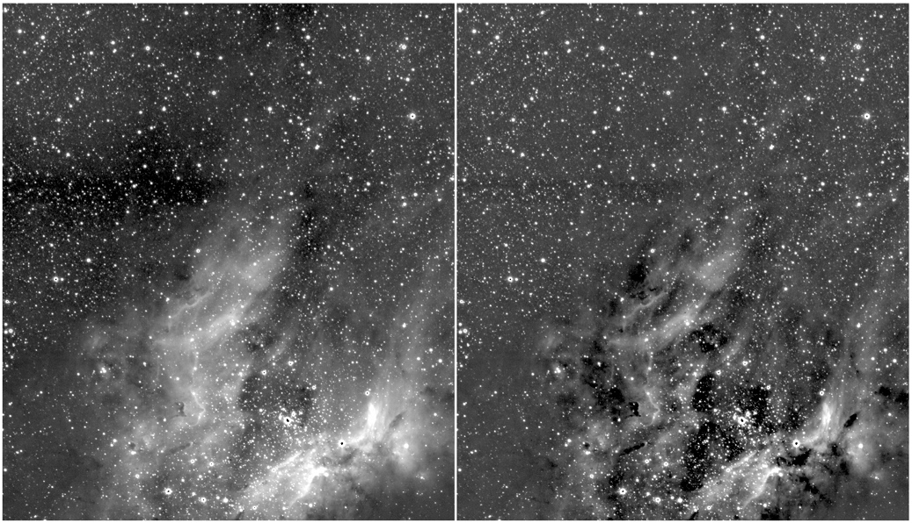
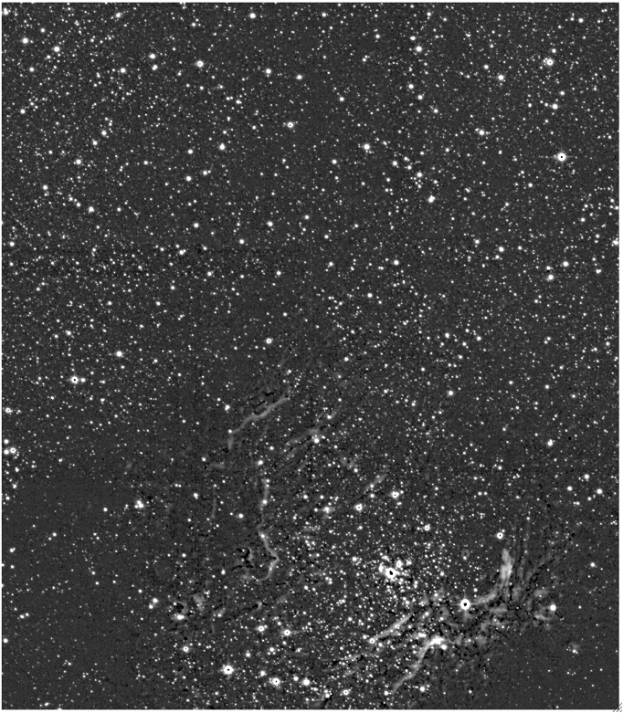
Nebuliser -> M17 K-band

Slide 29
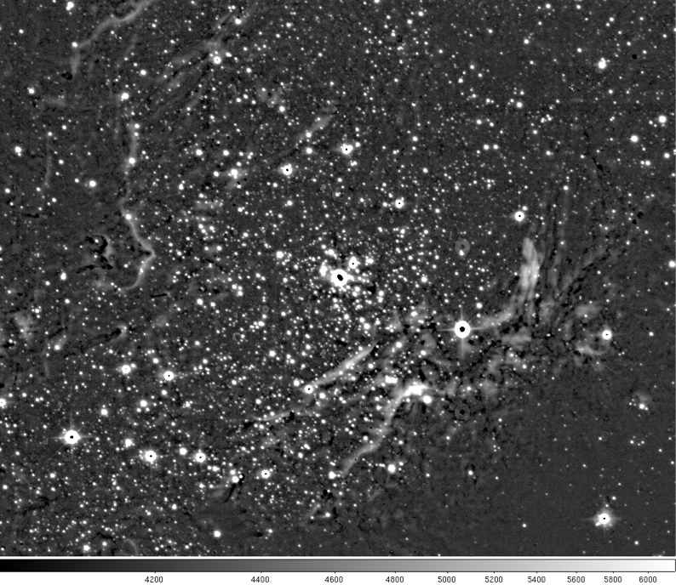
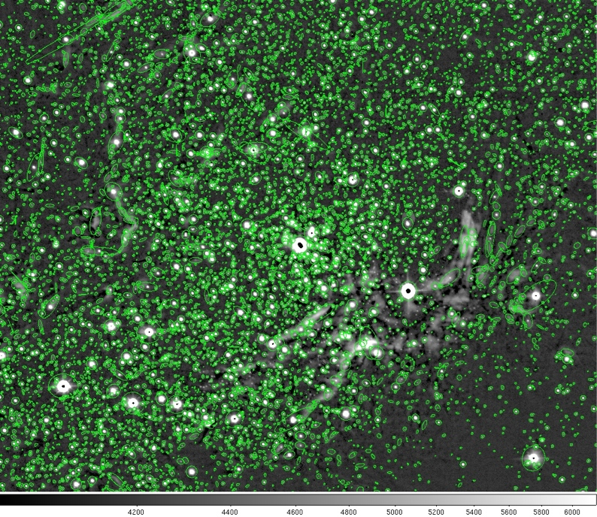

Slide 30
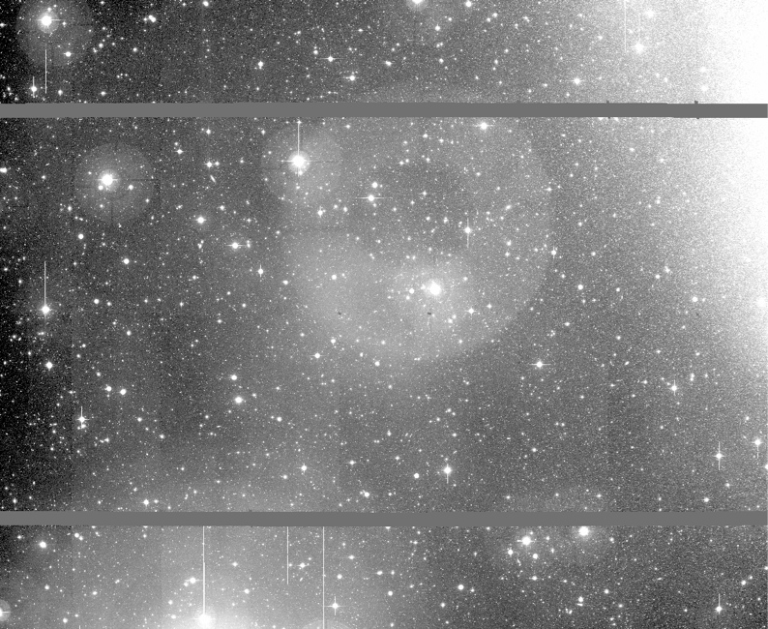
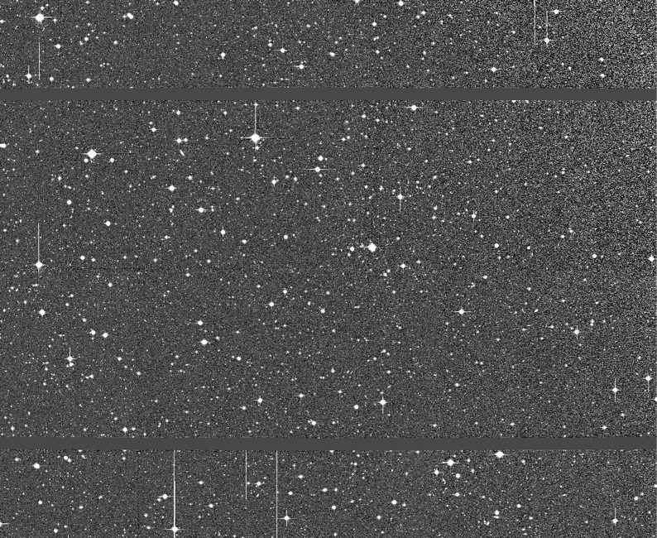
Nebuliser -> M31 field 23 MegaCam

Slide 31
Post-Processing Steps
monthly zeropoint updates
  stack 2MASS photometric residuals
  compute detector-level ZP offsets
  and residual spatial illumination correction
tile grouting
  fix catalogues for variable PSFs
  and for varying pawprint-level ZPs
  and for individual detector-level ZPs
reclassify and update tile catalogue calibration

Slide 32
Data Products - recap
products consist of:
  calibrated single exposure images
  shifted ”average” stack frames (pawprints) + conf maps
  calibrated stacked pawprint catalogues
  filled area tile images + confidence maps
  calibrated tile object catalogues
  sky background images, flats, darks, bad pixel mask
science products are MEF files (images Rice-compressed)
all QC parameters are stored in MEF headers
headers contain provenance information
processing web page updates
  http://casu.ast.cam.ac.uk/surveys-projects/vista

Slide 33
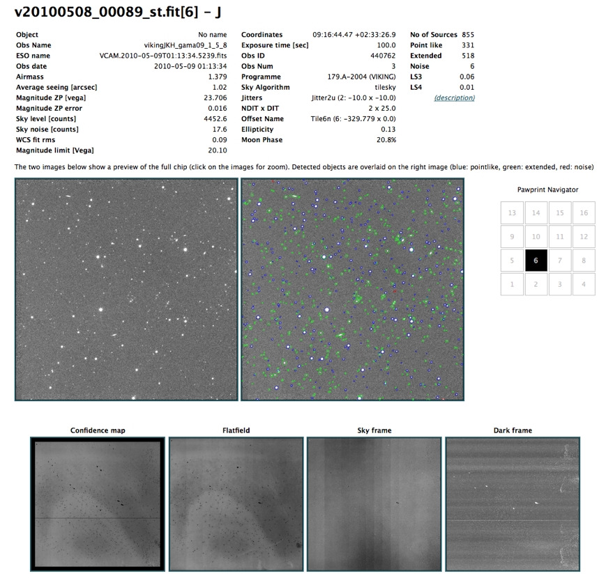
Preview of images, QC information, catalogue detections and calibration images.

Slide 34
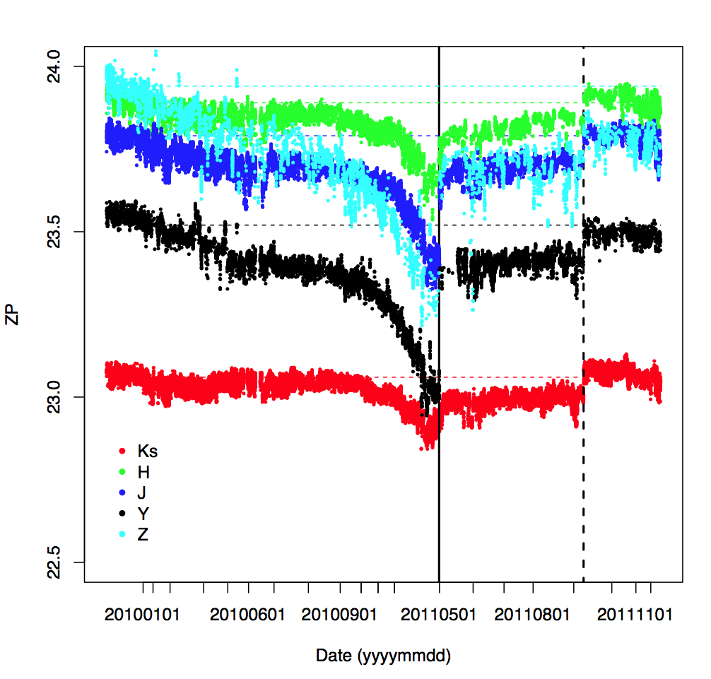
An example of long QC trend analysis
Variable zero-point (and hence survey depth) with time
  silvered mirror degradation
  aluminised mirror
  a bit of window cleaning

Slide 35

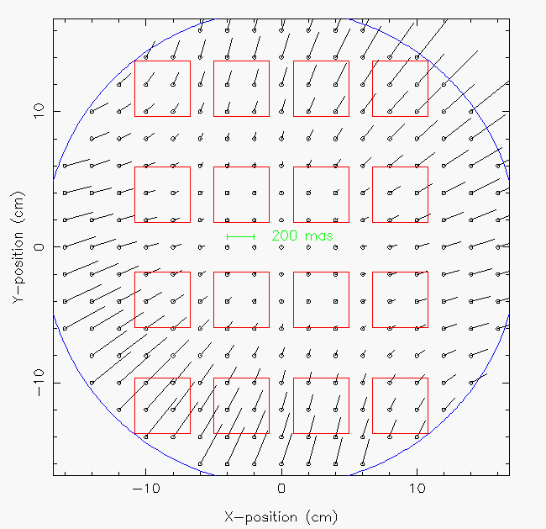
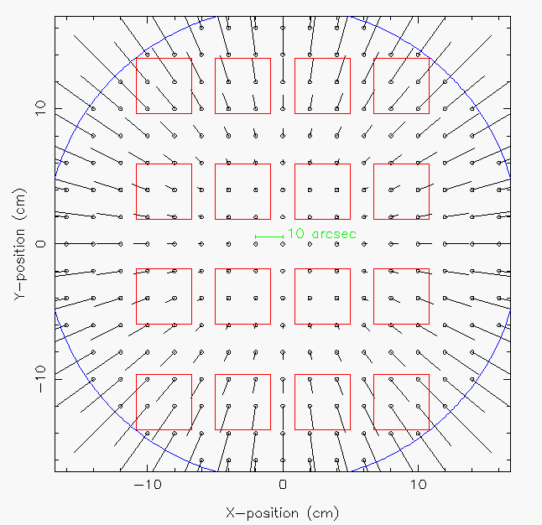
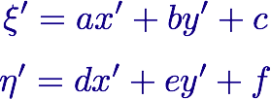
Astrometric Calibration from 2MASS/UCAC3
WCS - ZPN projection
Linear solution
per detector
rms < 100 mas
Tabulated
systematics
from stacked
residuals
sys < 25 mas

Slide 36
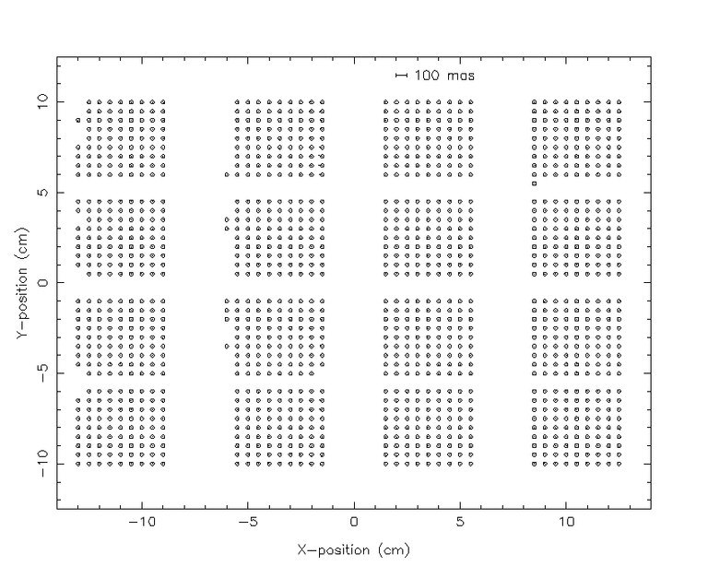

Slide 37
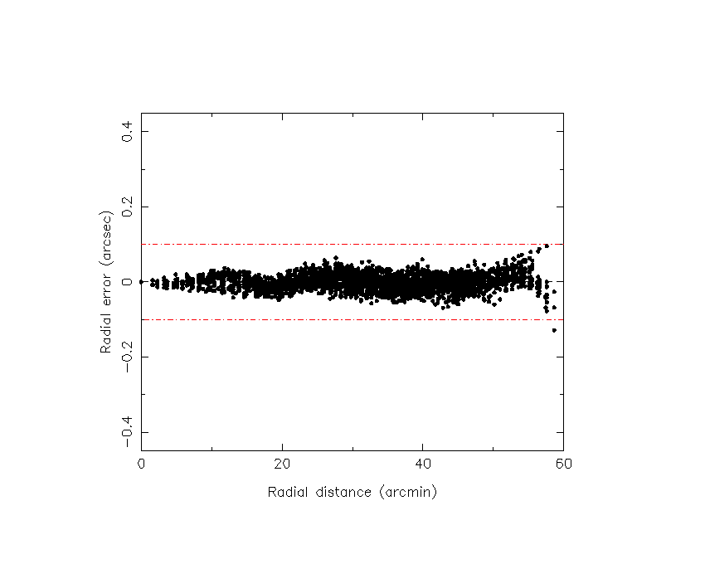
DECam@CASU PI data on Carina dwarf
From Mike Irwin this morning: “You might be interested in this. I only had 5 fields in and around the Carina dwarf to derive the ZPN coeffs but here's Decam’s radial residuals from 2MASS stars
distortion leftovers after our usual processing.

Slide 38
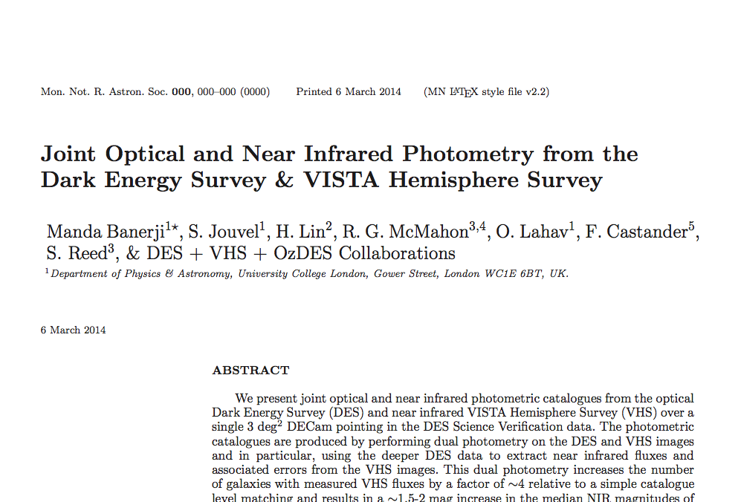

Slide 39
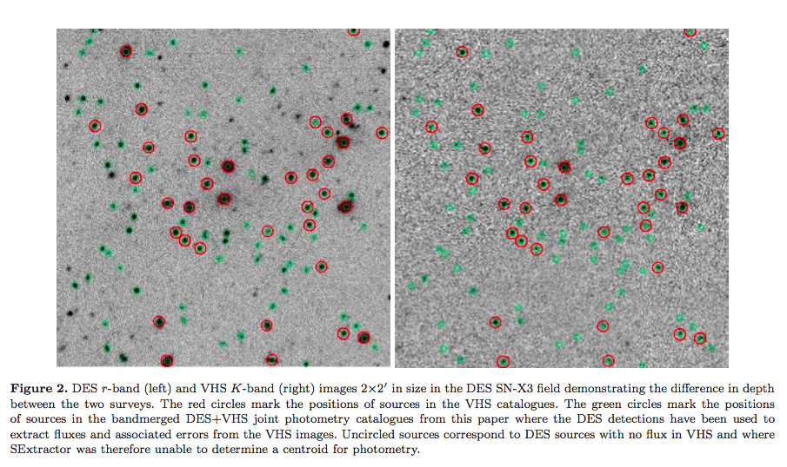
List driven photometry using DES as master image
DES r
VHS K
Uncircled objects are sources with K band detections < 1.5sigma

Slide 40
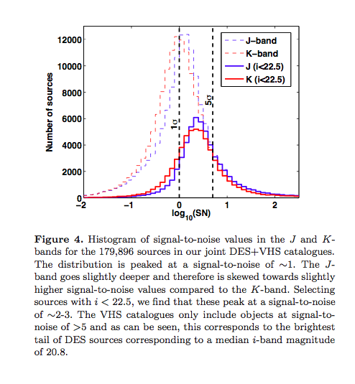

Slide 42
END

Slide 43
CASU mantra
MEFs as container -> simplifies bookkeeping
use lossless Rice-compression -> (x 2-4 less space)
FITS images and catalogue binary tables (CFITSIO)
FITS headers record processing provenance details
  derived data quality control (QC) parameters
  WCS astrometric calibration
  photometric calibration
  images used at image processing step
  versioning and software details
modular software -> C & perl/python scripts
minimise external software dependencies

