Slide 1
Education and Public Outreach (EPO) Suzanne Jacoby LSST EPO Project Manager March 25, 2014
DES-LSST Workshop
March 24 – 27, 2014

Slide 2
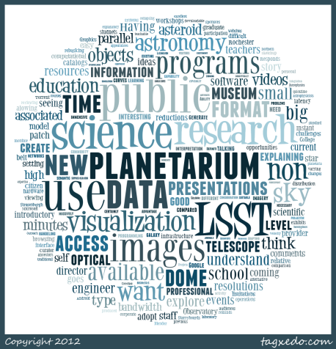
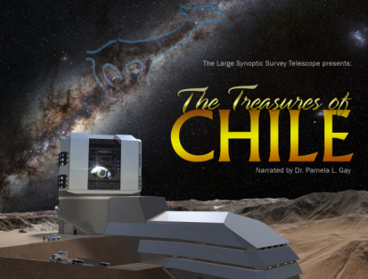
EPO is an Ambitious as LSST Itself
Part of LSST since the Beginning
Both Centralized and Distributed
Outreach Advisory Board
Mark Subbarao (Adler – IM), Rob Sparks (NOAO)
Seed Ideas for Thursday Breakout
Leverage DES efforts for LSST
Data for usability and ‘product’ testing
Use DES data with existing EPO activities

Slide 3
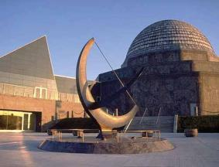
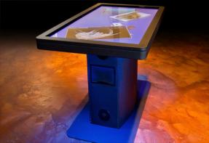
Broader Impacts of LSST Include EPO Activities
LSST EPO Goals
Broadening Participation to Include a Large, Diverse Audience
Actively engage public in science discovery and research process
Addressing National Priorities in STEM Education and Science Literacy
Incorporating Evidence-based Evaluation of Participant Outcomes
Make LSST a resource for content creators and education researchers
Notes:
EPO program is part of the LSST Broader Impacts. Broadening the reach of the federal investment to a large audience of diverse users, diverse in ethnicity and gender as well as being “non-specialists”.
Current initiatives in national education policy have the NSF taking a larger role in undergraduate education, and stress the value of having an authentic research experience, the need for evidence-based evaluation, and the need for all citizens to posses sufficient knowledge of STEM topics and habits of mind to function in today’s increasingly technological society. LSST EPO is aligned with all of this.

Slide 4
EPO is Integral Part of the LSST Project
Subsystem with WBS in PMCS
$12M, 2.5%, NSF construction budget
Limitations of MREFC funds
Build, not “do” EPO
Major Pieces of EPO construction
EPO Center – subset of DM data
Annual data releases; Nightly updates
On demand data flows
Transient alerts, mediated by an Event Broker
Data products - curated
Interfaces & Tools
Leverage / Share DM efforts
Visualization modules / Adler

Slide 5
EPO within Overall Integrated Project Schedule
EPO Begins in FY14 and Transitions into Early Operations in FY22 after 5-year Construction Period
FY2014 | FY2015 | FY2016 | FY2017 | FY2018 | FY2019 | FY2020 | FY2021 | FY2022 | Operations
Level of Effort |  |  | EPO Construction |  |  |  |  | Move to Early Ops
 | Add Staff
 | Requirements Acceptance |  |  |  |  | ComCam Data to EPOC | Data From US DAC
 |  |  | Database Development Instructional Design Build & Test UI
0.2 | 1.3 | 3.3 | 8.2 | 9.5 | 10.0 | 10.1 | 9.6 | 0.3 | 9.5 | FTE
Annual UI Releases
Operational Readiness Review
Notes:
The majority of effort in constructing the EPO system infrastructure takes place in the 5 years from FY2017 – 2021. 5 years is sufficient for that task. The schedule shown here gets the job done in the most cost-effective manner. Until 2017, we continue adding fidelity to the design with prototypes and collaboration, and build up the staff. After passing a readiness review at the end of FY2021 EPO moves from Construction to Operations.

Slide 6
In Operations, Learning Experiences for Each User Group
EPO Portal, database, collaborative workspace used by all user groups
One Citizen Science project running at all times; initially Visually Monitoring the Alert Stream. Additional CS projects could be run using LSST or Zooniverse infrastructure, as capacity allows in 2022
A few (4) Classroom Research projects available with curated data; workspace allows for independent work. Leverage DM capabilities as much as possible. Support user creation of additional projects
Library of modules for inclusion in kiosks, displays, shows. Online tutorials and F2F workshop for professional development. Community of LSST-savvy content developers. Connection to Science Centers and Planetariums.
Main entry EPO Portal open to all; exploration and adoption available to all registered users through LSST@HOME, adopting a patch of sky.
CS
CR
ISE
GP
Notes:
Framework document led us to identify these four groups, audiences where LSST EPO could make the biggest impact in terms of the number of users, the suitability of the LSST system to address audience needs, and identification of areas where LSST EPO could have a transformative impact.

Slide 7
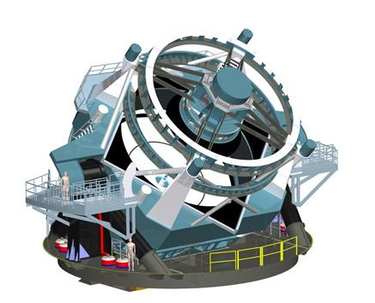
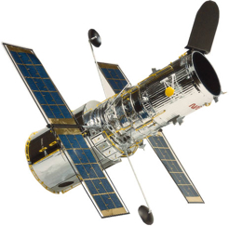
Citizen Science adds Value to LSST
LSST adds Value* to Citizen Scientist
understood data
all data
need human intervention
Aha!
machine learning
cool mysteries
* Value = understanding, skill, engagement, attitude
Credit: P. Gay/SIUE, S. Jacoby/LSST
understood data
Notes:
As an example, Citizen Science can advance science done by LSST by including the public in the data analysis pipeline. Through machine learning, involvement of Citizen Scientists can inform and improve the DM processing system. With appropriate instructional design and interface development, citizen scientists can increase their understanding, skill, engagement, and attitude of the science concepts involved in the project. Because CS has the ability to be utilized in a variety of settings, including classroom research projects and digital planetariums, I’ve featured it here in this slide.
The “extra slides” set recently posted describes how our other audiences can also be considered transformative.

Slide 8
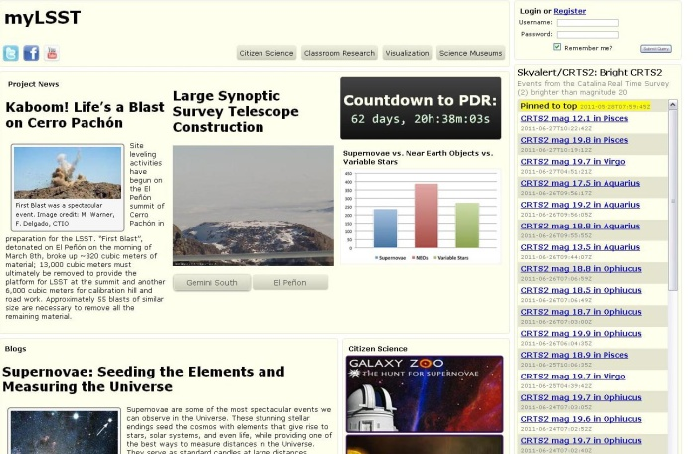
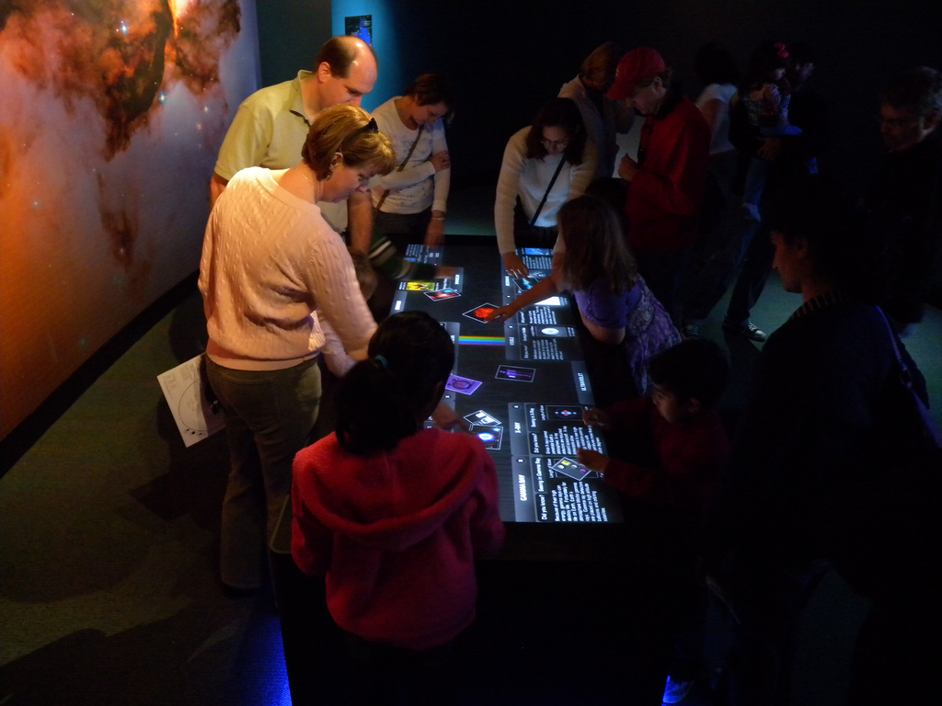
The LSST EPO Program Engages Many Audiences Including Education Researchers
LSST EPO will have a dynamic public web presence as well as a physical presence in classrooms and science centers promoting engagement in the research process.
Sustainable Partnerships with Institutional Member EPO programs and other organizations are necessary for dissemination, leveraging, and implementation. (LPACW)
LSST EPO Integrates Education & Research
Citizen science extends goals of LSST and impacts participants’ knowledge
EPO participants gain awareness, engagement, skills, knowledge
Education research possible from tracking registered users for 10+ years
EPO Portal wireframe, circa 2009
Notes:
LSST EPO will have both a virtual and physical presence in many environments.
Integration of Education & Research is seen in many parts of the plan, 3 examples given here.
Sustainable partnerships are necessary for broadest impact.

