Slide 1
QXF Support Structure
Slides addressing
Close-out comment:
Although the QXF magnets are a world first in size, energy and stress for Nb₃Sn, we saw no electromechanical modeling results. There is risk in this scale-up, we need to see how this is being managed.
Close-out recommendation:
Provide stronger evidence, including electromechanical modeling, that the planned QXF structure is adequate for managing the strain in this larger, higher stress magnet
Helene Felice
P. Ferracin, M. Juchno, G. Ambrosio, D. Cheng, R. Hafalia, Thomas Sahner, Bruno Favrat
02/19/2014

Slide 2
Outline
Strategy for addressing Nb₃Sn strain sensitivity
Axial effects
  During coil heat treatment
  During magnet cooldown and energization
Transverse effects
  During magnet assembly and preload
  During magnet energization
  Tests performed for assessing safe stress range
  QXF stress analysis
Strain during magnet quench

Slide 3
How is Strain sensitivity addressed in Nb₃Sn Accelerator Magnets?
Presently there is no capability of modeling with high precision the Nb₃Sn strain state in accelerator magnets
  This is work in progress in the accelerator magnet community and LARP contributed with several FEM and experimental studies which are the based for the LARP strategy
The LARP strategy consists of these steps:
  Minimization of the strain after coil heat treatment
  Minimization of the strain due to axial tension after cooldown and energization
  Experimental assessment of safe coil transverse stress range
  Control of coil transverse stress during all stages of magnet assembly and operation

Slide 4
Minimization of Nb₃Sn strain due to axial effects
Strain after heat treatment is minimized by inserting axial gaps in the pole pieces
  At the end of the heat treatment the gaps close, minimizing the axial strain in the conductor due to coil winding tension and to the different CTEs of materials involved (conductor, coil parts, reaction fixture)
Strain caused by axial tension due to cooldown and energization is minimized by choice of pole material
  LARP demonstrated that Ti pole pieces are more appropriate than Aluminum bronze pole pieces for shell-based structures (see next slide)
    Demonstration was performed on TQ magnets, Ti-poles have been used in LQ, HQ and are now used in QXF

Slide 5
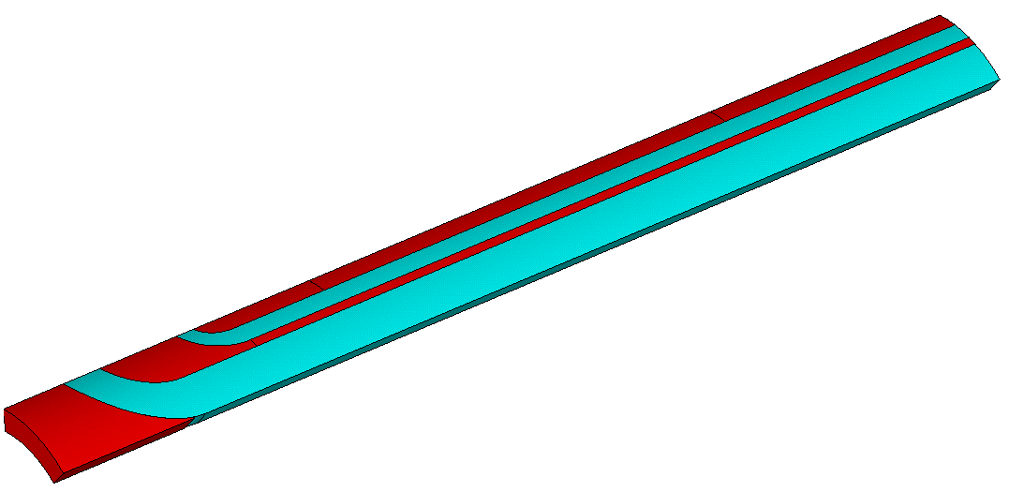
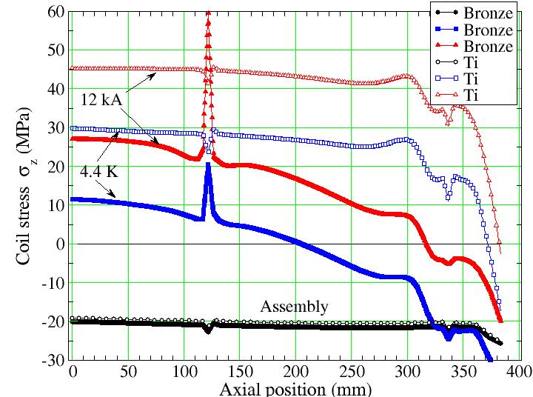
Analysis and selection of the pole piece material
TQ experience led to the change of pole material from Aluminum bronze to Titanium alloy
The pole is segmented for fabrication purpose
The graphs shows the computed axial stress peaking at the gap location after cool-down and during excitation when the pole piece is made of bronze
This was correlated with quench location in TQS01 series [1]
When the pole piece is changed to Ti, the computation shows that there is no peak axial stress at the gap. From TQS01 series to the TQS02 series the pole pieces were changed to Ti and magnet performance improved [1].
Since TQS02, all the LARP magnets have Ti pole pieces
[1] S. Caspi et al., Test and Analysis of Technology Quadrupole Shell
(TQS) Magnet Models for LARP, IEEE TRANSACTIONS ON APPLIED SUPERCONDUCTIVITY, VOL. 18, NO. 2, JUNE 2008

Slide 6
Control of transverse stress and assessment of safe range
Transverse stress is the control parameter during Nb₃Sn magnet assembly, preload and energization
  Azimuthal stress (transverse stress to the cable) criteria
    Under the effect of the Lorentz forces the pole turn tends to separate from the pole piece. The preload consists in applying enough compression to ensure that at nominal current the pole turn remains in contact with the pole piece
      Stress and strain are commonly output of the model
  The transverse stress to the cable is our control parameter.
    Structure: Shell based structure allow fine tuning of the preload level and a controlled application without overshoot (see following slide)

Slide 7
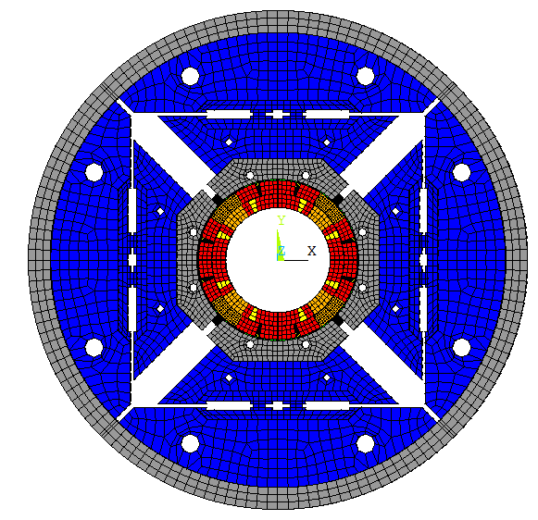
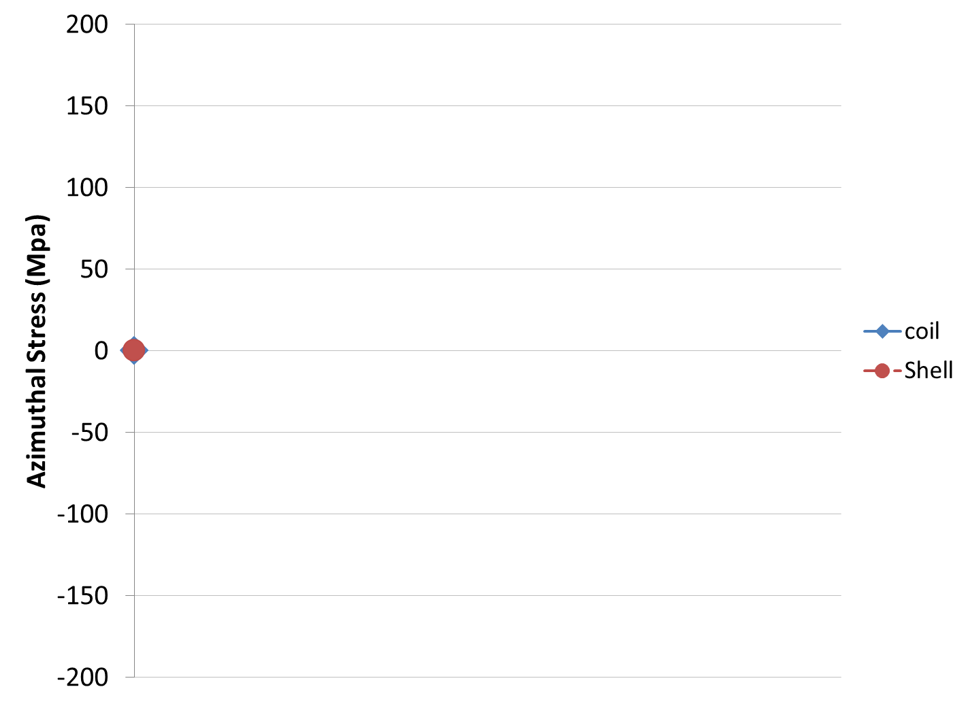
HQ Shell based support structure overview (I)
Shell-based support structure often referred as
“bladder and keys” structure
developed at LBNL for strain sensitive material
Shell stress at the mid-plane and coil pole piece stress are shown on the graph
Pole
Shell midplane

Slide 8
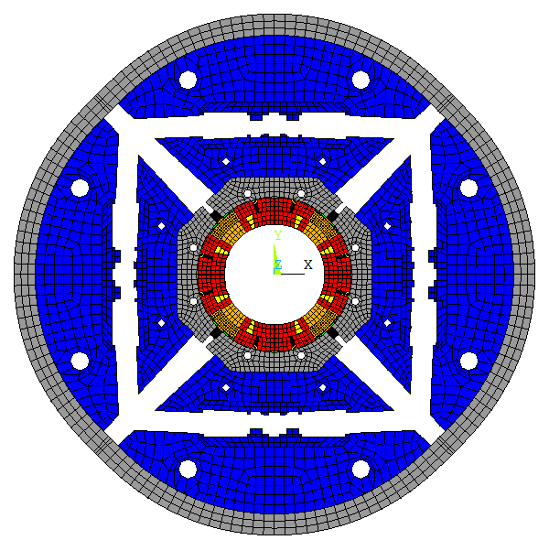
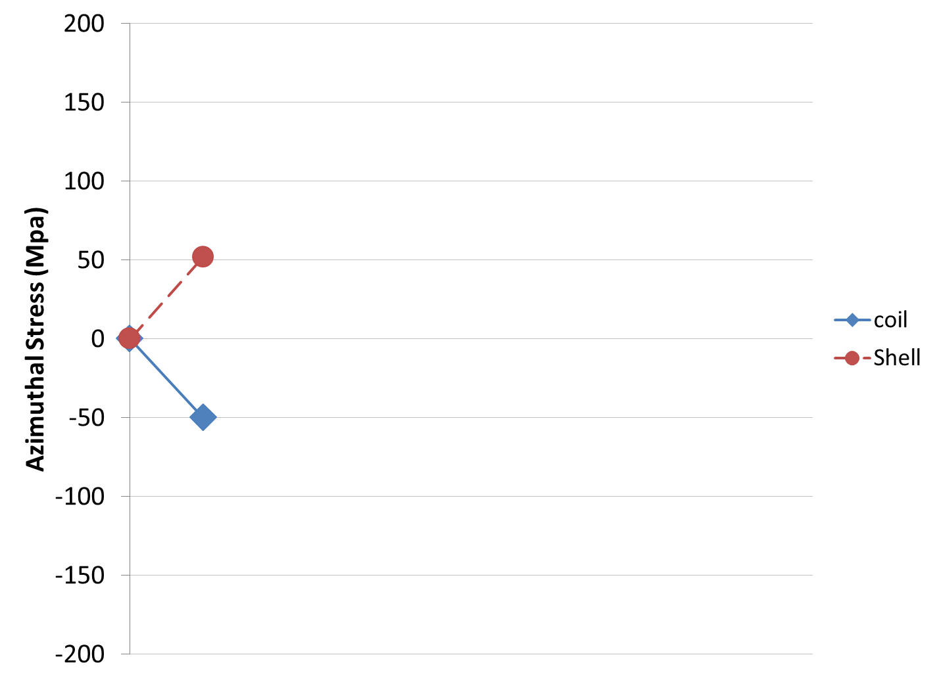
HQ Shell based support structure overview (II)
Inflated Bladders
Shell-based support structure often referred as
“bladder and keys” structure
developed at LBNL for strain sensitive material
Bladders are inflated: the coils are compressed and the aluminum shell is in tension
Bladder
Displacement scaling 30

Slide 9
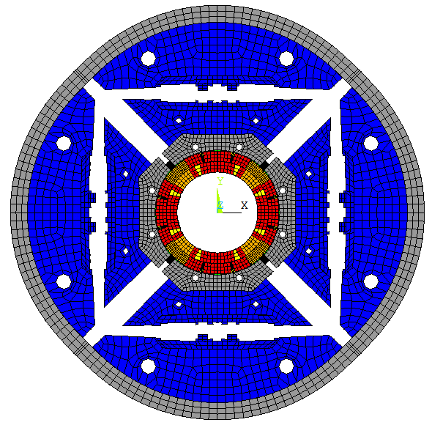
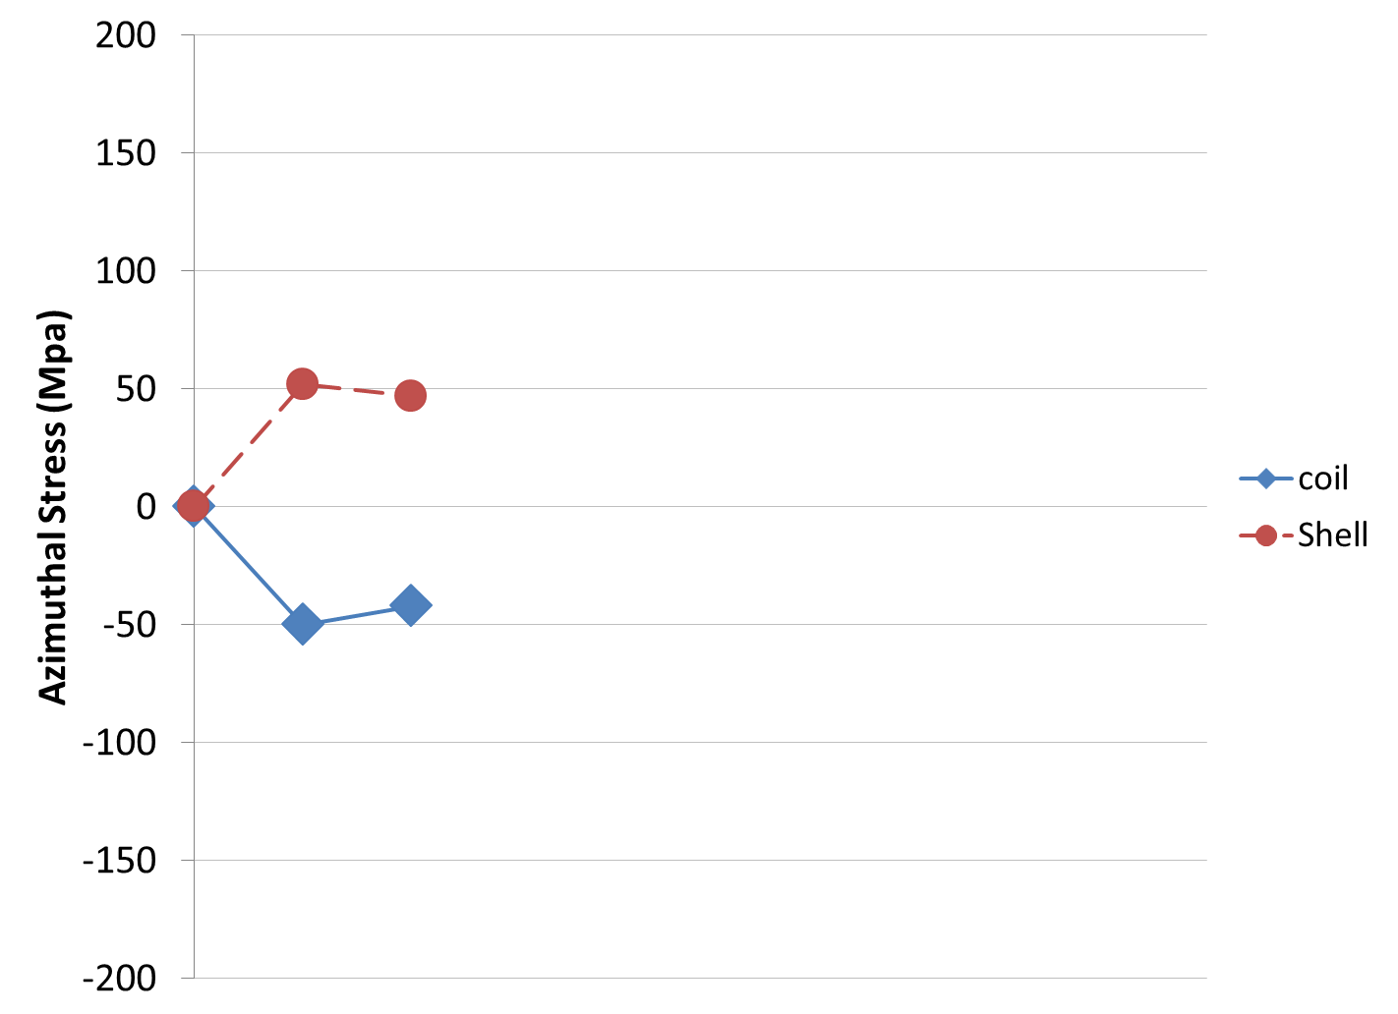
HQ Shell based support structure overview (III)
Shimming of the load leys
Shell-based support structure often referred as
“bladder and keys” structure
developed at LBNL for strain sensitive material
Load keys (red) are inserted and bladders deflated
A slight spring-back can be seen since the key required some clearance to be inserted
Bladder
Keys
Displacement scaling 30

Slide 10
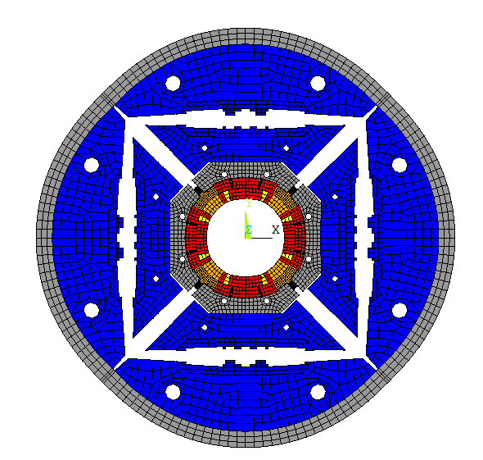
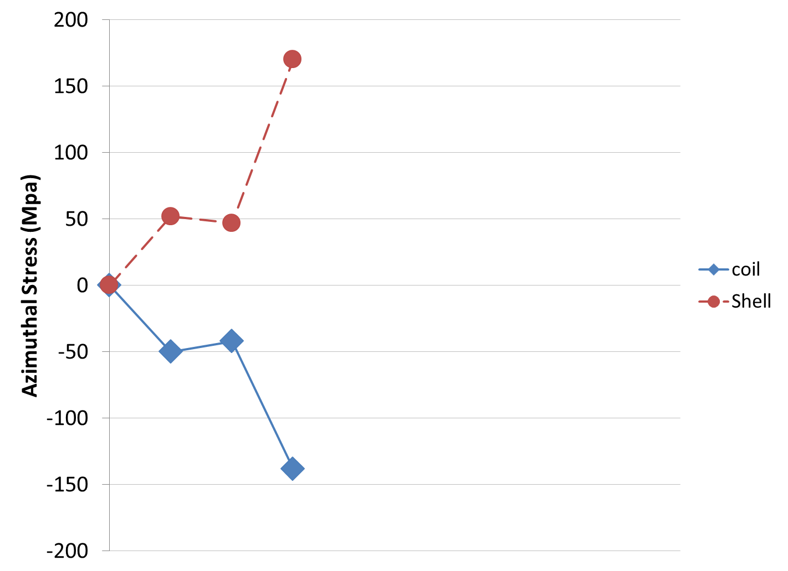
HQ Shell based support structure overview (IV)
Cool-down
Shell-based support structure often referred as
“bladder and keys” structure
developed at LBNL for strain sensitive material
During cool-down, the shell contracts more that the yoke and gets in strong tension providing strong azimuthal compression to the coil
Cool-down
Bladder
Keys
The final coil preload is reached at the end of the cool-down without overshoot.
Displacement scaling 30

Slide 11
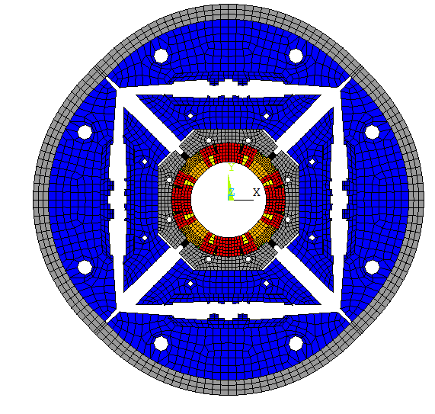
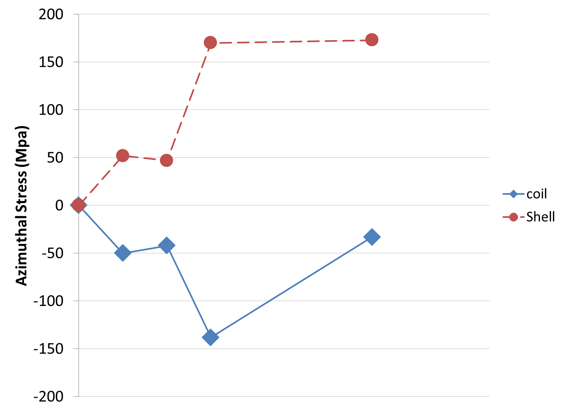
HQ Shell based support structure overview (V)
Energized
Shell-based support structure often referred as
“bladder and keys” structure
developed at LBNL for strain sensitive material
During excitation, the Lorentz forces pull the conductor away from the pole piece toward the mid-plane. That is why the compression of the pole is reduced.
Cool-down
Lorentz forces
Bladder
Keys
Displacement scaling 30

Slide 12
Assessment of safe stress range
Experimental correlation between preload levels and magnet performance allowed us to define a “safe” range of transverse stress in Nb₃Sn coils
  Extensive studies have been performed within LARP with the TQ program to identify the degradation limit due to high stress
    Examples in following slides

Slide 13
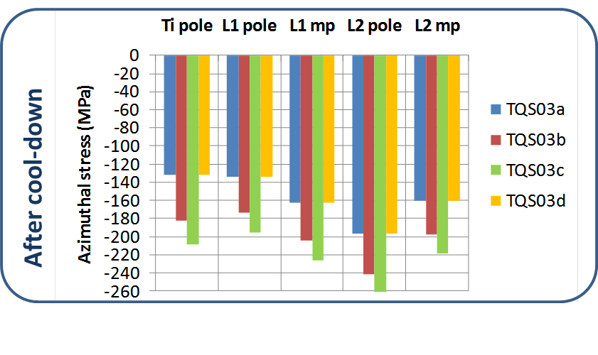
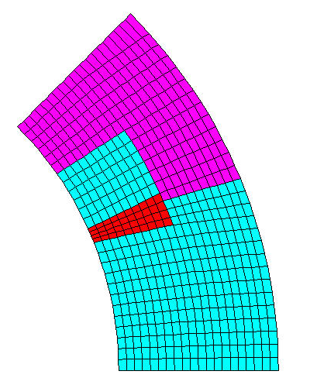
High stress extensively explored in LARP with the TQ program
4 tests: TQS03 a, b, c and d (supported by ANSYS analysis)
performed with variable pre-stress
  TQS03a: 120 MPa (at Ti pole)
  TQS03b: 160 MPa (at Ti pole)
  TQS03c : 200 MPa (at Ti pole)
  TQS03d: 120 MPa (at Ti pole)
Peak stresses in mid-plane area as high as 260 Mpa in compression
Room temperature
Ti pole
L2 pole
L1 pole
L2 mp
L1 mp

Slide 14
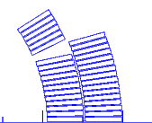
Test result of high stress TQ tests
[2] H. Felice et al., Performance of a Nb₃Sn Quadrupole Under High Stress, IEEE TRANSACTIONS ON APPLIED SUPERCONDUCTIVITY, VOL. 21, NO. 3, JUNE 2011
93 %
~ 12.3 / 13.5 kA
91 %
~ 12 / 13.2 kA
88 %
~ 11.6 / 12.8 kA
88 %
Only 5 % degradation from TQS03a to TQS03c [2]
TQS03d did not recover => Permanent degradation
All the plateau quenches located in the layer 1 multi-turn segment
=> highest stress with Lorentz forces

Slide 15
QXF Design
How is the high stress issue addressed in QXF?
  The stress level in QXF at nominal operation is similar to the stress level in HQ at its highest quench current (reached in HQ02)
    Forces in QXF are about 15% higher
    Cable is wider (18.1 versus 14.9 mm)
    In average, the azimuthal stress level remains the same (see following slides)
Therefore, QXF is operating in a stress range demonstrated safe by LARP magnets

Slide 16
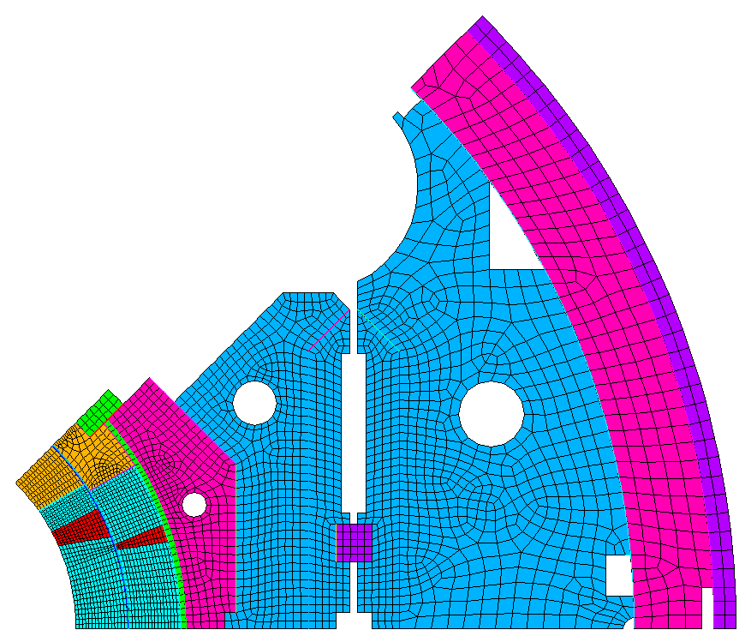
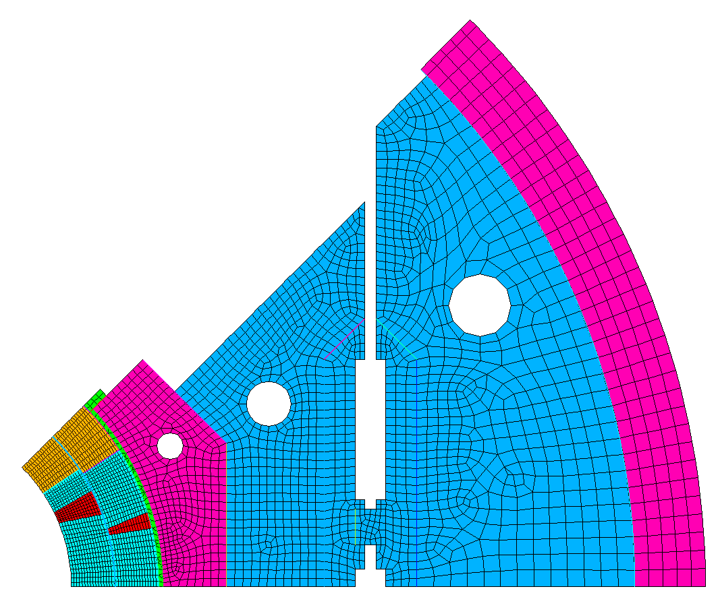
HQ – QXF models for comparison
Additional step with SS shell for LHe containment
HQ
Aperture 120 mm
Alu shell OD: 570 mm
Alu shell thickness: 25 mm
QXF
Aperture 150 mm
Alu shell OD: 614 mm
Alu shell thickness: 29 mm
LHe vessel OD: 630 mm

Slide 17
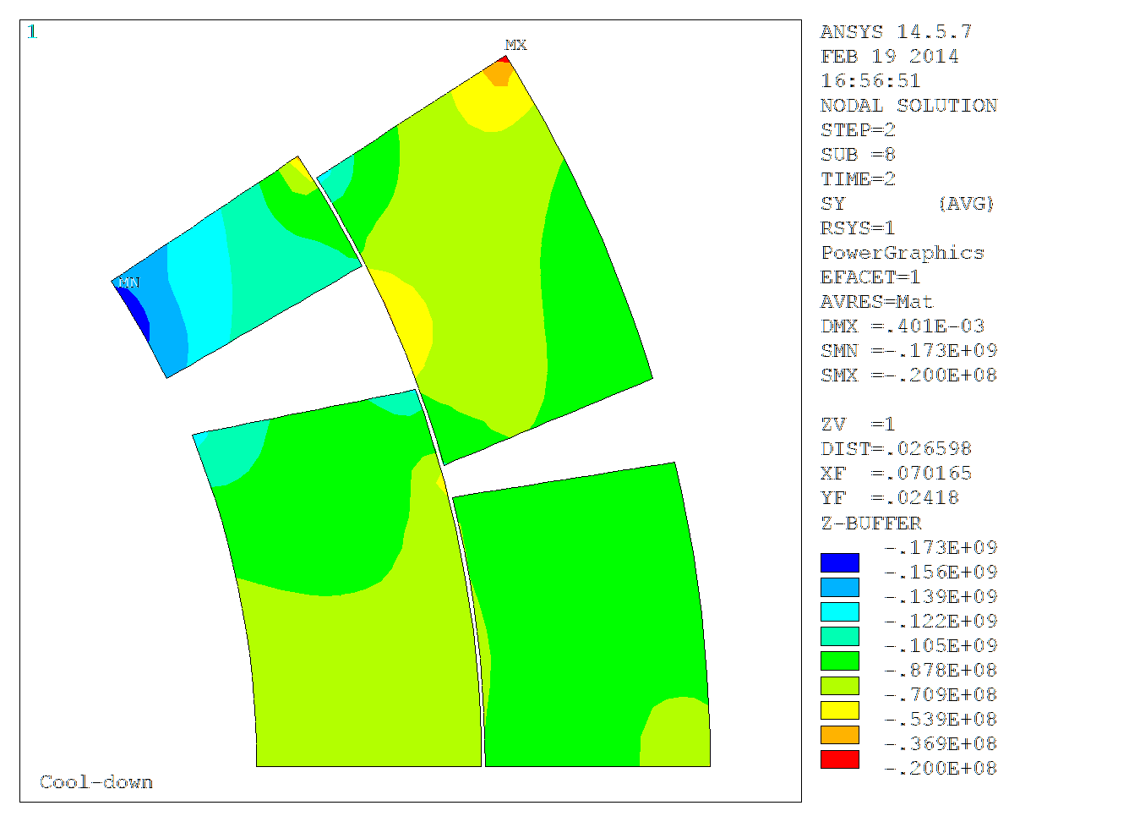
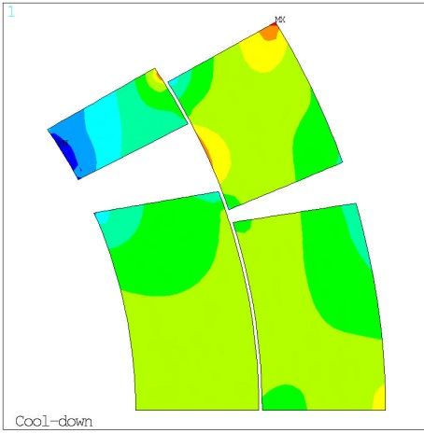

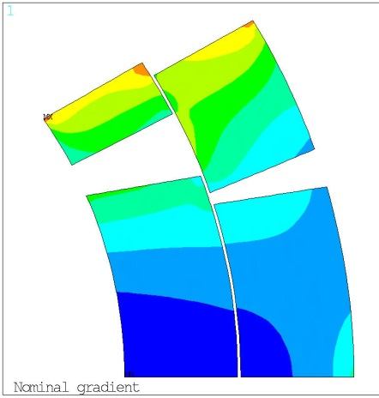
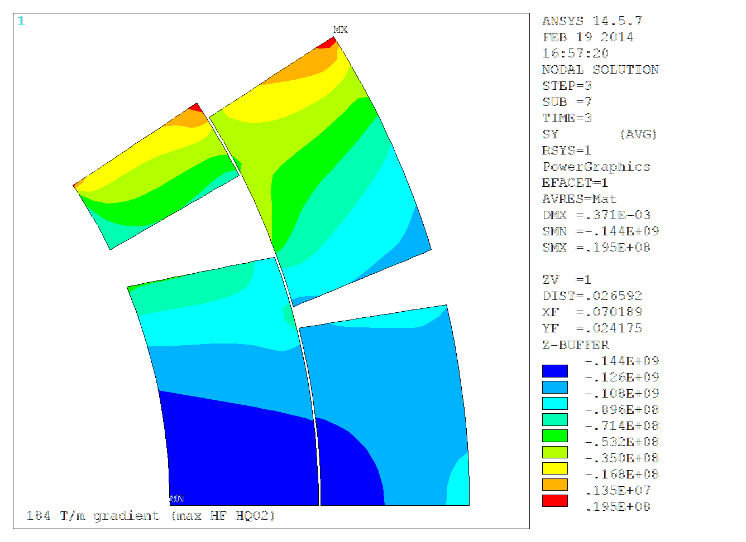

Coil Stress comparison
HQ versus QXF
HQ at maximum performance reached in HQ02 test : 16.2 kA – 184 T/m
QXF nominal performance
  17.4 kA – 140 T/m
σθ at 4.2 K
σθ at 4.2 K
σθ with Lorentz forces
σθ with Lorentz forces
Fx = 2.4 MN/m
Fy = -3.4 MN/m
Fx = 2.75 MN/m
Fy = -3.9MN/m
Comparison of highest HQ performance (reached in HQ02 magnet) with QXF nominal performance
15% more Lorentz force but larger conductor by 20 % => Lorentz stresses in the coil remain of the same level

Slide 18
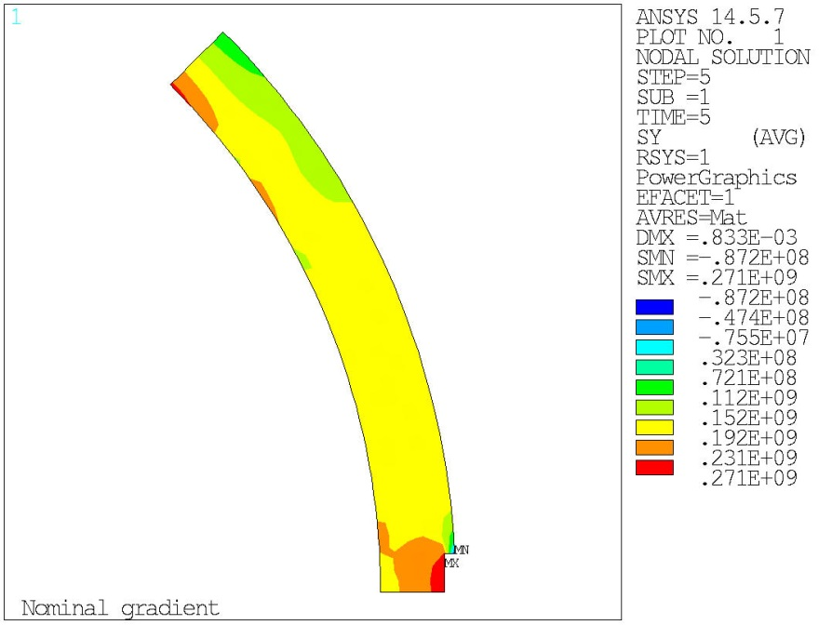
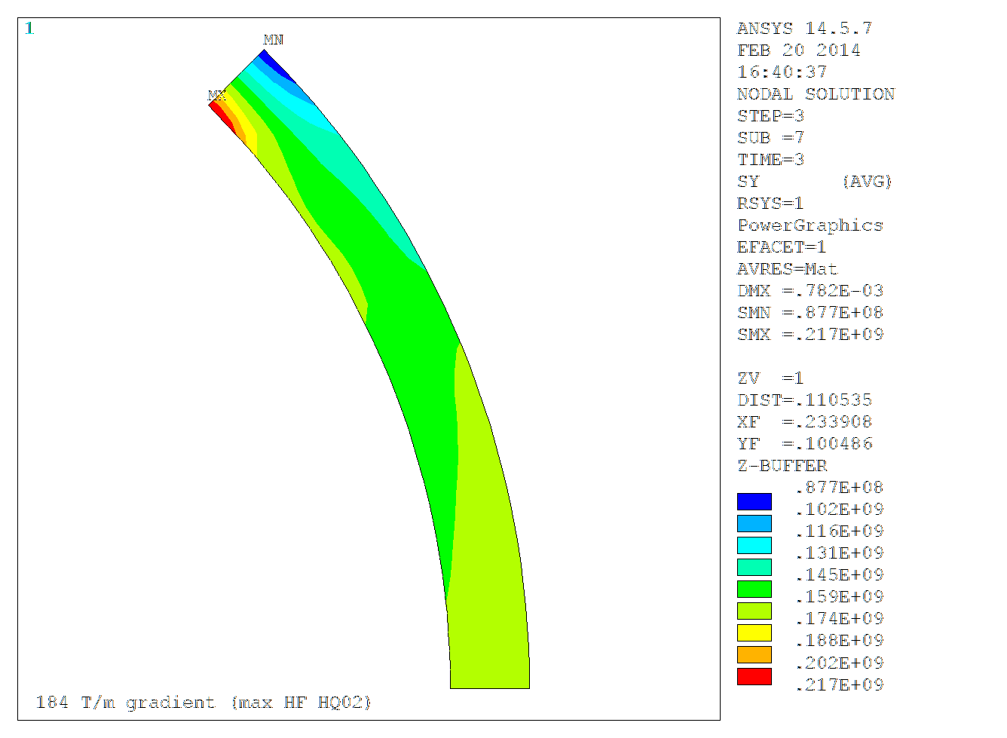
Shell azimuthal stress comparison
HQ/QXF comparison
HQ at maximum performance reached in HQ02 test : 16.2 kA – 184 T/m
  25 mm Aluminum shell azimuthal stress
QXF nominal performance
  17.4 kA – 140 T/m
  29 mm Aluminum shell azimuthal stress
  15% thicker than HQ shell
  QXF forces ~ 15 % higher than HQ
  Azimuthal stress in QXF shell similar to HQ
150 MPa
145 MPa
The level of azimuthal stress in HQ and QXF are of the same order

Slide 19
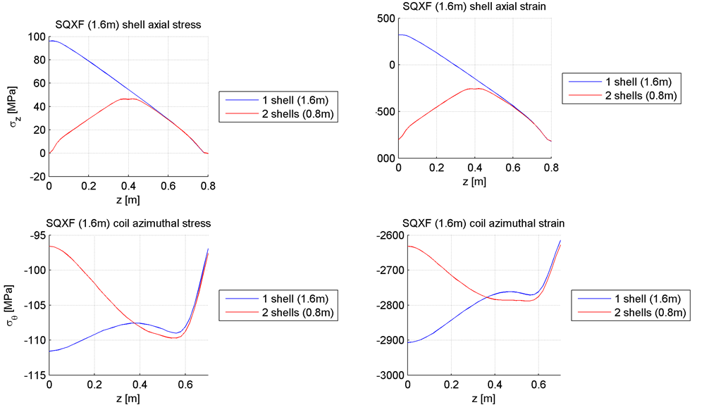
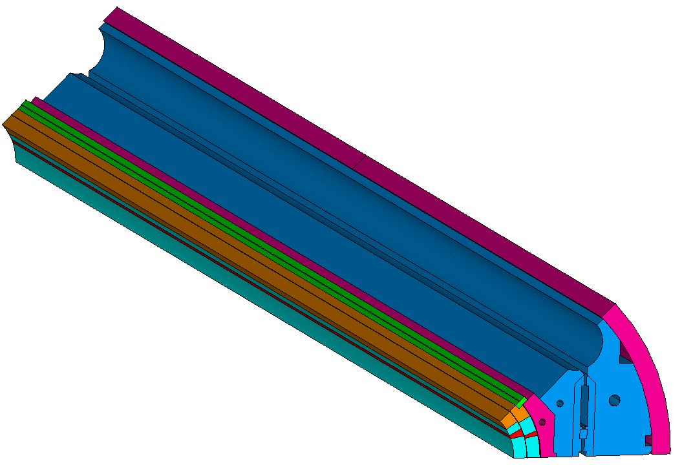
Shell
LR and LQ experience showed the need to segment the shell to prevent slippage
  During cool-down, shell shrinks more than yoke
  Friction limits the shell contraction
  During excitation, slippage may occur
3D ansys analysis
  Cross-checked results between LBNL and CERN
  Based on previous experience
  The SQXF shell will be made of 2 segments
  For LQXF: analysis ongoing
Ongoing analysis to finalize cutouts shape
  Rounded edges, chamfer choice is pending final analysis

Slide 20
Strain during Quench
During a quench the thermo-mechanical stresses may induce conductor strain up to the irreversible limit.
Tests performed on LARP and GARD magnets have shown that in well-designed magnets there is no permanent degradation below the glass transition temperature (T_{g}) of the epoxy†.
  T_{g} = 386 K for CTD-101K (LARP and QXF epoxy)
The QXF maximum acceptable temperature is in the 300-350 K range
  HQ02b test aims at setting this value
† Maximum Allowable Temperature During Quench in Nb₃Sn Accelerator Magnets
Available at: http://inspirehep.net/record/1277941/

Slide 21
Summary
During the LARP program conductor strain has been investigated and minimized through material and design choices
  Optimization of the pole piece material and gaps for HT
Transverse stress is the control parameter for safe magnet pre-load, cooldown and energization
  Experimental assessment of safe stress range
  Shell-based support structure providing fine-tuned preload without pre-stress overshoot
QXF level of azimuthal stress in the coil is similar to the level of stress in HQ highest performance
  Can be explained by larger force and wider conductor
2D/3D analysis ongoing to ensure appropriate preload reached at cold temperature and excitation

