Slide 1
Cost Estimates for LARP to Project Transition
Marc Kaducak
17-Feb-2014

Slide 2
Outline
Background
LARP->HL-LHC Scope in June 2013
Cost Estimating and Scheduling Methodology
Magnet schedule assumptions and overview
Project Management Ramp Up
Cost Summaries
The subject of this talk is construction project related costs. Current LARP funding and scope are discussed in each subsystem.

Slide 3
History
The first effort to converge on a scope, cost, and schedule for a HL-LHC related construction project borne out of LARP was conducted in late 2012. The result was a down-selection from several candidate deliverables.
Following the down-selection, cost and schedule estimates for the construction project were refined and presented at an internal LARP review with external reviewers in June 2013.
https://indico.fnal.gov/conferenceOtherViews.py?view=standard&confId=6836

Slide 4
LARP->HL-LHC Project Scope as of June 2013
Magnets
  Assemble, test, and deliver 20 (16 + 4 spares) Q1/Q3 quadrupole structures, where “structure” = coils clamped radially in aluminum shells, axially with stainless steel rods and end plates
Crab Cavities
  Assemble, test, deliver 10 cryomodules of 3 cavities each
    Contain cavities, He vessels, tuners, HOM mode dampers
    Cryogenics, RF power, local installation provided by CERN
    8 CM needed in pts 1 and 5, 2 spares (one per IP)
Wideband Feedback System
  Fully functioning wideband feedback system for SPS and commissioning support.

Slide 5
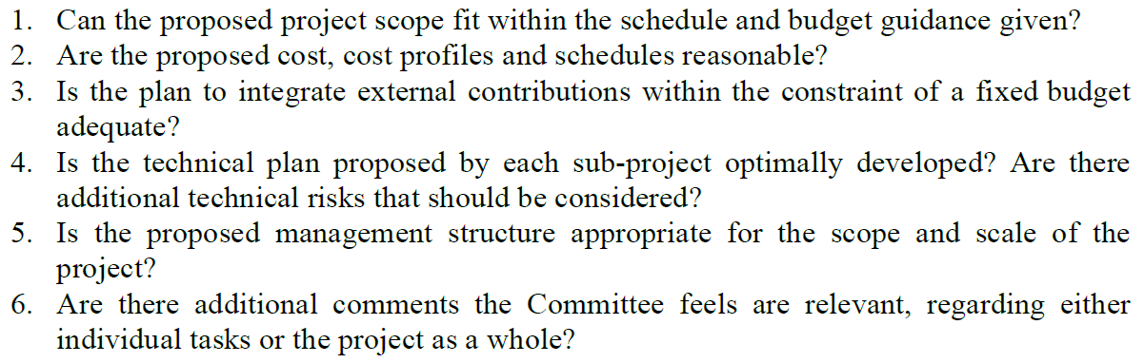
June 2013 Review Charge
June 2013 review charge was construction related.

Slide 6
June 2013 Review Outcome
Magnets
  The technical feasibility of the quad program seems reasonable.
  The cost have a decent basis in the LARP R&D program
  The scope is reasonable for a $200M US contribution.
  The major uncertainties and risk appear to be programmatic in nature.
Crab Cavities
  Costs & cost profiles: these are not unreasonable at this point in the project.
  Schedule: Can the proposed project scope fit within the schedule and budget guidance given?
    Yes, but only if the required budgets are forthcoming. It will be challenging to meet the 2015 schedule for the prototype cryomodule, and it's likely the schedule contingency of up to one year will be needed.
Wideband Feedback System
  We feel that proposed manpower allocations may be underestimated. To appropriately amortize the engineering work done in the research phase of the project (through 2016), there has to be continuity in engineering manpower.
  Presented schedule estimates are optimistic and have minimal headroom to react to additional budget pressures.

Slide 7
Updates since June 2013
The construction project cost estimates have not been updated to account for the following changes:
  Change of Crab Cavity deliverable from assembled and tested cryomodules to dressed cavities (4 cavities x 2 sides of the IP x 2 beams x 2 IPs = 32 cavities). Will likely lead to a net savings and a reduced pre-construction engineering effort.
  Change of test stand upgrade sequence. June plan was to upgrade FNAL test stand first using GARD funds, with BNL test stand being upgraded with construction funds. Latest plan is to upgrade BNL stand first using APUL funds in conjunction with LARP funds.

Slide 8
Construction Cost Estimate Methodology
  Guidelines issued for estimating each deliverable with respect to project accounting (overheads, escalation, contingency).
  Formats were time phased estimates on spreadsheets. These are ok for now, but do not lend themselves to straightforward updates based on status.
  Preliminary discussions with CERN regarding interfaces and handoff points.
  Attempted to reconcile with near term budget realities, but there are still challenges.

Slide 9
Basis of Estimate
Magnets
  Detailed study of coil fabrication rates, capacities, and labor. Joint effort of BNL and FNAL.
  Bottom up estimate of structure by LBNL.
  Magnet testing estimate by FNAL T&I department
  M&S costs based primarily on quotes and past procurements (LQ, LHQ).
Crab Cavities
  Bottom up engineering estimates
  Prototype cavity procurements
Wideband Feedback
  experience designing/constructing/commissioning wideband coupled-bunch systems for PEP-II, ALS, PLS, BESSY-II, DAFNE and KEKB.

Slide 10
Magnet Cost and Schedule Assumptions
June 2013 Review
Adjusted to latest LHC Shutdown Schedule
CD-3 in FY2017 FY2018. Guidance given is that CD-0,1,2 could occur simultaneously in FY17. This requires preparation.
Magnet Cold Mass Production window is FY2017-2021 FY2018-2022
  Goal is >1 year schedule contingency relative to CERN schedule. Deliver production cold masses by end of FY21 FY22 for 10/22-3/23 10/23-3/24 installation in LHC.
Funds for SC wire purchase available in FY2015 FY2016. Up front payment of 13% required, with another 27% less than one year later.
CERN Hi-Lumi TDR is complete in 2015 2016.
FNAL and BNL each produce coils -> cold masses. LBNL performs cabling and structure sub-assembly.
Coil yield is 8/9.
Test facility upgrades complete in time for production.

Slide 11
High Level Magnet Production Schedule
Identical schedule presented in June but delayed by one year here

Slide 12
Construction Project
Management Functions
Level of effort and functions based on other ~$200M projects, e.g. NOvA and Mu2e

Slide 13
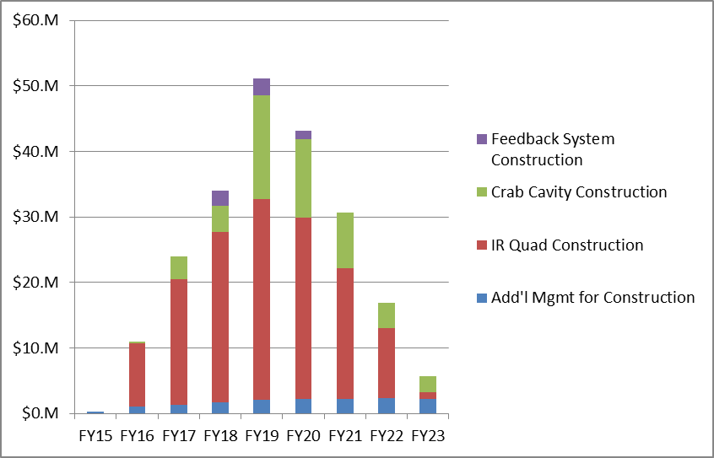
Summary of Construction
Cost Estimates
Assumed to be absorbed by LARP and not included in totals
SC Wire first payment, test facility upgrade, production engineering
SC Wire second payment, production tooling, coil and cold mass parts for first production year
Estimates based on June 2013 scope, but escalated by one additional year. Table includes ~30% contingency evenly spread.

Slide 14
Summary
  Substantial work put into estimates for a project at this stage.
  Management model and staffing plan under development. Unknown parameter is level of rigor required for a “proceed as-if in CD process” scenario.
  Technical and management CD-X readiness and long lead procurements will require funding in advance of the assumed FY18 CD-3 to supplement the existing flat-flat LARP levels.
  Thank you

