Slide 1
SQXF Coil Design and Fabrication Winding and Curing
Miao Yu
February 17, 2014

Slide 2
Outline
Introduction
QXF Coil Design
Coil Cross-section
Coil Layout
Coil Pole and End Parts
QXF Coil Fabrication-Winding and Curing
Winding and Curing Tooling
Winding and Curing Procedures (Traveler)
Winding Test
Summary

Slide 3
Introduction
Based on LARP successful R&D Quadrupole coil TQ/LQ/HQ/LHQ experience.
Coil parts design (BEND program)
Tooling design
Fabrication technology and procedure (winding – curing – reaction – impregnation)
Coil size control at each fabrication step (insulation and shim) to reach the final coil size
To meet CERN’s requirement
Field quality (x-section and end design)
Magnetic length (coil length)
Electrical requirement (plasma coating of metallic end parts)
Heat extraction (cooling channels in coil pole)

Slide 4
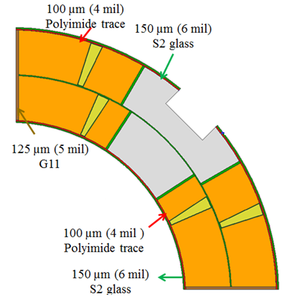
QXF Coil Design - Coil Cross-section
Backup slides:
Coil cross-section at each step
for ground insulation
Magnetic design
Fabricated Coil

Slide 5
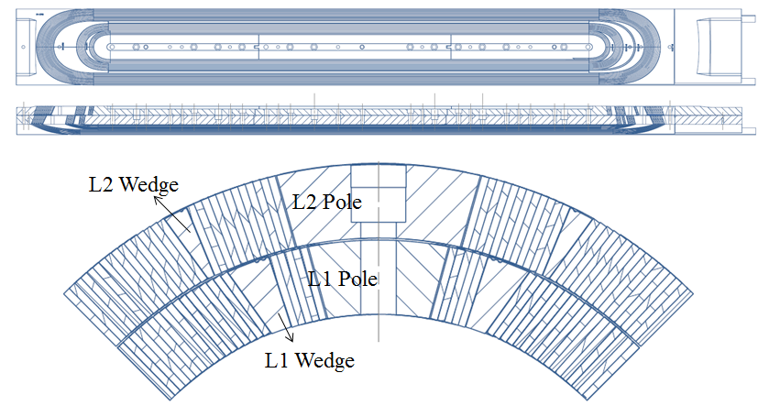
QXF Coil Design - QXF Coil Layout
RE
LE
1.51 m
Cooling channel
Ti-6Al4V pole and bronze wedge: used for LQ/HQ/LHQ.
Stainless steel end spacer, saddle and splice block: used for HQ/LHQ.
LQXF is 4.3 m long by adding 7 more center pole pieces.

Slide 6
QXF Coil Design - Coil Pole
> 80 % of the heat is evacuated via the pole piece with Φ8 mm holes and 50 mm spacing
Strain Gauge

Slide 7
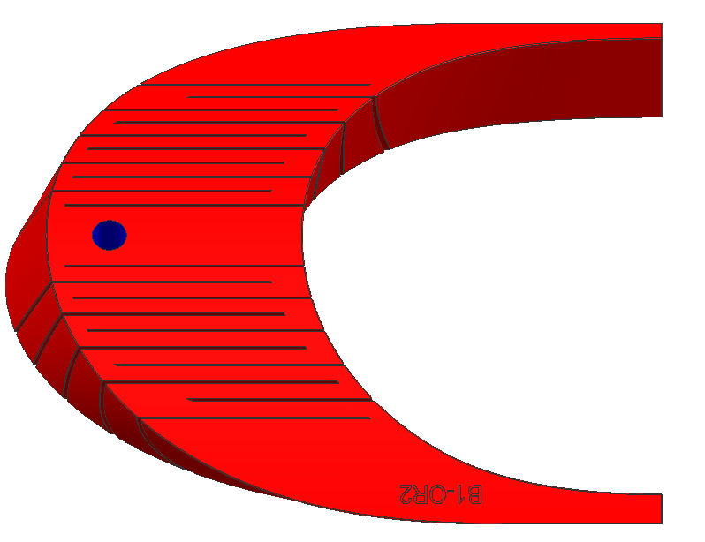
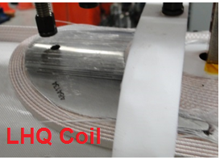
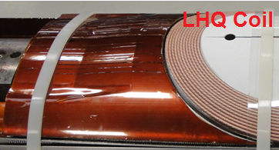
QXF Coil Design - Coil End Spacer and Saddle
End parts are designed based on the nominal coil size after coil reaction
During winding, the coil is not fully constrained inside the envelope. This effect is most pronounced at the ends. Prior to curing, the cable separates from radial surface of the mandrel in these areas (springback), causing the shape of the turn to not match the shape of the end parts.
The springback is larger with larger coil aperture and cable size.
Therefore flexible features (slits) have been introduced in LHQ and QXF coil.
Incremental change with respect to single slit design previously used.
End parts are plasma coated to increase the dielectric strength.
QXF slits design with bridges
temporary saddle during W&C

Slide 8
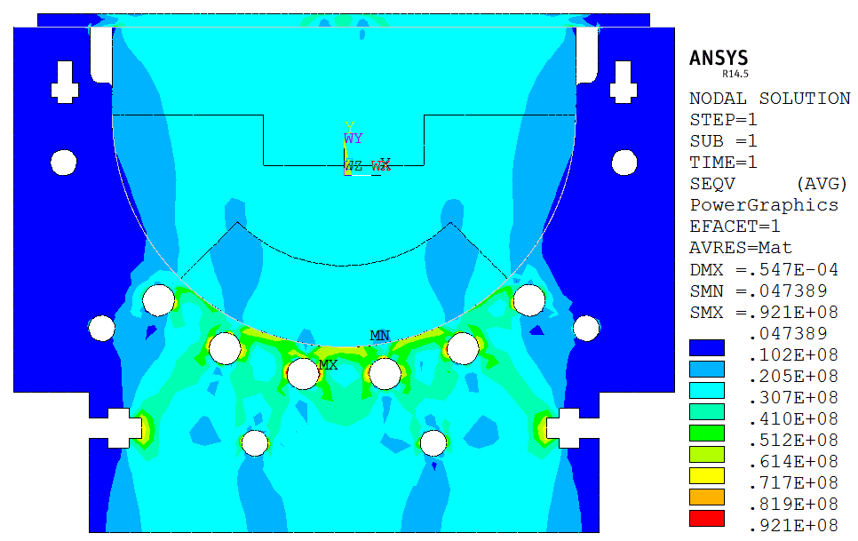
QXF Coil Fabrication - SQXF Winding and Curing Tooling Design
Coil Inner Layer
Winding
Rollover Station
Curing Mold

Slide 9
QXF Coil Fabrication - SQXF Winding and Curing Tooling Design
Coil Outer Layer
Winding
Rollover Station
Curing Mold

Slide 10
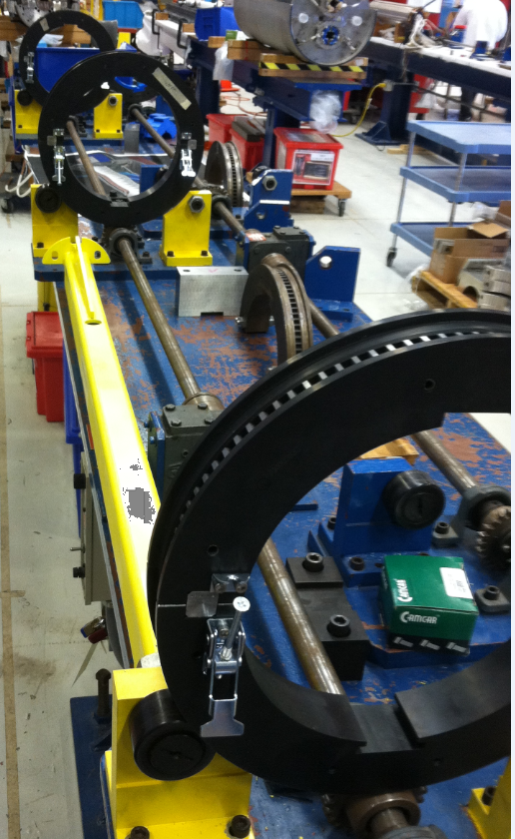
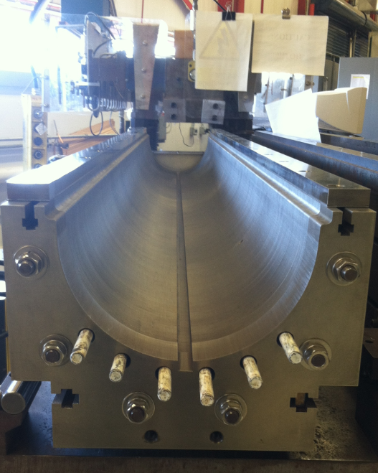
QXF Coil Fabrication - Winding and Curing Tooling
Tooling for SQXF coil was inspected and assembled.
Winding and Curing Tooling
Rollover Fixture
Curing Mold

Slide 11
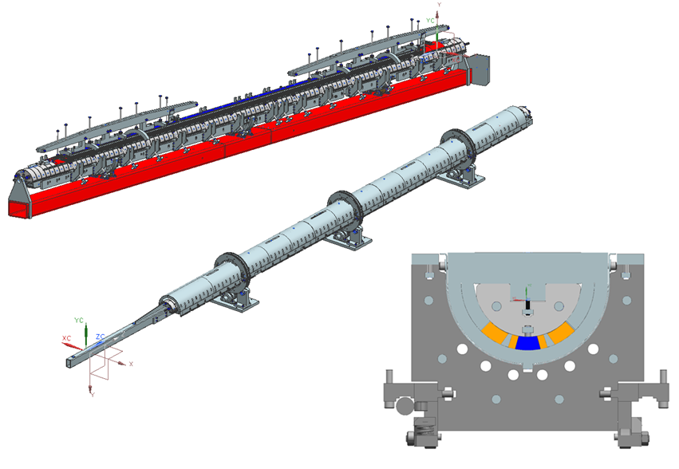
QXF Coil Fabrication - LQXF Winding and Curing Tooling
The design of LQXF W&C tooling was finished
Procurement will start this summer
Winding table will be tested in April
Selva winder will be commissioned by this Dec
Use the same rollover fixture for SQXF
Curing mold
348” long
5 sections (2: 66” and 3: 72”)
Stacking, welding and inspection
Final assembly and inspection

Slide 12
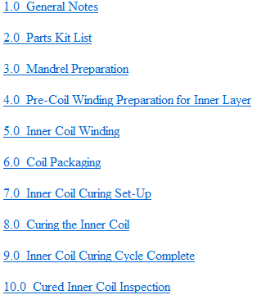
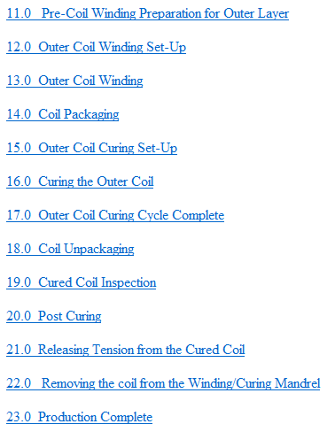
QXF Coil Fabrication - Winding and Curing Procedures (Traveler)
Online version based on HQ/LHQ winding and curing traveler
Typically, it takes 15 days for winding and curing

Slide 13
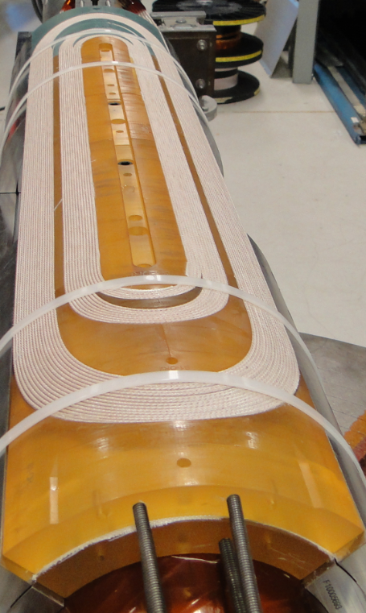
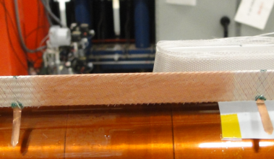
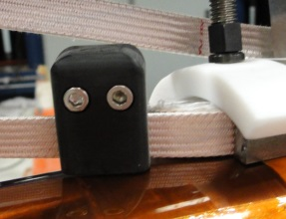
QXF Coil Fabrication - Winding Test
Coil Winding
Cured Coil
Reduce the risk of turn-turn short due to popped strands
Two 1 m coils, winding-curing
End parts inspection and design optimization
Pre-check tooling and W&C procedures
Fabrication of SQXF coils is starting this February

Slide 14
Summary
QXF coil is designed based on HQ/LHQ coil experience
Tooling is ready for SQXF coil winding and curing
LQXF coil winding and curing tooling will be procured this summer.
Winding and curing procedures are based on HQ/LHQ coil procedures
SQXF coil fabrication is starting this month.

Slide 15
Backup Slides - Coil Size at Each Step

Slide 16
IL Winding and Curing
1.5 mm (60 mil)
Curing Retainer
760 µm (30 mil) =
3 layers 10 mil Mylar
Curing Shell
IR: 94.168 mm
OR: 113.126 mm
250 µm (10 mil) Mylar + 100 µm (4mil) shrink wrap
Midplane
250 µm
(10 mil)
250 µm (10 mil)
SS shim

Slide 17
OL Winding and Curing
1.5 mm (60 mil)
Curing Retainer
760 µm (30 mil) =
100 µm shrink wrap + 660 µm SS Shim
OR: 113.126 mm
250 µm
(10 mil)
250 µm (10 mil)
SS shim
Midplane
250 µm (10 mil)
SS shim

Slide 18
Coil Reaction
125 µm (5 mil)
MICA
250 µm (10 mil)
S2 glass
125 µm (5 mil)
MICA
125 µm (5 mil)
MICA
Midplane
125 µm (5 mil)
MICA
125 µm (5 mil )
MICA
125 µm (5 mil)
MICA

Slide 19
Coil Impregnation
150 µm (6 mil)
S2 glass
RTV (removed after impregnation)
250 µm (10 mil)
MYLAR
(mold released, removed after impregnation)
100 µm (4 mil)
Polyimide trace
125 µm (5 mil)
MYLAR
(mold released, removed after impregnation)
100 µm (4 mil )
Polyimide trace
Midplane
150 µm (6 mil)
S2 glass
125 µm (5 mil)
G11

