Slide 1
QXF Plans and Preparation for Project
G. Ambrosio
2/17/14

Slide 2
Outline
Overview
Short models plan
Long models plan
Schedule and budget
Preparation for Project

Slide 3
LARP-CERN Integrated Plan
LARP and CERN are working closely together for developing and demonstrating the MQXF design:
Requirements from Hi-Lumi LHC WP3
With strong LARP participation
Shared work for the design (single design)
Working groups with representatives from 4 labs
Shared effort for the 1st short model (SQXF1)
Work in parallel for subsequent short models (SQXF)
LARP/CERN full-length (4m/6m) prototypes (LQXF)

Slide 4
Plan Overview
Short model program: 2014-2016
Fabrication of practice coils is starting this month
According to schedule presented at CM20 (4/13)
First SQXF coil test (Mirror structure) in Dec. 2014
First magnet test (SQXF1) in May 2015
2 (LARP) + 3 (CERN) short models + reassembly (~4)
Long model program: 2015-2017
Coil winding starts in 2015: Jan. (LARP), Sept. (CERN)
First LQXF coil test (Mirror structure) in Dec. 2015
First model test in Oct. 2016 (LARP) and July 2017 (CERN)
3 (LARP) + 2 (CERN) models in total
Series production: 2018-2022

Slide 5
SQXF plan and schedule: Coil fabrication
LARP
Number of coils
First set
2 practice coils
1 mirror coil
5 RRP coils
Second set
5 RRP coils
Fabrication steps
First set
FNAL: winding + curing
BNL, FNAL, LBNL : reaction + impregnation
Second set
FNAL: winding + curing
LBNL: reaction + impregnation
Fabrication time
~100 days (5 months) per coil
1 coil produced every month
Budget limited
CERN
Number of coils
First set
2 practice coils
1 mirror coil
5 RRP coils
Second set
6 PIT coils
5 RRP coils
Fabrication steps
Winding + curing + reaction + impregnation
Fabrication time
~100 days (5 months) per coil
1 coil produced
every 2 months in the 1st year
every 1.5 months in the 2st year
every 1 months in the 3st year

Slide 6
SQXF plan and schedule: Tests
From assembly to test and disassembly: ~5 months; Test by LARP or CERN
1st generation coils
First LARP coil test in 12/2014 (mirror structure)
First CERN coil test in 04/2015 (SQXF structure with practice coils or LARP mirror structure)
First magnet test (SQXF1) in 05/2015
Assembled ad tested by LARP with 3 LARP coils and 1 CERN coil
Then SQXF1b (prestress optimization)
First magnet test by CERN (SQXF2), then SQXF2b (test of LHe containment)
2nd generation coils
LARP RRP: SQXF3 (04/2016) and SQXF3b (11/2016)
CERN PIT: SQXF4 (2016-2017)
CERN RRP: SQXF5 (2017)
Test of 2-magnets in 1-cold-mass: SQXF5+SQXF3b (2017)

Slide 7
SQXF Schedule
| 2014 | 2015 | 2016 | 2017
Practice coils
Coil for mirror test
SQXF1
SQXF3
SQXF2 2b 4 3b+5

Slide 8
Long model program Plan and schedule
LARP
CERN
Number of coils
2 practice (1 FNAL & 1 BNL)
1 coil for mirror test
15 RRP coils
Coil winding starts 01/2015
Models/tests
3 models, 3 tests + mirror
2 structures
Vertical tests (BNL)
Mirror test in 12/2015
First model test in 10/2016
Last test 04/2018
Number of coils
3 practice
1 coil for mirror test
11 coils (5 RRP + 6 PIT)
Coil winding starts 09/2015
Models/tests
2 models, 3 tests
Horiz. “simplified” tests
Mirror test in 11/2016
First model test in 07/2017
Last test 10/2018

Slide 9
LQXF Schedule
“In preparing for battle, I have always found that plans are useless but planning is indispensable.”
DWIGHT D. EISENHOWER
SQXF3 test
SQXF1 test
SQXF1b test
SQXF mirror test
| 2015 | 2016 | 2017 | 2018
Practice coils
Coil for mirror test
LQXF1
NOT in plan
LQXF2
LQXF3
LARP only
Project

Slide 10
Planning - I
Minimal program.
Having LARP & CERN in parallel provides risk mitigation
Nb₃Sn magnets have never been used in any particle accelerator yet!
Short models (SQXF):
2new + 2re (LARP)
Minimum for quench performance and prestress range
2new + 2re (LARP, RRP) + 2new + 1re (CERN, RRP)
OK for understanding He-shell impact and 2-in-1 He-vessel
Minimum for field quality
1mirror (LARP)
Very minimum (HQ had 3)
Provides test bed in case of issues

Slide 11
Planning - II
CERN will start after LARP and will develop 6.8m long magnets.
➔ We count only on LARP for this.
Long models (LQXF):
3new (LARP)
Almost minimum for demonstration of reproducibility
0re (LARP)
This is a risk, LQS01b was very useful for LQ development
1mirror (LARP)
Minimum: if we have limited performance in LQXF1 the mirror test will help understanding cause btw coil/structure
Provides test bed in case of issues

Slide 12
QXF Schedule
From strand procurement to test analysis
Durations based on input from task leaders and L3s
Schedule is budget limited (scenario #1)
Resource loading is in progress
Started with this FY in order to compare RLS estimate with LARP-style estimate
Already providing useful feedback

Slide 13
LARP MS Budget Request
Need some trimming to fit into Scenarios #1,2
Unit: M$ | FY14 | FY15 | FY16 | FY17 | FY18
Labor | 6.1 | 5.8 | 5.7 | 6.9 | 0.2
M&S | 1.4 | 2.8 | 2.8 | 1.3 | 0.1
TOTAL | 7.5* | 8.6 | 8.5 | 8.2 | 0.3
*Assuming $0.3M from APUL contingency
In order to fit into Scenario #3 we have to remove the LQXF mirror ($1.5M):
Strand, Cable, Coil fabrication, Structure procurement, Assembly, Test.
➔ high risk in case of limited performance of LQXF1
M&S drivers:
Conductor (S/LQXF coils): $2.5 M
Assuming $1.2 M CDP contribution
QXF coil tooling: ~$1.5 M
LQXF structures (2): $0.8 M
BNL vert. test facility upgr.: $0.7 M

Slide 14
Preparation for Project
Each lab is focusing and starting/strengthening its contributions to the Construction Project
Starting wind&cure line for LQXF coils at BNL
Strengthening QC and QA in all areas
Setting up a test facility for L/MQXF magnets
Building documentation and process
Conductor specs
Functional test requirements
SQXF1 design report

Slide 15
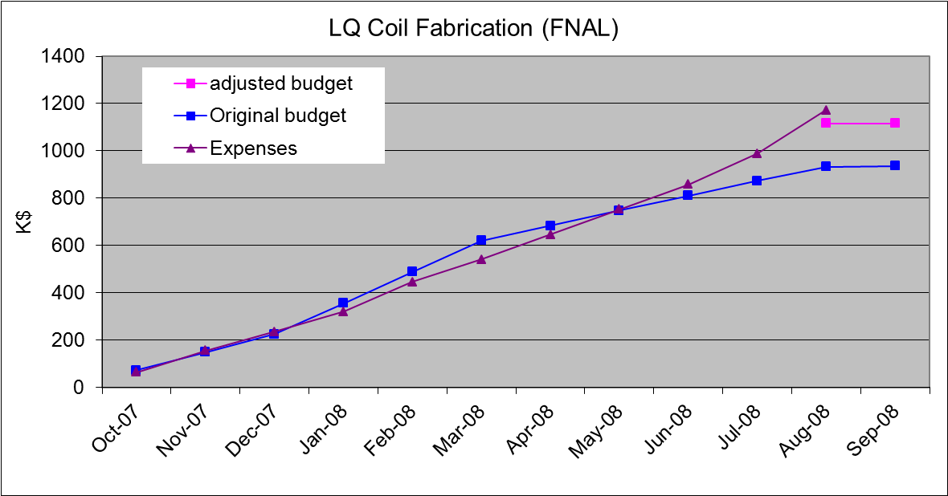
Monitoring Expenses
For all major tasks we plan to monitor expenses vs. estimates on a monthly base
Both Labor and M&S
Work performed vs. work scheduled is already monitored separately
Previously done for some LQ tasks
First step toward EVMS

Slide 16
Conclusions
In HiLumi, for the 1st time ever, Nb₃Sn magnets are a critical component of a particle accelerator
There is an intrinsic risk … unknown unknowns
LARP in collaboration with CERN has developed a plan adequate to this challenge
We can make it successful with the best resources at all labs and sufficient support from the funding agency.

