Slide 1
MQXF Quench Protection
G. Ambrosio
02/17/14

Slide 2
Outline
Status at MT23 (First complete analysis)
Recent progress
Plans

Slide 3
Status at MT23
Simulations performed with QLASA and ROXIE using MATPRO material property database
Using preliminary MQXF requirements
Assuming heaters only on the outer layer
With conservative assumptions:
Layer-layer propagation
Impact of bronze in strands
No dynamic effects
Hot spot temp. ~ 350 K
Without margin and redundancy
Close to epoxy glass transition temperature
~max acceptable temp. if there is no earlier detraining

Slide 4
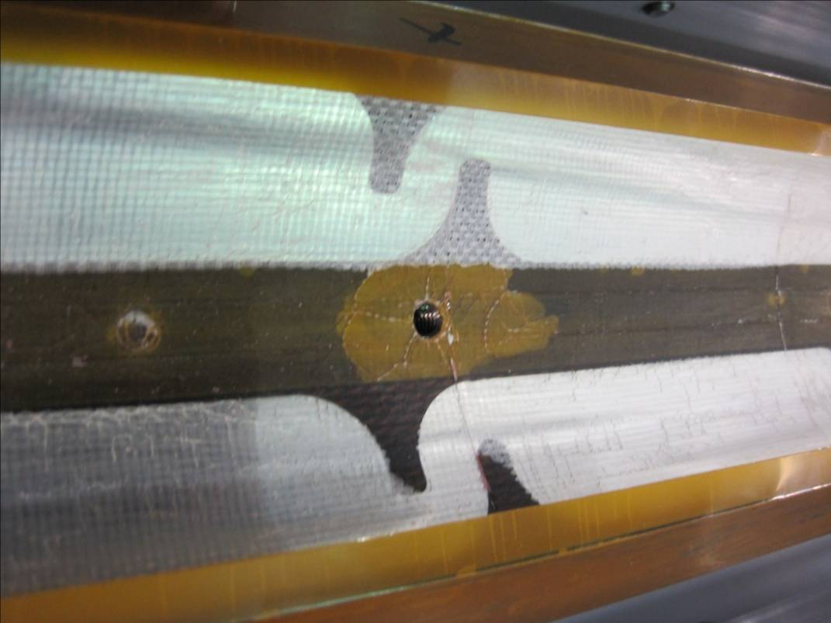
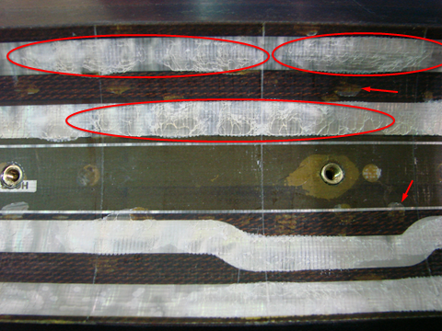
“Bubbles” Issue
“Bubbles” on coils inner surface
Coil-insulation separation
Heater-coil separation
Seen in TQ, LQ, HQ coils only non inner layer
TQ coils showed small “bubbles” (no heaters on IL)
HQ coils showed small “bubbles” and cracks along heaters
LQ coils had long “bubbles”
LQ coil
HQ coil

Slide 5
Progress so far
Demonstrated beneficial effect of bronze
➔ Hot spot temperature lower by ~ 30K
Compared property databases
➔ MATPRO is most conservative
Performed QP tests on HQ
Next slides
Compared HQ test data with simulations (using MT23 assumptions)
Next slides

Slide 6
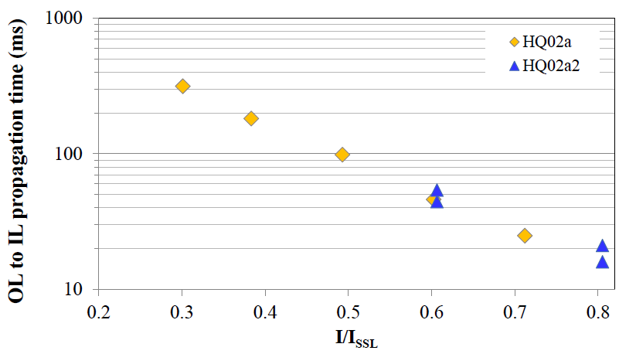
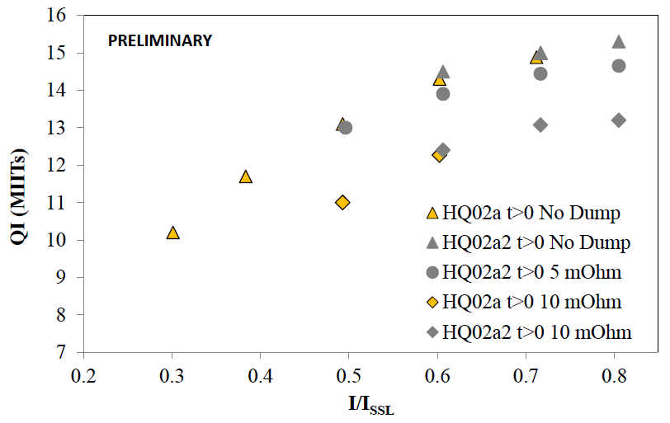
Feedback from HQ02 test
Measurement of quench propagation from Outer Layer to Inner Layer
Measurement of Quench Integral with different dump resistors
simulating MQXF conditions

Slide 7
Simulations vs. Measurements
Under the assumptions used for MQXF, the heaters-induced quench simulations are conservative.
At the current of interest (0.8 of SSL), the MIITs are overestimated by about 13 % (~ 65 K)
Margin is due to:
dI/dt effects
conservative assumptions in modeling of heaters and propagation OL to IL
Current/SSL | 0.8 | 0.7 | 0.6 | 0.5 | 0.4
MIITs difference % (no dump case) | 14.5 | 13.2 | 9.6 | 10.7 | 8.1
MIITs difference % (3 mΩ dump case) | 13.4 | 11.1 | 6.4 | 5.3 | 0.9
Most significant case for MQXF

Slide 8
Plans
The recent improvements may not be sufficient to provide redundancy and margin
This is a risk, therefore:
We are addressing it by:
Optimization of heater design and materials
Development of heaters for Inner Layer w/o bubbles
Exploring the use of CLIQ
Coupling Loss Induced Quench
Test max acceptable temperature (HQ02b)
Longer magnets with lower gradient are the back up solution (with several drawbacks)

Slide 9
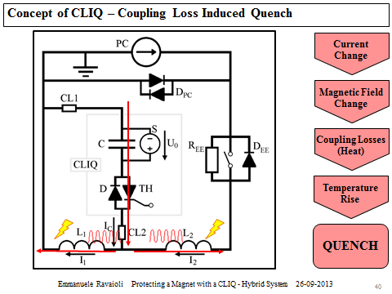
CLIQ
Developed at CERN for 120mm NbTi quads
May be an option for MQXF
Note: most effective on inner layer
Complementary to heaters on outer layer
To be tested on HQ02b

Slide 10
Heater development
Pattern optimization
LHQ coil test
HQ03 (MQXF style heaters)
Material optimization
Reduce heater delay time
Minimization of polyimide coverage of coil inner surface using copper plated heaters
Better heat extraction
Avoid bubbles

Slide 11
Conclusion
Quench Protection is the only part of the design that still needs some R&D
We are aware of this risk and are addressing it intensively developing alternative solutions in collaboration with CERN
A workshop is planned after HQ02b test to assess QP and finalize MQXF lengths
Temptative time: end of April

Slide 12
Back up Slides

Slide 13
Coils after Test
Some “bubbles” on coils inner layer
Coil-insulation separation
Possible causes:
Superfluid helium and heat during quench
Seen in TQ coils
Heat from heaters on inner layer
Only in LQ coils
Plans:
Strengthen insulation or
Change heater location or
Add support on coil ID

Slide 14
Coil Processing: Impregnation
Instrumentation traces
Do laminated polyimide trace materials pose problems for impregnation?
Trace behavior (bubbles) on inside bore after testing cycle have continued
Inside bore of HQ02a during
assembly (Coil 15 was previously
tested in HQ mirror)
Bubbles on inside bore of
LQS03 after magnet test

Slide 15
