Slide 1




LARP Crab Cavities Program Overview
Ratti
LBNL
Feb. 17, 2014

Slide 2
Outline
Motivation and Overview of the CRAB program
System requirements and description
  CERN’s functional specification (SPS)
  LHC requirements
Current status and LARP activity
  PoP and Prototypes, integration
  SPS test
Next Steps and Planning - in the final talk
  Including Cost and Schedule

Slide 3
Why crabs?
Substantial upgrade of integrated luminosity
  Luminosity leveling, vertex density control
  Effectiveness increases with larger crossing angles
  Only known way to improve luminosity during the store
Significant R&D on cavity technology for several years
  Encouraging results are making this possible
  Three designs under study in Europe and the US

Slide 4
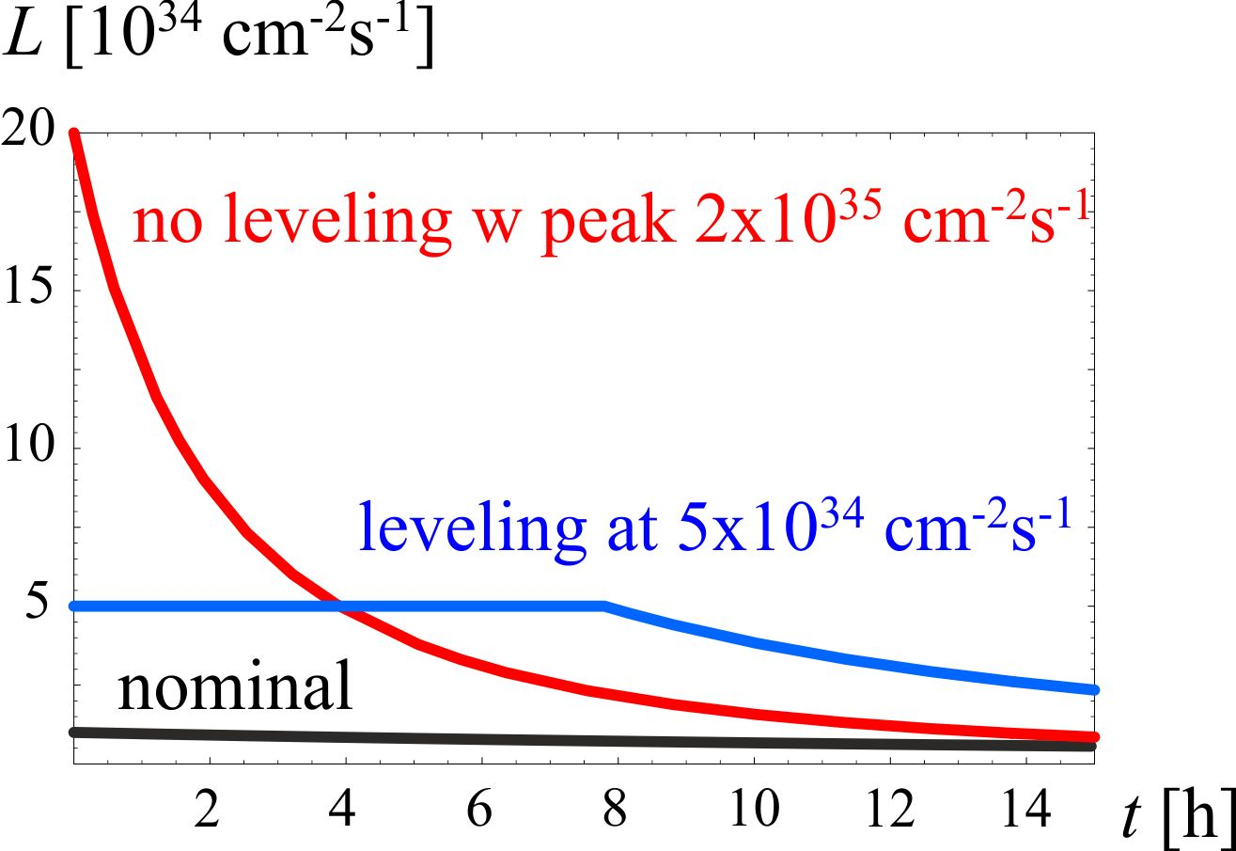
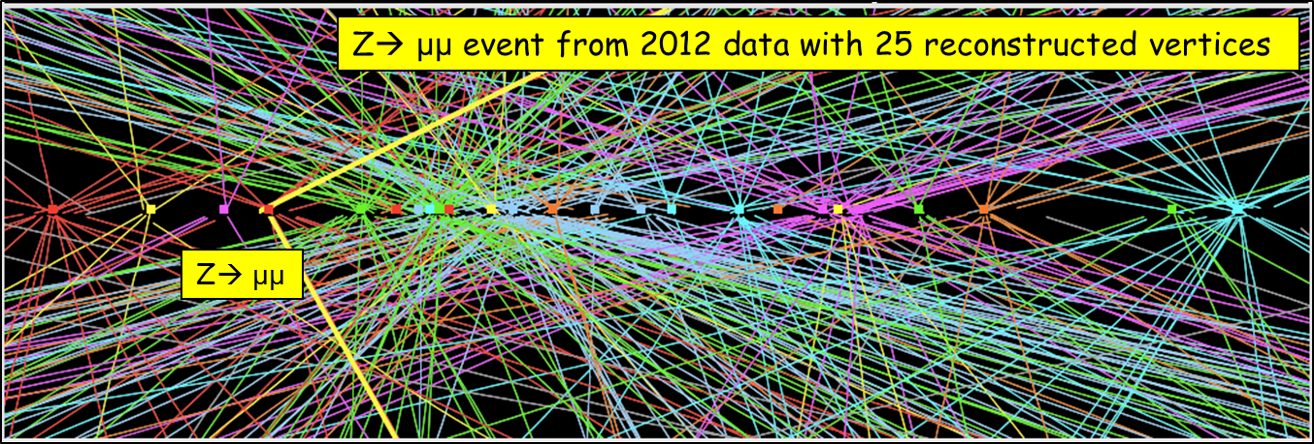
Luminosity Levelling
Luminosity decreases for proton burning (neglecting effects like emittance growth due to b-b, IBS, etc…)
Total number of collisions ∫Ldt in a run is limited by number of stored protons
⇒ store a lot of protons but keep instantaneous lumi «low» by detuning one (or more) parameter.
⇒keep the lumi constant by re-tuning the paramter(s) to compensate proton loss (and possibly any other effect).

Slide 5
System Requirements
Voltage >= 13 MV (3.3 MV/cavity)
  SPS test 2 cavities/module
  LHC 4 cavities/beam/location
Frequency = 400 MHz
Q_{ext} = 10⁵ - 10⁶, R/Q ~300 W
Cavity tuning/detuning ± 1.5-5.5kHz (or multiples of it)
Available RF power source = 60 kW (< 18 kW nominal)
Beam current ~ 0.5-1 A

Slide 6
Technical Specification
Functional parameters
  Including HOMs, Z…
Enclosures (incl. materials…)
Cryogenics
RF Power incl. couplers
LLRF
SPS Integration
Released by CERN in Feb. 2013

Slide 7
Overall CERN planning
L. Rossi: Dec 2013

Slide 8
Global Organization
CERN leads the global collaboration
  Directly responsible for several tasks
    RF power and controls, local installation, cryogenics, machine protection…
  Cross disciplinary working group to prepare SPS validation test
    Operations, RF, Vacuum, Cryogenics, Beam Dynamics, Machine Protection, Collimation, Instrumentation…
Lancaster Univ. and STFC actively involved
  4-rod cavity design and testing
  Cryomodule design
US proposes to contribute a well defined part of the activities
  “Cold Masses” = Dressed Cavities with HOM couplers and filters, tuners, FPC ports.

Slide 9
LARP Organization
Defined roles within LARP collaboration:
  BNL, ODU – cavity development with aux systems
  FNAL – Leads and coordinates cryomodule integration in the US
  SLAC – Leads and coordinates EM modeling support
  FNAL, LBNL - beam dynamics, dynamic quench and energy deposition studies
    Not shown here
Today’s presentations will cover each of these areas
(Unless otherwise noted)
US Industry - Niowave
  Built all three PoP cavities to date
  Funded by DOE SBIR phase II program to build prototypes
Points of contacts defined at each institution

Slide 10
Scope of US Contribution
LARP proposes to contribute R&D until the SPS test
  4 cavities (two of each kind) for testing in the SPS during the 2017-18 runs
    2 cavities, He vessels, tuners, HOM mode dampers
    RF couplers provided by CERN
    Cryogenics, RF power, local installation provided by CERN
Proposal to DOE for a US Contribution to HL-LHC
  All cold masses (fully dressed cavities)
Feedback from DOE reminds that the effort on crab cavities should be carried through construction and not be limited to the SPS test

Slide 11
Focus on SPS Tests
SPS Validation Tests
  Validate crab concept with proton beams
  Machine protection
  Beam studies (kick, LLRF, noise....)
Essential to finalize LHC design
  A final decision on a crab cavity system for the LHC will only come after a successful SPS test

Slide 12
SPS vs. LHC
NOTE: LHC now requires 4 cavities per location
3

Slide 13
Current LARP Activities
Proof of Principle Cavities – DQW, RFD
  Validated geometries and expected performance
    Both design met CERN’s kick requirements
Prototypes
  Plan to build 2 cavities of each designs
Cryostat
  Support CERN in design and integration of two designs
Modeling Support
  EM cavity design with peripherals
  Beam beam studies
Beam-Beam and energy deposition studies
  Also important, although not described here
    Reported in AP session

Slide 14
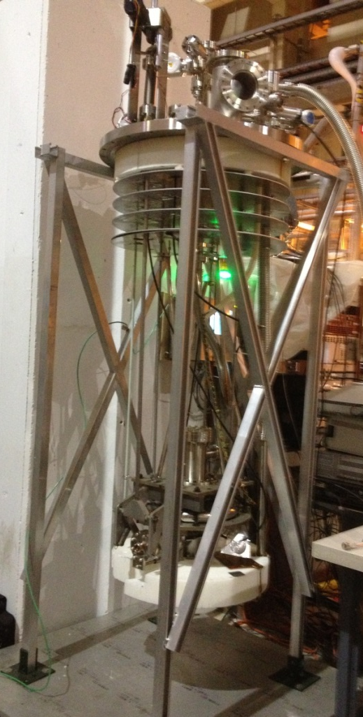
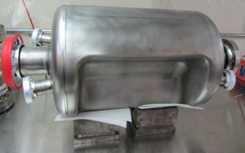
Status – Proof of Principle
Proof of Principle (PoP) Cavities
  Successful test of both LARP cavity designs proves that we can achieve the required fields
  Yet reaching 7 MV in a vertical test does not mean we can assume cavities will operate at that gradient.
  4-Rod test also successful
Focus now on peripherals and integration
  Tuners, dampers, power couplers…

Slide 15
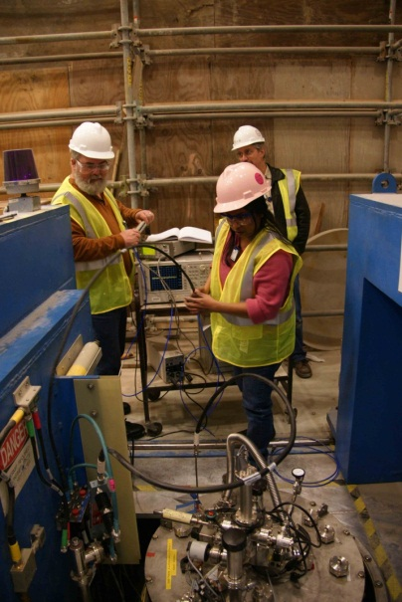

PoP RF Dipole 4.2 K and 2 K Test Results
Expected Q₀ = 6.7×10⁹
  At R_{S} = 22 nΩ
  And R_{res} = 20 nΩ
Achieved Q₀ = 4.0×10⁹
Achieved fields
  E_{T} = 18.6 MV/m
  V_{T} = 7.0 MV
  E_{P} = 75 MV/m
  B_{P} = 131 mT
Quench
3.4
5.0

Slide 16
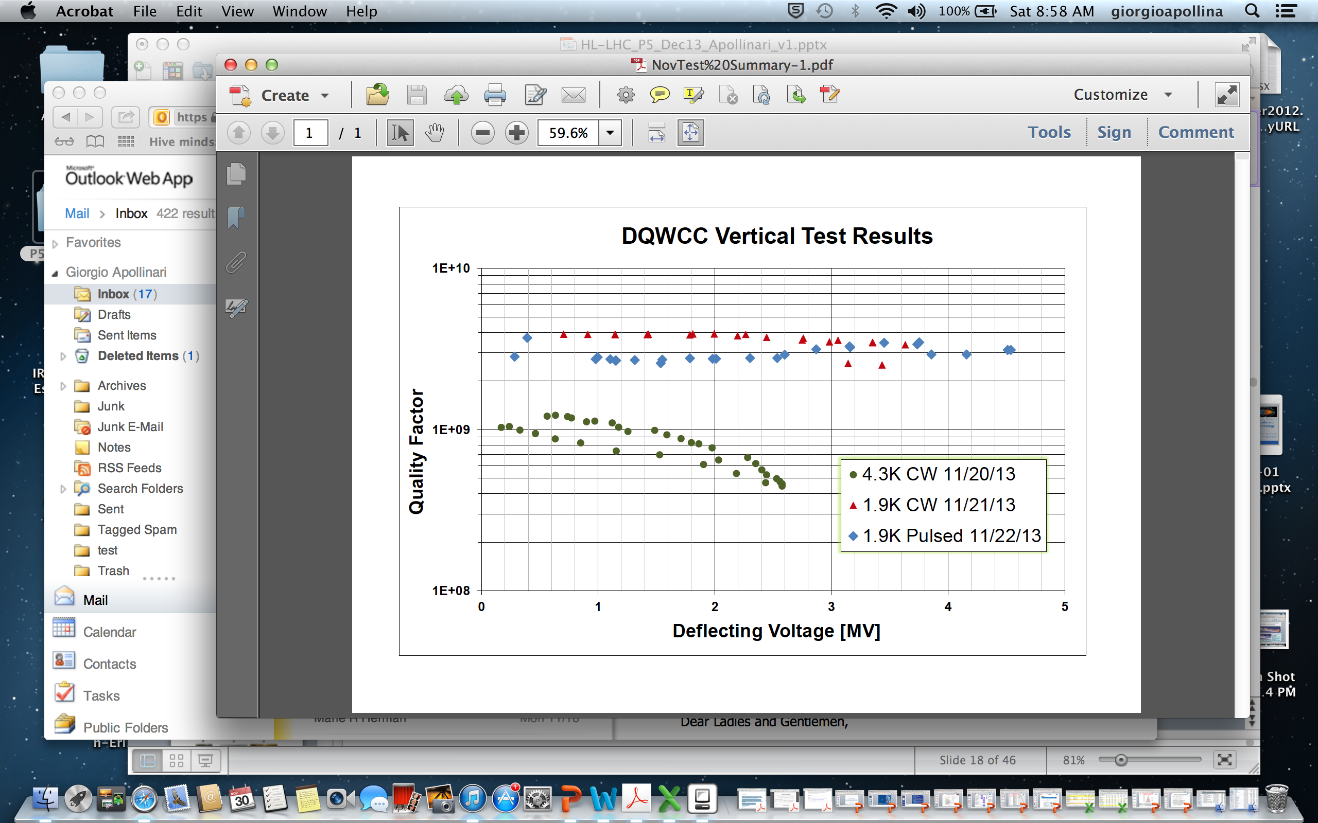
PoP DQW 4.3k and 1.9k Test Results
Q₀ at around 3~4.5e9
In CW mode, temperature of beam pipe flanges increase.
Reached 4.5MV kick in pulsed mode, limited by quench, consistent with conditioning test.
Temperature increase on pickup port blending area.
Quench field at ~110mT, with peak E field at 52.8MV/m

Slide 17
Status - Prototypes
Finalizing the design of a prototype system to use in the SPS test for both cavity designs
  Fundamental differences in the approaches in tuning and coupling (FPC and HOM)
Cryostat concepts are starting from studies made in the UK
Plan to carry both US designs until final integration in SPS cryostat
  Greatly reduces technical and schedule risk

Slide 18
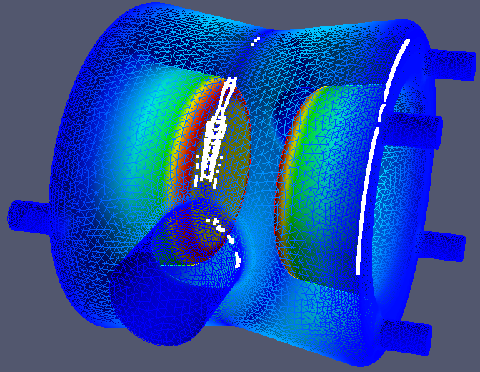
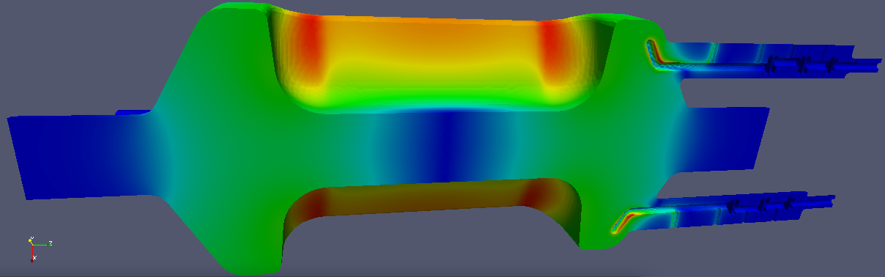
Modeling
Supporting EM design of cavities and auxiliary systems
  Multipacting analysis
  Mode dampers coupling
  …and fundamental power rejection
Comparative studies of three candidate designs

Slide 19
Other Studies
Energy deposition (FNAL)
  Neutron shower could compromise cavity integrity
Dynamic Quench (FNAL)
  Extreme stored energy planned for HL-LHC dictates extreme care managing rapid changes
Beam beam with crab scheme (LBNL and FNAL)
  Studies with increasing crossing angles planned for HL-LHC

Slide 20
Conclusions
Crab cavities have been selected as one of the activities in the construction project for the HL-LHC
R&D program is making great progress
  Very encouraging initial results
  Detailed design of prototype cavities and integration of a system for SPS test underway
CERN very actively involved
Systems requirements document released
US industry remains involved in a key role
Financial and planning details at the end of the session

Slide 21

Questions?

