Slide 1
Dressed Cavity Fabrication and Integration
Tom Nicol
February 17, 2014

Slide 2
Dress Cavity and Cryomodule Highlights
Three cavity designs.
4-Rod (Daresbury)
Double Quarter Wave (Brookhaven)
RF Dipole (Old Dominion University and SLAC)
(Probably) a single vendor for all three dressed cavity assemblies.
Funding source for US dressed cavities is a $1M 2013 Phase 2 SBIR award to Niowave for the crab cavity cryomodule design and fabrication. Due to changes in the down-select process and SPS testing requirements, the original scope is not relevant.
Niowave built the prototype for all three designs.
No dressed cavities have been built.
The cryomodule for both US cavities will be designed and built at CERN. As of the end of the December workshop at CERN, Daresbury will design and build their own cryomodule.
Desire as much commonality in the three cryomodule designs as possible.

Slide 3
Dress Cavity and Cryomodule Highlights (cont’d)
Goal is at least two cryomodules tested in SPS to ensure at least one US design.
BNL is coordinating the double quarter wave cavity design.
Bare cavity design at BNL
Dressed cavity design in collaboration with CERN
ODU is coordinating the RF dipole cavity design.
Bare cavity design at ODU
Dressed cavity design in collaboration with Fermilab
If an end-lever tuner is used, the design will likely be based on one from Saclay. Otherwise the tuner will be the responsibility of BNL and ODU.
The input coupler will be provided by CERN.
CERN will assist with pressure vessel code compliance issues.
In addition to being involved in the RF dipole dressed cavity design, Fermilab will play provide oversight in the fabrication of all three dressed cavity designs.

Slide 7
4-Rod (Daresbury)

Slide 8
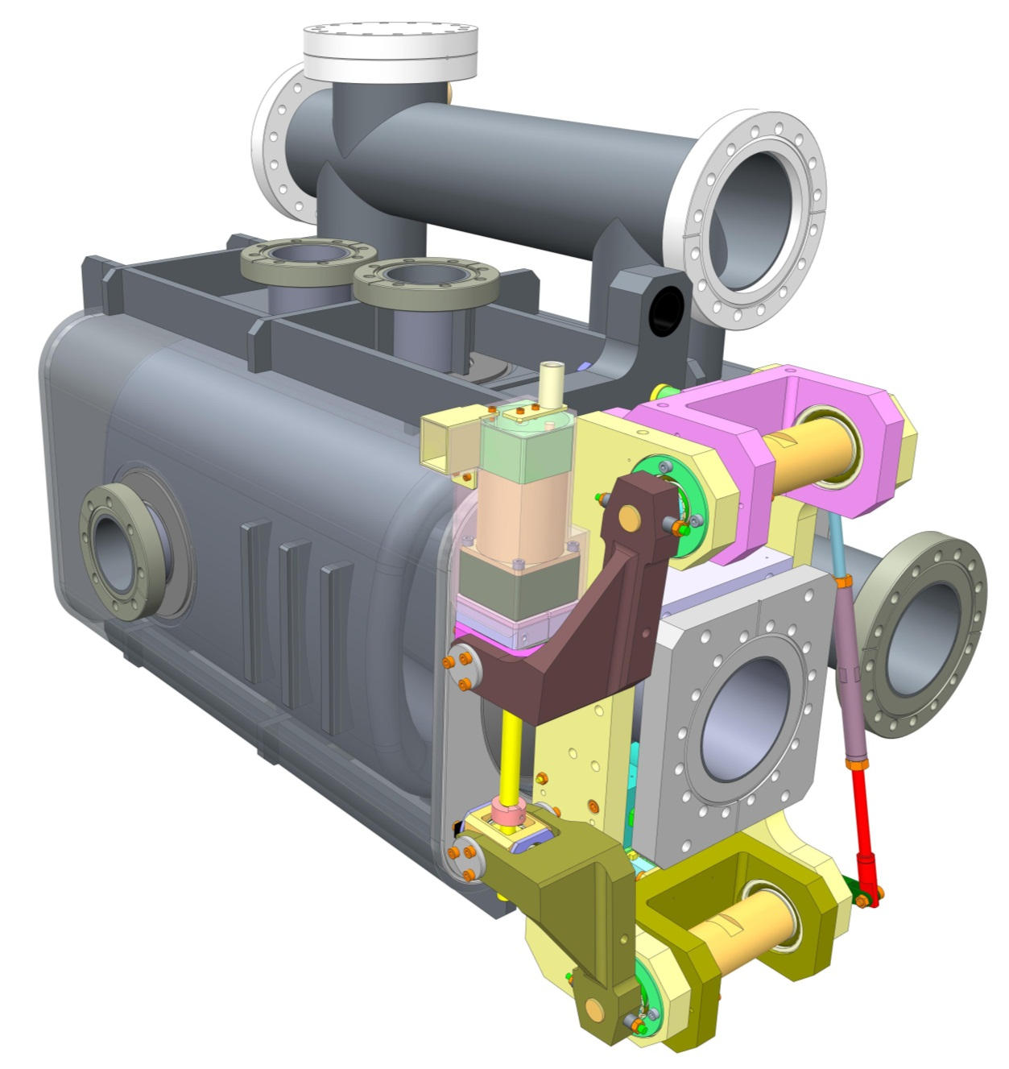
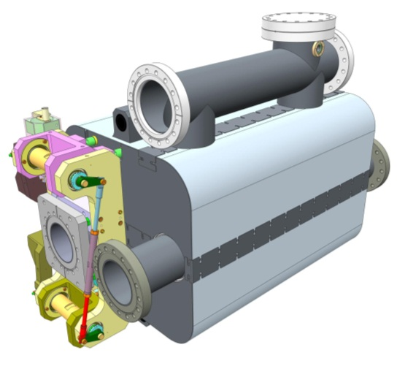
Helium vessel conceptual design
Slides from Tom Jones and Shrikant Pattalwar (Daresbury)
Helium 2-Phase line
Port for He level probe
Stiffening ribs
Input coupler port
Helium Vessel made from Grade 2 Titanium
Additional beam tube required for LHC installation
312mm
550mm
194mm
Cryoperm (magnetic shield)
Modified Saclay II tuner
UK 4 Rod Cavity

Slide 9
Cryomodule Concept
December 2012
1520mm
2150mm
800mm
Design Approach
Provide sufficient and easy access to internal components during assembly and after installation
August 2013
More details in - Conceptual design of a Cryomodule for Crab Cavities for HiLumi-LHC
S. Pattalwar, et al, MOP 087, SRF 2013, Paris

Slide 10
Double Quarter Wave (BNL)

Slide 11
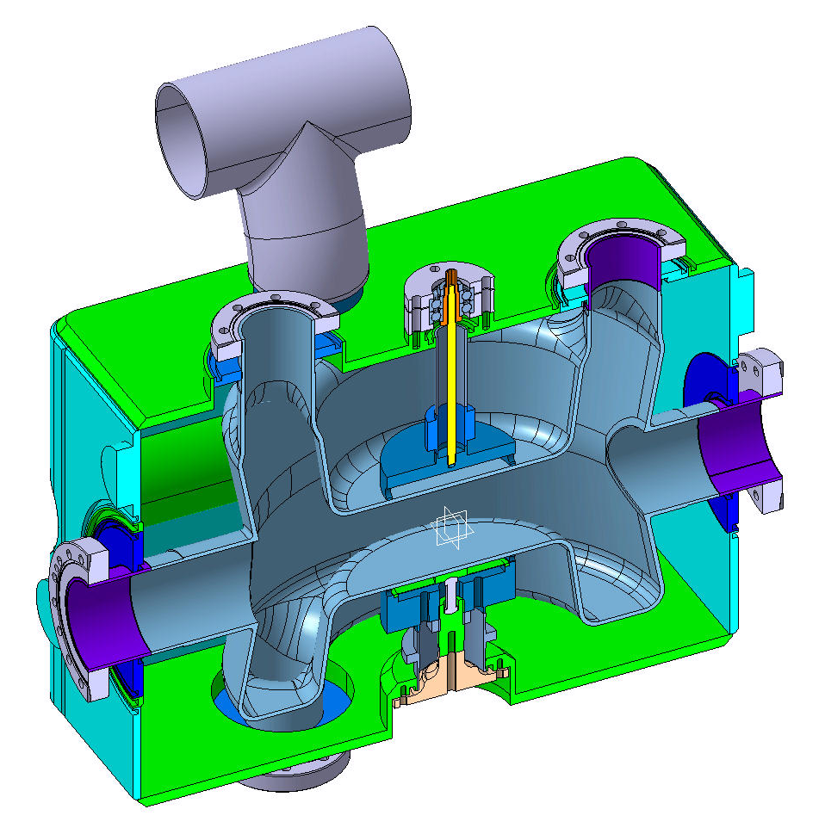
Helium vessel in titanium (BNL-CERN)
Slides from Silvia Verdú-Andrés (BNL)
Cryo jumper
362.4 mm
Tuner + reinforcement
400 mm
FPC
HOM
565 mm
beam
Space for
adjacent beam pipe
Titanium shows same thermal expansion coefficient than Niobium → rigid connections
Compact design, 55 liters of helium
HOM
Piezo + reinforcement
Notes:
Mention: 1) compactness and 2) assembly (esp. port tubes and vessel connections ).
We can reduce Helium volume with dummy pieces. Piezo at 2K can break and range is only 20% at warm temperature.
Membrane, piezo in vacuum. And membrane has vacuum on one side and he in another side.

Slide 12
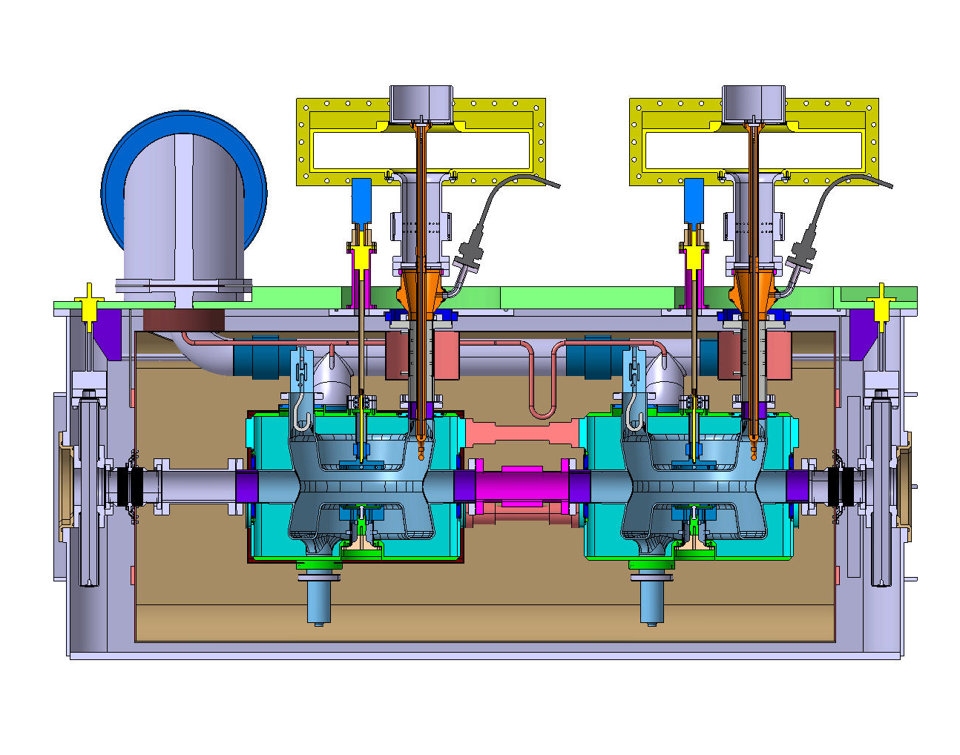
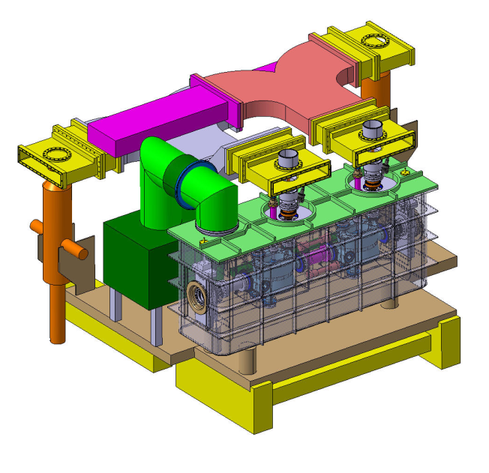
Integration of dressed cavity into cryomodule (CERN)
Input power waveguides
Cryo jumper
Tuning system
FPC
Helium vessel
Cavity
Thermal shielding
(80K – nitrogen)
Magnetic
shielding
For more details follow the talk by Luis Alberty

Slide 13
RF Dipole (ODU and Fermilab)

Slide 14
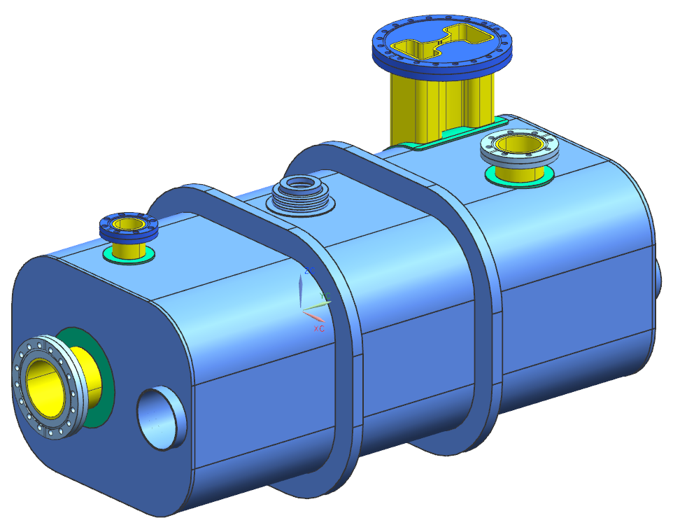
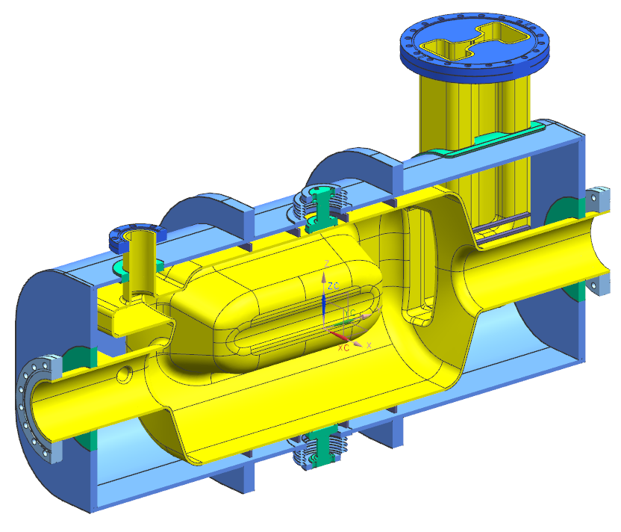
RF dipole dressed cavity assembly
HOM ports
Input coupler port
Tuner
port
Stiffeners
Dummy beam tube
February 2014

Slide 15
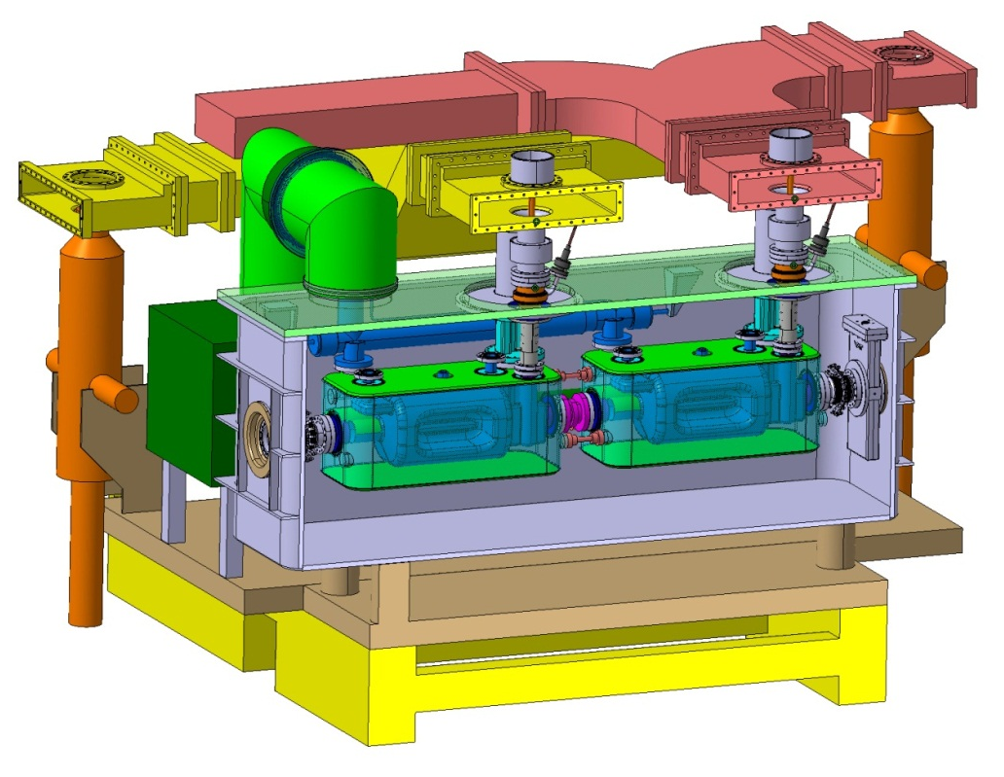
RF dipole cryomodule assembly concept
From 2013 CERN integration model

Slide 16
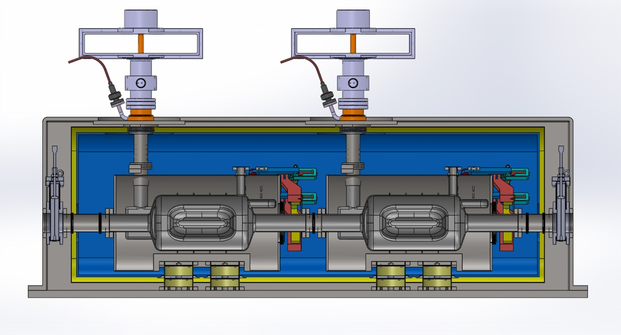
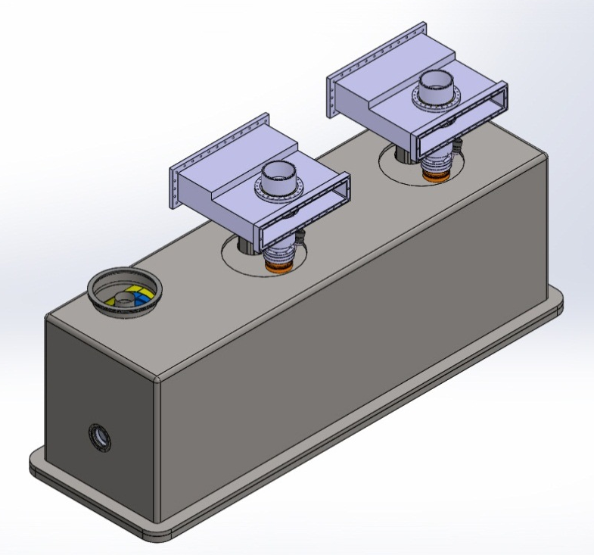
RF dipole cryomodule assembly concept cross section
From December 2013 workshop

Slide 17
Dress Cavity and Cryomodule Status
Preliminary designs for the DQW and RF dipole cavities are complete at BNL and ODU respectively.
Dressed cavity helium vessels, tuners, HOM interfaces, etc. are in process at BNL, ODU, CERN, and Fermilab.
Solid model and drawing data is being managed through CERN’s EDMS.
The initial release of this data to Niowave took place in February.
The release of the final design is scheduled for April.
In addition to oversight we need to develop a workflow consisting of inspection criteria, milestones, hold points, etc. to aid the fabrication process.
CERN will approve all drawings, material and fabrication specs, etc. prior to manufacture.

