Slide 1
Double Quarter Wave Crab Cavity Design and Plans
Qiong Wu
2/17/2014

Slide 2
Outline
Proof of Principle (PoP) Double Quarter Wave Crab Cavity (DQWCC)
Cavity Design
Cold Tests
SPS DQWCC
Cavity Design
Couplers
Helium Vessel, Tuner, Cryostat Design
Future Plans
Summary

Slide 3
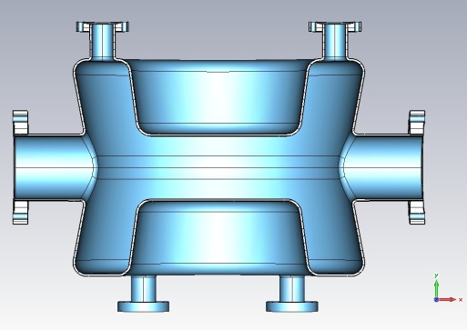
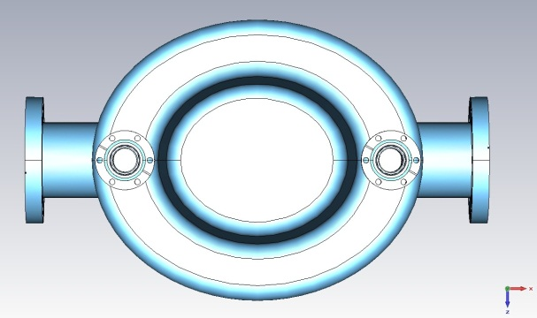
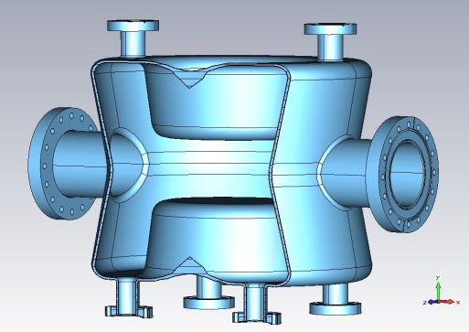
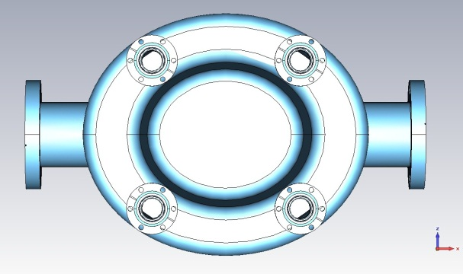
The Proof of Principle
 | Crabbing (fundamental) mode freq. | 1st HOM | Cavity length | Cavity width | Beam pipe diameter | Deflecting voltage
Unit | MHz | MHz | cm | cm | cm | MV
DQW crab cavity | 400 | 579 | 38.4 | 14.2 | 8.4 | 3.3

Slide 4
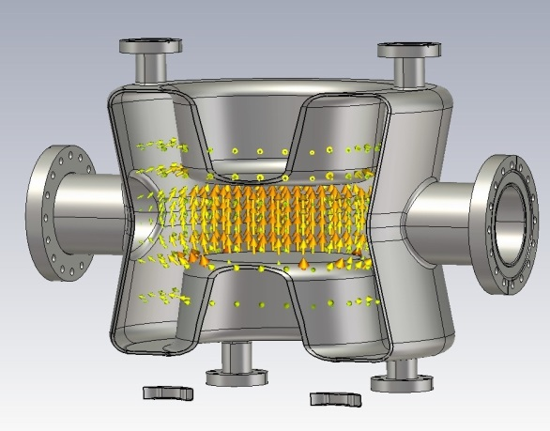
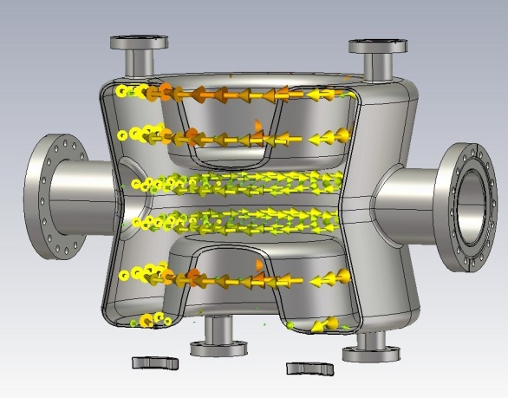
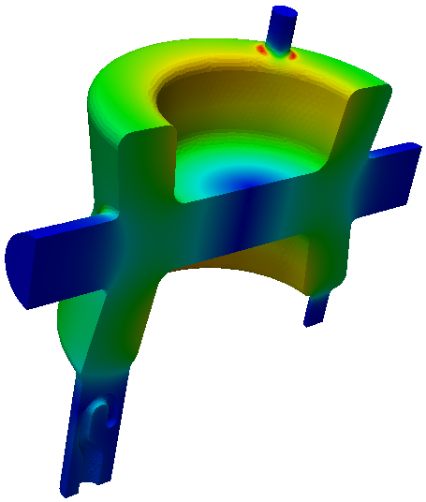
Cavity Parameters
 | Unit | DQWCC
Fundamental Mode Frequency | MHz | 400
Nearest Mode Frequency | MHz | 579
Vertical Deflection Voltage | MV | 3.3
Rt/Q (Fund. Mode) | Ohm | 400
Epeak | MV/m | 44
Bpeak | mT | 60 on cavity 79 on port blending
Energy Content | J | 12
Peak field on port blending region. Improved in SPS prototype cavity design, see later slides.
Electric field (top) and magnetic field (bottom) of the fundamental mode.

Slide 5
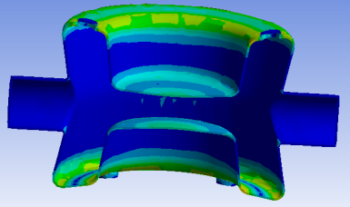
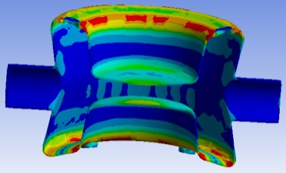
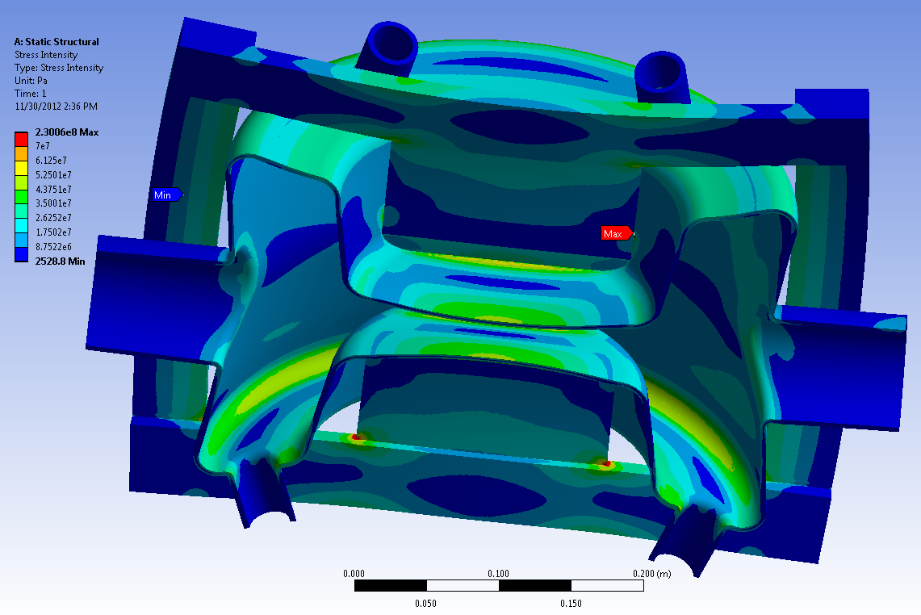
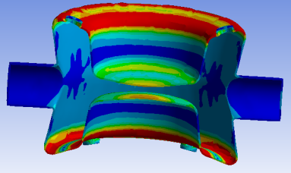
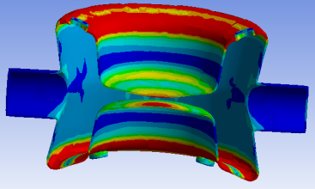
Cavity Stress Analysis
Pressure: 2e5 Pa (2 bar) outside, vacuum inside. Requirement for PoP Cavity.
Fixed Support: One side of beam port.
Stiffening plates and frames are added to the cavity for vertical cold tests.
The material for stiffening components can be either Nb or Ti.
Bare cavity without stiffening frame
Cavity stress with stiffening frame

Slide 6
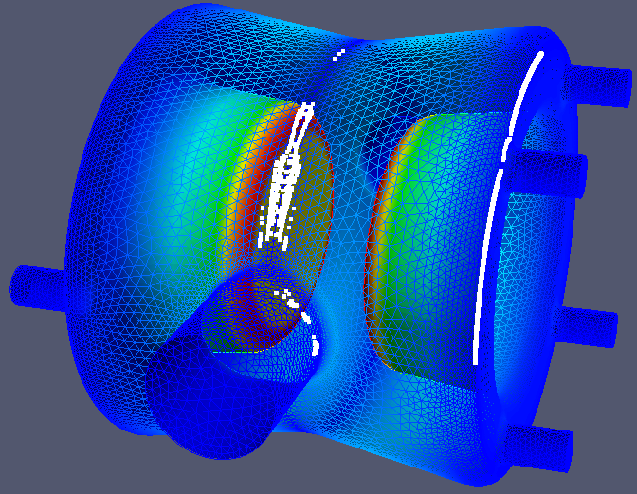
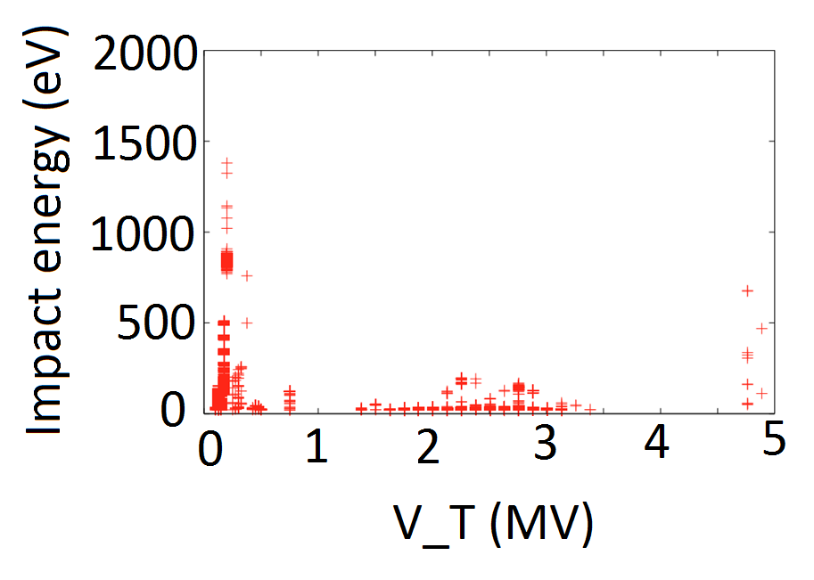
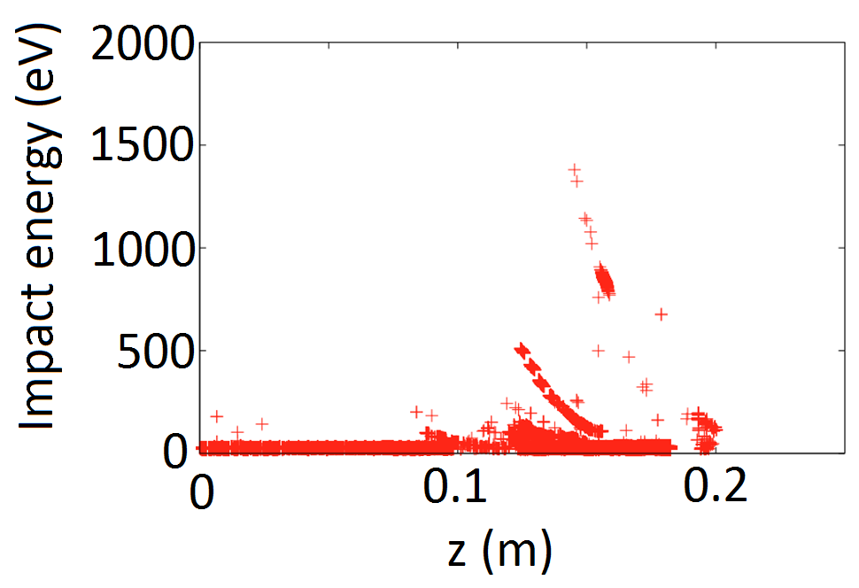
Multipacting study
© Z. Li @ CM20
Small multipacting (MP) region was found around the waist of the cavity at ~0.1 MV of deflection voltage. Verified and processed during vertical tests.

Slide 7
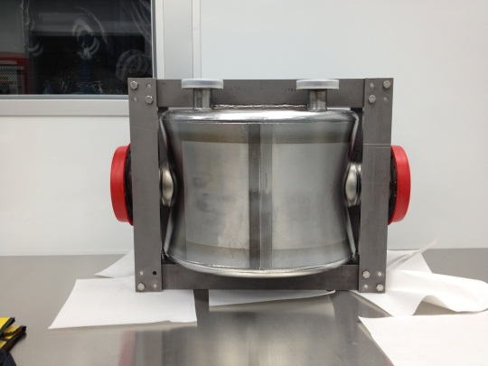
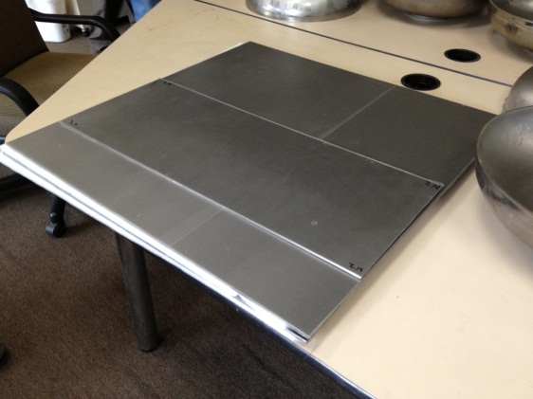
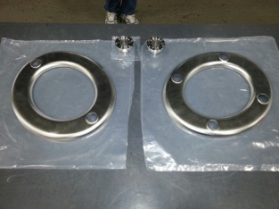
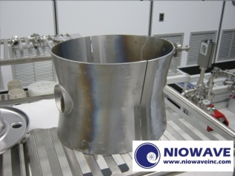
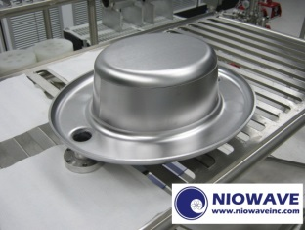
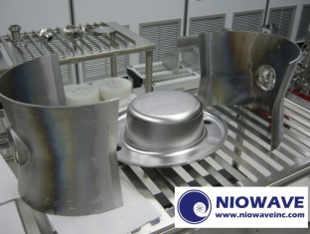
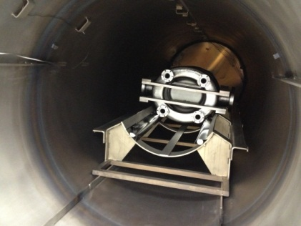
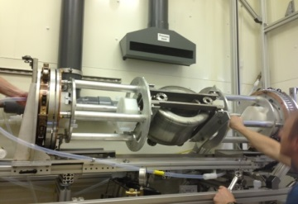
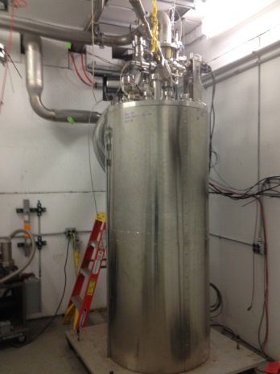
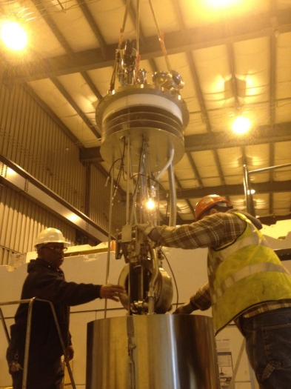
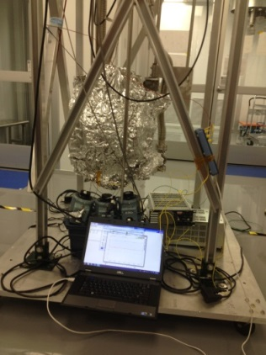
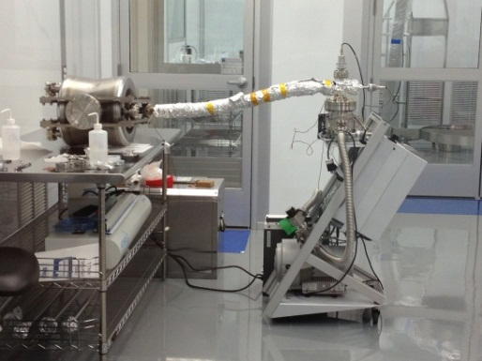
PoP Cavity Fabrication & Preparation
Test I
Test II

Slide 8
PoP cavity test results (1st)
1st cooled down test done in June 2013.
Multipacting (MP) was found for the region of 0.07-0.16 MV and was easily conditioned through. The MP did not come back after the conditioning.
Q₀ measured at 3×10⁸
Q₀ did not improve by cooling down from 4.2 to 2 K.
V_{t} reached 1.34 MV, limited by the RF power amplifier.
Further chemistry cleaning and niobium plated flanges helped decrease the heating issue in the cavity.

Slide 9
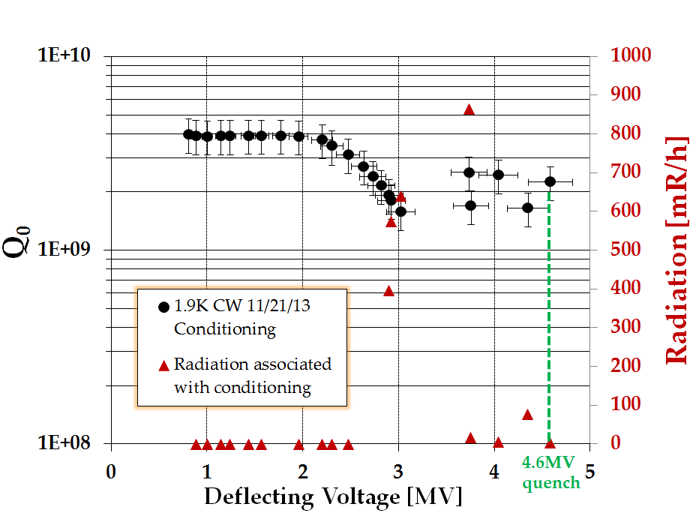
PoP cavity test results (2nd)
© B. Xiao@ CC13
Q₀ reached 3e9 at low field. The requirement is above 1e10.
Q₀ decreases starting from 2MV, associating with high radiation.
Q₀ got recovered after ~30 minutes conditioning.
Radiation is lower than 15mR/h after the conditioning.
Reached 4.6MV kick in CW with Q₀ above 2e9, limited by quench.
Temperature increase on both beam pipe flanges and pickup port blending area.
Rs at 4.3K: 57nΩ
1.9K: 18.6nΩ
Rres is 18.5nΩ

Slide 10
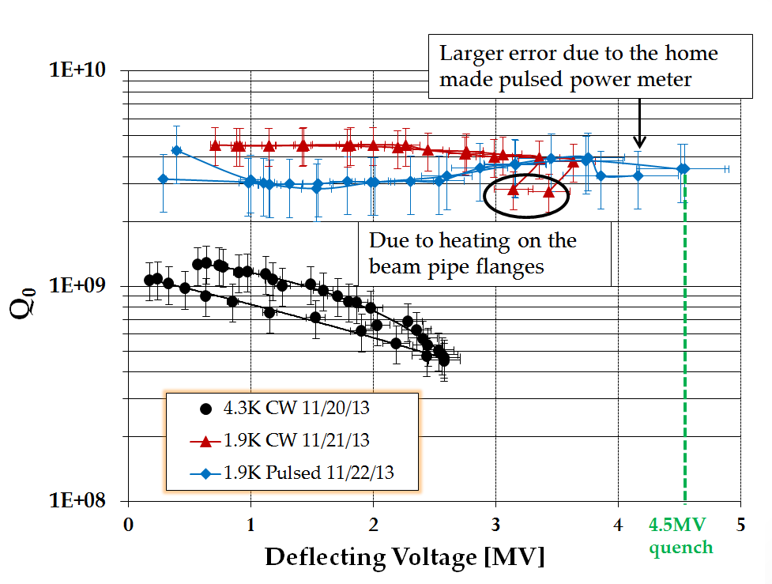
PoP cavity test results (2nd)
Q₀ at around 3~4.5e9.
In CW mode, temperature of beam pipe flanges increase.
Reached 4.5MV kick in pulsed mode with Q₀ always above 3e9, limited by quench, consistent with conditioning test.
Temperature increase on pickup port blending area.
Quench field at ~110mT, with peak E field at 52.8MV/m

Slide 11
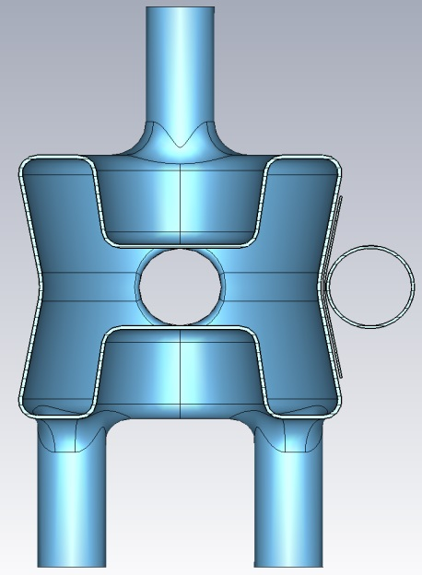
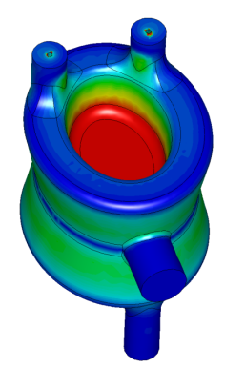
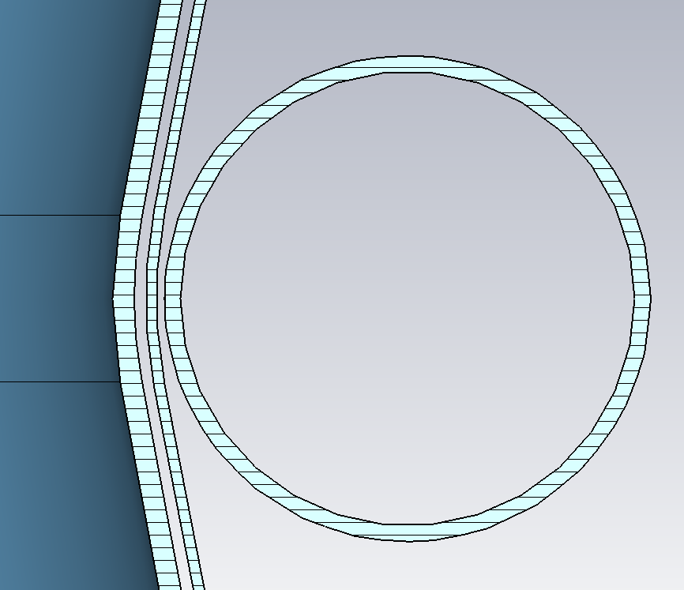
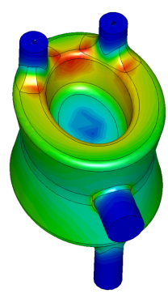
Prototype For SPS
342 mm
684 mm
286 mm
194 mm
f(0)
140 mm
352 mm
288 mm
524 mm
Electric field
Wall thickness = 4mm
MODES
Fundamental frequency (crab mode frequency) | f₀ | 400 | MHz
First HOM frequency | f₁ | 580 | MHz
FIGURES OF MERIT
Transversal R/Q | R_{t}/Q | 430 | Ohm
Geometry factor | G | 89 | Ohm
FIELDS
Maximum peak surface electric field | E_{max} | 37 | MV/m
Maximum peak surface magnetic field | H_{max} | 69 | mT
Accelerating voltage | V_{acc} | 15 | kV
OTHER
Field center offset | 𝒪_{field} | 0.22 | mm
Stored energy | U | 10 | J
Cavity
wall
4 mm
He vessel
wall
Magnetic field
Adjacent beam
pipe wall
3 mm
R 42mm
© S. Verdu-Andres
@ CC13

Slide 12
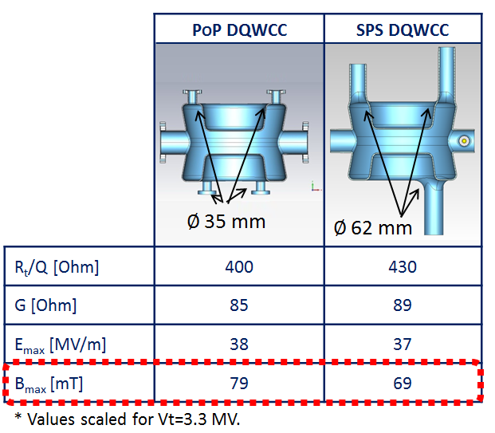
Improvement in SPS Design
The FPC port diameter was determined by CERN according to the cooling needed for the coupler. Then all ports were selected to be at the same dimension to minimize the field asymmetry.
Quench for SPS DQWCC extrapolated to
About 5.3 MV deflecting voltage using the measured quench voltage of the demo cavity (~ 14% higher voltage).

Slide 13
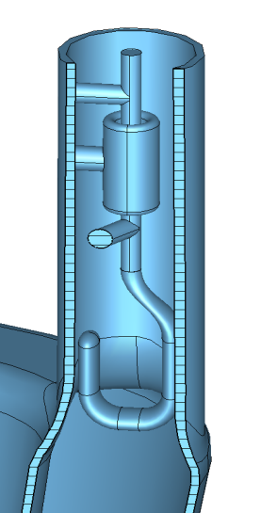
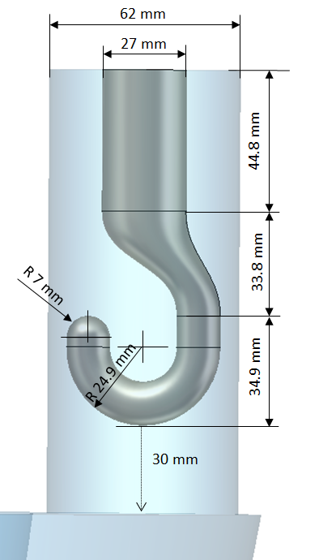
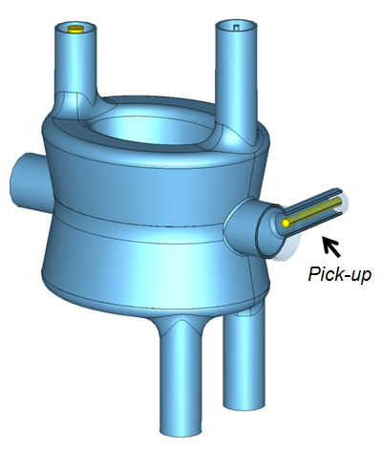
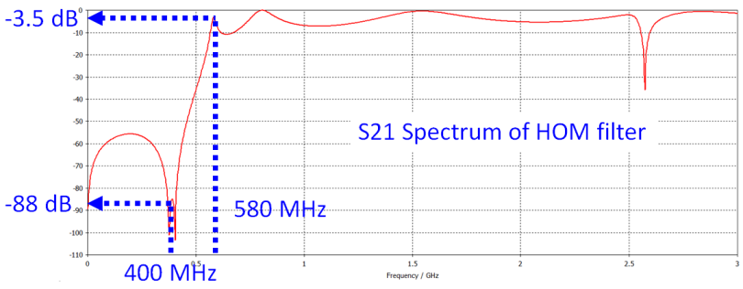
Couplers
Three (3) Higher Order Mode (HOM) couplers are proved by simulation to be sufficient for damping. The coupler hook and filter will be actively cooled by liquid helium, and the analysis is undergoing at CERN.
Fundamental mode coupler (FPC) is designed for providing coupling with Qext 1e5 to 1e6, and peak magnetic field at the same level of the cavity. The FPC waveguide, cooling, and power input will be provided by CERN.
Pick-up coupler should bring minimum disturbance to the cavity field symmetry and ~ 1 W of power for the low level control system.
HOM Coupler
FPC
HOM coupler and filter
The maximum magnetic field on the HOM coupler is 50 mT, and the coupling to the first HOM is 471.
HOM Coupler
FPC hook: Qext ^{f(0)} = 6x10⁵, 40 kW power supply is enough to feed the cavity
Pick-up antenna: Qext ^{f(0)} about 3x10¹⁰, enough to extract about 1W of fundamental mode.

Slide 14
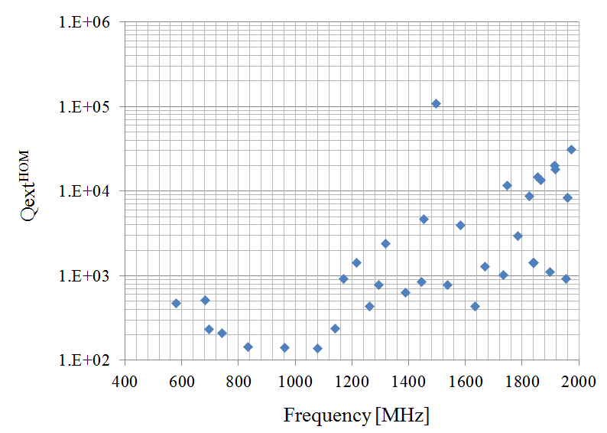
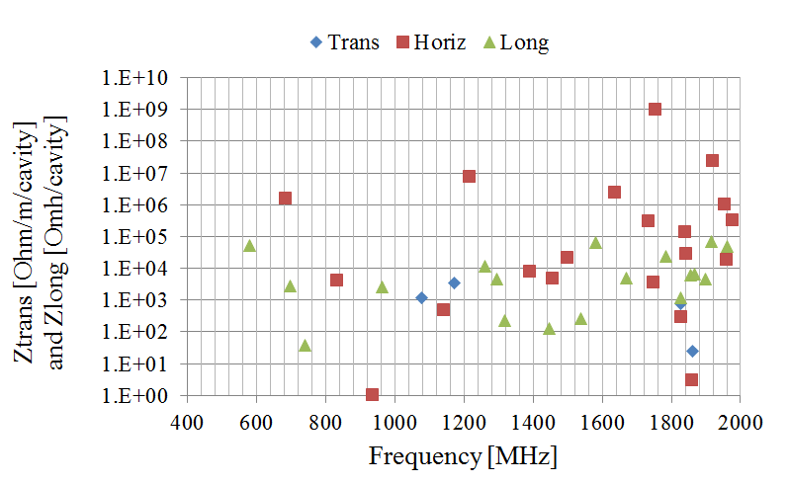
HOM table
The HOMs are coupled out with the design of the coupler hook shown in the.
The external Q of the first HOM is 471, which is much lower than the limit of 1000. The Qext shown here is before the filter.
The mode at 1.5 GHz with Qext above 1e5 has a very small R/Q of 6e-3 Ohm.
The impedance of each HOM is calculated accordingly. We will collaborate with beam dynamics study at CERN to validate the design.

Slide 15
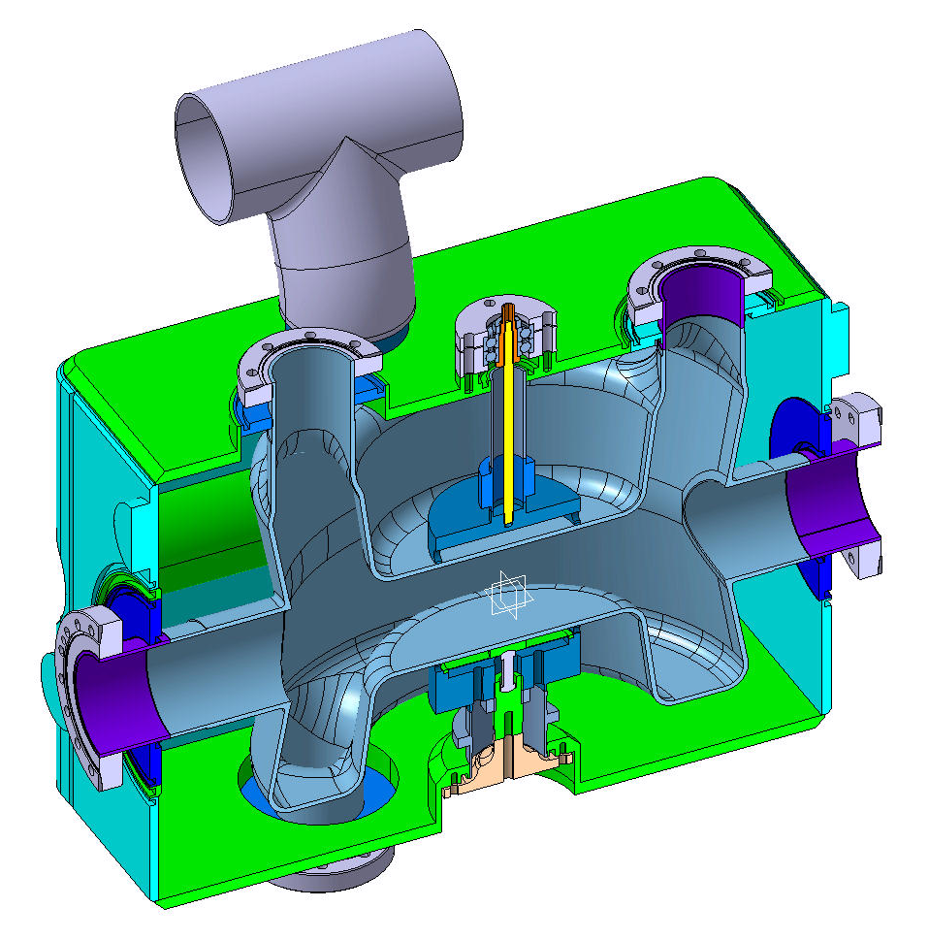
Dressed Cavity
Cryo jumper
362.4 mm
Tuner + reinforcement
400 mm
FPC
HOM
565 mm
beam
Space for
adjacent beam pipe
HOM
Piezo + reinforcement

Slide 16
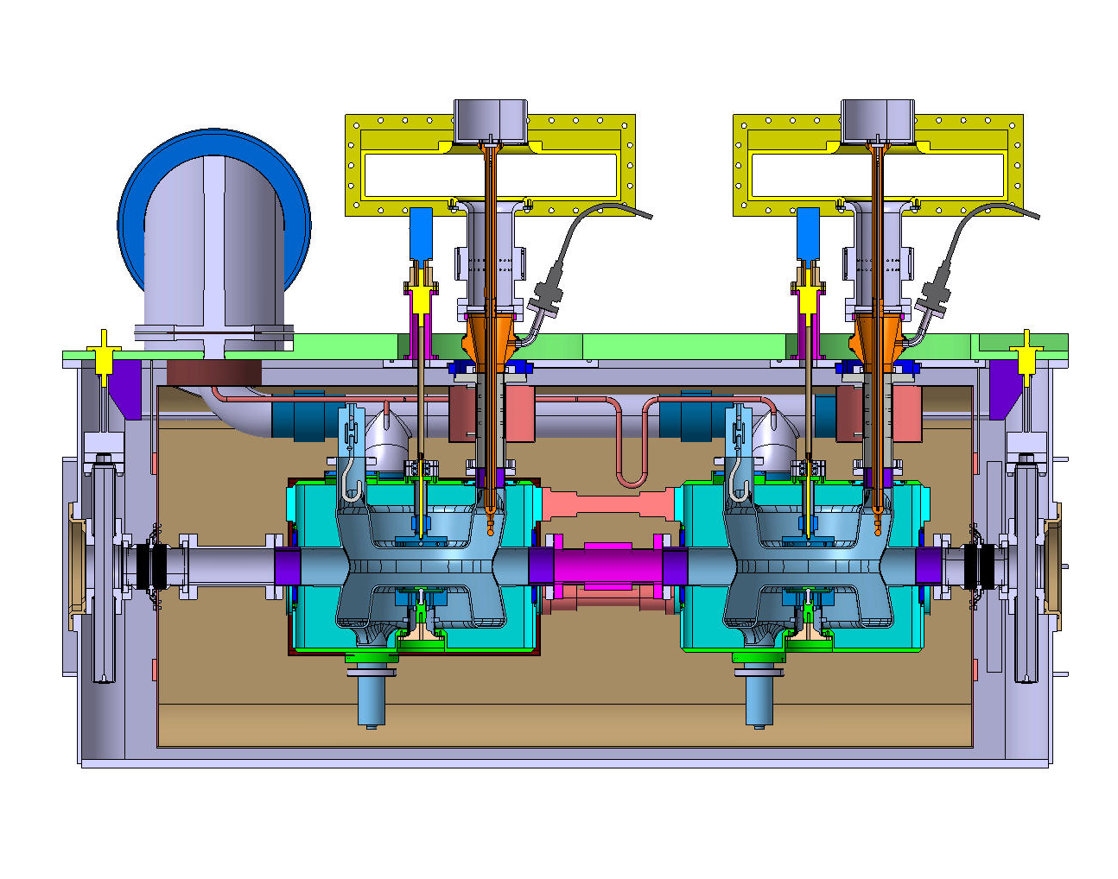
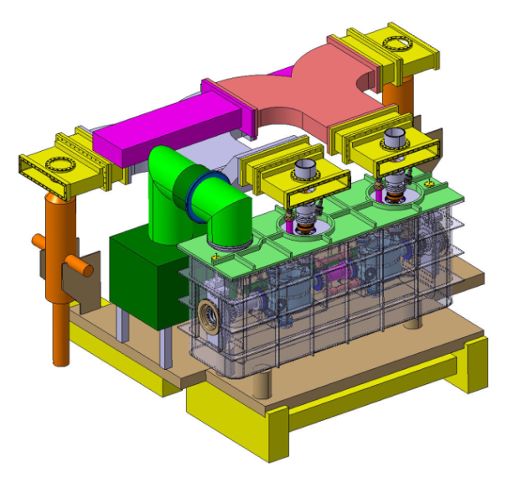
Cryostat (SPS)
Input power waveguides
The cryomodule design concept was first initiated at STFC Daresbury Laboratory (UK), then adopted and substantiated by CERN engineers.
Cryo jumper
Tuning system
FPC
Helium vessel
Cavity
Thermal shielding
(80K – nitrogen)
Magnetic
shielding

Slide 17
Plans (2014)
PoP Cavity
Profile measurement of PoP DQWCC (Done)
Static magnetic field measurement of the test dewar (Done)
Beadpull measurement for HOMs and off-center field
Cold test again at CERN
Test tuning system for SPS prototype cavity
SPS Prototype Cavity
Rf/thermal/mechanical studies of cavity-vessel system
Multipacting studies and verification of fields
Table of frequency shifts
Finalize thermal-mechanical design of helium vessel and tuning
Send final version of design with helium vessel to Niowave in April for fabrication
Multipole studies
HOM filter
RF design completion of HOM filter (near complete)
Make a 3D printing of the RF design and copper plate the surface (Done) for RF measurements
Thermo-mechanical design of HOM filter

Slide 18
Plans (2015-2017)
HOM coupler and filter
Finalize thermal and mechanical design.
Prototyping HOM coupler and filter for RF measurements at liquid He temperature.
Fabricate six assemblies for SPS cavities.
SPS prototype cavity
Cold test both prototype cavities
Cold test dressed prototype cavities
Deliver both dressed cavities to cryomodule assembly site
Support SPS beam test
LHC cavity
Adopt cavity for both deflection schemes (vertical & horizontal) at IP1 and IP5
Adopt cavity ancillaries for both deflection schemes
Collaborate with CERN to revisit both deflection cavity assembly specifications
Collaborate with CERN on alignment and other issues for LHC installation

Slide 19
Summary
The PoP cavity has confirmed our design concept by achieving 4.6 MV of deflecting voltage in vertical test.
The prototype cavity design for SPS test is coming to an end.
It will join the helium vessel design with CERN collaboration and delivered to Niowave for fabrication in April.
The HOM coupler and filter RF design is close to completion. Simulation will be verified with a Proof of Principle model. We will incorporate minor changes to lower surface field and suppress multipacting.
A prototype HOM filter will be made for testing.
Tuner and Cryomodule design is underway with close collaboration with CERN scientists and engineers.
We are using all the resource available to us at BNL to improve our design of the entire crab cavity assembly.

Slide 20
Collaboration
Sergey Belomestnykh, Ilan Ben-Zvi, John Skaritka, Silvia Verdú-Andrés, Binping Xiao, Qiong Wu
Luis Alberty, Rossana Bonomi, Rama Calaga, Ofelia Capatina, Federico Carra, Giuseppe Foffano, Raphael Leuxe, Thierry Renaglia
Zenghai Li

