Slide 1
DOE Critical Decision Process
Ruben Carcagno
February 17, 2014

Slide 2
Outline
Standard DOE/SC Critical Decision Process
Tailoring for LARP
  CD Consolidation
  LARP actions needed prior to CD process initiation
  Long Lead Items Procurements prior to CD process
Summary

Slide 3
Critical Decisions
Based on DOE Order 413.3B
  Applies to capital assets projects having a Total Project Cost greater than or equal to $50M
Critical Decision (CD) Gateways
  CD-0: Approve Mission Need
  CD-1: Approve Alternative Selection and Cost Range
  CD-2: Approve Performance Baseline
  CD-3: Approve Start of Construction/Execution
  CD-4: Approve Start of Operations or Project Completion
A project shall be completed at CD-4 within the original approved performance baseline (CD-2)

Slide 4
Project and Budget Process—Standard Scenario
*
Operating* Funds
PED
Funds
Construction & PED
Funds
Operating Funds
Initiation
Definition
Execution
Closeout
Conceptual Design
Preliminary Design
Final Design
Construction
Critical
Decisions
CD-0
Approve Mission Need
CD-1
Approve Alternative Selection
and Cost
Range
CD-2
Approve Performance Baseline (PB)
CD-3
Approve Start of Construction or Execution
CD-4
Approve
Start of Operations or Project Completion
Request
PED Funds
Receive/Spend
PED Funds
Request
Construction Funds
Receive/spend
Construction Funds
CY
2013
2014
2015
2016
2017
2018
2019
Operating Funds are used for conceptual design between CD-0 and CD-1.

Slide 5
CD-0 and CD-1
CD-0
  CD-0 is important because its approval officially marks a project start
    The Total Project Cost (TPC) clock starts ticking from CD-0 approval date
    All costs from this date forward accrue to the project’s TPC
  CD-0 approval allows Programs to request Project Engineering and Design (PED) funds
CD-1
  After CD-1 approval the project is allowed to spend design or PED funds
  Conceptual Design Report Complete

Slide 6
CD-2
CD-2
  Approval of CD-2 establishes the Performance Baseline (PB) against which the project success or failure will be measured
    The PB represents the DOE’s commitment to Congress to deliver the project’s defined scope by a particular date at a specific cost.
  CD-2 approval allows project to request construction/fabrication funds
    There is a waiting period of about 1.5 to 2 years before the project receives the funds for construction.
      During this time, PED funds can be used for long-lead procurement (LLP). LPP approval is designated as CD-3A, which may happen in advance of CD-2 approval.
  Preliminary Design Report Complete

Slide 7
CD-3
CD-3
  CD-3 approval allows contract awards and construction money can be spent.
    LLP option can be used to alleviate this constraint (CD-3A)
  Final Design Report Complete
CD-4
  Project is complete

Slide 8
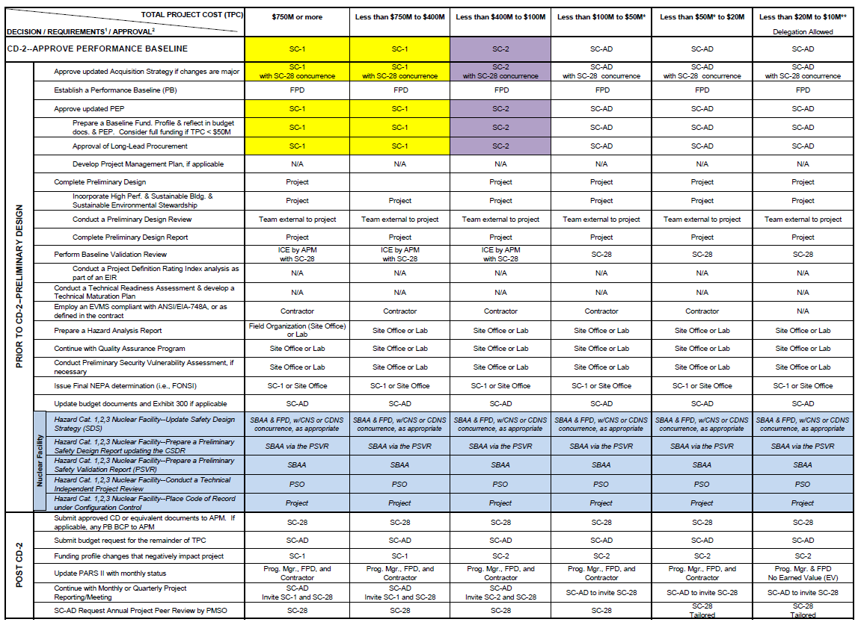
Specific DOE/SC CD Requirements
Documented in DOE/SC Project Decision Matrix:
http://science.energy.gov/~/media/opa/pdf/processes-and-procedures/Project_Decision_Matrix_11_2010_p.pdf
Provides requirements for documentation, reviews, and approval authority
Example for CD-2

Slide 9
Major Item of Equipment
The LARP project is expected to be funded as a Major Item of Equipment (MIE)
  This designation is only used by the Office of Science for large capital equipment projects
  It is designed to be more flexible than Line Item Construction (LIC) projects
    LIC projects involve civil construction (e.g., buildings or tunnels)
    MIE civil construction must be < $5M and < 20% of the TPC
  Equipment will be used for > 3 years
  Equipment cost (TEC) > $2M or Total Project Cost (TPC) > $5M
  Prototypes NOT included, unless will be incorporated into the final experiment
    Funded with R&D or Operating Funds
  For MIE projects “Fabrication” is used rather than “Construction”

Slide 10
MIE Funding Type
Included (Total Equipment Cost, TEC)
  Engineering and design of final instrument
  Fabrication of capital equipment
NOT included (Other Project Costs, OPC)
  Conceptual Design Report
  R&D, prototyping and testing
  Installation and commissioning/pre-operations before CD-4
TPC = TEC + OPC
Funds can move between TEC and OPC as long as the TPC is not increased
Project Engineering and Design (PED) funds are only called out separately in the budgets for LIC, not MIE.

Slide 11
Tailoring
Does not imply the omission of essential elements but may include:
  Consolidation or phasing of CDs
  Substituting equivalent documents
  Using a graded approach to document development and content
  Delegation of authority
  Adjust scope of IPRs and EIRs
  Others
Must be identified prior to CD-1 in the Acquisition Strategy, preliminary PEP and/or Tailoring Strategy (if separate document)

Slide 12
Proposed Tailoring for LARP
Consolidate CD-0/1/2 by mid-FY17
  Preceded by years of preparation
    Details in the following slides
CD-3 by early FY18
CD-4 by end FY23
Proposed tailoring requires funding for Long Lead Item (LLI) prior to CD-0/1/2 approval and availability of MIE funds. Examples:
  Superconducting Strand Procurement
  Magnet Fabrication Tooling
  MQXF Test Facility Preparations

Slide 13
LARP Actions Prior to CD-0/1/2
Finalize Work Breakdown Structure (WBS)
  WBS Dictionary
  Work Package
    Lowest WBS level
    Activity that has been planned and budgeted in detail
    Lowest level of activity to which resources are assigned
  Planning Package
    Has a firm budget, start and complete dates, and statement of work but details will be defined at a later stage and converted to a Work Package
Finalize Organizational Breakdown Structure (OBS)
  Defines L1, L2, and L3 managers and their areas of responsibility
Define Responsibility Assignment Matrix (RAM)
  WBS and OBS Intersection
Define Control Accounts
  Minimum WBS level where cost and schedule performance is compared to baseline
Appoint Control Account Managers (CAMs)
  Expected to be L2 Managers, after adequate training (e.g., 2-day EVMS training)
  Responsible for Control Account Plan, performance of the Control Account, and managing resources
  Monthly reporting
  Variance Analysis

Slide 14
LARP Actions Prior to CD-0/1/2
Finalize Integrated Master Schedule
  Milestones, Key Events, Technical Performance Measures
Finalize Cost Estimates and Time-Phased Budget Baseline
Develop Performance Measurement Baseline (PMB)
  Time-phased budget plan against which performance is measured
Have Change Control Process fully functional
  Document, track, and communicate changes to the PMB
Have Earned Value Management System (EVMS) fully functional and reporting monthly
  System must be in place, effective, tracking project progress, and reporting into DOE PARS II prior to CD-2 approval
  Agree on project thresholds and triggers (green/yellow/red) for cost and schedule variance
    A red trigger requires variance analysis report to be written. Includes explanation and corrective actions.

Slide 15
Example of Variance Analysis
Control Account Reporting Thresholds
Apply at Control Account level
Red trigger requires variance analysis report to be written
Default thresholds – more restrictive thresholds can be used with customer and senior management approval

Slide 16
FNAL Monthly Analysis and Management Reporting
External Organizations

Slide 17
LARP Actions Prior to CD-0/1/2
Finalize DOE/SC required documentation in collaboration with the Federal Project Director (when appointed by DOE). Examples (from Project Decision Matrix):
  Mission Need Statement
    Follows DOE G 413.3-17
  Acquisition Strategy
    Follows DOE G 413.3-13
  Project Execution Plan (PEP)
    Follows DOE G 413.3-15
    Prepared by the DOE Federal Project Director (FPD)
  Project Management Plan (PMP)
    Prepared by the Project Manager
  Preliminary Design Report
    Provides sufficient information to support the PB
  Performance Baseline (PB)
    Follows DOE G 413.3-5A
    Includes Total Project Cost (TPC), time-phased budget plan, CD-4 date, minimum Key Performance Parameters (KPPs)
    Represents DOE’s commitment to Congress
The Conceptual Design Report is eliminated because of CD-0/1/2 consolidation

Slide 18
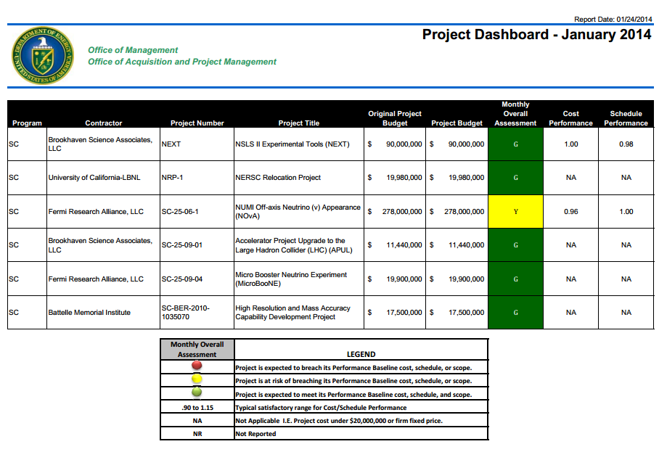
DOE Project Dashboard
Once LARP becomes a DOE 413.3B Project, the LARP PMO goal will be to remain in the DOE Project Dashboard “Green” category

Slide 19
Examples of Pre-MIE LLI funding needs
Assuming MIE funding is available in FY18:
  Strand Procurement
    Need to start in Q4FY16 to be ready for first coil fabrication in Q3FY18
      ~ $6.3M in Pre-MIE funding (preliminary)
  Magnet Fabrication Tooling
    Procurement in FY17
      ~ $3.7M in Pre-MIE funding (preliminary)
  Preparations for MQXF Test Facility
    Test Stand Upgrade needs to start in FY17 , first MQXF test expected January 2019
      Pre-MIE funding needs being identified

Slide 20
LLI: MQXF Strand Procurement
(preliminary)
Strand Procurement
  Starts Q4FY16
Cable production
  Starts Q1FY18
Coil Production
  Starts Q3FY18
Contract terms
  13% at contract award
  27% 6 months ARO
  First delivery 12 months ARO
  1000 kg of wire every two months
Total ~ $14.5M
CD-0/1/2
CD-3
Pre-MIE Funds ($6.3M)
MIE Funds ($8.25M)

Slide 21
LLI: MQXF Magnet Tooling
(Preliminary)

Slide 22
Summary
LARP is moving towards a DOE/SC Critical Decision(CD) Process Framework
A CD Tailoring Strategy for LARP has been proposed, involving consolidation of CD-0/1/2 by mid-FY17
  Substantial effort is required to be ready for this consolidated CD point
    Will proceed “as if already in a CD process framework”
      For example, equivalent level of readiness for CD-0 in FY15, CD-1 in FY16, and CD-2 in FY17
  With this tailoring strategy, pre-MIE funding is needed for LLI procurements starting in FY16 for items such as strand procurements, magnet fabrication tooling, and test facility preparations

