Slide 1
QXF Coil Fabrication & Tooling
Reaction / Impregnation
Jesse Schmalzle, BNL
February 17, 2014

Slide 2
Outline
Tooling design
Coil fabrication
Status
Summary

Slide 3
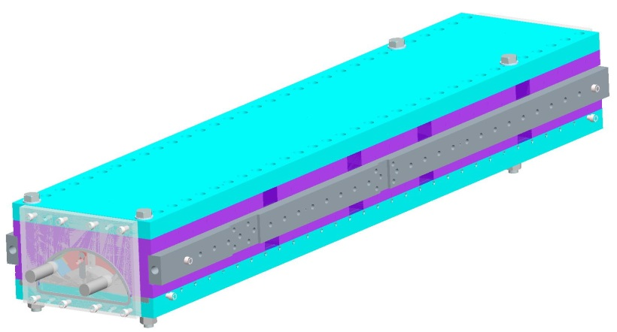
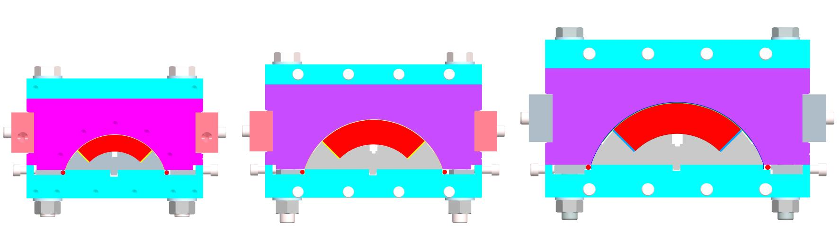
Coil Tooling Design
QXF tooling design is based on tooling used successfully for LQ and HQ.
  Reaction & Impregnation Tooling:
    Stainless steel fixtures used to react and impregnate coils.
    Full length base plate, top plate, side rails.
    Mandrel and form block pieces are short blocks, approximately 50 mm long.
    Thin stainless steel liner inside form blocks.
    End plates seal the ends.
LQ (90 mm)
Coil Length 3.3 m
HQ (120 mm)
HQ 1.2 m, LHQ 3.3 m
QXF (150 mm)
SQXF 1.5 m, LQXF 4.3 m

Slide 4
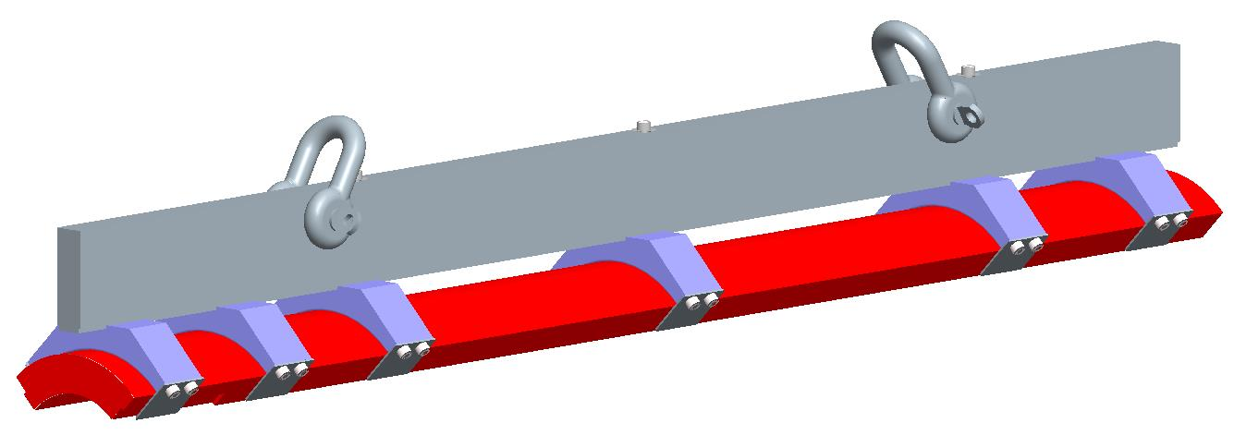
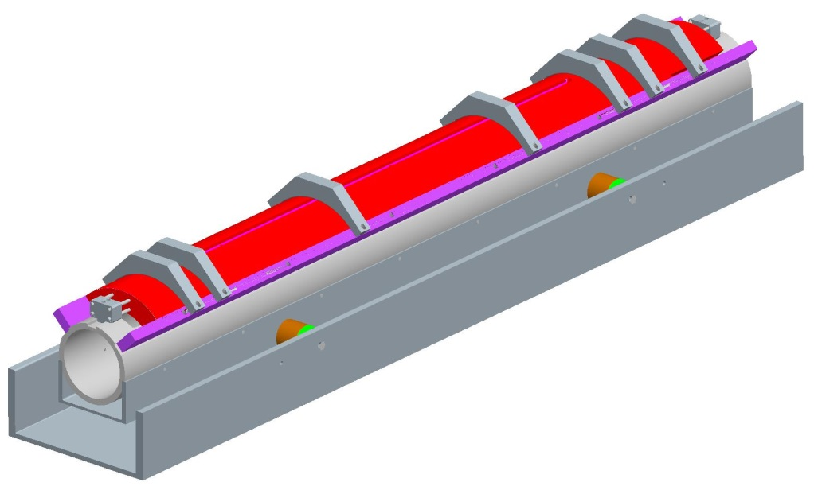
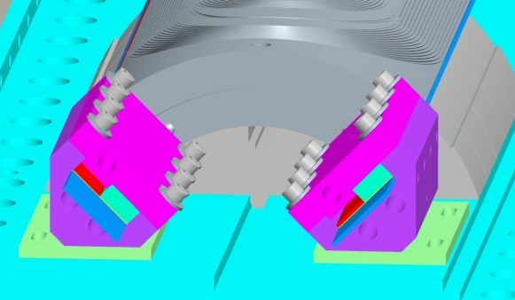
Coil Tooling Design
QXF tooling design is based on tooling used successfully for LQ and HQ.
  Coil Lifting Fixture:
    Rigid support for handling cured coil or impregnated coil.
    Reacted coil not handled until after impregnation.
  Coil Shipping Fixture:
    Coil support tube mounted on rubber shock mounts.
  Coil lead solder fixture:
    Make connection between Nb₃Sn conductor and NbTi extension leads.

Slide 5
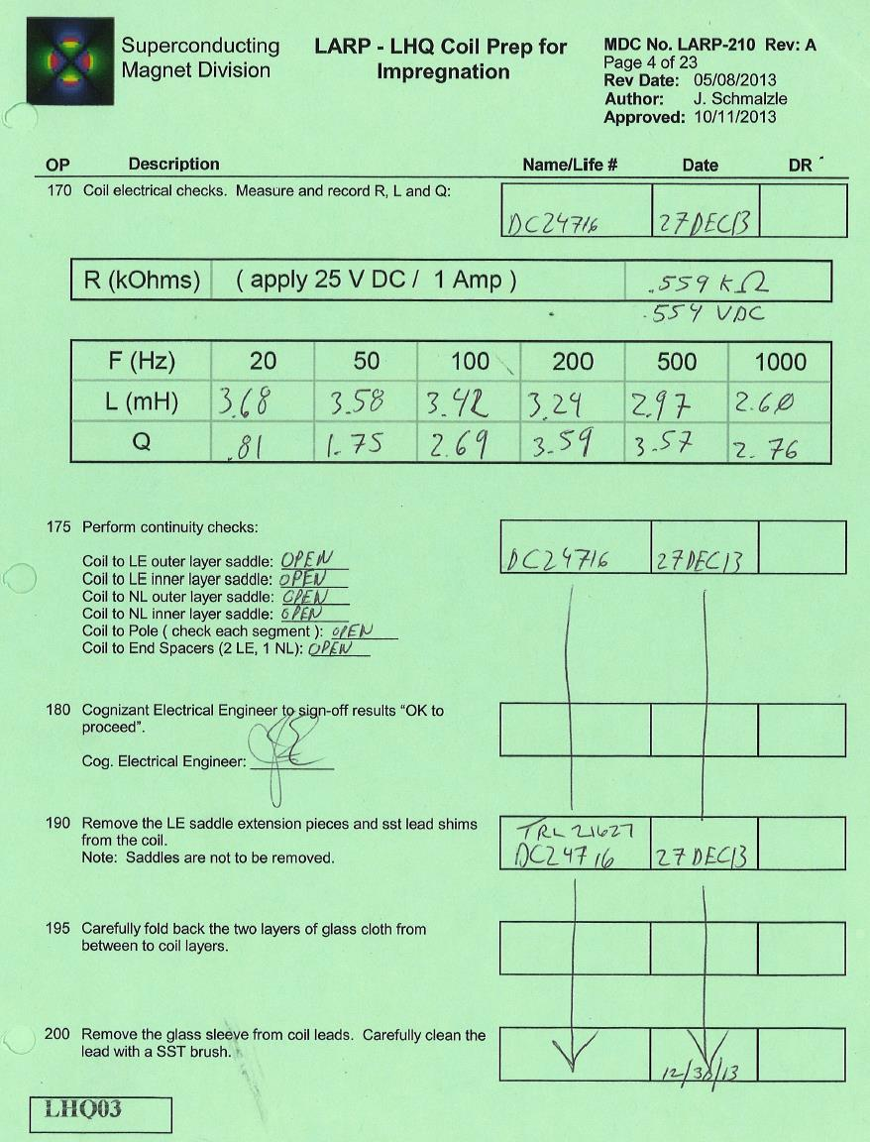
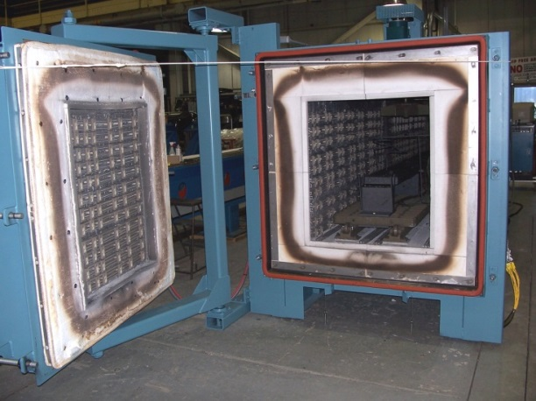
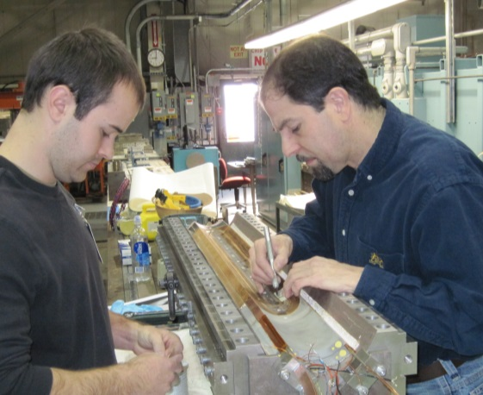
Coil Fabrication
Coil fabrication procedures are well established and documented from LQ and HQ.
  Travelers used on the shop floor provide step by step instructions, place for technicians to sign-off as operations are completed. Engineering sign-off at key points, e.g. after electrical checks.
  QXF travelers are based on most recent HQ travelers.
Facilities / Infrastructure is in place at multiple labs.
  Reaction ovens at 3 labs (accommodate 4m coils).
  Vacuum impregnation facilities at 3 labs.

Slide 6
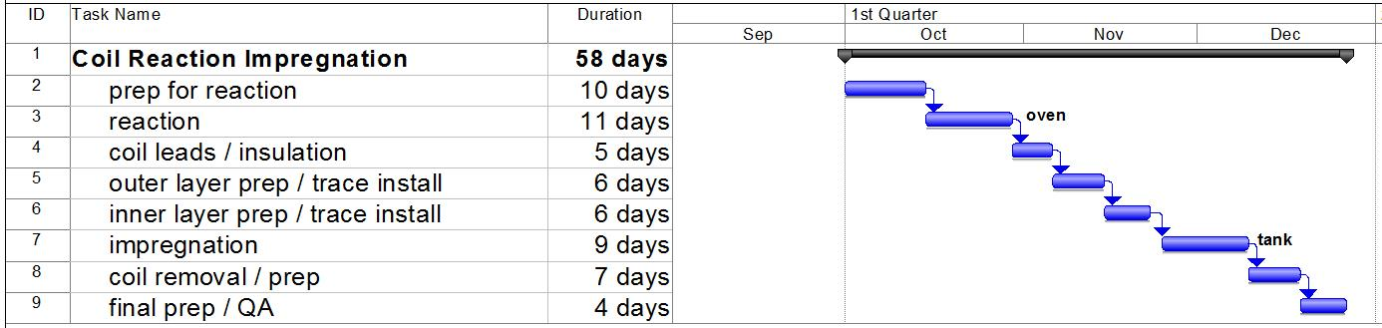
Coil Fabrication
Typical Reaction Impregnation schedule:
Impregnation:
  Fixture moved from oven to assembly table.
  Reaction top plate, form blocks, liner, mica, fiberglass removed.
  Lead extensions soldered to coil leads.
  Outer instrumentation trace installed, covered with fiberglass.
  Impregnation liner, form blocks and top plate installed.
  Fixture bolted closed, flipped over.
  Reaction mandrel blocks, base plate and mica paper removed.
  Inner instrumentation trace installed, covered with fiberglass.
  Impregnation mandrel blocks and base plate installed.
  Fixture bolted closed. End plates and lead seals installed.
  Fixture moved to vacuum tank for impregnation.
  Pump down, bake out.
  Impregnate with CTD101k.
  Cure includes steps at 110 C and 125 C.
Procedure Outline:
Reaction:
  Base plate and mandrel blocks laid out on assembly table.
  Cured coil placed into reaction mandrel blocks.
  Outer layer covered with fiberglass cloth and mica paper.
  Reaction liner, form blocks and top plate installed.
  Fixture bolted closed, flipped over and opened.
  Inner layer and midplanes covered with mica paper.
  Reaction mandrel blocks and base plate installed.
  Fixture bolted closed, end plates installed.
  Fixture moved into oven for reaction.
  Reaction includes steps at 210 C, 400 C and 640 C.

Slide 7
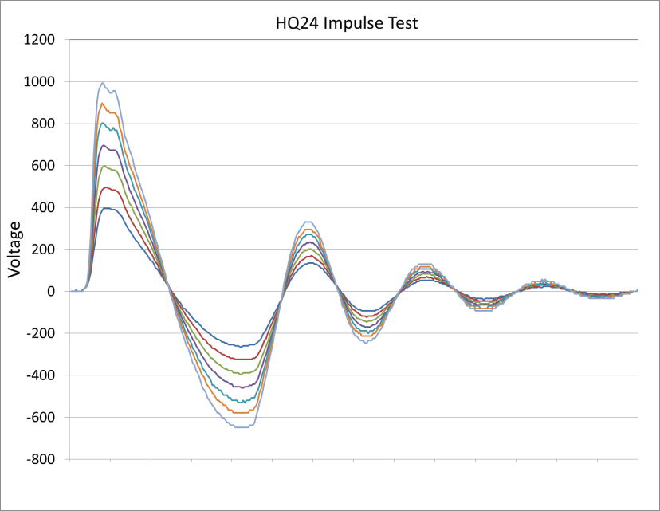
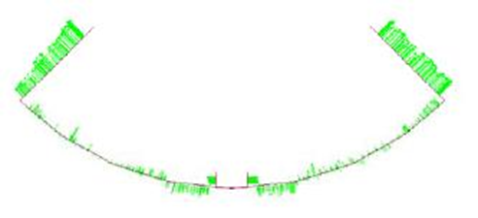
Coil QA
Coil QA
  Electrical:
    Resistance / RLQ
      Coil
      Voltage Taps
      Heaters
    Hipot
      Coil to Heaters
      Coil to End Shoe
      Heaters to End Shoes
      End Shoe to End Shoe
    Impulse
  Mechanical:
    Coil Length
    Coil Azimuthal Size
Coil CMM Measurements

Slide 8
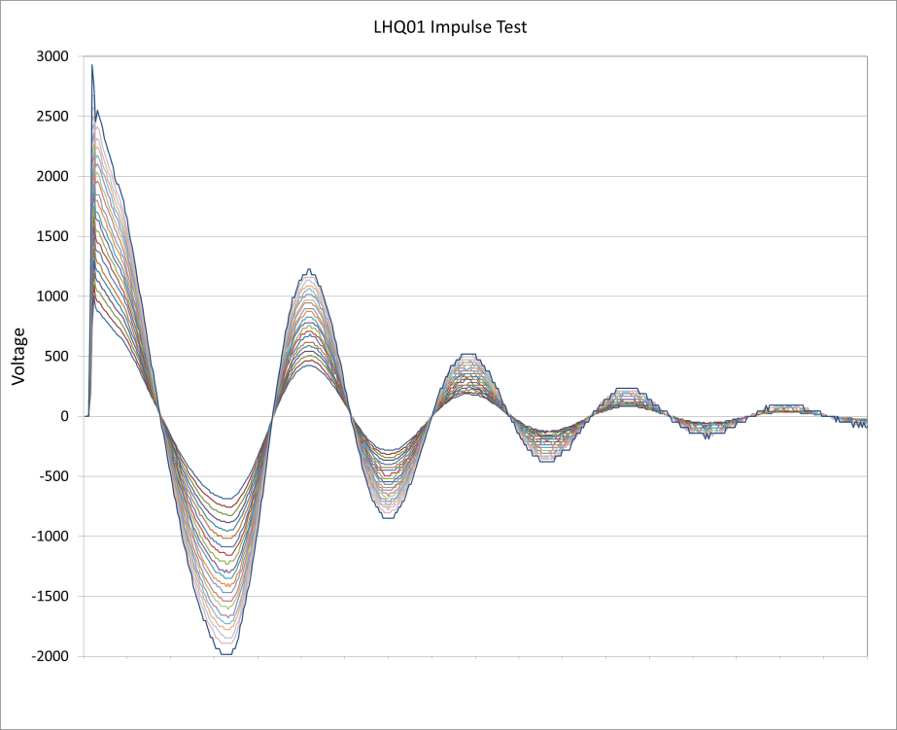
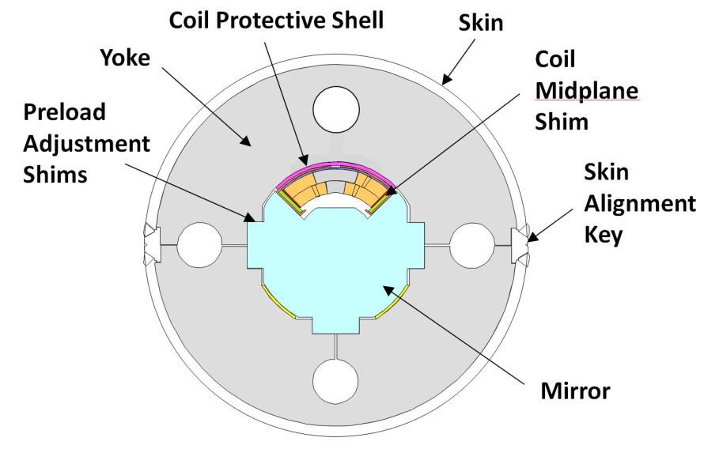
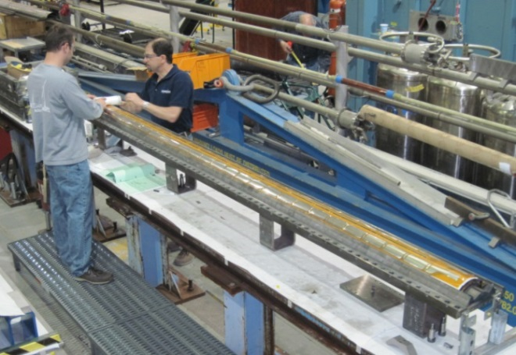
LHQ Coil Fabrication & Testing
Electrical tests of the LHQ practice coil were run at higher levels than normal for HQ in order to demonstrate the ability to meet CERN’s more stringent requirements.
  Hipot coil to quench heaters – Passed at 5000 volts.
    (Normal HQ test - 1000 volts)
  Coil Impulse test – Passed at 3000 Volts.
    (Normal HQ test - 1000 Volts)
Upcoming mirror test of LHQ coil will demonstrate HQ features not present in the LQ magnets.
    Cable with core, braided insulation, stainless steel end parts.

Slide 9
Status
Coil fabrication procedures:
  SQXF traveler preparation underway (based on HQ).
  Coil QA is in place, being reviewed for compliance with CERN requirements.
Tooling fabrication:
  SQXF Reaction Impregnation fixtures – fabrication underway (FNAL).
    First reaction set due early March.
    First impregnation set due mid March.
    Remaining sets by end of March.
  SQXF Coil lifting fixtures - fabrication underway (BNL).
    Some parts received, remaining due by end of February.
  SQXF Coil shipping fixtures - fabrication underway (BNL).
    Some parts received, remaining due early March.
  Coil lead solder fixture - fabrication underway (BNL)
    Due mid March.
  LQXF Reaction Impregnation fixtures – design complete, drawings ready.
  LQXF Coil lifting & shipping fixtures - design complete, drawings ready.

Slide 10
Summary
QXF tooling designs based on tooling used successfully for LQ and HQ.
Procedures well established and documented.
Facilities / Infrastructure in existence at multiple labs.
SQXF tooling fabrication well underway.

