Slide 1
LARP DOE Review – Q&A
G. Ambrosio, G.L.Sabbi, J. Fox, A. Ratti, R. Carcagno, M. Kaducak, G. Apollinari
February 18th 2014

Slide 2
Show ramp up of LAP (LHC Accelerator Project) and ramp down of LARP
Based on “Preliminary Deliverables” (June ‘13)
CD-4 by FY23
 | FY15 | FY16 | FY17 | FY18 | FY19 | FY20 | FY21 | FY22 | FY23 | LARP TOTAL | PROJECT TOTAL
LARP funding | $16M | $16M | $16M |  |  |  |  |  |  | $48M
LLI (pre-Project funding) |  | $10M | $23M |  |  |  |  |  |  |  | $33M
Project funding |  |  |  | $34M | $51M | $43M | $31M | $17M | $6M |  | $182M
TOTAL | $16M | $26M | $39M | $34M | $51M | $43M | $31M | $17M | $6M | $48M | $215M
 | FY15 | FY16 | FY17 | FY18 | FY19 | FY20 | FY21 | FY22 | FY23 | LARP TOTAL | PROJECT TOTAL
“R&D” LARP Funding | $ 5M | $ 5M | $ 5M | $ 6M | $ 7M | … | … | … | …
LARP funding | $16M | $16M | $16M |  |  |  |  |  |  | $48M
LLI (pre-Project funding) |  | $10M | $23M |  |  |  |  |  |  |  | $33M
Project funding |  |  |  | $34M | $51M | $43M | $31M | $17M | $6M |  | $182M
TOTAL | $16M | $26M | $39M | $34M | $51M | $43M | $31M | $17M | $6M | $48M | $215M
CD-0/CD-1/CD-2

Slide 3
What is included in funds required for MIE and total amount. (?) Consistency in funding profile over a number of presentations

Slide 4
What is included ?
From M. Kaducak Presentation
Magnets
Assemble, test, and deliver 20 (16 + 4 spares) Q1/Q3 quadrupole structures, where “structure” = coils clamped radially in aluminum shells, axially with stainless steel rods and end plates
Crab Cavities
Assemble, test, deliver 10 cryomodules of 3 cavities each
Contain cavities, He vessels, tuners, HOM mode dampers
Cryogenics, RF power, local installation provided by CERN
8 CM needed in pts 1 and 5, 2 spares (one per IP)
Wideband Feedback System
Fully functioning wideband feedback system for SPS and commissioning support.

Slide 5
Funding Profile Tables
You saw 2 “overall cost tables”
LAP(MIE) estimate: 205$ -> 215 M$
Escalation effect + 1 extra year of Management
LARP: From 62M$ in FY14-17 to 48 M$ in FY15-FY17
Accounts for funds received in FY14
Based on “Preliminary Deliverables” (June ‘13)
CD-4 by FY22
Based on “Preliminary Deliverables” (June ‘13)
CD-4 by FY23

Slide 6
LLI (Pre-Project) Funding
 | FY15 | FY16 | FY17 | FY18 | FY19 | FY20 | FY21 | FY22 | FY23 | LARP TOTAL | PROJECT TOTAL
LARP funding | $16M | $16M | $16M |  |  |  |  |  |  | $48M
LLI (pre-Project funding) |  | $10M | $23M |  |  |  |  |  |  |  | $33M
Project funding (MIE) |  |  |  | $34M | $51M | $43M | $31M | $17M | $6M |  | $182M
TOTAL | $16M | $26M | $39M | $34M | $51M | $43M | $31M | $17M | $6M | $48M | $215M
“LLI-like/Preproject Funding” presented by Mark do include more than just SC strand contract to insure immediate production start inFY18

Slide 7
Benefits of spending 15-18% of budget on HQ testing. In worst case needs to reduce magnet development by 5%. Justify the quench protection from the HQ testing vs. the 5% reduction.

Slide 8
HQ = Risk Reduction for QXF
Quench Protection
Field Quality
Personal note: although HQ activities in FY14 represent ~15% of the magnet budget, the HQ03 test is a small fraction of such budget. The amount of knowledge gained vs. the rather limited savings is for me the outstanding argument to continue the effort.

Slide 9
Quench Protection
Test of Maximum acceptable temperature
Present understanding based on single TQ test (TQS01c), which did not have stainless steel core
First test of CLIQ on a Nb₃Sn magnet
Very promising, but tested only on a short NbTi magnet
Test of quench heaters optimized for QXF
If we do not do perform these tests on HQ we will have to perform them on SQXF1 or SQXF1b
But we need a magnet that can approach SSL, and this is a destructive test (not likely on the 1st SQXF model)
➔ ~Two year min. delay on a critical part of the design

Slide 10
Field Quality
HQ03 test will either confirm that HQ02 low order harmonics are out of tolerance, or will show that we fixed them with more uniform coils
It should also show the effectiveness of the planned correction scheme
If we do not test HQ03 we will have to wait for SQXF1 and SQXF2 in order to have two similar magnets for checking field quality reproducibility
➔ ~Two year delay for feedback to beam dynamic simulations and setting of Field Quality requirements

Slide 11
NOTE: a ~2 year delay in these critical parts of the design (Quench Protection and Field Quality) is an extremely high risk
We will have to make decisions without this feedback
Even if we cancel HQ we will have to do the scientific and engineering work associated with addressing these points, so the potential saving is limited.

Slide 12
Two issues: detail impact of various budget scenes on program changes for WBF and Crab Cavities. Never brought together. Bottom line impact.

Slide 13
CC - Funding Scenario 1
Full funding
Still has a problem managing the difficult spending profile with peak in FY15
FY15
Request FY14 contingency to restore most of the scope delayed from FY14 into FY15
Design and build tooling and structures for VT
Materials and service procurements for final processing (at JLAB/ANL) and VT
Expedite HOM dampers and tuners development
Staged delivery of 2 cavities into FY16
Still compatible with global schedule

Slide 14
CC - Funding Scenario 2
Reduced LARP Funding ~ 10%
Reduce CC ~5-15% or ~$200k/year
Options to trade scope to CERN (to be discussed)
Reduce engineering effort + ask for more CERN engineering help
CERN procures all materials and fabs all peripherals (tuners, HOM dampers…)
Reduce participation to SPS testing and beam studies
Continue leading cavity production, testing for SPS and preparation for LHC

Slide 15
CC - Funding Scenario 3
AKA - Nightmare
Reduce LARP ~20%
Reduce CC by ~25-35% or ~$500k/year
Major scope reduction
To be discussed with CERN
Options:
Eliminate cavity string assembly and test + ship separate cavities
Move final testing of dressed cavities to SM18
CERN procures all materials and fabs all peripherals (tuners, HOM dampers…)
Reduction in participation in SPS testing and beam studies
Still keep a core staff together to monitor production, advise CERN and participate in MDs
Cavity production and bare cavity testing
Peripherals design and fab support
Cryomodule integration + LHC implementation studies
Some participation to SPS testing
Such reduction would make LARP’s contribution less and less relevant

Slide 19
NIOWAVE, DOE/LAB no supplying engineering plans/resources. What is plan B.

Slide 20
Interaction with Niowave
We are well aware that we don't even have a direct contract with the company.
They're are under contract with DOE's SBIR Program. Beneficial aspect of interaction between Niowave and LARP are multiple:
Access to superb technical expertise at National Labs/Universities
Activity in conjunction with world-wide “science phenomenon”
In the interest of both Niowave, DOE and LARP to have proficient handshaking.
At this point we don’t know for sure that they will make four cavities with the funds available in the SBIR. They did make that statement
We are establishing strict processes with verification points and reviews to insure success on all sides of the equation.

Slide 21
Vendor Interaction (1)
This document outlines the interactions/joint contribution points recommended by the cavity design teams as pertains to the fabrication by vendors of crab cavities for the US LARP Hi-Lumi upgrade project. Each design team will appoint a lead to serve as the single point of contact for such design. This includes BNL and ODU for the cavity design, and FNAL for cryostat design and integration.
Initial discussion with the engineering team at the vendor.
The initial discussion on the fabrication process is a necessary step that would allow the cavity design teams to have a reference context for subsequent discussions. As part of the discussion, the cavity design teams would provide tolerances for fabrication as well as input in the production approach proposed by the vendors.
Review of mechanical production drawings.
From the cavity design perspective, this is the most important checkpoint, the inspection and cross-check of the mechanical drawings for the different dyes/parts to be fabricated, as any conflicting dimensions could be detected by the cavity design teams.
Pre-production material qualification.
The properties of all Nb material used in the systems need to be verified and documented before using such material in production. CERN supplied steel will be used in flanges and vacuum components where specified.

Slide 22
Vendor Interaction Document (2)
Advance notice of changes.
If during the fabrication process, the engineering team at the vendor encounters a problem that requires a deviation from the original plan/drawings, the cavity design teams should be given the opportunity to determine how any proposed changes in the original plan/design would impact the different parameters of interest, and whether the proposed changes to the original plan are acceptable from the cavity performance standpoint or new solutions need to be found. No change is authorized without written authorization from the design teams.
Regular progress updates.
In order to ensure a successful outcome, the cavity design and engineering teams should have frequent and regular communication, both during the fabrication process and the cavity testing. The vendor team should expect full collaboration from the cavity design teams in terms of simulations and parameters needed for different fabrication steps, such as for example information needed for fine-tuning trimming purposes.
Regular visits from a LARP representative are planned to monitor production and compliance with requirements and specified processes. All visits will be in a non-intrusive way and on a mutually agreed upon schedule.
Procedure for chemical/heat treatment and HP rinsing (if needed).
Conceptually new cavities might require different procedures for chemical/heat treatment and/or HP rinsing. The cleaning process for such complex structures might require bulk BCP treatment of parts prior to welding, for example. The cavity design teams will provide, with input from the vendor, the detailed process including all steps required for chemical/heat treatment and/or HP rinsing, and how those steps fit into the fabrication/testing procedures.

Slide 23
Vendor Interaction Document (3)
Cavity testing.
The cavity design teams will participate in any testing of the cavity performed by the vendor, at all key steps of the production process. The vendor should provide a schedule for checks and testing with as much advance notice as possible, to allow the cavity design teams to plan accordingly.
Documentation
All documentation will be delivered in the CERN EDMS system, including production drawings, test qualification results, measurements and procedures. LARP receives full rights to all drawings generated in the process.
Niowave has agreed to this plan and will add the internal production schedule so we can interact accordingly.

Slide 24
Cavity Fabrication Plan
Presented by ODU
BNL preparing a very similar one
Regular monitoring from FNAL
Dedicated visits from cavity designers at stated check points
Preparing a material qualification document
Requesting all documentation be prepared in CAD compatible format
Niovawe will generate the fabrication drawings
And has agreed to give them to the collaboration at the end of the SBIR for anyone to use

Slide 25
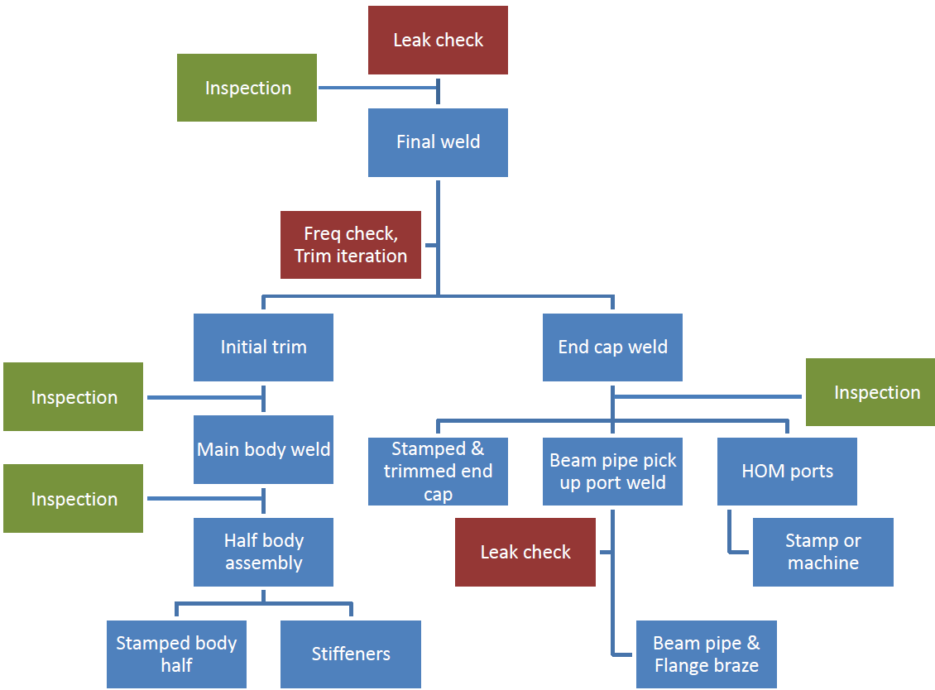
Cavity Fabrication Plan (ODU)
Inspection
Performed by Niowave
Performed by Niowave under ODU supervision
Performed by ODU

