Slide 1
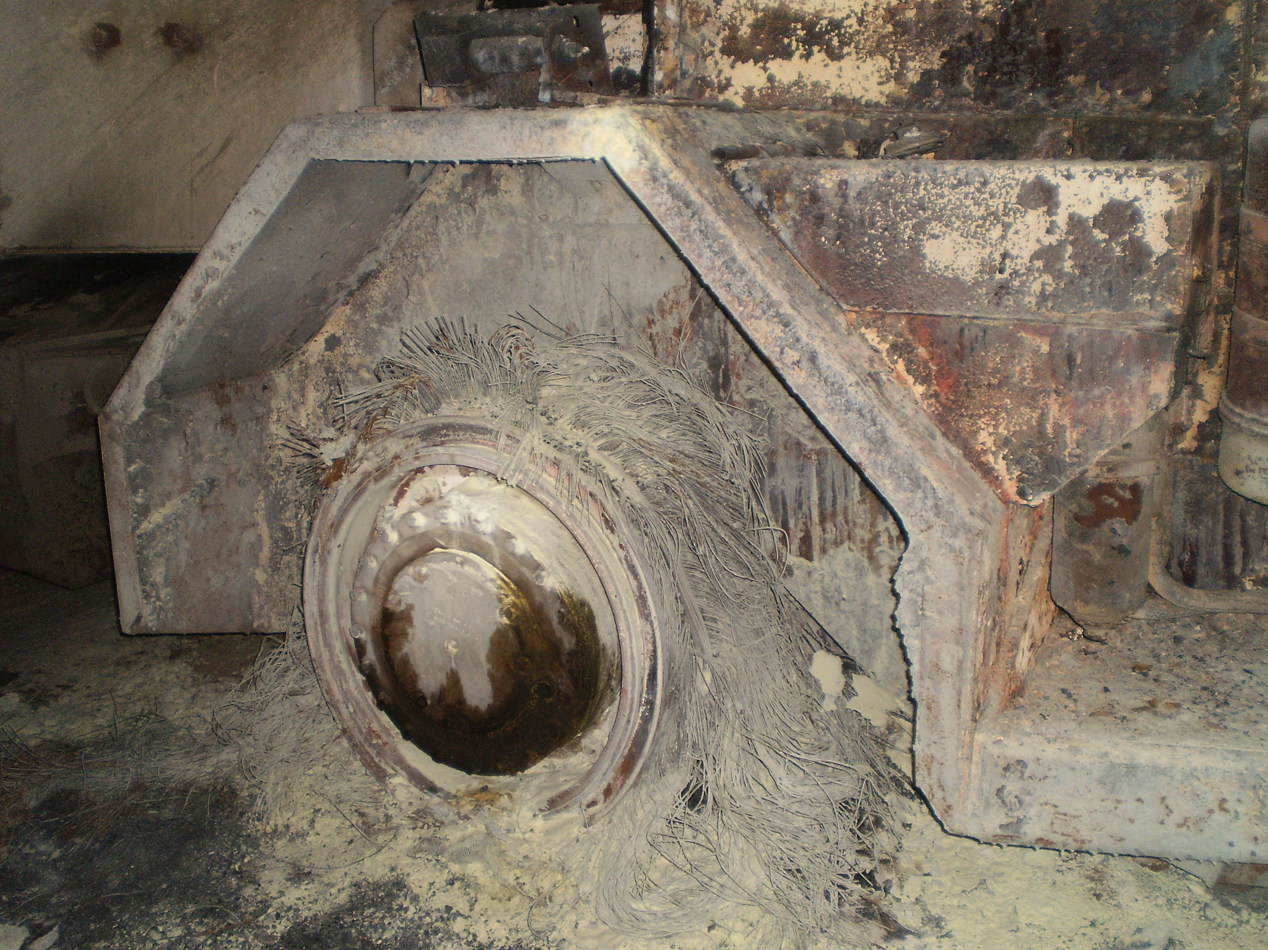
Fire Down Below: 2014 Truck Fire and Transuranics Release at the Waste Isolation Pilot Plant

Slide 2
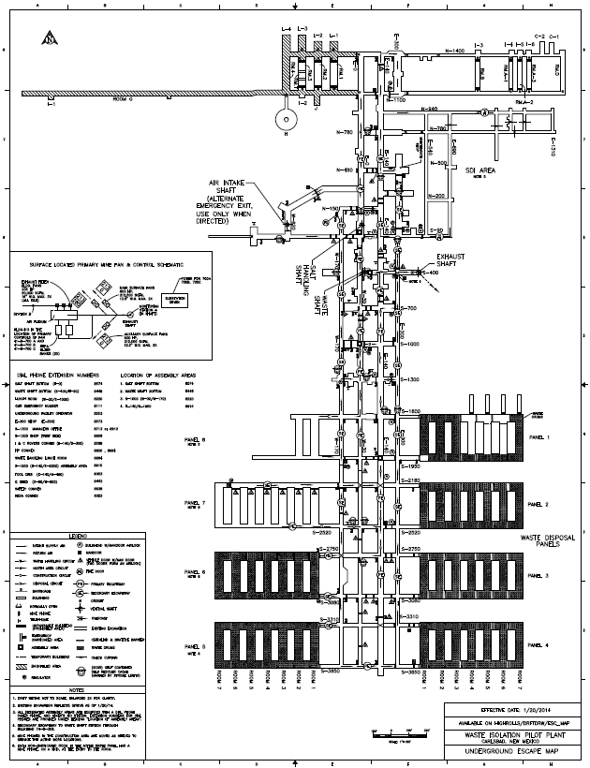
Fire Down Below: 2014 Truck Fire and Transuranics Release at the Waste Isolation Pilot Plant
WIPP: Underground transuranic waste interment facility outside Carlsbad, New Mexico
Run by a contractor (Nuclear Waste Partnership) for the U.S. DOE
Mine cut into large salt formation
Also plays host to a small number of experiments requiring low rad backgrounds
EXO-200: Search for neutrinoless double-beta decay in 200 kg of enriched liquid xenon-136
Built at Stanford University
In place at WIPP since 2011
Installed in a portable clean room in a 25x100m cavern (“the drift”)

Slide 3
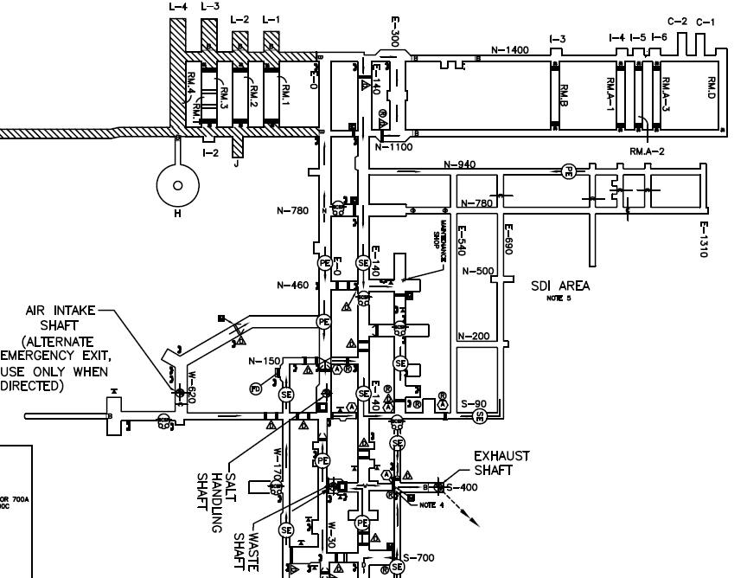
Fire Down Below: 2014 Truck Fire and Transuranics Release at the Waste Isolation Pilot Plant

Slide 4
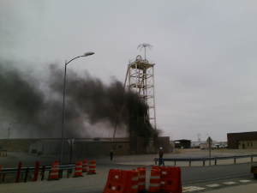
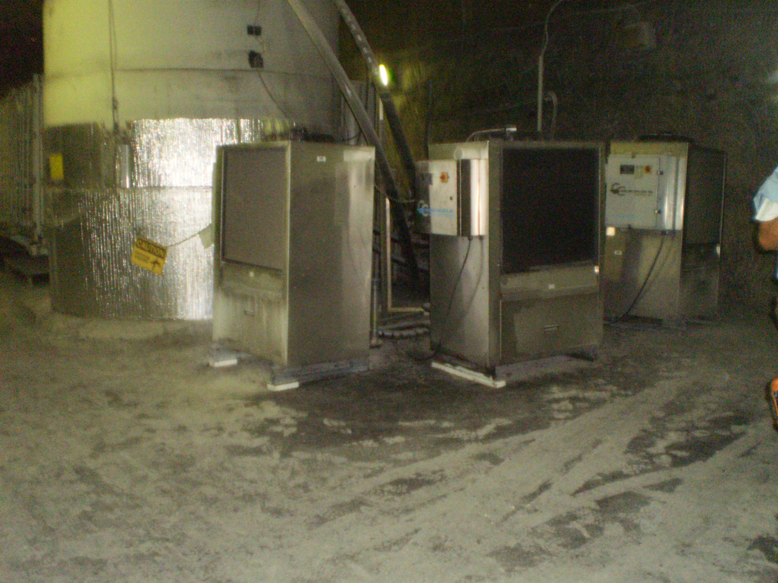
Fire Down Below: 2014 Truck Fire and Transuranics Release at the Waste Isolation Pilot Plant
Feb. 2014
Aug. 2014

Slide 5
Fire Down Below: 2014 Truck Fire and Transuranics Release at the Waste Isolation Pilot Plant
11:30 a.m. 3 workers smelled smoke
11:32 distorted, loud, and unintelligible message transmitted over mine phones
11:35 workers evacuate through alternate exit
11:36 fire alarm sounds
11:40 workers meet a WIPP miner
11:42 workers arrive at Waste Hoist
Aug. 2014

Slide 6
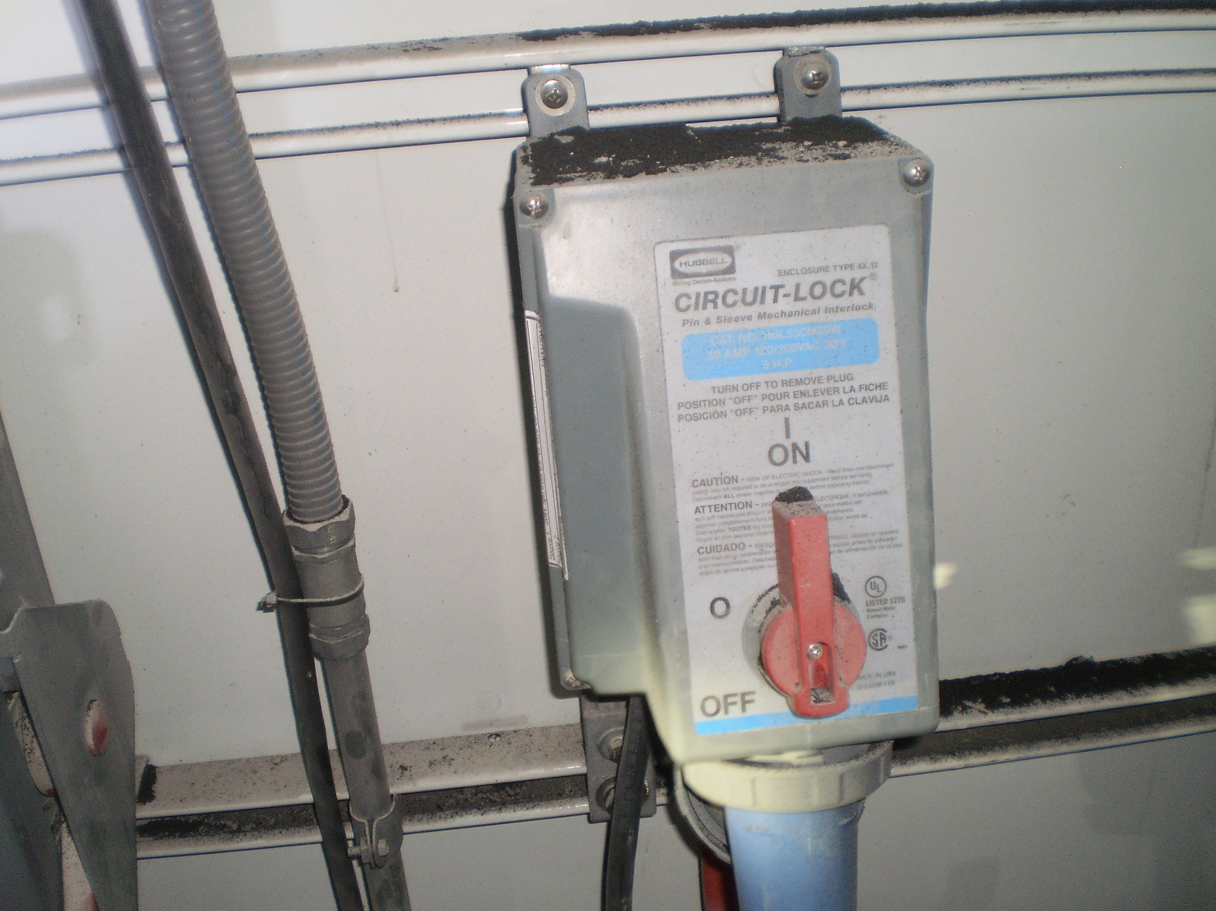
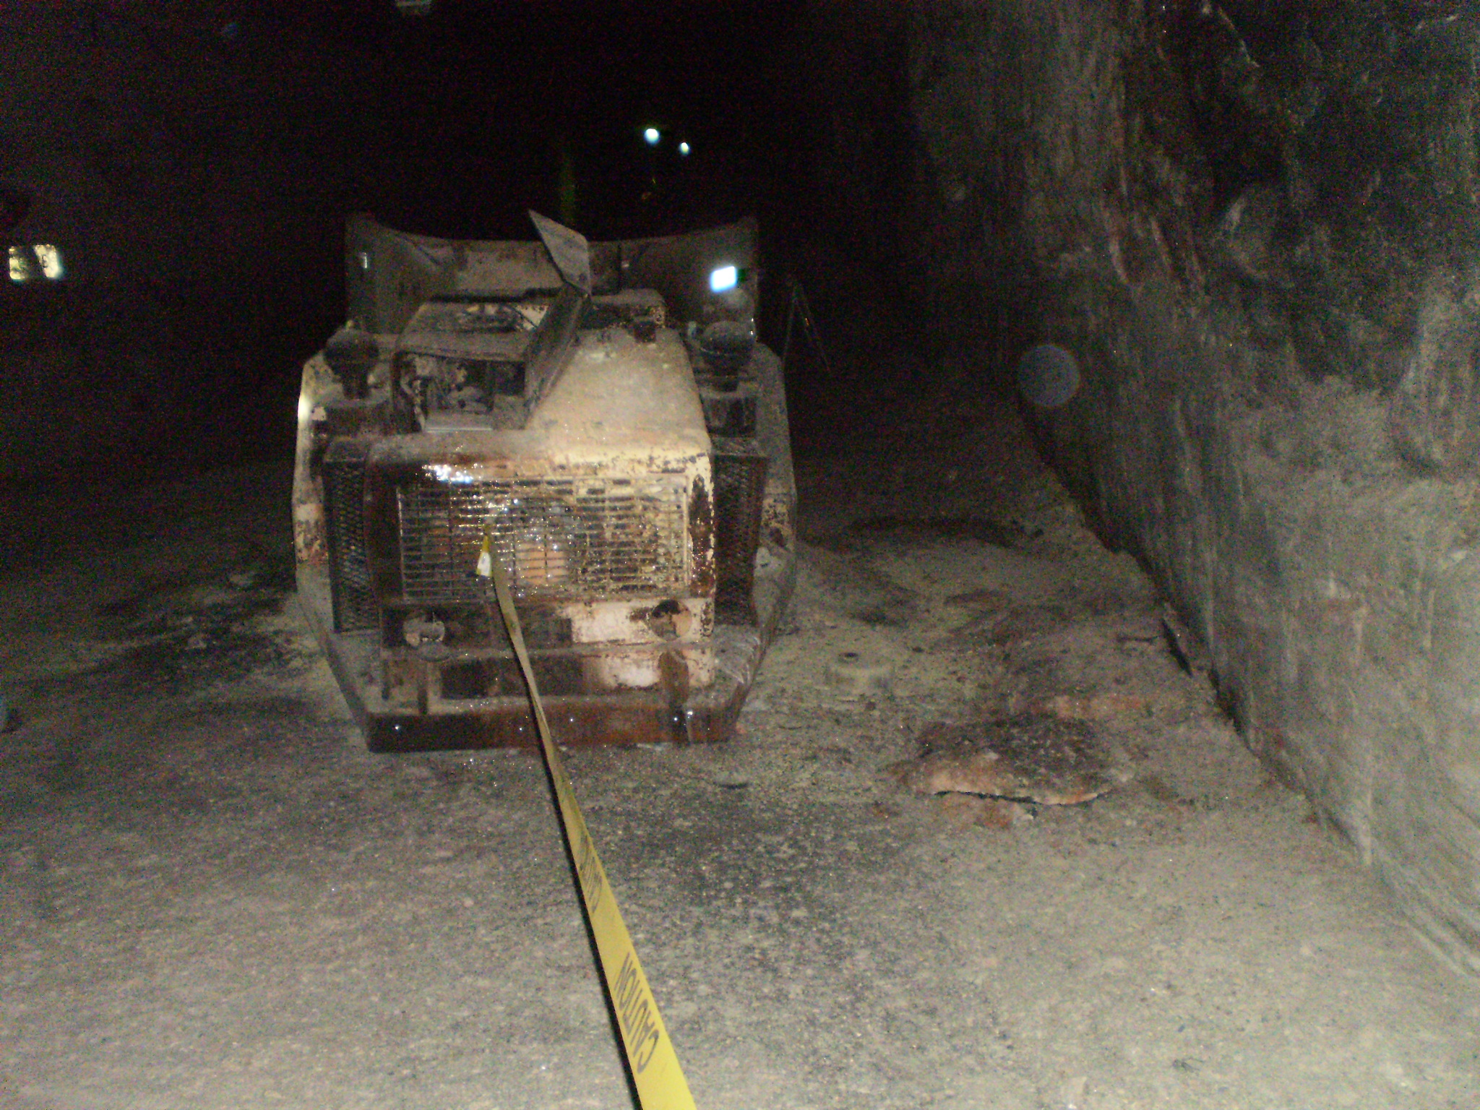
Fire Down Below: 2014 Truck Fire and Transuranics Release at the Waste Isolation Pilot Plant
Mine entries halted
Direct cause: broken hydraulic line sprayed hydraulic fluid onto hot catalytic converter
DOE investigation had 35 findings:
Preventive maintenance
Emergency preparedness
Communication
Control of combustibles
Culture

Slide 7
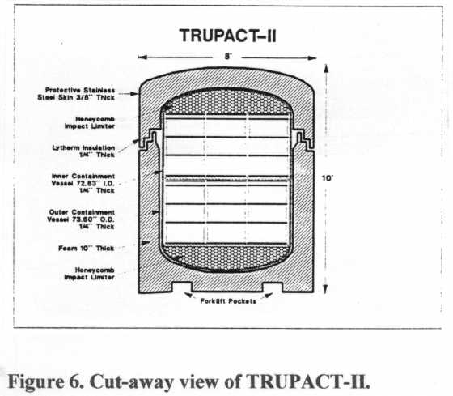
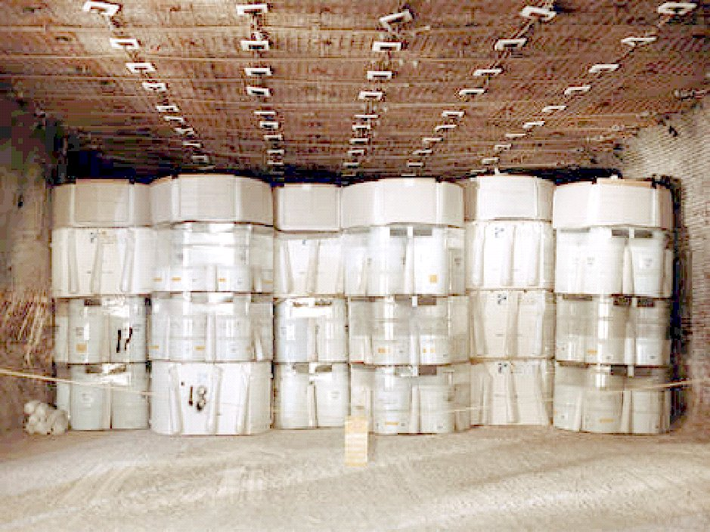
Fire Down Below: 2014 Truck Fire and Transuranics Release at the Waste Isolation Pilot Plant
Waste release:
Area monitor alarms
TRU detection offsite
Cause unknown
EXO entries since accidents:
14 Feb 2014: Only inspection and photography allowed
21 August 2014: Only inspection and photography allowed

Slide 8
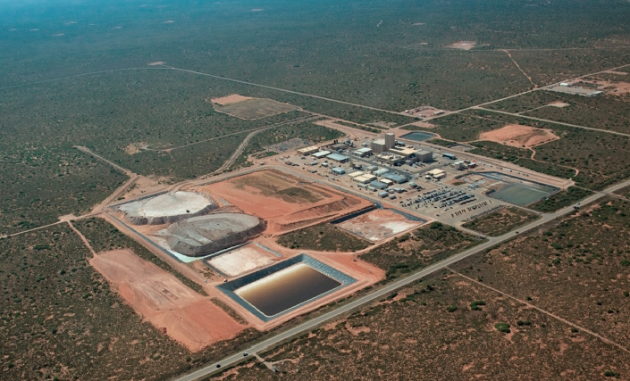
Fire Down Below: 2014 Truck Fire and Transuranics Release at the Waste Isolation Pilot Plant

Slide 9
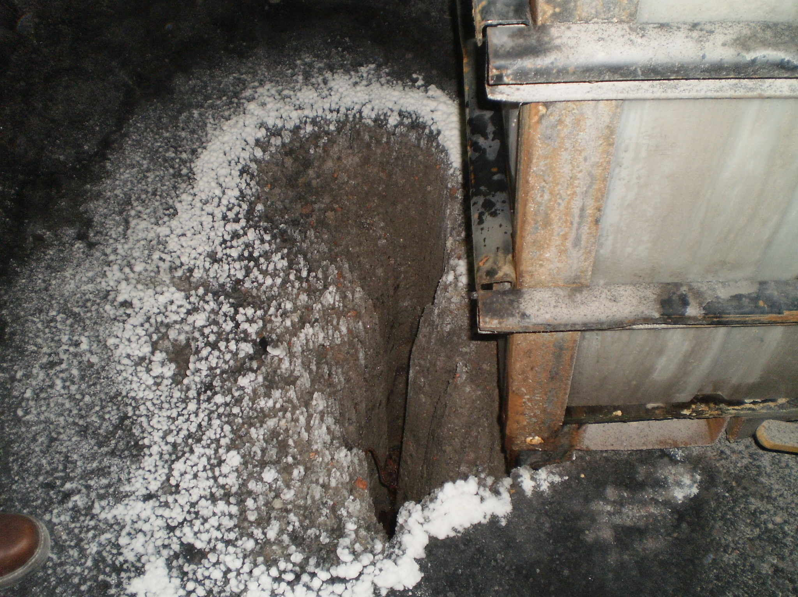
Fire Down Below: 2014 Truck Fire and Transuranics Release at the Waste Isolation Pilot Plant
Effects on EXO:
Chiller failures necessitated Xenon recovery
Water leak from thermal-store system
Other system failures

Slide 10
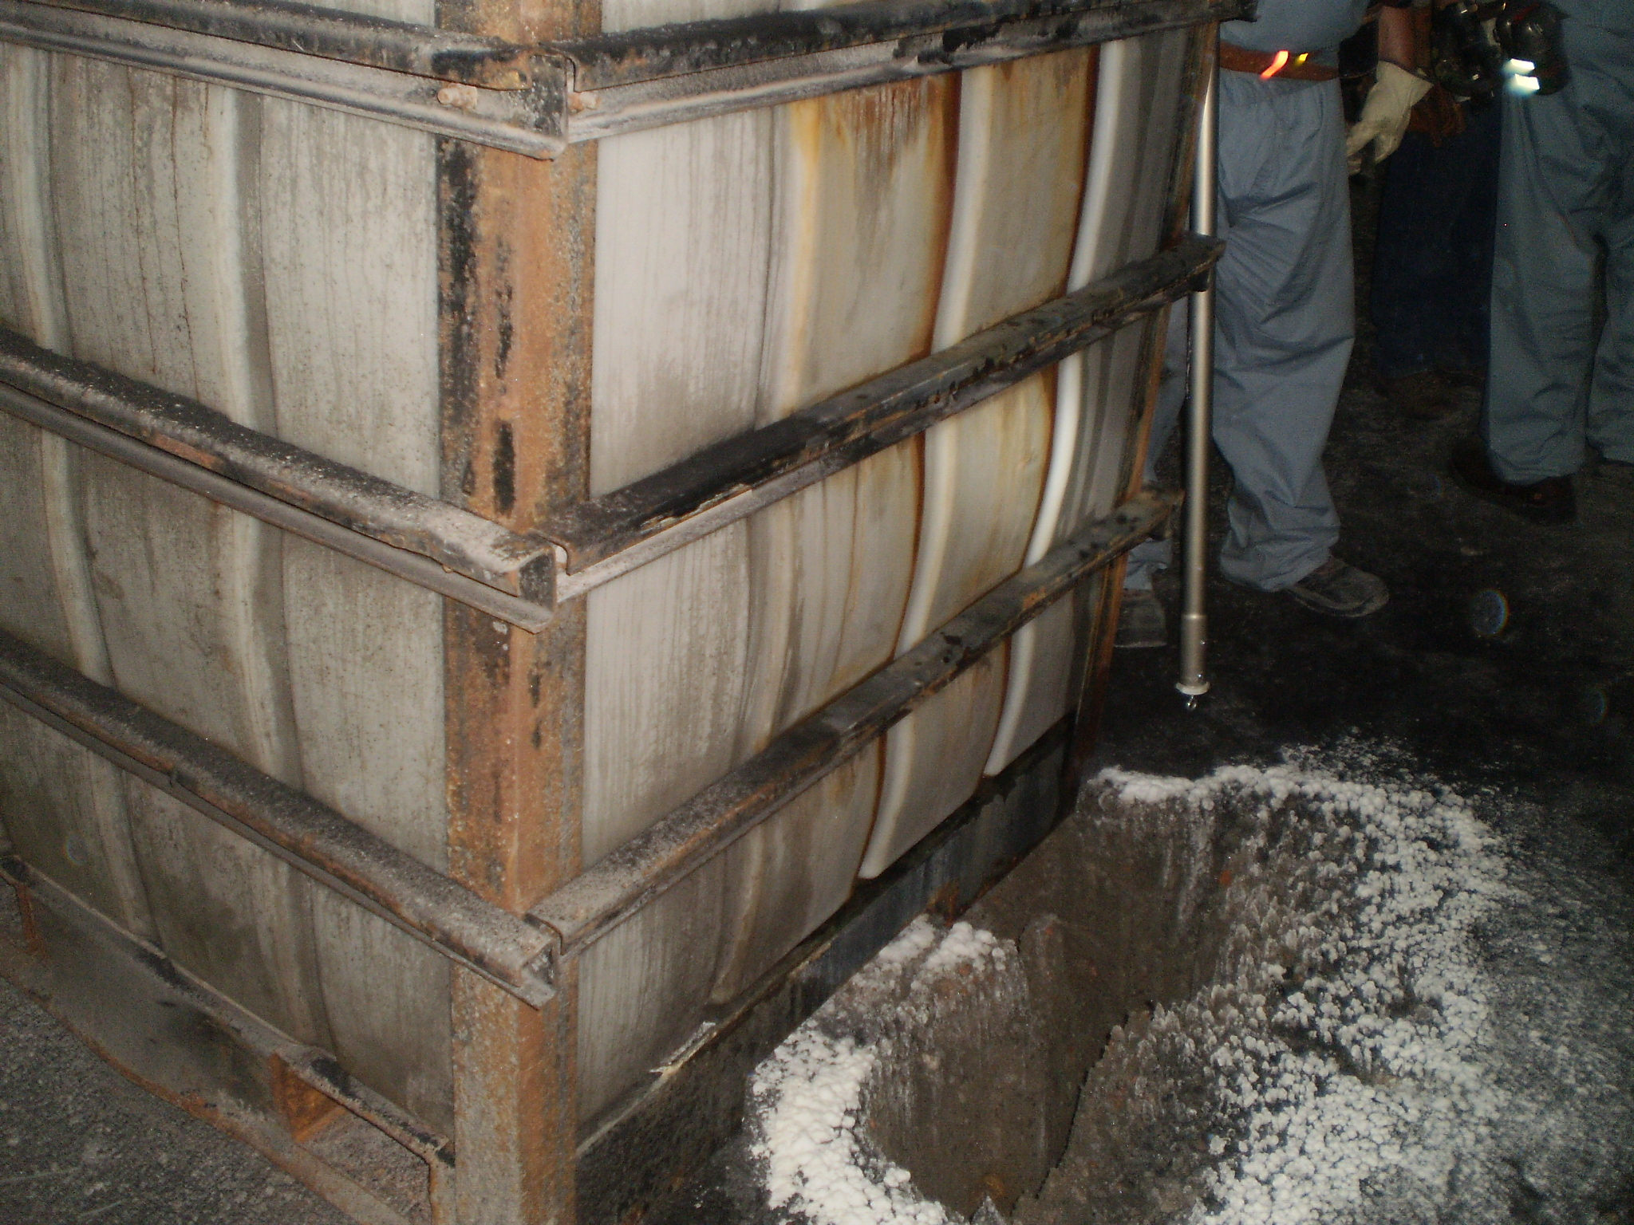
Fire Down Below: 2014 Truck Fire and Transuranics Release at the Waste Isolation Pilot Plant

Slide 11
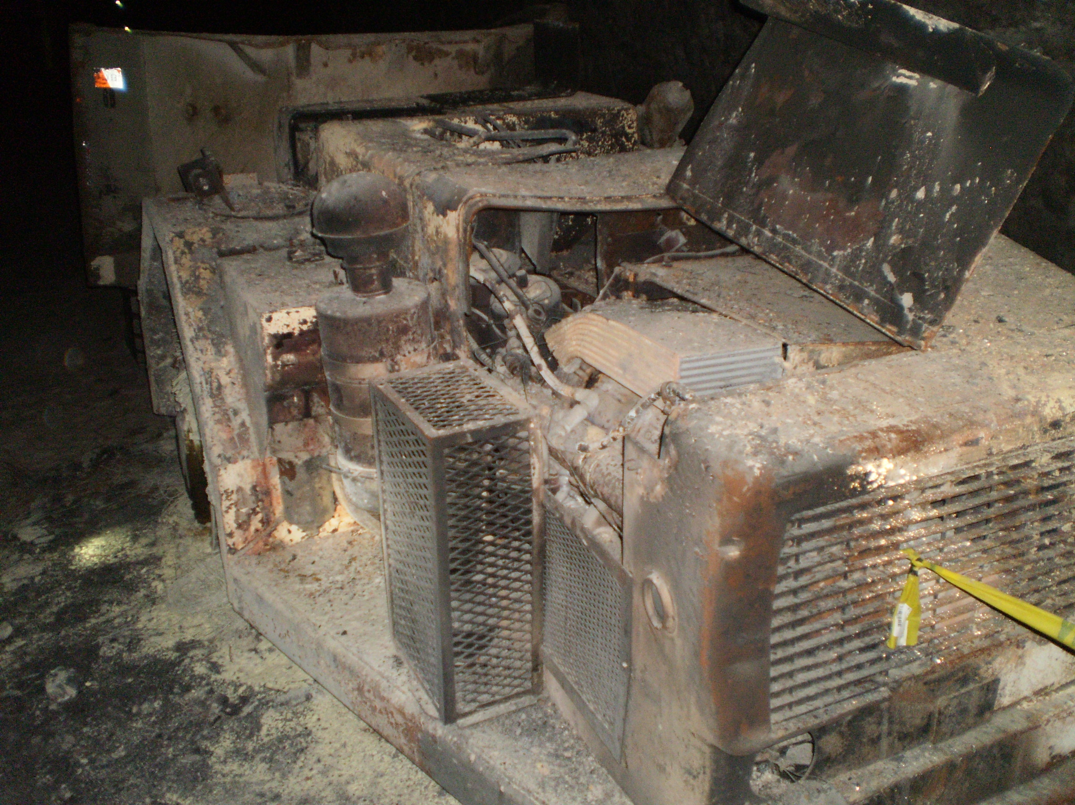
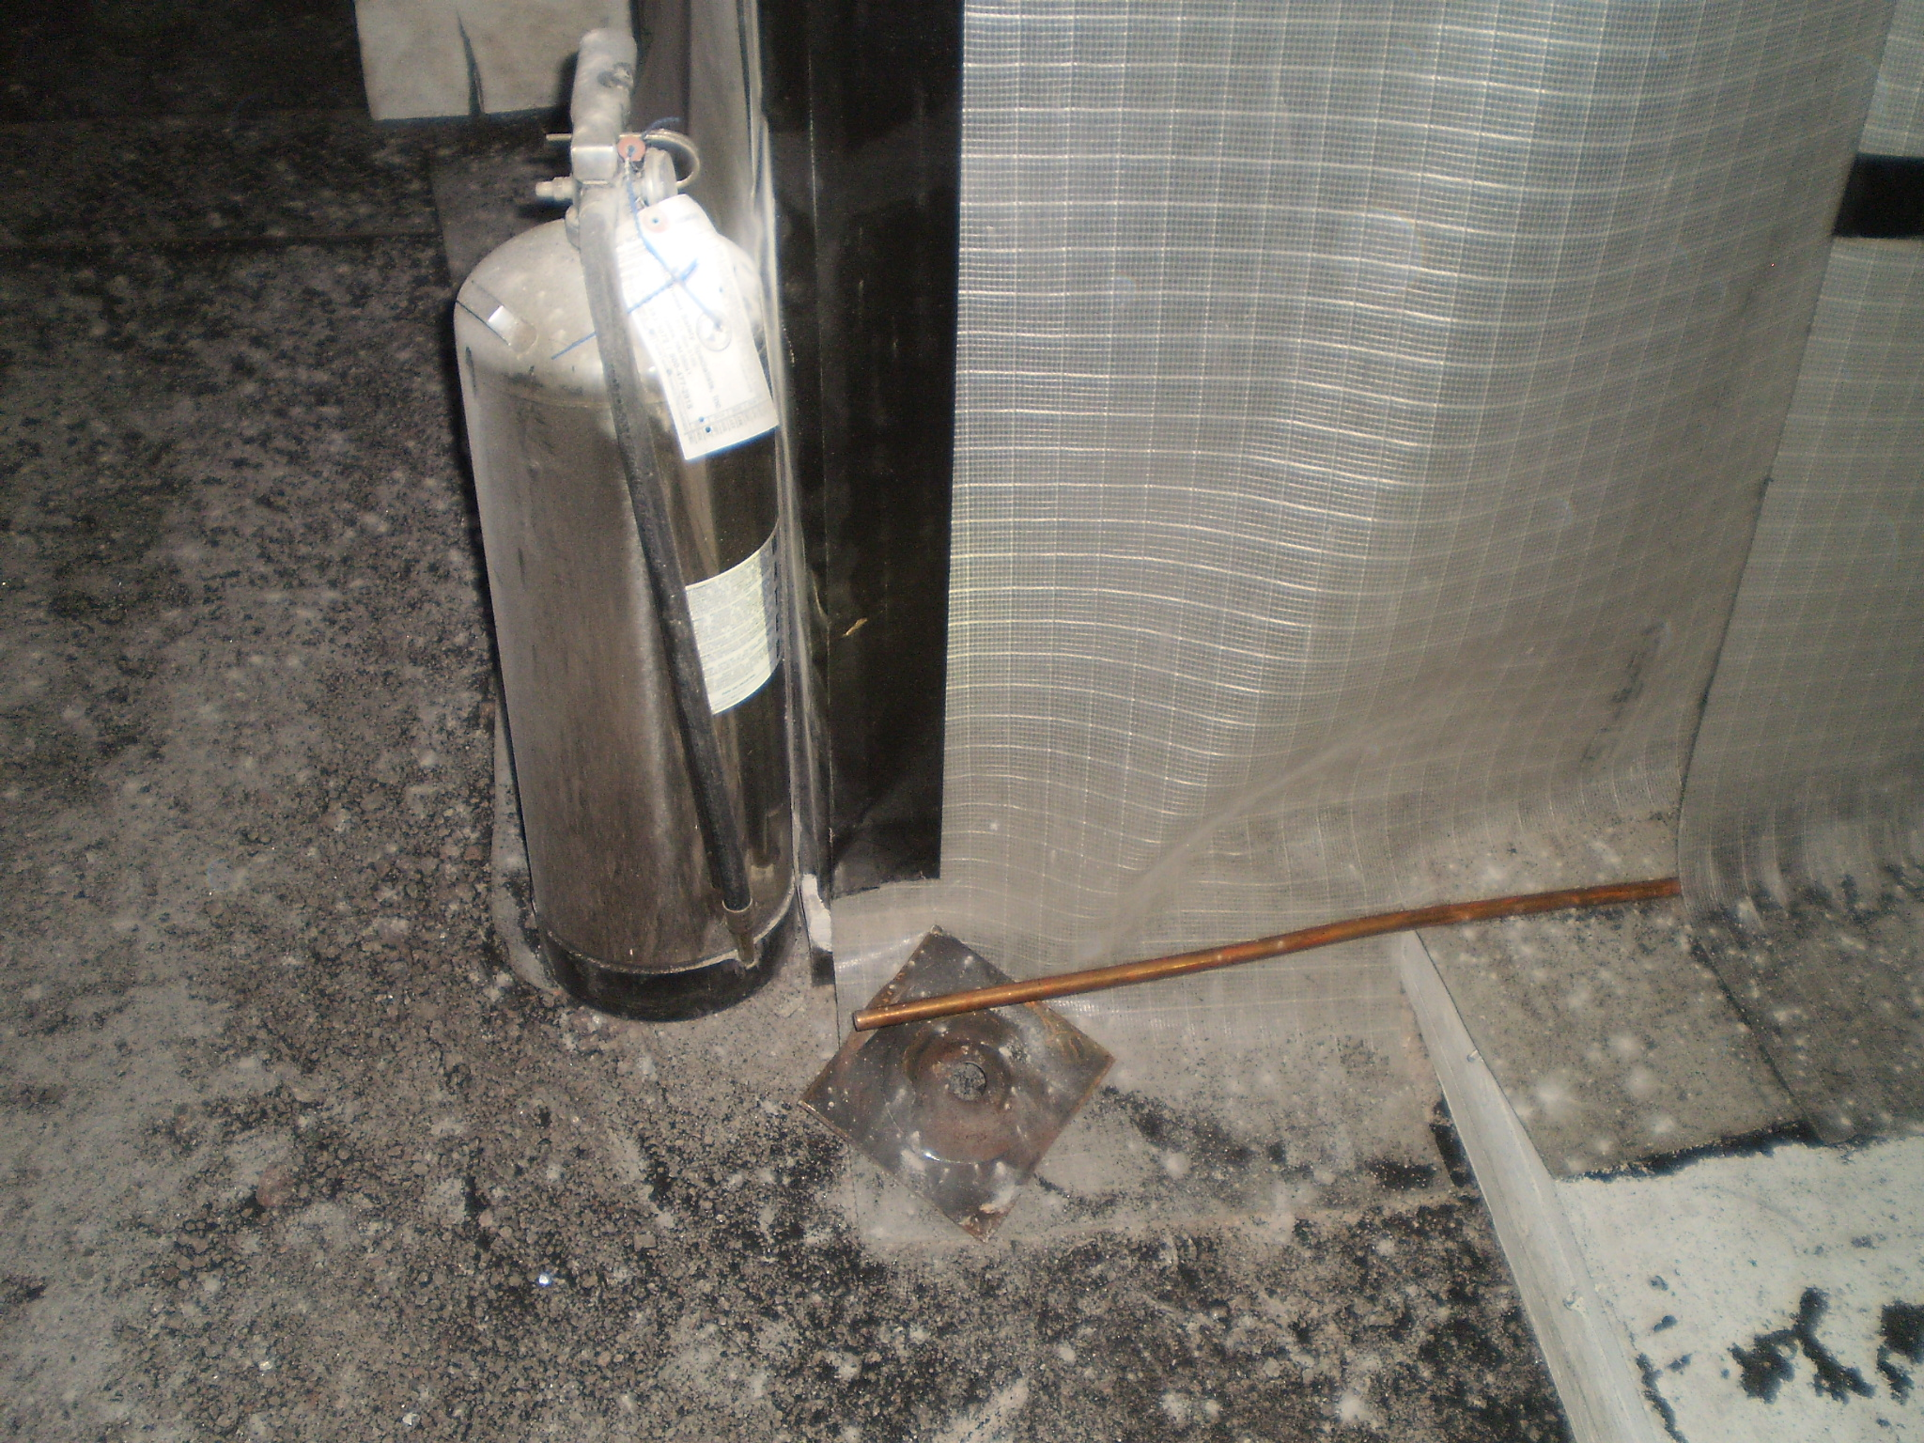
Fire Down Below: 2014 Truck Fire and Transuranics Release at the Waste Isolation Pilot Plant
What we learned:
Fate of experiment uncertain
Our remote-operation capabilities were a little weak
Removal of access privileges did the most damage
Take advantage of fungibility of assets with host
Rad-waste mines are poor places for physics experiments

