Slide 1
Equipment certification at the ESRF
S. Ricot
P. Berkvens – V. Landuré
International Technical Safety Forum 2014
September 8 – 12, 2014 · Fermilab, Batavia, IL USA

Slide 2

EQUIPMENT CERTIFICATION AT THE ESRF
New approach regulating the free movements of goods
CE certification approach
CE certification at the ESRF
Practical examples
  XY - Polishing Machine
  ID02 SAXS tube
Future developments at the ESRF
  Creation of an expert team for equipment certification
  A few examples awaiting CE certification

Slide 3
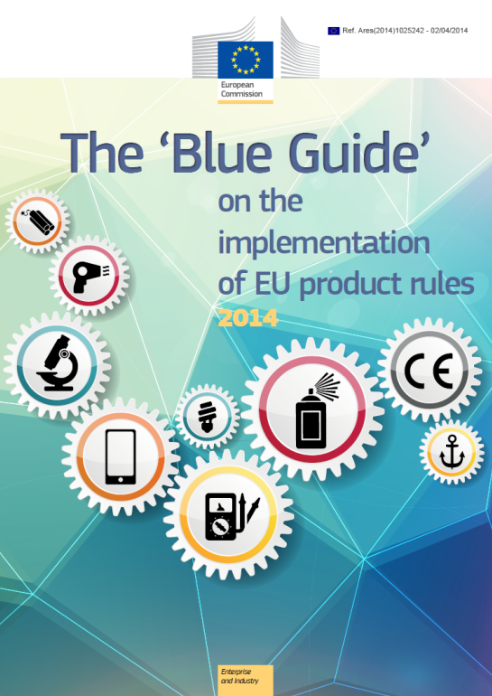
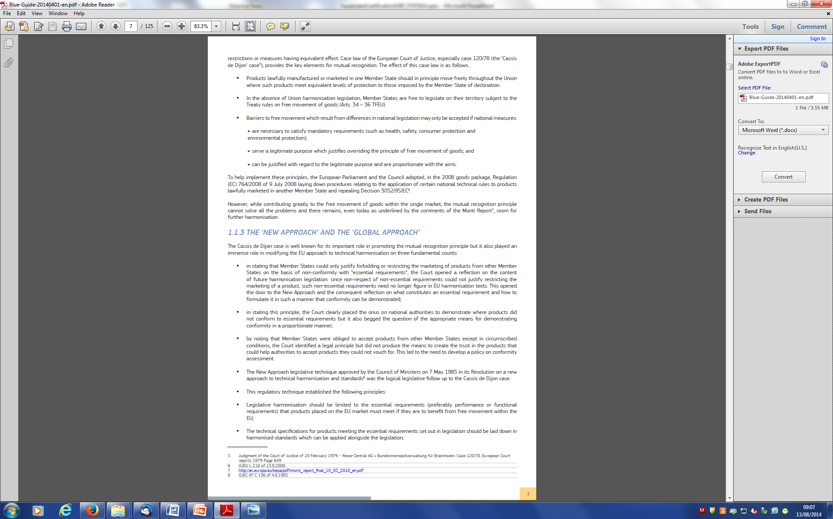

New approach regulating the free movements of goods
New approach directives set out the essential requirements (on safety for example), written in general terms which must be met before products may be sold anywhere else in the European Community.
European harmonised standards provide the detailed technical information enabling manufacturers to meet the essential requirements.
The directives also explain how manufacturers are able to demonstrate conformity with the essential requirements.
Products which meet the essential requirements are to display the CE marking, as described in the particular directive, which means that the products can be sold anywhere in the European Community.

Slide 4
CE CERTIFICATION approach
Stage 1: Identify the applicable Directive(s)
  Low Voltage directive, Electromagnetic compatibility directive, Machinery directive, ATEX directive…
Stage 2: Identify the applicable requirements of the Directive(s)
Stage 3: Identify an appropriate route to conformity
  Self certification or need for notified body…
Stage 4: Assessment of the equipment's conformity
Stage 5: Compile the technical documentation
  Technical description, Drawings, circuit diagrams and photos, Test reports and/or assessments, User instruction…
Stage 6: Make a Declaration of conformity and affix the CE marking

Slide 5
CE CERTIFICATION AT the ESRF
Not many custom-made equipment CE certified
  Concerns both equipment purchased from industry (e.g. diffractometers) and equipment built in-house (essentially electronics equipment).
Equipment brought on site by users
  We explicitly ask for CE certification, but not respected in majority of non-standard or non-commercial equipment.
We try for a number of major equipment to obtain CE certification, as shown in the few examples presented in the talk.

Slide 6
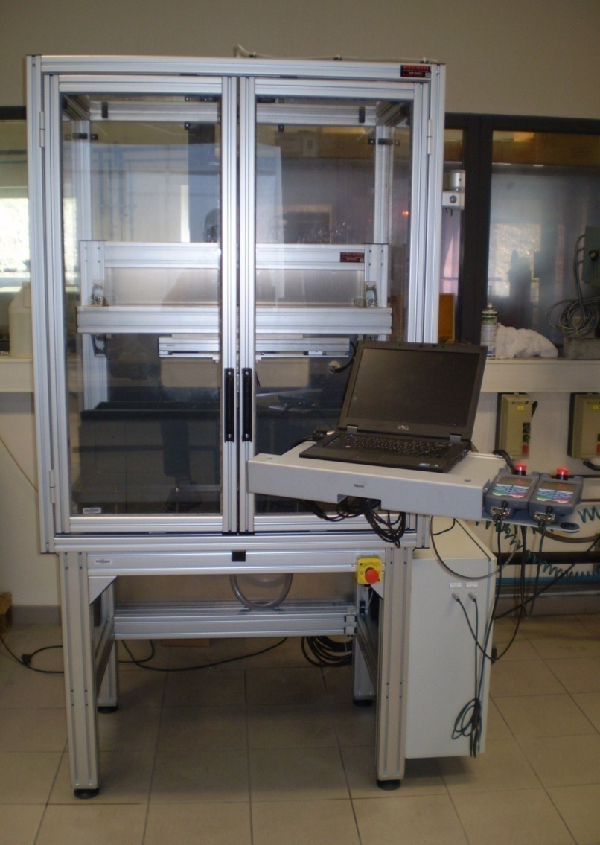
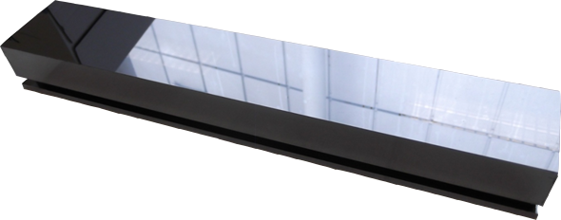
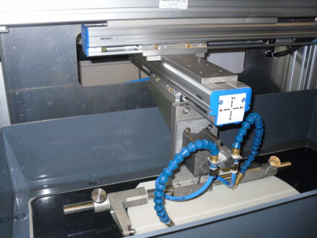
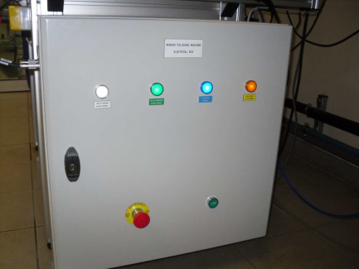
XY-POLISHING MACHINE
Description:
  Abrasive polishing of silicon or germanium materials (300 mm to 400 mm length crystal)
Applicable directives:
  Machinery directive
  Low voltage directive

Slide 7
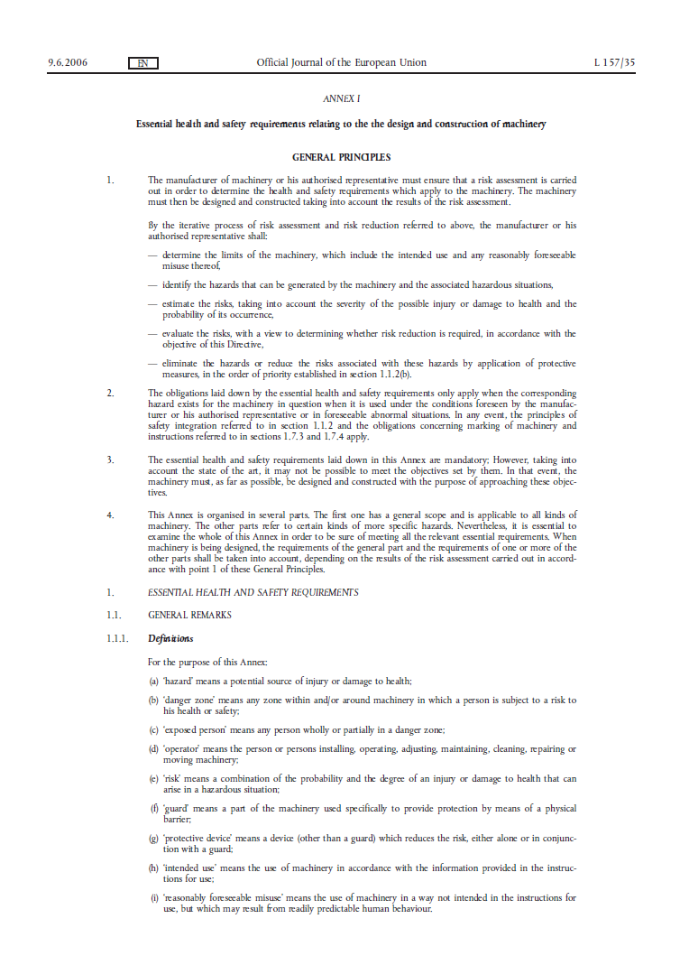
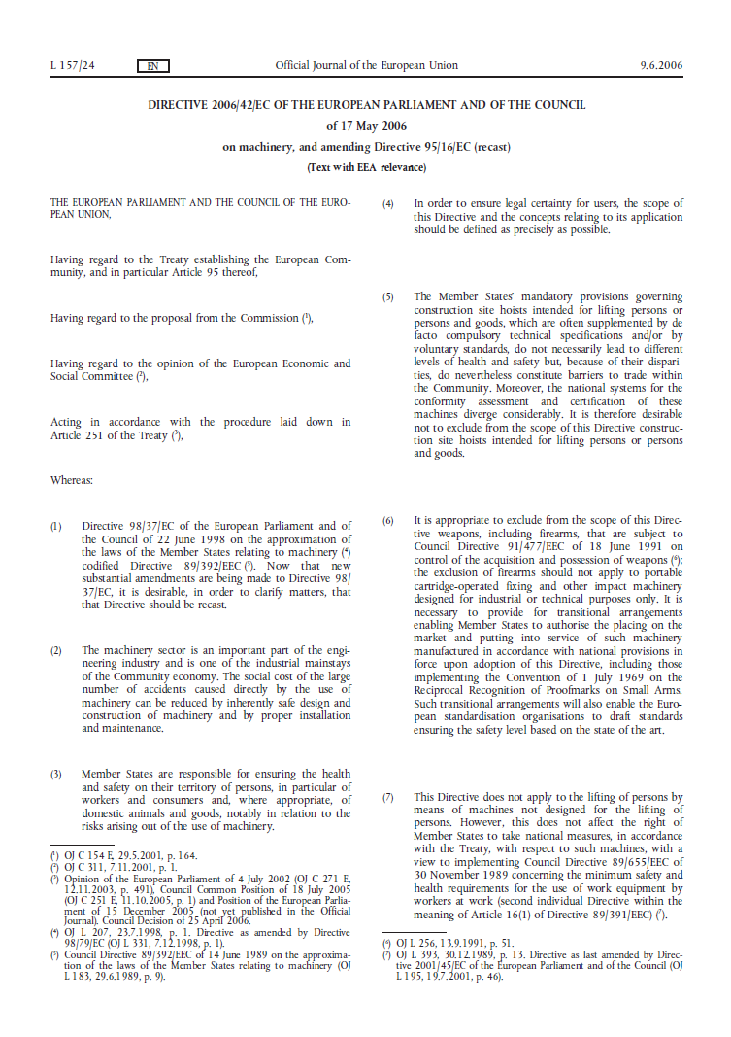
XY-POLISHING MACHINE
Applicable requirements of the Machinery Directive:
1. Essential health and safety requirements | Directive references | Applicable (YES/NO)
Principles of safety integration | 1.1.2 | YES
Materials and products | 1.1.3 | YES
Lighting | 1.1.4 | YES
Design of machinery to facilitate its handling | 1.1.5 | YES
Ergonomics | 1.1.6 | YES
Operating positions | 1.1.7 | YES
Seating | 1.1.8 | NO
Safety and reliability of control systems | 1.2.1 | YES
Control devices | 1.2.2 | YES
Starting | 1.2.3 | YES
Normal stop | 1.2.4.1 | YES
Operational stop | 1.2.4.2 | YES
Emergency stop | 1.2.4.3 | YES
Assembly of machinery | 1.2.4.4 | NO
Selection of control or operating modes | 1.2.5 | YES
Failure of the power supply | 1.2.6 | YES
Risk of loss of stability | 1.3.1 | YES
Risk of break-up during operation | 1.3.2 | YES
Risk due to falling or ejected objects | 1.3.3 | YES
Risk due to surfaces, edges or angles | 1.3.4 | YES
Risks related to combined machinery | 1.3.5 | NO
Risk related to variations in operating conditions | 1.3.6 | YES
Risk related to moving parts | 1.3.7 | YES
Choice of protection against risks arising from moving parts | 1.3.8 | YES
Fixed guards | 1.4.2.1 | YES
Interlocking movable guards | 1.4.2.2 | YES
Adjustable guards restricting access | 1.4.2.3 | NO
1. Essential health and safety requirements | Directive references | Applicable (YES/NO)
Special requirements for protective devices | 1.4.3 | YES
Electricity supply | 1.5.1 | YES
Static electricity | 1.5.2 | YES
Energy supply other than electricity | 1.5.3 | YES
Errors of fitting | 1.5.4 | YES
Extreme temperatures | 1.5.5 | YES
Fire | 1.5.6 | NO
Explosion | 1.5.7 | NO
Noise | 1.5.8 | YES
Vibrations | 1.5.9 | YES
Radiation | 1.5.10 | NO
External radiation | 1.5.11 | NO
Laser radiation | 1.5.12 | NO
Emissions of hazardous materials and substances | 1.5.13 | YES
Risk of being trapped in a machine | 1.5.14 | YES
Risk of slipping, tripping or falling | 1.5.15 | YES
Lightning | 1.5.16 | YES
Machinery machine | 1.6.1 | YES
Access to operating positions and servicing points | 1.6.2 | YES
Isolation of energy sources | 1.6.3 | YES
Operator intervention | 1.6.4 | YES
Cleaning of internal parts | 1.6.5 | YES
Information and warnings on the machinery | 1.7.1 | YES
Warning of residual risks | 1.7.2 | YES
Marking of machinery | 1.7.3 | YES
Instructions | 1.7.4 | YES

Slide 8
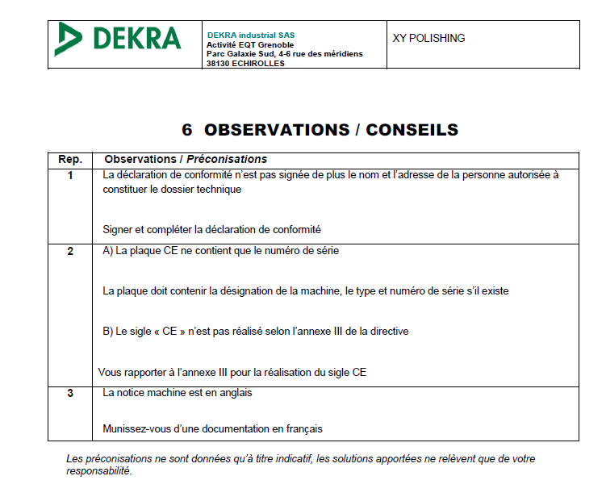
XY-POLISHING MACHINE
1. Essential health and safety requirements | Directive references | Applicable (YES/NO) | Conformity (YES/NO)
Principles of safety integration | 1.1.2 | YES | YES
Materials and products | 1.1.3 | YES | YES
Lighting | 1.1.4 | YES | YES
Design of machinery to facilitate its handling | 1.1.5 | YES | YES
Ergonomics | 1.1.6 | YES | YES
Operating positions | 1.1.7 | YES | YES
Seating | 1.1.8 | NO | NA
Safety and reliability of control systems | 1.2.1 | YES | YES
Control devices | 1.2.2 | YES | YES
Starting | 1.2.3 | YES | YES
Normal stop | 1.2.4.1 | YES | YES
Operational stop | 1.2.4.2 | YES | YES
Emergency stop | 1.2.4.3 | YES | YES
Assembly of machinery | 1.2.4.4 | NO | NA
Selection of control or operating modes | 1.2.5 | YES | YES
Failure of the power supply | 1.2.6 | YES | YES
Risk of loss of stability | 1.3.1 | YES | YES
Risk of break-up during operation | 1.3.2 | YES | YES
Risk due to falling or ejected objects | 1.3.3 | YES | YES
Risk due to surfaces, edges or angles | 1.3.4 | YES | YES
Risks related to combined machinery | 1.3.5 | NO | NA
Risk related to variations in operating conditions | 1.3.6 | YES | YES
Risk related to moving parts | 1.3.7 | YES | YES
Choice of protection against risks arising from moving parts | 1.3.8 | YES | YES
Fixed guards | 1.4.2.1 | YES | YES
Interlocking movable guards | 1.4.2.2 | YES | YES
Adjustable guards restricting access | 1.4.2.3 | NO | NA
Conformity assessment:
1. Essential health and safety requirements | Directive references | Applicable (YES/NO) | Conformity (YES/NO)
Special requirements for protective devices | 1.4.3 | YES | YES
Electricity supply | 1.5.1 | YES | YES
Static electricity | 1.5.2 | YES | YES
Energy supply other than electricity | 1.5.3 | YES | NA
Errors of fitting | 1.5.4 | YES | YES
Extreme temperatures | 1.5.5 | YES | NA
Fire | 1.5.6 | NO | NA
Explosion | 1.5.7 | NO | NA
Noise | 1.5.8 | YES | YES
Vibrations | 1.5.9 | YES | YES
Radiation | 1.5.10 | NO | NA
External radiation | 1.5.11 | NO | NA
Laser radiation | 1.5.12 | NO | NA
Emissions of hazardous materials and substances | 1.5.13 | YES | YES
Risk of being trapped in a machine | 1.5.14 | YES | NA
Risk of slipping, tripping or falling | 1.5.15 | YES | YES
Lightning | 1.5.16 | YES | YES
Machinery machine | 1.6.1 | YES | YES
Access to operating positions and servicing points | 1.6.2 | YES | YES
Isolation of energy sources | 1.6.3 | YES | YES
Operator intervention | 1.6.4 | YES | YES
Cleaning of internal parts | 1.6.5 | YES | YES
Information and warnings on the machinery | 1.7.1 | YES | YES
Warning of residual risks | 1.7.2 | YES | YES
Marking of machinery | 1.7.3 | YES | NO
Instructions | 1.7.4 | YES | NO

Slide 9
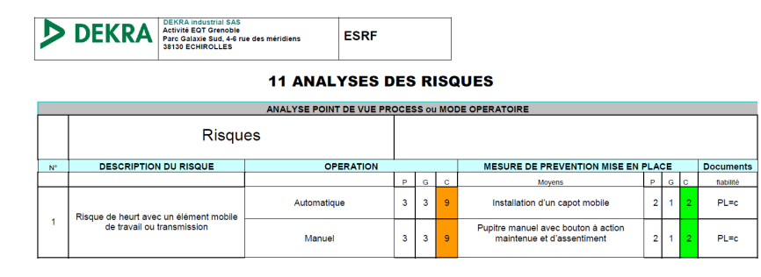
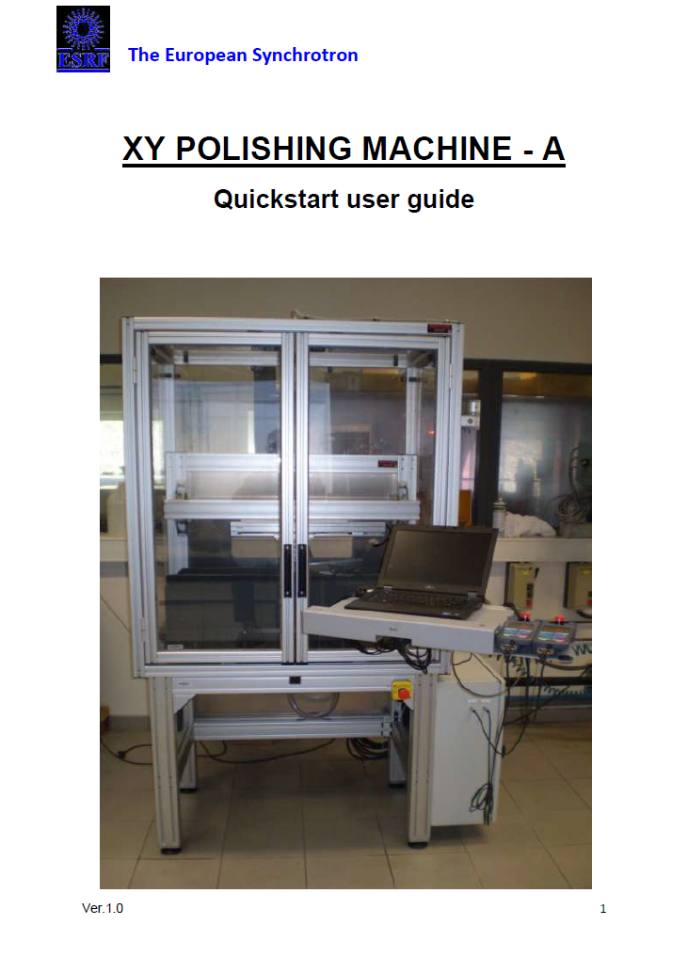
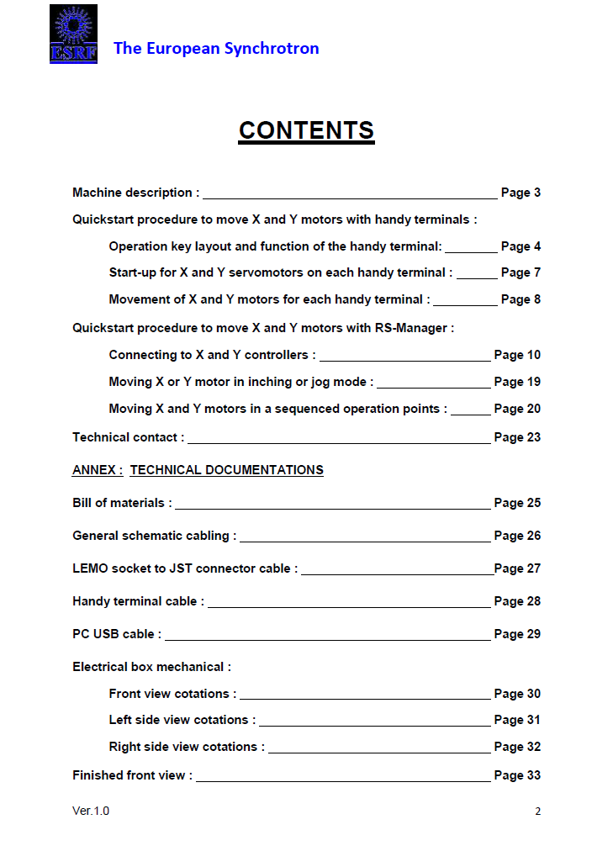
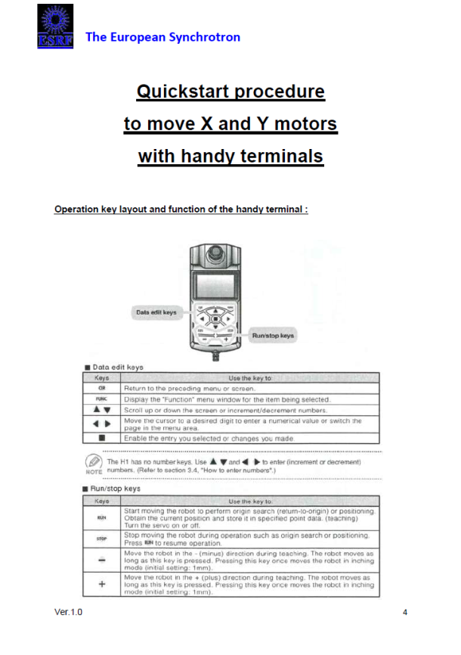
XY-POLISHING MACHINE
Technical construction file:
  Risk assessment
  User instructions
Risk of impact with moving elements

Slide 10



XY-POLISHING MACHINE
EC declaration of conformity:
                Business name and full address of the manufacturer
                Name and address of the person authorised to compile the technical file
                Description and identification of the machinery, including generic denomination, function, model, type, serial number and commercial name
                A sentence expressly declaring that the machinery fulfils all the relevant provisions of this Directive
                Where appropriate, the name, address and identification number of the notified body which approved the full quality assurance system
                The place and date of the declaration
                The identity and signature of the person empowered to draw up the declaration on behalf of the manufacturer or his authorised representative

Slide 11
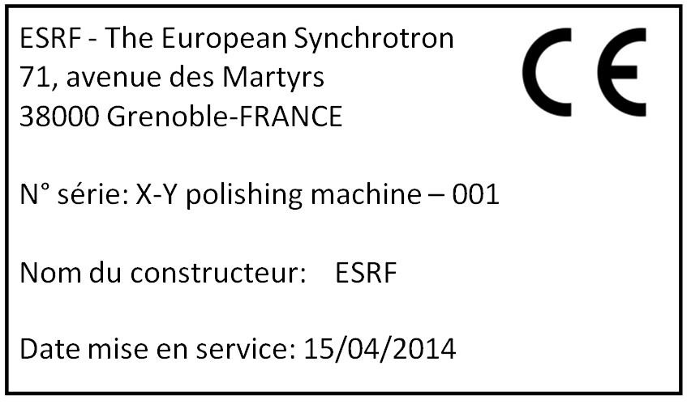
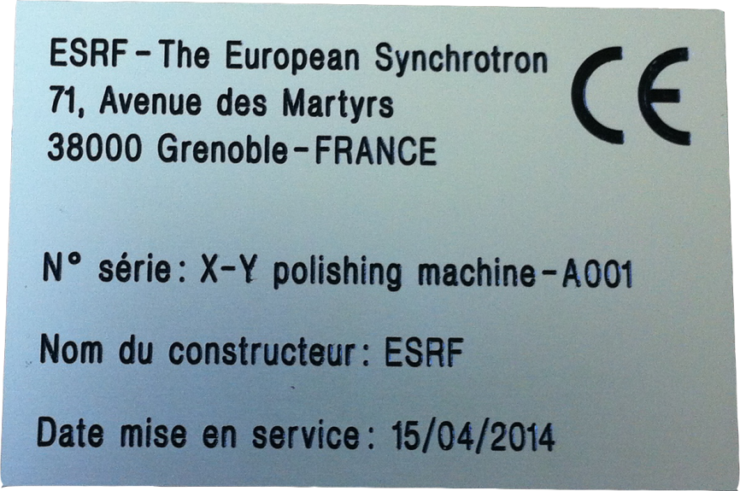
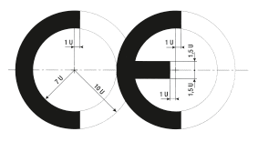
XY-POLISHING MACHINE
CE marking:
The business name and full address of the manufacturer
The designation of the machinery
The CE marking
The designation of the series or type
The serial number
The year of construction that is the year in which the manufacturing process is completed
C and E not formed by perfect semi-circles.
The top and bottom arms extend to one unit beyond the semi-circles.
The middle arm of the E stops one unit short.

Slide 12
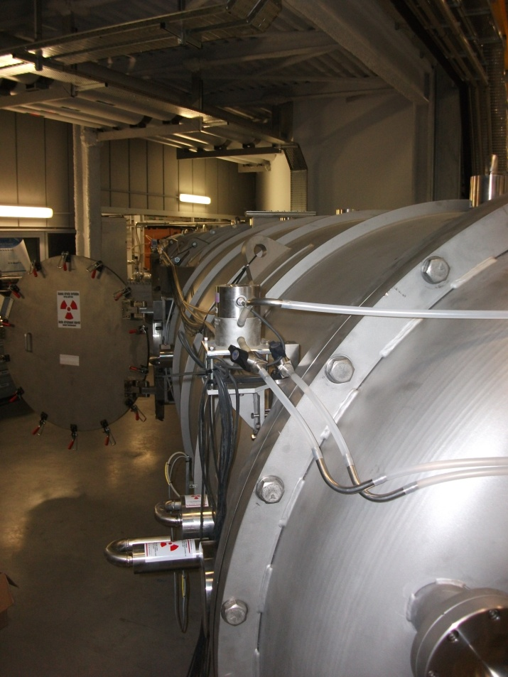
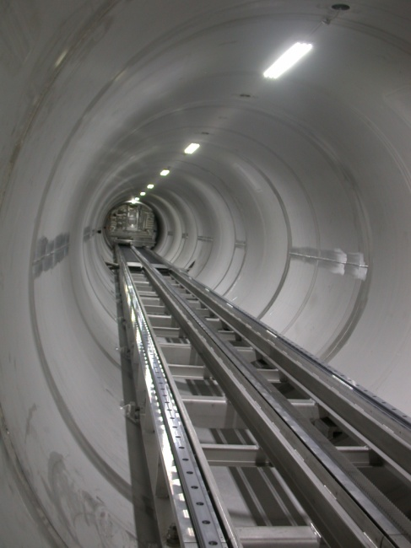
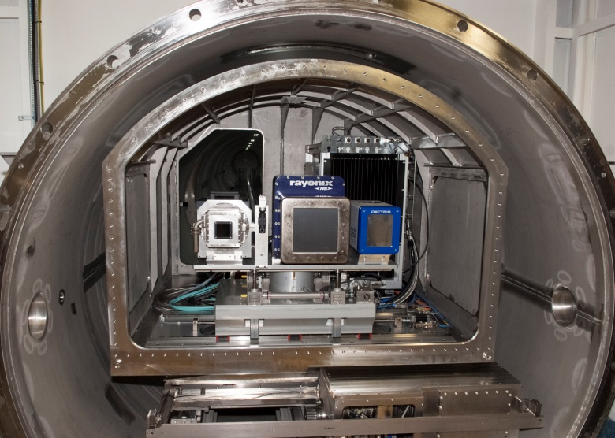
ID02 SAXS TUBE
Description:
  Large detector tube installed in ID02 Beamline
  Facilitate easy change of sample-detector distance over 0,5 meter to 30 meters in small-angle X-ray scattering (SAXS)
  Stainless steel tube of length about 34 meters and diameter 2 meters
Applicable directives:
  Machinery directive
  Low voltage directive
  Pressure equipment directive

Slide 13
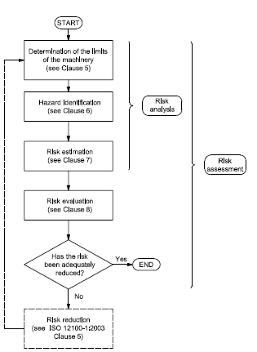
ID02 SAXS TUBE
Risk assessment:
  Standards: ISO 14121-1 & 2: Risk Assessment – Principles & Practical guidance and examples of methods
  Risk estimation = Severity x Probability of occurrence
Severity | RESULT
Catastrophic (death, loss or eye or arm) | 5
Serious (permanent injury, loss of fingers) | 4
Moderate (reversible injury, medical attention) | 3
Minor (reversible injury, first aid) | 2
Negligible | 1
Risk
1 | Negligible
2 | Negligible
3 | Negligible
4 | Acceptable
5 | Acceptable
6 | Moderate
8 | Moderate
9 | Moderate
10 | Moderate
12 | Moderate
15 | Serious
16 | Serious
20 | Unacceptable
25 | Unacceptable
Risk adequately reduced
Probability of occurrence | RESULT
Frequent | 5
Probable | 4
Occasional | 3
Improbable | 2
Icredible | 1

Slide 14
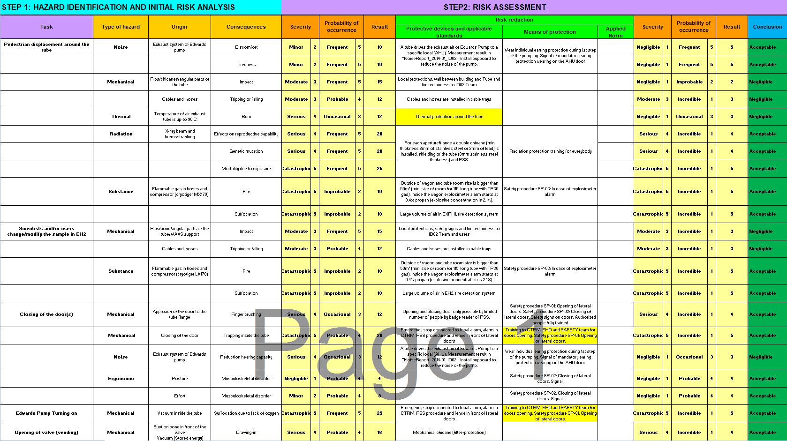
ID02 SAXS TUBE
Risk assessment:

Slide 15
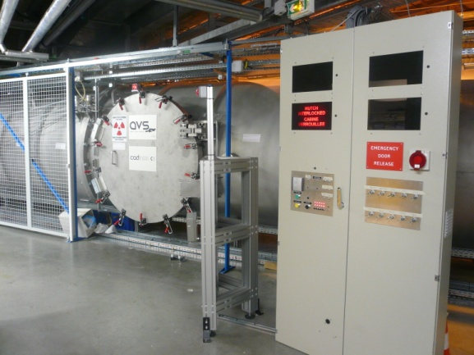
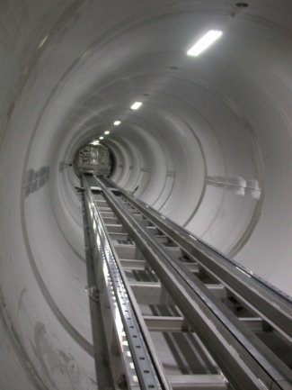
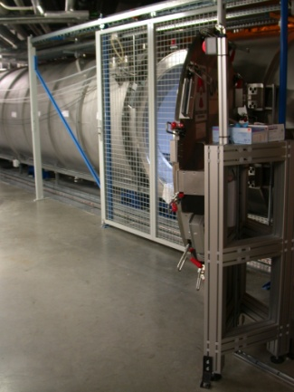
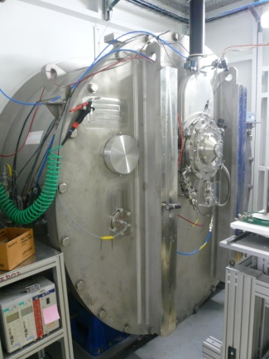
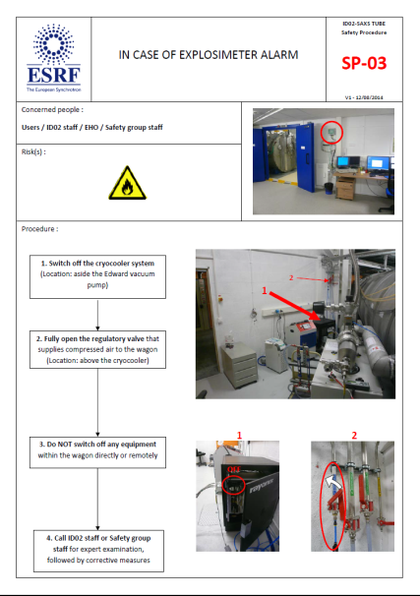



ID02 SAXS TUBE
Risk assessment:
  Specific Protective devices
  Means of protection
Opening and closing door only possible by limited number of people by badge reader of PSS
LED lighting system supplied by dedicated UPS
Local protections, wall between building and Tube and limited access to ID02 Team
Protective covers avoid rupture of the view ports
Safety procedure SP-03: In case of explosimeter alarm
Personal protective equipments

Slide 16
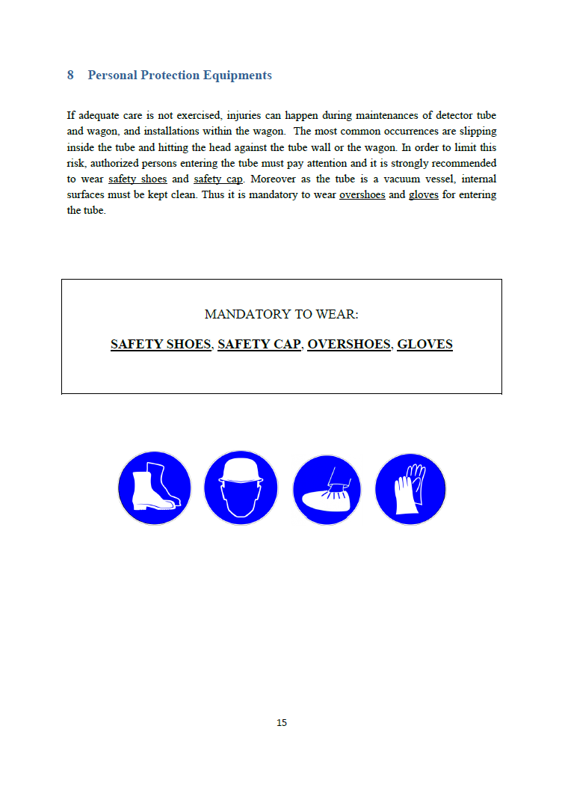
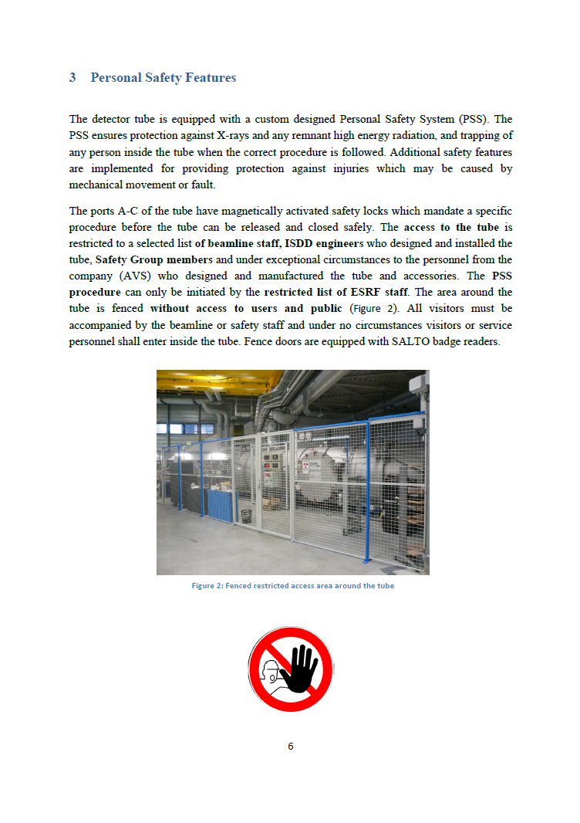
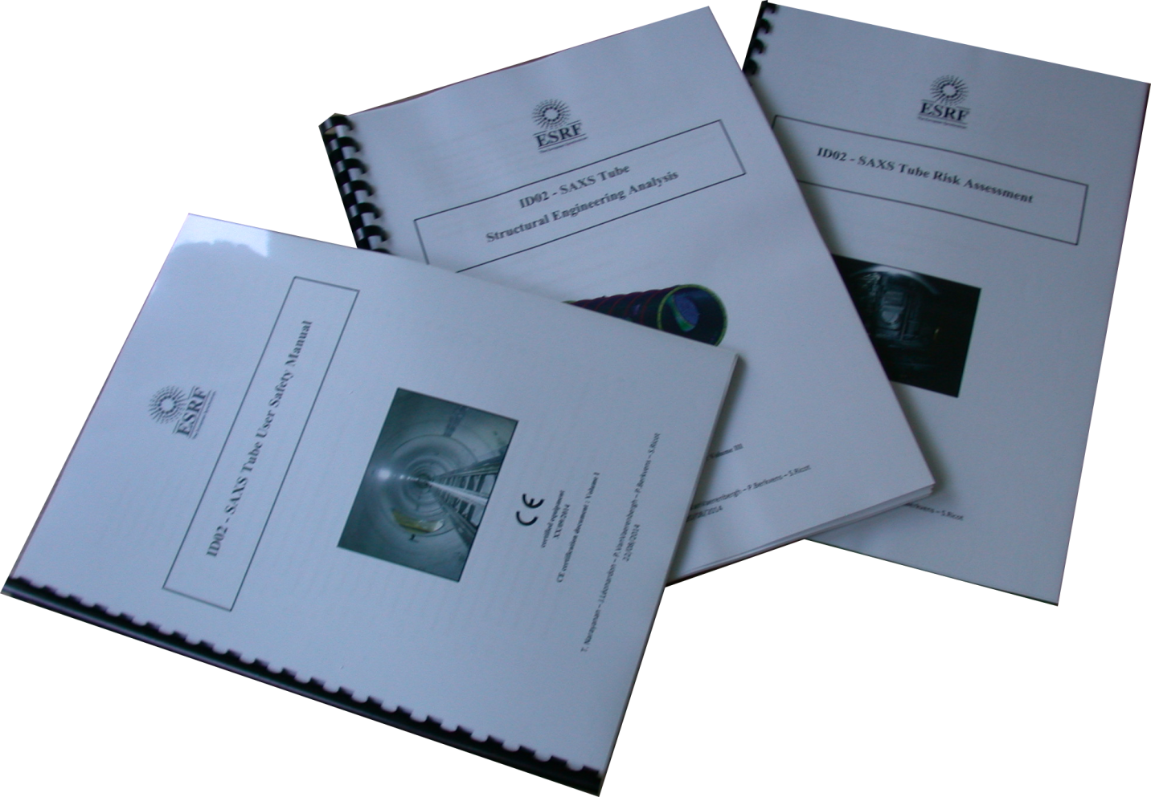
ID02 SAXS TUBE
Technical documentation and user instructions:

Slide 17
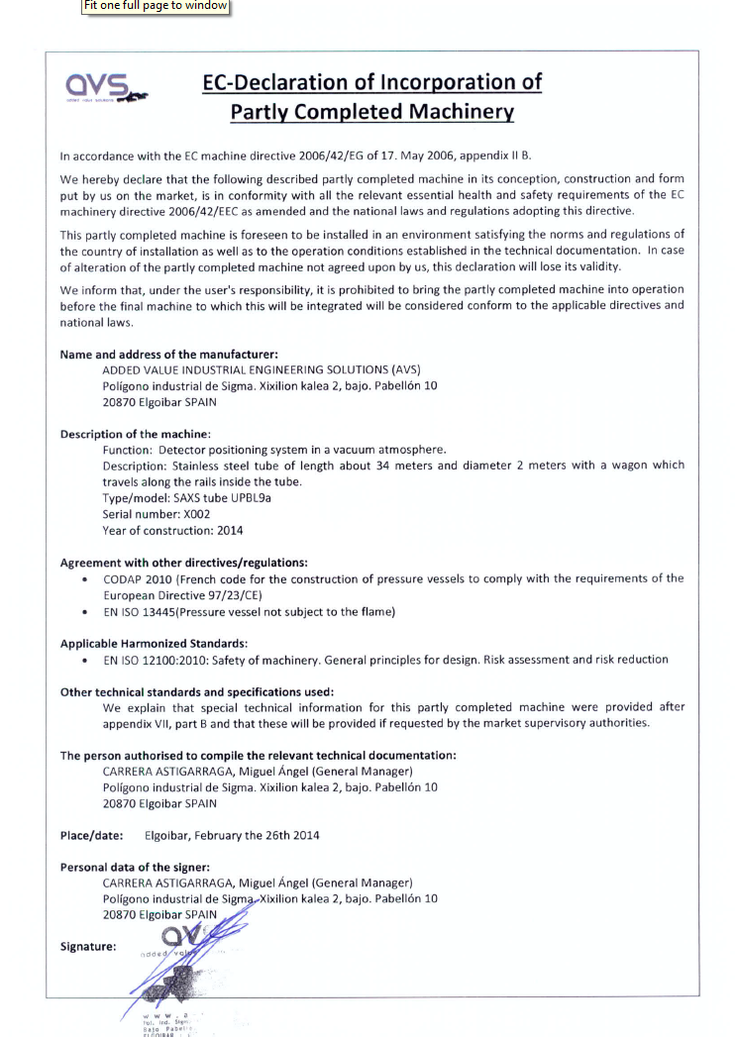
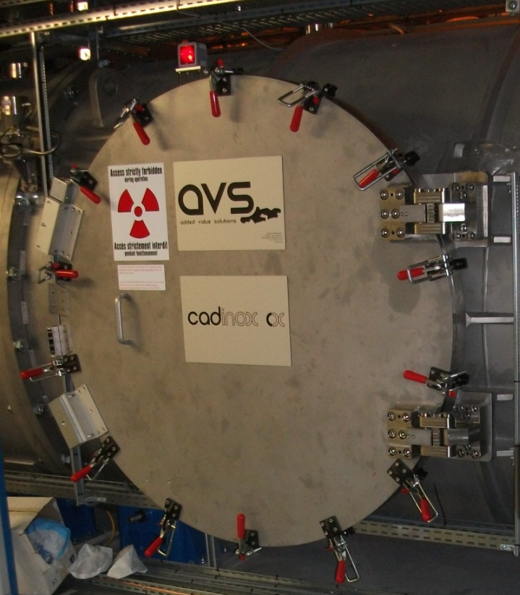
ID02 SAXS TUBE
EC declaration of incorporation:

Slide 18
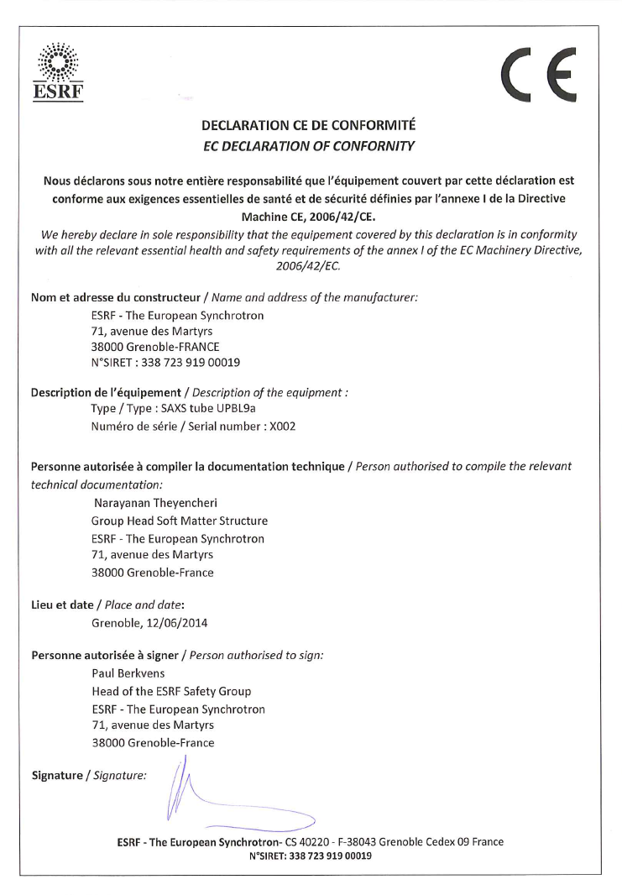

ID02 SAXS TUBE
CE marking and EC declaration of conformity:

Slide 19
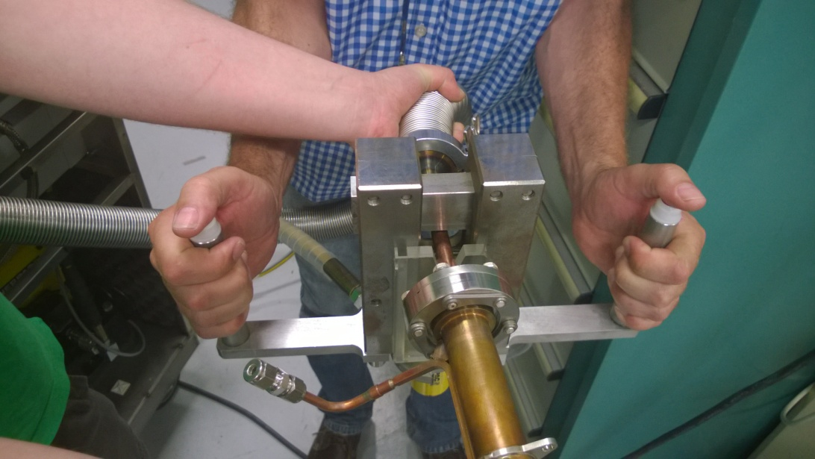
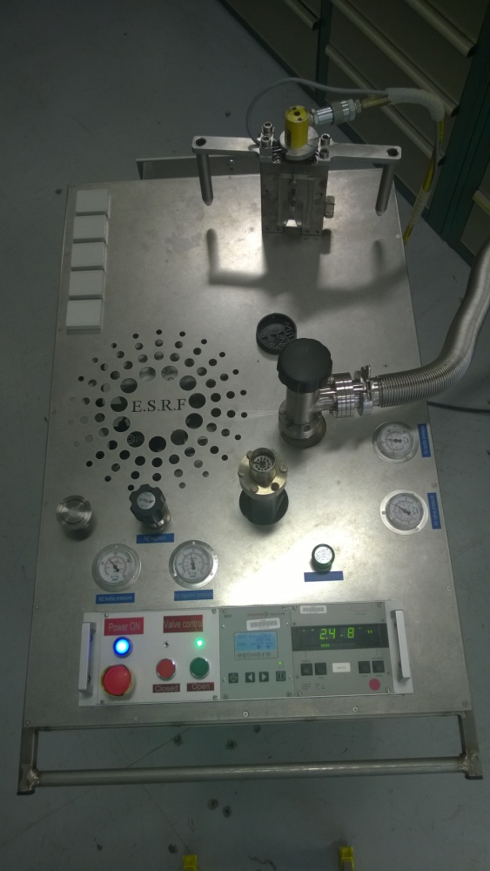
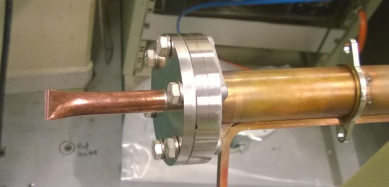
Future EQUIPMENT CERTIFICATION AT ESRF
  Coordination by the Project Management Office (PMO)
  Creation of an ESRF expert team for equipment certification
  Some examples:
    Hydraulic pinch-off tool

Slide 20
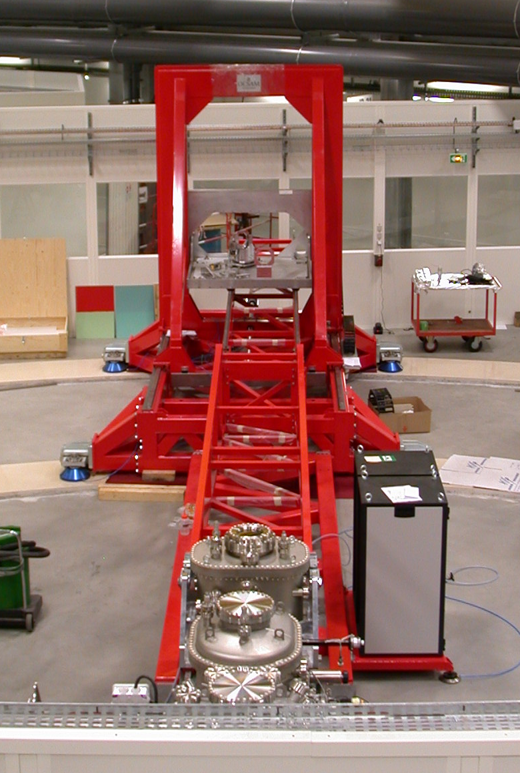
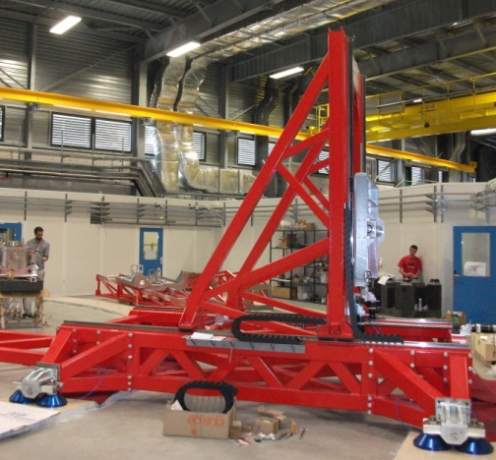
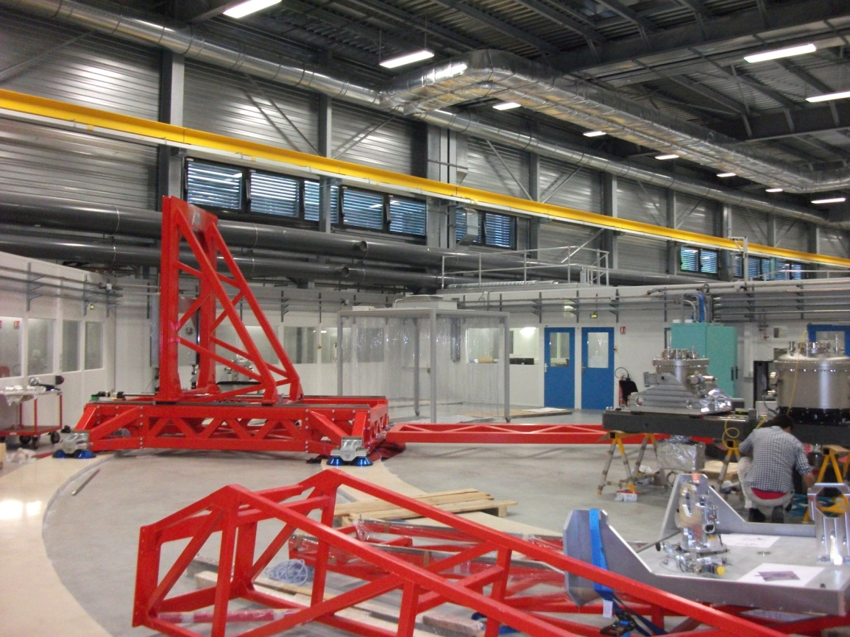
future EQUIPMENT CERTIFICATION AT ESRF
  Some examples:
    ID32 Resonant Inelastic X-ray Scattering (RIXS) spectrometer

Slide 21
THANK YOU FOR YOUR ATTENTION...
International Technical Safety Forum 2014
September 8 – 12, 2014 · Fermilab, Batavia, IL USA

