Slide 1

Anatomy of the Hall D Cryotarget and its
Hazard Analysis
Bert Manzlak, CSP

Slide 2
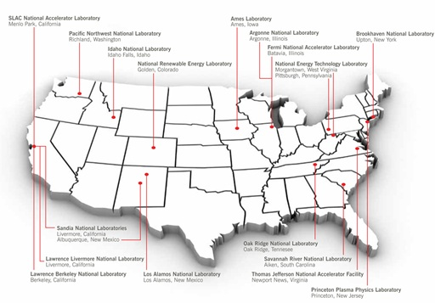
Thomas Jefferson National Accelerator Facility
one of 17 national laboratories funded by US Department of Energy

Slide 3
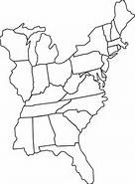
Geographic Location of Jefferson Lab
Newport News, Virginia
900 miles / 1450 km
14 hours drive
Femi Lab
370 miles / 600 km
7 hours drive
New York City
180 miles / 290 km
3 hours
Washington, DC

Slide 4
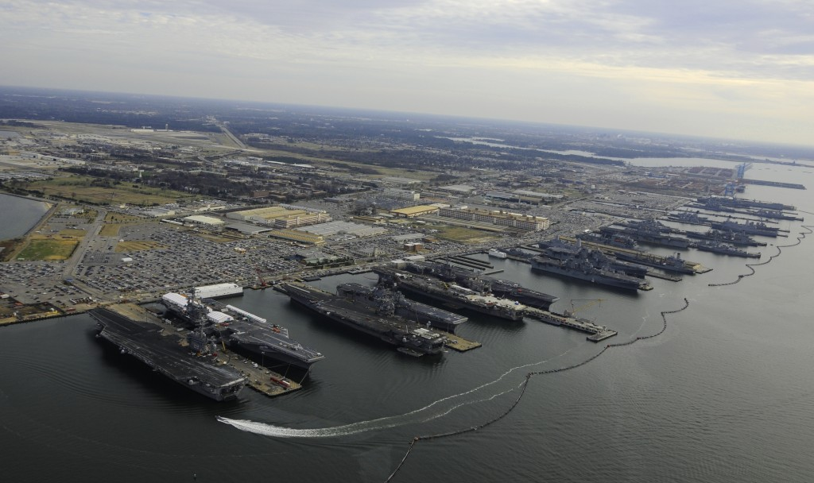
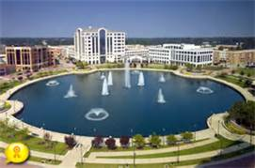
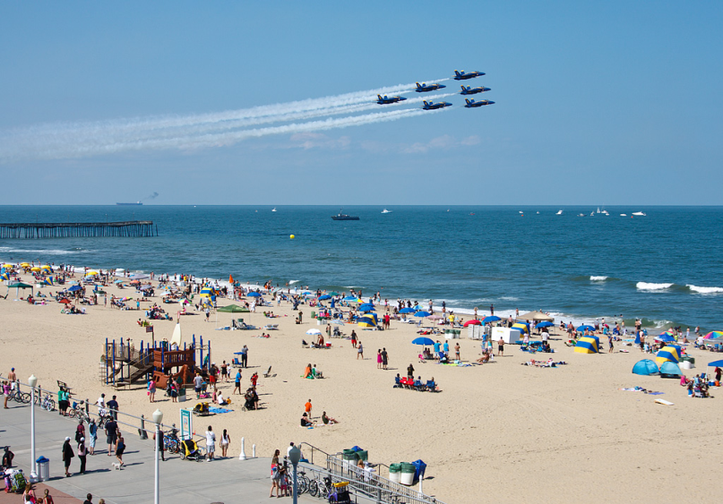

Jefferson Lab
Located in Newport News,
Virginia is 5 - 45 minutes from:
Norfolk / 30
Newport News / 5
Virginia Beach / 45
Williamsburg / 30

Slide 5
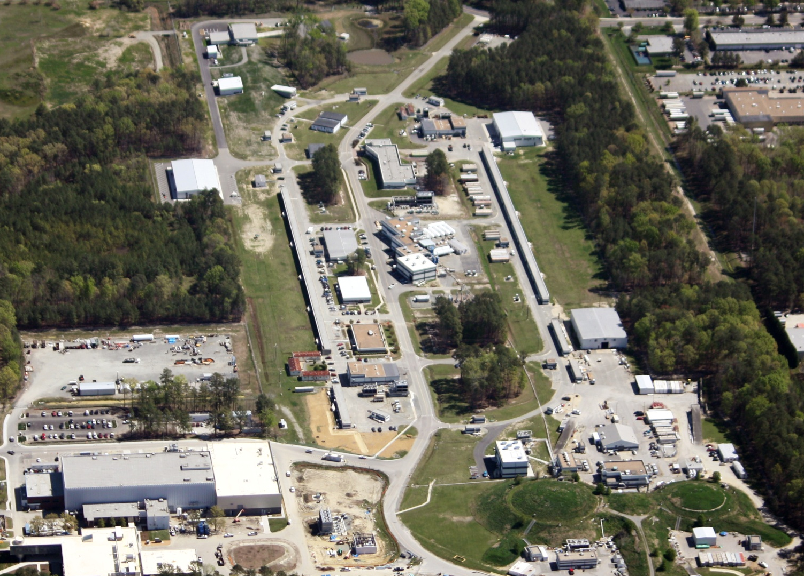

Slide 7
12 GeV Upgrade Project
The completion of the
12 GeV Upgrade of CEBAF was ranked the highest priority in the 2007 NSAC Long Range Plan.
New Hall
Upgrade arc magnets
and supplies
Add 5 cryomodules
20 cryomodules
CHL upgrade
Add arc
20 cryomodules
Add 5 cryomodules
$338M DOE project (FY09-17)
$9M Va. contribution
Currently - Nnearing completion
Commissioning – In progress
Enhanced capabilities
in existing Halls

Slide 8
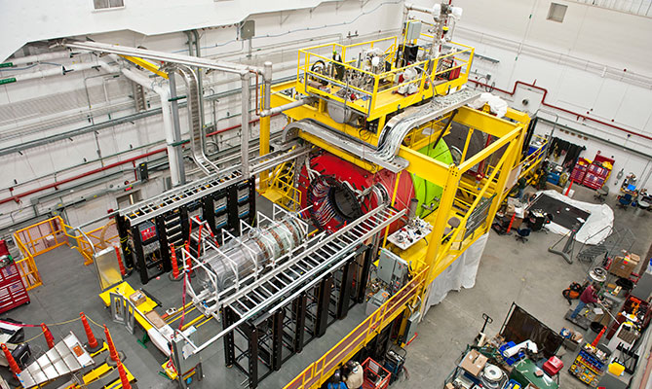
Hall D

Slide 9
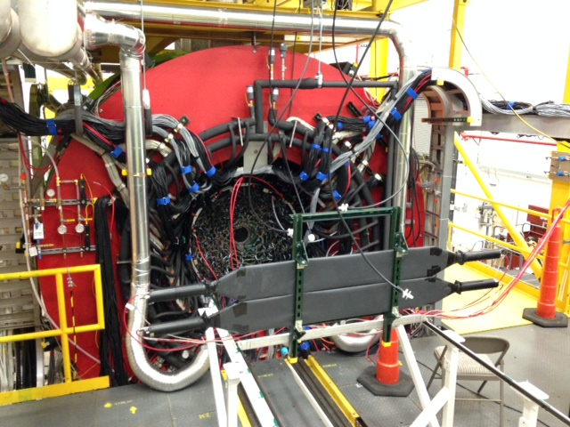
Hall D Cryotarget
The target goes HERE!

Slide 10
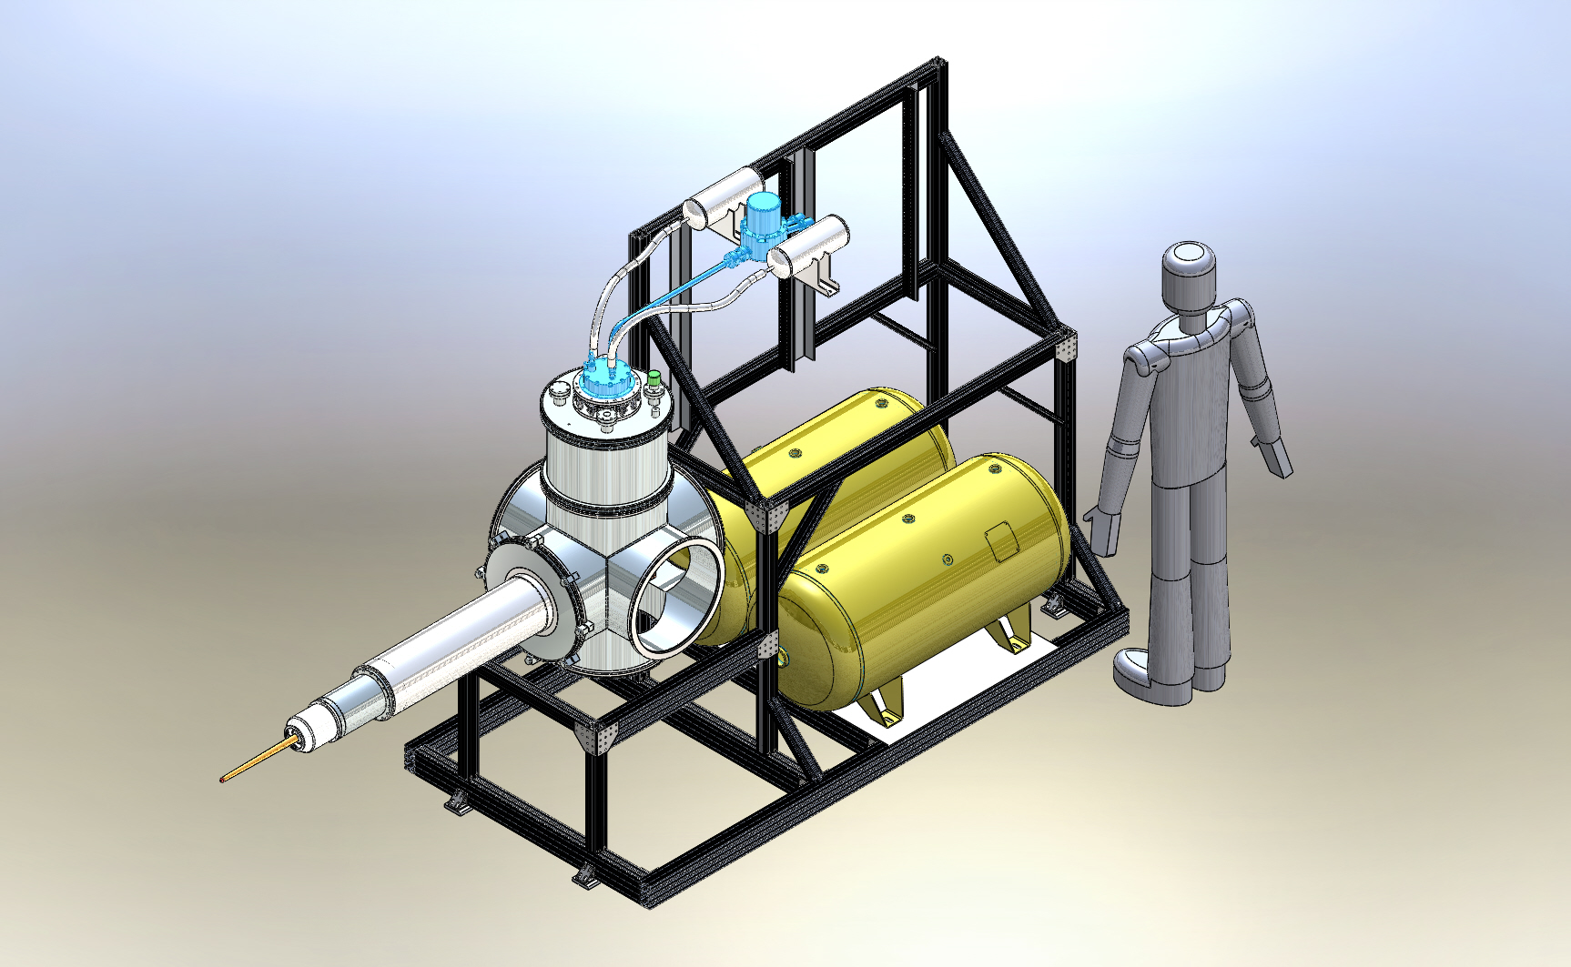
Hall D GlueX Cryotarget
Gas panel & electronics
BEAM
Pulse tube refrigerator
Vacuum chamber
Insertion cart
Storage tanks
2 @ 55 gal.
Target cell

Slide 11
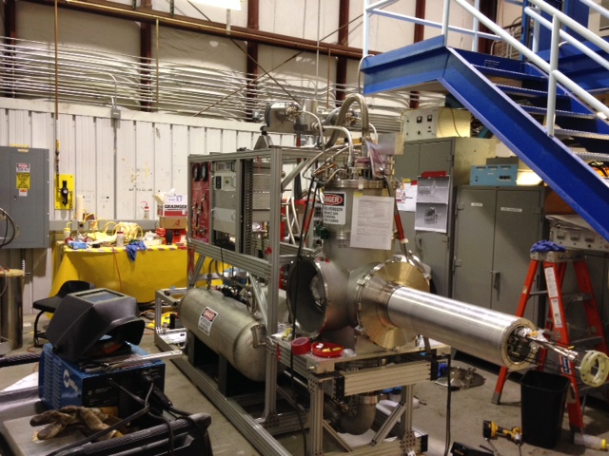
Cryotarget in Target Group Lab

Slide 12
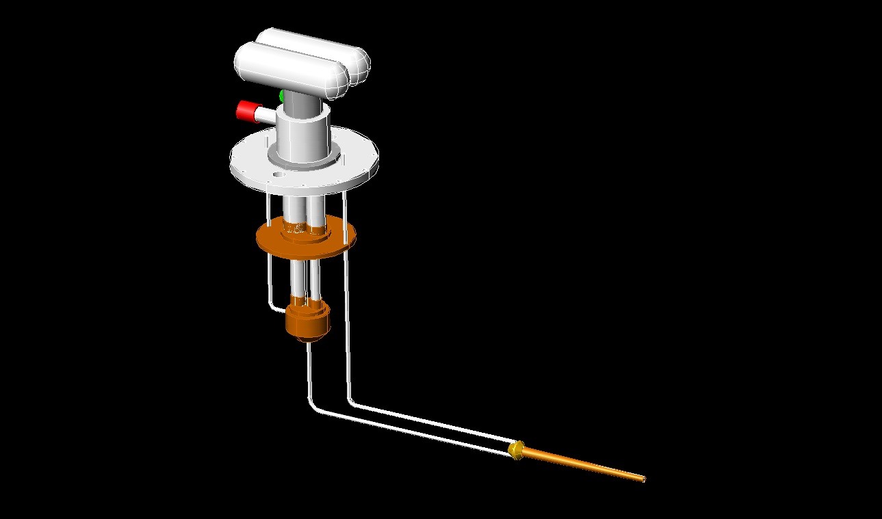
Hall D Cryotarget
A small cryotarget (100 cm³) for LH₂, LD₂ and possibly LHe
Photon beam only → no appreciable heat load
Use two stage Pulse-Tube refrigerator for target cooling
Pulse Tube Refrigerator
Vacuum flange
H2 fill tube
1st cooling stage
H2 vent tube
2nd cooling stage
LH₂ condenser
Target cell, kapton
30-cm x 2-cm
D. Meekins

Slide 13
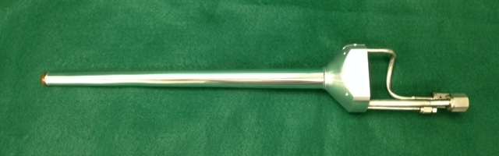
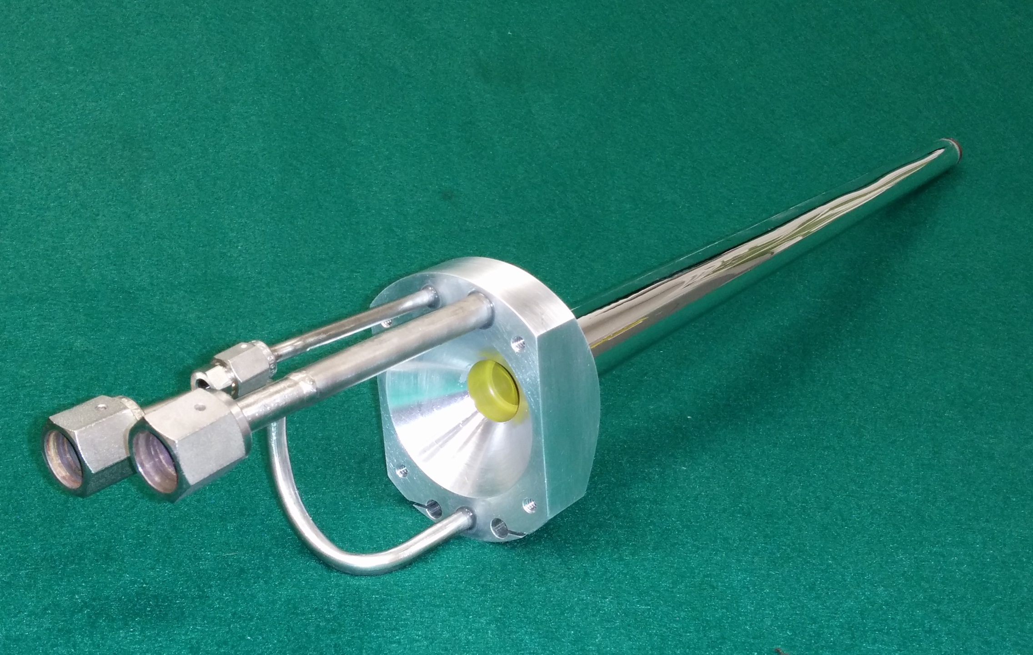
Hall D Cryotarget
Target Cell
Cylinder 130 µm
Al kapton
Entrance & Exit Windows
75 µm kapton
Base Al w/ SS tubes
Epoxy 3M DP-90
Burst pressure 180 psid @ room temperature
Two internal thermometers
(Cernox 1050SD)
50 W external heater

Slide 14

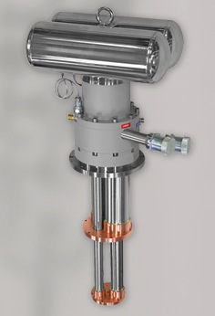
Hall D Cryotarget Pulse Tube Refrigerator
Cryomech PT415
Pulse Tube Refrigerator
2.8 K base temperature
One hour to 4.2 K (no load)
1.5 W at 4.2 K
20 W at 20 K
20,000 hour maintenance cycle
Helium reservoirs
Valve system
Compressor connections
1st stage pulse tube
and regenerator
(heat shield & heat exchanger)
2nd stage pulse tube and regenerator
(condenser)

Slide 15
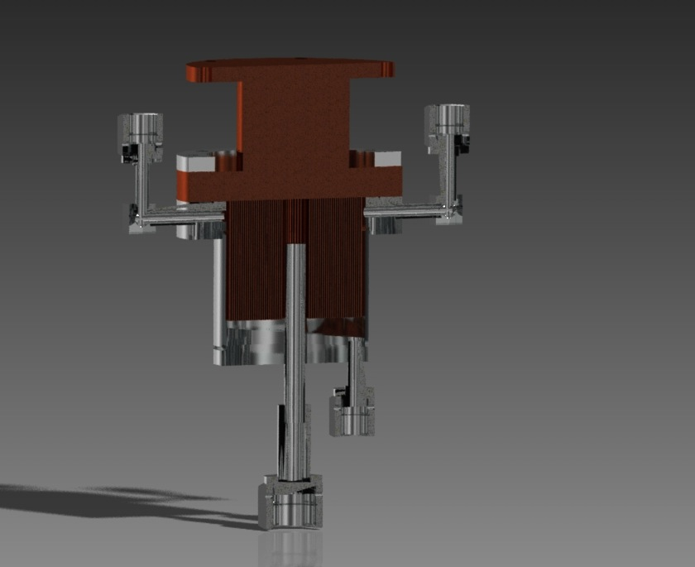
Cryotarget
3 .7 “
Condenser
Single block of OFHC copper
63 vertical fines (2600 cm2)
Sealed inside SS can (100 cm3) w/ drain tube leading to & from the target cell
Heater & thermometer used to control temperature
Thermometers & Heaters
Indium seal
Copper fins
Stainless can
Gas return
(from cell)

Slide 16
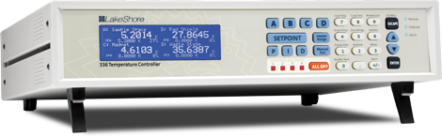
Hall D GlueX Cryotarget
A 100 W temperature controller (Lake Shore Model 336) maintains the condenser at a predetermined temperature using redundant heater and thermometers attached outside the condenser.
A second heater (50 W) is attached to the target cell for empty target (cold gas) runs.
Lake Shore 336
Four sensor inputs
Two PID-controlled heater outputs (100 W and 50 W)
Four alarms
Two NO/NC relays

Slide 17
Hall D Cryotarget
A Programmable Logic Controller (PLC) controls and monitors the target
Users have access to three buttons: FILL, EMPTY, and OFF
Condenser heater set to 18 K
Target heater is OFF
Liquid alarm set points loaded
Condenser heater remains at18 K
Target heater set to 25 K
Gas alarm set points loaded
Turns OFF pulse tube & heaters
Alarms turned OFF
Fill Target w/ LH2
Empty Target
Target OFF
Target is Cooling
NOT Ready for Beam
Target is Emptying
NOT Ready for Beam
Target is OFF
Warming up
“Target is FULL &
Ready for Beam”
Target is EMPTY
Ready for Beam

Slide 18
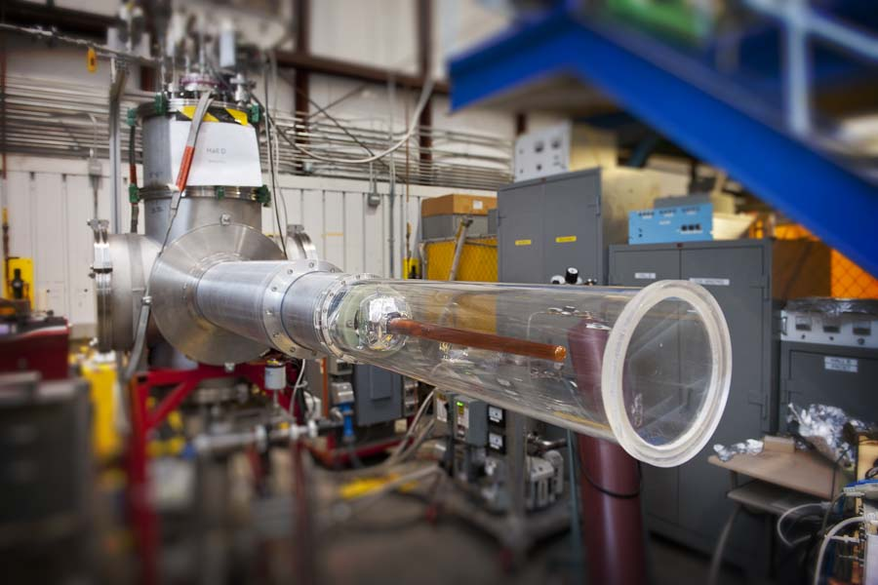
Target Cell Neon Test

Slide 19
Consequence Levels
Consequence Level | Severity | Property Loss
High (H) | Serious impact on-site. May cause death or loss of facility operation. Major impact on the environment. | > $100,000
Medium (M) | Significant impact on-site. May cause severe injury, severe occupational illness to personnel, major damage to the facility operation, or impact on the environment. | > $50,000
Low (L) | Minor impact on-site. May cause minor injury, minor occupational illness, or minor impact on the environment. | > $500
Extremely Low (EL) | Insignificant injury, occupational illness, or impact on the environment. | < $500
Based on the analysis of the Final Safety Assessment Document (FSAD), there are no credible offsite impacts.

Slide 20
Probability of Incident
Probability Level | Description* | Estimated Probability of Incident Occurrence per Year
High (H) | An incident is likely to occur several times during task. | > 10^{–1}
Medium (M) | An incident may occur during the task. | 10^{–2} to 10^{–1}
Low (L) | Probability of an incident occurring is unlikely to happen during the task. | 10^{–4} to 10^{–2}
Extremely Low (EL) | Probability of an incident occurring is extremely unlikely to happen during the task. | 10^{–6} to 10^{–4}

Slide 21
Risk Code Assignment
Consequence Level | H | 1 | 3 | 4 | 4
 | M | 1 | 2 | 3 | 4
 | L | N* | 1 | 2 | 3
 | EL | N* | N* | 1 | 1
Probability Level |  | EL | L | M | H

Slide 22
Risk Code
Risk Code assigned based on hardware and procedures already in place |  | Level of Task Review required before new work can begin
4 | High | Formal written and approved procedures in the form of an OSP, or temporary work permit. Division ESH&Q Officer may require additional approvals. Generally requires Laboratory Director Approval.
3 | Medium | Formal written and approved procedures in the form of an OSP, or temporary work permit
2 | Low | None Workers and supervisors should explicitly review the hazards and mitigating measures.
1 | Extremely Low | None This level of risk is common for appropriately trained personnel.
N | Negligible | None This level of risk is common, and the relevant measures are

Slide 23
Hazard Analysis
Magnetic field Hazard
Consequence Level: Low
Probability Level: Low
Mitigation: Locate sensitive equipment upstream of magnet bore. Limit use of tools near bore of magnet
Risk Code after Mitigation: 1

Slide 24
Hazard Analysis
Oxygen deficiency hazard
Consequence Level: Extremely Low
Probability Level: Medium
Mitigation: Minimization of ODH gases
Risk Code after Mitigation: 1

Slide 25
Hazard Analysis
Power Failure
Consequence Level: Low
Probability Level: Medium
Risk code before Mitigation: 2
Mitigation: Temperature / pressure interlocks fail open, and shut off heaters and PTR
Risk Code after Mitigation: 1

Slide 26
Hazard Analysis
Vacuum hazard
Consequence Level: Medium
Probability Level: Medium
Mitigation: Locate sensitive equipment upstream of magnet bore. Limit use of tools near bore of magnet
Risk Code after Mitigation: 1

Slide 27
Hazard Analysis
Pressure System Safety
Consequence Level: High
Probability Level: Low
Risk Code before Mitigation: 3
Mitigation: Design and construction compliance with relevant ASME pressure system codes. Routine inspection, testing and replacement of system components.
Risk Code after Mitigation: 1

Slide 28
Hazard Analysis
Cryogenic Hazards – Freezing the H2 gas
Consequence Level: Medium
Probability Level: Medium
Risk Code before Mitigation: 3
Mitigation: Temperature and pressure alarms. Temperature and pressure interlocks. Relief valves on fill and return lines and vacuum chamber.
Risk Code after Mitigation: 1

Slide 29
Hazard Analysis
Cryogenic Hazards - Freezing contaminants in the H2 gas
Consequence Level: Medium
Probability Level: Medium
Risk Code before Mitigation: 3
Mitigation: Check the integrity of the gas system prior to cool down. Documented gas handling procedures and high purity gas. Temperature and pressure alarms. Temperature and pressure interlocks. Relief valves on fill and return lines and vacuum chamber.
Risk Code after Mitigation: 1

Slide 30
Hazard Analysis
Cryogenic Hazards - Hydrogen leak into the vacuum chamber
Consequence Level: Medium
Probability Level: Medium
Risk Code before Mitigation: 3
Mitigation: Check integrity of target system prior to cool down. Vacuum pressure alarms and interlocks. Relief valve on vacuum chamber.
Risk Code after Mitigation: 1

Slide 31
Hazard Analysis
Cryogenic Hazard – Sudden vacuum breach
Consequence Level: Medium
Probability Level: Medium
Risk Code before Mitigation: 3
Mitigation: Covers over thin windows when exposed. Compliance w/ ASME code. Relief valves on gas panel and vacuum chamber.
Risk Code after Mitigation: 1

Slide 32
Hazard Analysis
Target Cell
Cannot Simultaneously comply w/ ASME Pressure Codes and meet requirements for the physics program in Hall D
Cell – unlisted material (kapton & torlon)
Cell base & tubes joined w/ 3M epoxy
Pull & pressure tests performed
Cell ruptures above 180 psid
Peer reviewed & level of safety exceeding ASME Pressure Codes

Slide 33
Hazard Analysis
Overpressure protection
credible sources of overpressure - fire, loss
of vacuum, gas bottle regulator failure
Various ASME relief devices, tanks, piping
Code designed hydrogen vent system
Conservative calculations for gas panels, storage tanks, vacuum chamber check valves, regulators

Slide 34
Hazard Analysis
Lifetime and cycles
Estimated lifetime for target – 10 years
Estimated # of full pressure cycles < 500
All piping w/ exception of cell rated > expected number of cycles
Estimated acceptable lifetimes for cell is difficult at best – cell shall be replaced w/ new cell at least every two years

Slide 35
Emergency & Interlock Response Procedures
Flammable Gas Alarm
ODH Alarm
Pressure Interlock
Low Temperature Interlock
Vacuum Interlock
Vent Purge Interlock

Slide 36
Inspection & Maintenance Schedule
Every Run - 15 specific procedures
Every year
Have pressure gauges calibrated by an ASME-certified
vendor
Have storage tanks inspected by an ASME-certified vendor
Other
  Inspect/ test all relief and check valves in system every two years
  Replace kapton target cell every two years minimum
  Change oil in vacuum pumps after 5,000 hours of operation
  Replace adsorber in PRT compressor after 20,000 hours of operation (consult PRT manual)

