Slide 1


European XFEL
installation progress
by Sven Mohr
DESY
Department Safety and Environmental Protection

Slide 2

structure
reminder
state of affairs
general conditions
TOP FIVE of safety issues

Slide 3

reminder
a total of 5.4 kilometers of underground tunnel system
3 sites with a total area of ca. 185,000 m²
tunnels 6 to 38 metres deep
2 clients

Slide 4
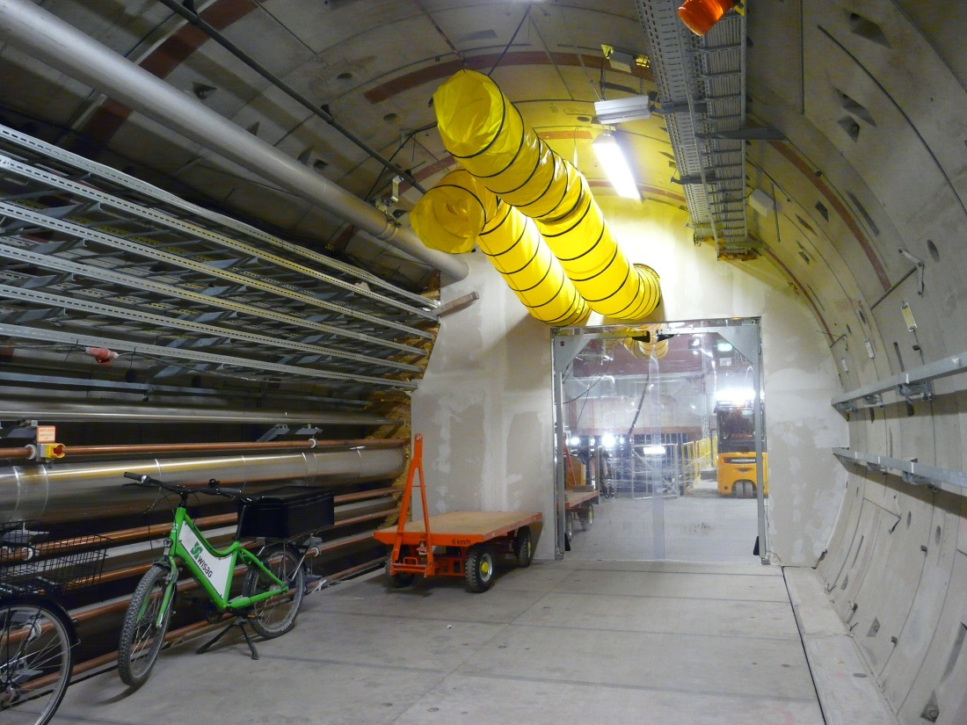
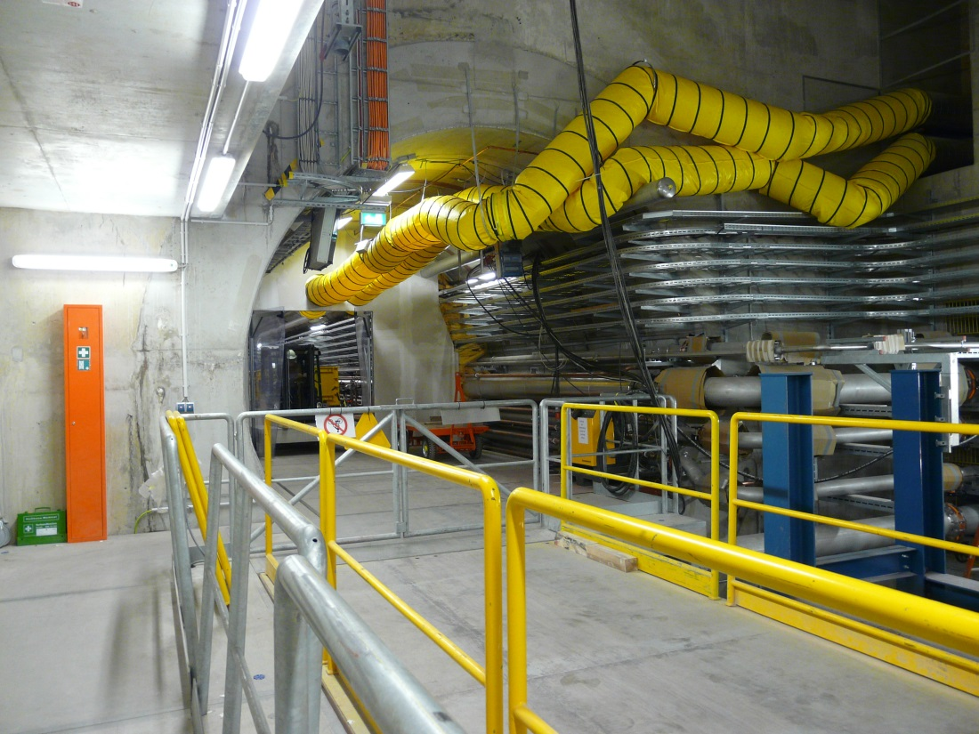
state of affairs
(makeshift) tunnel ventilation started

Slide 5
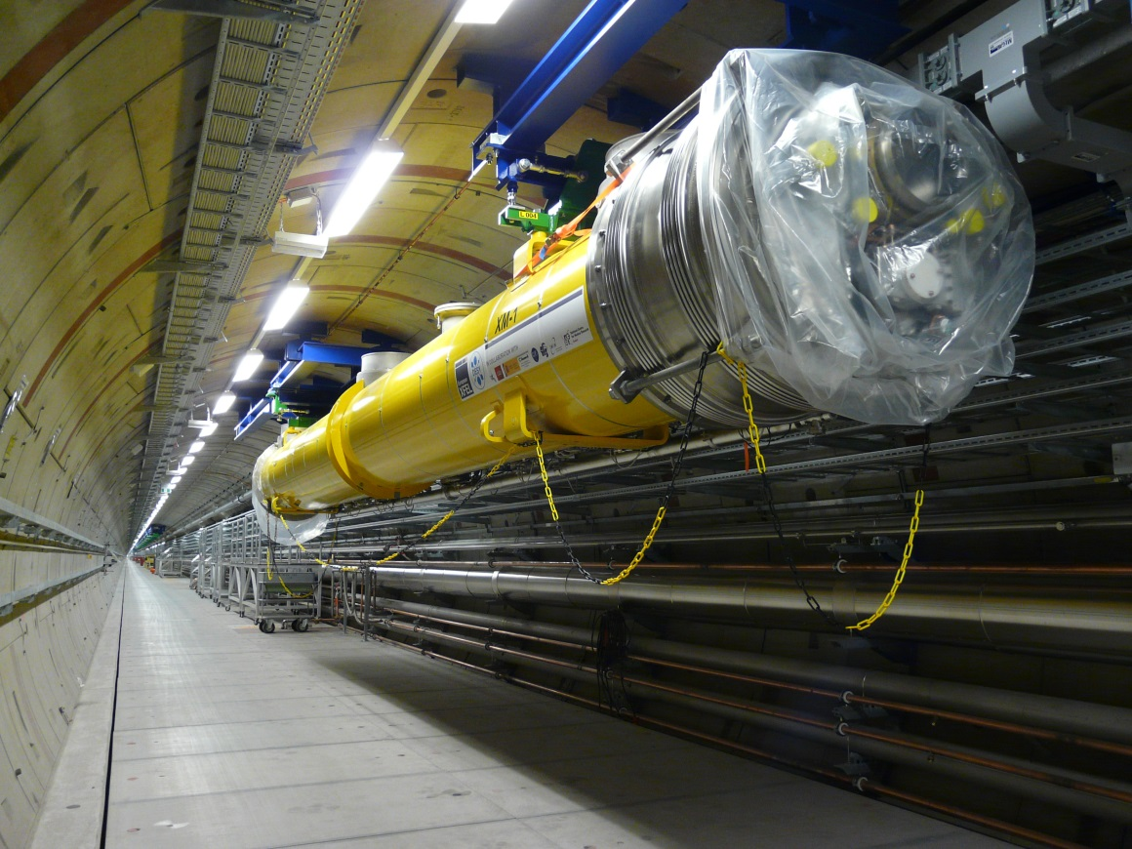
state of affairs
1st cryomodule brought in

Slide 6
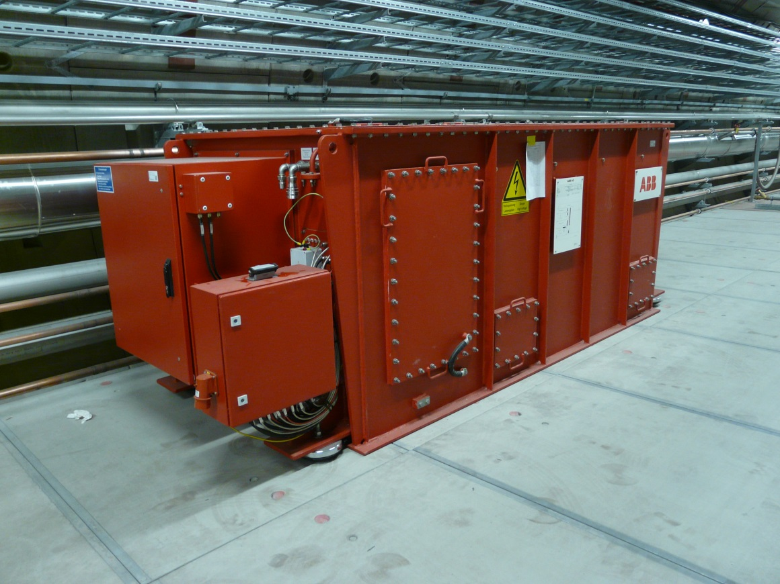
state of affairs
pulse transformer in tunnel – potential fireload!

Slide 7
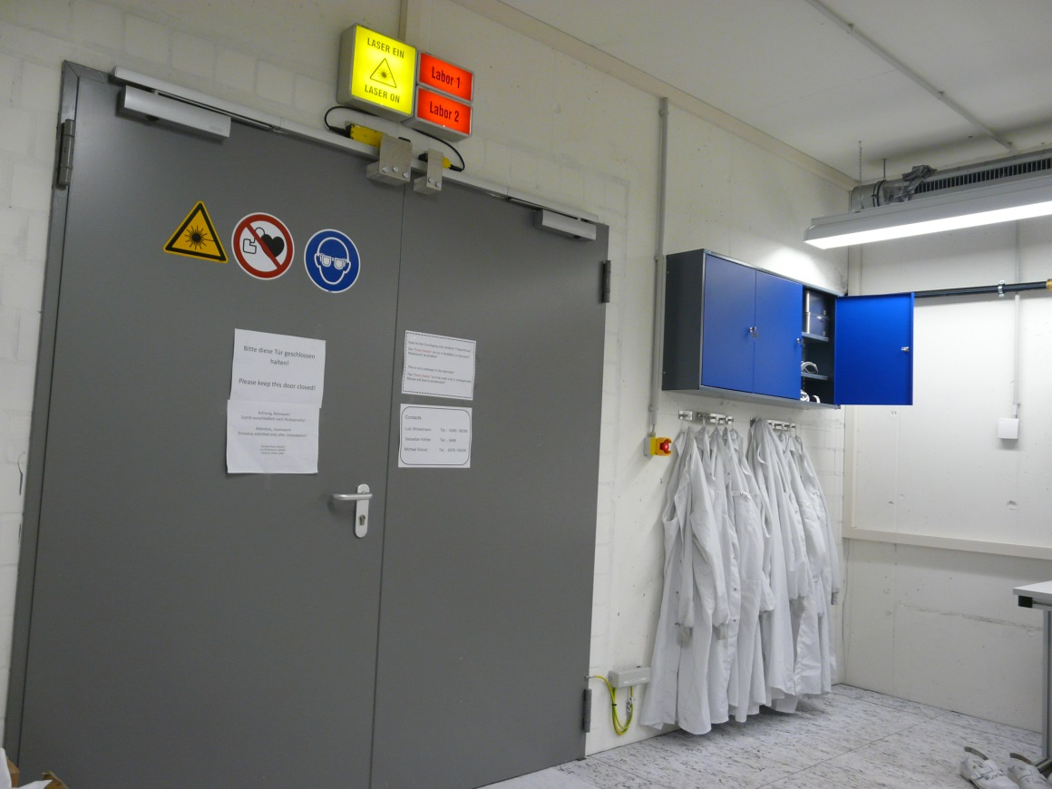
state of affairs
laser lab running in injector

Slide 8
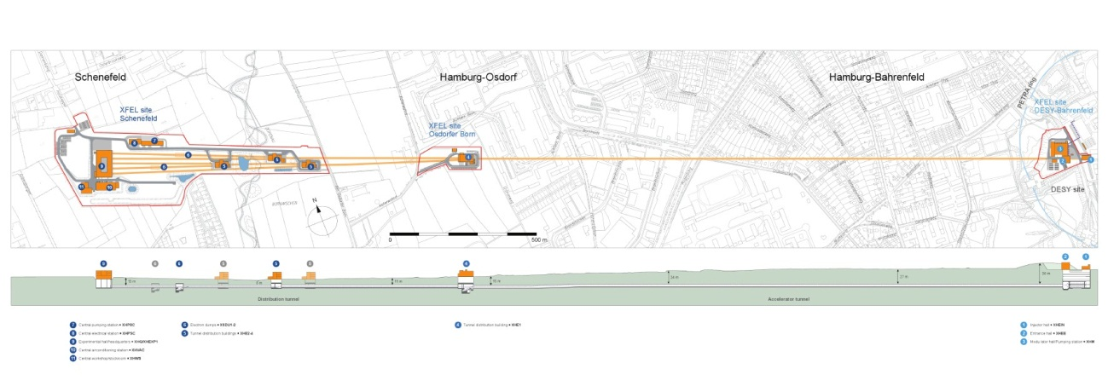
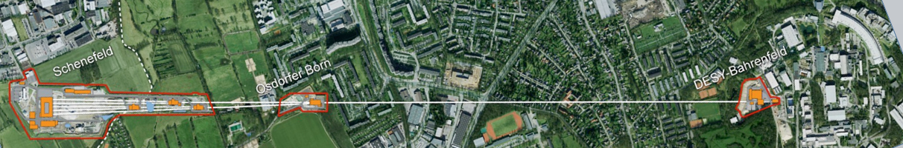
general conditions
3 different phases at the same time
➔ 3 different focuses!
civil construction
Infrastructure installation
machine installation

Slide 9
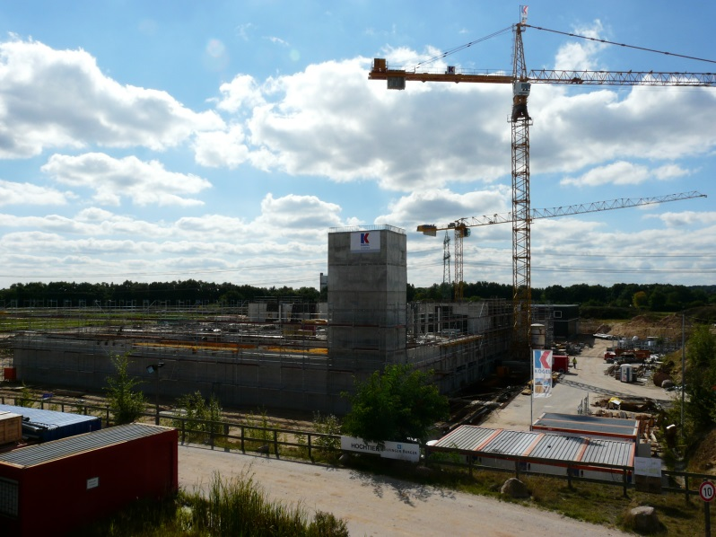
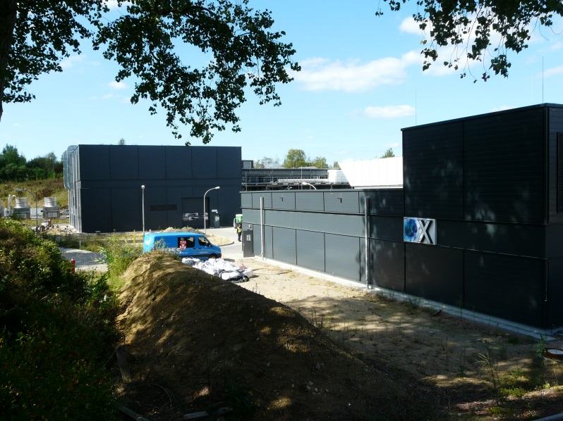
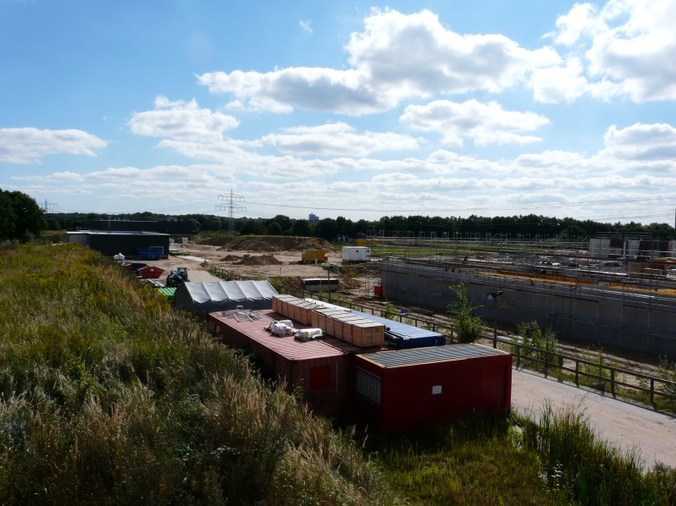
general conditions
campuses in:
Bahrenfeld (DESY site Hamburg) and Schenefeld (Schleswig-Holstein)

Slide 10
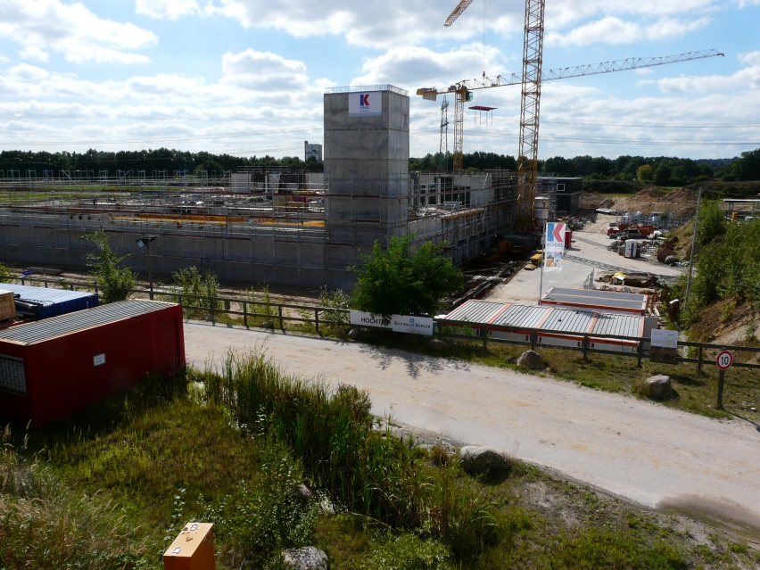
general conditions
civil construction
free falling edges
construction machinery
physical strain
electric shock
moving material
noise

Slide 11
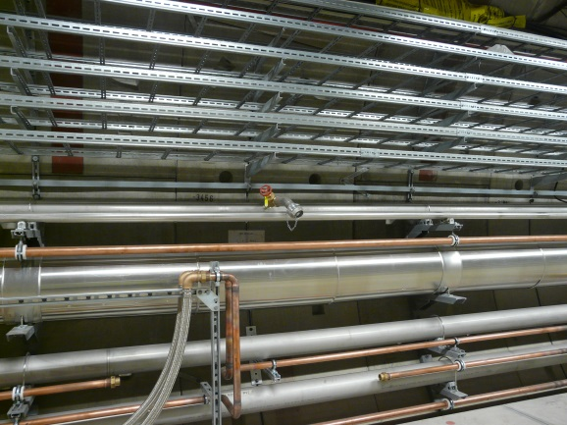
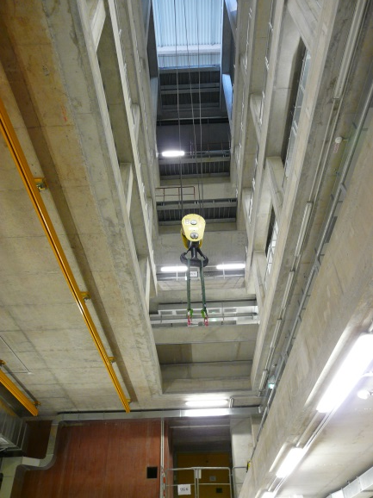
general conditions
installation
moving material
electric shocks
moving work equipment
hot surfaces
inhalation of hazardous substances
combustable gases

Slide 12
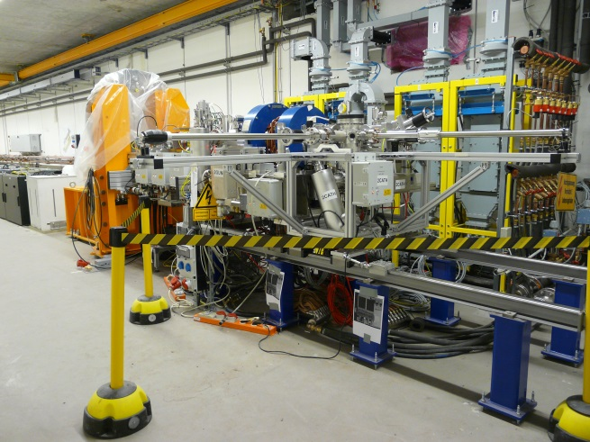
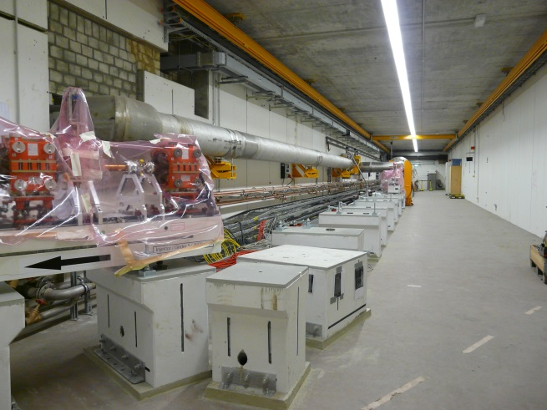
general conditions
machine installation
electric shock
electric arcs
combustible gases, liquids
Inhalation hazardous substances
electrostatic charges
skin contact hazardous substances
hot/cold surfaces
radiation

Slide 13



European
XFEL GmbH
DESY
general conditions
responsibility
managerial authority
supervision
limitations
project supervisor
safety and health coordinator
supervisor infrastructure installation
supervisors civil construction
section coordinators
trade supervisors
safety coordinators

Slide 14
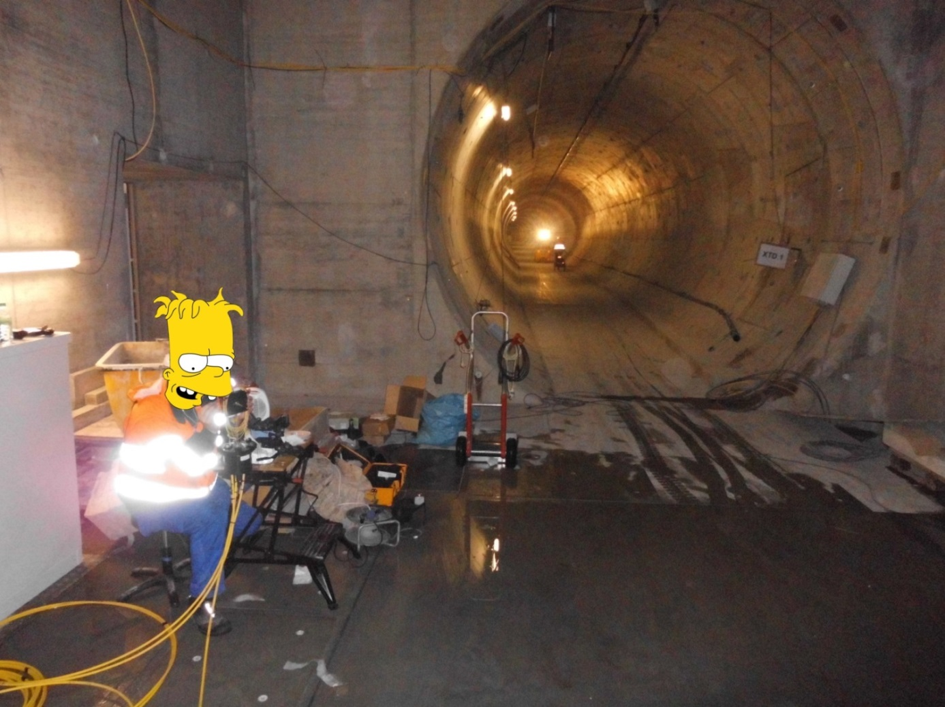

TOP FIVE
5th place:
electronic hazards

Slide 15
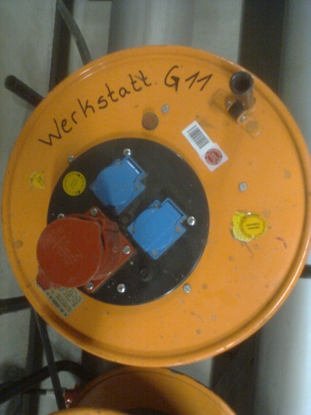
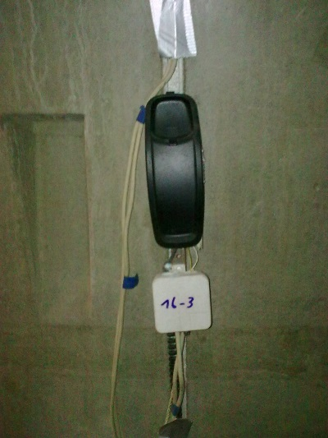

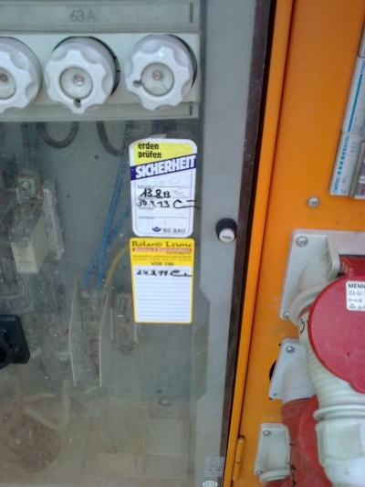
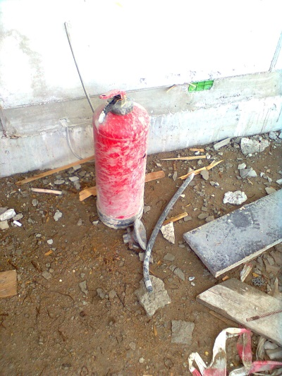
TOP FIVE
4th place:
uninspected equipment

Slide 16
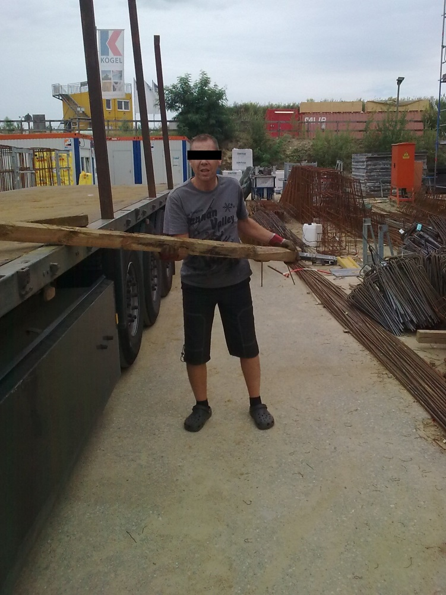

TOP FIVE
3rd place:
Personal Protective Equipment

Slide 17
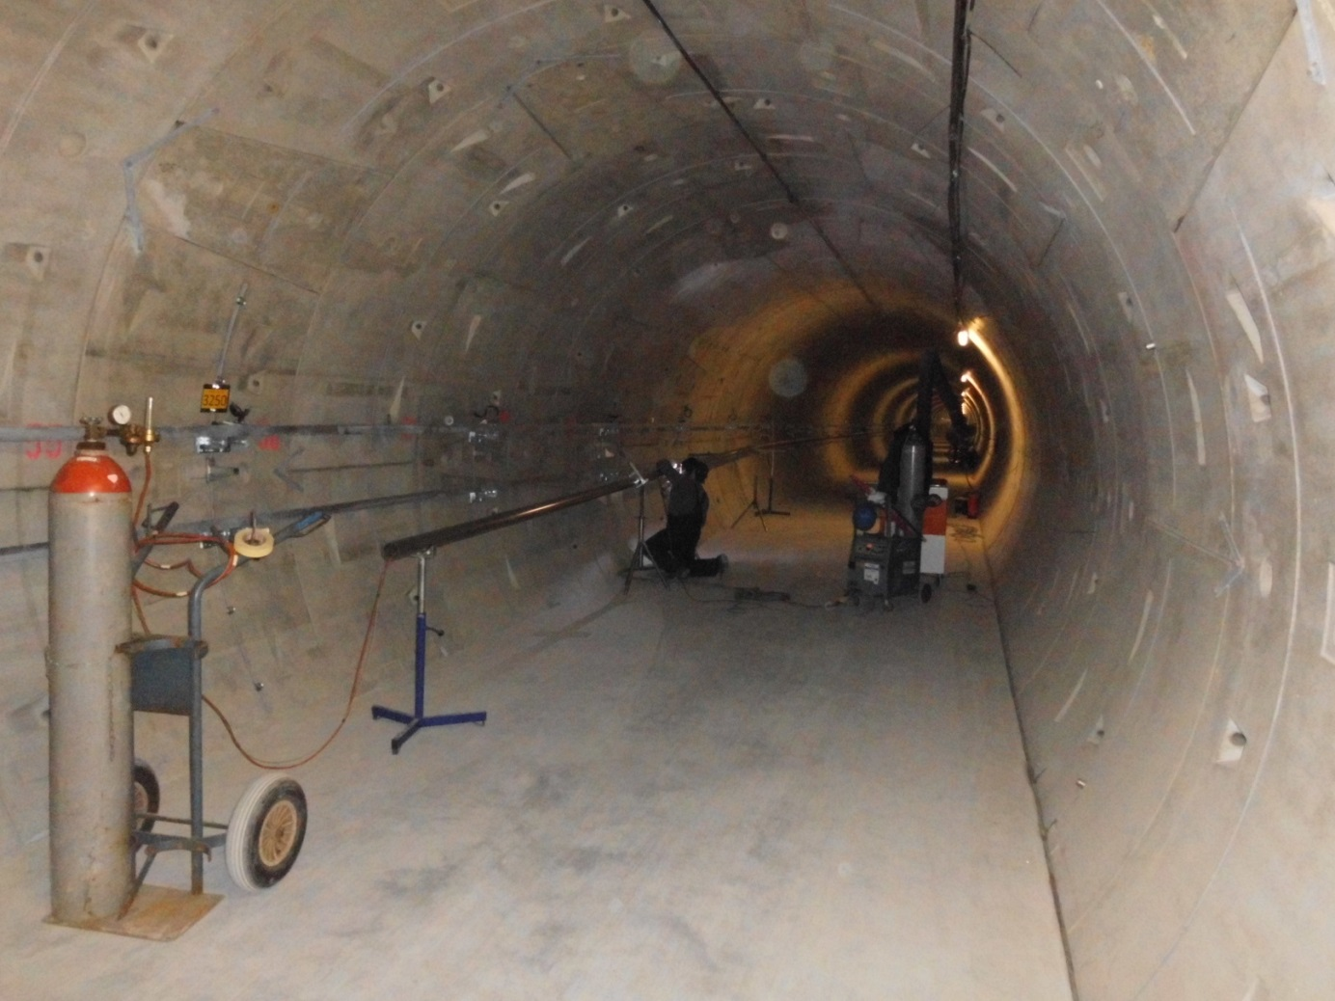

TOP FIVE
2nd place:
welding / gases

Slide 18
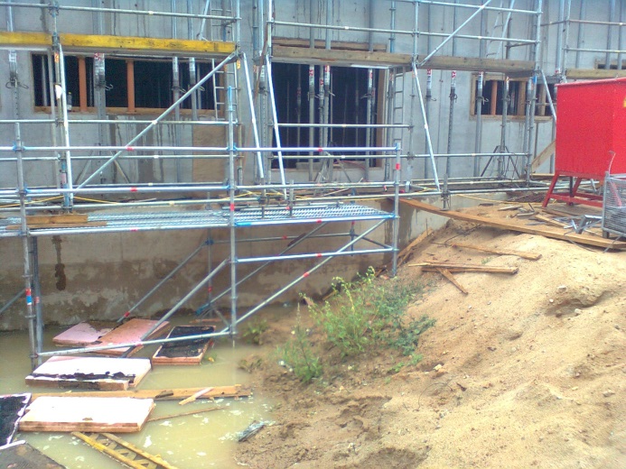
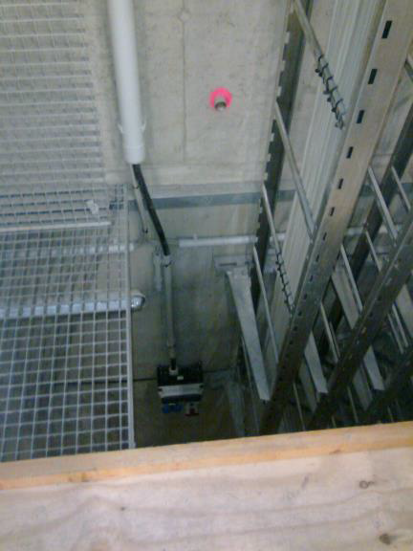

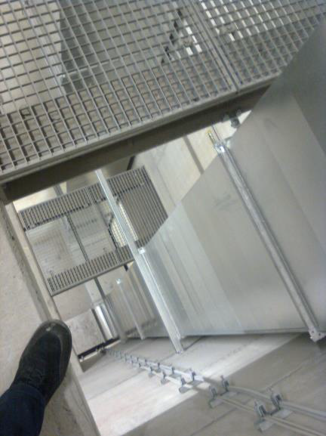
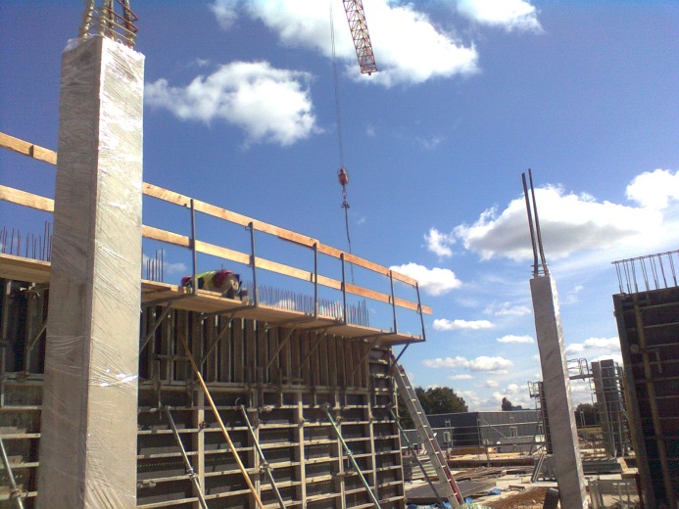
TOP FIVE
1st place:
scaffolding / fall protection

Slide 19
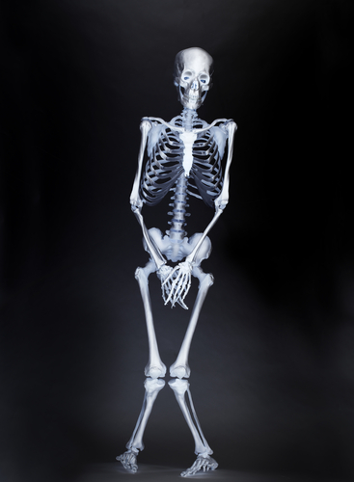
Sven Mohr
Coordination XFEL
Work package 36 - General Safety
Deutsches Elektronen-Synchrotron
D5 - Arbeitssicherheit/Umweltschutz
Notkestraße 85, Gebäude 35
22607 Hamburg
Tel.: +49 40 8998 - 4831
Fax.: +49 40 8998 - 4311
Mobil: +49 175 2619881
Mail: sven.mohr@desy.de

