Slide 1
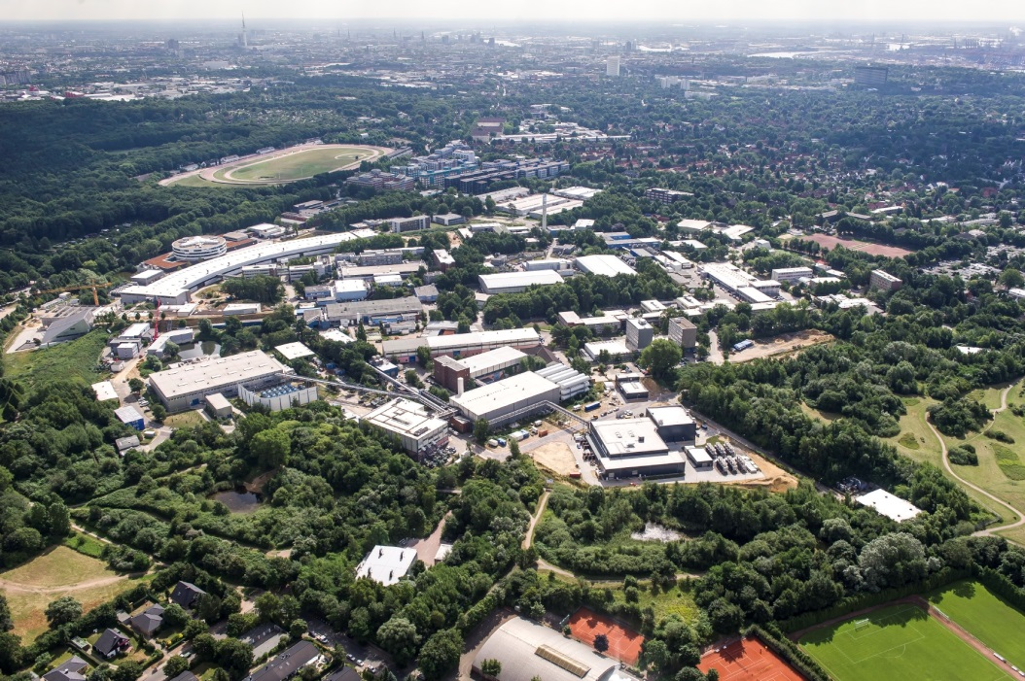
Safety Measures & Organisation in DESY Photon Science User Laboratories
Sabine Lessmann
Chemistry Laboratory Organisation
ITSF 2014

Slide 2
Contents
DESY Photon Science infrastructure
Application procedure for chemistry / biological laboratories
Long-term user
Lessons learned: burst waste container
Improvements in DOOR (DESY Online Office for Research with Photons)
Summary

Slide 3
DESY Photon Science on-site infrastructure
Every year, the regular researchers on the DESY campus are joined by more than 3000 scientists from 45 countries to make use of the DESY photon sources and of the technical infrastructure like chemical, biological or other specialized laboratories.

Slide 4
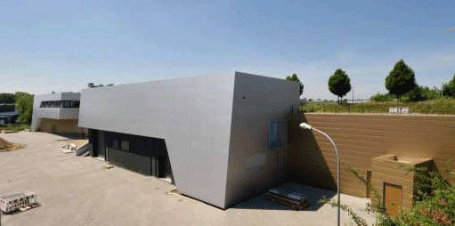
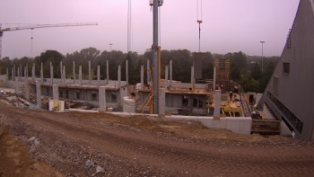
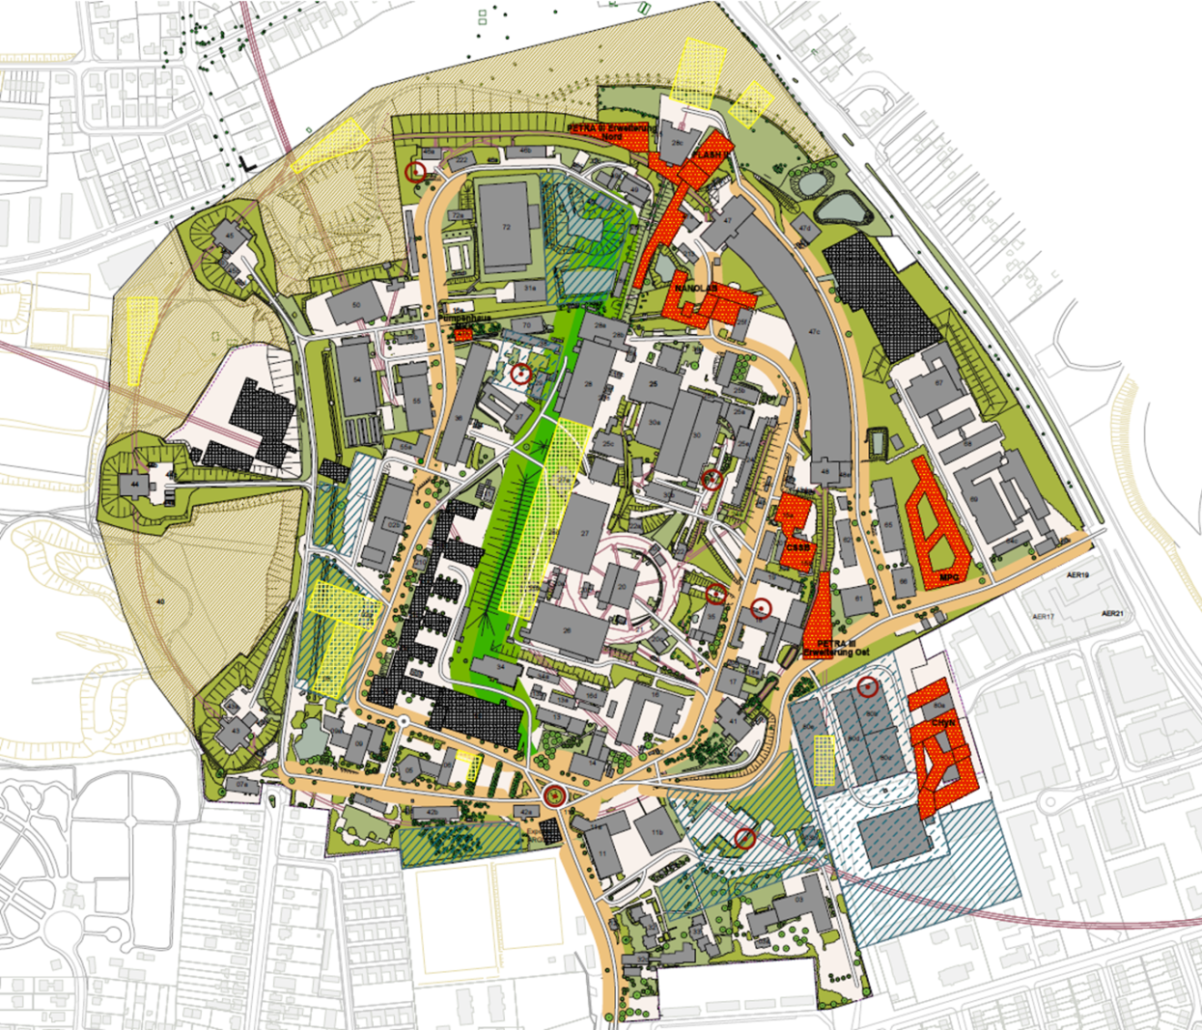
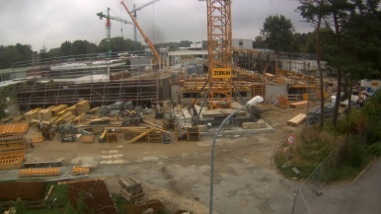
DESY Photon Science on-site Infrastructure
User laboratories PETRA III + FLASH
2 chemistry labs / cleanroom condition
S1 biolab PETRA III
Chemistry and preparation lab (DORIS)
Others: laser, sample environment and extreme conditions, workshop etc.
User laboratories under construction
S2 biolab PETRA III
2 chemistry labs PETRA III ext.
Chemistry lab FLASH II
NanoLab for sample characterization (planned)
PETRA III ext. north
FLASH I / II
PETRA III
NanoLab
PETRA III ext. east

Slide 5
Chemistry laboratory application
Short-term user (during beam time)
Chemistry / biological declaration form via DOOR at least 4 weeks before beamtime. Registration of substances (database of ~ 8000 substances in DOOR) and participants.
Planned activities, upload of a safety concept (working steps, disposal, safety measures etc.).
Online safety instructions (basic, chemistry/ biology, PETRAIII, FLASH)
Risk assessment, additional safety measures and approval by a DESY safety officer.
On-site instructions
Lab access (DESY access control system).
Access right for beamtime period
Valid safety instructions required for access
Laboratory work and disposal
Always after consultation with lab responsibles:
Users take substances back home or disposal at DESY
DOOR
Chemistry declaration
Substances
Activities,
safety concept
Online safety instructions
Approval by safety officer
DESY
On-site instructions
Lab access
Lab work, disposal
Well-functioning process

Slide 6
Chemistry laboratory application
User groups during beamtime at PETRA III, FLASH, (DORIS)  short-term users
DESY staff users not related to a specific beamtime at DESY  long-term users using the same laboratories
FLASH I+II
PETRA III, PETRA III ext.
Estimation
PETRA III
FLASH
DORIS
PETRA III
FLASH
PETRA III shutdown 2/14
FLASH
constant, significant number of users

Slide 7
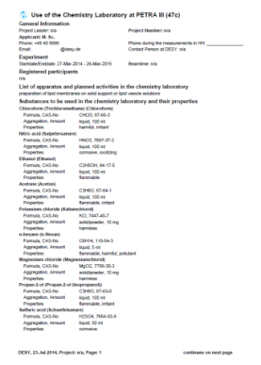
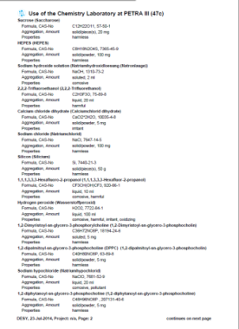
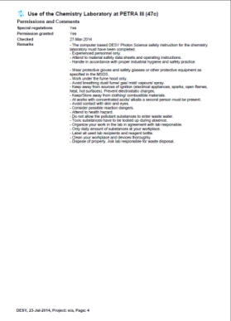
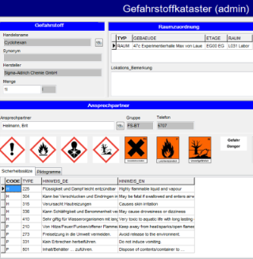
Long-term user
Long-term user (DESY staff / external institute on-site)
Not related to a specific DESY beamtime.
Registration of single person up to groups of 20 participants.
Cleaning, sample preparation for beamtime at a different facility, etching, synthesis etc., many different substances.
Use of same application form via DOOR as for short-time users (same safety requirements apply).
Validity of chemistry declaration up to one year.
Organisational measures (arrangements with lab responsibles and other user groups, schedule).
Substances are listed in DOOR, but if used for a longer time period have to be added to the DESY hazardous substance register (new own-developed software based on floor plan)
Lab work and disposal
Always after consultation with lab responsibles
If in doubt separate waste containers for each mixture (see lessons learned)

Slide 8
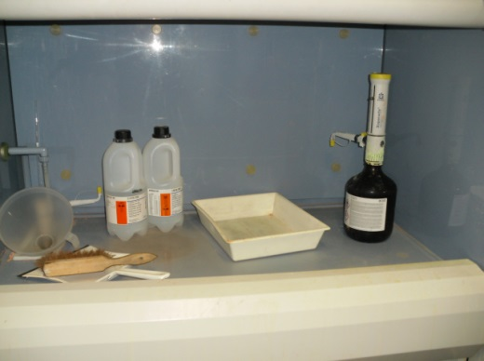
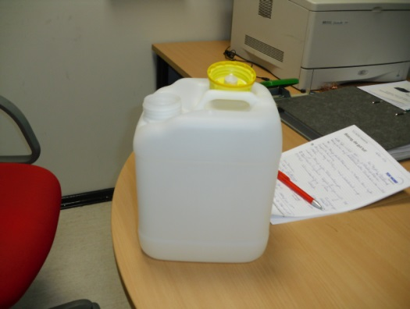
Lessons learned: burst waste container (2011)
What had happened?
Regular procedure
Chemistry laboratory with restricted access, used by qualified and trained DESY staff only.
Use of standard recipe for etching crystals (nitric acid/ acetic acid/ hydrofluoric acid). Diluted mixture is diposed of in 5l waste container with a vented cap placed inside the fume hood in a spill bath.
Changed procedure
Lab staff was asked by a student to try a different recipe at once (ethanol, hydrofluoric acid, water). After an oral risk assessment the colleague agreed to do so.
The work was successfully done and the mixture (250ml) was disposed of in the same waste container as used for the standard recipe.
The lab was closed and the colleague went home (4pm).

Slide 9
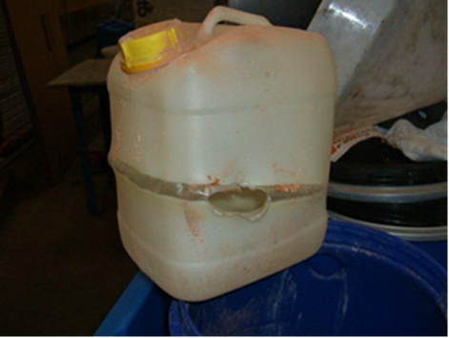
Lessons learned: burst waste container
Half an hour later…
The container blew up, softened and burst (exothermic reaction: nitric acid - ethanol). No persons had been endangered, because nobody was in the lab.
Short time later the incident was discovered by the remaining lab staff, who was not informed in detail about the etching process and the used substances.
At 5pm the DESY Technical Emergency Service was called.
Because of the uncertainty what had caused the incident, the DESY Technical Emergency Service called the Hamburg fire / environmental department to secure the place.
If the person who had carried out the etching, had been on site, the spilled liquid could have been absorbed with a chemical binder by DESY staff (under self-protection) with less effort.

Slide 10
Lessons learned: burst waste container
Internal investigation (by DESY safety department)
Risk evaluation did not sufficiently consider the disposal.
New workflows have to be discussed with supervisor.
Use of different waste containers for each mixture.
A safety concept, as required for chemistry declarations via DOOR, might have prevented this incident.
...
Mixture 1
Mixture 2
This incident confirmes, that we should go on processing chemistry laboratory work of all users / DESY staff via DOOR.
Careful work planning is essential, some improvements in DOOR were made to support chemistry and biology laboratory applications.

Slide 11
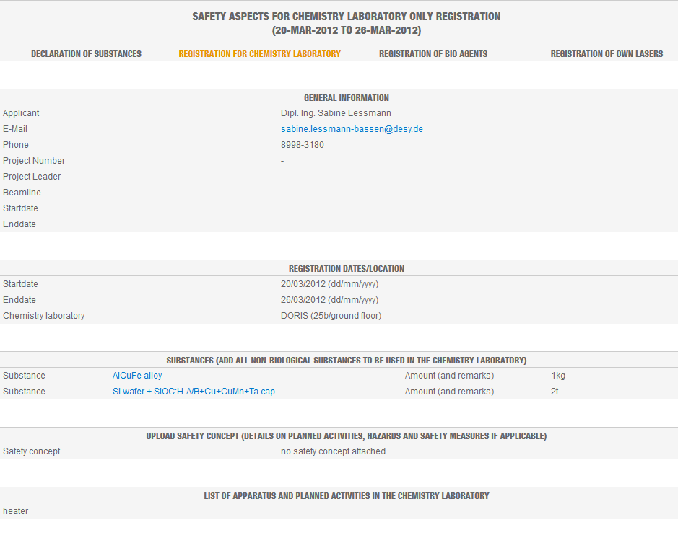
Improvements in DOOR to support the chemistry lab use
Integration of new features to support lab responsibles and safety officers:
List of long-term registered users in DOOR ⇨ better information of lab users by responsibles in case of maintenance work etc.
DOOR based time schedule for laboratories.
Overview on all activities (long- and short-term) in the laboratories and beamline in one form

Slide 12
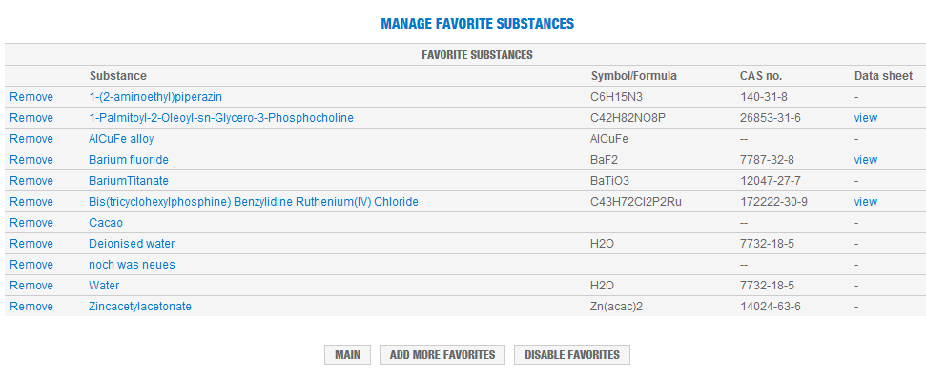
Improvements in DOOR to support the chemistry laboratory
Benefits for users:
Implementation of a user‘s favourite list of substances in DOOR.
History of lab applications in DOOR.
Users are forced to do systematic work planning (safety concept, detailed work description).

Slide 13
Summary
With the new PETRA III extension and FLASH beamlines additional user laboratories are built. Therefore a good user laboratory organization is essential.
Although incidents cannot always be prevented, DOOR is a useful instrument to handle chemistry / biology laboratory work for both short- and DESY long-term users.
Improvements in DOOR were made to assist safety staff and users.
Acknowledgements to:
DESY Photon Science Safety Officers and laboratory staff
DOOR (DESY Online Office for Reasearch with Photons)
DACHS (DESY Access Handling System)
DESY safety department D5
Thanks for your attention!

