Slide 1
Risk management and safety coordination through interactive models for
the construction sites of Xenon1T in the Gran Sasso National Laboratory.
8-12 September 2014, Chicago
R. Perruzza, M. Tobia , R. Tartaglia (LNGS-INFN)
In collaboration with E. Aprile (Columbia University) & D. Orlandi (LNGS-INFN)

Slide 2
Overview
Xenon1T @ LNGS
Xenon1T facilities:
Water Tank
Service Building
Regulatory asset
Construction sites safety and management:
interferences
solutions
results
Conclusions & Future prospects

Slide 3
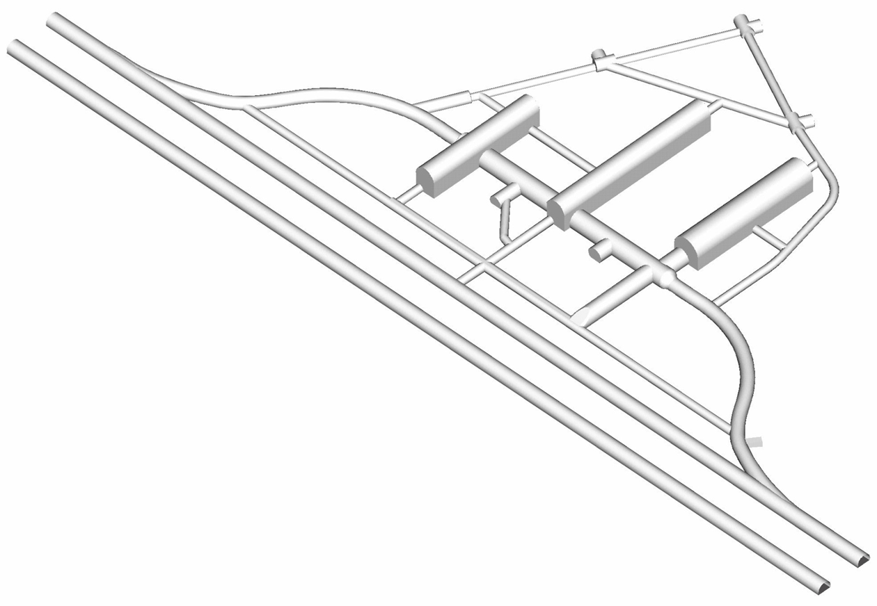
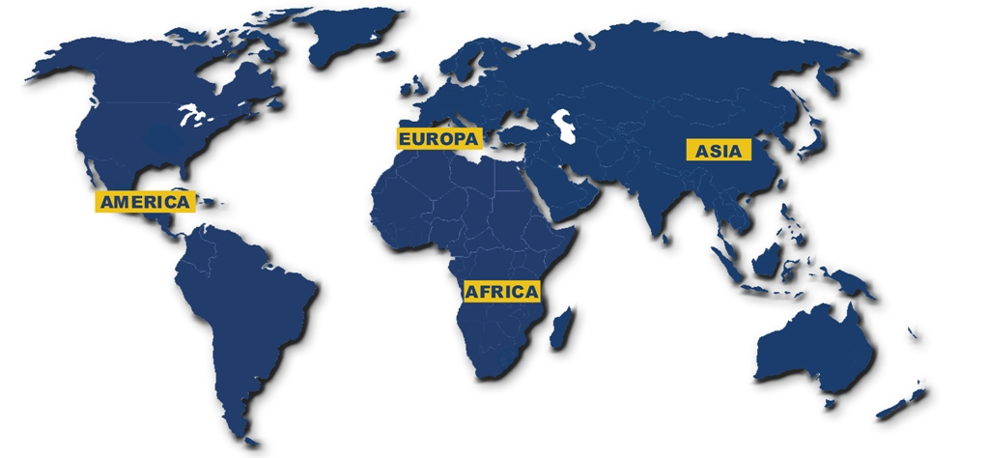
Xenon1T @ LNGS
Xenon100
LNGS
EXIT
Pulex
Interferometer
Truck Tunnel
LUNA 2
L’AQUILA
LVD
Hall A
ICARUS
Car Tunnel
CRESST
CUORE
Xenon1T
DAMA
WArP
BOREXino
Car Tunnel
Hall B
DarkSide
Xenon1T Experimental Collaboration
Truck Tunnel
OPERA
GRAN SASSO TUNNEL
LUNA-MV (next)
Services Tunnel
Hall C
Car Tunnel
University of Nantes
Nantes
Columbia University, New York
Truck Tunnel
University of Coimbra
Portogallo
Car Tunnel
Universitat Zurich
Zurigo
Nikef Institute
Amsterdam
Wilhelms Universitat
Monaco
By-pass 13
LNGS ENTRANCE
Max Planck Institute for
Nuclear Physics
Germania
Shanghai Jiao Tong
University
Shanghai
TERAMO
INFN-LNGS
Assergi
Rice University Houston
INFN e Università di Bologna
Bologna
University of California
Los Angeles

Slide 4
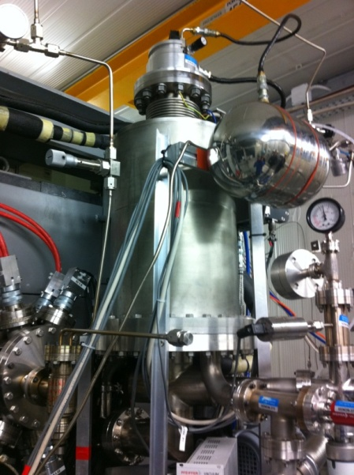
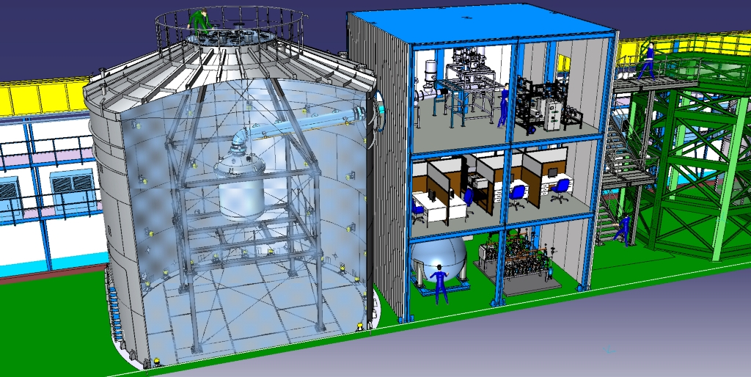
Xenon Project
Xenon10
Xenon100
Xenon1T
Objective → DARK MATTER Research
DIRECT REVELATION METHOD OF WIMPS
1 ton xenon double phase TPC

Slide 5
Xenon1T facilities: Water Tank Service Building

Slide 6
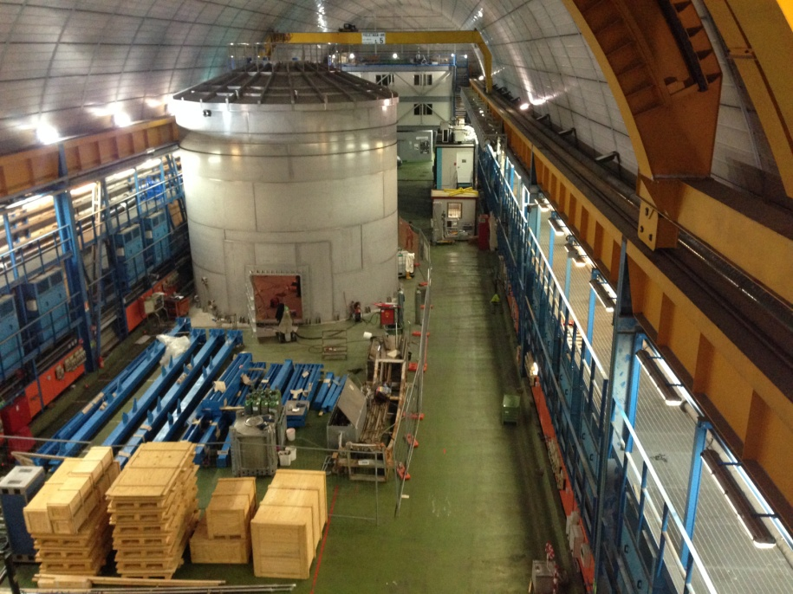
Hall B

Slide 7
Hall B planimetry
WArP
Xenon1T
ICARUS

Slide 8
Xenon1T: Water Tank
Weizmann Institute
Water Tank
Vertical Cilinder with Conic roof
Stainless steel AISI304
Volume: ~700 m³
Weight: ~33.500 kg
Diameter: 9.600 mm
Height: 11.600 mm

Slide 9
Xenon1T: Service Building
Service Building
3-floor steel structure
Width: 7.000 mm
Length: 8.000 mm
Height: 11.000 mm
INFN

Slide 10
Regulatory asset

Slide 11
LNGS regulatory asset
The regulatory asset within which LNGS, and so the structure presented, move is complex and articulated.
Fire Safety Regulation
Health & Safety in Workplaces
Regulation
Anti Seismic Design & Construction
Regulation
Close & Confined Spaces
Non-routine work conditions
Needing to work in night/holiday shifts sometimes
Complex and high technology apparatuses
International environment
(different behaviors, different standards, etc.)
Direct connection with highway
Storage and processing of dangerous substances
Code of Public Contracts
Construction Site
Regulation
Environment Regulation
Seveso Directive 2003/105/CE
(Control of Major Accident Hazards)

Slide 12
Water Tank & Service Building construction sites
Water Tank
Service Building
Code of Public Contracts
Financed by Weizmann Institute of Science (Israel)
Commissioned by INFN (Italy)
Possibility to use the private law with the ability to directly choose the executing company
Public tender for the award of the contract

Slide 13
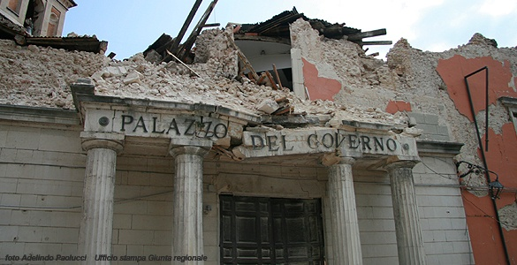
Water Tank & Service Building construction sites
Water Tank
Service Building
Anti Seismic Design & Construction
Regulation
Technical standards for construction in seismic areas (NTC2008)
Technical standards for construction in seismic areas (NTC2008)
All structures designed and built in order to guarantee:
Seismic Request ≤ Capacity Design
All structures designed and built in order to guarantee:
Seismic Request ≤ Capacity Design
L’Aquila

Slide 14
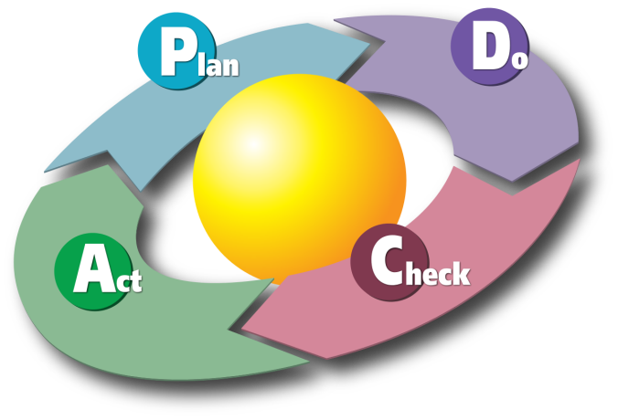
Water Tank & Service Building construction sites
Water Tank
Service Building
Seveso Directive 2003/105/CE
(Control of Major Accident Hazards)
Constraints of LNGS Safety Management Systems & procedures
Constraints of LNGS Safety Management Systems & procedures
Respect of all the procedure i.e.
Emergency Plan
Access procedure in the underground area;
Hot Work Permit;
Confined Space Permit.
Respect of all the procedure i.e.
Emergency Plan
Access procedure in the underground area;
Hot Work Permit

Slide 15
Water Tank & Service Building construction sites
Water Tank
Service Building
Health & Safety in Workplaces
Regulation
Defined as a “Construction Site” needing of a
Safety Coordinator
Defined as a “Construction Site” needing of a
Safety Coordinator
Construction Site
Regulation
Safety Coordination Plan:
- Risk Assessment
- Coordination activity and phases
- Construction Site Layout
- WorksTimetable
- Estimate of Safety Costs
Safety Coordination Plan:
- Risk Assessment
- Coordination activity and phases
- Construction Site Layout
- WorksTimetable
- Estimate of Safety Costs

Slide 16
Construction sites safety and management: interferences solutions results

Slide 17
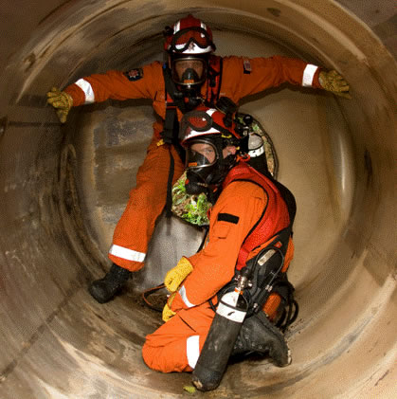
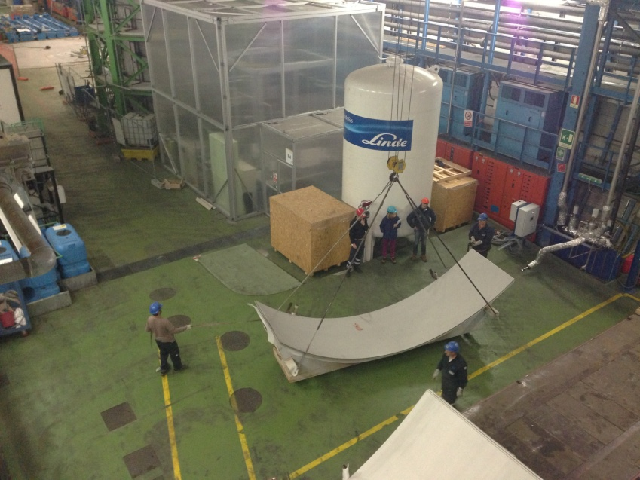
Specific Risks&Criticalities: Water Tank
Specific Risks
Use of manual tools
Materials falling from heights
Artificial Optical Radiation Risk
Chemical risk
Confined Spaces
Falling from heights
Criticalities
Handling of ferrules & positioning saddles
TIG welding
Hydraulic Test

Slide 18
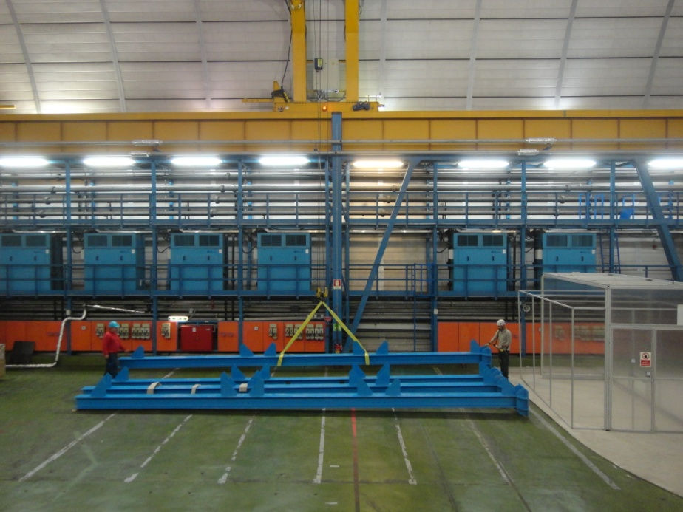
Specific Risks&Criticalities: Service Building
Specific Risks
Use of manual tools
Materials falling from heights
Falling from heights, slips
Criticalities
Shipping and handling of pillars and beams
Identifying areas for the unloading and storage of pillars and beams
Anchoring pillars

Slide 19
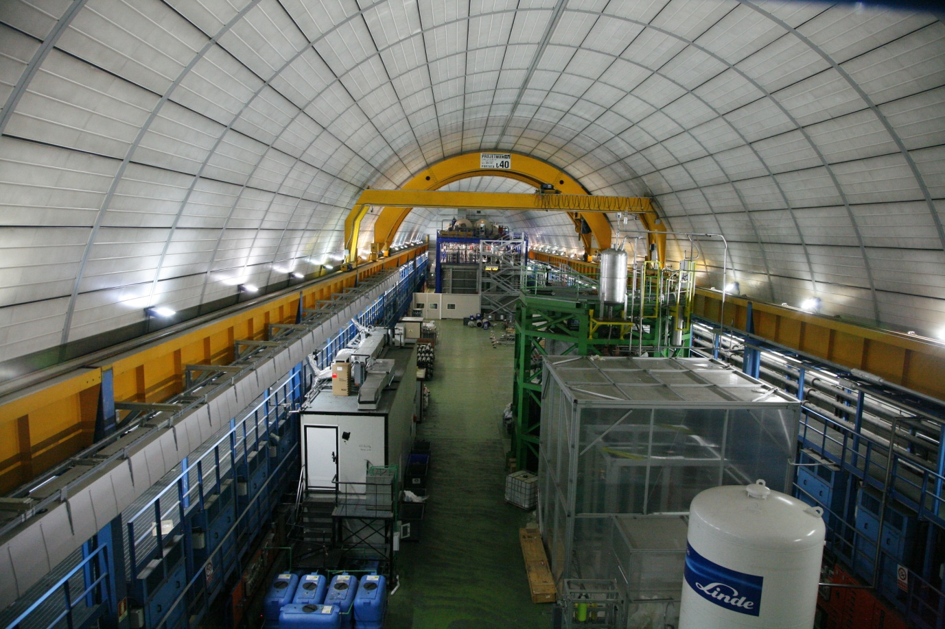
Interferences: same space and time
Hall B
Both construction sites (WT&SB) operating phase, in the same space at the same time
required a considerable effort to the analysis, assessment and management of risks due to interferences.

Slide 20
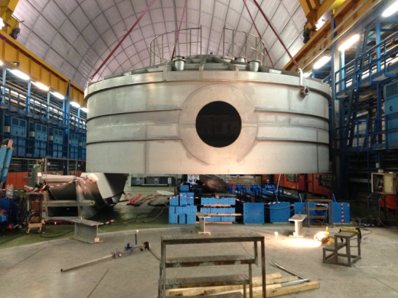
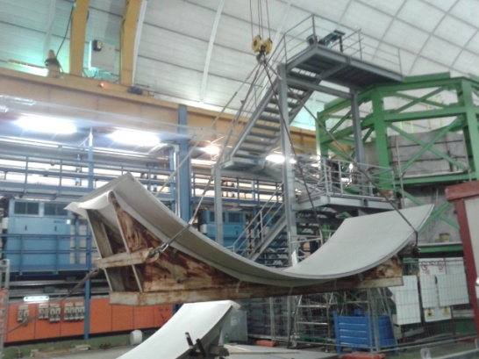
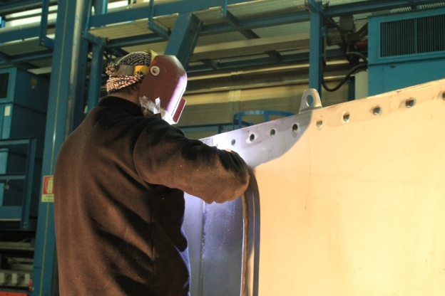
Interferences: WT & SB
Water Tank construction site
Service Building construction site
Logistics
Storages/Spaces
Work phases
(Noise, Dust, Hot works, falling from heights)

Slide 21
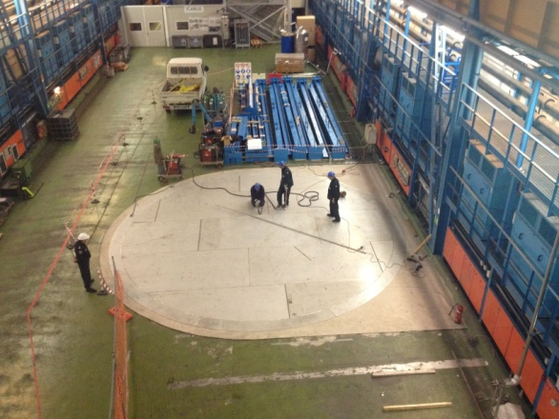
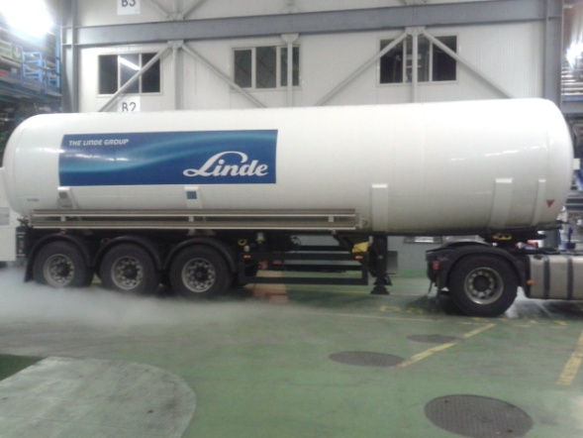
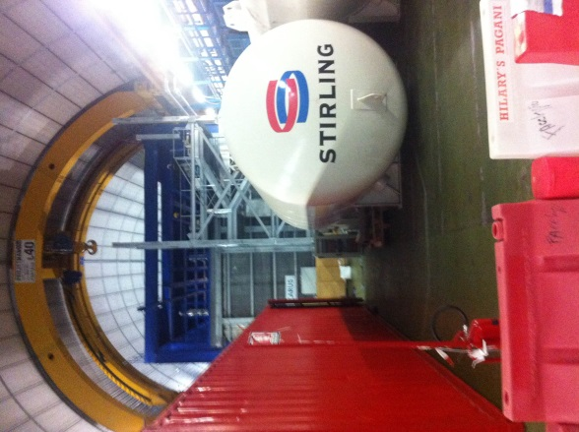
Interferences: WT + SB & ICARUS
WT + SB
construction site
ICARUS
decommissioning
Logistics
Storages/Spaces
Cryogenics

Slide 22
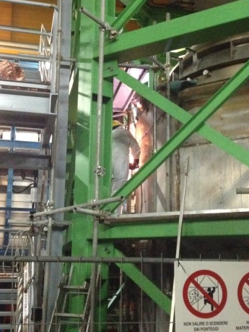
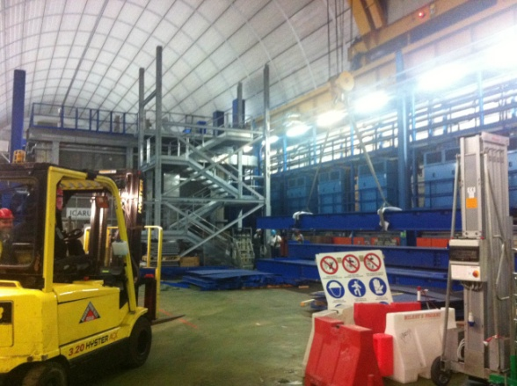
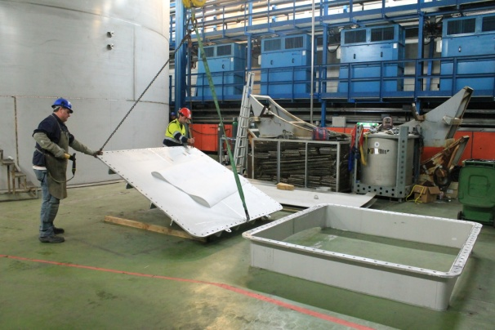
Interferences: WT + SB & WArP
WT + SB
construction site
WArP
decommissioning
Logistics
Storages/Spaces
Work phases
(Noise, Dust, Hot works, falling from heights)

Slide 23
Solutions: figures and documents
WT
SB
ONE Safety Coordinator for both the construction sites: Marco Tobia
Hall B
(by LNGS Director)
WT+SB
Unique and Integrated Safety Coordination Plan for both the construction sites

Slide 24
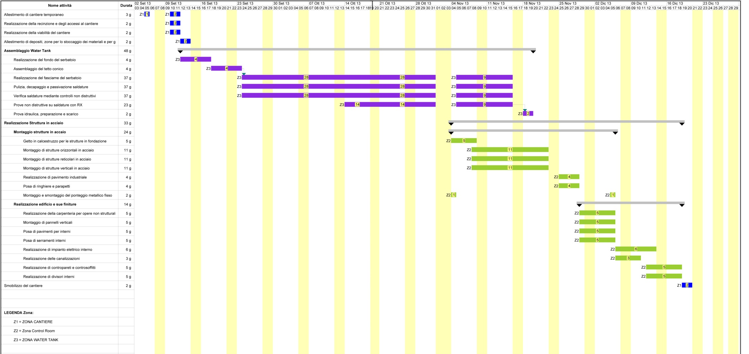
Solutions: time
To avoid additional risks and for a better coordination of the activities it was decided a time shift between the activities.
Work Phases
WT Activities
Common
Activities
SB Activities

Slide 25
Solutions: space
Continuous trade-off between space needed by Xenon1T construction sites and Icarus&WArP decommissioning
Clear identification and respect of the layout and spaces defined by the Safety coordinator.

Slide 26
Solutions: management
Weekly coordination meeting among all the figures involved: experiments GLIMOS, LNGS staff, Workers & Responsibles of External companies involved.
Direct partecipation and shared solutions: team working.

Slide 27
Solutions: management
Daily report (standard one) on the activities carried out underground:
Date and Hour
Presence (LNGS staff, Collaboration Staff, Workers)
Working phase description
Recommendations and prescriptions
Photos

Slide 28
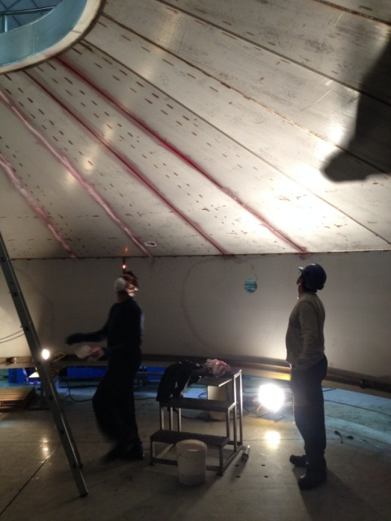
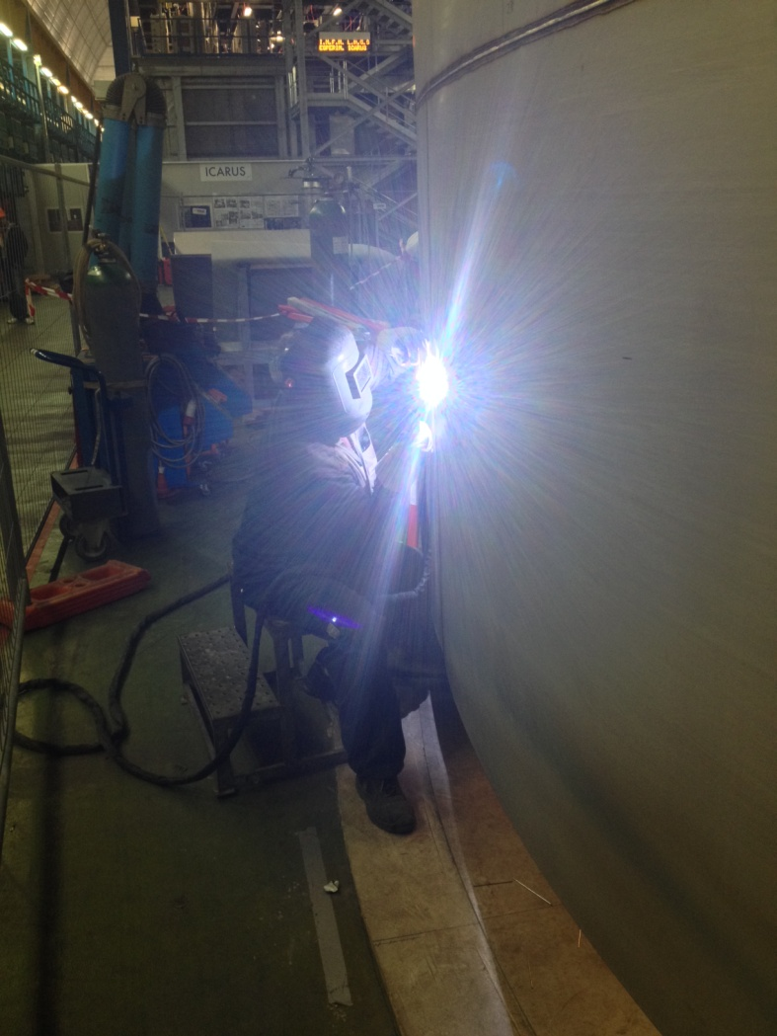
Solutions: management
Hot permits and Confined spaces permit as foreseen by the Safety Management System of the LNGS

Slide 29
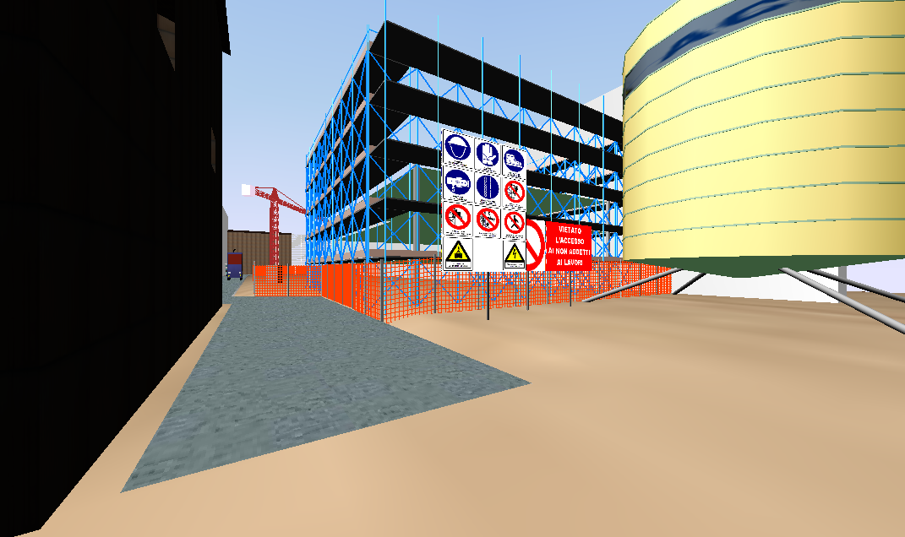
Solutions: interactive tools
Use of ACCA® software for the interactive management of the Safety coordiantion plans. e emergency management
Pyrosim® and Pathfinder® tools for the simulation of an emergency in the site, and evaluate the time response of workers.

Slide 30
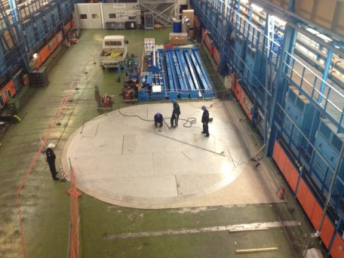
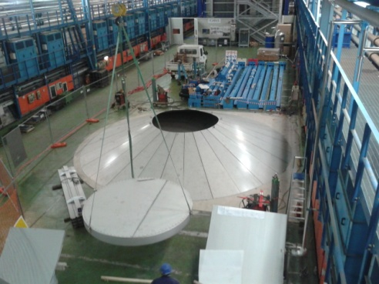
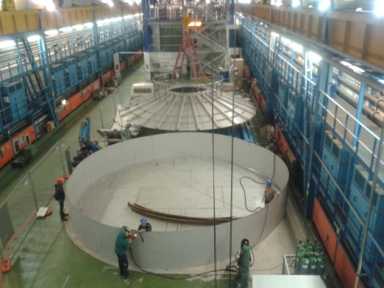
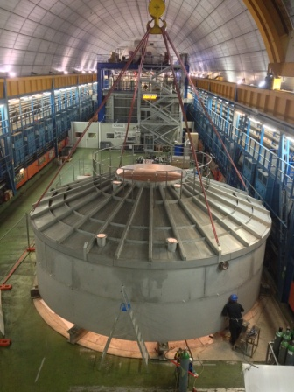
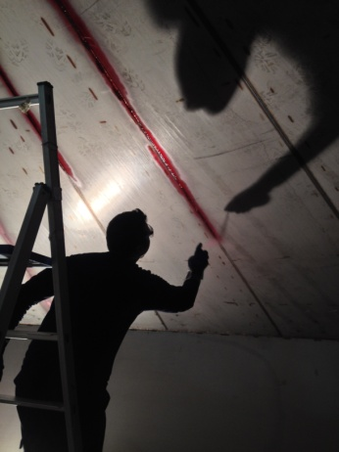
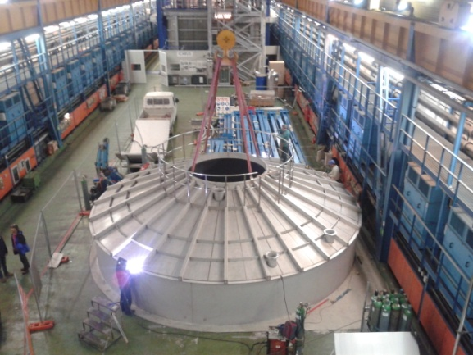
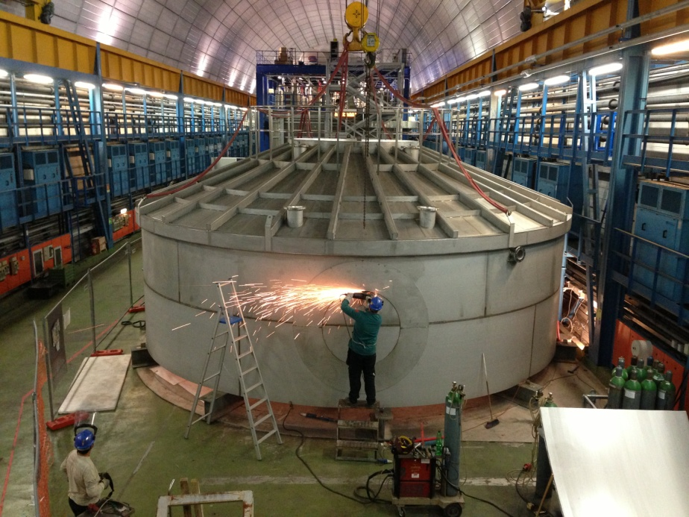
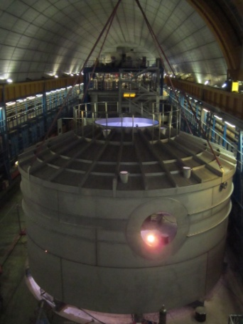
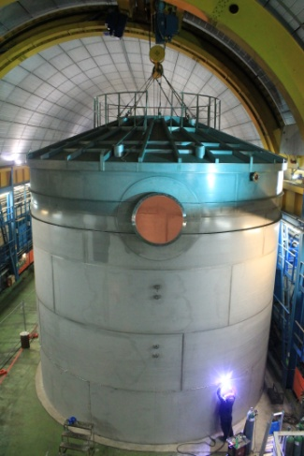
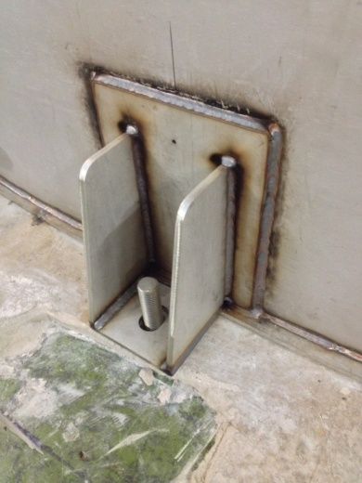
Results: Water Tank
Video
Video

Slide 31
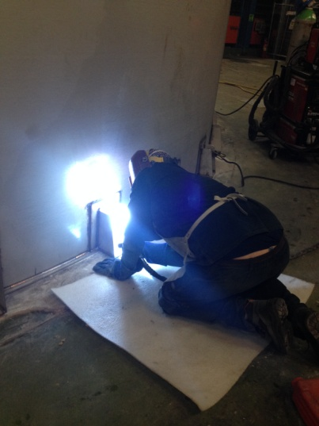
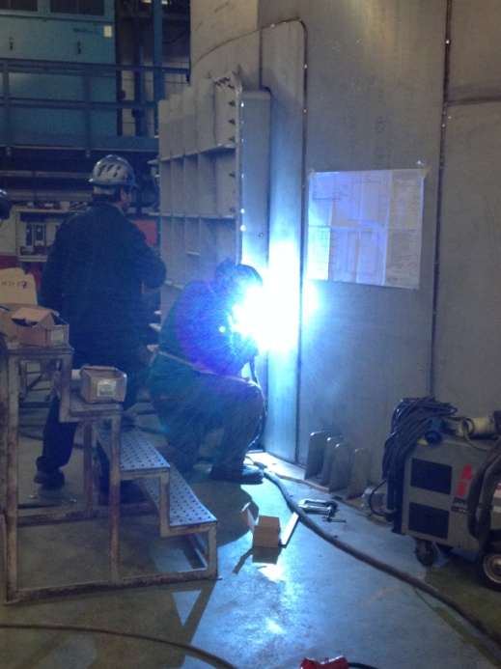
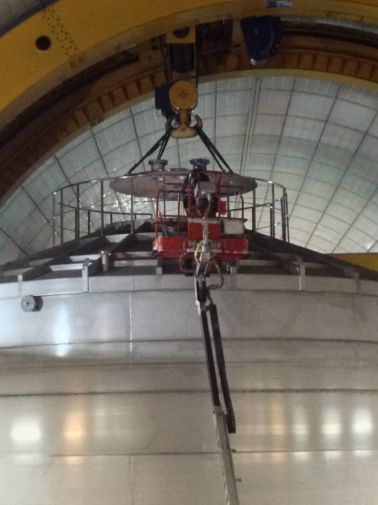
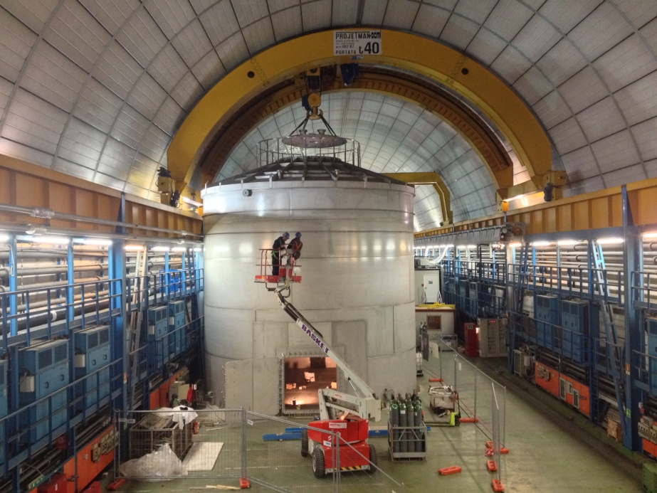
Results: Water Tank

Slide 32
Results: Water Tank
At the end of the works the hydraulic test of the Water Tank was performed.

Slide 33
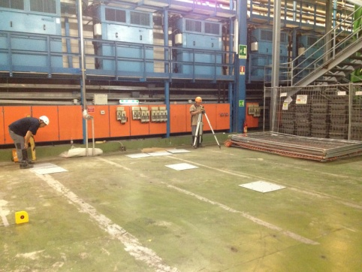
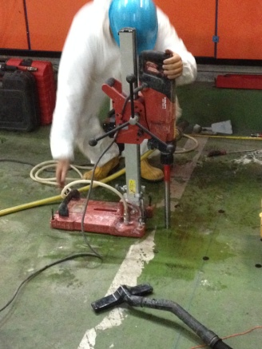
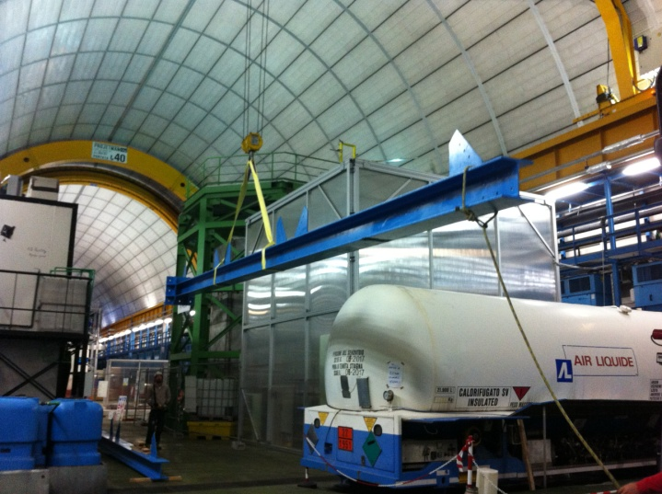
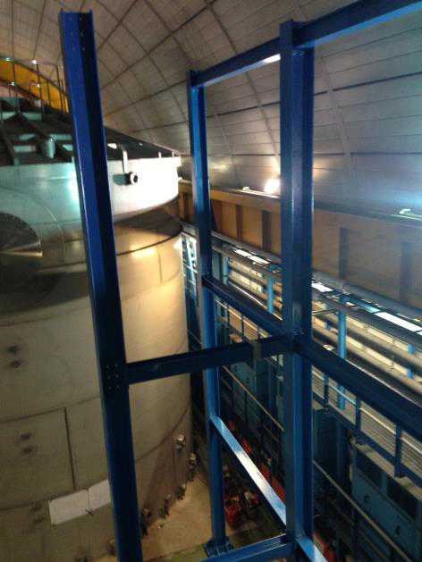
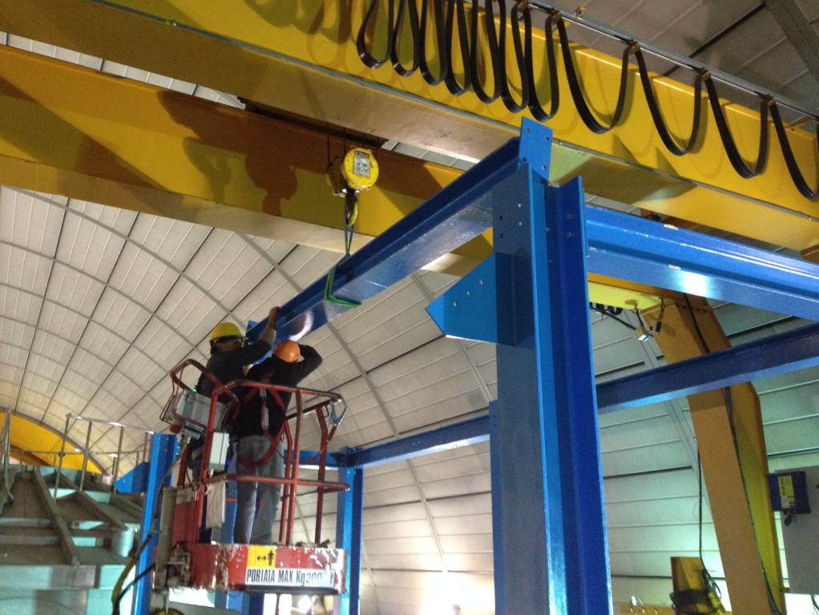
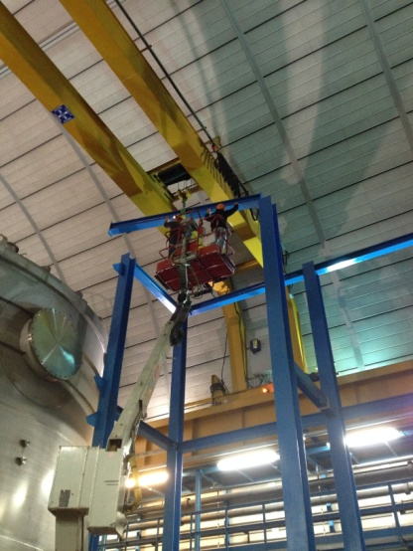
Results: Service Building
Video

Slide 34
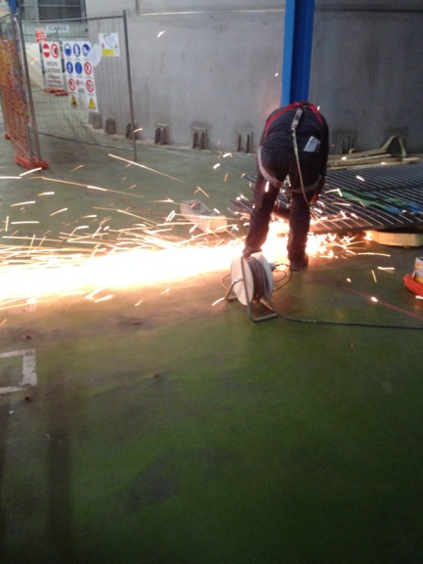
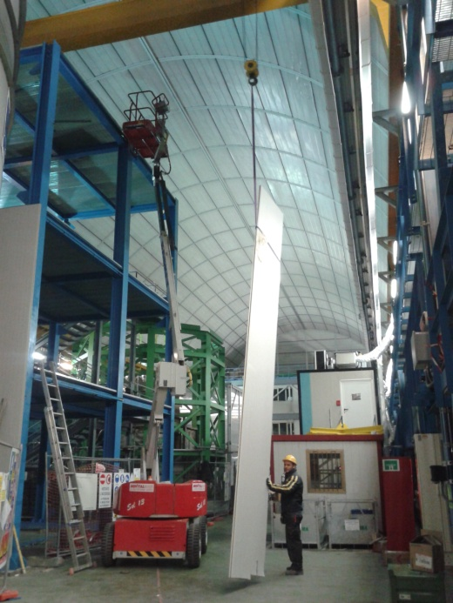
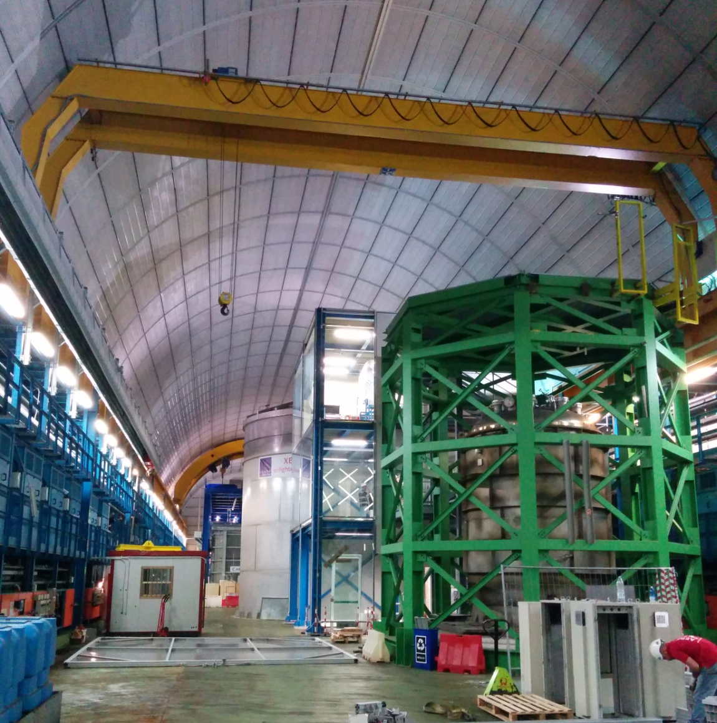
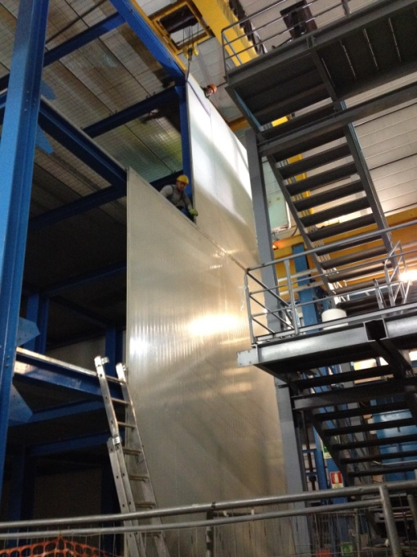
Results: Service Building

Slide 35
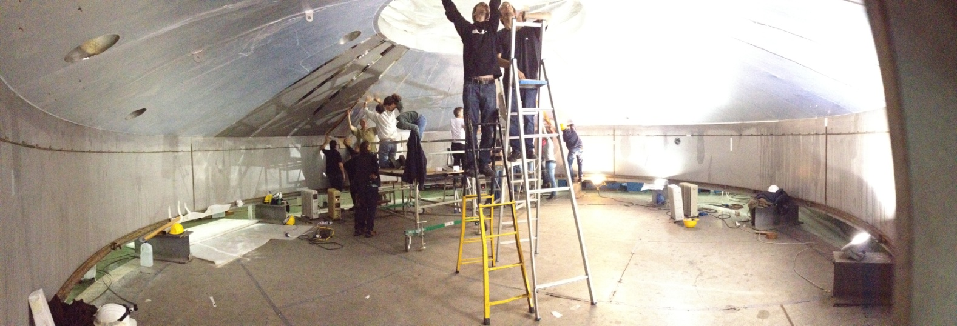
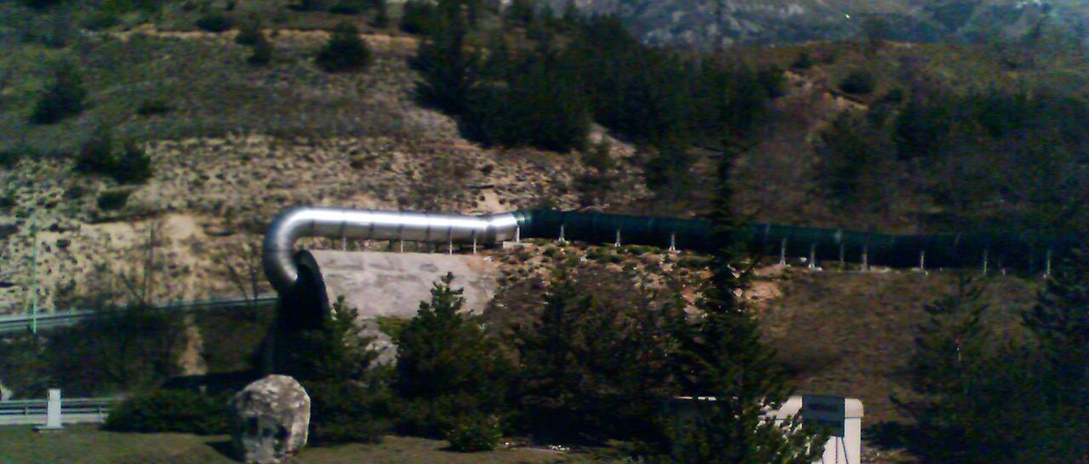
Results: supensions
Application of reflective foil inside the Water Tank by XENON1T collaboration.
Tests on ventilation plant by the SEM LNGS (missed communications)

Slide 36
Results: supensions
Service Building elevation
November 26th and 27th, big snowfall on L’Aquila (traffic in highway very difficult or closed).

Slide 37
Results: supensions
December 2nd: Di Zio CM SpA company not present due to flooding in Spoltore – Pescara and consequently unavailability of A14 highway.

Slide 38
Results: supensions
WArP decommissiong: environmental measurments by LNGS to evaluate the quality of air in Hall B (dusts by removal of WArP shielding by Plasma Cutting)
Video

Slide 39
Results: Timelapse

Slide 40
Conclusions
Use of a Tools oriented (Acca©, Pyrosim©, Pathfinder©) approach for optimization and management of two Safety Coordination Plans for Water Tank and Service Building of Xenon1T.
Critical analysis of Italian regulation limits for complex construction sites and extra-UE fundings.
New proposed approach with one Safety Coordinator and a unique and integrated Safety Coordination Plan.

Slide 41
Conclusions
Correct implementation of all laws and regulations that contribute to the safety of the LNGS from Seveso to the Italian law about Safety and Health.
Works (1-year duration) recorded:
zero accidents,
the respect of the scheduled timelines,
a great satisfaction by workers actively involved at all levels and by Xenon people (except the spokesperson)

Slide 42
Future prospects
1. The Xenon worksite, up to now, has been the real case of the 3° generation experiment @ LNGS
2. The experience passed tells us that the worksite organization of a new experiment really requires professionality in the safety field.
Internal and/or external registered professional as safety coordinator
3. In an experimental Hall “multi-purpose” it’s really important to elect a safety/logistisc coordinator

Slide 43
Future prospects
4. The idea to “reply” the same configuration for the next installation/decommissioning/removal is the leading idea right now.
5. Lesson learned: the WARP decommissioning weighted on the LNGS staff – Collaboration disappeared (Pb particles all over...)
6. Include the decommissioning cost and time-schedule in the Experiment proposal
7. Software “agenda” in order to monitor the activities of all the Companies working underground (guards and firemen involvment).

Slide 44
Thank you!

