Slide 1
Sustainability Writ Large
Managing at the Landscape Level
Notes:
Define sustainability and apply to large landscapes (if we value complex, dynamic and diverse)
Introduce qualitative aspect → implies careful choice of measurement
Stewardship model preserves/sustains landscapes for the future

Slide 2
Fermilab Neighborhood
Notes:
6800 acres or 2750 hectares
Currently surrounded by residential, commercial and industrial development

Slide 3
Community Types
Notes:
Patchwork of community types – microcosm of northern Illinois land uses.
Only about 1/8 of the site is developed.

Slide 4
Restored Prairie
Notes:
Over 1000 acres

Slide 5
Woodlands
Notes:
1000 acres

Slide 6
Lakes and Ponds
Notes:
Several hundred acres of wetlands and open water

Slide 7
Corn
Notes:
Over 1000 acres of non-native grassland and over 2000 acres of cropland – typical for Illinois

Slide 8
40 years ago…
Notes:
Aerial from 1973 when Lab has just started
Relatively undeveloped around the perimeter.
So, if we’re only interested in the quantity of open or green land, we’ve been successful at preserving it for the future.
Reasonable to assumethat if Fermilab wre not here, it would have been developed.
But here is where the notion of quality becomes important.

Slide 9
Fermilab’s Ecological Identity
Notes:
Another way to put it is “How valuable is this space for the future occupants”?
If we ask about the quality of this open space, one measure is its ecological quality.
Fermilab has evolved a stewardship model in order to maximize the ecological value of the site.
What does this mean? I alluded at the beginning to diverse biological communities, and biodiversity is a good measure of ecological quality because it correlates well with other measures.
Biodiversity also desirable for practical reasons (potential resources) and aesthetic.
Diverse plant communities ultimately provide habitat for similar diversity in fauna.

Slide 10
Whitetail Deer

Slide 11
Coyote

Slide 12
Green Heron

Slide 13
Butterfly on Spring Beauty
Notes:
Should say at this point that implementing this stewardship model requires a lot of volunteer help and…
An important aspect is that through the connection of employees and volunteers to the land in this way, they become invested in the resource.

Slide 14
Volunteer Clean-up Day
Notes:
Highly valued resource for the present as well as the future.
I want to talk a bit about the restored prairie at Fermilab as an example of this stewardship strategy .

Slide 15
Restored Prairie
Notes:
The prairie restoration was begun in a small way in 1975 and was expanded each year until about 10 years ago.
This is a great example of how this stewardship model results in an ecologically functional resource that preserves the functions, including aesthetic and historical.
Pre-settlement patchwork of prairie, wetlands and oak savannas that reached from Dakotas and Iowa.
Part of the motivation is this idea of preserving a valuable resource for the future as well as for the present.

Slide 16
Hand Collecting Seed
Notes:
Maintaining a prairie restoration requires a commitment to active manage indefinitely.
I mentioned the work of volunteers earlier, and here, volunteers are hand collecting seeds for processing…

Slide 17
Seed Processing
Notes:
…and eventual replanting.

Slide 18
Prescribed Fire
Notes:
A very important tool for managing prairie is prescribed burning – a very time and labor-intensive activity that obviously carries some inherent risk unless sufficient care is taken.
This invites the question, “Why not just mow it”? But of course that would mean releasing significant amounts of greenhouse gasses and other pollutants into the air, and more importantly would drastically reduce biodiversity.
This approach is not limited to prairies. Other ecosystems on the site are managed in similar fashion and require similar commitments of resources.

Slide 19
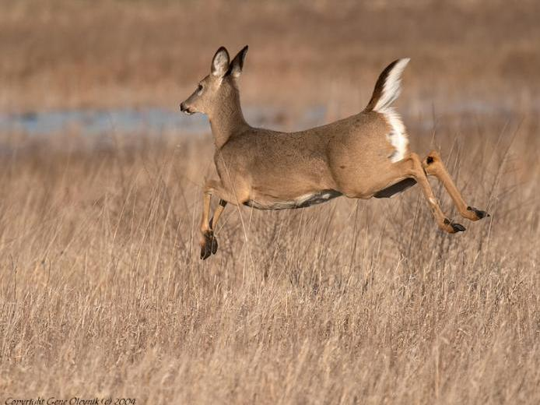
Deer Management
Notes:
Another activity that plays into this overall management strategy is whitetail deer management
Late 1990’s ~750 animals. Density resulted in huge amount of pressure on forested areas.
Since then, we have managed by annual culling → down to 150 individuals → allowed forests to regain a more “natural” level of diversity.

Slide 20
Triple Bottom Line
Environment
Sustainability
Economics
People
Notes:
A complete sustainability approach requires more than just taking care of the physical environment.
The “triple bottom line” looks at costs and the results of actions on people as well, and
true “Sustainability” must reside in the intersection.
When we design buildings → healthy and pleasant workplace for occupants
At the landscape level, this means paying attention to the ways in which present and future occupants interact with and understand the resource. Because the resource is more valuable to the extent that people understand and appreciate it.

Slide 21
Spring Butterfly Walk
Notes:
To that end, we provide many opportunities for employees and the public to learn about the ecological aspects of the site.

Slide 22
Lederman Science Education Center
Notes:
The Lederman SEC runs programs for 1000’s of K-8 students each year, including many ecology oriented programs.

Slide 23
Bioenergy Plots
Notes:
Fermilab is one of 7 NERP, so outside researchers can work here.
Here is ANL bioenergy project.
Also working on soil dynamics,
CO2 flux,
Carbon sequestration

Slide 24
Fermilab Natural Areas
Notes:
In 2006, a not-for-profit corporation called FNA formed to assist the lab in fulfilling this strategy.

Slide 25
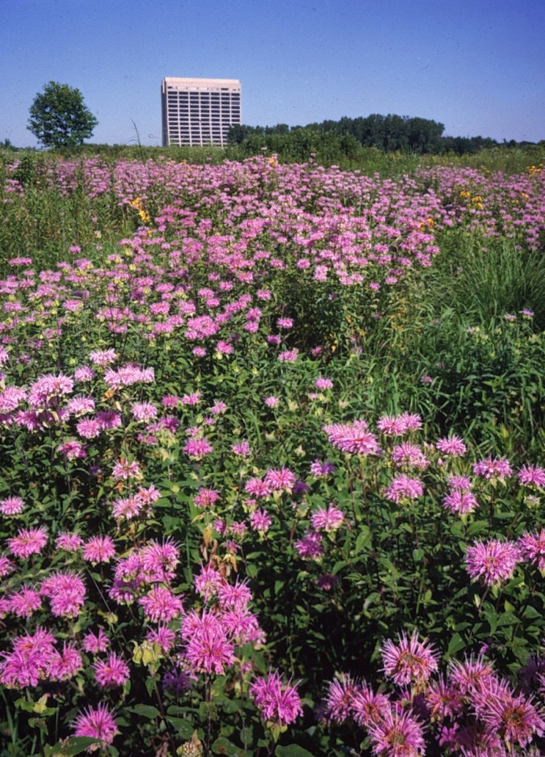
Fermilab as an Ecological Entity
Notes:
Future?
More restoration
More research
Organic farming
Convert ag to natural
What have to do with Sustainability?
Think of the larger resource as worth sustaining; think about the quality of the resource.
The landscape of the future is a product that todays actions make possible.

Slide 26
Questions?

