Slide 1
The Commuter “Last Mile Problem”
Eric Mieland
International Technical Safety Forum
Oct. 10, 2014

Slide 2
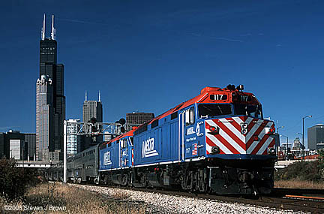
Fermilab Commuter Last Mile Challenge
Fermilab’s campus is located near two Chicago metropolitan commuter transit train lines (Metra). However there is no convenient connection between the trains and the site.

Slide 3
Metra Train Lines
FERMILAB

Slide 4
Union Pacific Rail Line
Fermilab
Burlington Northern Rail Line

Slide 5
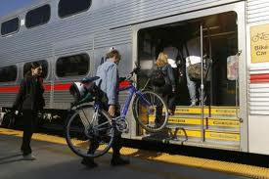
Train Commuters
The Creative Crowd
Leave a dedicated car overnight at the train station
Car pool with an overnight parker
Bike to and from the train station; bikes are allowed on trains.
Understand the Potential
Laboratory demographics suggest many riders possible
Workforce spread throughout metropolitan area
Launch commuter survey, April 2014

Slide 6
Motivations
Average Fermilab employee commutes 28 miles daily.
Reduce carbon footprint associated with commuting, 15% GHG reduction by 2020.
Attract and retain high quality workforce.
Young professionals seek alternatives to owning a car and gravitate towards the amenities of urban Chicago.
Relief for crowded parking, particularly Wilson Hall footprint

Slide 7
Survey Results
Out of 413 people who took the survey, 79% would consider taking the train if a low-or-no cost shuttle to Fermilab was available. Of commuters who would take the train line running along the north:
82% said they would commute by train year-round
72% of possible shuttle riders work in Wilson Hall
31% said Yes, 63% said Maybe to using a mass transit shuttle for a fee.
60% were employees, 36% researchers, 2% contractors & DOE

Slide 8
Survey Outcome
Develop a small-scale pilot shuttle using Fermilab resources
Fermilab 14 passenger minibus and driver
Focus on train line running to the north of Fermilab. Six months pilot.
Routes to one train station meeting one morning and one evening train
Lottery for riders if popular
Door to Door service
Challenges
Limited resources available
Cost and government requirements
Cannot compete with other mass transit

Slide 9
PACE Bus Service
Fermilab in contact with suburban public transit agency Pace Bus Service. Encouraged by our favorable survey data Pace announces:
New local service to include Fermilab
Daily morning/evening direct runs between Geneva Train Station and Fermilab’s Wilson Hall
Call-and-Ride on demand service
Starts Mid October 2014
*Fermilab cancels plans for pilot shuttle*

Slide 10
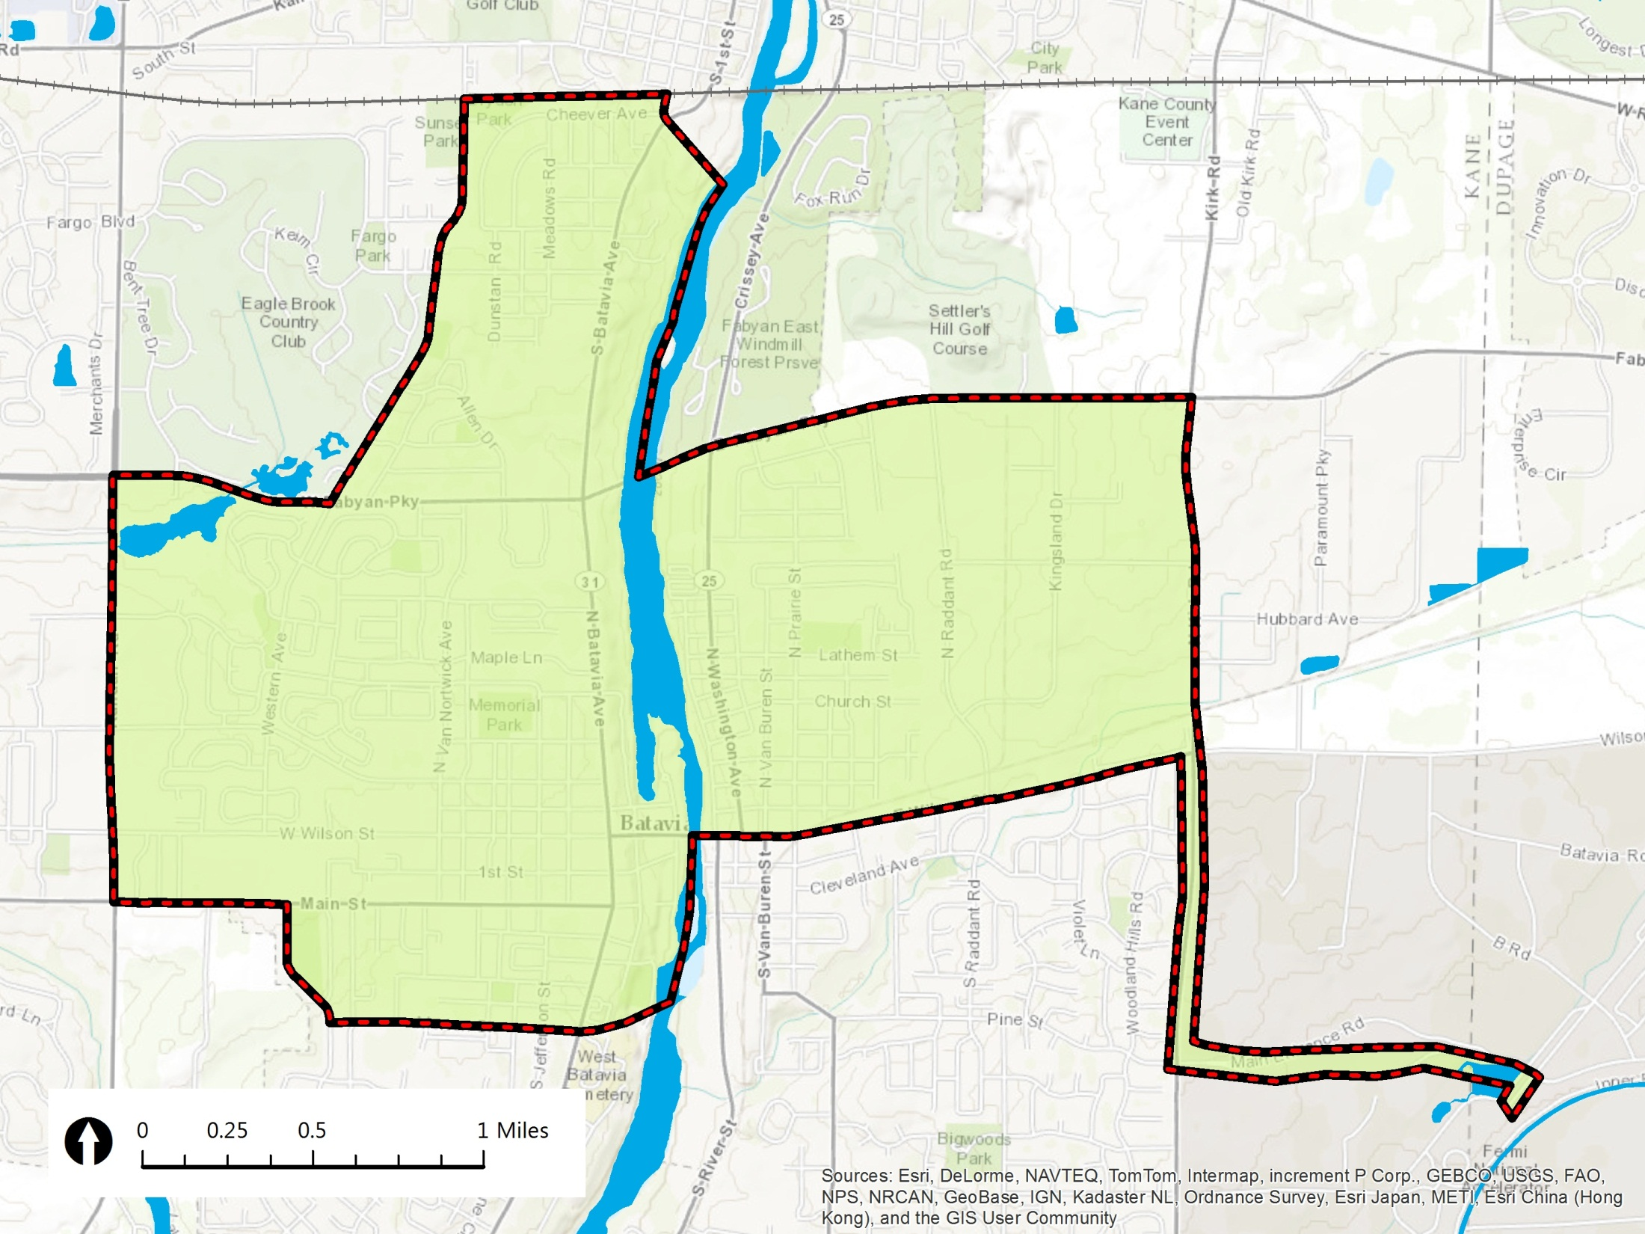
Geneva
Train Station
Western Ave.
Fabyan Pkwy.
Fabyan Pkwy.
Kirk Rd.
Randall Rd.
Expanded Service Area
Wilson St.
Main St.
Fermilab
Morton St.

Slide 11
The Shuttle: When and Where
On Demand
Planned Stops
Weekday Mornings
Geneva Metra Station | Fermilab
6:50 | –
7:38 | 7:52
8:52 | 9:06
9:55 | –
Weekday Afternoons
Fermilab | Geneva Metra Station
– | 12:00
– | 2:25
4:17 | 4:32
5:11 | 5:26
6:17 | 6:32

Slide 12
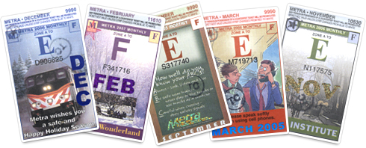
Fees and Service
Pace fare $1.75
50% discount with a monthly train pass
As a public mass transit provider Pace must service facilities accessible to the public
Wilson Hall meets the requirement – other areas do not
Service beyond Wilson Hall will be handled by transfer to our internal bus system – Fermilab Taxi
Next Steps:
Employee Awareness
Initiate transit fare pre-tax benefit program.

