Slide 1
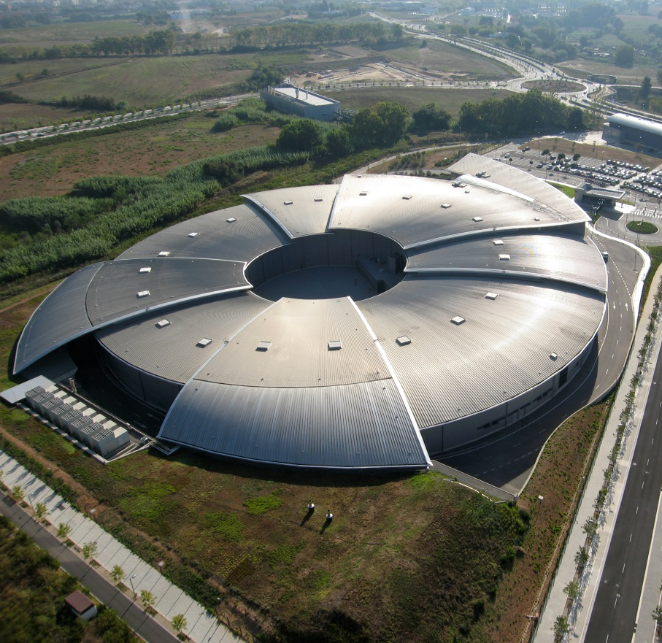
Health & Safety
Handling hazardous and greenhouse gases at ALBA Synchrotron facility

Slide 2
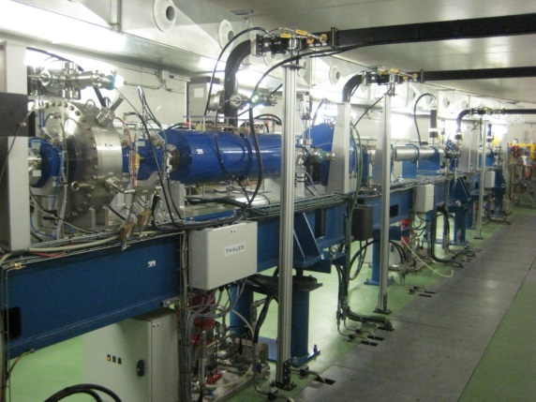
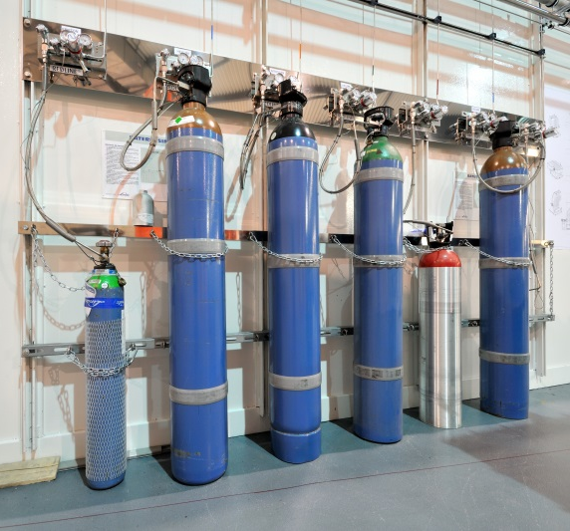
INDEX
ALBA LINAC
BL22 - CLӔSS

Slide 3
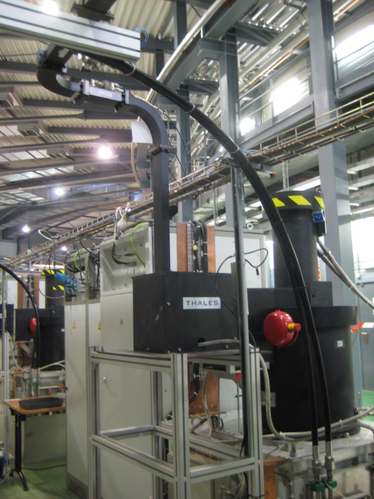
ALBA LINAC
1
LINAC Function
2
Klystrons
3
Sulfur hexafluoride (SF6)
4
Maintenance tasks
5
Conclusions
Greenhouse gas case
6
Acknowledgement

Slide 4
1. LINAC FUNCTION
LINAC accelerates the electrons and increases the energy
100 MeV
Main Acceleration
70 MeV
Bunching
EGun
16 MeV
v ~ c
90 keV

Slide 5
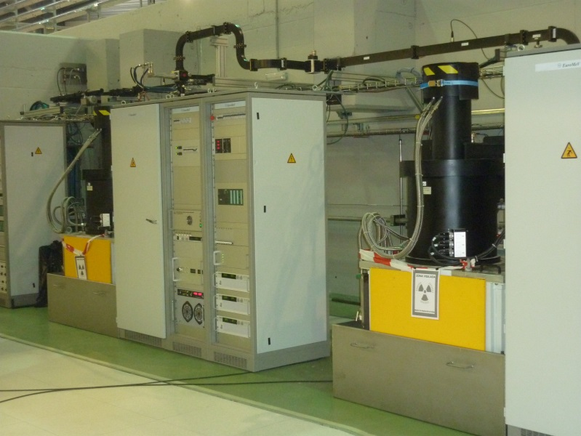

2. KLYSTRONS
Function:
  Supply RF power to LINAC through waveguides
waveguides
Problems:
  Electric arcs
SF6 is used as electrical isolation
waveguides

Slide 6


3. SULFUR HEXAFLUORIDE (SF6)
Disadvantages of SF6 usage:
  Greenhouse gas
  Global-warming Potential (GWP):
    1 GWP SF6 → 23900 GWP CO2
  Thermal decomposition generates toxic substances(produced during repeated sparking inside
  the waveguide)
  (GWP): is a relative measure of how much heat a greenhouse gas traps in the atmosphere.

Slide 7



3. SULFUR HEXAFLUORIDE (SF6)
More common SF6 Decomposition By-products during repeated sparking
SF6 + H2O + Cu + ε → HF, SO2, SF4, CuF2, …
HF(g): Hydrogen fluoride
SF4(g): Sulfur tetra fluoride
SO2 (g): Sulfur dioxide
CuF2(s): Copper fluoride

Slide 8
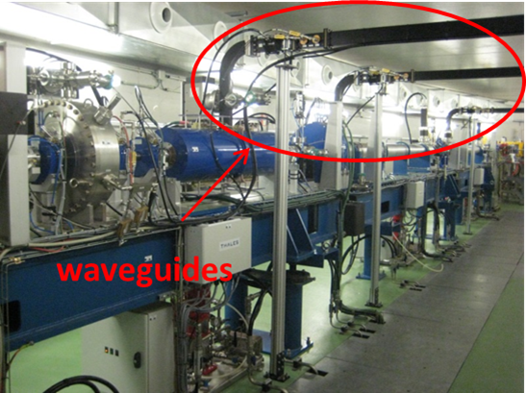
3. SULFUR HEXAFLUORIDE (SF6)
It means that during our maintenance tasks (specially after sparkling events) we have three problems to solve:
  Presence of:
  - Used gas (SF6).
  - Toxic & Corrosive decomposition gaseous & powder products.

Slide 9
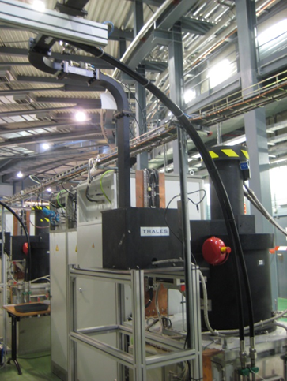
3. SULFUR HEXAFLUORIDE (SF6)
Actions to be taken when the waveguides are opened:
  To recover the used & contaminated gas
  To protect our staff during the operation
waveguide

Slide 10
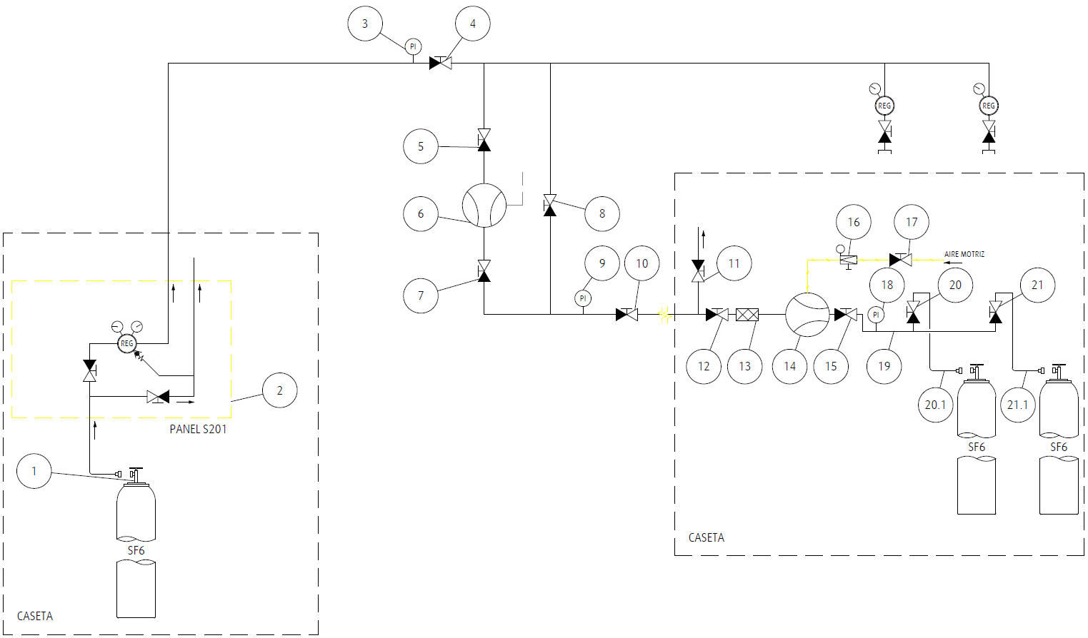
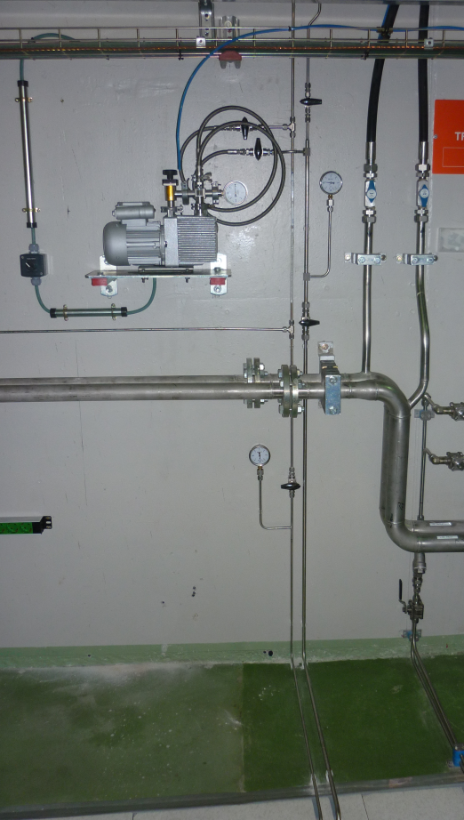
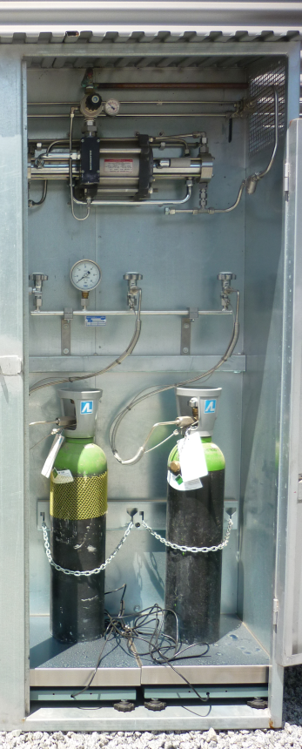
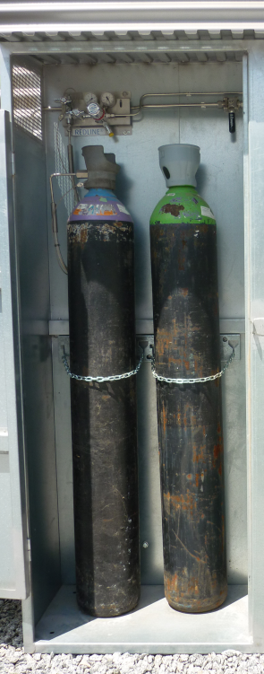
4. MAINTENANCE TASKS
Step 1: Gas recovery
Compressor
Indoor
SF6 Supply Bottle
Outdoor
Recovery Bottle
Outdoor

Slide 11
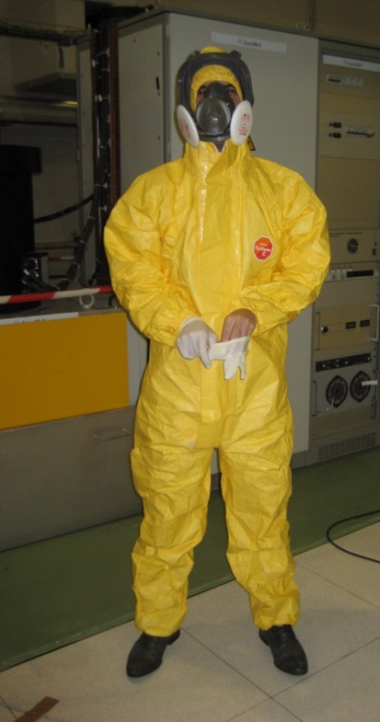
4. MAINTENANCE TASKS
Step 2: Open waveguides
  Working area delimited
  Personal Protective Equipment:
    Filter mask: FFP3 EN type
    Disposable coverall: Tyvek C type 5 EN
    Latex gloves
  Waveguides cleaning:
    Check if there are white powder
    Use of a vacuum cleaner with HEPA filters

Slide 12


5. CONCLUSIONS
Maintenance performed properly:
From a safety point of view
From an environmental point of view

Slide 13
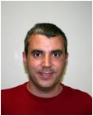
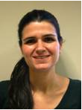
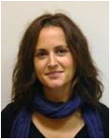
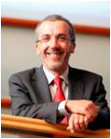
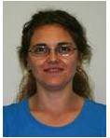
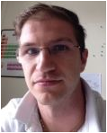
6. ACKNOWLEGMENT
Infrastructure section staff:
David Carles
Cristina Orozco
Núria
Martí
LINAC section staff:
Francis Pérez
Raquel Muñoz
Davide Lanaia

Slide 14
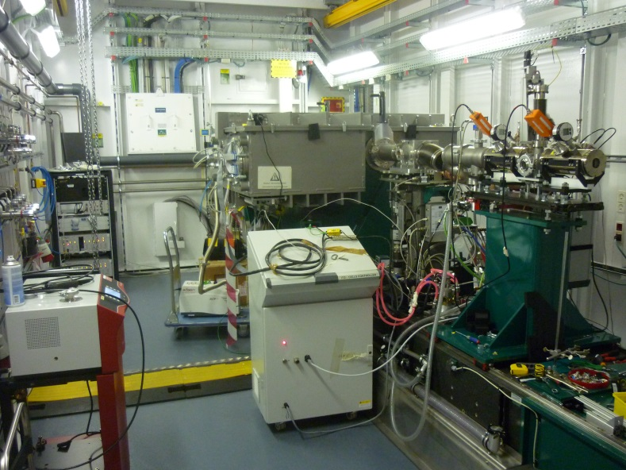
BL22 - CLӔSS
1
CLӔSS Function
2
Experiment set-up
3
New set-up
4
System reaction
5
Improvements
Hazardous gases case
6
Acknowledgement

Slide 15
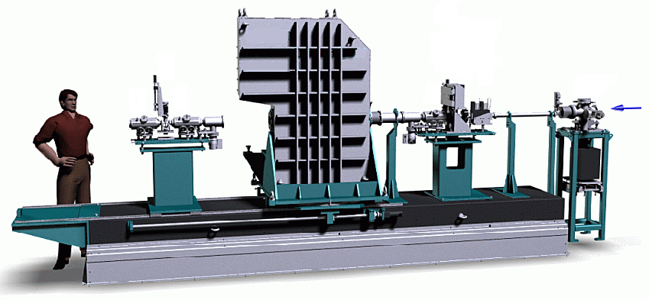
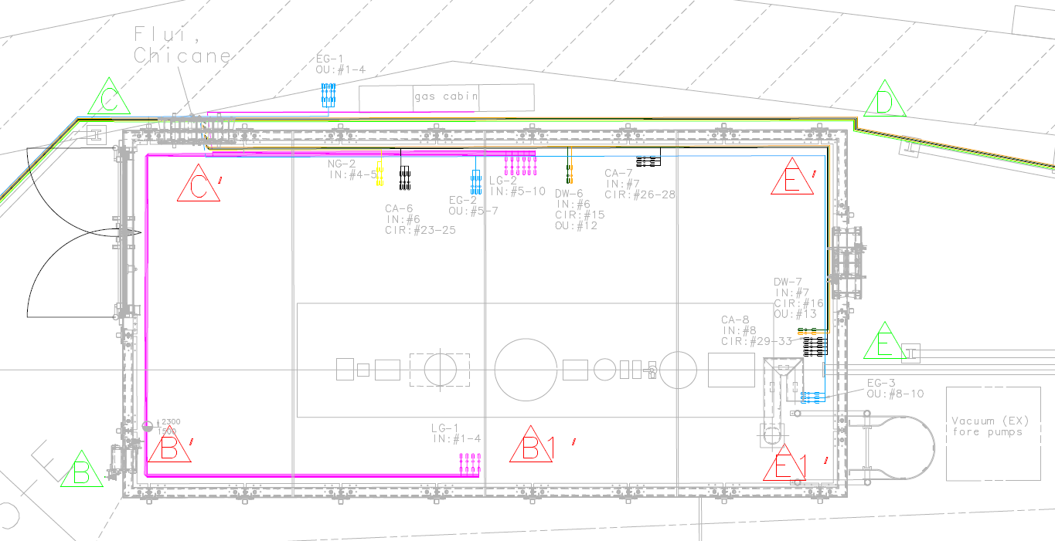
1. CLӔSS FUNCTION
The CLÆSS beamline develops “in situ” chemical and catalytical research
X-ray Beam
X-ray Beam

Slide 16
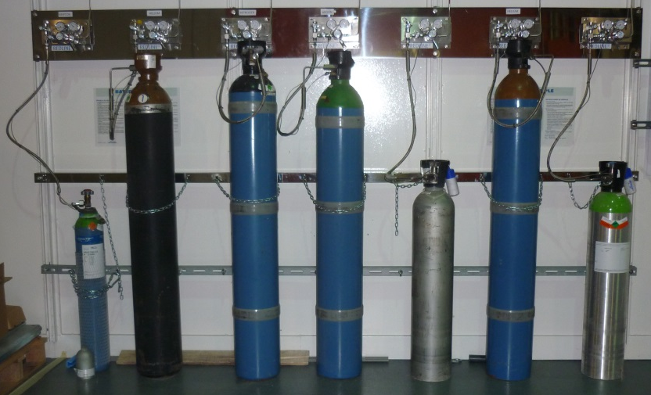
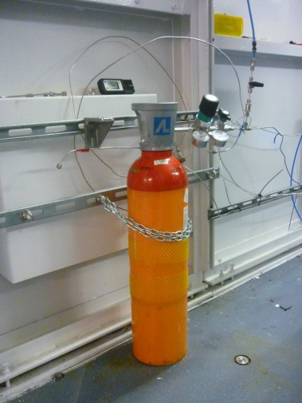
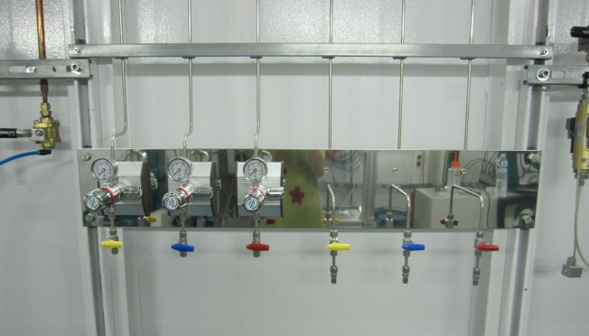
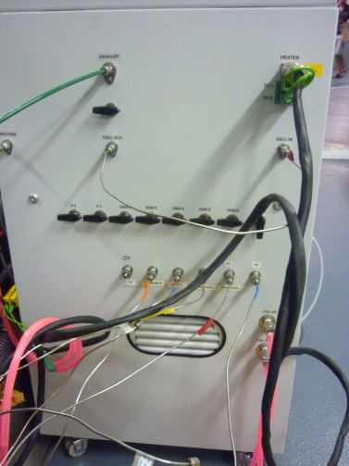
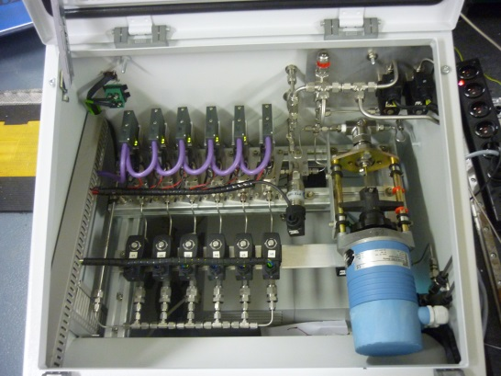
2. EXPERIMENT SET-UP
Pressurized Gas Bottle location:
He
Kr
He
N
Ar
Soft Mixture pipeline
1a. Outside EH
1b. Inside EH
P up to 10 bar
High P up to 50 bar
2. Dedicated pressure regulator
Inside EH
3. Mass Flow Controller (MFC)

Slide 17
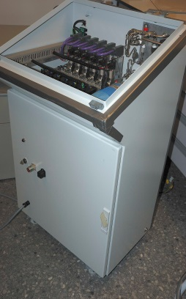
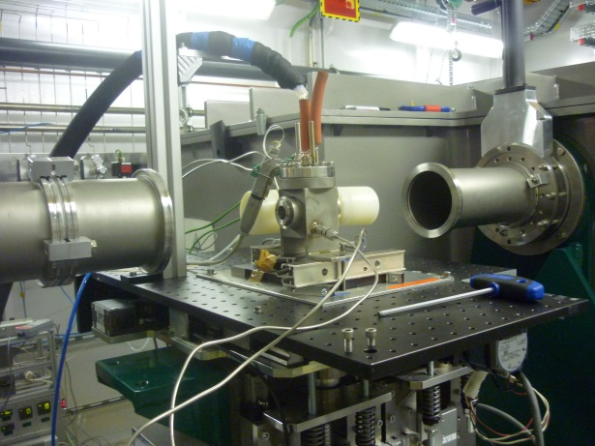
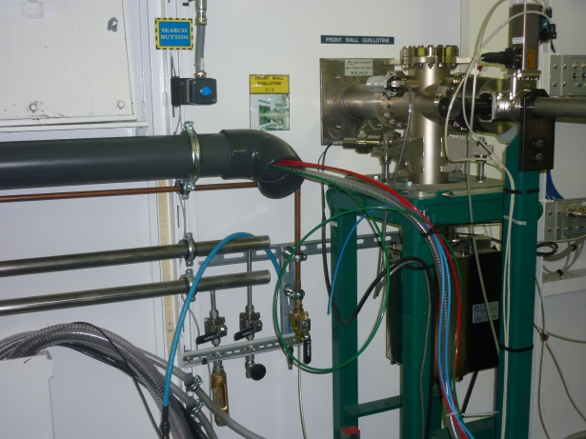
2. EXPERIMENT SET-UP
4. Reactor Cell
5. Exhaust system
T = 700ºC
P = 6 bars
V = 100 ml
Air flow = 280 m3 / h
Dedicated line
3. Mass Flow Controller (MFC)
Allows remotely control: up to 6 gases
1 x 1l / min flow max.
5 x 100ml / min flow max.
Can be adjusted to different reactor cells

Slide 18
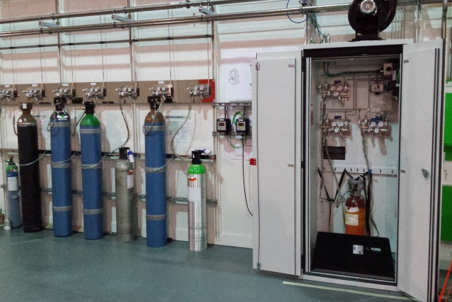
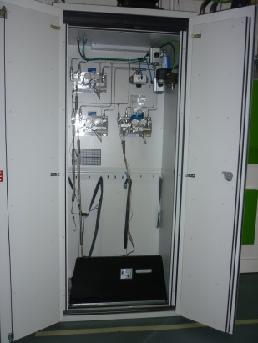
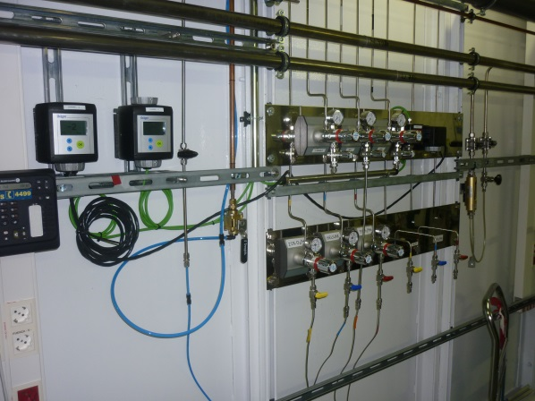
3. NEW SET-UP
Safety Cabinets:
Flammable gases:
  H2
  HxCx
Fixed gas detectors:
Hazardous gases:
  CO
  H2S
  NO

Slide 19

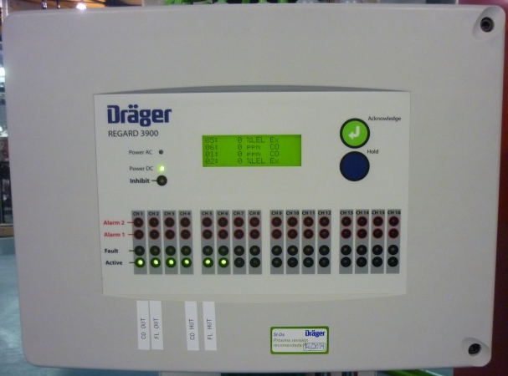
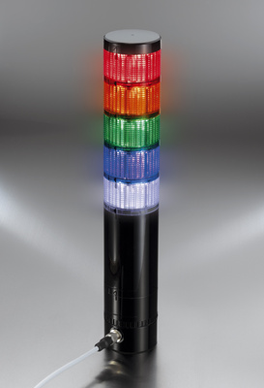

3. NEW SET-UP
Electrovalves:
Alarm gas system:

Slide 20
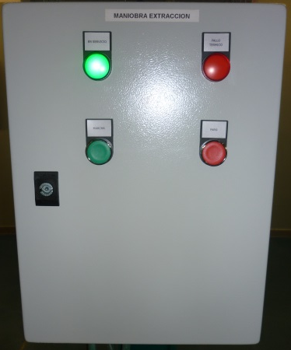
3. NEW SET-UP
Alarm exhaust system:

Slide 21


4. SYSTEM REACTION
Fixed detectors read values on line
(inside the hutch and the safety cabinet)
In case a leak is detected:
Electrovalve closes the bottle immediately

Slide 22
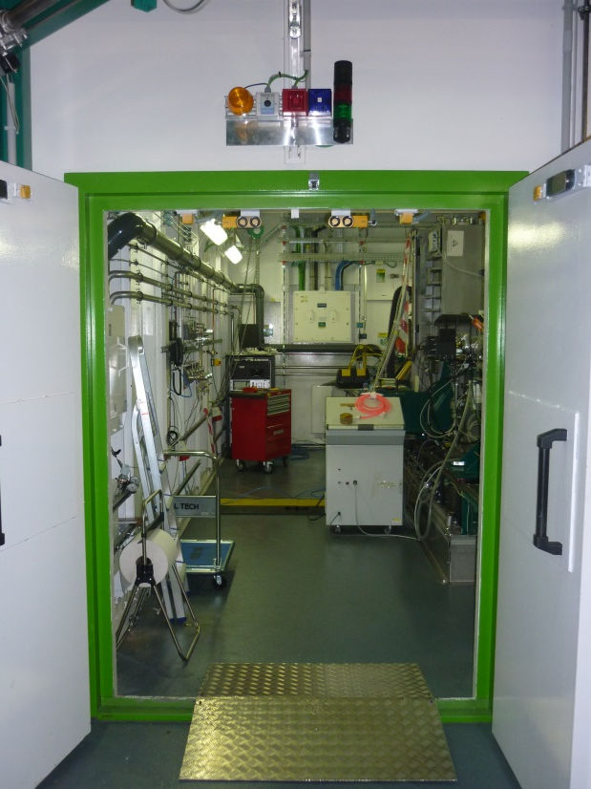
4. SYSTEM REACTION
Alarm gas system warns the leak to user
  Sound
  Light

Slide 23

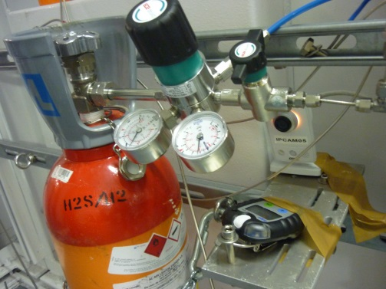
5. IMPROVEMENTS
The exposition & gas volume lost are reduced in case of leak
  Automatic electrovalves Vs Manual intervention
Time reduction in taking actions

Slide 24
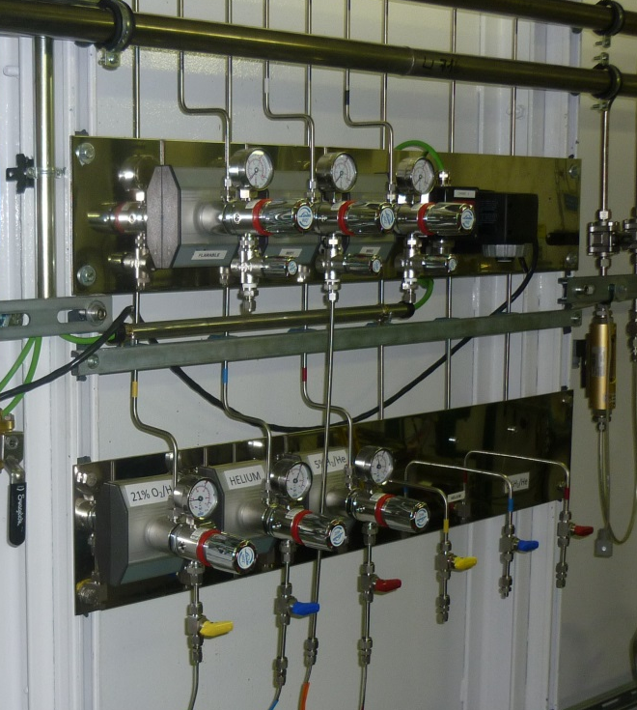

5. IMPROVEMENTS
Reliability
  Permanent Vs Temporal

Slide 25
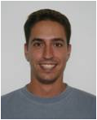
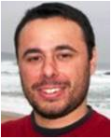
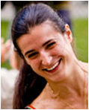
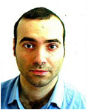
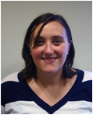

6. ACKNOWLEGMENT
Infrastructure section staff:
David Carles
Cristina Orozco
Núria
Martí
Ignasi Serra
BL22-CLӔSS staff:
Edmundo Fraga
Laura Simonelli
Carlo Marini
Marta
Ávila
Wojciech
Olszewski

Slide 26
ANY QUESTION?
THANK YOU

