Slide 1
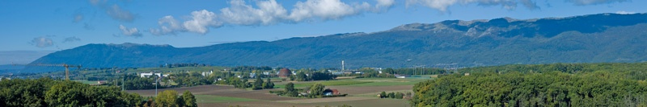

CERN on the way to sustainable development
E. Cennini, S. Kleiner, D. Rio
1. CERN in brief
2. Current status of sustainable development @ CERN
3. Focus on Environmental responsibility

Slide 2
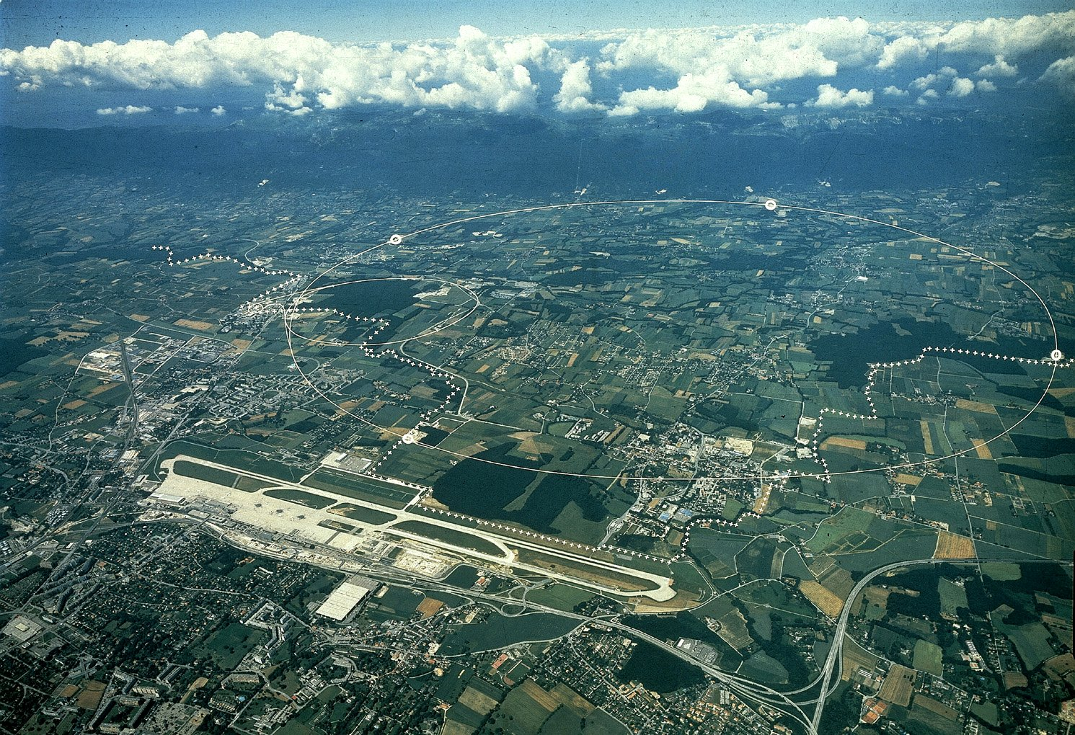
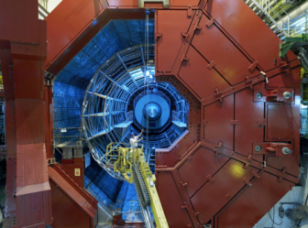
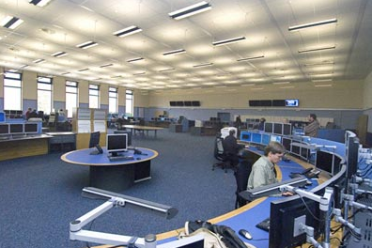

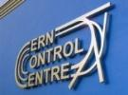

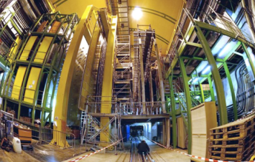
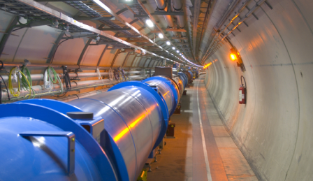
~ 9’000 workers/in situ
~ 10’000 visitors/year
~ 17 Sites
Globe of Science and Innovation
3 hotels, 3 Canteens, kindergarten
~ 800 Buildings
1. CERN in brief
ALICE
LHC
CMS
Meyrin
Prévessin
SPS
PS
ATLAS
LHCb
LHC Tunnel

Slide 3
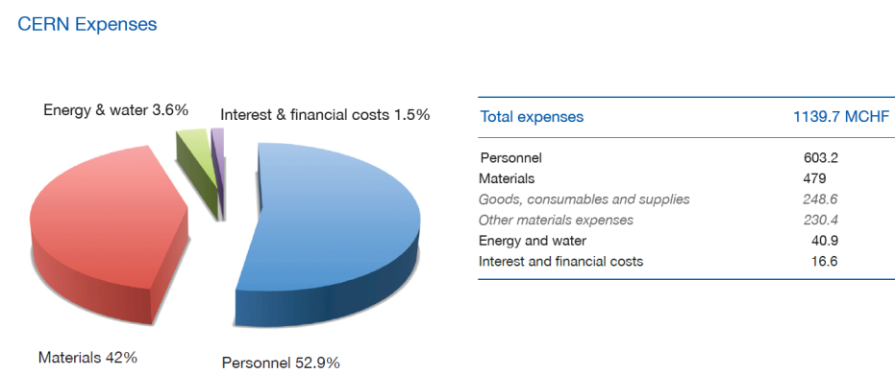
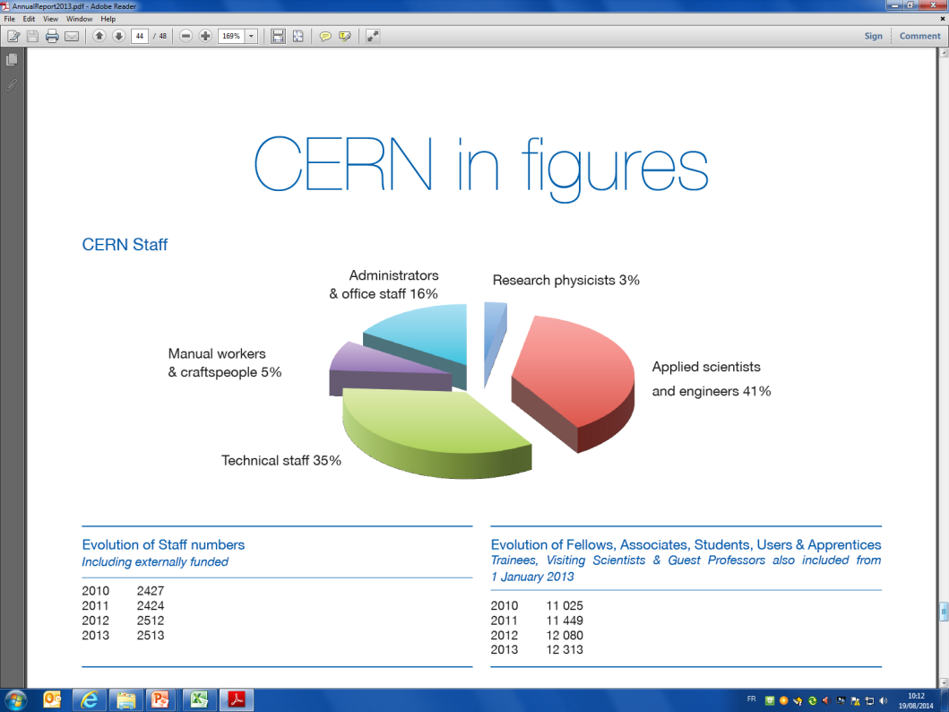
1. CERN in brief – Key figures for the year 2013
(about 2500)

Slide 4
2. Current status of sustainable development @ CERN
CERN scientific activities integrate since more than 20 years the notion of sustainability. It is part of the mission of the Organization…..” Accelerating Science and Innovation “ – CERN contributes to the role of science for the sustainable development of the society…
In addition:
Legal requirements depending on technical issues;
Specific requests of the Host State Authorities;
Voluntary initiatives beyond science (e.g. mobility, site development, life-work-balance…).

Slide 5
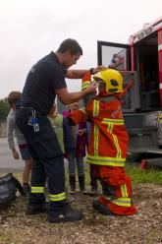
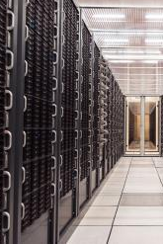
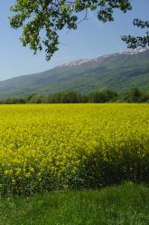
2. Current status of sustainable development @ CERN
Nowadays, sustainability is typically reported through following issues:
Social
Economical
Environmental

Slide 6
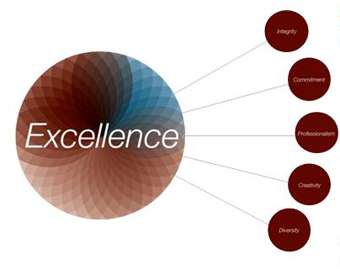
2. Current status of sustainable development @ CERN
Human resources and social responsibility
CERN Values – The code of conduct
Integrity
Commitment
Professionalism
Creativity
Diversity
Appreciating differences, fostering equality and promoting collaboration

Slide 7
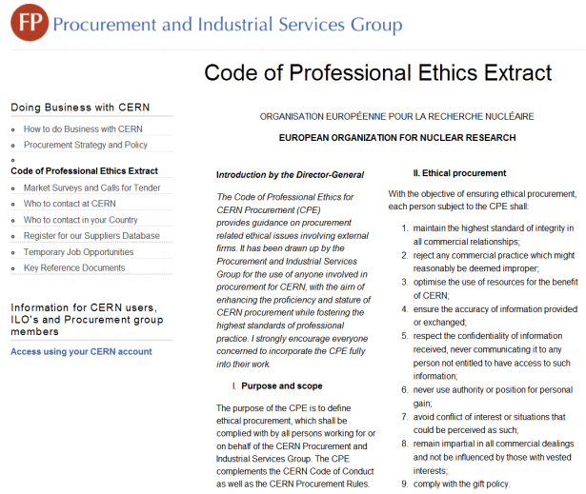
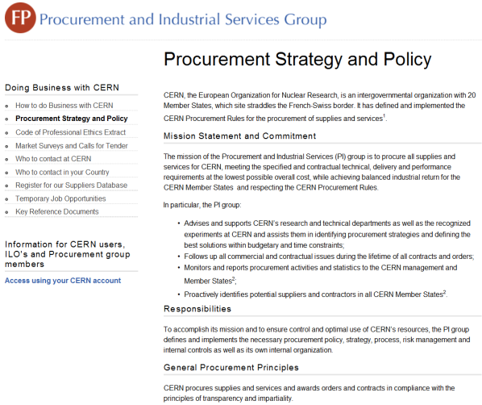
2. Current status of sustainable development @ CERN
Procurements

Slide 8
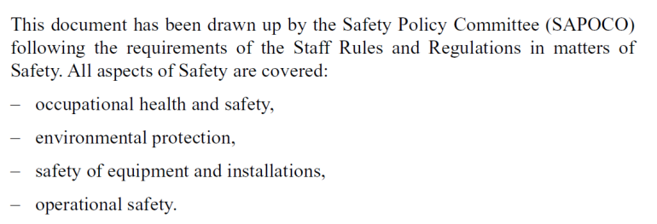

2. Current status of sustainable development @ CERN
Environmental Responsibility
Through the SAFETY POLICY of the Organization :
Follow-up within the mandate of the HSE Unit

Slide 9
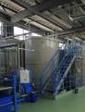
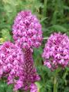
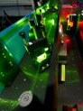
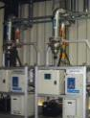
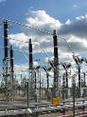

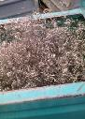
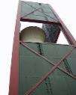
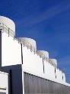

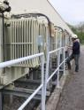
3. Focus on environmental responsibility
PROTECTION OF NATURAL RESOURCES (biodiversity)
PREVENTION OF ENVIRONMENTAL ACCIDENTS
NON-IONIZING RADIATION
IONIZING RADIATION
ENERGY MANAGEMENT
AIR PROTECTION
ENVIRONMENT @ CERN
WASTE MANAGEMENT
ENVIRONMENTAL NOISE
WATER PROTECTION
HAZARDOUS SUBSTANCES
SOIL PROTECTION

Slide 10
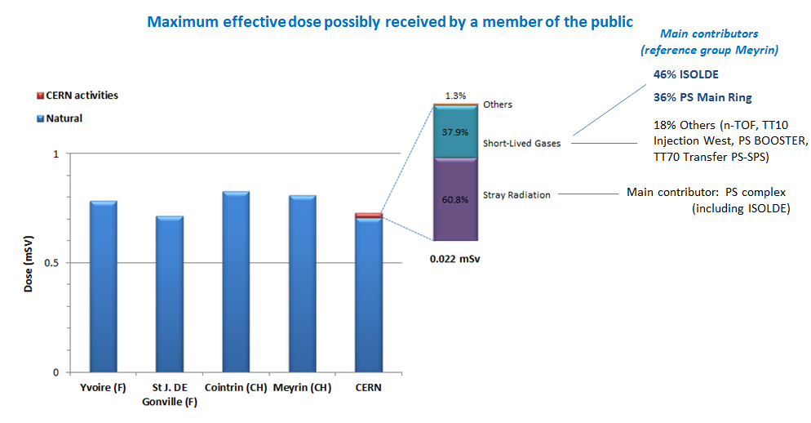
3. Focus on environmental responsibility – Relevant Indicators
Radiological Environmental impact in 2012
Year 2012

Slide 11
3. Focus on environmental responsibility – Relevant Indicators

Slide 12
3. Focus on environmental responsibility – Relevant Indicators
Distribution of the annual consumption (m3)

Slide 13
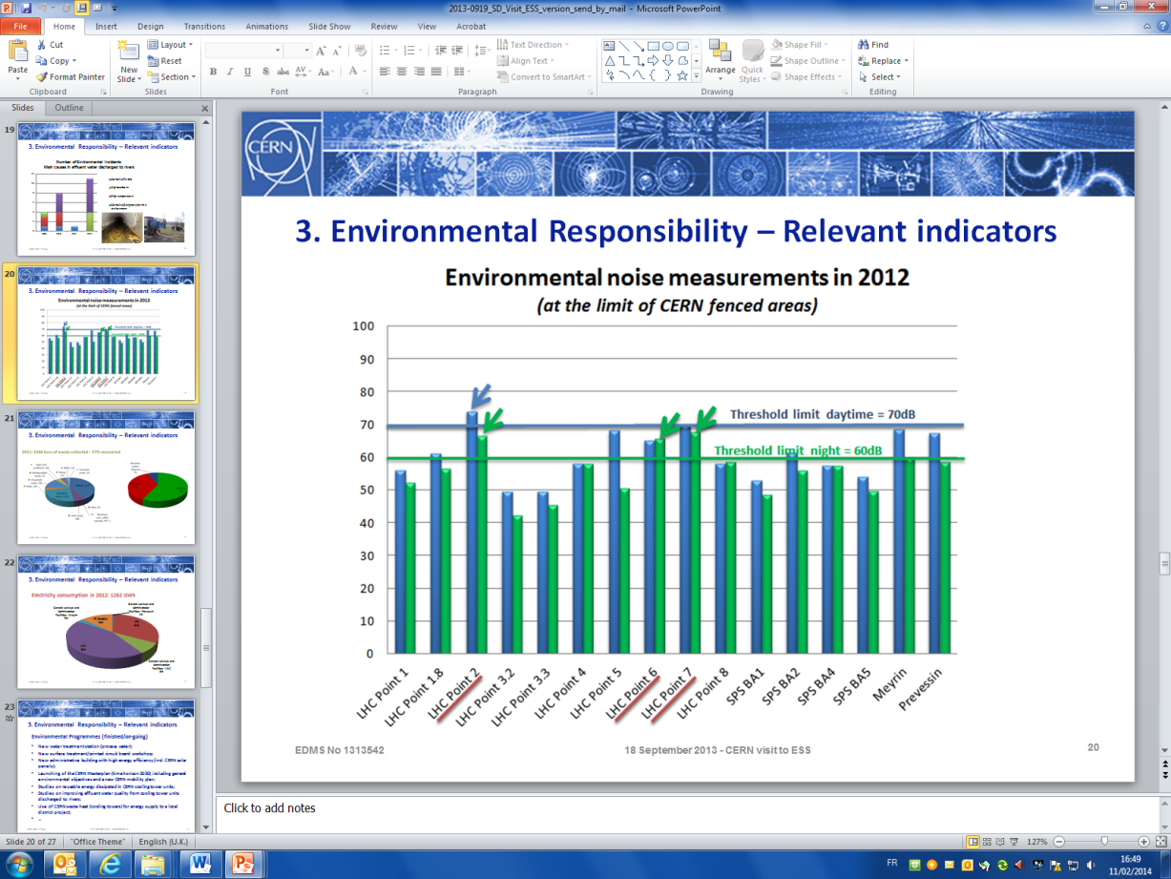
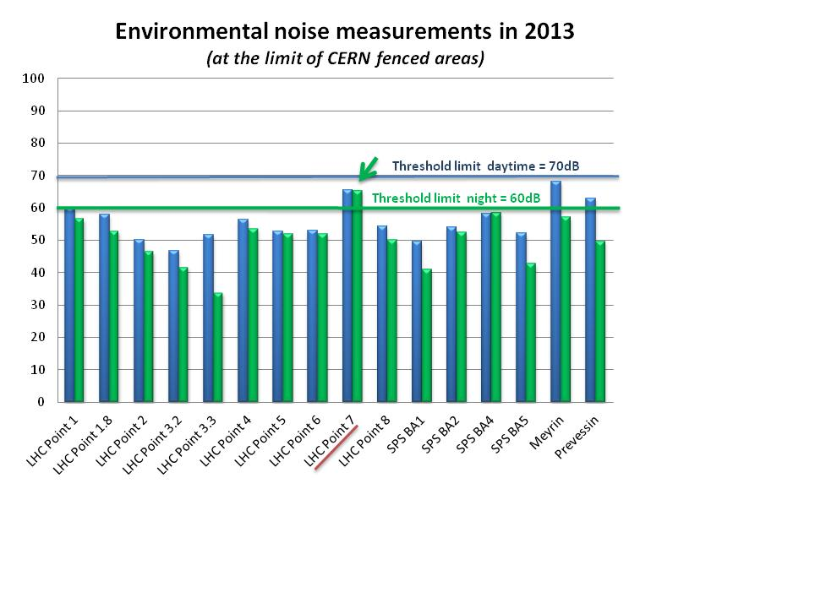
3. Focus on environmental responsibility – Relevant Indicators

Slide 14
3. Focus on environmental responsibility – Relevant Indicators
WASTE MANAGEMENT
Total waste collected in 2012: 5118 tonnes
Recovery rate : 54%

Slide 15
3. Focus on environmental responsibility – Relevant Indicators
ENERGY MANAGEMENT

Slide 16
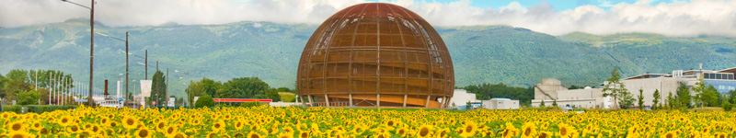
The Organization has not yet a structured approach to act and report in the sense of sustainable development. The roots for SD are there….a long way is in front of CERN to let them grow….
Social
  Shared vision to SD…
Economical
Environmental

Slide 17
Thank you for your attention – questions ?

