Slide 1
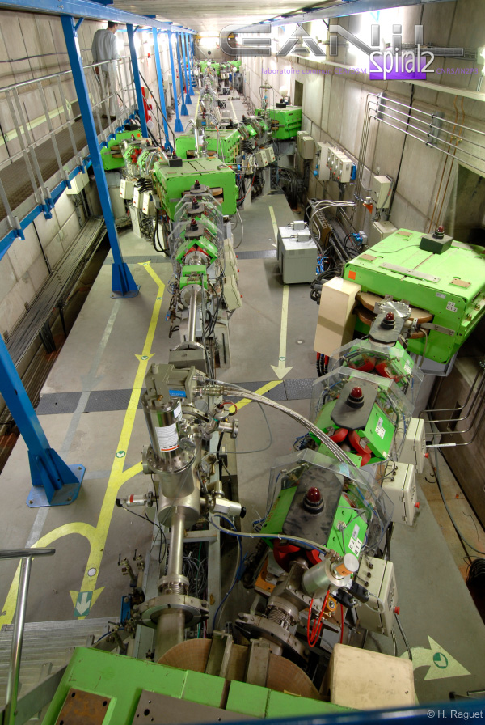
ITSF 2014 GANIL SAFETY REVIEW
GANIL FACILITY
SAFETY REVIEW OF THE ORIGIN GANIL FACILITY
FIRE RISK ANALYSIS
SAFETY CONTROLLED ACCESS SYSTEM
B RANNOU
P ROYET
And the safety
Group,
JC PACARY (uga)

Slide 2
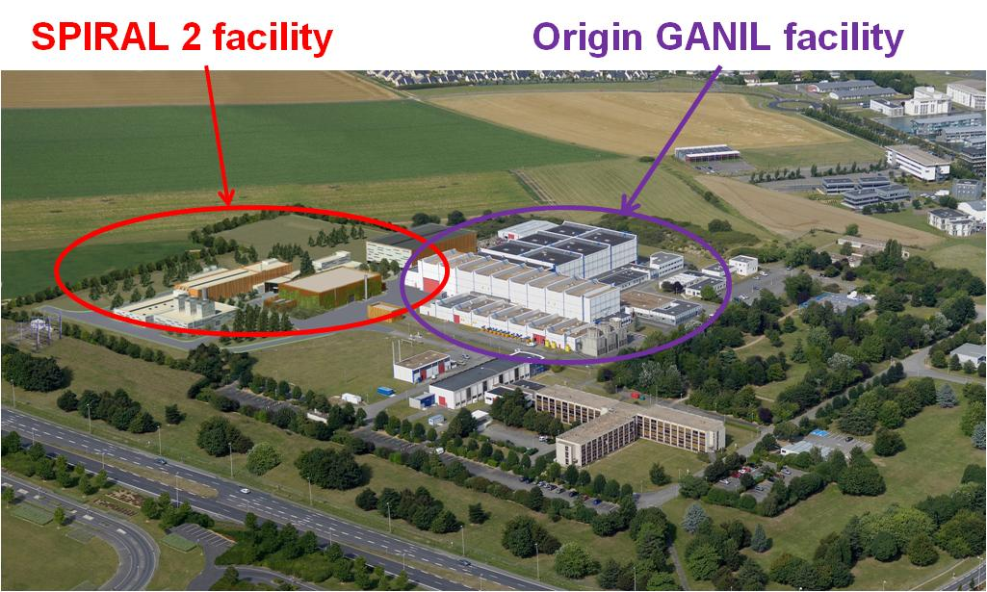
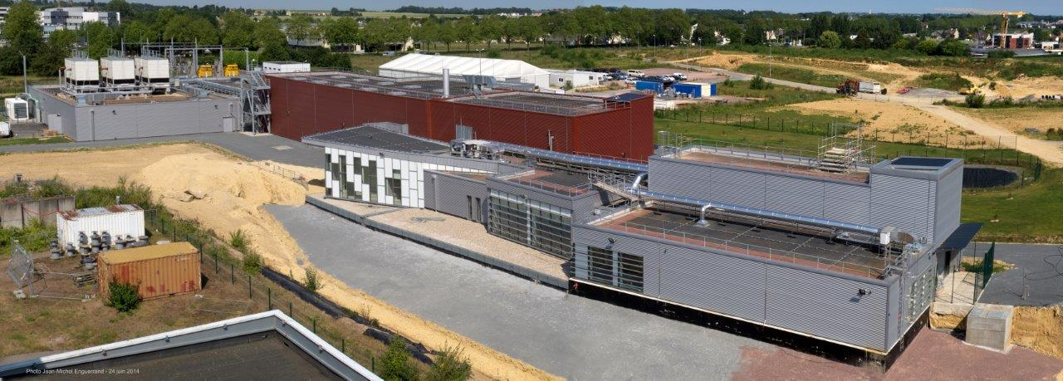
GANIL SITE OVERVIEW
Last month picture SPIRAL 2 buldings

Slide 3


LABORATY from
- CEA/DSM
- CNRS/IN2P3
GANIL
SPIRAL
Stable Beams
from Carbon to Uranium
maximum energy 95 MeV/A
maximum intensity: 2.10¹³ pps (6 kW)
Radioactive ion beams
by fragmentation : LISE
by ISOL method : SPIRAL 1 (SIRA)
SISSI
experimental equipments :
EXOGAM
VAMOS
TIARA
LISE CLIM
AGATA
INDRA
SPEG
LISE

Slide 4
2. Safety review of the « origin GANIL Facility »
Obligation by law for all nuclear facility in France (every ten years) first time at GANIL since the 80’s!!
GANIL is the only accelerator laboratory rated as nuclear facility in France,
Complete analysis of the safety including all risks
  internal hazard (nuclear and conventional)
  external risk : earthquake, extrem climatic conditions (flooding, wind, snow), road traffics explosion, …
Examination of the “real state” of the facility
Lessons learned from passed events
Comparison to the best safety standards & to the actual regulation
Examination of the internal organization including normal operation and emergency situations
Program of modifications to improve the safety validate by the french nuclear safety authority (8 years, cost 10 M€)

Slide 5
3 FIRE RISK ANALYSIS
STATUS
  Fire risk not well took into account at the conception of the facility,
  New regulations for nuclear facilities for fire risk management (2012 & 2014) with higher level of requirements,
  Strong pressure of the Safety authory to improve the level of fire protection of the GANIL facility
ANALYSIS (frequency & gravity)
  For all buildings and rooms : fire start, fire intensity (quantity and nature of fuel materials, nature of wall and roof), Fire spread,
  Definition of safety targets that must be protected from a fire (radioactivity, safety function equipements, emergency exit, …),
  Stability of structures during fire,
  Intervention conditions and equipements needed
  Quotation of the fire risk & identification of needed improvement

Slide 6
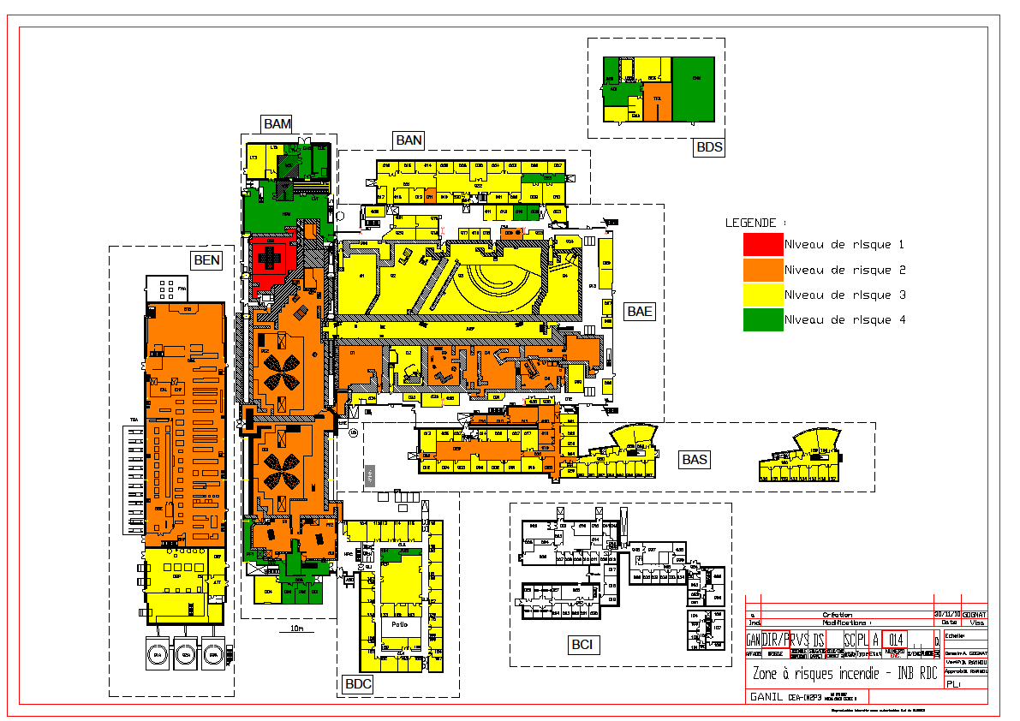
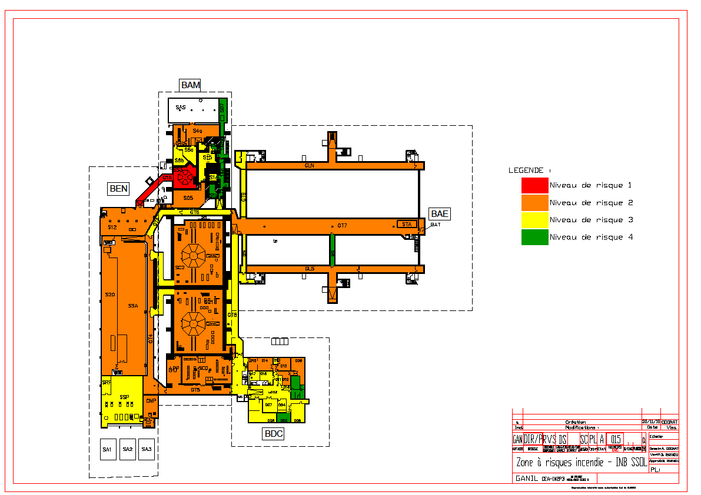
Criticity for fire risk
CIME CYCLOTRON,
Ignition (hydrogene)
Technical corridors
Fire start + spread
Energy hall
Fire start (électric origin)
spread

Slide 7
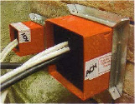
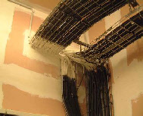
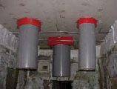
Improvement of the fire protection
fire spread
Fire block (2 hours)
Fire walls (2 hours)
Automatic extinction systems
Containment of extinction water (600 m³)
Stability of the buildings during 2 hours (metal structural)
Water reserve for extinction (600 m³ under pressure)

Slide 8
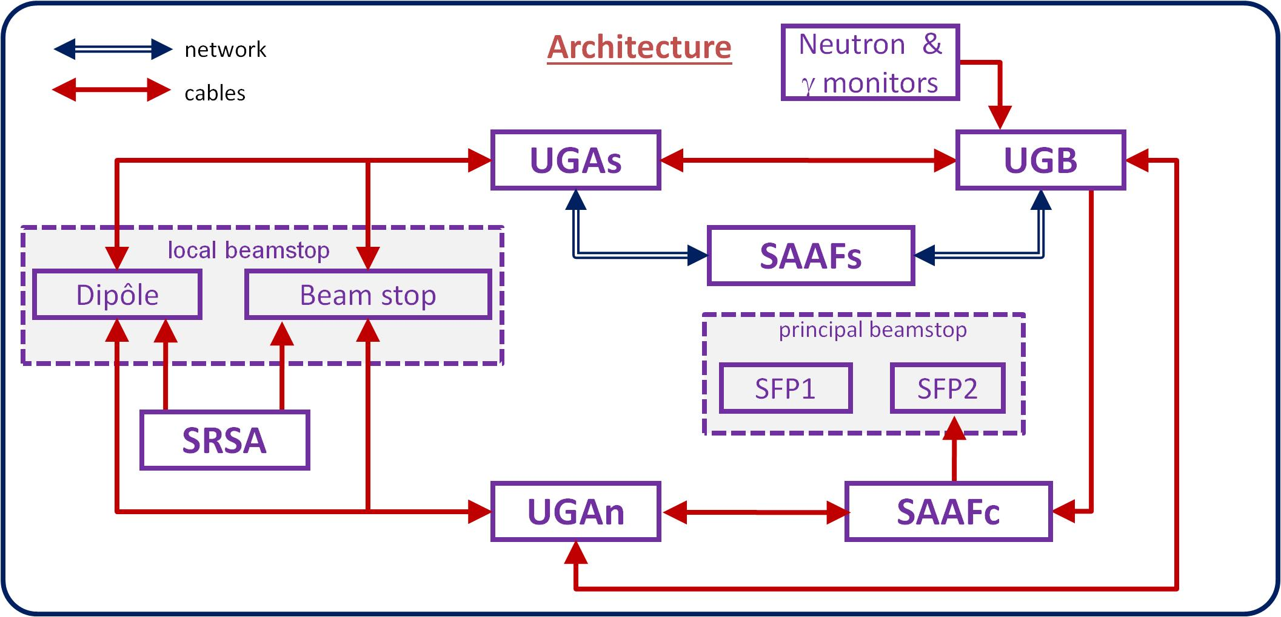


4. SAFETY CONTROLLED ACCESS SYSTEM
Status :
  The Major safety function : impossibility to have a person and the beam at the same time in the irradiation cave, forbidden accces when radiations are note acceptable
  Old access system was obsolete, conception (material and software ) not safe
  19 rooms to be controlled
Principles : redundancy, differenciate materials, failure analysis
Norm 61508
(SIL 3 level)

Slide 9
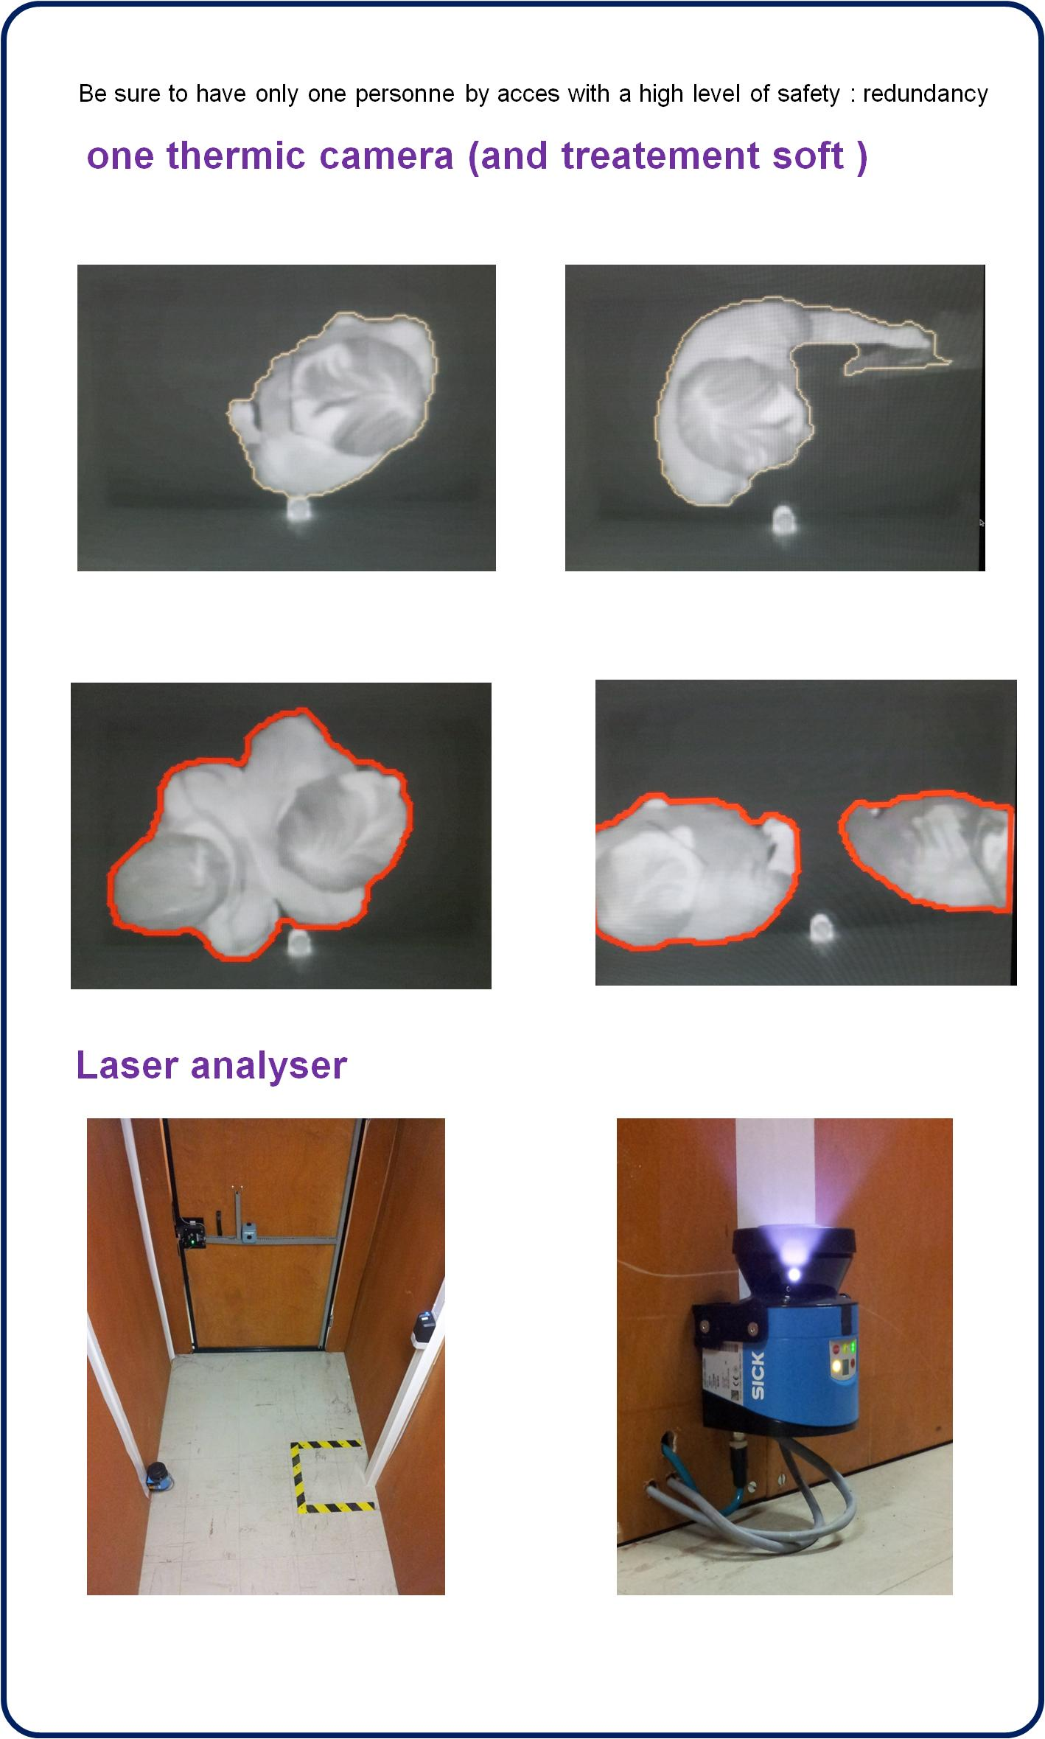
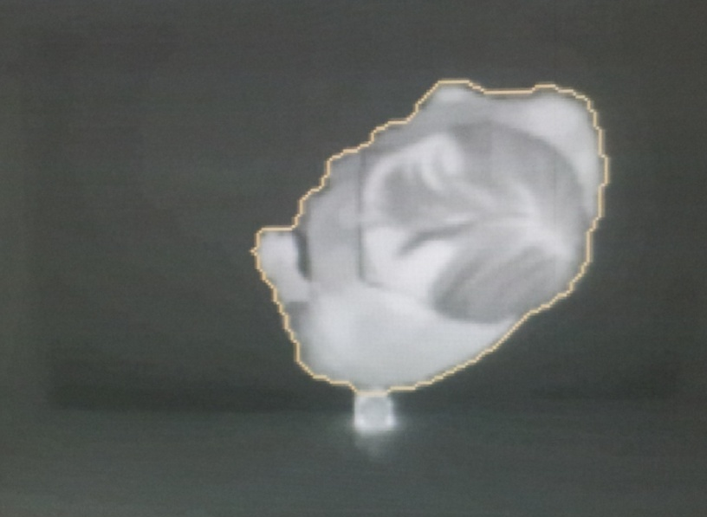
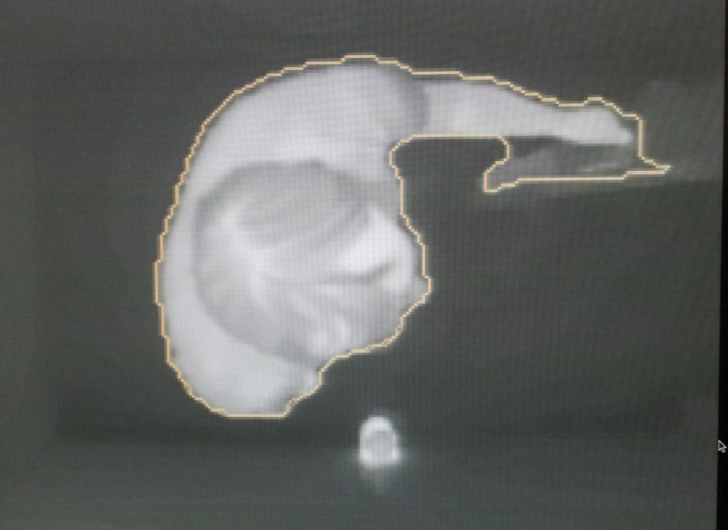
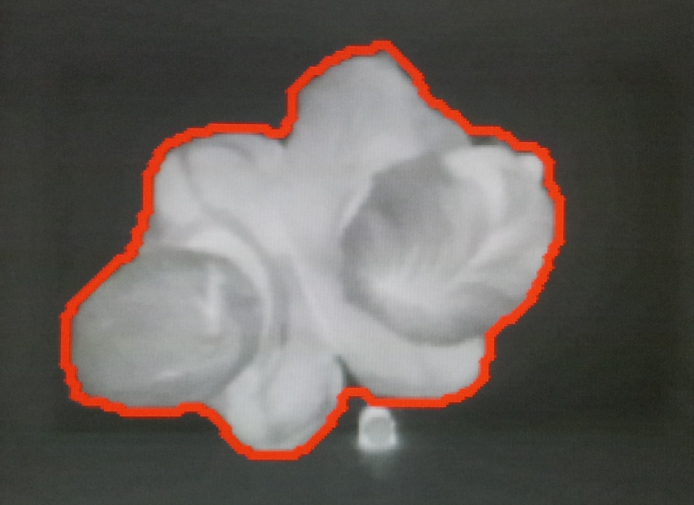
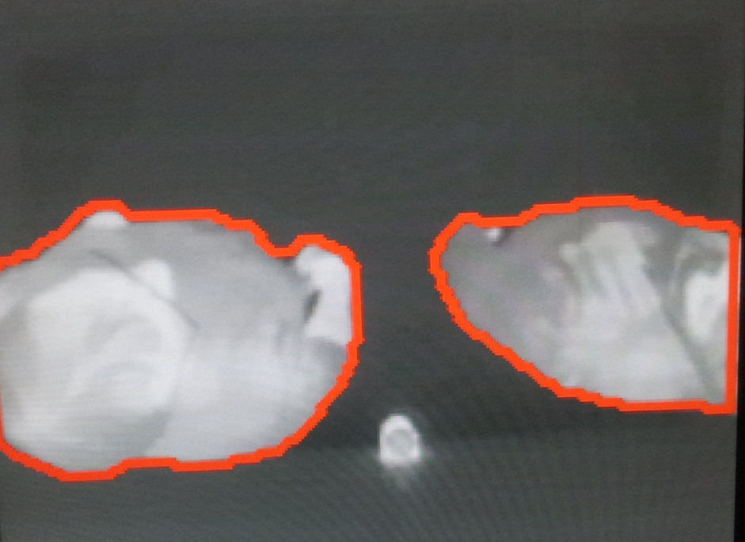
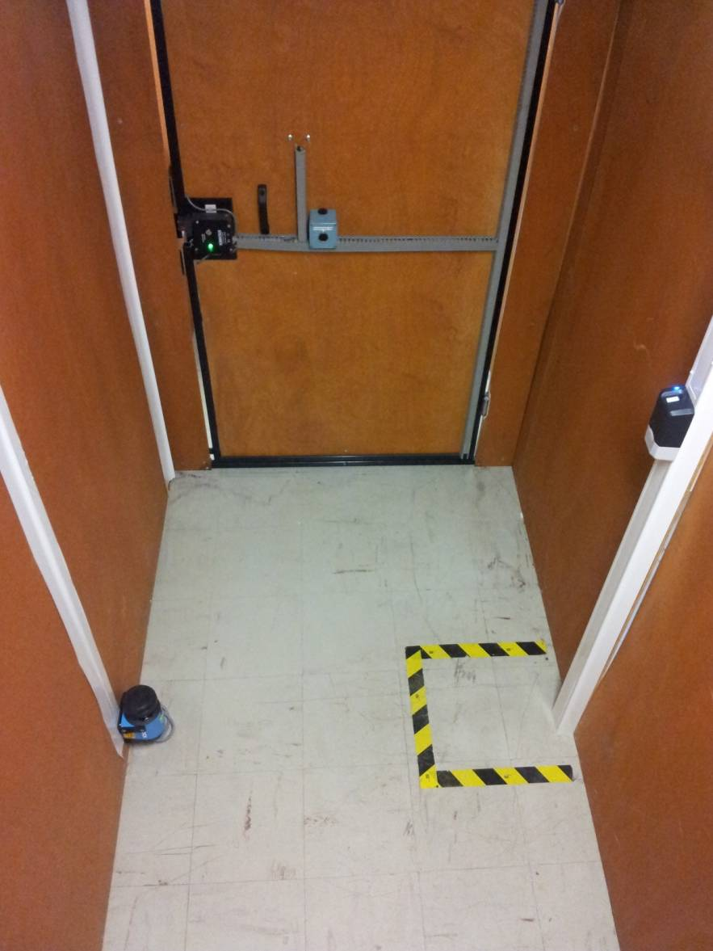
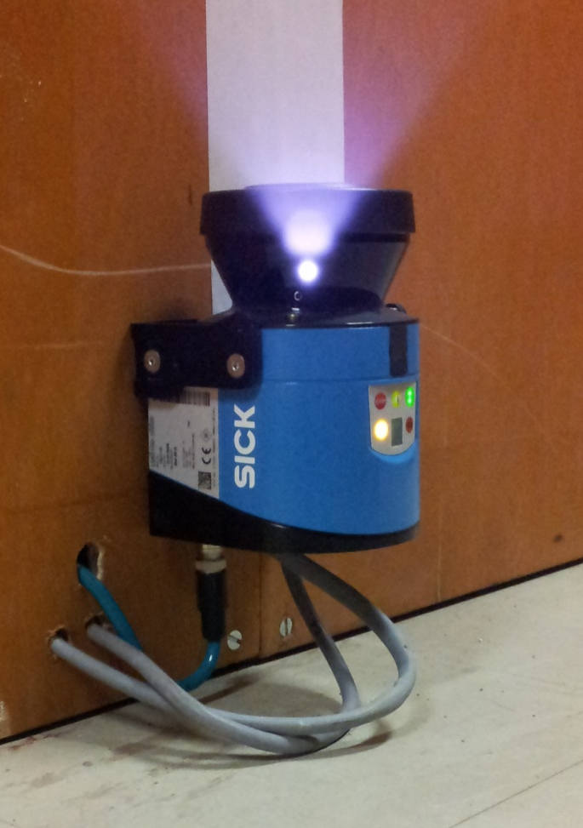
Acces accounting
Others functions :
  Biomedric identification
  Consignation for other purpose : handling, …
Acces comptabilisation
Be sure to have only one personne by acces
one thermic caméra (and treatement soft )
Présence of person :.
L’unicity (only one person in the acces sas)
2 tâches thermiques détectées
Un LASER analyser
La fonctionnalité est identique à celle d’un tapis contact
Vue de l’intérieur du sas

