Slide 1
Hi-Fog Water Mist at XFEL
The application of a stationary hi-fog extinguishing system at the new XFEL accelerator at DESY
by Fabian Saretzki
DESY
SAVE – service center for system safety, fire prevention and emergency service

Slide 2
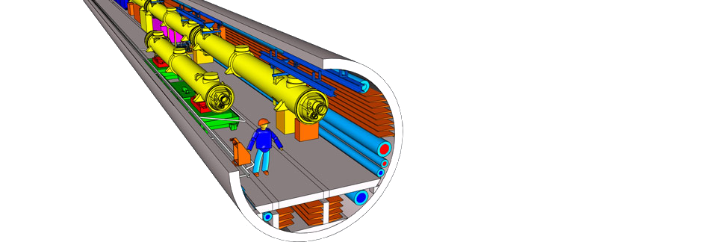
structure
XFEL – a short overview
main safety requirements
fire prevention
main hazards in case of fire
hi-fog extinguishing system
advantages over conventional sprinkler-systems
current status of installation

Slide 3
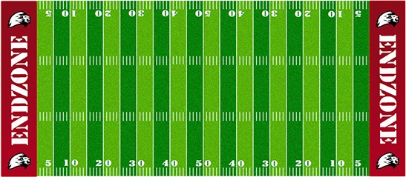
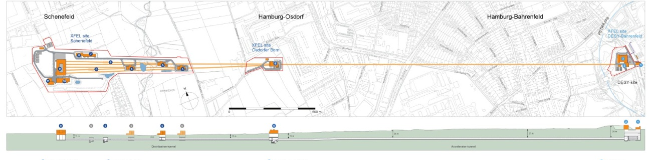
XFEL – a short overview
x-ray free electron laser
collaborative project of 12 participating countries in the EU
a total of 5.4 kilometers of underground tunnel system
total length of 3.4 kilometers
source: xfel.eu

Slide 4
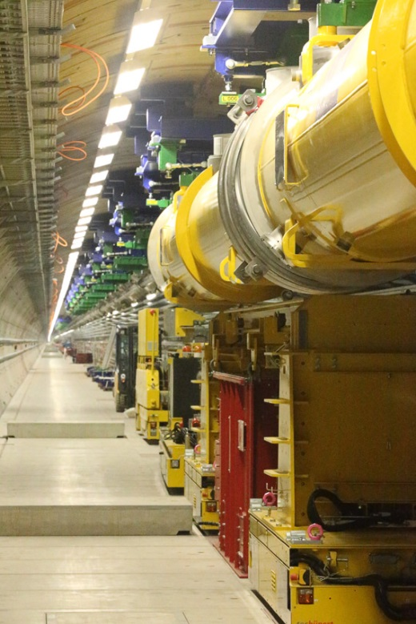
XTL – the main linac tunnel section
superconducting linear accelerator
total length of the tunnel: 2011 m
cooling temperature -271°C
25 accelerating sections
source: Dirk Nölle

Slide 5
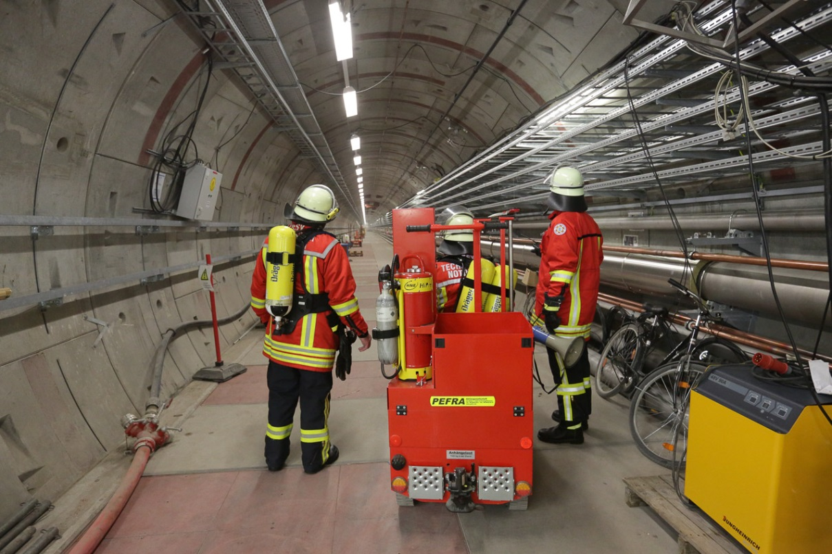
main safety requirements
most dangerous zone
- XTL
protection of personnel
minimize hazards
ensure the ability to escape
fast intervention by DESY emergency service
source: Dirk Nölle
protection of the machine takes a backseat in the safety concept
Notes:
- Each tunnelvehicles carrys four self rescuers (works with potassium oxyde cartridge), hi-press foam extinguisher, carbondioxyde extinguisher, halligan-tool, first responder equipment

Slide 6
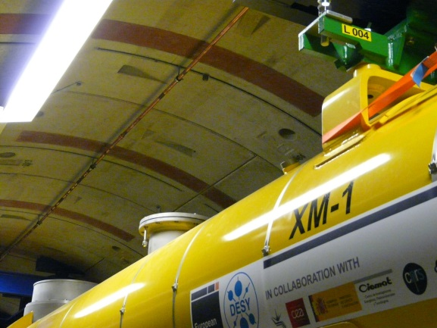
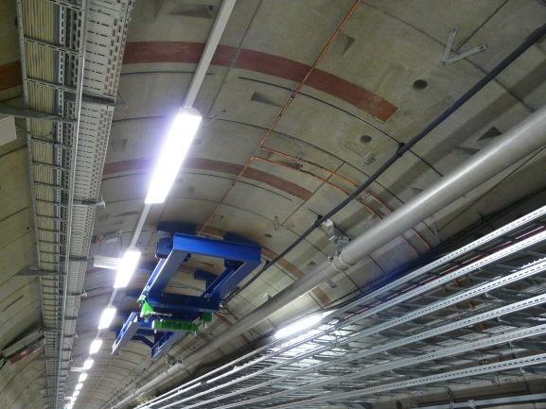
handling risk of fire
smoke aspiration system for fast fire detection
minimize fire loads in general
using materials of low flammability
extinguishing systems for electronic devices mounted in racks
most of the cables are FRNC-cables
prohibition of halogen containing cable to reduce consequential damages for all other cables
Bild RAS

Slide 7
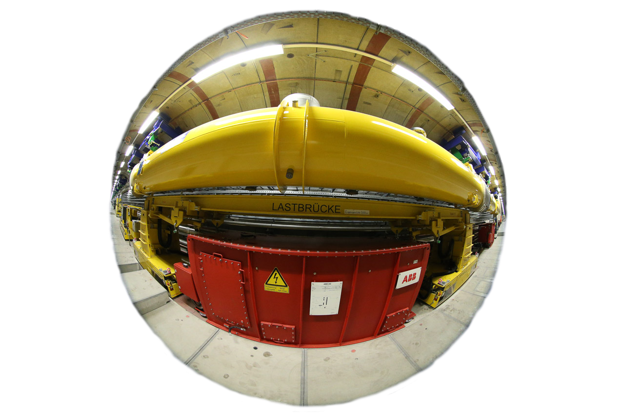
main safety hazards in case of fire in the XTL
pulse transformers
filled with approximately 1,4 t flammable, electrical insulating oil - most hazardous source of ignition: forklift (calorific value above 500 kilowatt hours)
tunnel length
2011 m with no additional exit
no possibility to build massive firewalls
source: Dirk Nölle
solution: hi fog extinguishing system
Notes:
Due to the risk assesment the pulsetransformers are failure resistant, wont start burning by themselves – the extinguishing system is not an extinguishing system – more a protection (and seperation) system – although its able to extinguish fires within the protection area
Burning forklift could ignite a pulsetrafo
Pulsetrafos must be protected from thermal radiation
Many reasons against massive firewalls like trafficability of the transport path, survey system
challenges for DESY
no technical framework available

Slide 8
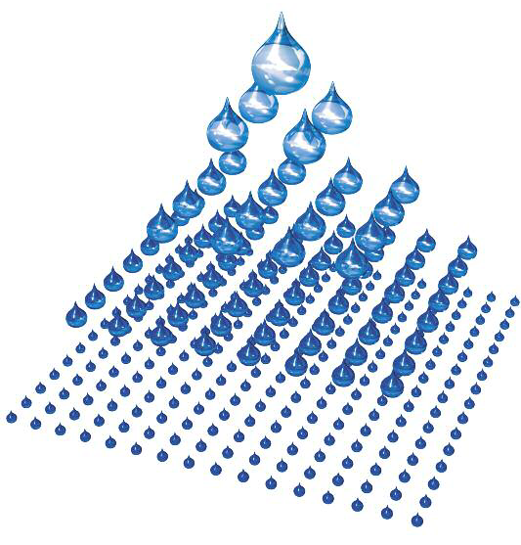
hi fog: general facts and technical data of the XFEL system
heat-absorption speed depends on the reaction surface
1 l water drops with a diameter of 0,01 mm have a surface of 200 m²
fast cooling of area surrounding the fire
generates inerting effect at the source of fire
working pressure of about 120 bar
5 plunger pumps (one for redundancy)
approx. 3300 meters of high-grade steel pipe
source: Fogtec
Notes:
For comparison 1 l of drops with a diameter of 1 mm (Sprinklertechnology) have a surface of 2 m²
No emergency power supply needed due to the distance between pumping plant and extinguishing zone (double events not taken into account)
Increasing watervolume due to the evaporation displaces the oxygen in the hot zone at the source of fire

Slide 9
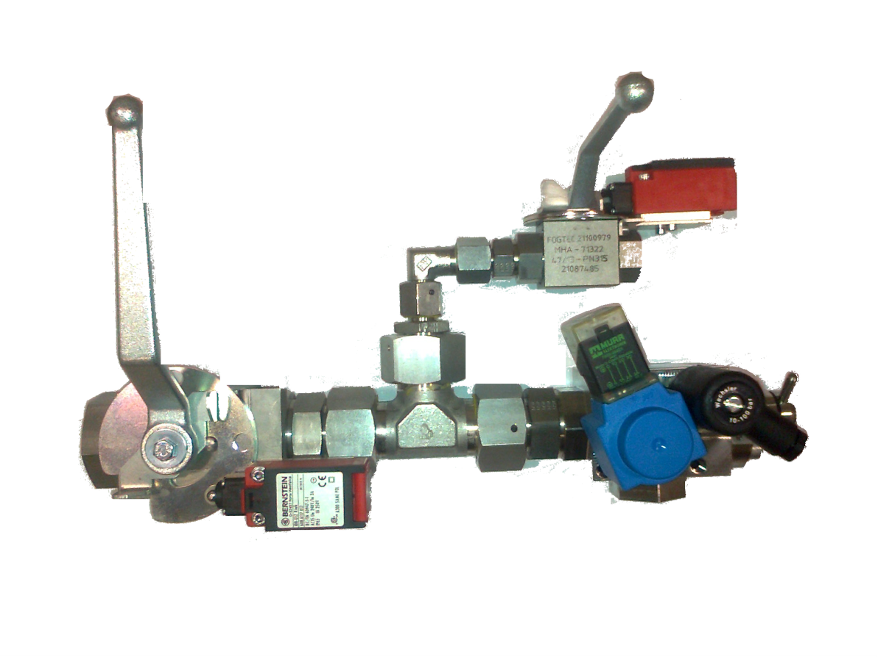
building the extinguishing zones and fire compartments
28 extinguishing zones - 25 pulse transformers - 3 firewalls
6 control units in the tunnel
monitored valves and electronics

Slide 10
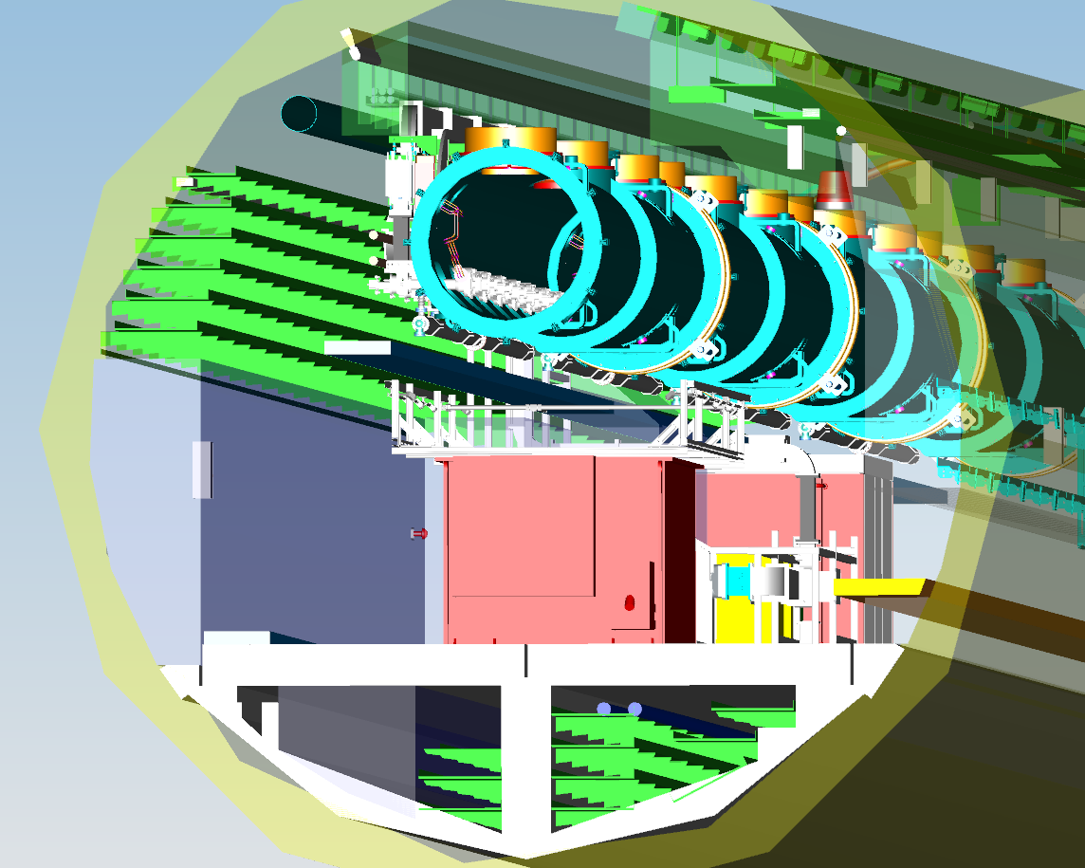
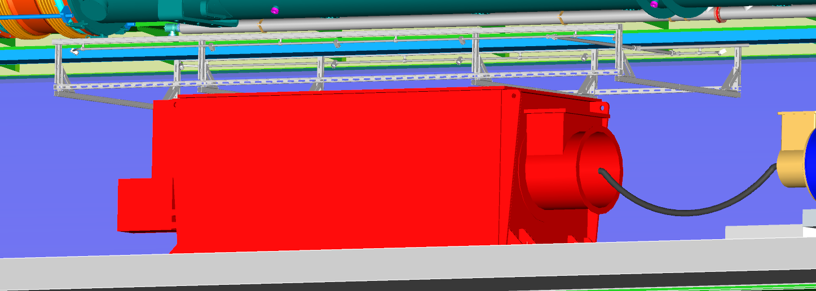
pulse transformer protection
protects transformers from nearby fire
water mist absorbs heat radiation
approx. 100 l/min/extinguishing zone

Slide 11
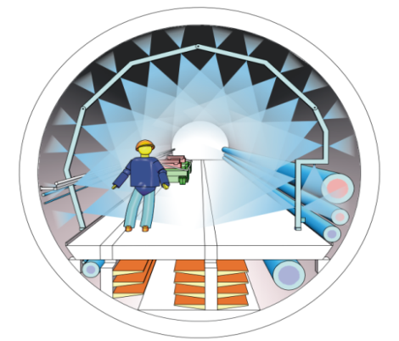
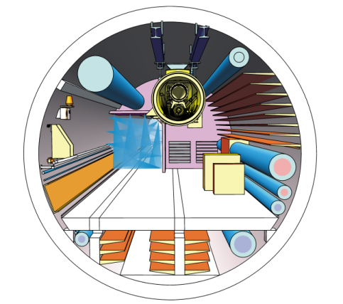
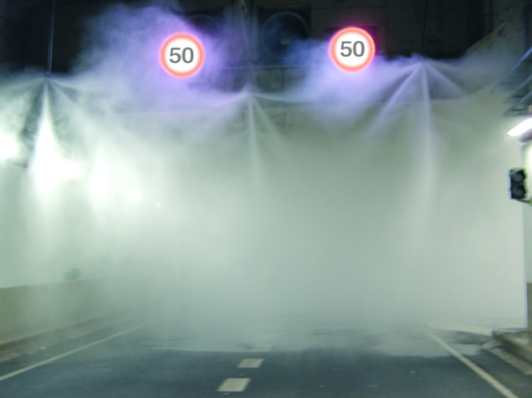
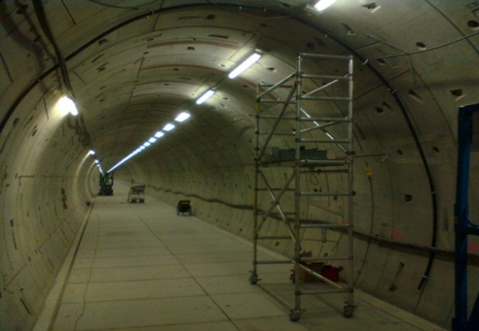
fire compartments
water mist curtains generate the fire compartments
keeps area free of smoke and fire
temporary solution for installation phase
Installation phase
operating phase
technical design
in progress
source: Fogtec
Notes:
Two solid firewalls at the beginning and the end of the tunnel and three water mist curtains every 500 m within the tunnel
Equivalent to fire resistance of F90
Curtains ensure areas free of smoke and fire -> save areas

Slide 12
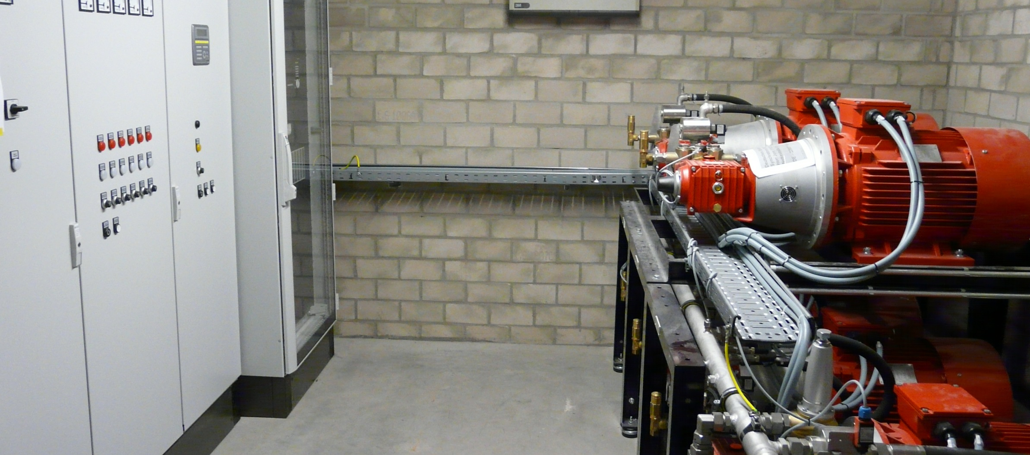
how it works
Notes:
max. 5 extinguishing zones activ at once

Slide 13
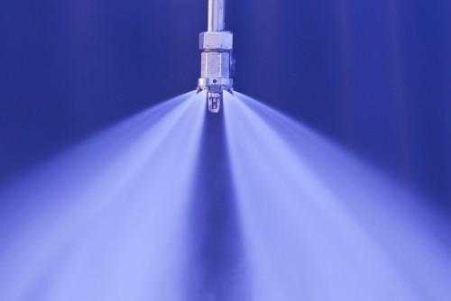
comparing hi-fog and conventional systems
advantages of hi-fog extinguishing system
safe for people → no pre-warning time
safe for the environment → pure water
water consumption approx. 10% of conventional sprinklers → minimal water damage
even safe in electrical environment
suppression of toxic smoke gas
source: Fogtec
Notes:
Water mist behaves like gas. Filles the room.

Slide 14
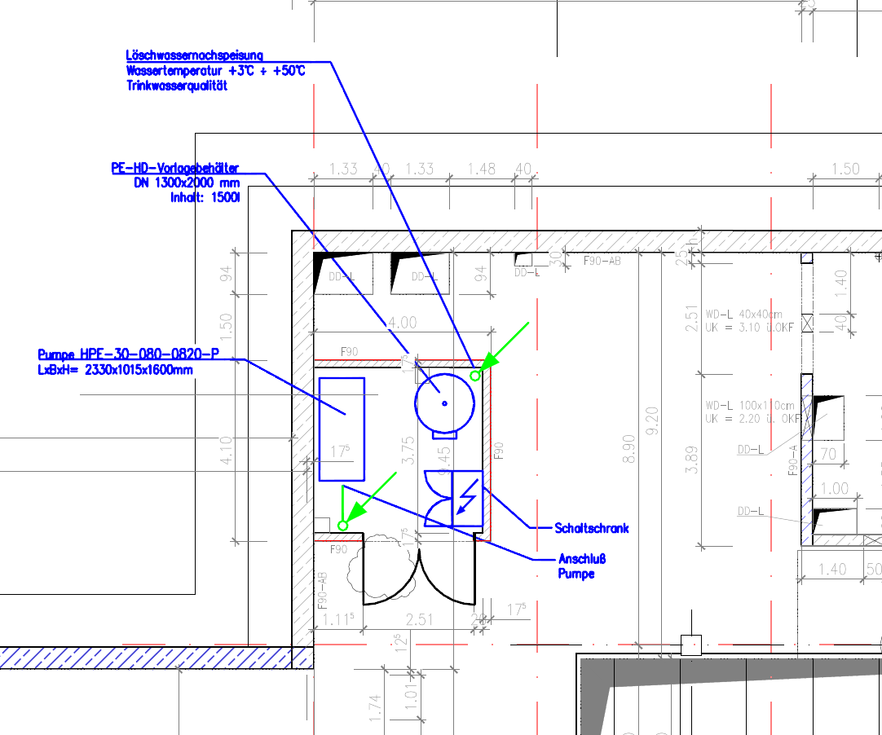
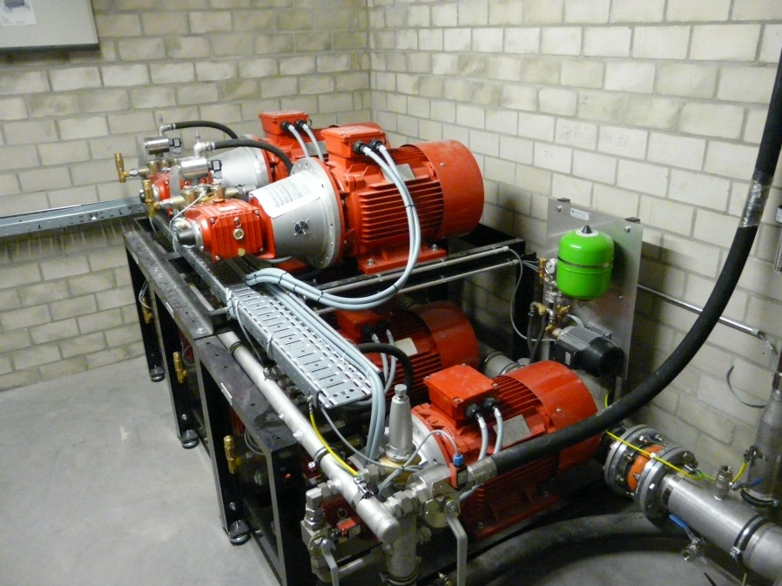
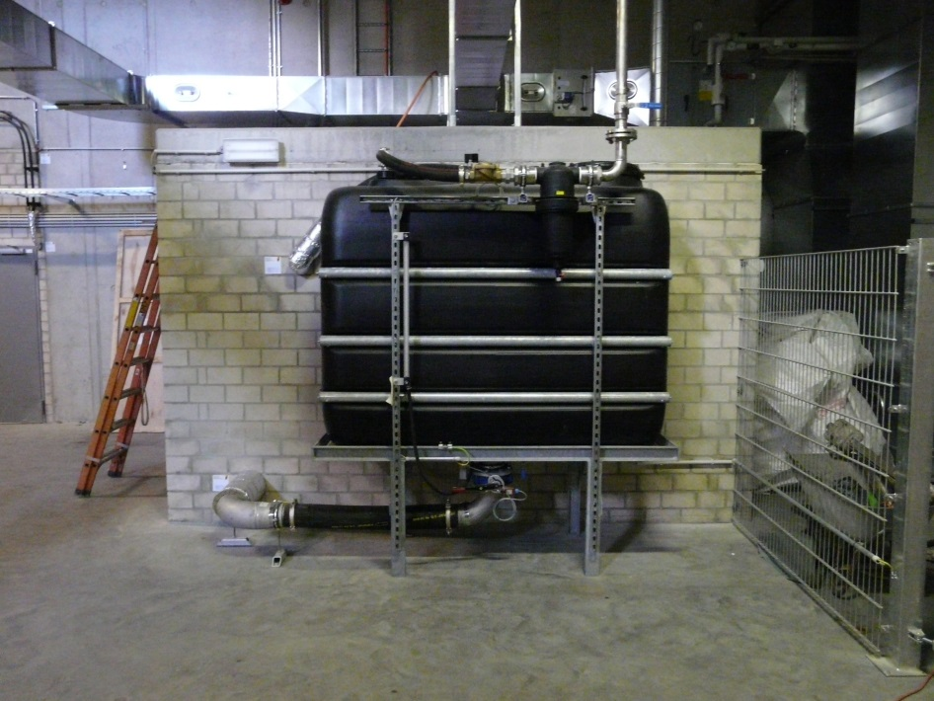
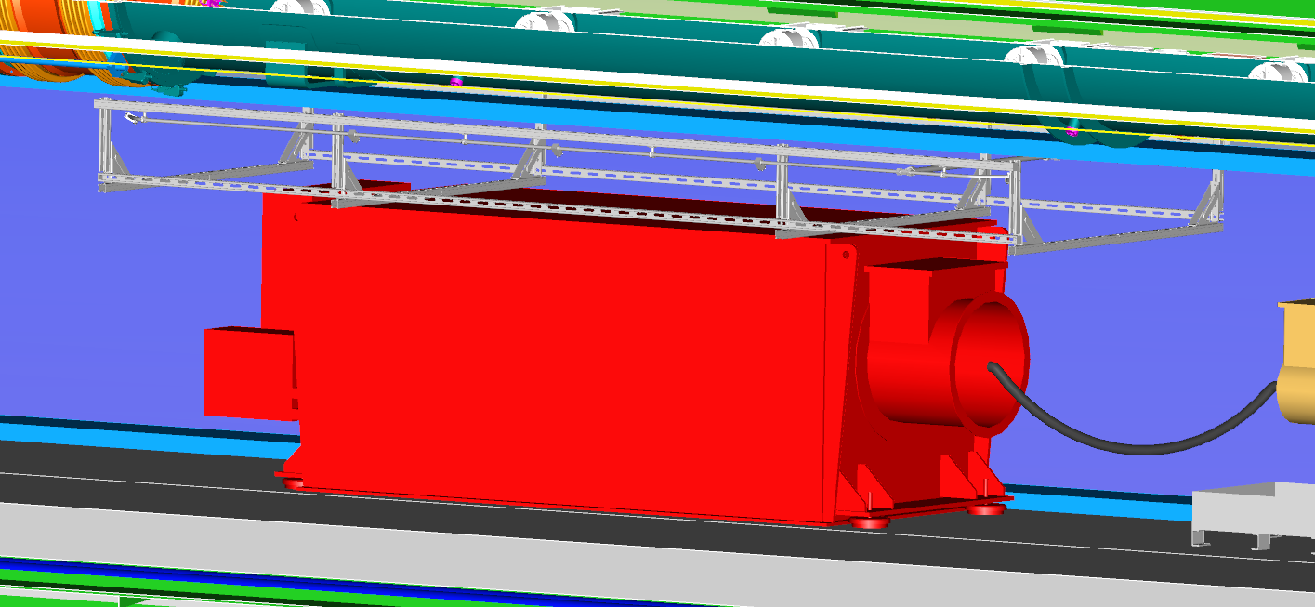
current status of installation
technical design
pump plant
main piping system
water and power supply
extinguishing zones
witnessed test
activation
✓
✓
✓
✓

…
…
Notes:
Witnessed test by a german association for technical inspection called TÜV

Slide 15
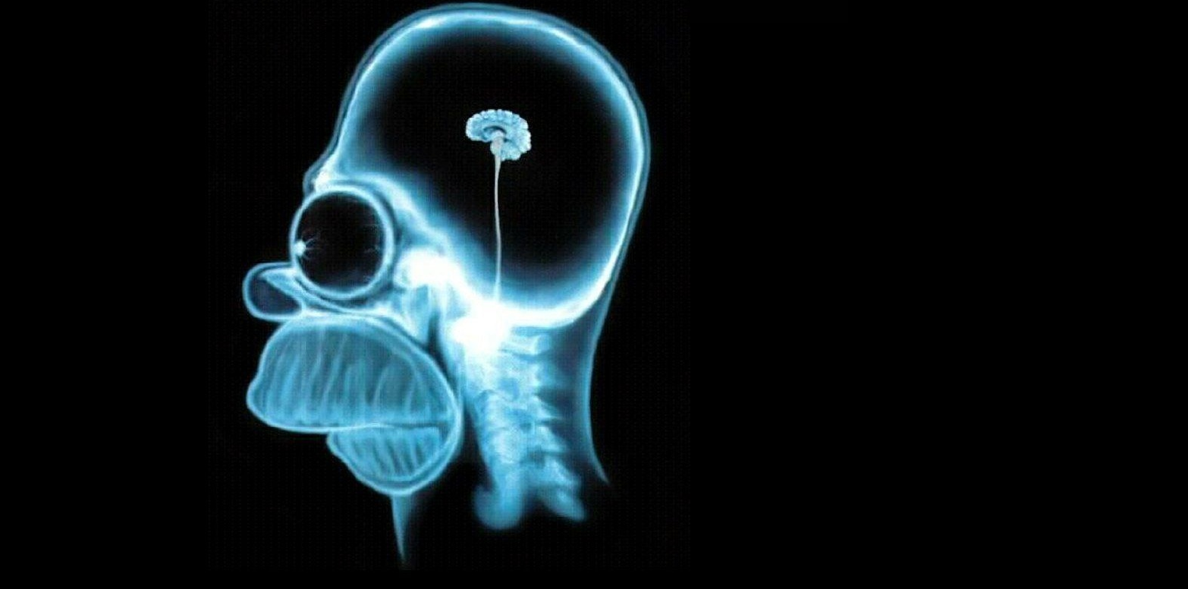
x-ray - wihout you‘d never know
Fabian Saretzki Work package 36 - General Safety Deutsches Elektronen-Synchrotron SAVE Notkestraße 85, Geb. 35 22607 Hamburg Tel.: +49 40 8998 - 4763 Fax.: +49 40 8998 – 4311 Mobile: +49 171 105 3424 Mail: fabian.saretzki@desy.de

