Slide 2
Paul Scherrer Institut
Yves Loertscher, HSE officer
The new safety analyse procedure for experiments at the Paul Scherrer Institute

Slide 3
Proposal request procedure
edit proposal form
no
Questions: i.e. any radiation hazard?
Have all compulsory questions an answer?
yes
compulsory questions
no
submit proposal
yes
acceptance procedure
scientific
safety
feasibility
Technical safety

Slide 4
Acceptance procedure: safety
Submit proposal
duty: safety expert
Comment from safety specialist to beamline scientist, should set “feasibility” to “no”
Danger to high / outside range
Safety review
More informations needed?
Condition known?
yes
no
no
Questions to user
safety locked
yes
Comment from safety specialist
1
Condition?
safety approved with condition
yes
no
safety approved
1
conditons
1

Slide 5
Acceptance procedure: technical safety
Submit proposal
duty: beam line scientist
Danger to high / outside range
set feasibility to “no”
Technical safety
More informations needed?
Condition known?
yes
no
no
Questions to user
locked
yes
Comment from beam line scientist
2
Condition?
feasible under condition
yes
no
2
conditions
feasible
2

Slide 6
Acceptance procedure: scientific committee
feasibility “no”
1
1
1
2
2
2
Scientific committee?
not approved
Status:
proposal rejected
info to user
approved
By ① / ② : info to user, that proposal can be rejected, if condition can’t be solved.
Proposal to beam time planning

Slide 7
Beam time planning
Accepted
proposal
info to user
Experiment can’t be done
no
status?
Cost?
Cost can be pay?
Risk analysis to define safety condition resp. condition for technical feasibility
yes
①②
no
①② ①②
status ①② →①②
yes
Resolve condition
Beam time planning:
1st: ①②
2nd: ①②/①②
3rd: ①②
Check that measures are made
①②
status?
①②
Experiment can be done

Slide 8
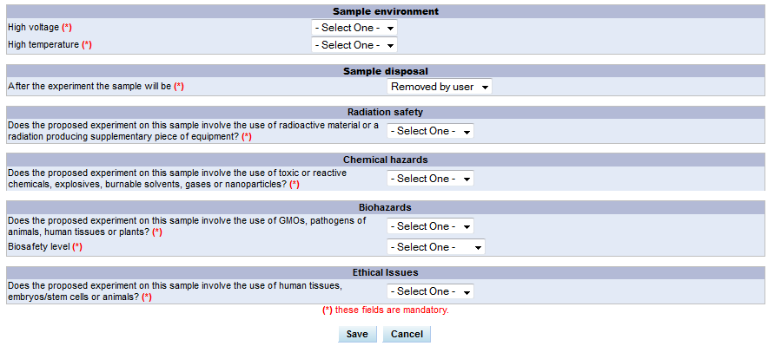
„genetically modified organism (GMO)“
If the user selects “yes” for radiation safety, chemical hazards, biohazards or ethical issues
a detailed input mask appears (see below). These information will then be evaluated by the corresponding PSI safety person.

Slide 9
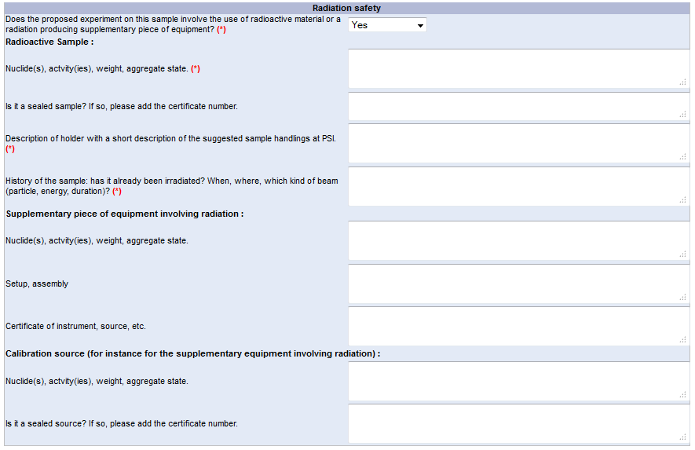

Slide 11
Safety & technical safety checks
Safety experts
Safety check based on compulsory data
Beamline scientist
feasibility & technical safety check

Slide 12
Feasibility Check (“Certify proposals”)
New option: “Yes, but…”

Slide 13
Technical Safety Check (“Certify Proposals”)
New functionality
To be filled out the same time as “feasiblity check.”
Visible by beamline manager only.
Status/Comments may be changed later (e.g. once the proposals is accepted)

Slide 14
Review of Samples by “Safety experts”
“Safety experts” will set the status to all samples marked for review (Approved, Restricted, Locked).
The Safety review is done before the Programm review committee meeting.

Slide 15
After the PRC
Coordination and scheduling by beamline scientist
Approved free scheduling
Approved with restriction scheduling but performing first when restrictions are kept
Locked take care the restrictions can be defined and are kept or experiment cannot be performed

Slide 16
Beamline scientist duty for “locked” proposals
Contact relevant experts
Discuss experiment (together with users) and define restrictions/boundary conditions that experiment can safely be done
Evaluate cost/balance effort
When decided condition can be implemented : → Contact the corresponding safety expert who has set it to locked. Send list of restrictions, only he/she can send it to approved with restrictions
Note that this might take some time.
→ A locked experiment cannot be performed

Slide 17
New columns on all proposal list (Beamline manager)
New columns. Click on label for details (see next slide).

Slide 18
Beamline manger view to “Sample safety”
State of each topic (check color code)
Comments

Slide 19
New icon on schedule (not on public schedule)
New Icon for proposals with safety issue.

Slide 20
New safety procedure – safety declaration at PSI
Users get in the email the link to the declaration.
http://www.psi.ch/useroffice/safety-at-psi
(safety application form)
Must be printed and signed at PSI
Experiment can only start when user has signed the form
Paper must be storage by the beamline scientist, at a place accessible by deputy and safety people, but not too obvious for other users. (Electronic solution in the future)

Slide 22
Thank you for your attention
Notes:
Beispiel um die Schlussfolie als Danksagung zu nutzen

