Slide 1
Lessons learned from “human errors”
How to learn lessons ?
Event analysis
Human errors, organizational gaps ?
Defining appropriate corrective and preventive measures
Deviations from safe operating domain,
Lessons learned

Slide 2
1 – How to learn lessons ?
In French: REX = RETEX = Retour d’Experience
In English = learning from experience
= REM = Record Experience & Monitoring
Experience of what ?
Experience of unwanted events, mishaps, accidents…
Experience from good practices
Experience from any “deviation” from “standard practice”
Q : Who has a systematic REM system ?

Slide 3
2 – Event analysis
Event reporting is essential
Event recording, for memory & statistics
Good practices recording ?
Minutes of debriefings
Repository for “deviations”
Analysis methods
Root-tree analysis or else…
Remember:
If you only identify only 1 root cause, you must have forgotten something !

Slide 4
3 – Human errors
Why humans in complex instrumented systems ?
Because systems are
- designed,
- built,
- operated
- maintained and
- managed
…by humans !
← sources
← of
human
errors
& organizational gaps

Slide 5
3 – Human errors
Why humans in complex instrumented systems ?
Because systems are
- designed,
- built,
- operated
- maintained
- managed
…by humans !
Humans can react appropriately (sometimes) to unpredictable and complex situations

Slide 6
3 – Human errors
It is commonly accepted that 90% of the unwanted events result from “human errors”.
Maybe, but what does that mean ?
Type of human errors:
Error of omission: not do what should be done
Error of commission: do the wrong thing
Degrees of human errors: slip or carelessness
mistake (incompetence ?)
rule violation
← Why ?

Slide 7
3 – Human errors
Humans learn (also) by experience (mainly ?)
by shared experience ?
( Some ) humans like risk !
Many ?
Is the “lack of competence” a possible root cause for an incident ?
Which managerial process led to this lack of competence ?
Same question for “fatigue of operator”
Same question for “inappropriate procedure”

Slide 8
3’ – Examples of human errors
Truck incident in front of CCC
Electrical arc in RF cabinet
Worker trespassing a forbidding ribbon (radiation)
Worker “forgetting” to connect a water pipe
…

Slide 9
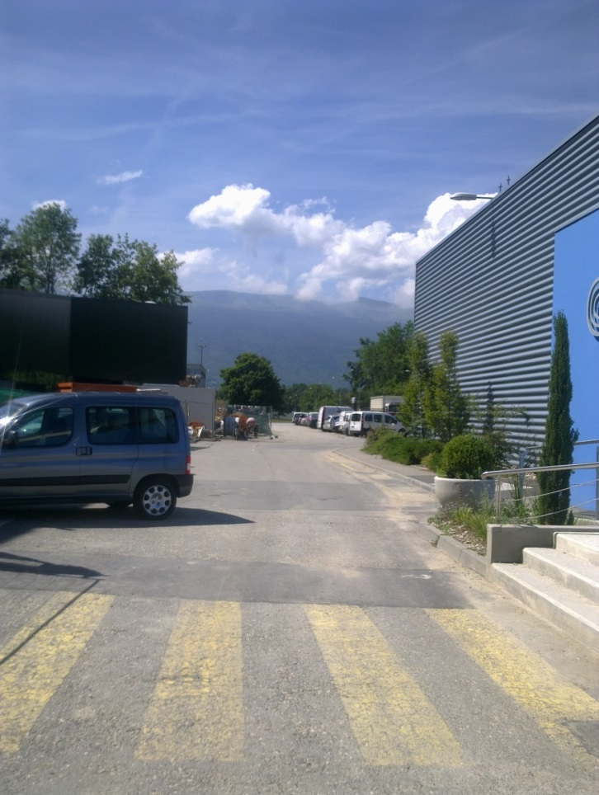
3’.1 – Lessons learned from the truck incident
Fact: The truck hit a handrail on his right.
Analysis 1: This is a “slip”; The driver was clumsy.
Analysis 2: A parked car obstructed his way
Analysis 3: Car drivers park anywhere ☹
Analysis 4: Car drivers park where they can; Not enough parking places around. Case needs resources.

Slide 10
3’.2 – Lessons learned from an electrical incident
While carrying a phase check, the operator created a short with the probe touching a metallic partition.

Slide 11
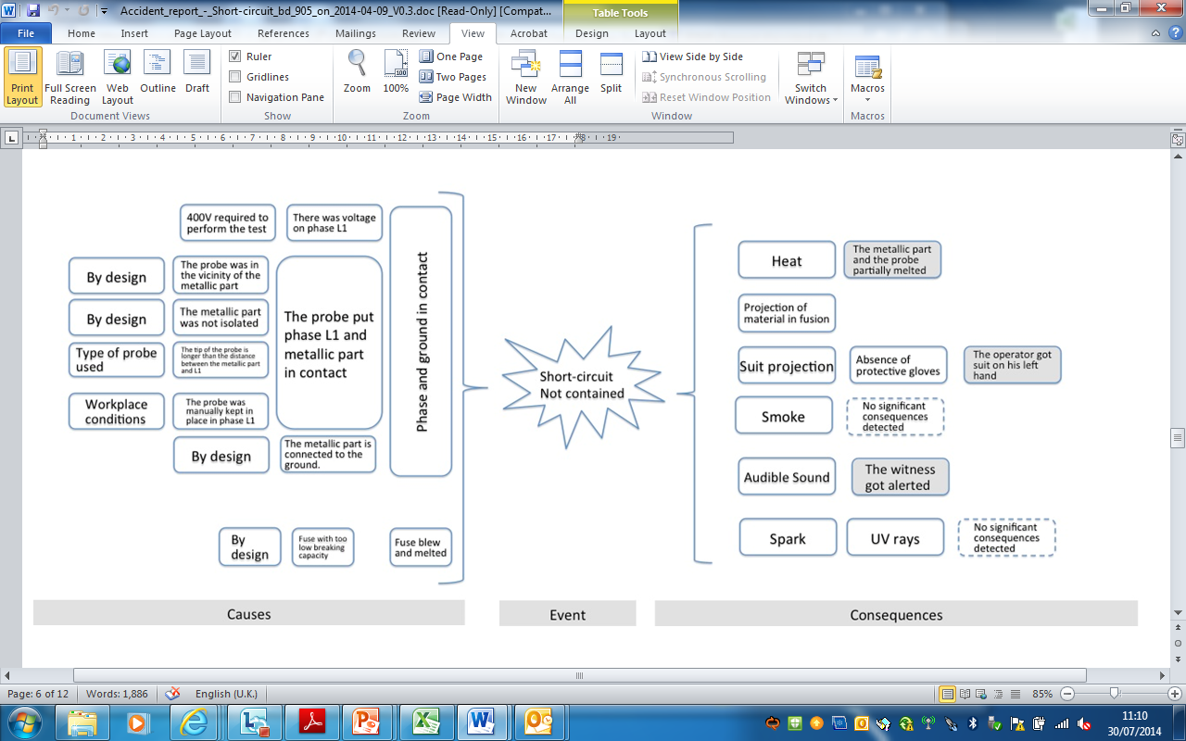
3’.2 – Lessons learned from an electrical incident
Who made the design ?
Who checked it ?
Who approved it ?
Who validated it ?
Who bought the probe ?
Who decided to install the cabinet there ?
Courtesy C.Gaignant, EDMS 1375828

Slide 12
4 – Defining corrective measures
Corrective measures:
Immediate and specific to the incident
Punish the guilty one (?)
More general, from analysis and follow-up
Systemic, but who dares to propose corrective measures to the “organization” ?
(i.e. his management)

Slide 13
(4) – Lessons learned from “human error” analysis
Need to define preventive measures wrt
Technical context
Human behavior
Technical context
Undesired event
Organizational
context
3. Organization
Human
decision
But the analysis methods based on a 2_factor_root ( = thing (or somebody) + action ) are too weak !

Slide 14
4’ – Defining preventive measures
2- Preventive measures wrt human behavior
Proper selection and training
Rules ; general, aims
Procedures ; specific, for “risky” activities
More procedures… to cover all activities
Still more procedures… to cover all (?) possibilities
… till “trapping safety into rules” ?
Sanction mechanisms (?)

Slide 15
4’ – Defining preventive measures
3- Preventive measures wrt organization
Clear structure, including reporting lines and “safety officers”
Visibility, not only on risks, but on safe operation and safety margins, “safe operating domain”
Crisis management program and team
Flexibility to react and adapt

Slide 16
4’.3 – Safe operating domain ?
Risk 2
Freedom about:
Technics
Processes
Operators
Structure
…
Risk 1
Safe operating domain
Degrees of freedom
Ideal
operation
Risk 3
Deviation
Risk 4

Slide 17
4’.3 – Safe operating domain ?
Important to record “deviations”
Any undesirable incident
Technical failures, unavailability of systems…
Human behavior, unavailability of operators
Try to analyze (in depth = motivation, reasons, history…)
Do not look for guiltiness ; no blame (or rarely, “just”)
Encourage and promote “human error” reporting
“deviation (of human type)” reporting
Otherwise…

Slide 18
4’.3 – Safe operating domain ?
Risk 2
Risk 1
No more degree of freedom
Safe operating domain
Real
Operation domain
Even if you know the hazards and risk, but have no visibility on the real operation,
you are “blind”.
Risk 3
Risk 4

Slide 19
5 – Lessons learned
Perfection does not exist
No perfect humans ; They have to – and like to – learn
They need to “express” themselves
They “learn from experience”
They don’t do what they are told, but what they understand they are told to do !
They may be under stress
Perfection does not exist
No perfect humans ; They have to – and like to – learn
They need to “express” themselves
They “learn from experience”
They don’t do what they are told, but what they understand they are told to do !
They may be under stress

Slide 20
5 – Lessons learned
Perfection does not exist (cntd)
No perfect organization ; Needs to be flexible, reactive
Needs to know the hazards
Needs to learn from collaborators
and to consider the “human factor”
Needs to define clear and adapted procedures or guidelines
Needs to know its own weaknesses
With all of these, it is possible to draw “protective barriers” against undesired events.
Includes human beings from bottom to top !

Slide 21
Further reading…
Reason J. : Human error. NY Cambridge University Press (1990)
Carroll J.S., Rudolph J.W., Hatakenaka S. : Learning from experience in high-hazard organizations. Research in Organizational Behavior, 24, 87-137 (2002)
Guidance on Investigating and Analyzing Human and Organizational Factors Aspects of Incidents and Accidents. ENERGY Institute, London (2008)
OHSAS 18002 (sections 4.3.2 & 4.4.6, about the changes in the organization activities, materials and management) (2008)
A. Macpherson, LHC operation: the human risk factor. 2nd Evian workshop on LHC beam operation, 2010
C. Bieder & M. Bourrier, Trapping Safety into Rules. Ashgate Publishing Ltd, (2013) ISBN: 978-1-4094-5226-3

Slide 22
Some incident analysis methods
ARCA (= APOLLO Root Cause Analysis); chart where each effect ← 1 condition + 1 action
(Black) BOW TIES; graphical representation of causes and consequences, in cascade + possible preventive and protective barriers
ECFA (= Events and Conditional Factors Analysis; = Root Tree Analysis); chart where each event ← 1 actor + 1 action + 1 object
Fishbone Diagram; each factor having influenced the incident are linked to the backbone, like ribs. + the “Five Whys” for each factor
HERA-JANUS (= Human Error Reduction; mainly used in air traffic management); analyses error details and error mechanisms
HFACS (= Human Factors Analysis and Classification System); based on Reason’s concepts of “latent failures” and “Swiss cheese”
MORT (= Management Oversight and Risk Tree); based on pre-filled fault trees for nuclear and petroleum industries.

