Slide 1

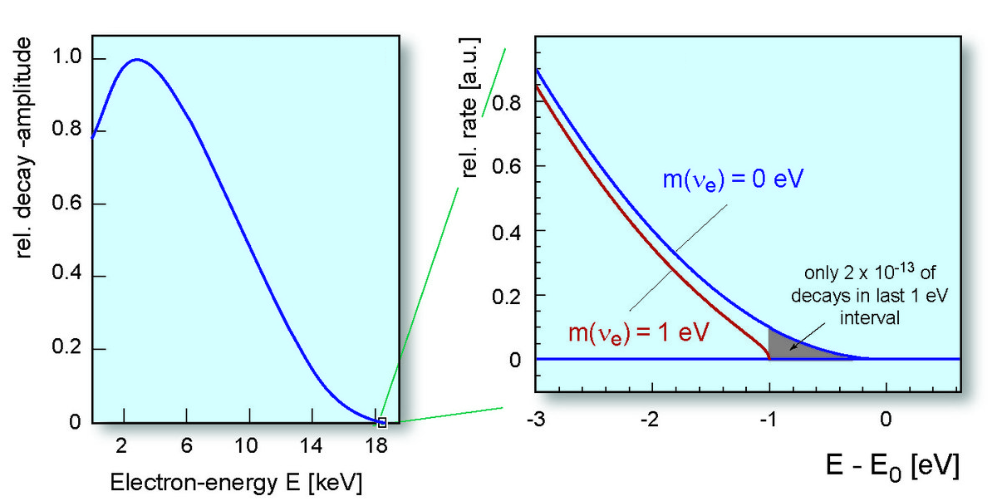
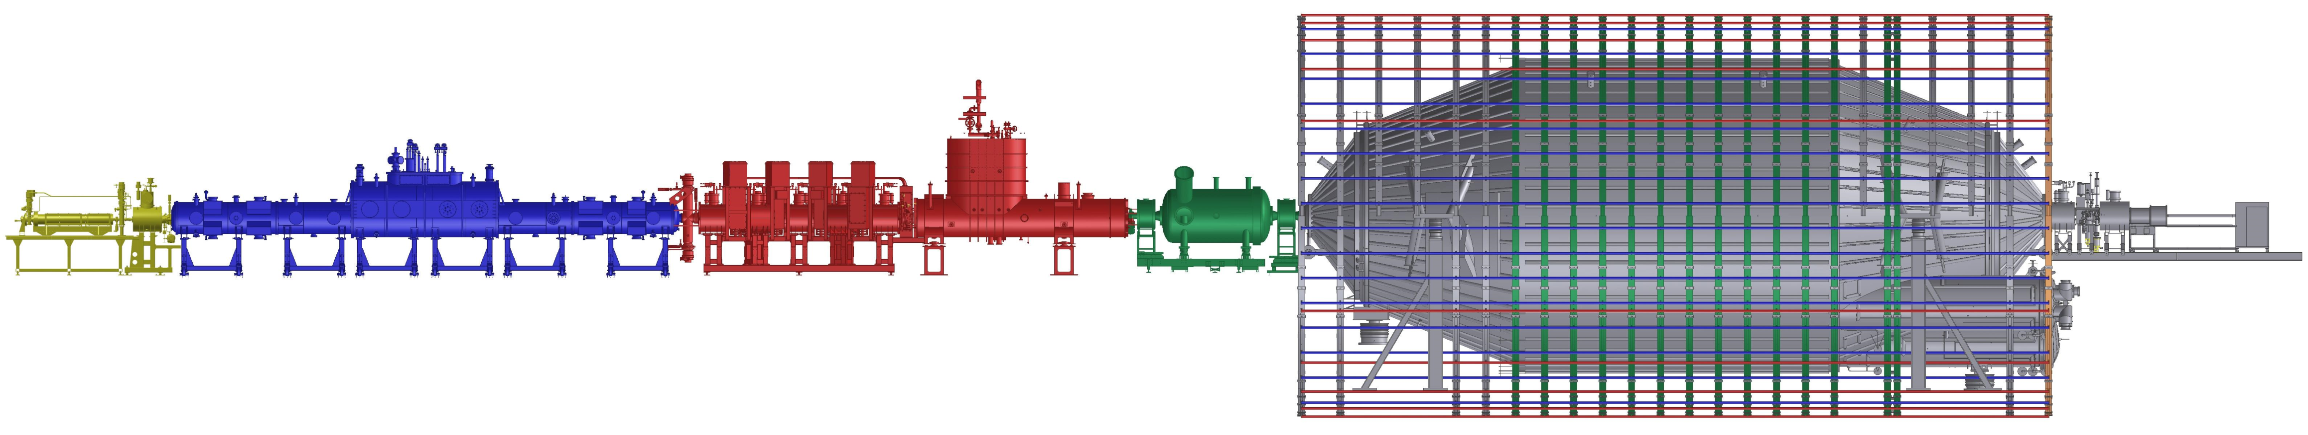
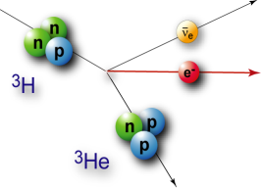
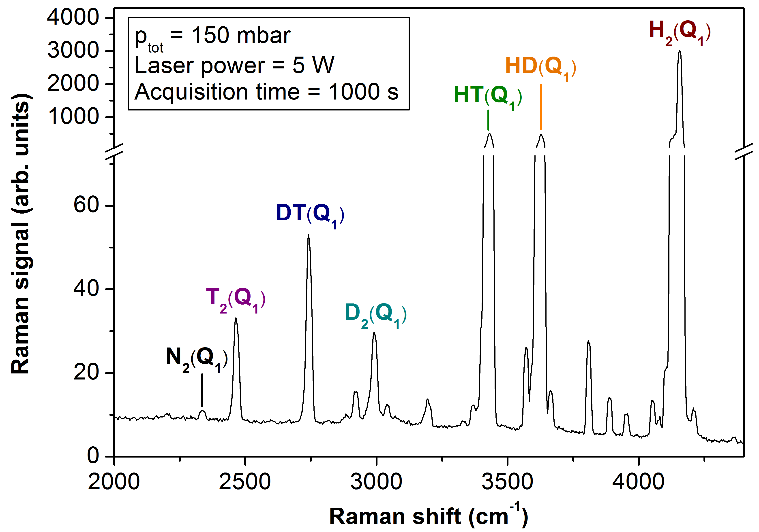
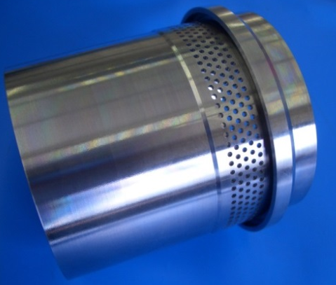
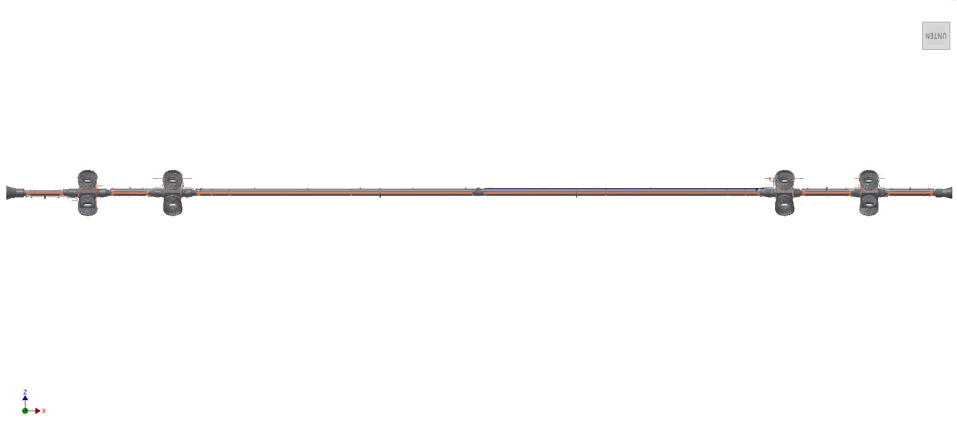
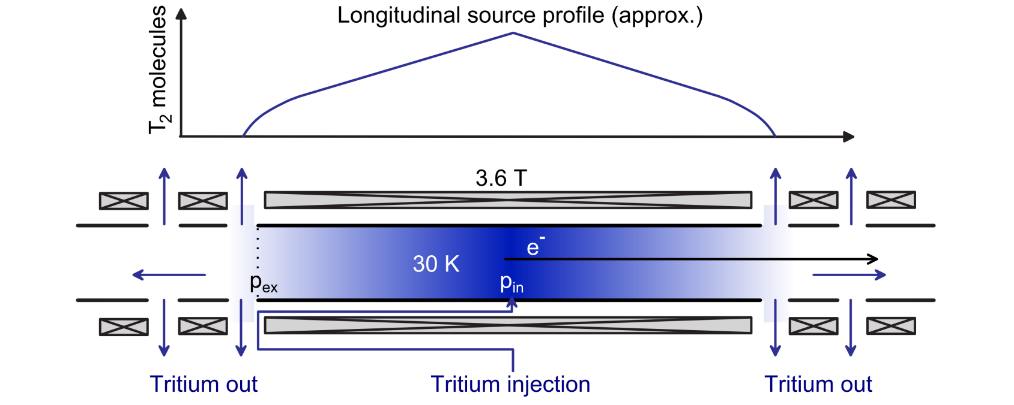
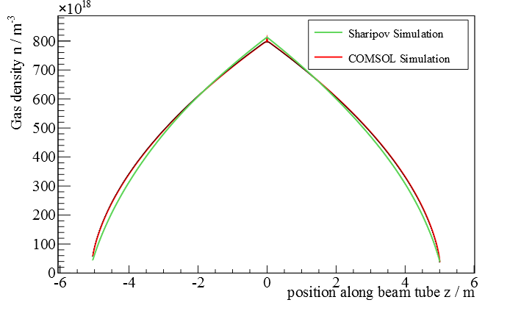
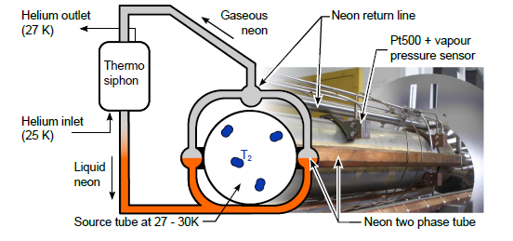
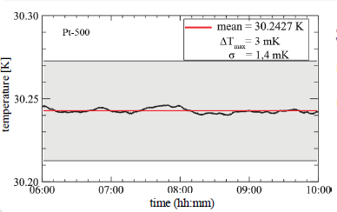
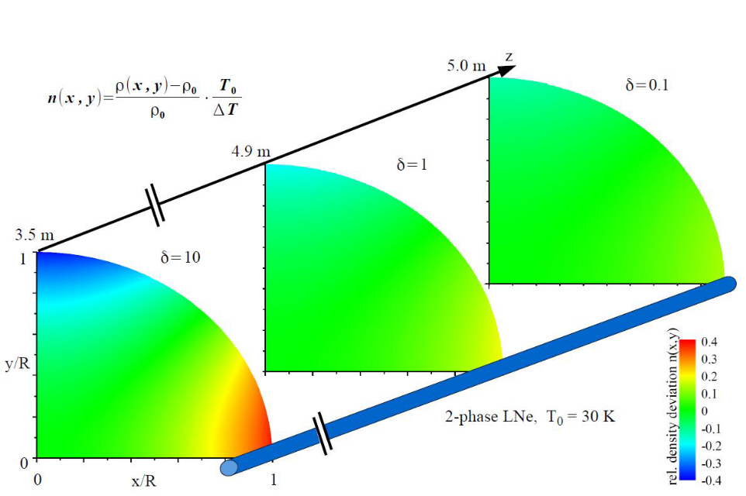
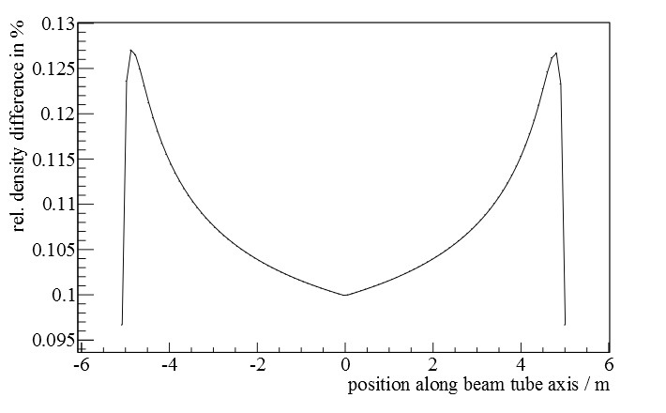
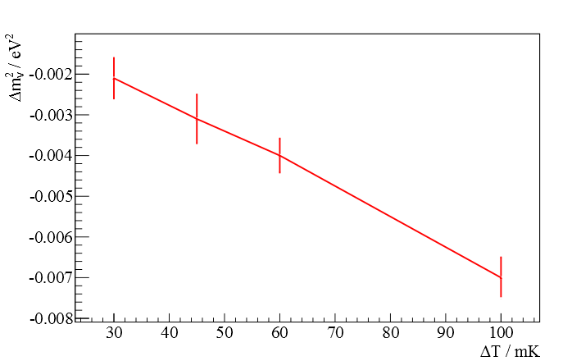
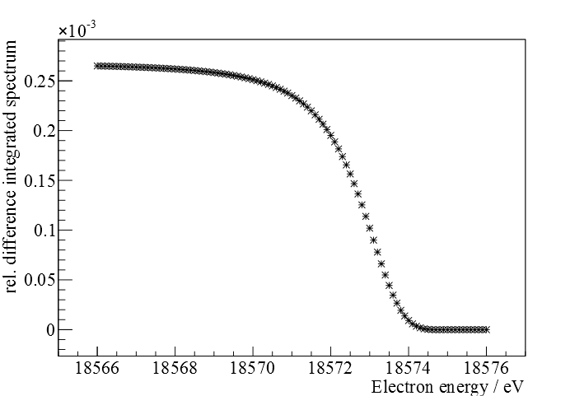

The windowless gaseous tritium source (WGTS) of the KATRIN experiment
Laura Kuckert for the KATRIN Collaboration, KCETA, Karlsruhe Institute of Technology
KATRIN Experiment
Source and transport section
Spectrometer and detector section
Entire spectrum
End point region
Calibration
and
monitoring
system
DPS1-R
WGTS
DPS1-F
DPS2-F
CPS
Direct and model independent determination of the neutrino mass with sensitivity of 200 meV/c² (90% CL)
Measuring integrated electron spectrum from beta decay
of molecular tritium with large electrostatic spectrometer
(MAC-E filter)
WGTS
Raman
spectrum
of injected
gas
4-fold pump port with connection to TMP‘s
Beam tube: length 10m,
diameter 90 mm
Magnetic guiding field 3.6 T
Beam tube temperature 30K
Pressure reduction by turbo molecular pumps (TMP) at both ends
Tritium injection 5∙10¹⁹ T₂-molecules/s (column density 5∙10²¹m⁻² ) →
→ luminosity 1.7∙10¹¹ Bq
Closed Tritium cycle with continuous purification →
purity of injected tritium > 95% (monitoring with Raman spectroscopy)
Injection orifices
Temperature and gas dynamics
Temperature measurement
+
Monitoring of injection pressure, column density
1D density profile
High beam tube temperature stability (<3 mK/h) using
two phase Neon cooling
Simulation of
gas dynamics
Precise temperature measurement with PT500 sensors
+ vapour pressure sensors (∆T < 4mK)
Gas density profile from numerical simulation
rel. density deviation n(x,y)
0.4
0
-0.4
Pseudo-3D density profile
2-phase LNe, T₀=30K
Source sytematic uncertainties
Example: syst. uncertainty
in WGTS temperature
4 of 5 KATRIN main systematic uncertainties related to source
One systematic uncertainty allowed to cause shift in neutrino
mass squared of ∆m_{ν}² < 7.5∙10⁻³ eV²/c⁴
Systematic uncertainty in parameter
for ∆T=30mK
Source parameter | Requirement | Max. syst. ∆m_{ν}² / eV²
Column Density → Temperature → Injection pressure | ∆ρd/ρd < 2∙10⁻³ ∆T/T < 2∙10⁻³ ∆p_{in}/p_{in} < 0.06 | < 1.5∙10⁻³
WGTS potential → Space charges | ∆U < 10mV | < 1.2∙10⁻³ 3∙10⁻⁴
Final state distribution (FSD) → Ortho-Para ratio | ∆FSD/FSD < 0.01 | < 6.2∙10⁻³ < 3∙10⁻³
Unfolding of energy loss function → Inel. scattering cross section | ∆σ_{in}/σ_{in} < 2∙10⁻³ | 2 - 6.2∙10⁻³ < 4∙10⁻³
Shift in fitted
neutrino mass
Difference in integrated β-spectrum
∆T_{S} =3mK, ∆T_{Sensor} =4mK
for ∆T=30mK
Neutrino mass shifts due to source systematics are in agreement with sensitivity of of 200 meV/c²

