Slide 1
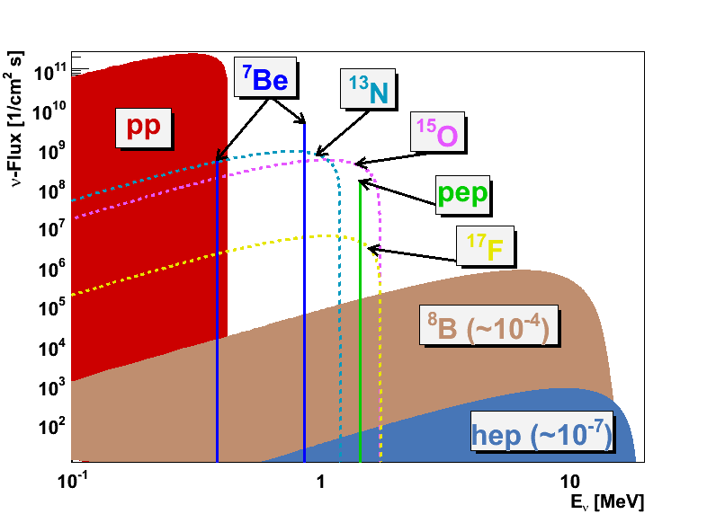
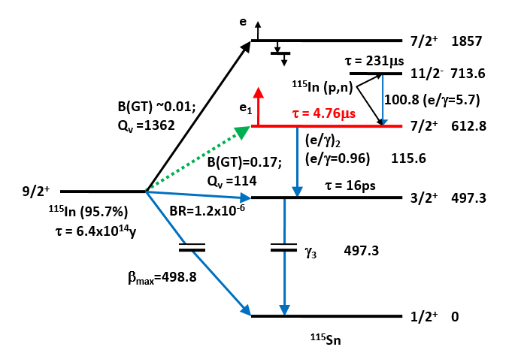
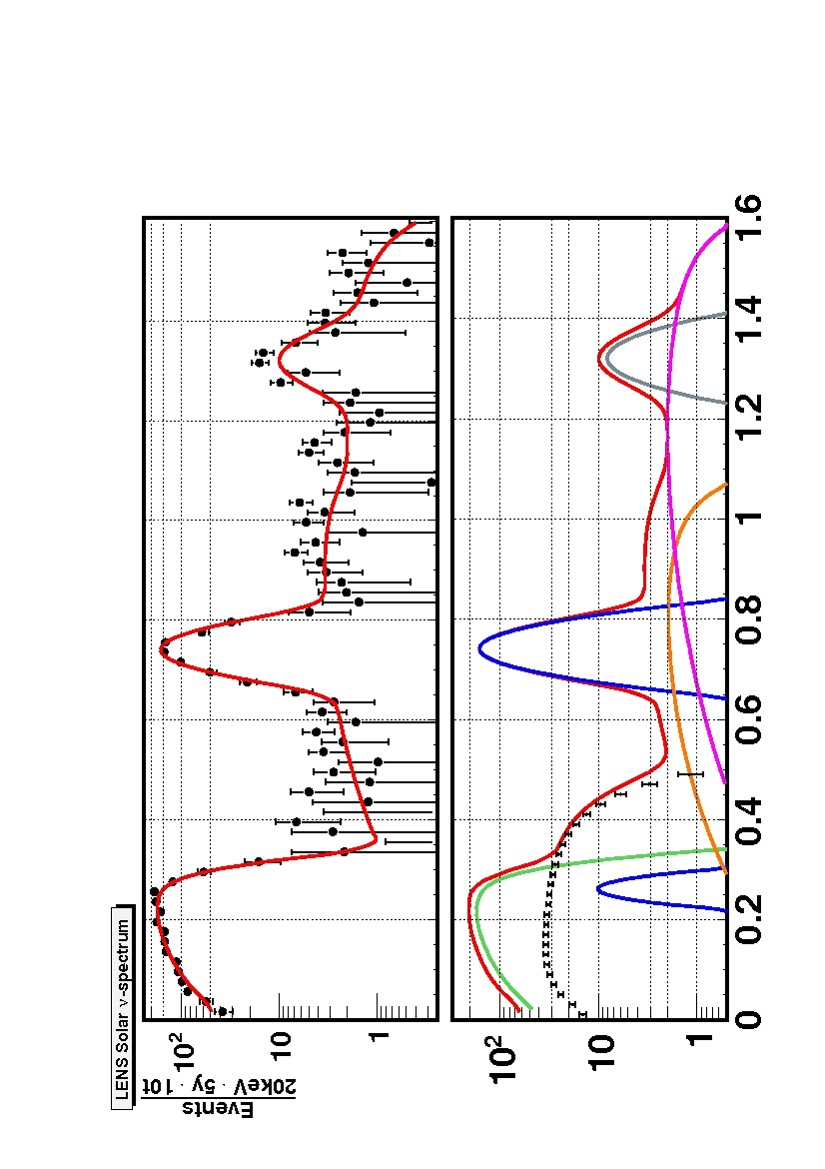
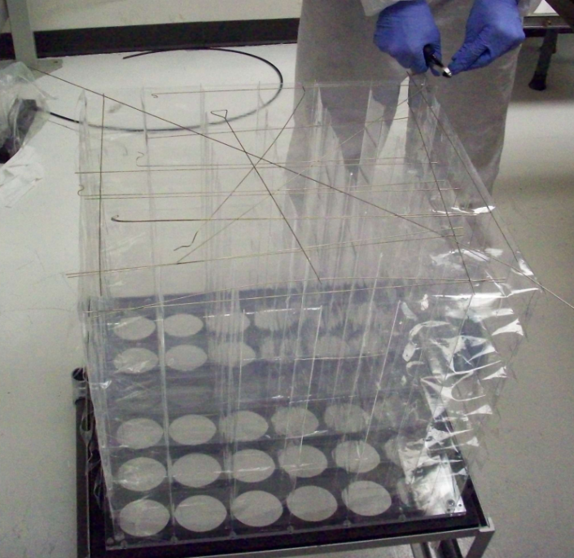
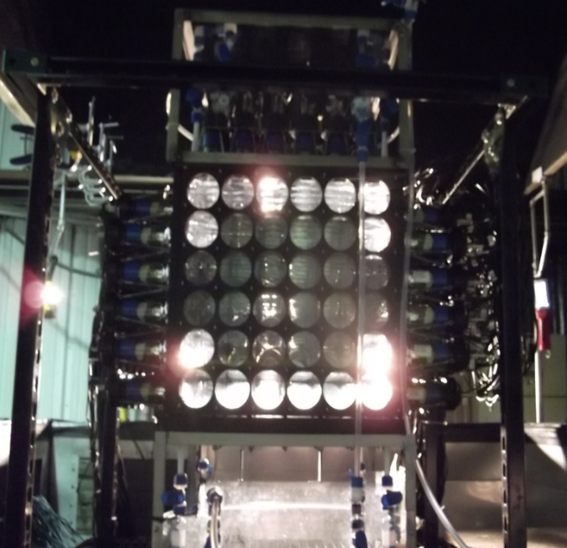
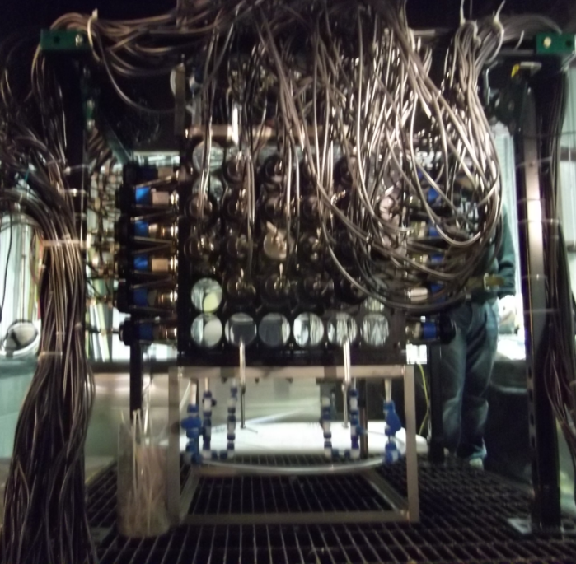
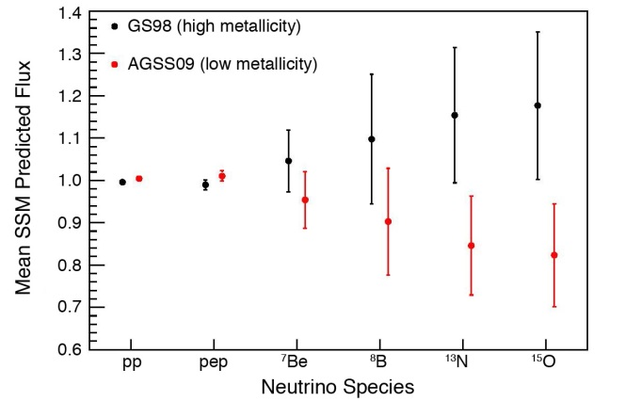
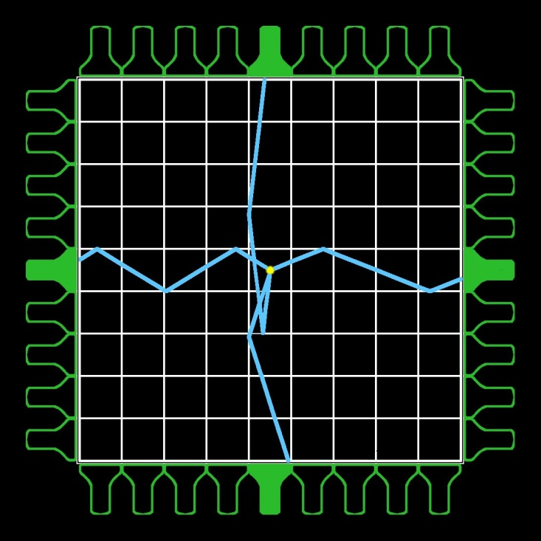
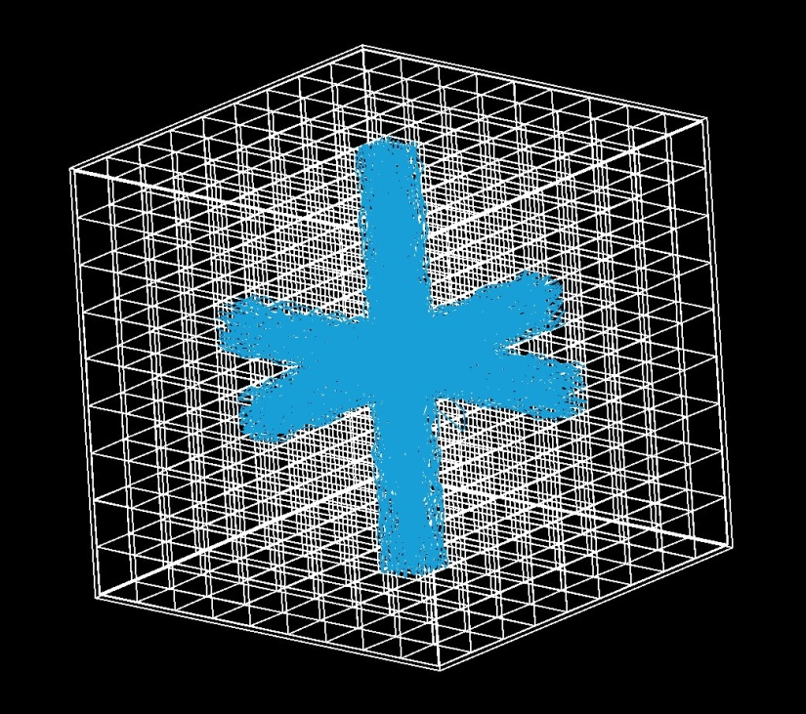
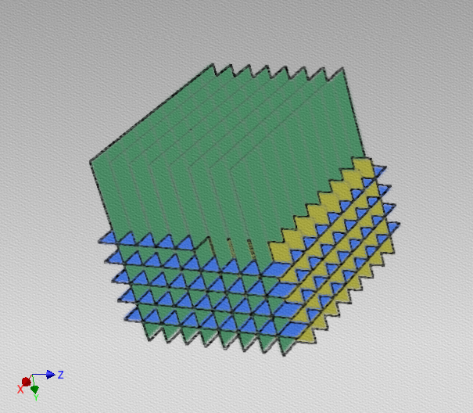
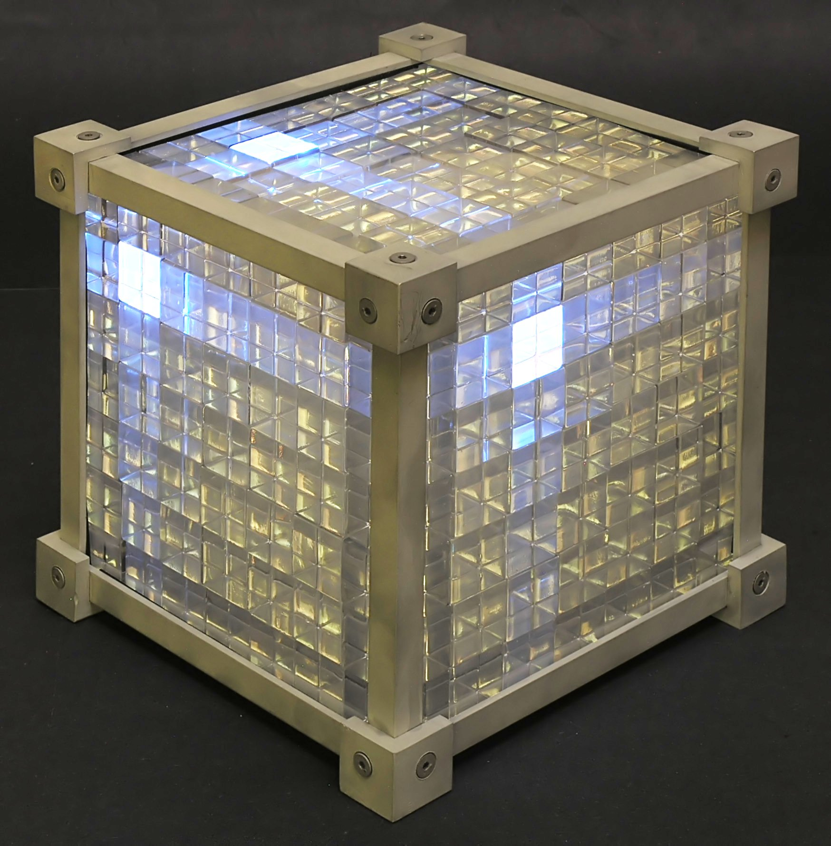
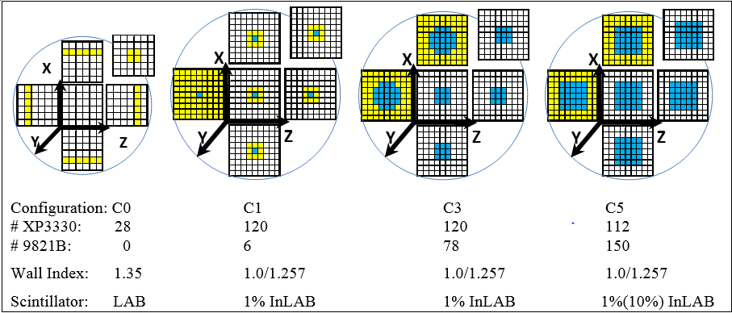
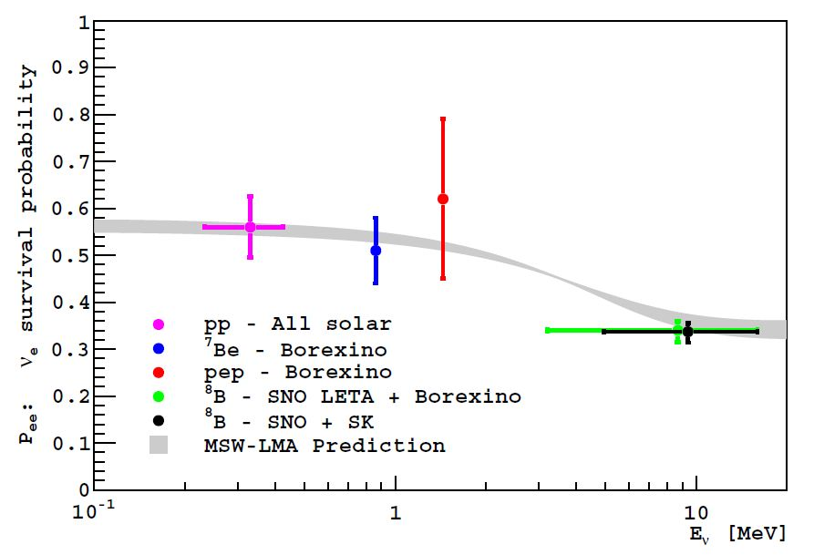
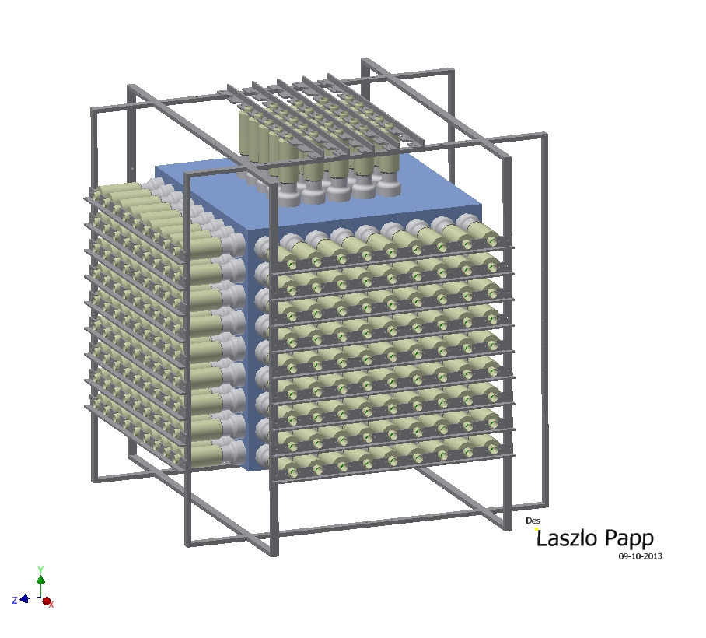
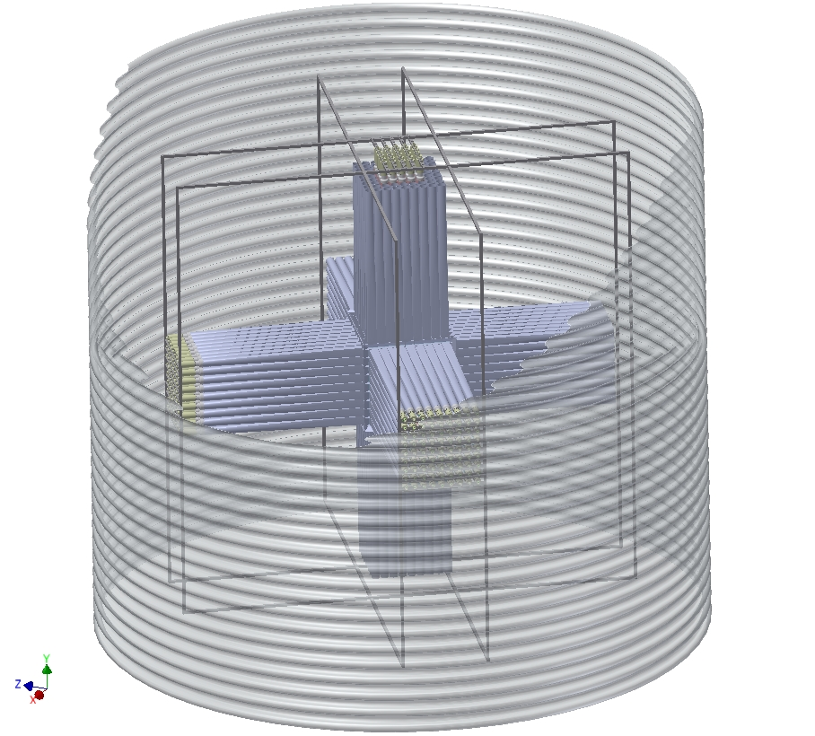
LENS and miniLENS:
Progress toward a precision solar neutrino measurement
Z. W. Yokley¹, on behalf of the LENS Collaboration:
Liudmyla Afanasieva², Jeff Blackmon², Art Champagne³, Vivek Datar⁶, Eric Diaz¹, Kevin Macon², Diane Markoff⁴, Camillo Mariani¹, Mark Pitt¹,
Marc Pomeroy¹, Charles Roscoe², S. Derek Rountree¹, R. Bruce Vogelaar¹, Tristan Wright¹, Minfang Yeh⁵, Zachary Yokley¹
¹Department of Physics, Virginia Tech; ²Department of Physics, Louisiana State University; ³Department of Physics, University of North Carolina;
⁴Department of Physics, North Carolina Central University; ⁵Brookhaven National Lab; ⁶BARC, India
Science Goals:
The luminosity of the Sun as derived from neutrino flux; Solar equilibrium on a ~50,000 year timescale;
CNO neutrinos and solar metallicity;
MSW resonant neutrino conversion;
CPT in the neutrino sector;
Physics beyond-the-Standard-Model;
Challenges:
Production of indium-loaded liquid scintillator with high light yield, high transparency, good chemical stability and high content of indium;
Accurate knowledge of the capture cross section, or normalization to ⁷Be results from Borexino;
Discrimination of internal background due to the ¹¹⁵In beta decay;
Detector construction technology;
Background Discrimination:
Time/space coincidence of prompt event and tag in the same cell required for trigger;
Tag requires at least three ‘hits’ (energy deposition in different cells), to reduce the random coincidence rate;
Narrow energy cut: The total tag energy is 614 keV, whereas the ¹¹⁵In β endpoint energy is 499 keV;
A tag topology cut distinguishes patterns that are more likely to be a superposition of several βs from patterns that are more likely to be Compton showers.
ν_{e} Detection:
Triple coincidence tag e⁻ + γ + (γ/e⁻) allows powerful background discrimination;
The abundance of ¹¹⁵In in natural indium is 96%;
Low capture threshold of Q = 114 keV, thus sensitive to about 95% of the pp spectrum;
Prompt beta has the incident neutrino energy shifted by the Q-value;
Beta decay of ¹¹⁵In (250kHz/ton): End point affects pp signal only.
 | Signal (pp) y⁻¹ (t In)⁻¹ | Bgd (In) y⁻¹ (t In)⁻¹
RAW rate | 62.5 | 79 x 10¹¹
Tag in Space/Time delayed coincidence with prompt event in vertex | 50 | 2.76 x 10⁵
B. + ≥3 Hits in tag shower | 46 | 2.96 x 10⁴
C. +Tag Energy = 614 keV | 44 | 306
D. +Tag topology | 40 | 13 ± 0.6
Table 2: Results of the GEANT4 Monte Carlo simulation with the cuts found above.
(cell size = 7.5cm, S/N=3):
Current Work:
Built and ran the μLENS prototype in the Kimballton Underground Research Facility (KURF);
μLENS demonstrated film lattice construction (Teflon FEP films), detector filling, and rudimentary light transport in the lattice;
Light transport studies hampered by un-channeled light and large surface-to-volume ratio;
Fig. 1: The theoretical solar neutrino fluxes. LENS will be sensitive to solar neutrinos above 114 keV, approximately 95% of the total spectrum.
Fig. 5: Level diagram showing the relevant states for neutrino capture and intrinsic background.
pp
⁷Be
Detector Design:
Optical segmentation of the scintillator volume into cubic cells with a low index of refraction material (air-gap or film). This is called a scintillation lattice (SL);
Total internal reflection channels light along the three main axes of the cells;
Position resolution is the size of the basic cell element, and it is independent of energy;
The time-of-flight information is redundant and can be used to examine the shower structure.
Fig. 7: Top Left: The completed μLENS SL. Each cell in 3.25” on a side. SL constructed from Tefon FEP. Top Right: The μLENS SL installed in an acrylic box and filled with scintillator in KURF. The background lights show channeling in the lattice. Bottom Right: μLENS instrumented and cabled with 3” PMTS.
In-β⁻
CNO
pep
⁷Be*
Fig. 2: Simulated spectrum from LENS 10 t loading and 5 years of data taking.
Fig. 8: Left: The construction method for the miniLENS SL. The lattice is composed of “slats” made with acrylic sheets containing a 0.015 inch air-gap. The slats colored for clarity.
Currently developing a larger air-gap lattice called miniLENS;
MiniLENS will demonstrate the event reconstruction needed for LENS;
With In loaded scintillator and shielding miniLENS can probe the rate of intrinsic false tags;
Fig. 6: Top Left: A 2D schematic representation of scintillation light channeling in the SL. Photons are channeled by total internal reflection along the main axes towards the PMTs. Top Right: A 3D schematic of channeling in the SL from an event located in the center. Bottom Right: An as-built SL using UV LED illuminated plastic scintillator and acrylic cubes. Here the low index is a small air-gap between the cubes.
Fig. 3: Comparison of predicted solar neutrino fluxes under the two abundance assumptions (from Saldanha, R. (2012). Princeton Ph.D. Thesis).
Background Discrimination:
Signal Signature: Prompt beta ( ) followed by a low energy (e⁻/γ) ( ) and a Compton-scatter γ ( ).
Backgrounds: Random time and space coincidence between two β-decays ( ); Extended shower ( ) can be created by:
498 keV γ from decay to excited state;
Bremsstrahlung γ-rays created by betas;
Random coincidence (within about 10 ns) of more beta decays;
Any combination of a, b, or c.
Fig. 9: Phases of operations for μLENS (C0) and miniLENS (C1,3,5). C1-2 will have unloaded scintillator and no shielding. A water shielding tank will be installed during C3-4 as well as the addition of 1% In loaded scintillator. This phase will allow for electronics shakedowns. Finally in C5 the external shield is completed and the detector is filled with 10% In loaded scintillator.
Fig. 4: Comparison of solar neutrino data with the LMA-MSW prediction, arXiv:1205.2989. LENS will be able to directly measure the pp and CNO neutrinos.
Signal
E_{ν} -114 keV
¹¹⁵In
τ=4.76μs
Table 1: Expected fluxes, cross section, and event rates for the LENS detector. Fluxes in SNU taken from Bahcall, J. N., & Ulrich, R. K. Rev. Mod. Phys, 60 (2), 297 (1988). CNO fluxes taken from a. Altmann, M. F., et al. Rep. Prog. Phys., 64 (1), 97 (2001), b. and c. Serenelli, et al., The Astrophysical Journal Letters, 705 (2), L123 (2009). The cross section was taken from Rapaport, J., et al. Phys. Rev. Lett., 54 (21), 2325 (1985).
116 keV
γ
498 keV
Fig. 10: Left: An initial phase of the miniLENS deployment without external shielding. During this phase light transport and event reconstruction will be studied. Right: MiniLENS installed in its shielding tank with light guides connecting each lattice channel to its associated PMT. These guides allow for the light channeling to be maintained while shielding from the PMTs.
Background
¹¹⁵Sn
¹¹⁵In
E_{max}< 2 keV
BR = 1.2x10⁻⁶
The SL can be used for other experiments needing tight spatial resolution; for example, double beta decay and short baseline reactor experiments;
Currently investigating a short baseline reactor experiment with ⁶Li loaded scintillator using a SL.
γ
498 keV
E_{max} = 499 keV
BR ≈ 1
¹¹⁵Sn

