Slide 1
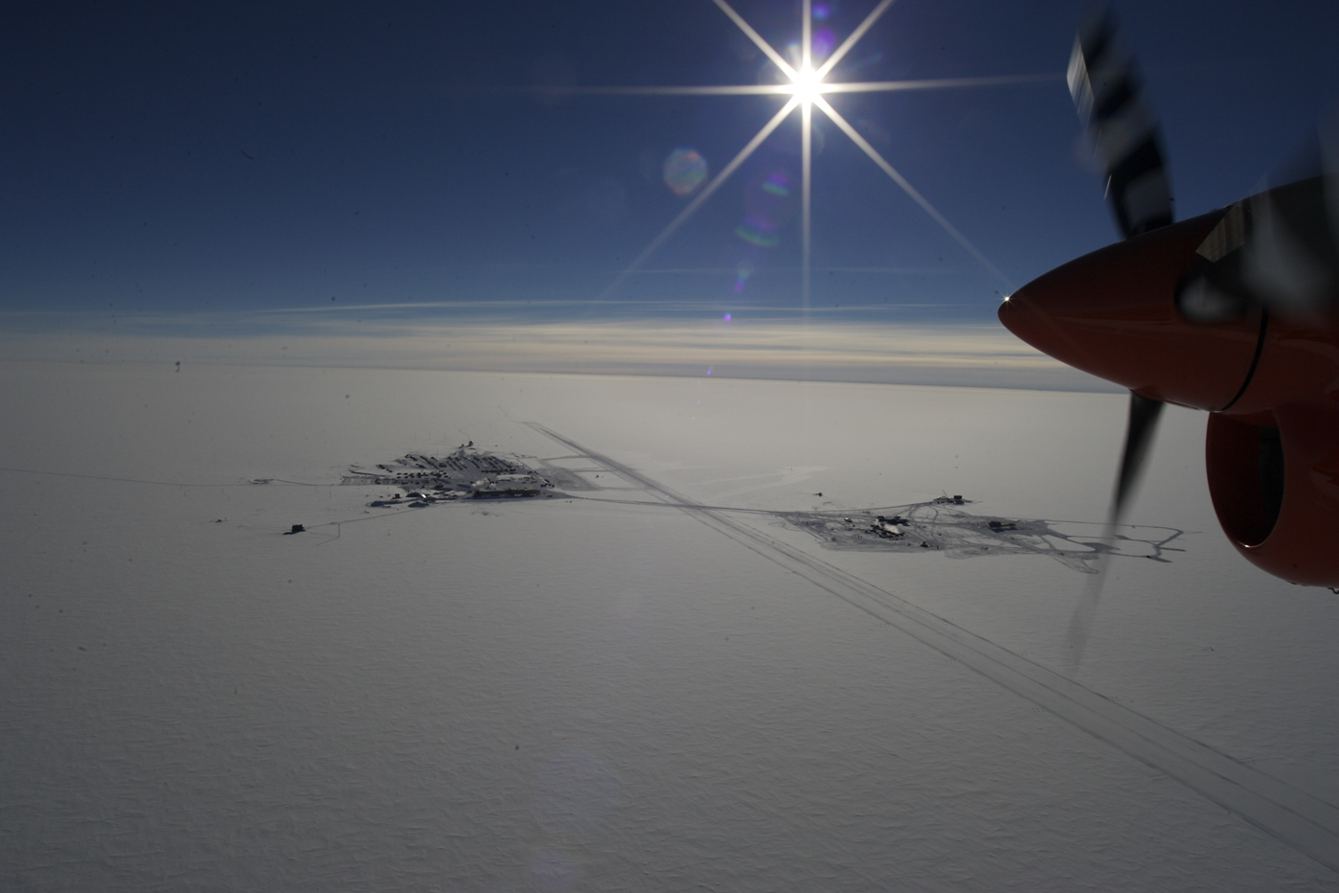


First detection of high-energy astrophysical neutrinos with IceCube
Gary C. Hill
University of Adelaide
for the IceCube collaboration
Neutrino 2014 Boston, June 2nd, 2014
Photograph: Forest Banks

Slide 2
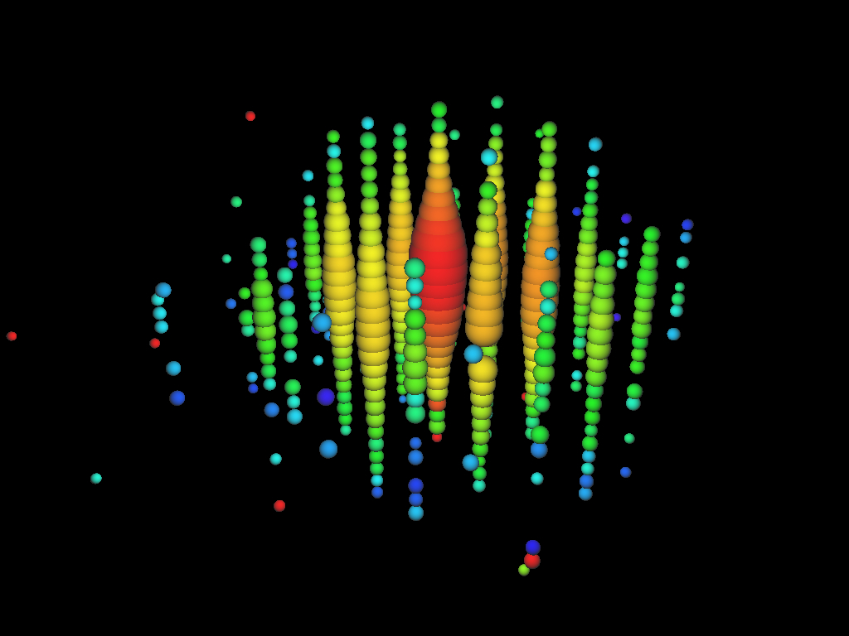
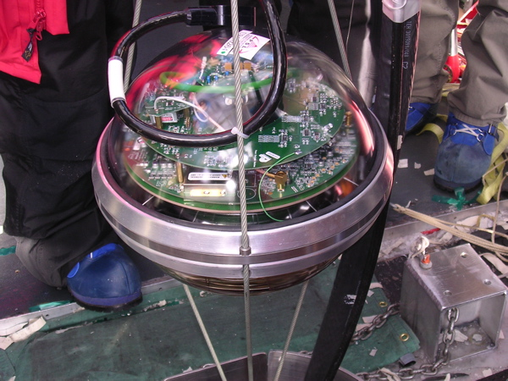
Cherenkov light from a 2 PeV neutrino
induced particle shower in IceCube
ν_{e}
photon arrival
timings:
red - early
yellow
orange
green
blue - late
string spacing 125 m
DOM spacing 17 m

Slide 3
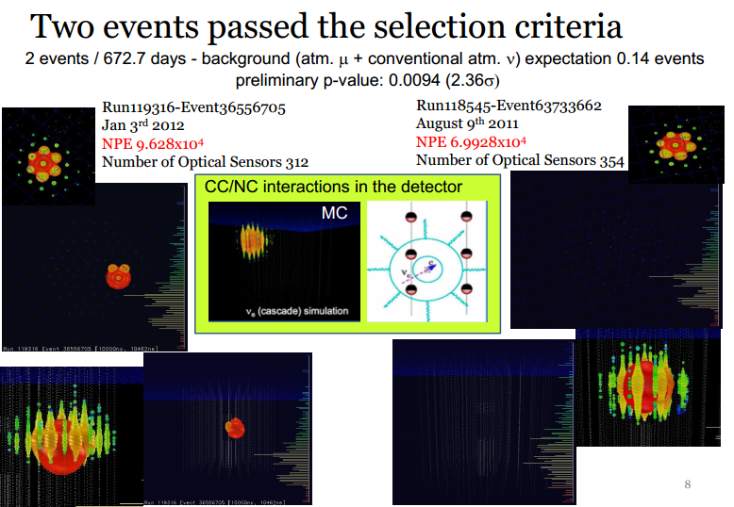
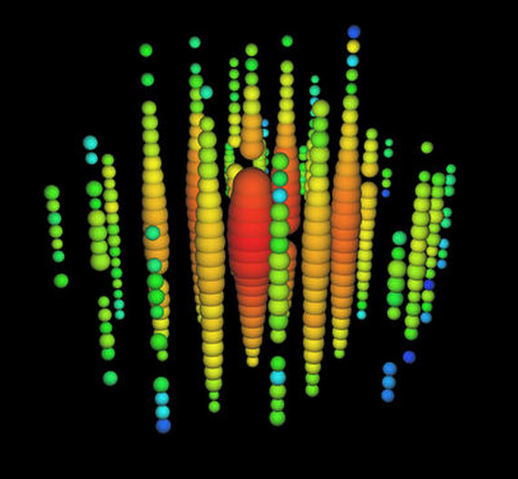
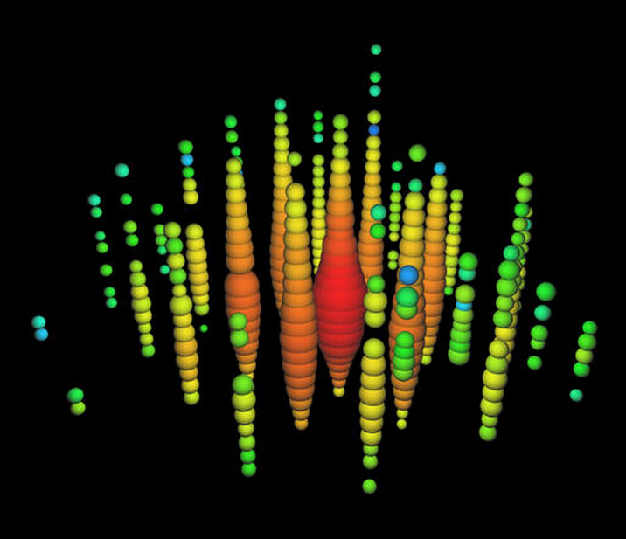
Flashback: Neutrino 2012, Kyoto

Slide 4
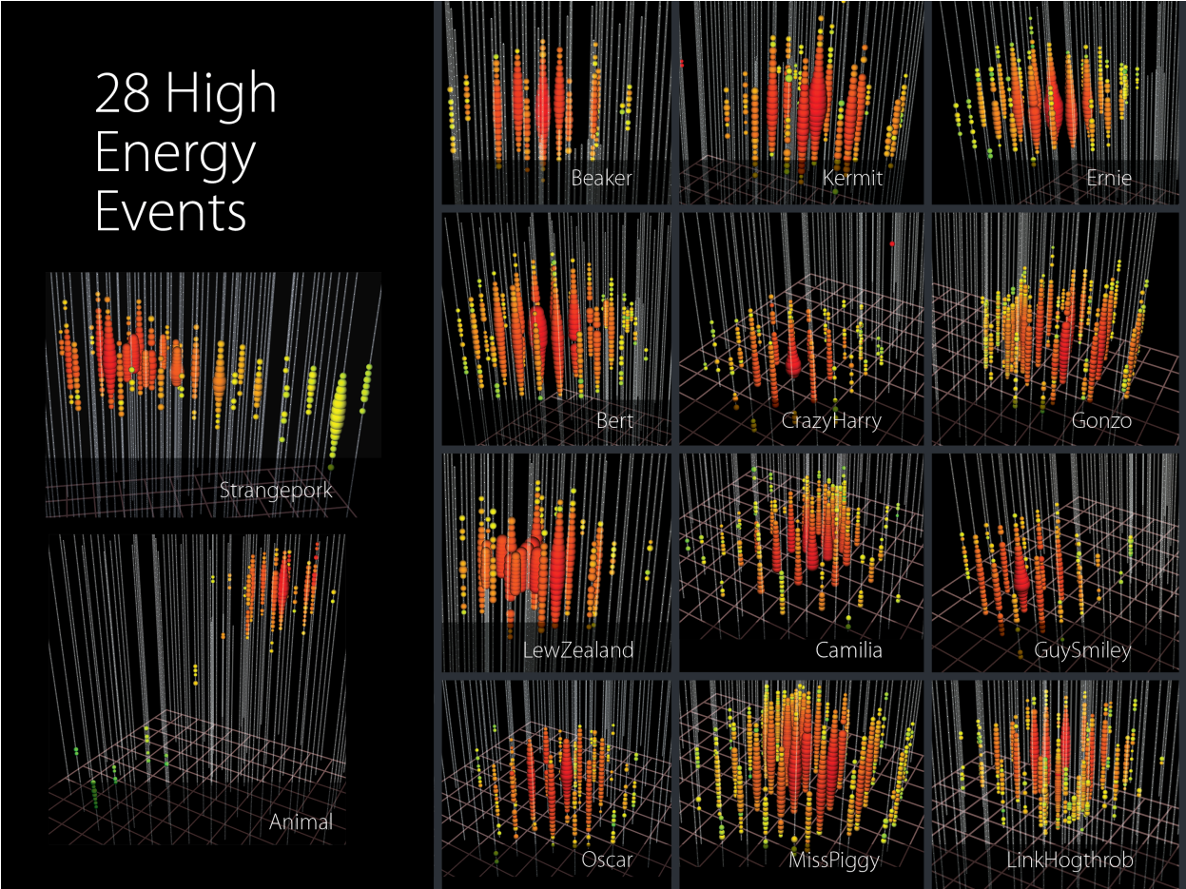
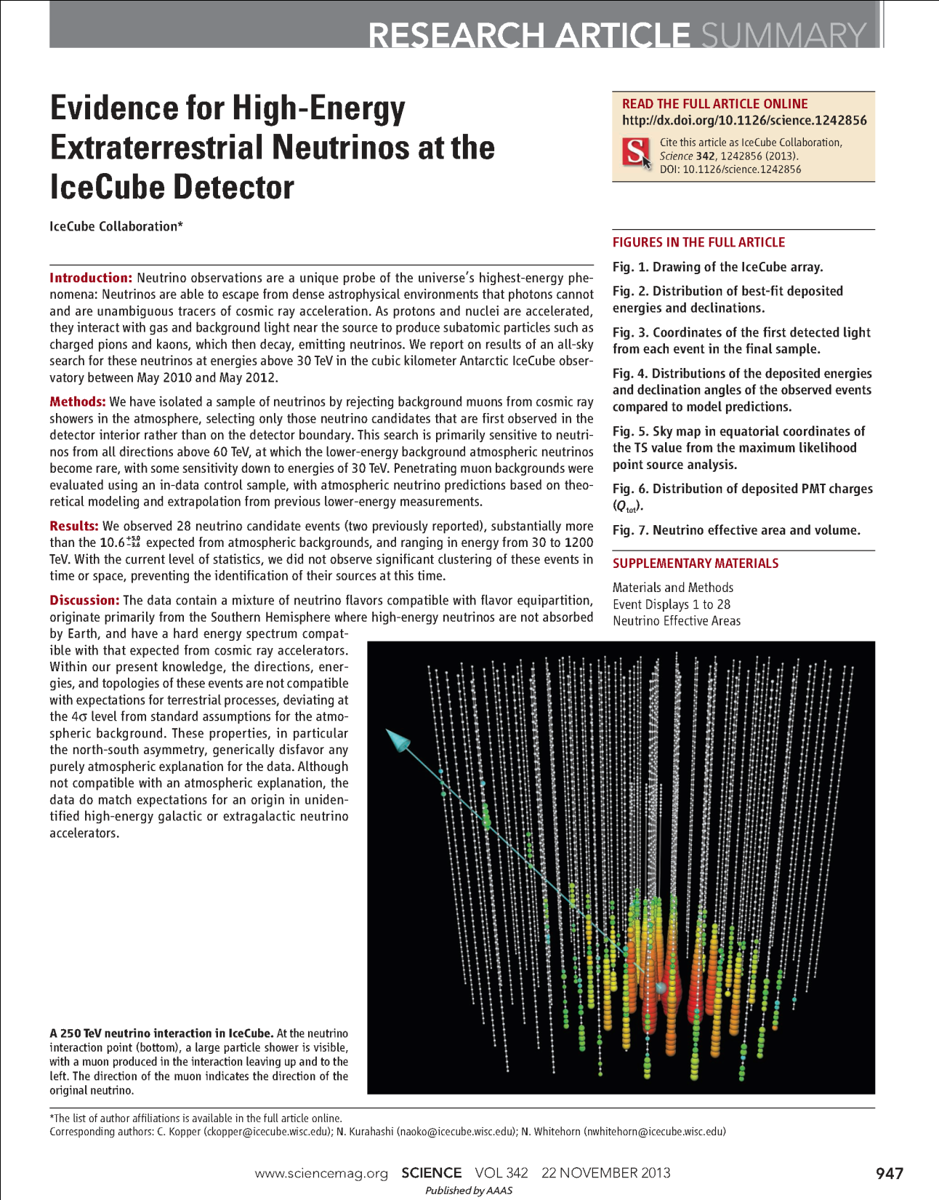
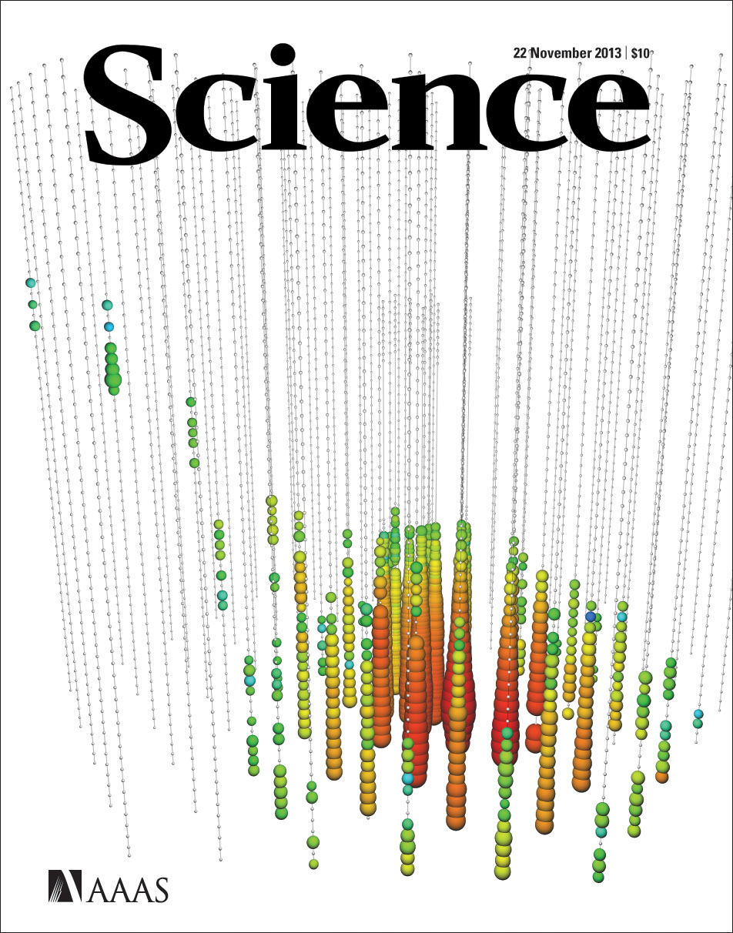
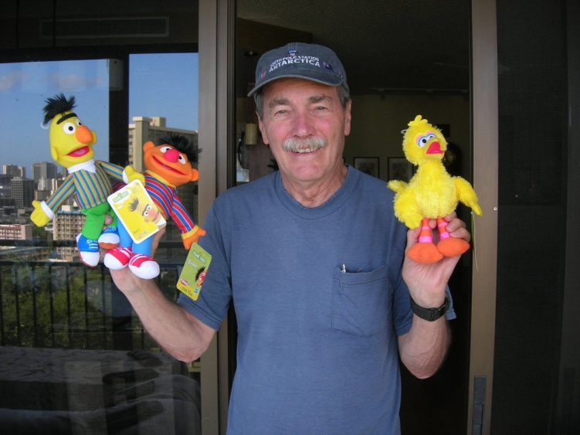
22 November 2013

Slide 5
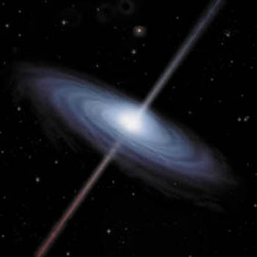
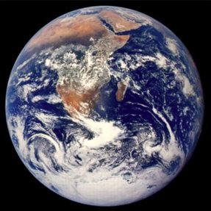
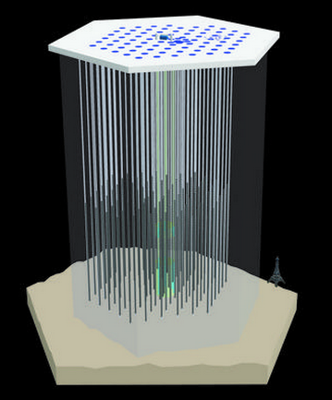
Messenger particles for
high- energy astronomy:
cosmic rays
(charged, absorbed – GZK neutrinos)
gamma- rays
(neutral, absorbed)
neutrinos
(neutral, not absorbed)
astrophysical
neutrino and
gamma-ray
cosmic
ray
downgoing muons
upgoing muons
upgoing neutrinos
through-going
muon tracks
atmospheric
neutrinos
astrophysical
neutrino
cosmic
rays
gamma-ray
absorbed
at source

Slide 6
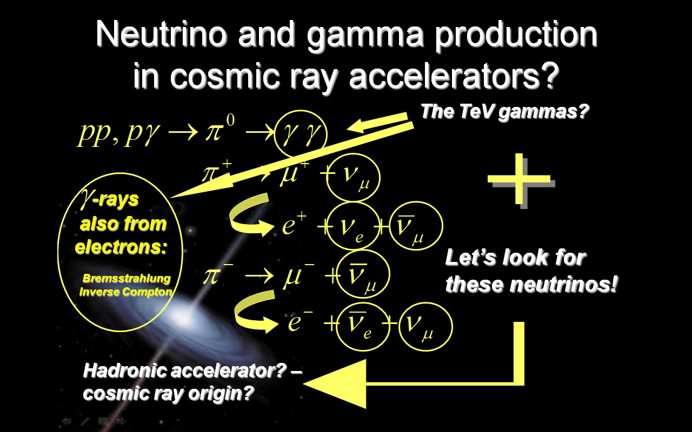

Slide 7
pions,
kaons
Atmospheric
neutrinos at Earth
π⁺
cosmic rays
μ⁺
e⁺
Ф ~ E^{-2.7}
conventional
ν_{e}
ν_{μ}
Ф ~ c.E^{-3.7}
ν_{μ}
D⁺
ν_{μ}
μ⁺
D’s -
charm
prompt
ν_{μ}
e⁺
Kº
Ф ~ p.E^{-2.7}
ν_{e}
Use: Enberg Reno Sarcevic (ERS)
≈15 Km

Slide 8
neutrino oscillations:
~ 1 : 1 : 1
flavour mixture
Astrophysical
neutrinos at Earth
ν_{e}
astrophysical
ν_{μ}
Ф ~ a.E^{-2.0}
many model predictions
key feature is harder
energy spectrum
a.E^{-2.0} vs p.E^{-2.7} + c.E^{-3.7}
ν_{T}
≈15 Km

Slide 9
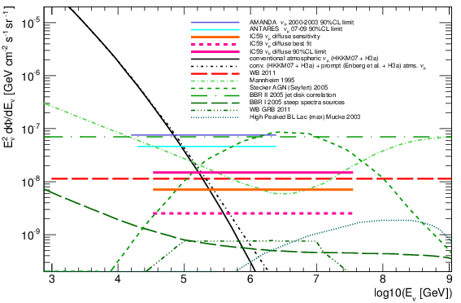
The high-energy neutrino sky, a little history from Frejus to IceCube-59
Frejus
AMA B10
AMA II
IC 59

Slide 10
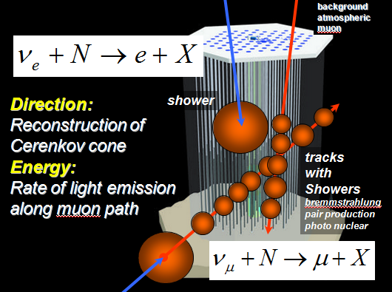
astrophysical
neutrino and
gamma-ray
cosmic
ray
downgoing muons
upgoing muons
upgoing neutrinos
through-going
muon tracks
“Classical” picture of
neutrino astronomy:
Earth filters out CR muons
look for upgoing muons from neutrinos
atmospheric
neutrinos
astrophysical
neutrino
cosmic
rays
gamma-ray
absorbed
at source

Slide 11
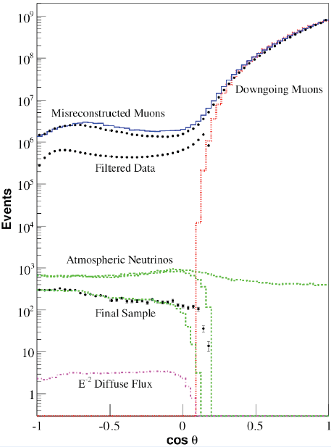
astrophysical
neutrino and
gamma-ray
cosmic
ray
Upgoing muons
Downgoing muons
downgoing muons
upgoing muons
“Classical” picture of
neutrino astronomy:
Earth filters out CR muons
look for upgoing muons from neutrinos
No hope to see downward through going neutrino induced muons!!!!!
upgoing neutrinos
through-going
muon tracks
“Classical” picture of
neutrino astronomy:
Earth filters out CR muons
look for upgoing muons from neutrinos
atmospheric
neutrinos
astrophysical
neutrino
cosmic
rays
gamma-ray
absorbed
at source

Slide 12
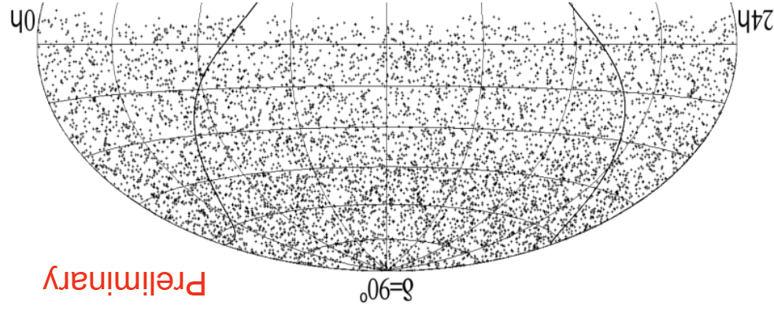
Looking down at the south pole into the northern sky
reject
downgoing
muons
upgoing neutrinos through-going muon tracks
astrophysical neutrino
point source as excess
on background?
atmospheric
neutrinos
cosmic
rays

Slide 13
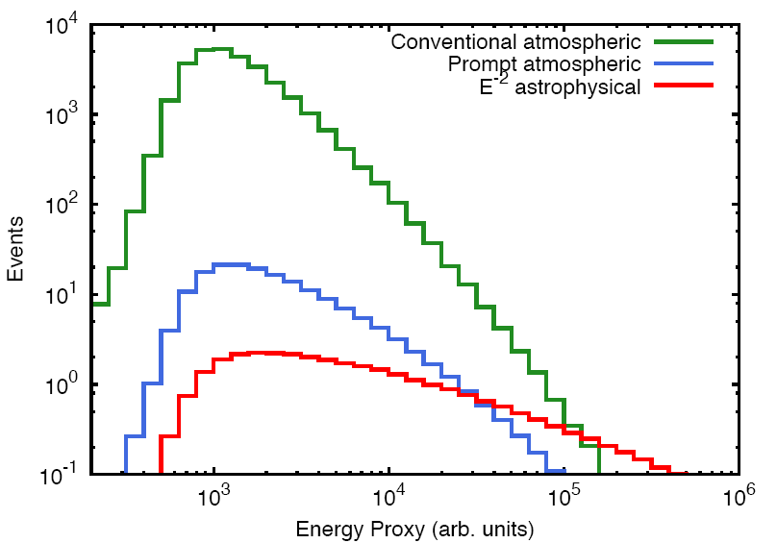
Looking down at the south pole into the northern sky
upgoing neutrinos through-going muon tracks
reject
downgoing
muons
astrophysical neutrino
excess at high energy?
cosmic
rays
muon energy in detector

Slide 14
Atmospheric prompt is an important background
muon energy in detector (arb. units)

Slide 15
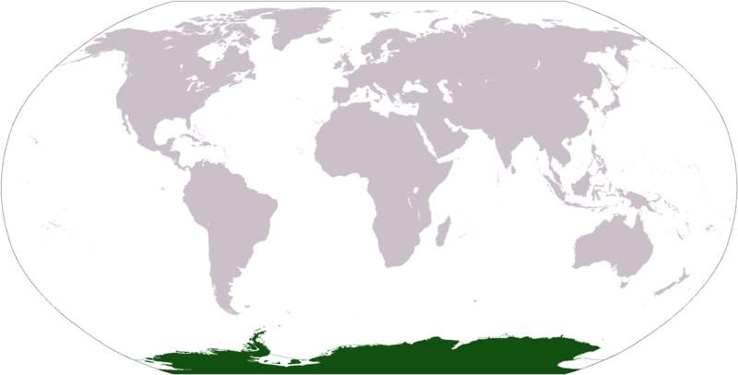
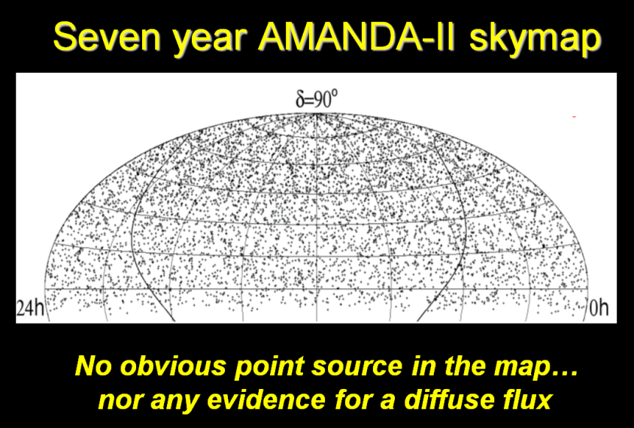
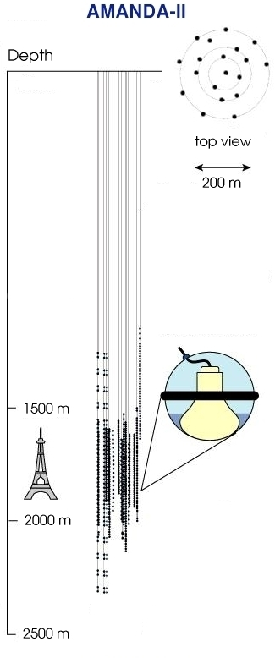
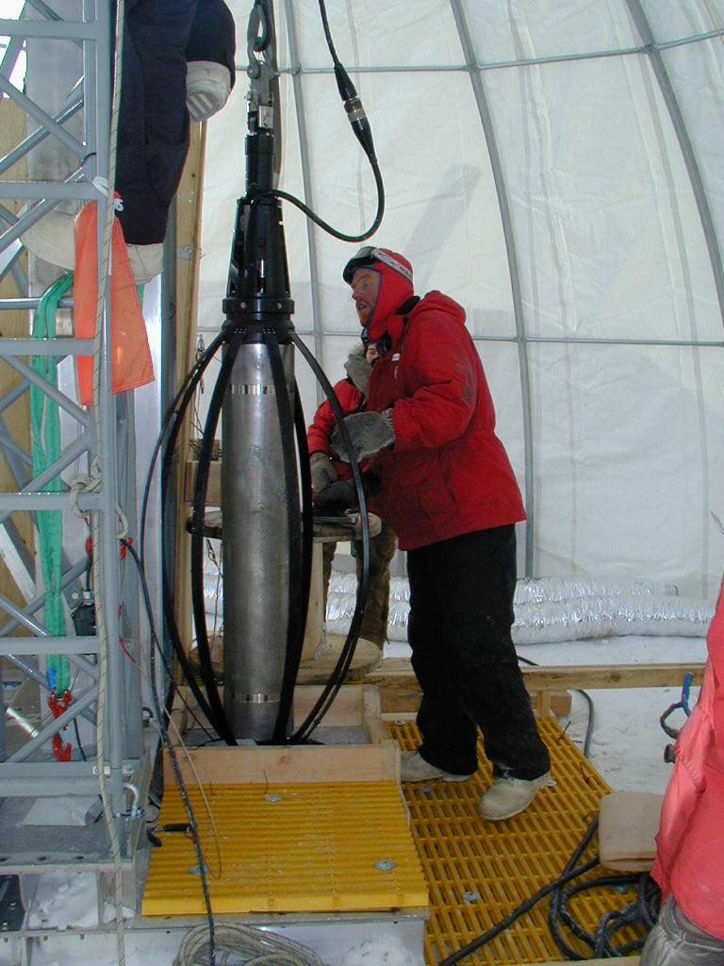
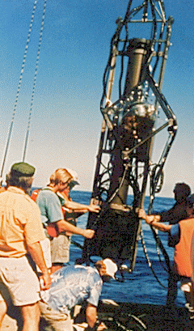
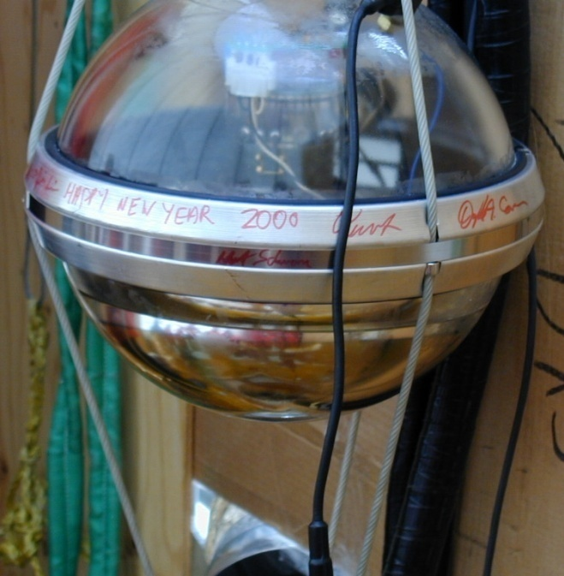
Optical Cherenkov neutrino detectors
Lake Baikal
ANTARES,NEMO
NESTOR, KM3NET
DUMAND
AMANDA, IceCube

Slide 16
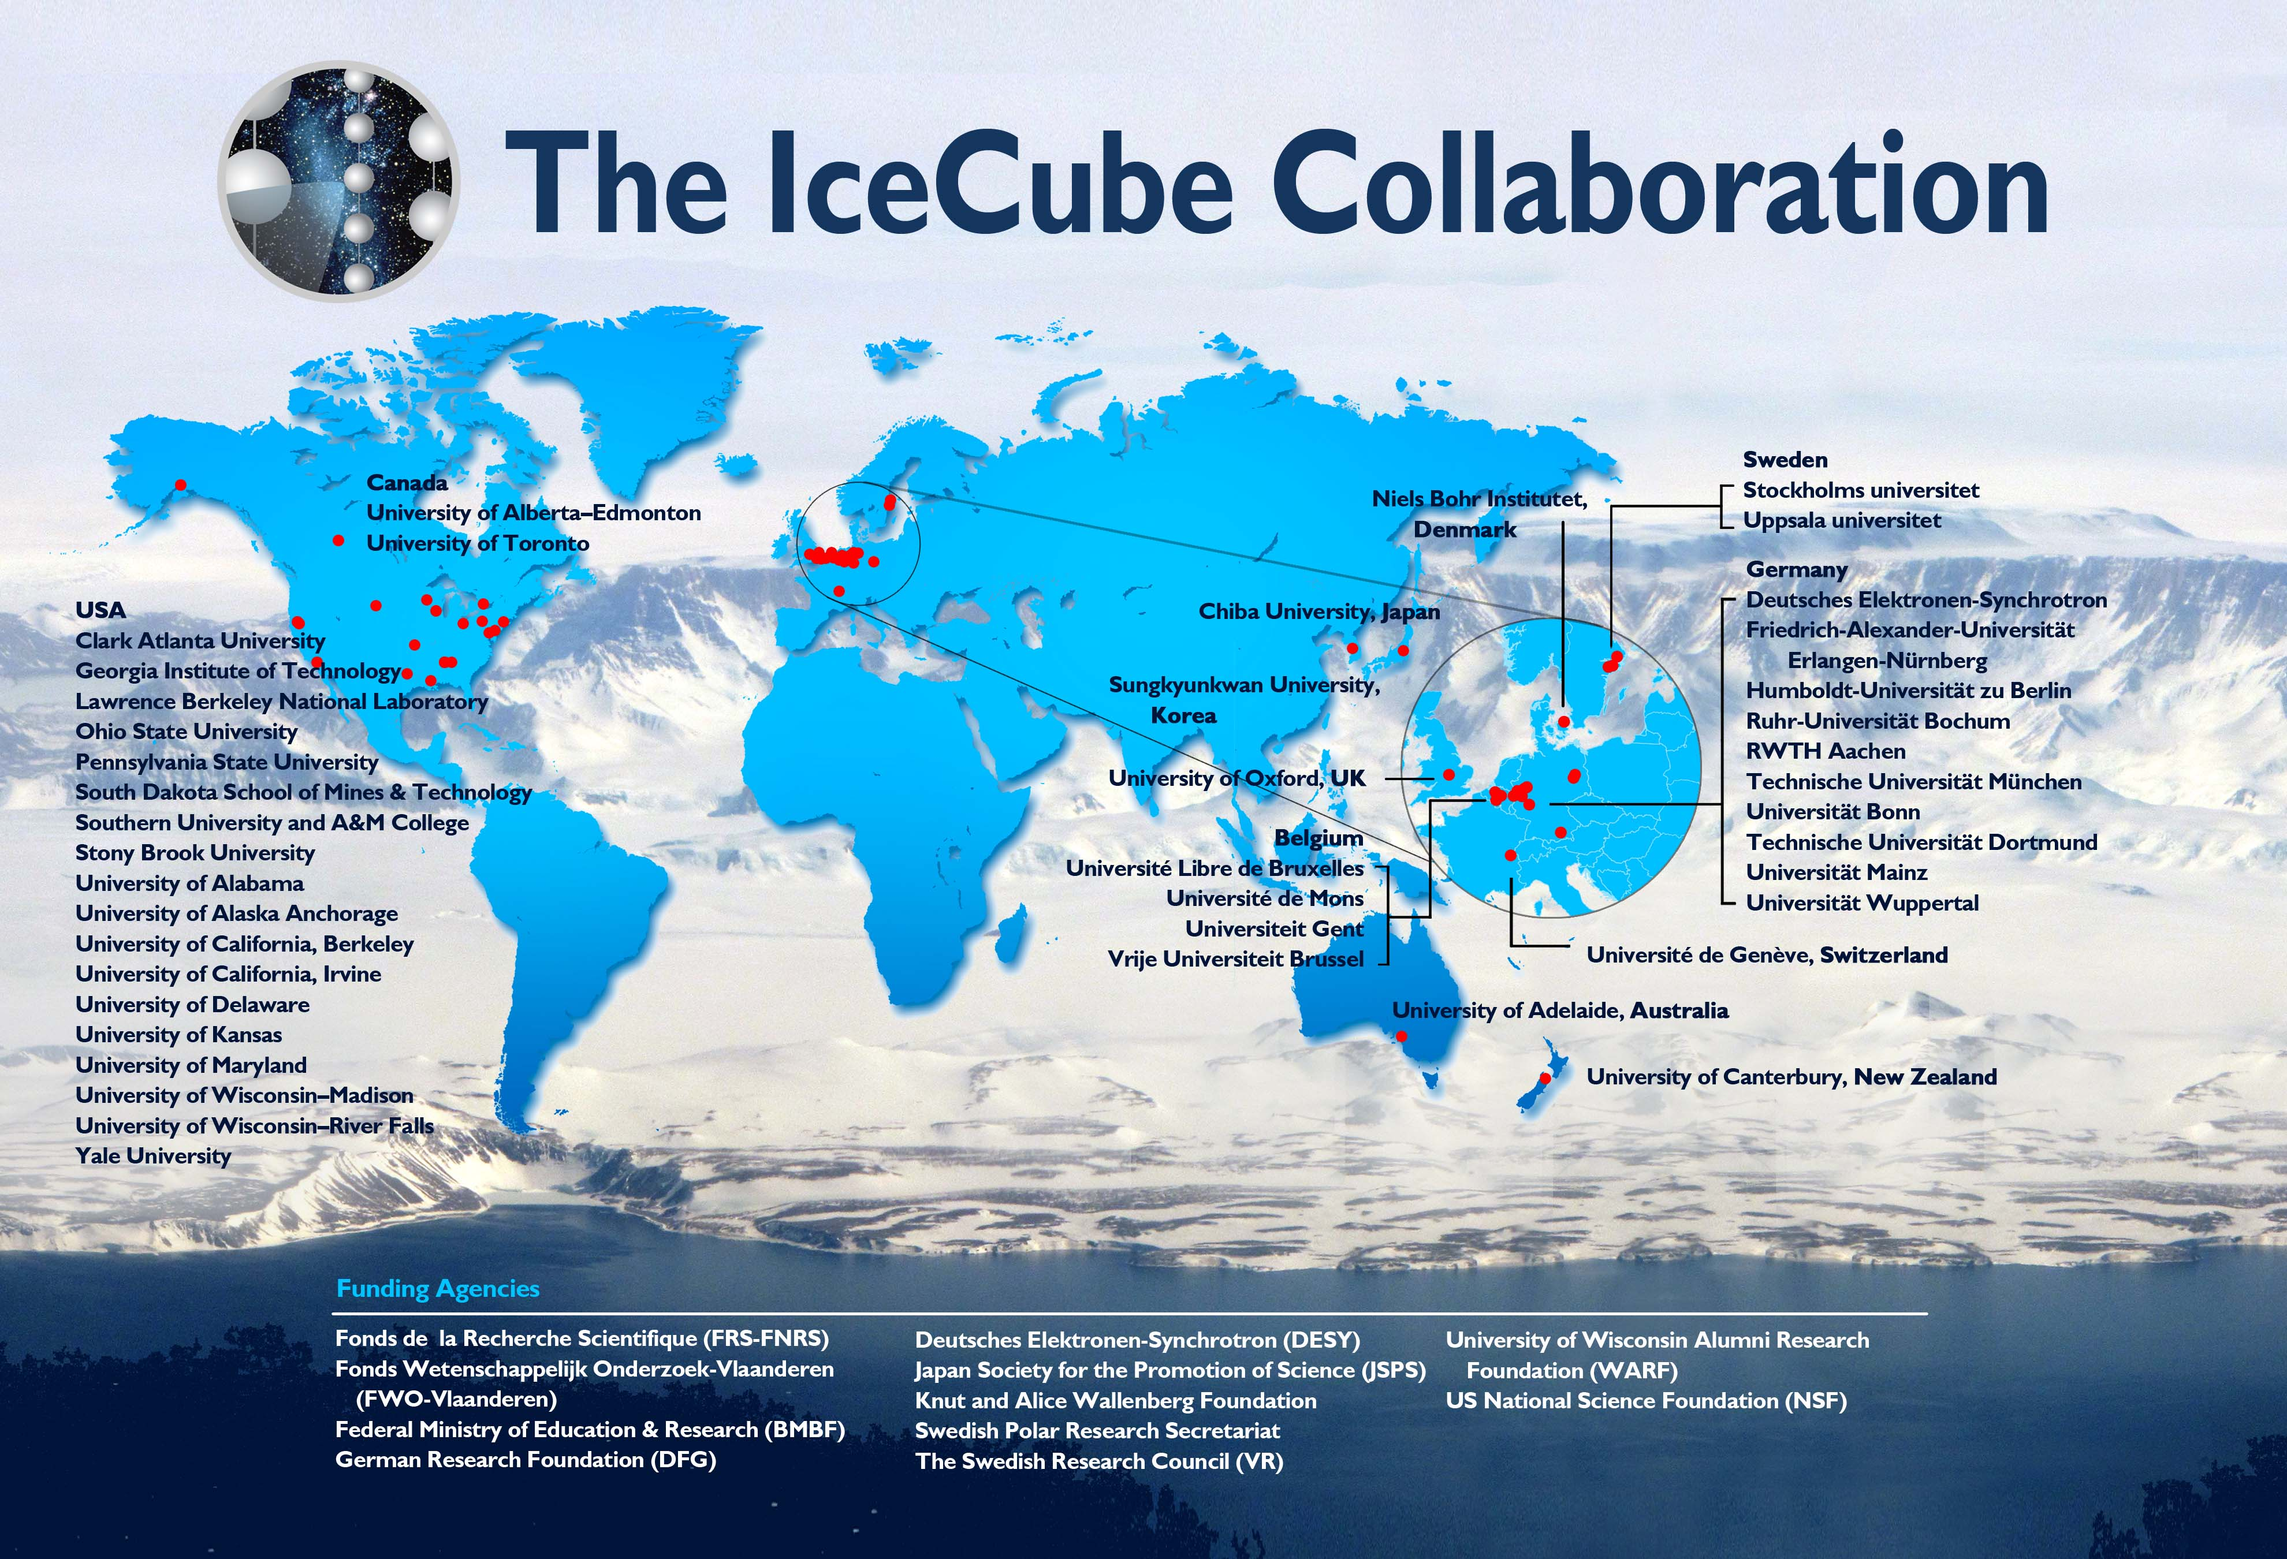

Slide 17
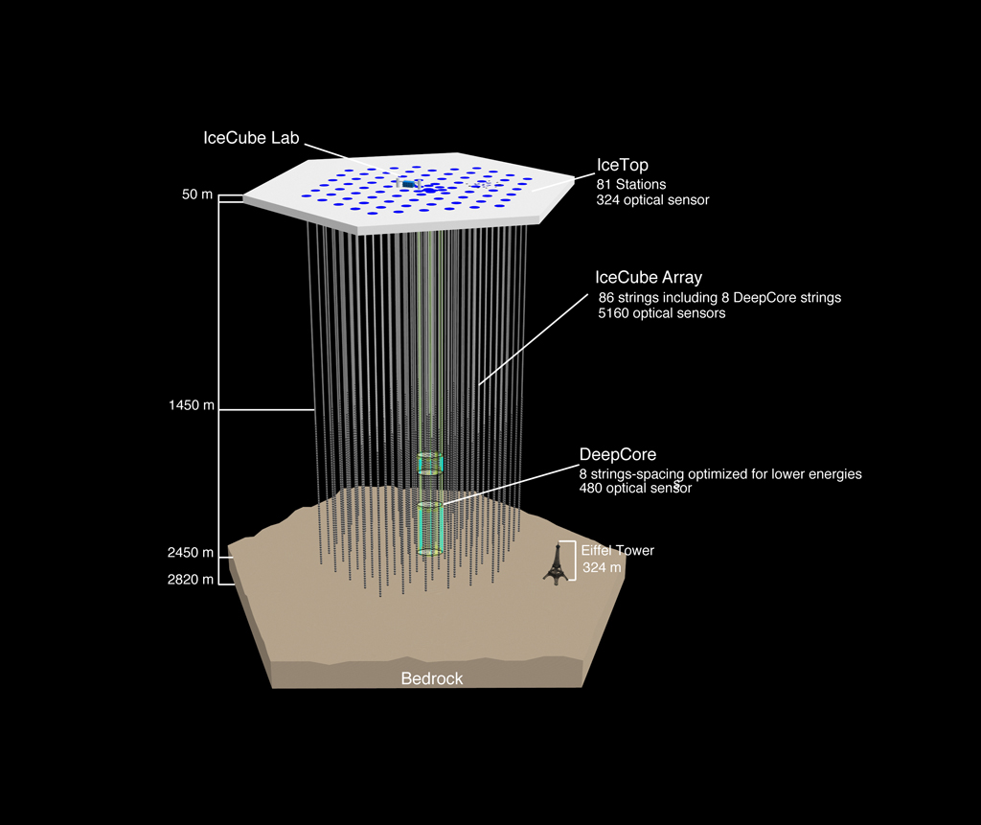
IceCube
IceTop
Construction:
Dec 2004 – Dec 2010
86 strings x 60 DOM
IceTop air shower array
Partial detectors analysed:
IC40, IC59, IC79
Full detector:
IC86, 3 ½ years running to date
HESE: IC79/86-1
HESE-2: IC79/86-1/86-2
IC 86

Slide 18
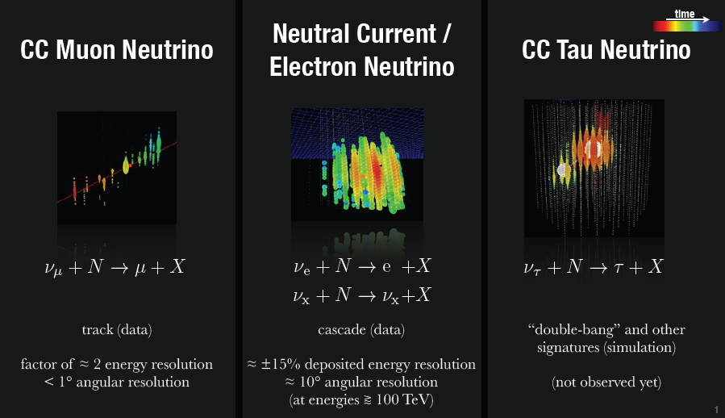
Neutrino event signatures

Slide 19
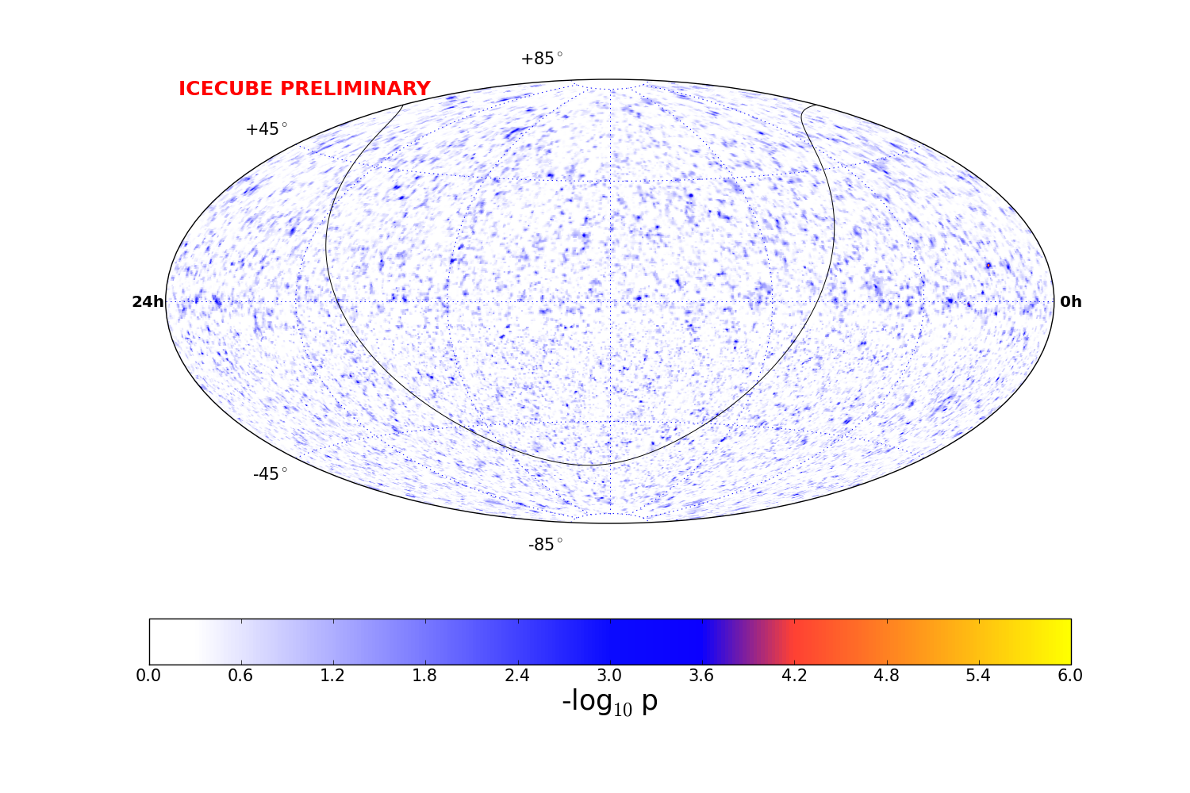
IC40+59+79+86 significance: all-sky through-going muons
Point source
in the sky?

Slide 20
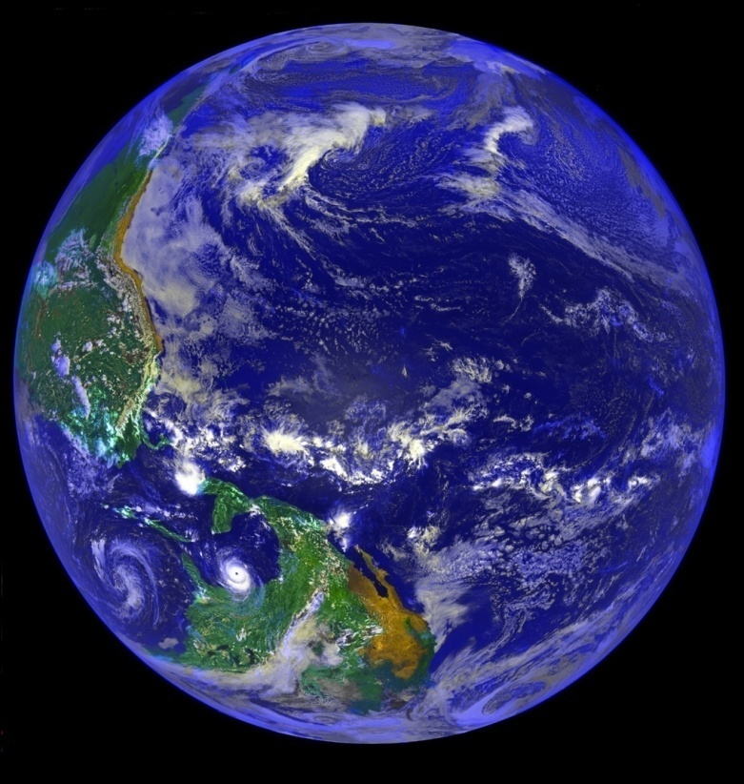
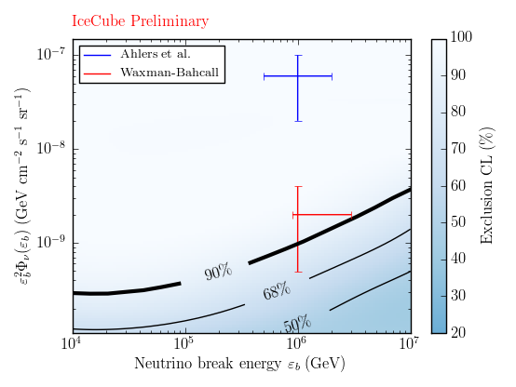
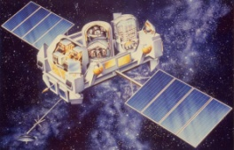
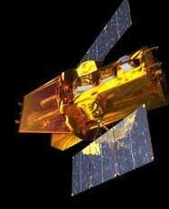
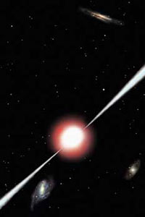
Neutrinos in coincidence with gamma-ray bursts?
Neutrinos in coincidence with
gamma-ray bursts?
IceCube
IC40, IC59,
IC79, IC86-1
506 GRBs
ν
upper
limits
are
below
WB
Gamma-ray
satellites
Where are the neutrinos?
Are GRBs really
cosmic ray sources?
γ, ν
GRB timing/localization information
from correlations among satellites
distant GRB
Direction plus time (10-100s) cuts
– much reduced background

Slide 21
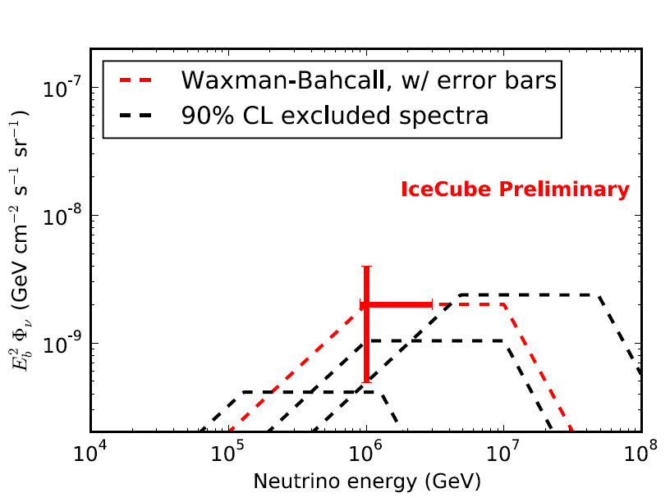
Neutrinos in coincidence with gamma-ray bursts?
Neutrinos in coincidence with
gamma-ray bursts?
IceCube
IC40, IC59,
IC79, IC86-1
506 GRBs
ν
upper
limits
are
below
WB
Gamma-ray
satellites
Where are the neutrinos?
Are GRBs really
cosmic ray sources?
γ, ν
GRB timing/localization information
from correlations among satellites
distant GRB
Direction plus time (10-100s) cuts
– much reduced background

Slide 22
Detection of an extra-terrestrial diffuse flux of high-energy neutrinos!
Clues:
Diffuse muon analysis (IC59)
Diffuse shower analysis (IC40)
EHE GZK search – two 1 PeV cascades
(IC79/86)
Detection analyses: (IC79/86)
High Energy Starting Event (HESE)
Through-going upward muon

Slide 23
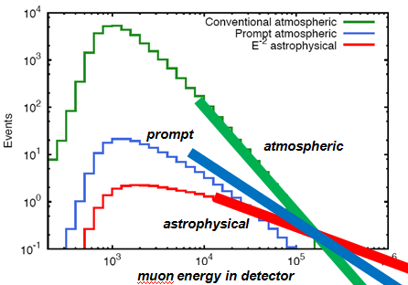
Looking down at the south pole into the northern sky
reject
downgoing
muons
upgoing neutrinos through-going muon tracks
astrophysical neutrino
excess at high energy?
cosmic
rays
muon energy in detector

Slide 24
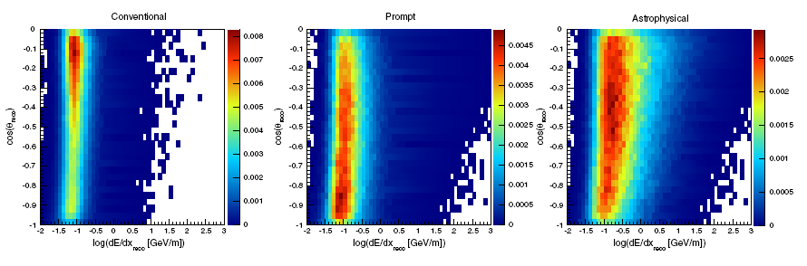
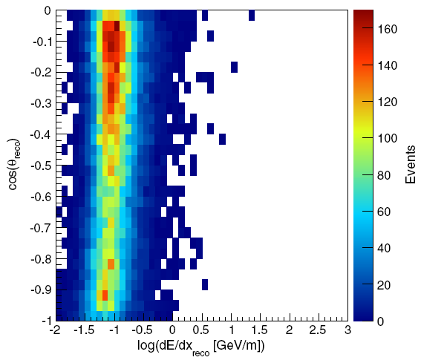
IC59 diffuse analysis forward folding – include angular information
cos θ
cos θ
cos θ
earth
absorption
log E
log E
log E
conventional
prompt
astrophysical
Fit data to mixture of
conventional
prompt
astrophysical
with flux and detector systematics
allowed to vary
horizon
earth
absorption
data
horizontal
upgoing

Slide 25
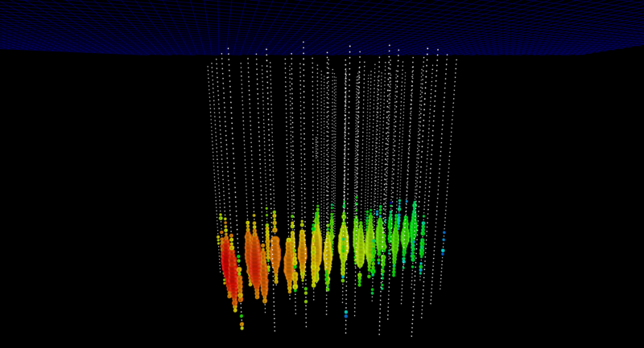
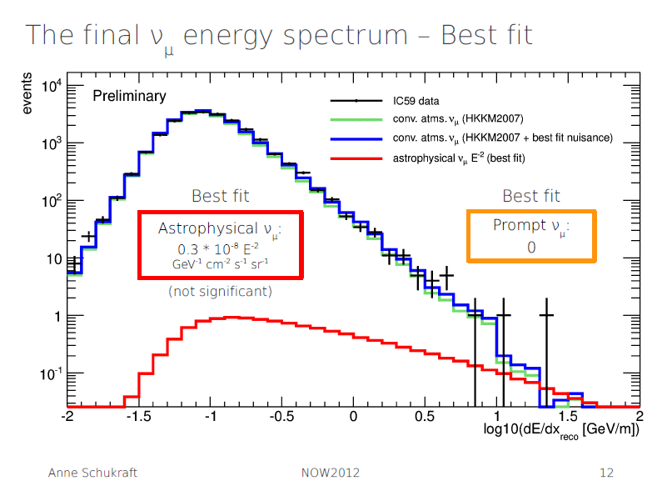
IC59 upgoing muon analysis
three high energy events lead to a
non-zero astrophysical fit 1.8 sigma
+
expected conventional atmospheric
+
zero prompt
=
fit to data
rejects bg-only at 1.8 sigma
~1 PeV neutrino

Slide 26
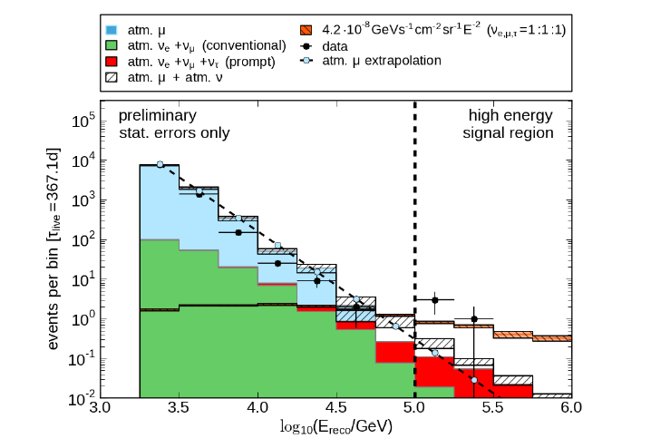
IC59 upgoing muon analysis
1.8 sigma excess
~1 PeV neutrino
IC40 shower analysis
2.4 sigma excess

Slide 27
Flashback: Neutrino 2012, Kyoto
Science 342
22 November 2013
E = 1.1 PeV
θ = 62º
E = 1.0 PeV
θ = 23º
These two 1 PeV showers are downgoing!
How were they found amongst
billions of atmospheric muons?

Slide 28
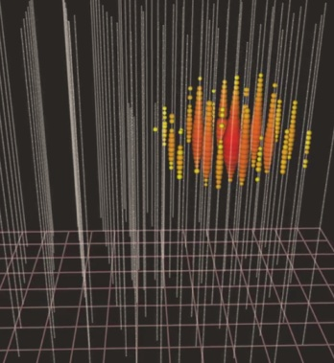
These two 1 PeV cascades are downgoing!
They are “contained”
-starting in the detector.
Atmospheric muons emit light as they enter the detector
-we can veto these!
“atmospheric muon
self veto”

Slide 29
accept events with
no light in veto layer
and high charge in
fiducial volume
reject events with light in
veto layer
atmosphericmuons:
rejected
high energy
neutrinos
accepted
(look for
Npe > 6000)

Slide 30
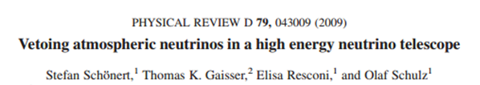
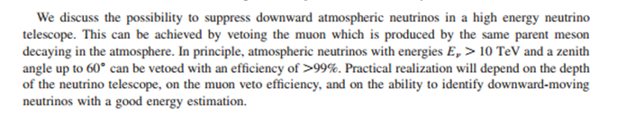
These two 1 PeV cascades are downgoing!
Can they be atmospheric neutrinos?
:
Schonert, Gaisser,
Resconi, Schulz
“atmospheric neutrino
self veto”
True also for electron
and tau neutrinos:
see muons from other decays in the
entire air shower
van Santen, Jero, Gaisser, Karle
for muon-neutrinos:
see muon from same
parent meson decay

Slide 31
cosmic rays make
neutrinos in air showers
and
lots of muons
neutrinos
muons

Slide 32
cosmic rays make
neutrinos in air showers
and
lots of muons
If this neutrino
came from an
airshower,
where is
the muon?

Slide 33
starting contained vertex
events from above most
likely have come from
beyond the atmosphere
best veto for
high energy events
from overhead

Slide 34
Can atmospheric
neutrinos still
leak in?
neutrinos
muons can
range out
leaving a
small rate of
atmospheric
neutrinos
which we need
to simulate

Slide 35
accept events with
no light in veto layer
and high charge in
fiducial volume
reject events with light in
veto layer
atmospheric
neutrinos
accompnied by muons:
rejected
high energy
astrophysical
neutrinos
accepted
(look for
Npe > 6000)

Slide 36
muons
range
out;
or no light in
veto layer
accept events with
no light in veto layer
astrophysical
neutrinos
accepted
atmospheric
neutrino
background
Downgoing starting:
2.6 per 3 years
Upward starting:
4.0 per 3 years

Slide 37
muons range out; no light in
veto layer
accept events with
no light in veto layer
astrophysical
neutrinos
accepted
leak through
muon
background

Slide 38
How often do muons sneak in
through the veto layer?
tag muons
check
with
real
data!
check how often they fail to be seen in veto layer
but meet charge threshold in active
volume
Rate: 8.4 +/- 4.2 for
3 year data set

Slide 39
backgrounds: HESE-2 (IC79 + IC86-1 + IC86-2)
6.6 +5.9 -1.6 atmospheric neutrinos
8.4 +/- 4.2 downgoing muons
-------
15.0 total expected background

Slide 40
backgrounds: HESE-2 (IC79 + IC86-1 + IC86-2)
6.6 +5.9 -1.6 atmospheric neutrinos
8.4 +/- 4.2 downgoing muons
-------
15.0 total expected background
HESE (IC79 + IC86-1) :
26 new events (but no more at 1PeV)
28 events Science paper

Slide 41
backgrounds: HESE-2 (IC79 + IC86-1 + IC86-2)
6.6 +5.9 -1.6 atmospheric neutrinos
8.4 +/- 4.2 downgoing muons
-------
15.0 total expected background
HESE (IC79 + IC86-1) :
26 new events (but no more at 1PeV)
28 events Science paper
HESE-2 (IC79 + IC86-1 + IC86-2):
28+9 = 37 events total PRL submitted

Slide 42
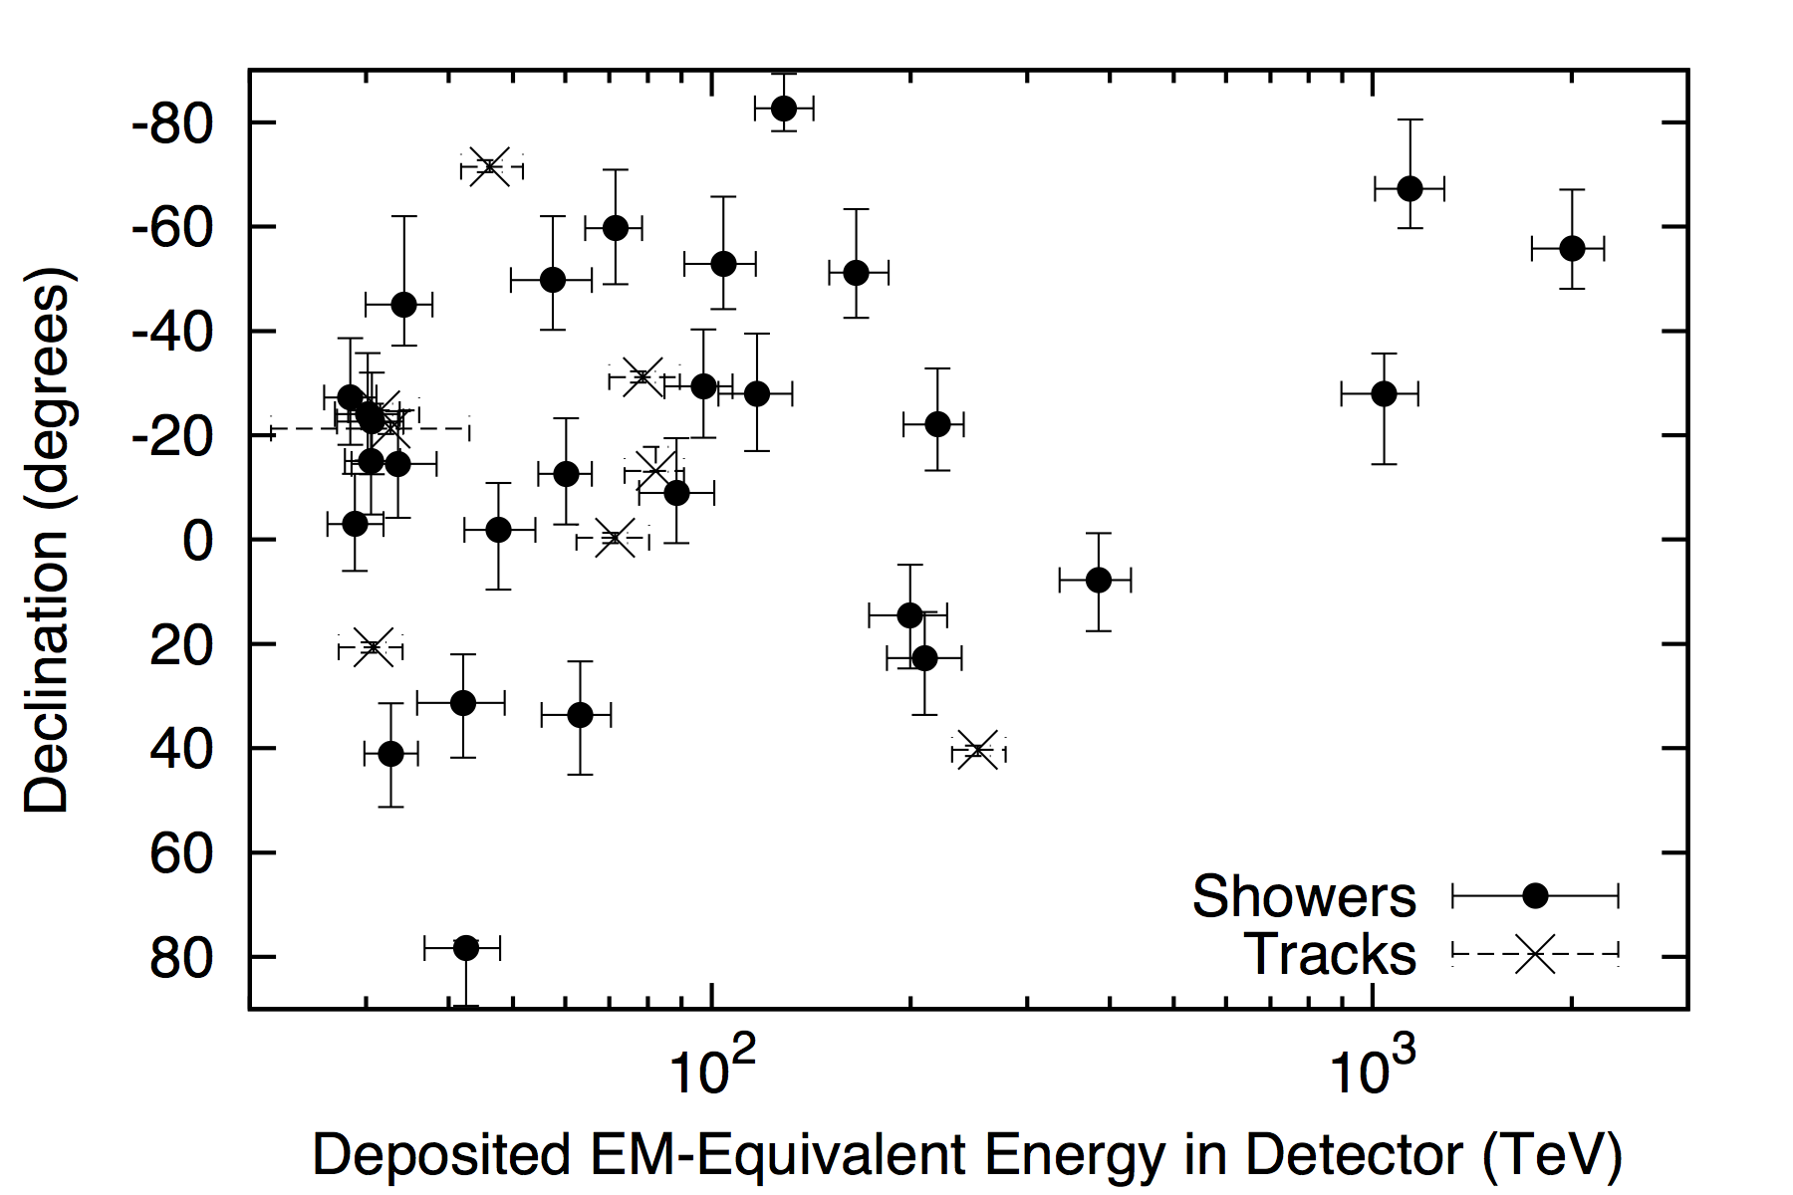


E = 1.1 PeV
θ = 23º
E = 1.0 PeV
θ = 62º
E = 2.0 PeV
θ = 34º

Slide 43
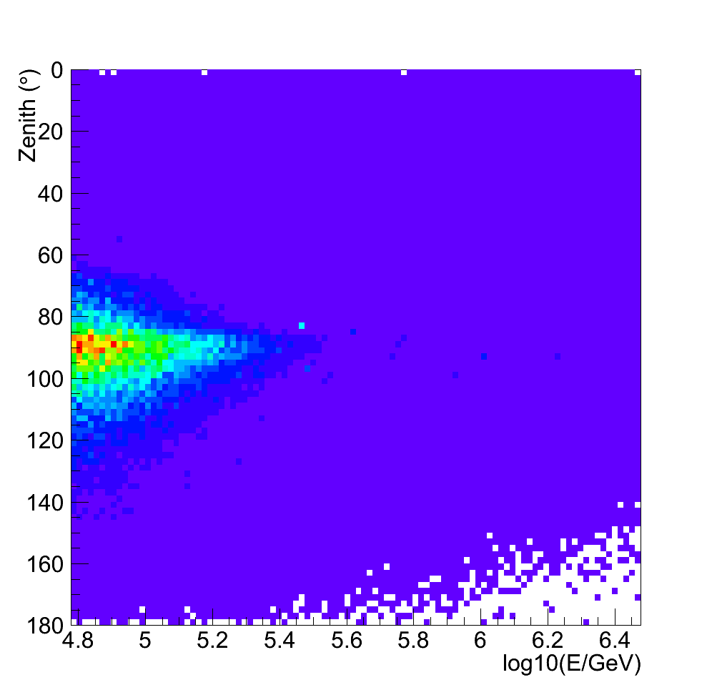
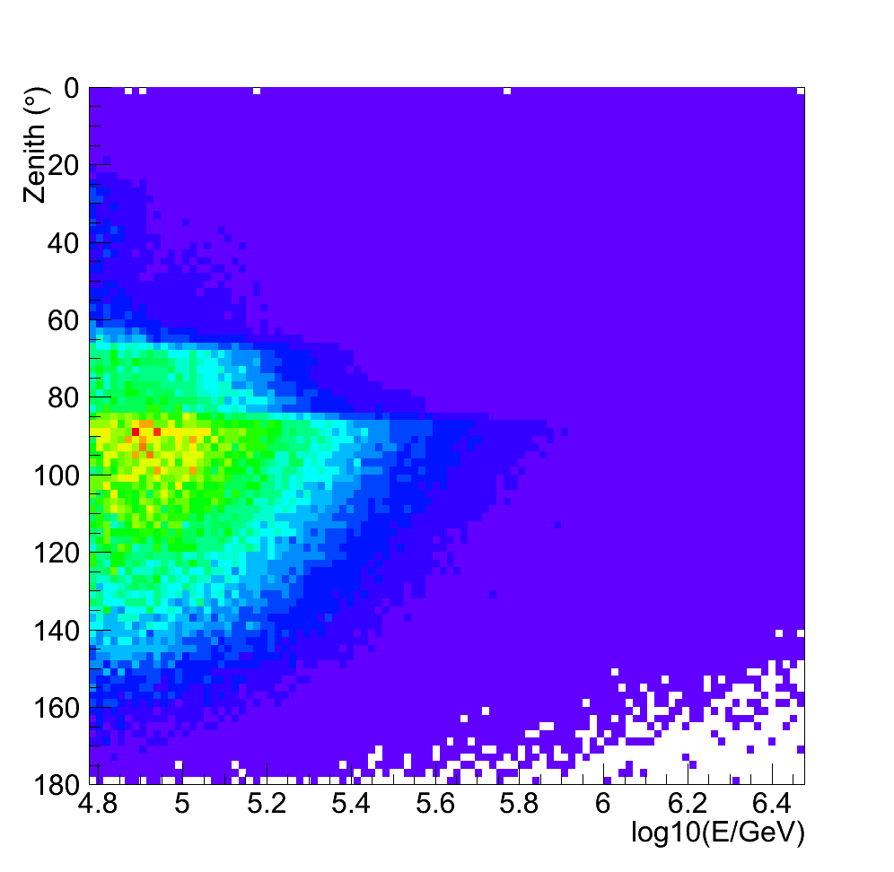
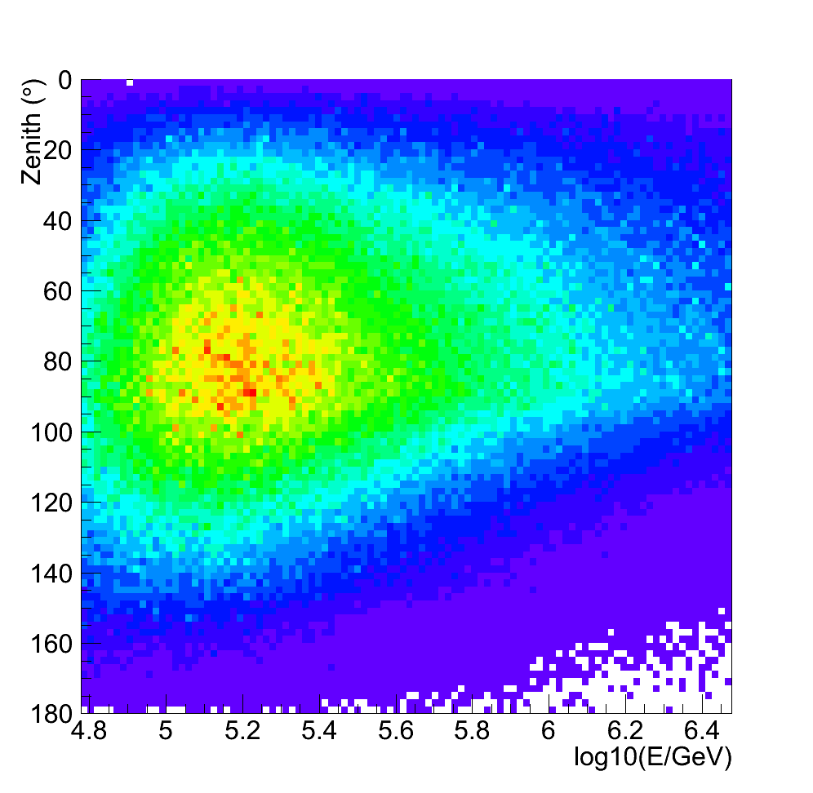
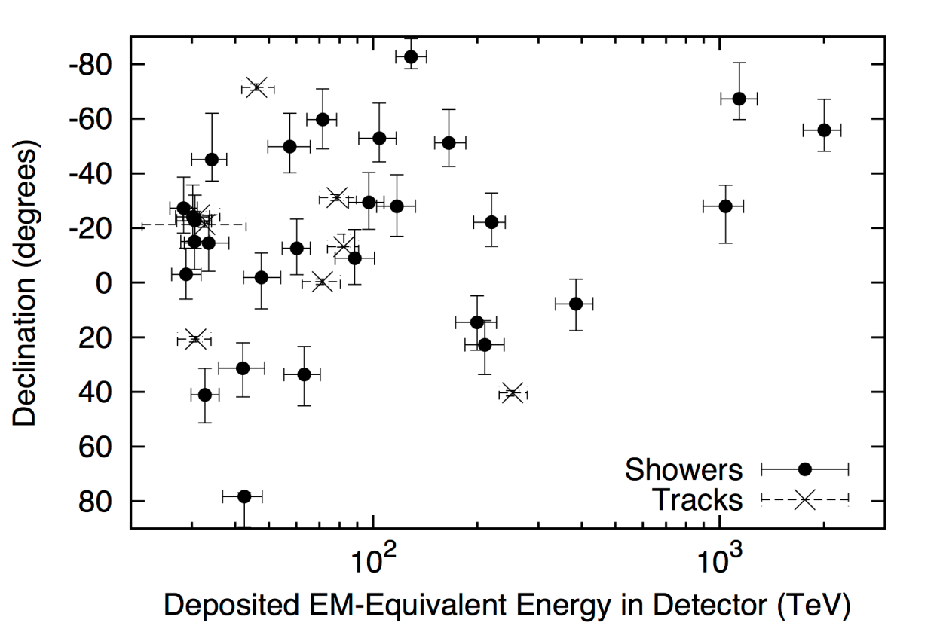
downgoing
self-veto
self-veto
θ
θ
θ
earth
absorption
upgoing
log E
log E
log E
conventional
prompt
astrophysical
IC79/86-1/86-2
diffuse analysis
forward folding
downgoing
self-veto
Fit (track/shower) data to mixture of
conventional
prompt
astrophysical
horizontal
data
earth
absorption
upgoing
60 TeV
3 PeV

Slide 44
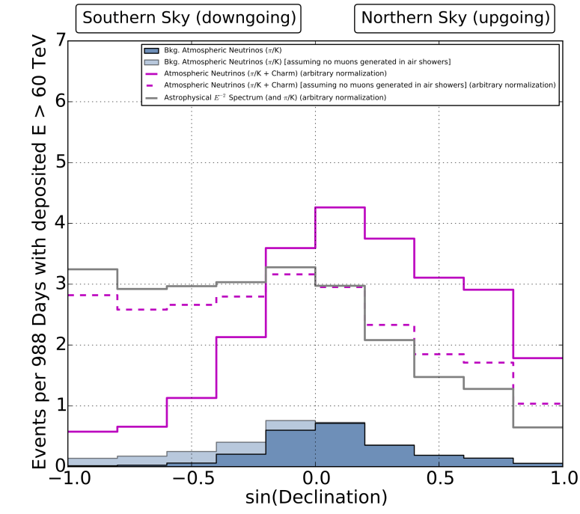
The power of the self-veto
Without self-veto
astro (grey) and
prompt (dash-purple)
have same zenith
shape
With self-veto
prompt (solid-purple)
is highly suppressed
from above

Slide 45


Global fit of energy vs angle to a mixture of atmospheric and astrophysical E⁻² neutrinos
best fit flux: E²Ф = 10⁻⁸ GeV cm⁻² s⁻¹ sr ⁻¹
5.7 sigma rejection of atmospheric-only hypothesis

Slide 46


Results of the best fit angular distribution
for increasing
energy cut… log

Slide 47

Results of the best fit angular distribution
for increasing
energy cut… linear

Slide 48

Global fit, energy (60 TeV – 3 PeV) vs angle,
best fit flux: E²Ф = 10⁻⁸ GeV cm⁻² s⁻¹ sr ⁻¹ (per flavour)
5.7 sigma rejection of atmospheric-only hypothesis
best fit flux:
right at level of Waxman-Bahcall bound

Slide 49

global fit, energy (60 TeV – 3 PeV) vs angle,
float astrophysical spectral index:
best fit spectral index = -2.3 +/- 0.3

Slide 50

global fit, energy vs angle,
float each energy bin of astrophysical flux:
consistent with E⁻²
best fit flux:
right at Waxman-Bahcall bound

Slide 51

global fit, energy vs angle,
float each energy bin of astrophysical flux:

Slide 52


Hint from IC59 (1.8 sigma); now IC79/86-1 upgoing muon neutrinos give 3.9 sigma
astrophysical neutrinos
atmospheric
neutrinos
as expected
E²Ф = 10⁻⁸ GeV cm⁻² s⁻¹ sr ⁻¹
3.9
sigma
Prompt neutrinos
0.45 x ERS

Slide 53




Also found in HESE
Highest energy event
0.5 PeV
muon
~1 PeV
neutrino
Examples of muons found in IC79/86 upgoing diffuse analysis

Slide 54



Through going muons
Contained vertex events
~1 PeV muon neutrino
2 PeV electron neutrino
2 P
electron neutrino
northern hemisphere
neutrino events (best fit) above 100 TeV muon energy:
  astrophysical: 7 events/yr
  atmospheric: 3 events/yr
significance in first 2 years of data: 3.9 sigma (prel.)
mostly southern hemisphere
neutrino events above 60 TeV:
  astrophysical: 6 /yr
  atmospheric: 1/yr
significance in first 3 years of data: 5.7 sigma

Slide 55

Diffuse flux summary
Frejus
AMA B10
AMA II
Upgoing IC79/86-1
HESE-2 IC79/86-1/86-2
IC 59
( 1.01 +/- 0.35 ) x 10⁻⁸
( 0.95 +/- 0.3 ) x 10⁻⁸

Slide 56

Do the HESE events cluster -
is there a brighter than average source?
cascades
p-value = 7%

Slide 57

Do the events correlate
with potential sources?
northern
source list
p-value = 28%
southern
source list
p-value = 8%
cascades
p-value = 7%
northern
source list
p-value = 28%
southern
source list
p-value = 8%

Slide 58

Do the events correlate
with the galactic plane?
best fit width +/-7.5 degrees, p-value = 2.8%
fixed width +/-2.5 degrees, p-value = 24%

Slide 59
IceCube has taken the first steps towards high-energy neutrino astronomy:
Where and how are these neutrinos produced?
High energy extensions – increase volume
for muons and cascades
Surface vetoes – improve ability to see
downward (esp. throughgoing) astrophysical neutrinos
PINGU – oscillations and mass hierarchy
(Darren Grant’s talk – June 3)
Photograph: Forest Banks

Slide 60

High energy extensions – increase volume for muons and cascades with more strings
100 new strings
240 m spacing
IC86
PINGU: extra strings
inside original IC:
oscillations and
mass hierarchy
- Darren Grant

Slide 61



Initial simulation studies of geometries
IceCube
Sunflower 96
Supercluster
strings: IC86
string spacing: ~125m
strings: IC86+96
string spacing: ~240m
strings: IC86+2x60
string spacing: ~240m
Angular resolution:
0.5°
0.4°
0.4°
Effective area:
1.6 km²
5.0 km²
6.5 km²

Slide 62


1 PeV (cosmic primary) veto: reject most atmospheric muon AND neutrino background above 100 TeV.
An efficient surface veto, 100 km², for 3–5 sr background free cosmic muon neutrino and some shower detection
Surface veto arrays:
- particle detectors
- Cherenkov detectors

Slide 63

An extended surface array would increase the angular veto coverage
For HESE-3 flux
giving more sensitivity to
through going neutrino
induced muons
~75% increase in rate >100TeV
Surface veto arrays:
- particle detectors
- Cherenkov detectors
Surface array to 5 km

Slide 64
IceCube has taken the first steps towards high-energy neutrino astronomy:
- diffuse flux: Ф = 10⁻⁸ E⁻² GeV⁻¹ cm⁻² s⁻¹ sr ⁻¹ (1:1:1 flavour)
- contained vertex (5.7σ), upgoing muons (3.9σ)
- atmospheric prompt origin strongly rejected
- lack of correlation with galactic plane, and events at high galactic latitudes may suggest extra-galactic origin
- many theoretical speculations and attempts to correlate with sources have been proposed proposal for a next generation detector
- increased in-ice volume
- enhanced surface veto
- PINGU

Slide 65
* Future Atmospheric Measurements with PINGU
Darren Grant
* Results from atmospheric neutrino oscillations with IceCube/DeepCore
Measurement of ν_{μ} disappearance
Juan Pablo Yáñez
* Search for Exotic Double Track Signatures in IceCube – an Overview on Simulation and Reconstruction
Sandro Kopper
* New calibrations methods for IceCube, DeepCore and PINGU Martin Jurkovič
* Event Reconstruction and Particle Identiﬁcation for Low Energy Events in DeepCore and PINGU
Timothy C. Arlen, J.P.A.M. de André
* Sensitivity to ντ appearance with DeepCore and PINGU
Joao Pedro Athayde Marcondes de Andre
* Search for Neutrinos from GRBs with IceCube Robert Hellauer
* An improved data acquisition system for Detection and search of Supernova Neutrinos in IceCube
David Heereman
* Astrophysical Tau Neutrino Search with the IceCube Neutrino Observatory Matthias Vraeghe
* Calculating PINGU's Sensitivity to the Neutrino Mass Hierarchy
Lukas Schulte, Timothy C. Arlen, Sebastian Böser
* Unfolding of the Muon Neutrino Energy Spectrum with IceCube Martin Schmitz
Talks -Tuesday
Posters
More
IceCube
Photograph: Forest Banks

