Slide 1
Horn Optimization Updates nuSTORM weekly meeting 02/07/14
Ao Liu*
Fermilab, Indiana University

Slide 2
Goals
Reminder from last time

Slide 3
Optimizing the pion beamline (summary)
We can optimize the horn to increase the number below:
N_{tot} is the number of pions in [(1-0.2)*5, (1+0.2)*5] GeV/c at the downstream end of the horn. m is an arbitrary number which is larger than 0.18, we use m=0.2 in our study.
a and b are the linear coefficients of the momentum distribution density function of the pions, at the same location.
We take the pions from the target,transport them through different horns,and record the beam at the downstream end.
“Different horns” are different in horn inner conductor shape, outer conductor radius, the horn length,horn current and target position in the horn.

Slide 4
Optimize the horn
Genetic algorithm
Suitable for this problem since it is
Nonlinear and non-analytic;
Multi-objective;
Use GA to:
Minimize the distance of fitted TWISS parameters at the downstream end of the horn to the feasible TWISS range. (This number is non-negative. If within the feasible range, it’s 0, see the figure next)
Maximize the value from the previous equation and the number of pions in the phase space acceptance (2 mm)

Slide 5
Some tiny changes

Slide 6
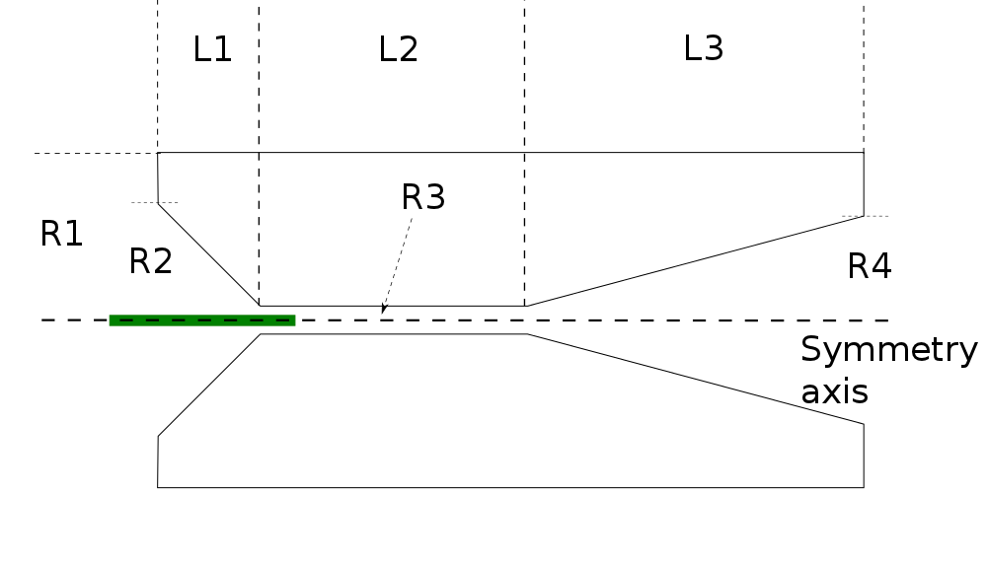
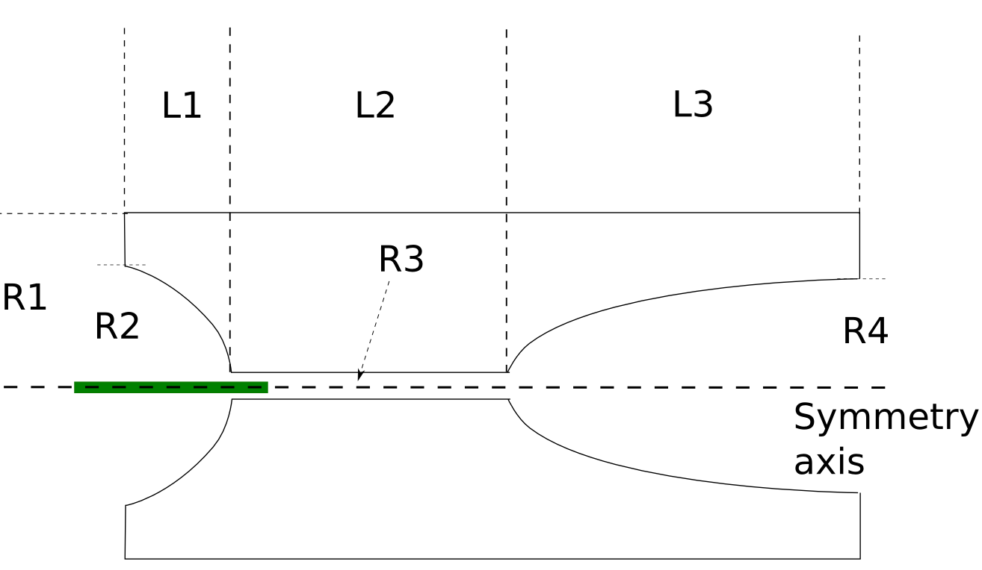
Horn inner conductor shape
The parabolic shape provides
focusing proportional to r, which
is proved to work much better
than linear shape.

Slide 7
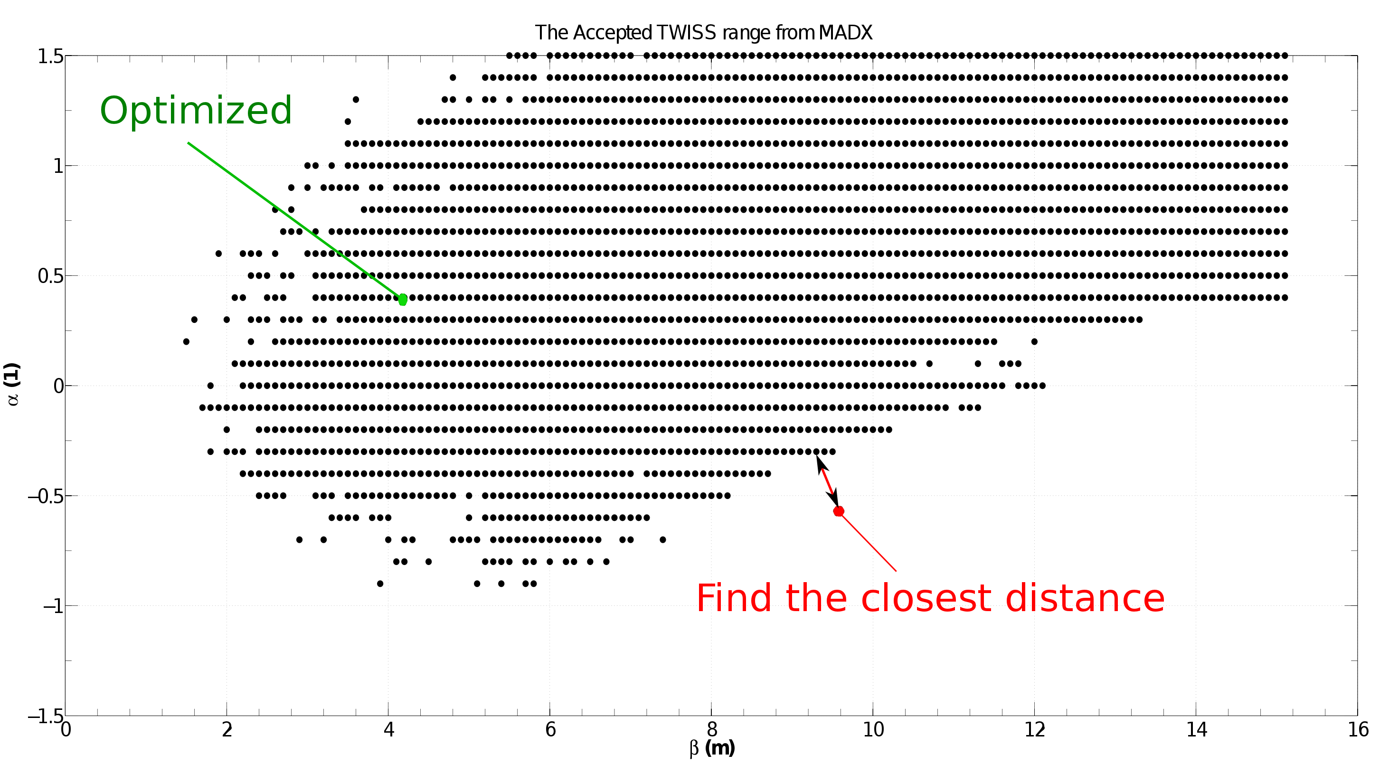
Feasible TWISS range
checked a wider range to accept more
possible horn shapes

Slide 8
Preliminary Result

Slide 9
GA code development
The previous horn was put into the population as a seed.
The algorithm is under development, since
The convergence is not guaranteed yet.For 5 searches, which took about 4 days in total and ran 12,000 horns, only one better horn was obtained. This means the algorithm could be modified to fit our problem better.
It consumes a lot of computing time. For example, 4 days = 138,240 core hrs on NERSC. The time allocated for MAP is only 6M hrs (I’ve used 700,000 hrs, 12% of the total).
However it’s still more efficient than scanning the parameters. If we have 8 variables to twiddle and each variable is allowed to have only 4 different values, that gives 4**8~=65,000 different horns.
In conclusion, more work needed on the GA code. Some more computing resources are needed.

Slide 10
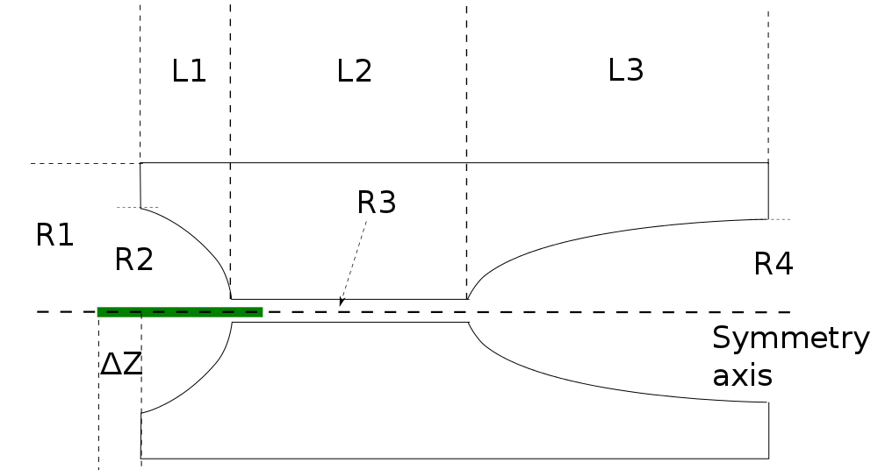
A better horn configuration
800 to 720
39.8 to 35.8
2160.2 to 1944
13.5 to 12.15
100.3
to
90.3
149.2 to
198
no change
220 to 134.28

Slide 11
Performance Improvement
Number of pions in 2 mm rad:
650774 to 658887 (1.2% increase)
536123 to 563217 (5% increase)
Tracking result (Only quads and drift spaces before the 1st dipole were changed):
0.012 muons within 3.8±0.38 GeV/c to
0.015 (An amazing 25% increase)

