Slide 1
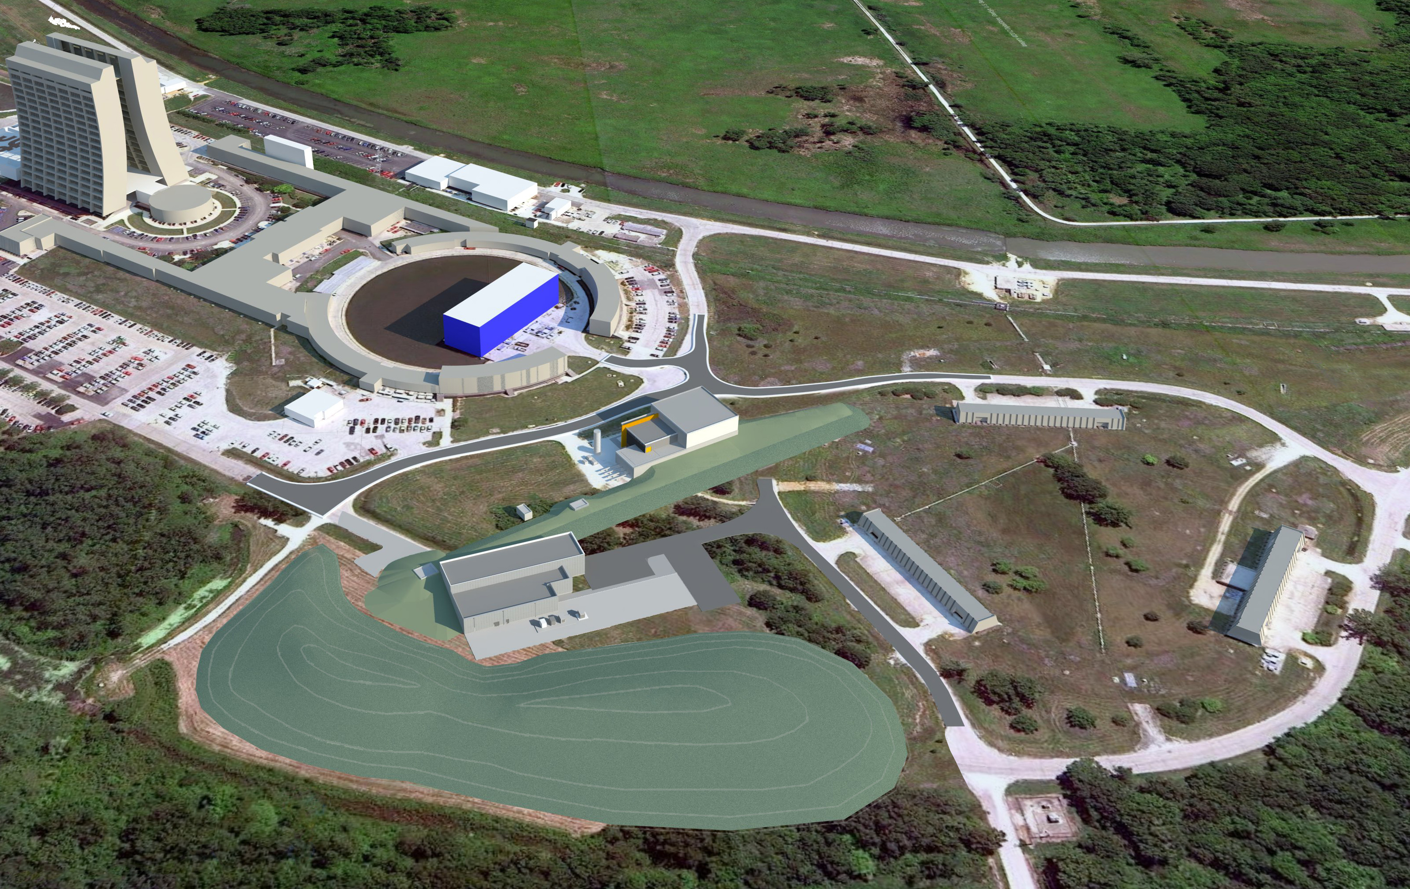
Muon Campus Adventure Cons Gattuso 2/05/14

Slide 2
Tunnel work status
Alignment work
Network
Referencing
Other issues
Work area prep
General tunnel cleaning
storage area setup
Component tagging
Start the program next week
Need clear direction as to the final destinace of some components

Slide 3
Alignment work
Network monuments are all in…
Rings
Transport to the Gates
Label control and painting done
Vertical network
Elevation runs started
tie in the tie rods to the floor control points
Horizontal Network will follow
~2-3 days of work prior to the start of referencing…..
Start Refereeing and as founding ( ~1 hour per magnet)
Glue on monuments
Building models of our tunnel magnets
Supplied them with out CAD modeling to speed up the reference process
Start the process
D/A line
The 30 straight section Delivery ring and Accumulator

Slide 5
Work area prep
Images can be found at Muondept.bd\\Projects\Off Project Jobs\Tunnel Prep for Shutdown Work\Muon Campus tunnel tour pictures
E760 pit area
Cabling
Cryo Dewar
Misc pipe
Support Department messes
Carts
Hoses
Ext
Muon Department Inherited messes
Magnets
Every thing else

Slide 6
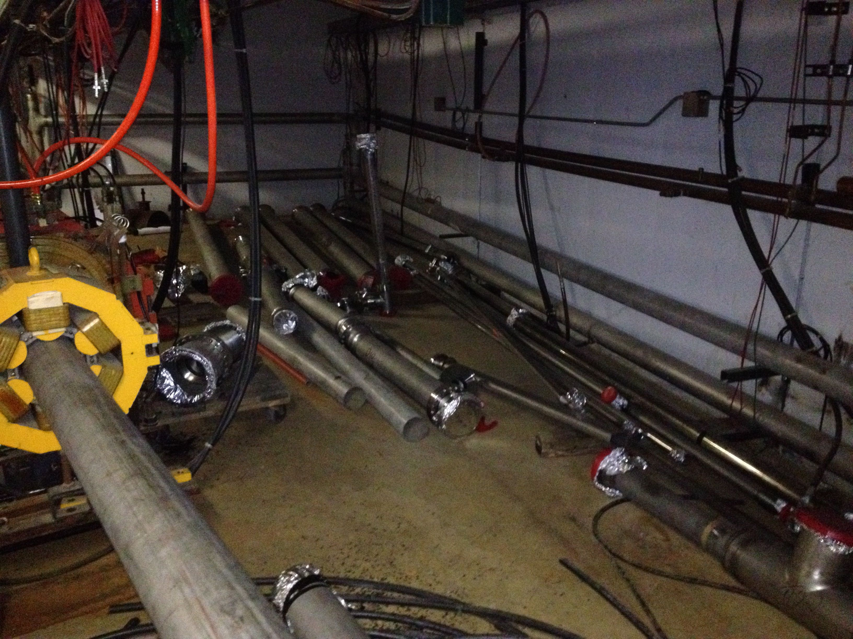
E760 Pit Area

Slide 7
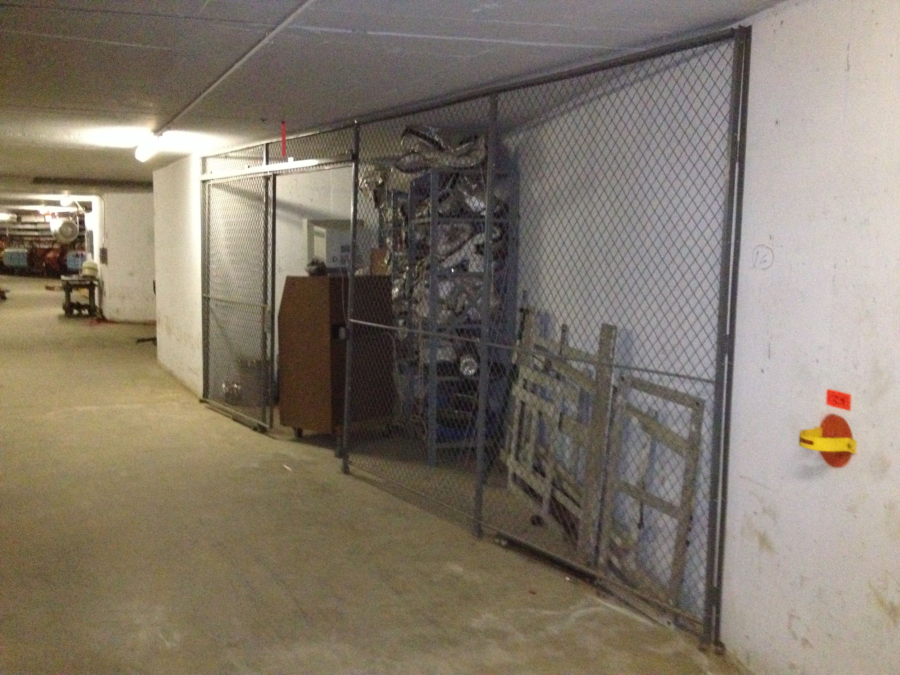
20 Drop Area

Slide 8
Alignment work Issues
Delivery Ring
Refinancing will consist of monuments on Top, radial inside and Bottom
potential issues
Shunt panels
Bean line interfacing points
Accumulator
Refinancing will consist of monuments on Top, radial outside and Bottom
This will impact the alignment of the components at its final resting place.
Setting magnet orientation in dentation beam, lines
Or referencing them
Or if magnet is opened

Slide 9
Delivery Ring magnet
Only referencing the Radial inside Top /Bottom of the magnets
Accumulator Ring magnet
Only referencing the Radial outside Top /Bottom of the magnets.
We will need to define magnet orientation for beam line

Slide 10
Component Tagging
Three Classes
Red: Components to be removed from tunnel
Either Storage
Rad waste
Blue: Components to removed from current location and installed back to there original location.
Magnet in the Delivery ring 30 section for example
Green: Components to removed from current location and store at its jump point prior to being re installed else ware.
Magnet being moved the Accumulator to the M3/M4 or M5 lines

Slide 11
Next week long access period.
Set an upper limit as to the amount of space we will need to store components/devices outside our tunnel region. ( looking for ~ square footage of floor space needed.)
TD storage at either magnet storage build (MSB), or Tagged Photon Lab (TPL).
Get an approximate value for the total weight and sore of the components that will be wasted.
Waste management facility would like to have a rough idea as to amount of material to expect for processing….
Tag Fest
RED: Components to be removed
BLUE: Components to be put on ice

Slide 12
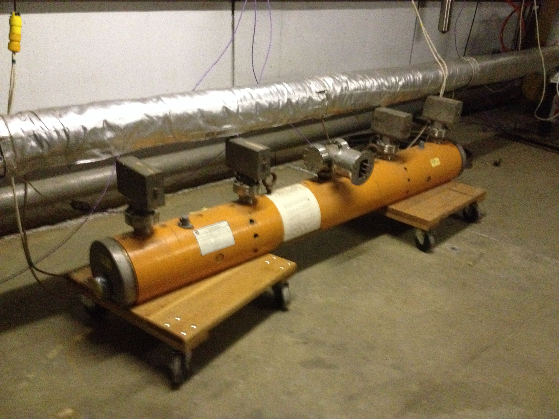
Red Tag Items
Near A3Q7
Near D4B17
Near D4Q19

