Slide 1
Fine-Grained Tracking Detectors for Neutrino Physics: Part II
Christopher Mauger
Los Alamos National Laboratory
26 October 2014

Slide 2
Outline
Motivations
Demonstration of reconstruction capability
  Coherent neutral pion production in NOMAD
Demonstration of distinguishing nuclear models
  Minerνa quasi-elastic scattering results
    Anti-neutrinos
    Neutrinos
Demonstration of finding important phenomena
  Minerνa measurement of ratios of charged-current cross-sections on carbon, iron, lead and polystyrene
Conclusions

Slide 3
Motivations
The physics of neutrino-nucleus interactions is beautiful – sitting on the interface of many topics in contemporary physics (cup half full).

Slide 4
Motivations
The physics of neutrino-nucleus interactions is beautiful – sitting on the interface of many topics in contemporary physics (cup half full).
The standard model is older than most people in this room and we still don’t understand how to implement it properly. This should disturb you! (cup half empty).

Slide 5
Motivations
The physics of neutrino-nucleus interactions is beautiful – sitting on the interface of many topics in contemporary physics (cup half full).
The standard model is older than most people in this room and we still don’t understand how to implement it properly. This should disturb you! (cup half empty).
Neutrino oscillation experiments require us to get this right.

Slide 6
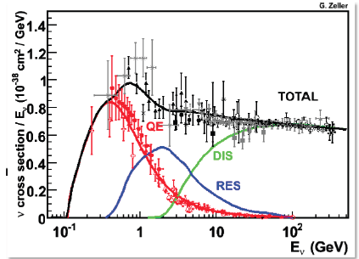
LBNE Physics Challenges – medium-energy neutrinos
LBNE does long-baseline physics in resonance regime (1st Oscillation Maximum at ~2.4 GeV) and resonance/DIS cross-over regime
Atmospheric neutrinos are measured in the same neutrino energy regime
Neutrino oscillation phenomena depend on mixing angles, masses, matter densities, distance from production to measurement point, neutrino flavor and neutrino energy
Critical to understand the correlation between true and reconstructed neutrino energy
ν_{μ}
μ
n
Ar
π
p
n
n
Let’s think about neutrons for a moment.

Slide 7
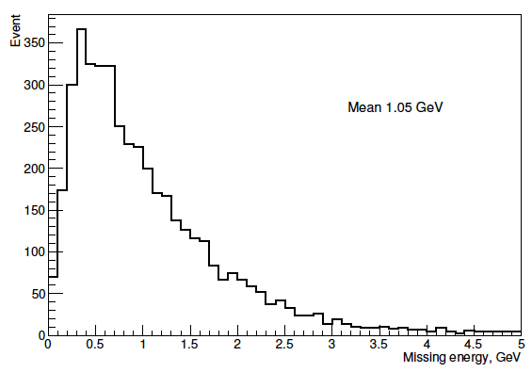
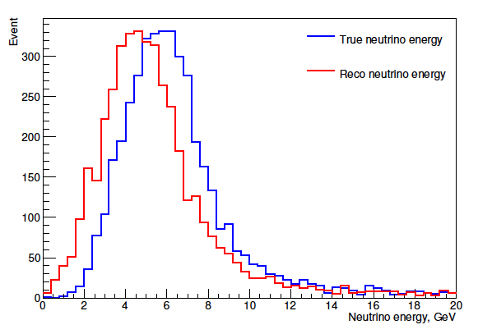
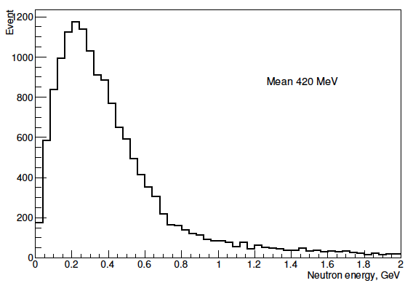
NuMI Medium Energy Tune
Neutrons can carry away significant energy
Uncertainties also large
Sum of energy into neutrons
Energy of a single neutron
Simulation by Qiuguang Liu

Slide 8
LBNE Beam
Missing neutrons for LBNE. Neutrino – Anti-neutrino differences.
Simulation by Elena Guardincerri

Slide 9
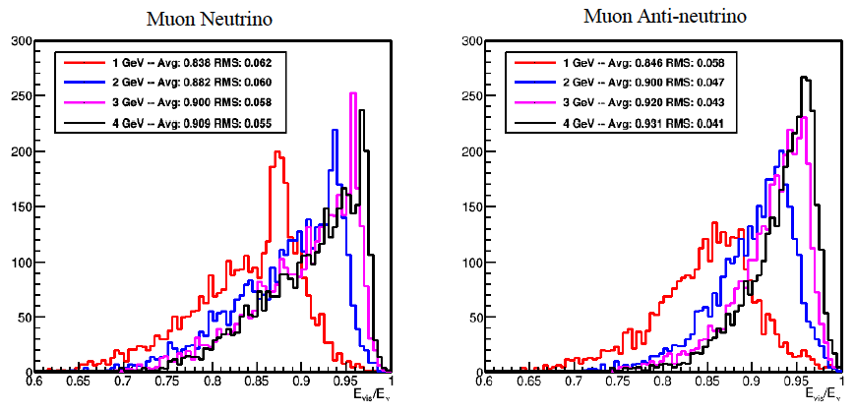
Fraction of neutrino energy that is visible
Can’t we simply measure the energy calorimetrically? No!
Fraction is different for neutrinos and anti-neutrinos
Clark McGrew at the Santa Fe LBNE Scientific Workshop (http://public.lanl.gov/friedland/LBNEApril2014/)

Slide 10
Long-Baseline Neutrino Oscillation Experiments
We need to understand what we are doing.
Measurements in fine-grained trackers can help us make headway.

Slide 11
NOMAD Coherent Neutral Pions

Slide 12

Coherent Neutral Pion Production in NOMAD
Target mass: 2.7 tons
Composition: Carbon (64%), Oxygen (22%), Nitrogen (6%) and Hydrogen (5%) – effective atomic number A=12.8 (similar to carbon)
Over 1.7 Million neutrino interactions recorded in the fiducial volume
Beam energies 1 to 300 GeV – average of 24.8 GeV

Slide 13
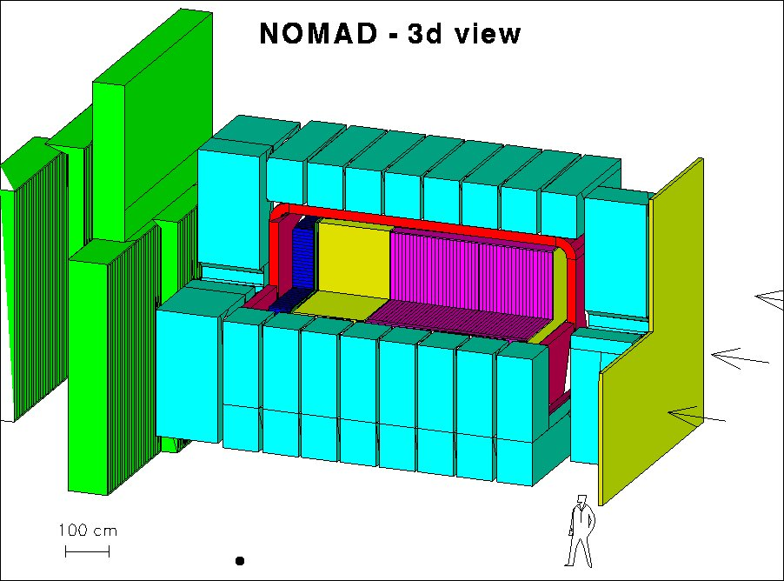
Examples of detectors - NOMAD
Drift planes
Transition radiation detectors
E&M calorimeter
Hadronic calorimeter
Muon detectors
Magnet
Magnet Return
Veto plane

Slide 14
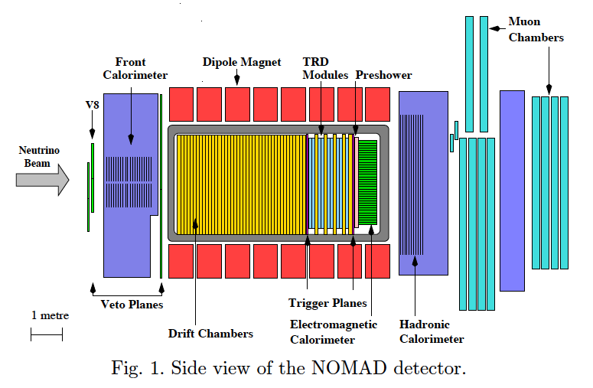
NOMAD Detector
Density in the drift region 0.1 g/cm³
Average material encountered ~ 0.5 radiation length
Predominantly muon neutrino beam
Neutral pions decay to 2 gammas
Gammas can convert in the drift chamber region or calorimeters
Event signature: 2 gamma-rays and nothing else
This analysis requires both gammas to convert in the drift chamber region

Slide 15
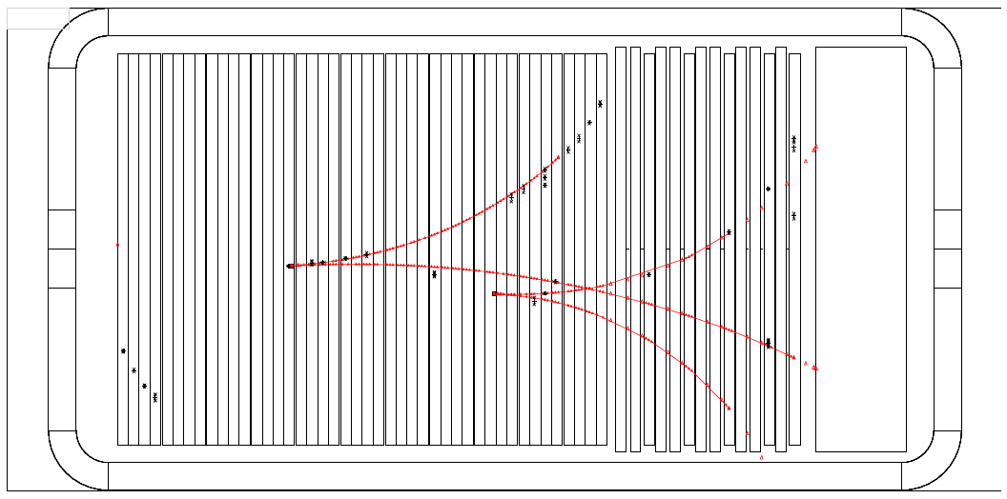
Event display of a typical candidate
Text
Reconstructed neutral pion momentum not written in the paper, but …

Slide 16
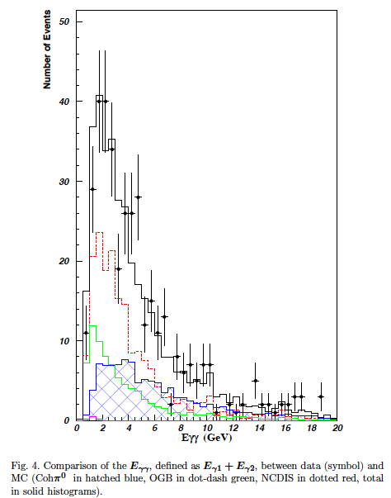
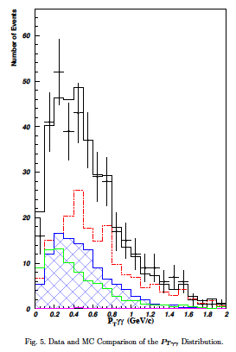
Salient Distributions
Left plot: Summed gamma-ray energy
Right plot: Transverse momentum distribution
Blue hatched region: Coherent neutral pion simulation
Dot-dash green: Entering background
Dotted red: Neutral current background
Solid: Sum total of the simulation
Points: data

Slide 17
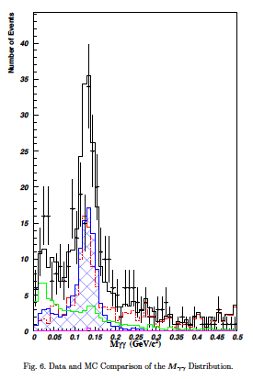

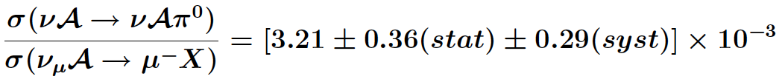
NOMAD Coherent Neutral Pion Results
Extracted observed signal:
Efficiency: 2.27%
After correction for non muon neutrinos:

Slide 18
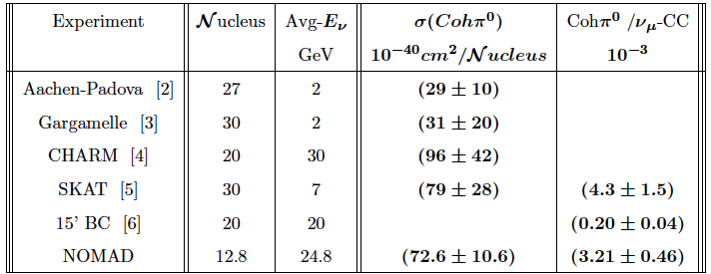
Results II
Comparison with other experiments and final cross-section result – consistent with Rein-Sehgal model

Slide 19
Minerνa Quasi-elastic Cross-sections

Slide 20
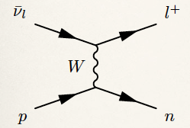
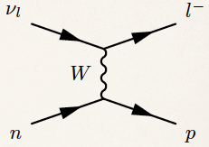
Quasi-elastic Scattering Assumptions
From Cheryl
Patrick’s 2013
EPS talk
Simple process with no pions in the final state
On free nucleons, if we know the direction of the neutrino, the free nucleon mass, and the muon mass, the kinematics are completely constrained by momentum and direction of the muon

Slide 21
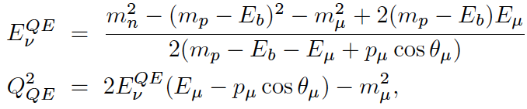
Quasi-elastic Scattering Assumptions
In an nucleus, there is binding energy, Fermi motion, short-range correlations that impact the final state kinematics
Fermi motion smears the kinematics
Short-range correlations more complicated
With binding energy:

Slide 22
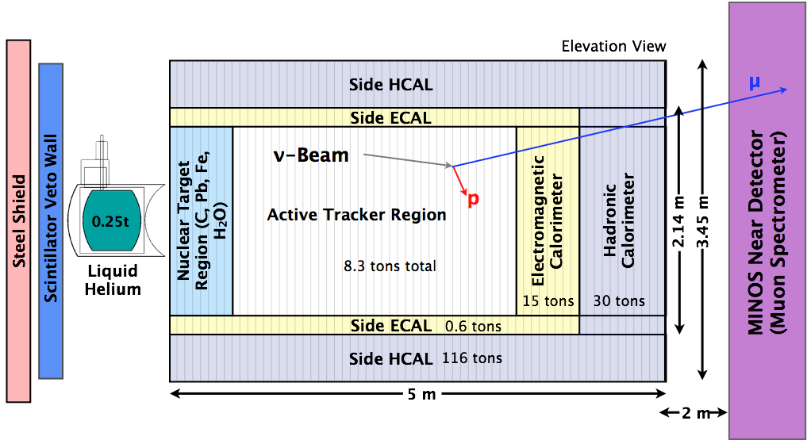
Examples of detectors – Minerva
120 modules for tracking and calorimetry
Magnetized MINOS near detector for downstream muon tracking/sign selection
From: Brian Tice

Slide 23
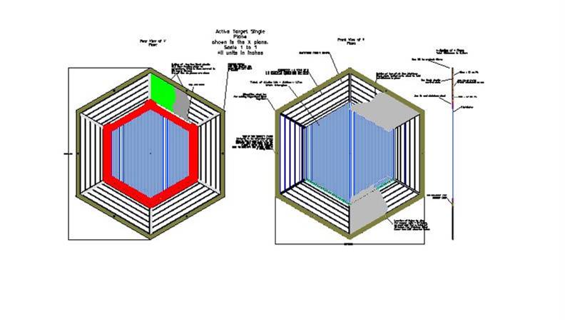
Examples of detectors – Minerva active target modules
Inner detector: active scintillator strip tracker – triangular extrusions using charge sharing rotated by 60 degrees for stereo views
Lead pieces on outer 15cm of active target for side electromagnetic calorimeter
Outer frame provides side hadronic calorimeter/muon identifier
3.3 cm
From: Jorge Morfin

Slide 24
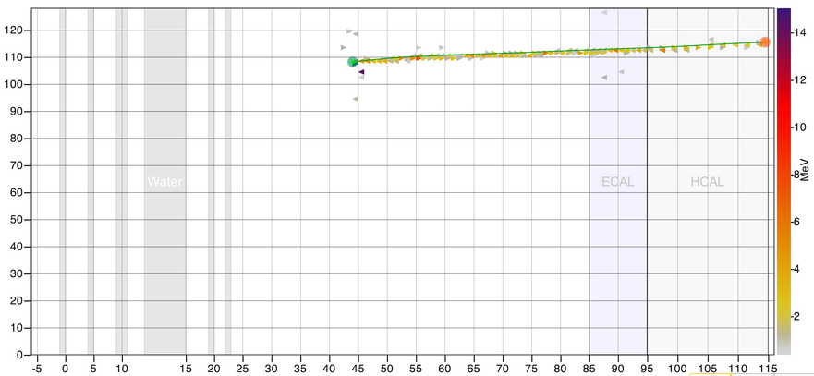
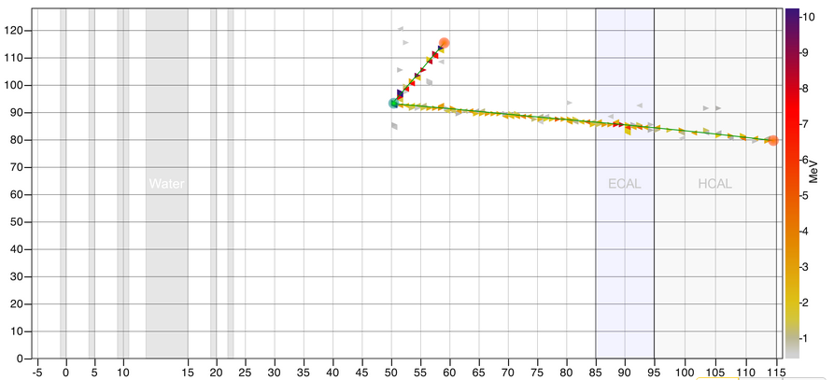
ν Beam
charged-current quasi-elastic scattering
MeV
Strip number ➛
TRACKER
ECAL
HCAL
Module number ➛
MINOS ND
Module number ➛
Strip number ➛
TRACKER
ECAL
HCAL

Slide 25
Event Selection Criteria
Look for muon from the 5.57 ton fiducial volume in the tracker region of the detector that is also measured downstream in MINOS (17 degree angular acceptance). Muon charge should be positive for anti-neutrinos and negative for neutrinos
Define a region close to the vertex that is ``blacked out’’ where one or more nucleons might interact. This ``vertex energy region’’ is not used in the event selection.
  Neutrino sample: 30cm around vertex
    proton kinetic energy 225 MeV
    pion kinetic energy 100 MeV
  Antineutrino sample: 10cm around vertex
    proton kinetic energy 120 MeV
    pion kinetic energy 65 MeV
Remainder of the tracker is the ``recoil energy region.’’ If the interaction produced a pion (or if there are multiple neutrino interactions in the beam bunch), expect signal. Reject events with significant activity in this region.

Slide 26
ν Beam
charged-current quasi-elastic scattering
MeV
Fiducial volume:
5.57 tons scintillator (CH)
Vertex Energy
Strip number ➛
Recoil Energy Region
TRACKER
ECAL
HCAL
Module number ➛
MINOS ND
Module number ➛
Fiducial volume:
5.57 tons scintillator (CH)
Vertex Energy
Strip number ➛
Recoil Energy Region
TRACKER
ECAL
HCAL

Slide 27

Data Sample
Anti-neutrinos: NuMI low-energy anti-neutrino tune, November 2010-February 2011
Neutrinos: NuMI low-energy neutrino tune, March-July 2010
aa

Slide 28
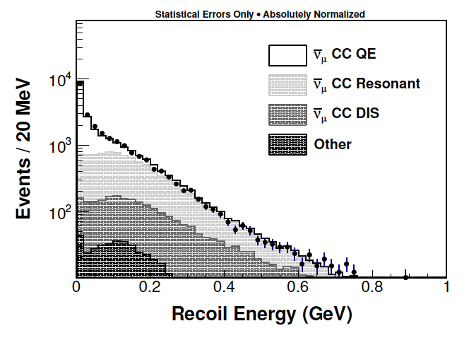
Anti-neutrino recoil energy spectrum
Expect low recoil energy for quasi-elastic sample
Inelastic events should have more energy deposited away from the vertex

Slide 29
Anti-neutrino differential cross-section
16,467 anti-neutrino events, 54% efficiency, 77% purity
Compare absolute predictions to several different models

Slide 30
Shape comparison
Normalize predictions to compare shape to several different models containing different microphysics.
Minerνa can distinguish between models!

Slide 31
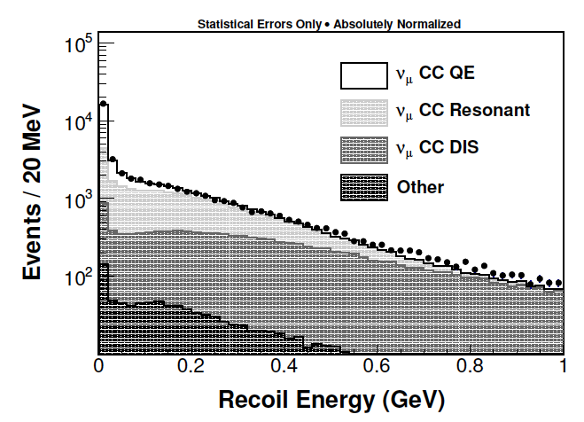
Neutrino recoil energy spectrum
Expect low recoil energy for quasi-elastic sample
Inelastic events should have more energy deposited away from the vertex

Slide 32
Neutrino differential cross-section
29,620 neutrino events, 47% efficiency, 49% purity
Compare absolute predictions to several different models

Slide 33
Shape comparison
Normalize predictions to compare shape to several different models containing different microphysics
Minerνa can distinguish between models!

Slide 34
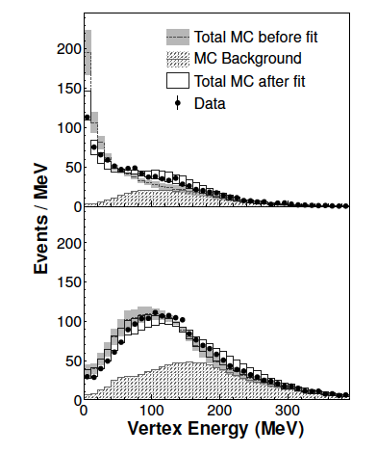
Vertex energy in neutrino mode
Left upper: Q² < 0.2 GeV²/c²
Left lower: Q² > 0.2 GeV²/c²
Minerνa uses vertex energy distributions to ask the question, ``additional protons possible’’?
Prefer additional proton of < 225 MeV K.E. in 25% of sample
Evidence for short-range correlations in neutrino data?

Slide 35
Minerνa CC Cross-section Ratios

Slide 36
Cross-section ratios important
Cross-section ratios of different nuclei can constrain models of the impact of the nucleus
Important demonstration of the validity of a model
Crucial for planning future experiments that have a large nucleus like argon

Slide 37
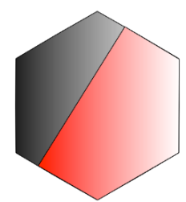
Minerνa nuclear targets
Nuclear target region of Minerνa allows us to look at cross-section ratios
Begin with inclusive charged-current cross-sections
In the future, such comparisons with specific topologies will be very interesting
3.3 cm

Slide 38
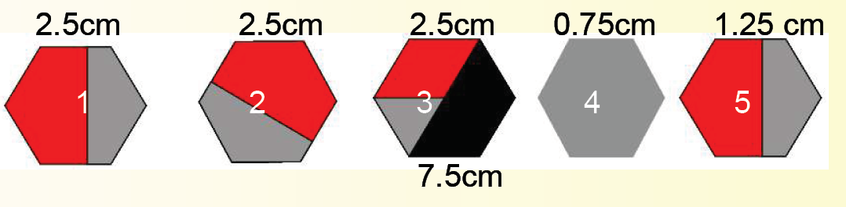
Solid Nuclear Target Region
XUXVXUXV (4 tracking points) between each layer
Main detector
Beam
Carbon, Iron, Lead – mixed elements in layers to give similar systematics
From: Jorge Morfin

Slide 39
Data Sample
Data from March 2010 to April 2012
NuMI low energy tune – peak at 3.5 GeV
95% muon neutrinos at peak energy
5953 events on carbon, 19,024 on iron, 23,967 on lead, 189,168 on CH

Slide 40
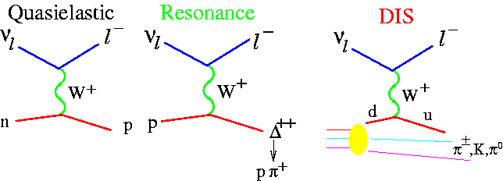
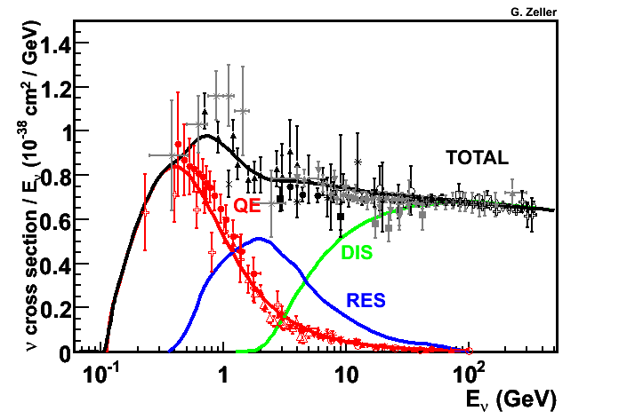
Inclusive Neutrino Cross Sections
Quasi-Elastic (CCQE)
-knock out nucleon-
J.A. Formaggio and G.P. Zeller, Rev. Mod. Phys., 2012
ν_{μ}
Resonance
Production (Res)
-excite nucleon-
Deep Inelastic Scattering (DIS)
-destroy nucleon-
Notes:
This is the flux. We only use neutrino here.
Hits all channels

Slide 41
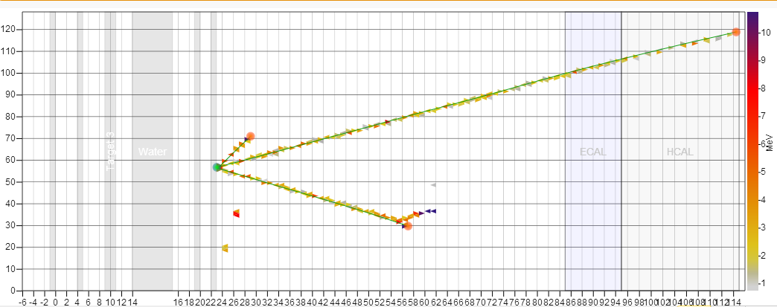
Event Selection
Pb
CCν_{μ}
X View
Pb
Fe
Fe
This Event
Run: 2000
Subrun: 7
Gate: 119
Slice: 5
DATA
Strip Number
Module Number
Event Topology
Muon must be matched to a momentum- and charge-analyzed track in MINOS ND
Interaction Material
Vertex must be in passive nuclear target or adjacent scintillator plane
Notes:
This is one view
Require minos match
Targets are passive. Multitracks can be fit into target. Single tracks, first hit is in first plane DS. Assume it came from target, will subtract BG later.
Events in scintillator of tracking volume in fiducial area

Slide 42
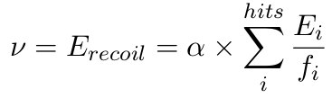

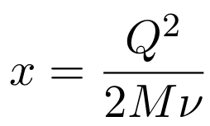

Event Reconstruction
Hadronic Energy
Sum of non-muon visible energy.
Weight for passive material traversed.
Muon Energy
From range or curvature in MINOS.
Add energy lost in MINERvA.
Muon Angle
Fitted track slopes at vertex.
Unfold neutrino energy distributions
Use simulation of detector smearing
Do not unfold x distributions
Large migration among x bins
Avoid systematic effects
Notes:
Muon rec from minos + dedx for material in Minerva
Calo e for all other hits

Slide 43
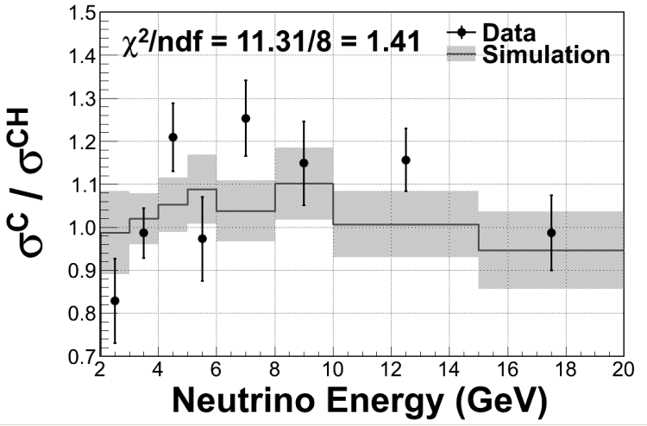
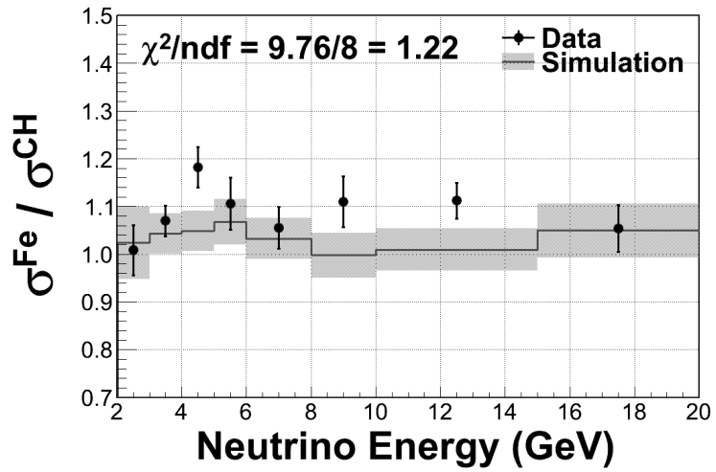
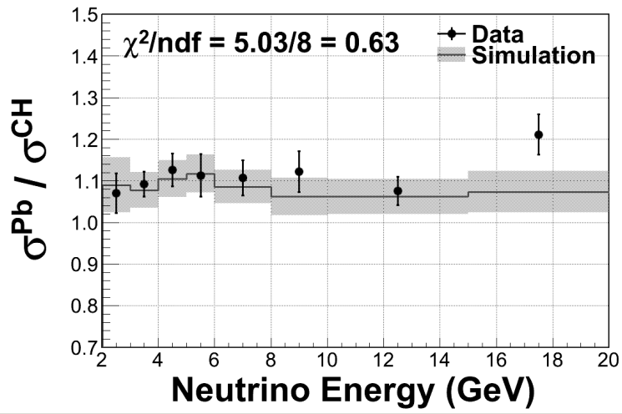
Neutrino Energy
No evidence of tension between our data and simulation here
  Good news for oscillation experiments so far…
σ^{C}
σ^{CH}
σ^{Fe}
σ^{Pb}
σ^{CH}
σ^{CH}
Notes:
Neutrino E looks OK. Happy oscillators
Data/MC agreement increases with better stats.
Energy bins are 1 GeV. Working to improve resolution, going to lower E.

Slide 44
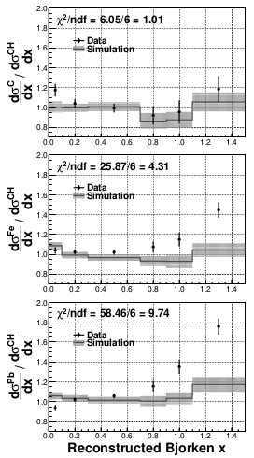
Results
Discrepancies between data and simulation at both low and high x – both discrepancies increase as a function of A
Low x due to insufficient shadowing in the simulation
High x (dominated by quasi-elastic)

Slide 45
Conclusions
Fine-grained trackers allow us to make precision neutrino measurements – even in broad-band neutrino beams
The measurements can distinguish between models and even find new effects with statistical significance
It is crucial for us to continue a program of measurements and incorporate these programs into neutrino oscillation experiments at the near site

Slide 46
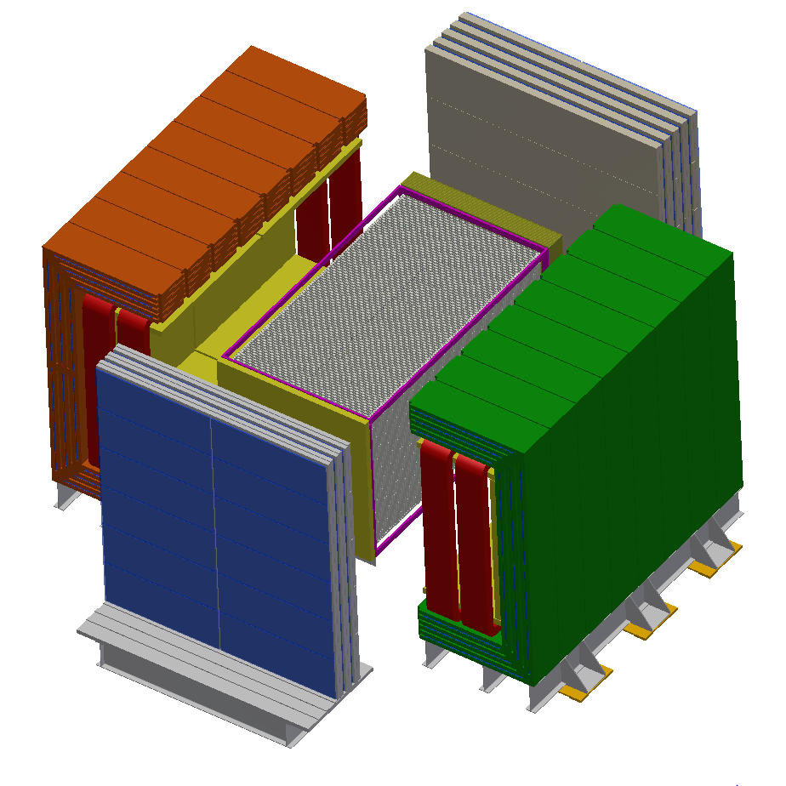
LBNE Near Neutrino Detector
High precision straw-tube tracker with embedded high-pressure argon gas targets
4π electromagnetic calorimeter and muon identification systems
Large-aperture dipole magnet
Philosophy
  make high-precision, high-statistics measurements of neutrino interactions with argon (far detector nucleus)
  measure inclusive and exclusive cross-sections to build and constrain models to predict the event signatures at the far site and correlate them with the true neutrino energy
  make detailed studies of electron (and muon) neutrinos and anti-neutrinos separately
3.5 m

Slide 47
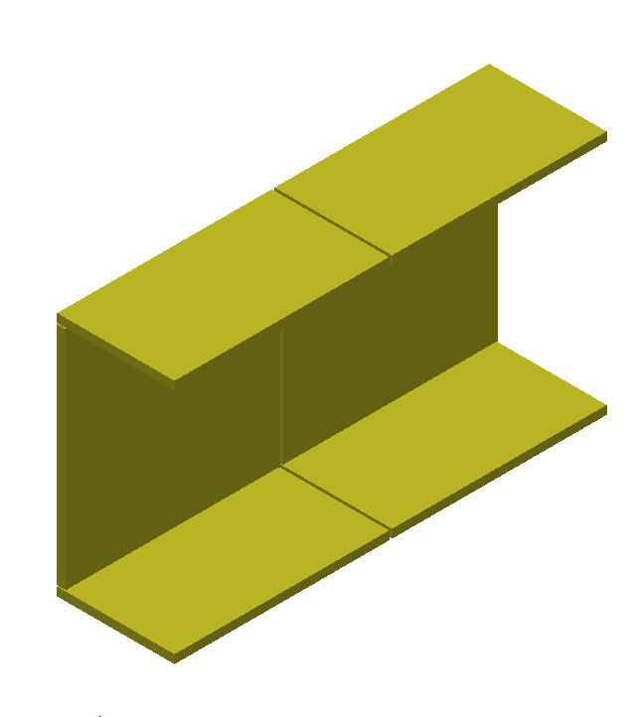
Electromagnetic Calorimeter
4π coverage gives
excellent neutral
pion identification
and containment
ECal designed to identify electrons and photons – critical for measuring neutral pion background
Sandwich of lead and plastic scintillator
Downstream ECal has 58 layers of 1.75mm lead with scintillator bars of 2.5cmx0.5cm profile (4m long)
The Barrel ECal (shown at left) and Upstream ECal have 3.5mm of lead
Total lead mass is 110 tons, scintillator mass is 35 tons

Slide 48
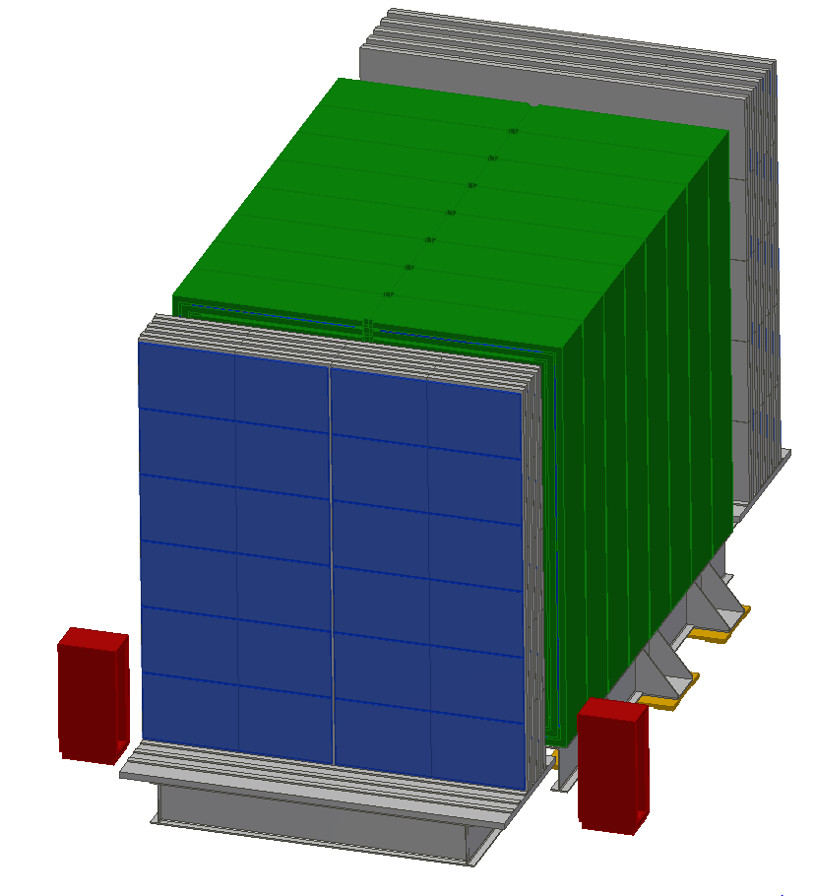
External Muon
Identifier
Steel interleaved with Resistive Plate Chambers
Identifies muons – separates muons and charged hadron (e.g. pions)

Slide 49
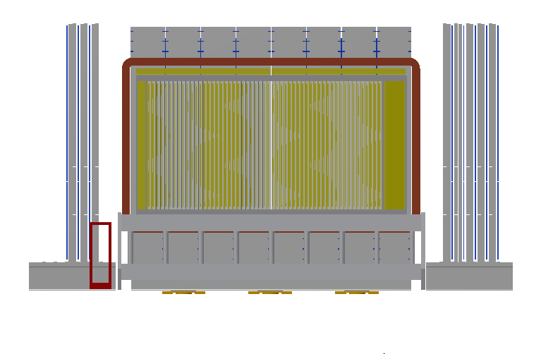
LBNE Near Neutrino Detector
Transition Radiation Detector
Radiator foils, argon gas targets, other
nuclear targets
UA1-style dipole magnet – 0.4 T
Muon identifier – also interleaved in magnet
Average density ~ 0.1 g/cm³

Slide 50
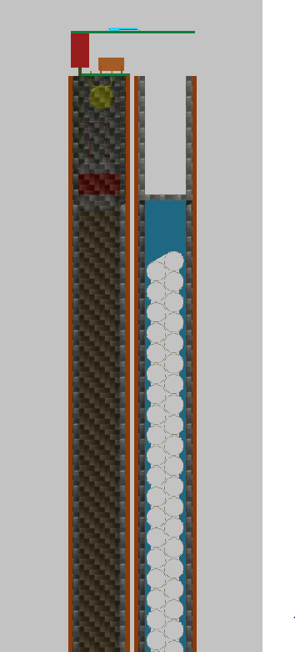
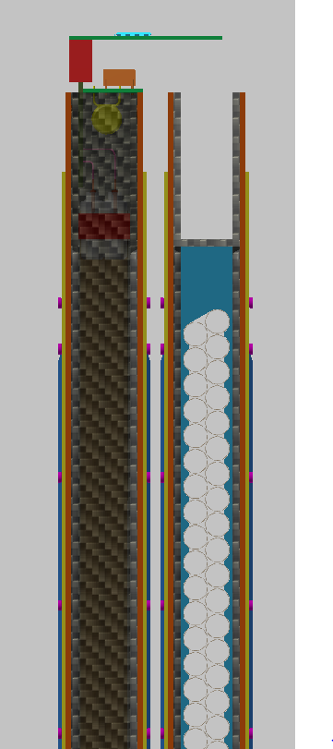
Strawtube Tracker
Module
XX YY Module
62mm thick leaving 18mm for a nuclear target module
TRD XX YY Module
76mm thick

Slide 51
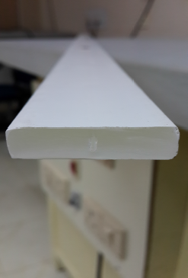
Basic Elements – Scintillator Bars
Scintillation peaks at 420nm, cuts off at 400nm
Collect scintillation light with wavelength shifting fiber – emission peak at 476 nm (green) – total internal reflection to end of bar
Maximize collection efficiency with a reflector around the outside of the bar
TO₂ reflecting material co-extruded with scintillator at FNAL
Wavelength shifter attenuation length > 3m, so long bars are possible
Versatile – used for tracking, ECal, Hcal
Useful in moderate density applications

Slide 52
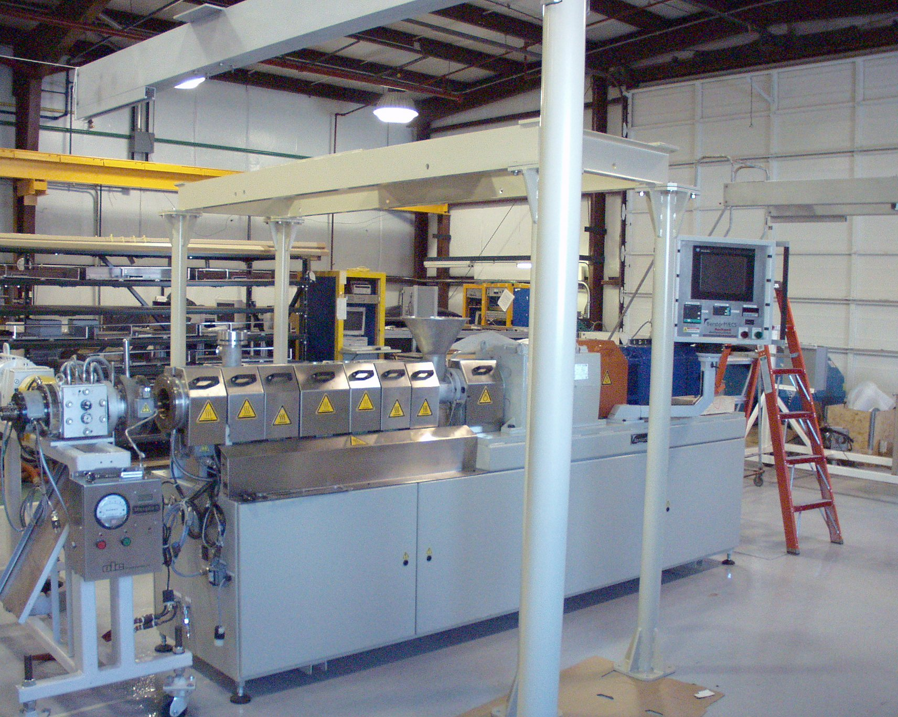
Basic Elements – Scintillator Bars
Lab 5 at FNAL, polystyrene scintillator extrusion
Co-extrusion with titanium dioxide successful, R&D on wavelength-shifting fiber co-extrusion

Slide 53
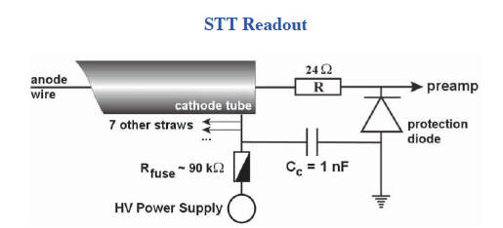
Basic Elements – Straw Tubes
Straws fabricated with conducting material (or coated with conducting material)
Anode wire threaded through the straw (which can be a few meters in length)
High electric field – especially near the anode results in electron multiplication
Excellent response to charged particles
Excellent in low-density applications
Charged particle
Ground
HV
Gas Volume
Ionization track

Slide 54
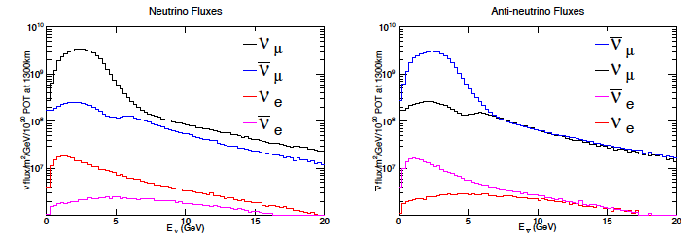
Characteristics of the Neutrino Beam
Resultant Neutrino Beam (LBNE case)
Neutrinos from few hundred MeV to 10’s of GeV
Predominantly muon (anti)neutrinos, but enough electron (anti)neutrinos to carry out studies in high-flux environments – it’s a good thing, since LBL experiments are searching for electron neutrino appearance!

Slide 55
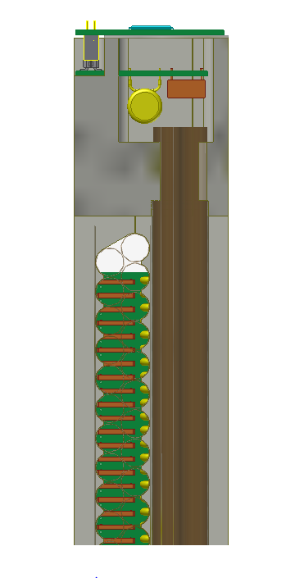
Tracking Detectors vs Monolithic Detectors
3.5 m
Localization of particles by deploying many low-profile detector elements
Detector elements throughout the volume
Anisotropic distribution of elements
Elements can be the target or targets can be separate from the elements

Slide 56
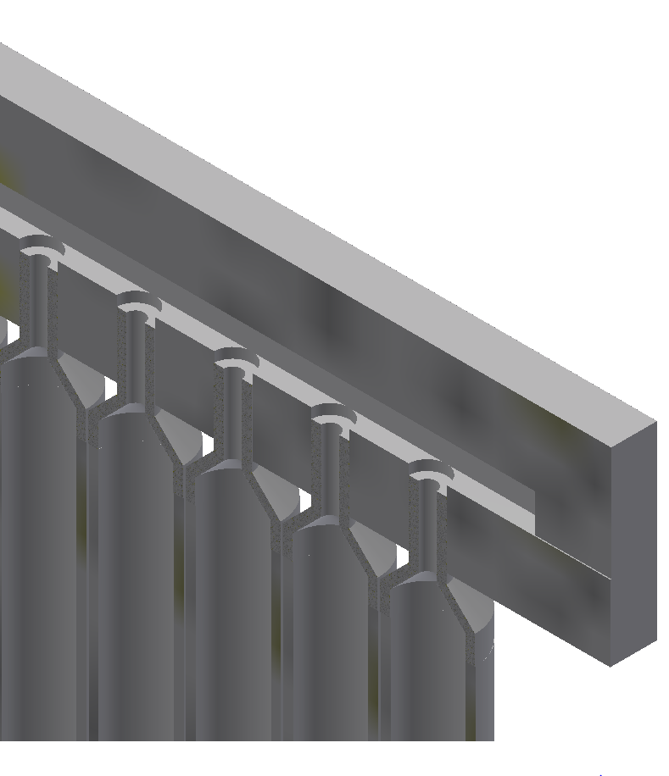
Gross Design Features – Nuclear Targets
Some materials require specialized target containment – gases, liquids
In the case of liquid, liquid in, liquid out studies can be performed
In the case of gas, can vary the pressure continuously to enable efficiency studies
SS Tube .625” OD x .065” wall butt welded to adapter and cap
SS Tube Adapter
Manifold Cover
Weld
Manifold

Slide 57
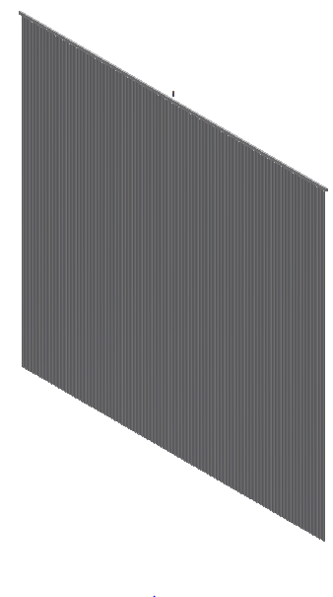
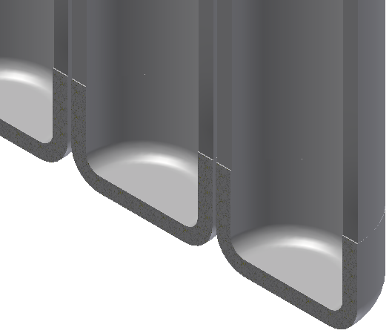
Argon Gas Target Assembly – SS Version
216 tube assemblies welded to manifold
SS Tube .625” OD x .065” wall butt welded to adapter and cap
SS Tube Adapter
Manifold Cover
Weld
Manifold
SS Tube Cap

Slide 58
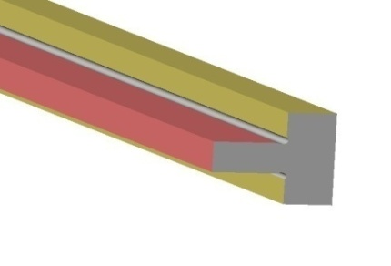
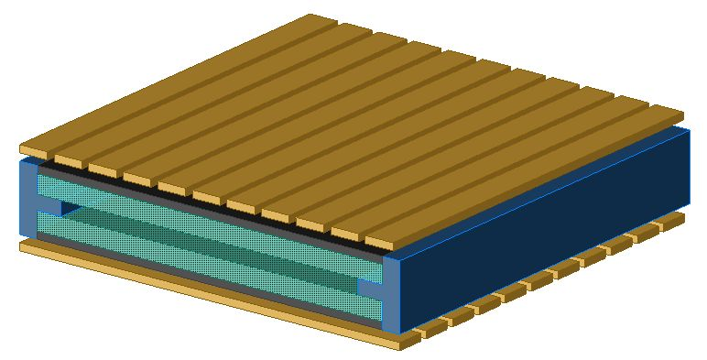
Construction of RPC
Two 2 mm thick float Glass
Separated by 2 mm spacer
2 mm thick spacer
Pickup strips
Glass plates
Resistive coating on the outer surfaces of glass
Naba Mondal
58
Notes:
58

Slide 59
Basic Elements – Resistive Plate Chambers
RPCs can be built with glass or plastic (bakelite)
Voltage drop across the plates (several kV)
Spacers used to keep the plates separated (few mm thick)
Charged particles induce a localized discharge
Good timing resolution (25 ns)
Enables inexpensive readout over a broad area

Slide 60

Examples of detectors - NOMAD

Slide 61



UA1 magnet at CERN:
Yoke material: EN S235JRG2, a European low Carbon steel
Yoke sections assembled, tested
2 yoke sections on carriage, the total number of yoke sections is 16
Assembled magnet in hall

Slide 62

UA1 magnet at CERN:
Essential to have a continuous magnetic circuit in steel yoke -
Assembled yoke sections on carriage in UA1 experimental hall at CERN. Total magnet weight 850. tons.
Data taking started in November, 1981.
Operating properties: 10,000 amps, 576. V., resistance .0576Ω @ 40.º C. Cooling water flow 50. liters/sec.
Original yoke costs – 2,000,000.00 Euros in 1978.
Sondheim

Slide 63

Gross Design Features – Nuclear Targets
Geometry of typical fine-grained trackers such that planes of un-instrumented nuclear targets can be interspersed with tracking material
This allows good possibilities for neutrino-nucleus interaction studies. Targets can even be swapped out.
Care must be taken due to absorbed particles and side-going particles that will be missed.
Petti

Slide 64



Examples of detectors - Minerva
From Minerva website

Slide 65
Gross Design Features - Magnets
Magnetic field useful for charge separation and momentum measurements
Geometry of typical neutrino beams favors dipole configuration
Low-density trackers (e.g. straw tubes) can do electron-positron separation
Requires significant power – especially for cooling (few Mwatts)

