Slide 1
Fine-Grained Tracking Detectors for Neutrino Physics: Part I
Christopher Mauger
Los Alamos National Laboratory
24 October 2014

Slide 2
Outline
What are we trying to measure?
  Characteristics of typical neutrino beams
  Event signatures
What are the characteristics of a fine-grained tracking detector?
  Monolithic vs. tracking detectors
  Characteristics of neutrino targets
Examples of fine-grained tracking detectors
Basic Principles of tracking elements
  Scintillator/Fiber Bars
  Straw Tubes
  Resistive Plate Chambers
Gross Design Features
  Tracking detector assembly
  Magnet Issues
  Nuclear targets
Advantages/Disadvantages
Conclusions

Slide 3
Long-Baseline Neutrino Oscillation Experiments
The study of oscillation physics provides the opportunity to study interaction physics with the near detector

Slide 4
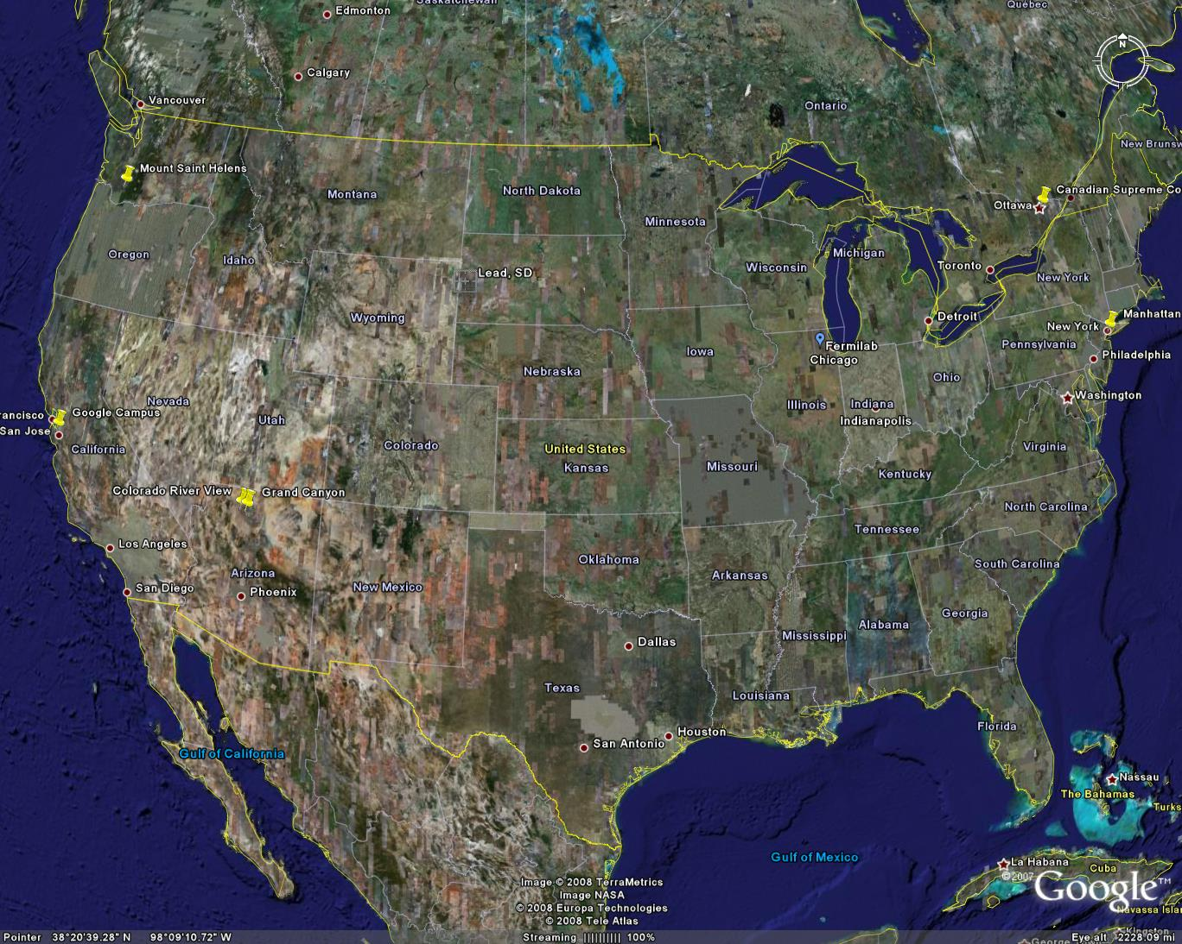


The Long-Baseline Neutrino Experiment
LBNE consists of
  an intense neutrino beam at Fermilab
  near detector systems at Fermilab
  a 34 kt liquid argon time-projection chamber (TPC) at Sanford Laboratory at 4850 foot depth – 1300 km from Fermilab
When constructed, LBNE will have the longest manmade baseline of any neutrino experiment

Slide 5
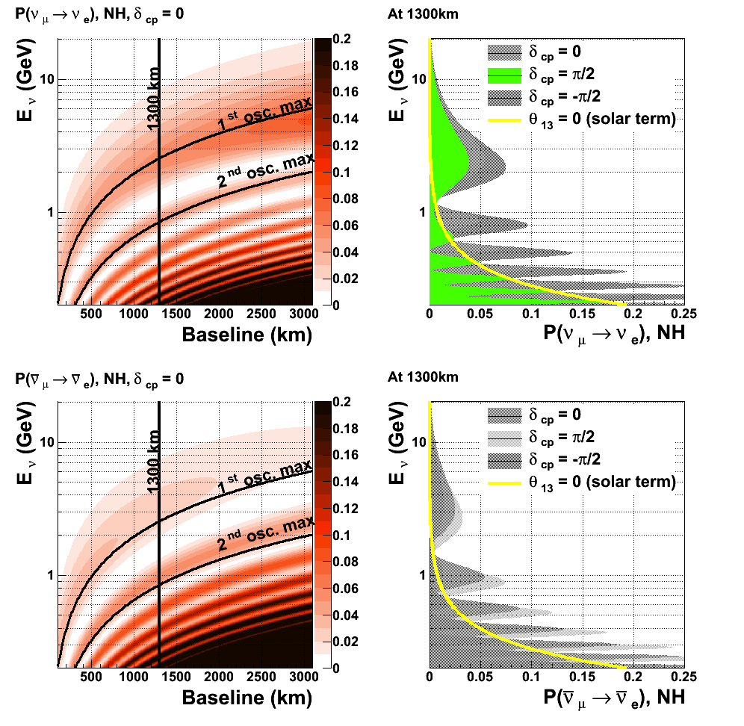
Appearance Oscillograms (Normal Hierarchy)
Left plots: Neutrino oscillations vs energy and baseline for neutrinos (top) and antineutrinos (bottom) for δ_{CP} = 0
Right: Neutrino oscillations as a function of neutrino energy for different values of δ_{CP} for neutrinos (top) and antineutrinos (bottom) – solar term shown in yellow
All plots assume Normal Hierarchy

Slide 6
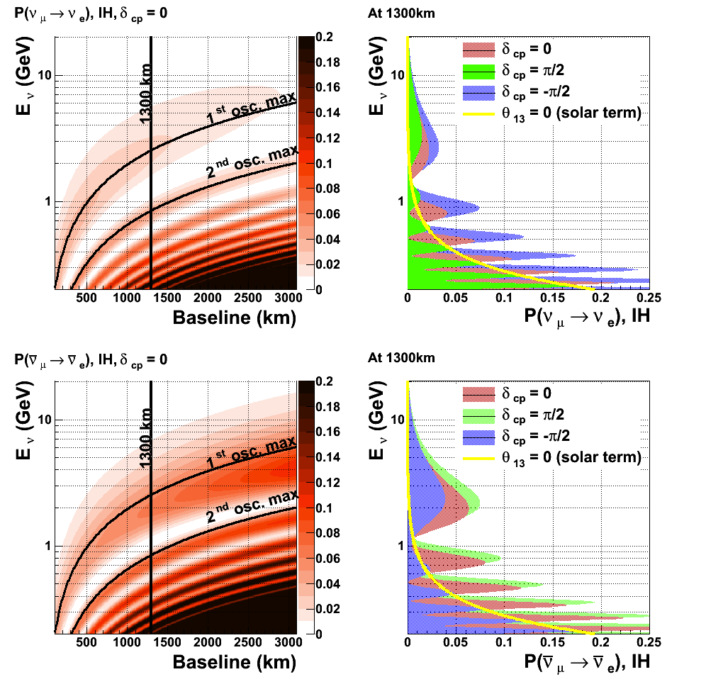
Appearance Oscillograms (Inverted Hierarchy)
Left plots: Neutrino oscillations vs energy and baseline for neutrinos (top) and antineutrinos (bottom) for δ_{CP} = 0
Right: Neutrino oscillations as a function of neutrino energy for different values of δ_{CP} for neutrinos (top) and antineutrinos (bottom) – solar term shown in yellow
All plots assume Inverted Hierarchy

Slide 7
Long-Baseline Neutrino Oscillation Experiments
The study of oscillation physics requires the study of interaction physics with the near detector

Slide 8
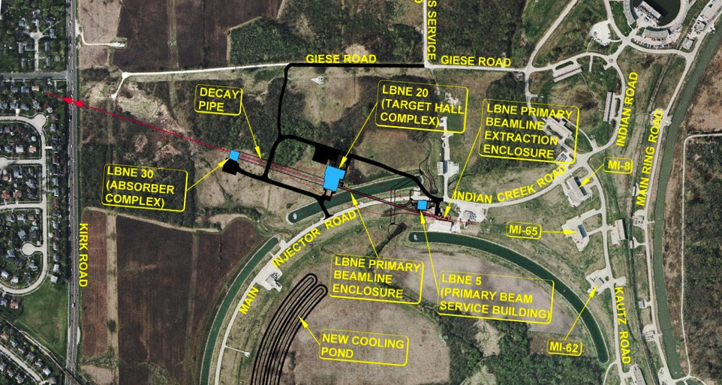
Layout on the Fermilab site
asD

Slide 9
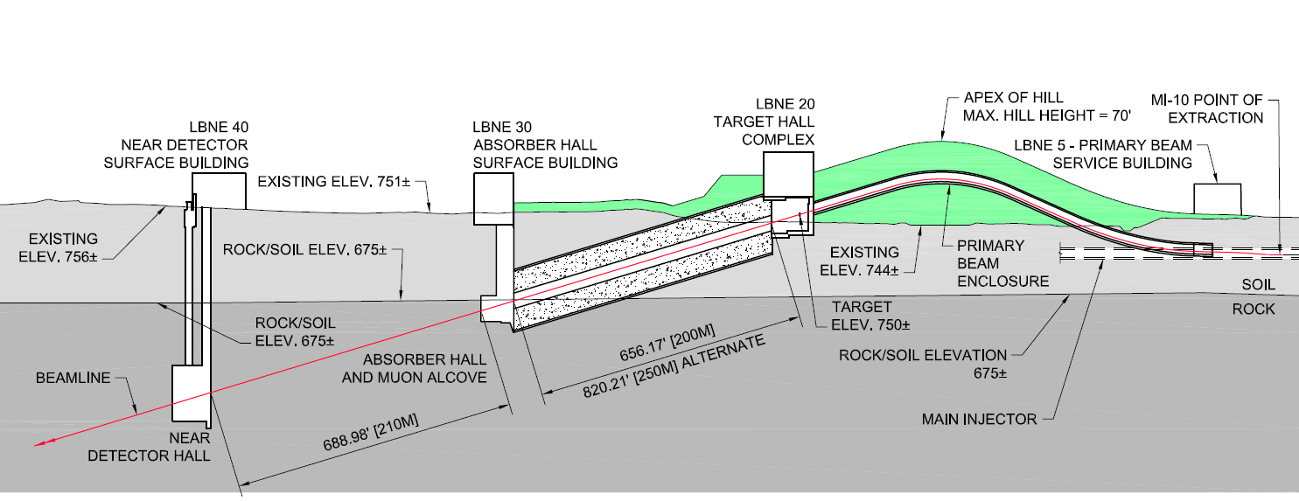
Cross-section of LBNE Near Site

Slide 10
Layout of LBNE: Neutrino Beam
π⁺ μ⁺ + ν_{μ}
π⁻ μ⁻ + ν_{μ}

Slide 11
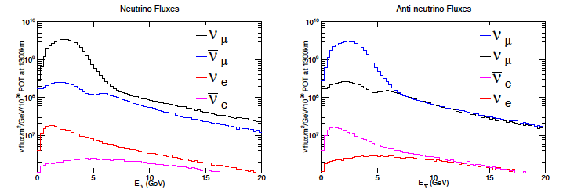
Characteristics of the Neutrino Beam
Resultant Neutrino Beam (LBNE case)
Neutrinos from few hundred MeV to 10’s of GeV
Predominantly muon (anti)neutrinos, but enough electron (anti)neutrinos to carry out studies in high-flux environments – it’s a good thing, since LBL experiments are searching for electron neutrino appearance!

Slide 12
Event signatures of these beams
Signature label | Charged Current | Neutral Current
Quasi-elastic | Charged lepton + proton or neutron | Neutrino + proton or neutron
Resonance | Charged lepton + proton or neutron + a few other hadrons | Neutrino + several hadrons
DIS | Charged lepton + hadronic shower | Neutrino + hadronic shower
Particle type: electron, gamma, muon, charged and neutral mesons, protons, neutrons (not usually done well
Particle sign
Momentum: Range of 10’s MeV/c to multi-GeV
Direction: Mostly forward-going, but some high-angle and backward-going

Slide 13
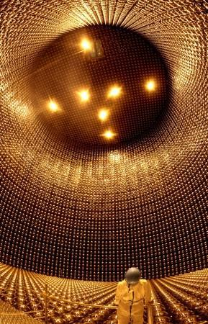
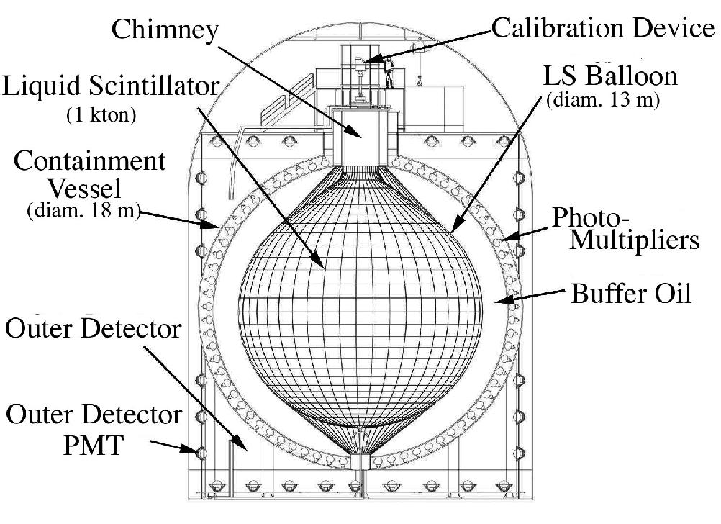
Tracking Detectors vs Monolithic
Super-Kamiokande: water Cherenkov
KamLAND: organic liquid scintillator
Monolithic detectors have large uniform volume of neutrino target
Target material is active – creates light, ionization, phonons, etc.
Detectors positioned on the outer surface
Good isotropic capabilities

Slide 14
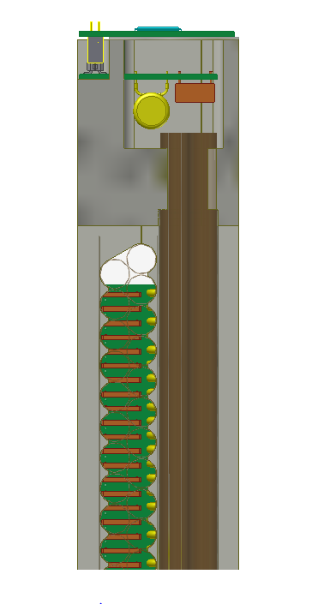
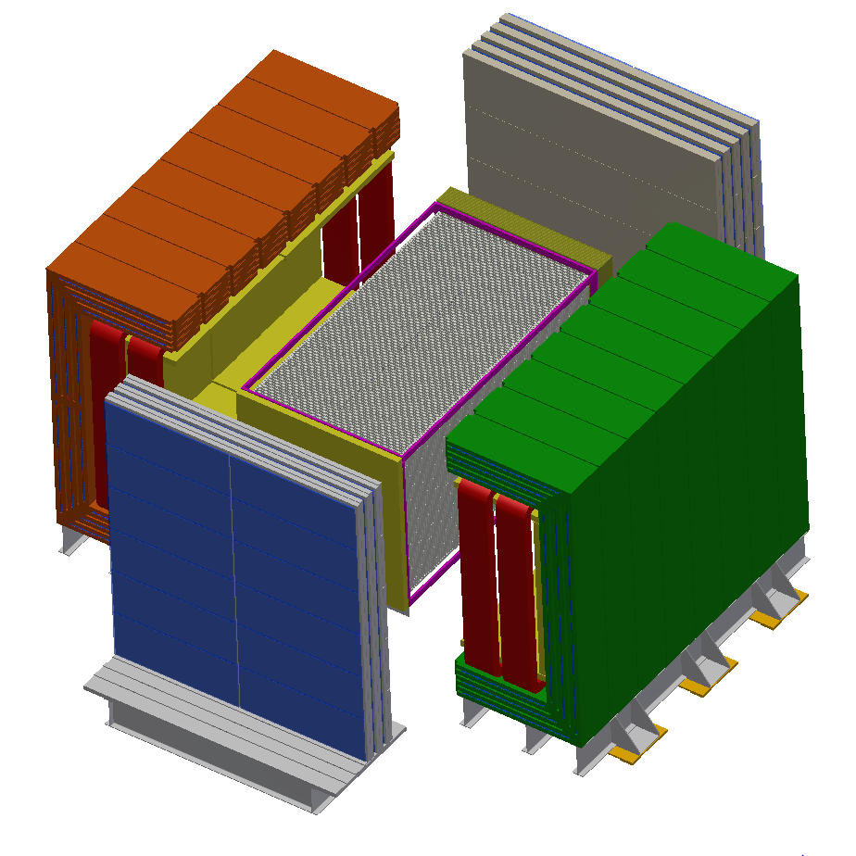
Tracking Detectors vs Monolithic Detectors
3.5 m
Localization of particles by deploying many low-profile detector elements
Detector elements throughout the volume
Anisotropic distribution of elements
Elements can be the target or targets can be separate from the elements

Slide 15
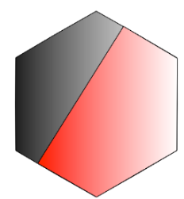
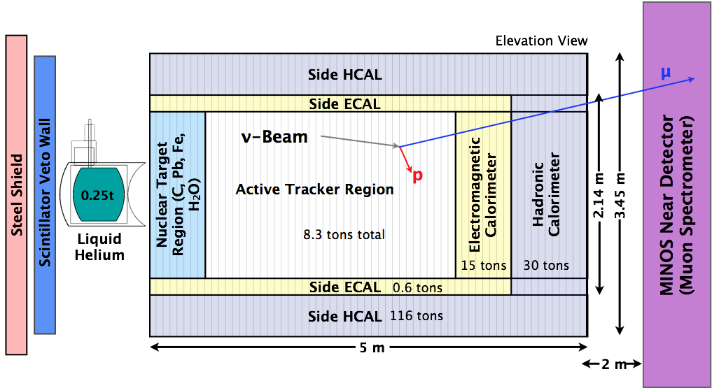
Fine-grained trackers and targets
Fine-grained trackers mean high pixelization of the detector – many detector elements
The neutrino target can be active or passive
Passive targets allow for the study of any nucleus
Active targets in principle give better signal efficiency
3.3 cm

Slide 16
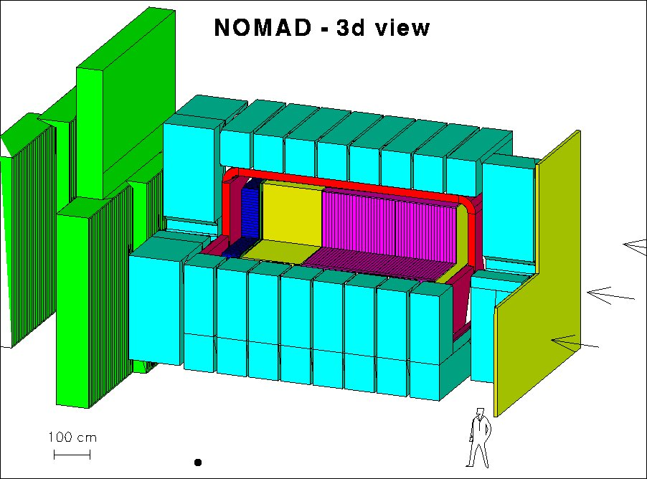
Examples of detectors - NOMAD
Drift planes
Transition radiation detectors
E&M calorimeter
Hadronic calorimeter
Muon detectors
Magnet
Magnet Return
Veto plane

Slide 17
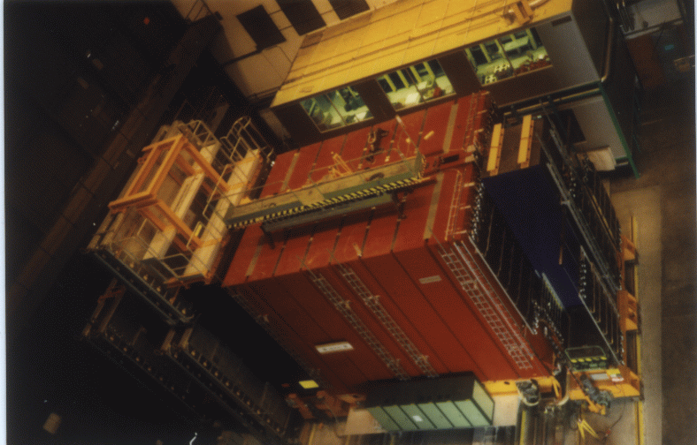
Examples of detectors - NOMAD

Slide 18
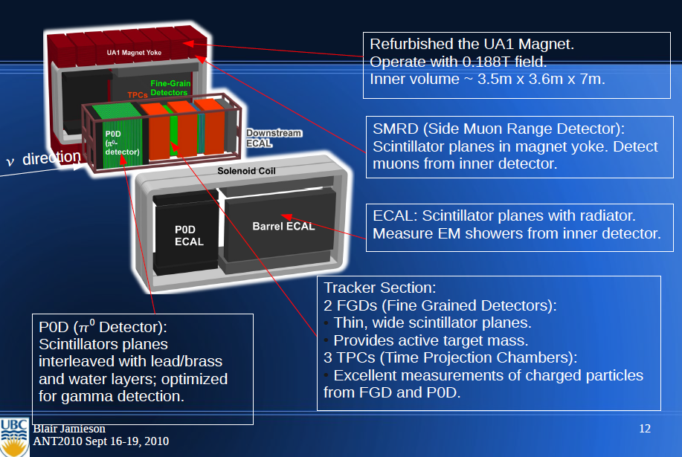
Examples of detectors – T2K
See Professor Kendall Mahn’s talk for more details

Slide 19
Examples of detectors – Minerva
120 modules for tracking and calorimetry
Magnetized MINOS near detector for downstream muon tracking/sign selection
From: Brian Tice

Slide 20
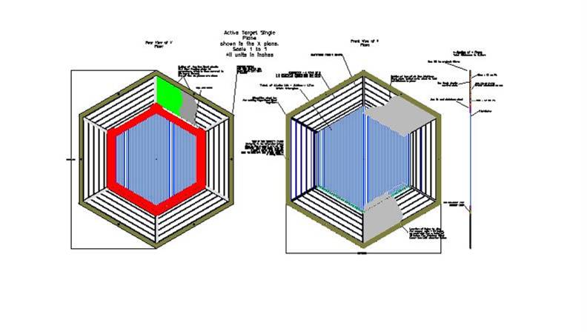
Examples of detectors – Minerva active target modules
Inner detector: active scintillator strip tracker – triangular extrusions using charge sharing rotated by 60 degrees for stereo views
Lead pieces on outer 15cm of active target for side electromagnetic calorimeter
Outer frame provides side hadronic calorimeter/muon identifier
3.3 cm
From: Jorge Morfin

Slide 21
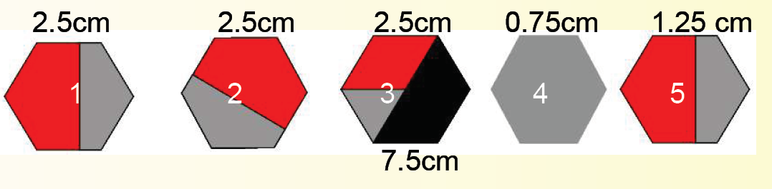
Solid Nuclear Target Region
XUXVXUXV (4 tracking points) between each layer
Main detector
Beam
Carbon, Iron, Lead – mixed elements in layers to give similar systematics
From: Jorge Morfin

Slide 22
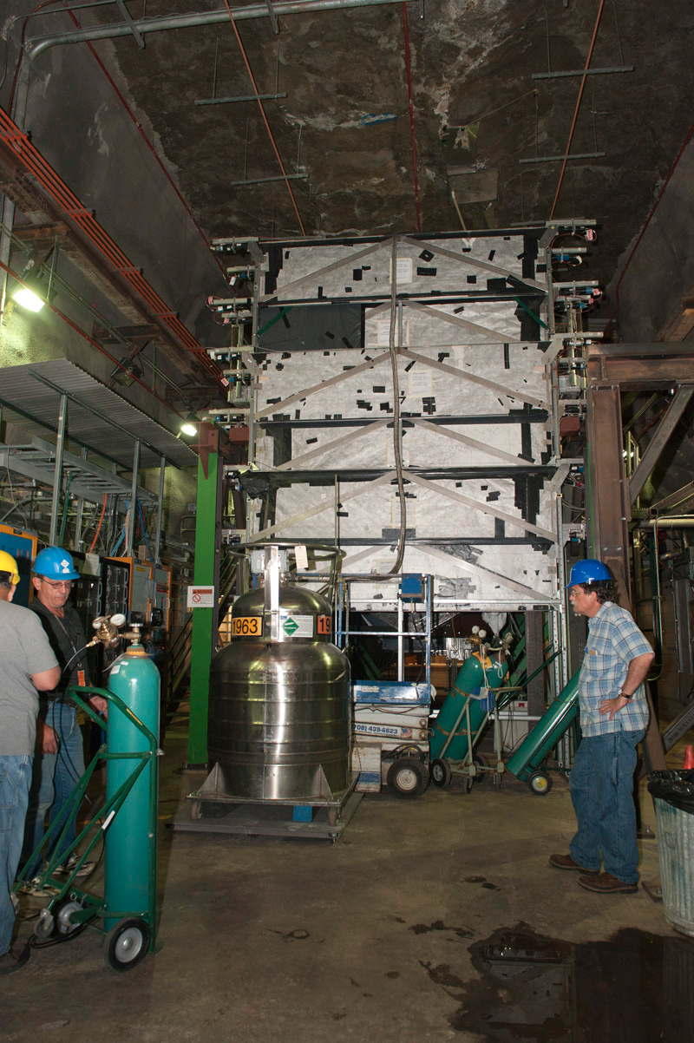
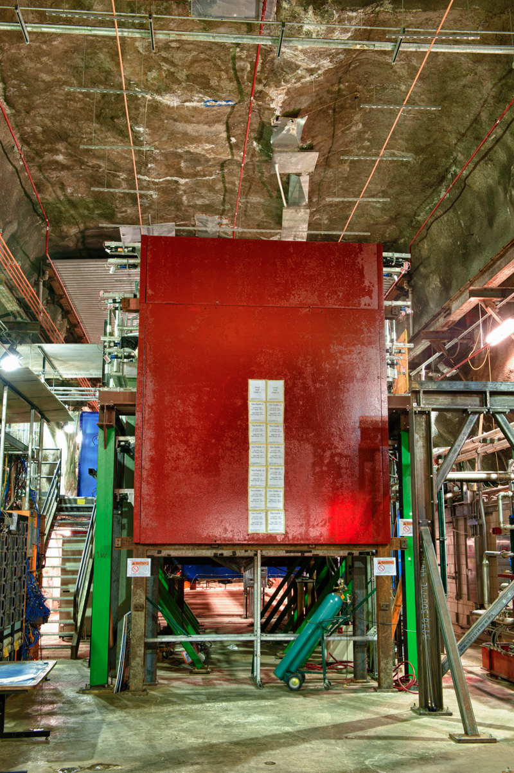
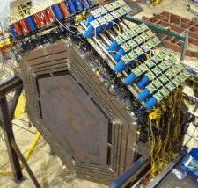
Examples of detectors - Minerva
From Minerva website

Slide 23
LBNE Near Neutrino Detector
High precision straw-tube tracker with embedded high-pressure argon gas targets
4π electromagnetic calorimeter and muon identification systems
Large-aperture dipole magnet
Philosophy
  make high-precision, high-statistics measurements of neutrino interactions with argon (far detector nucleus)
  measure inclusive and exclusive cross-sections to build and constrain models to predict the event signatures at the far site and correlate them with the true neutrino energy
  make detailed studies of electron (and muon) neutrinos and anti-neutrinos separately
3.5 m

Slide 24
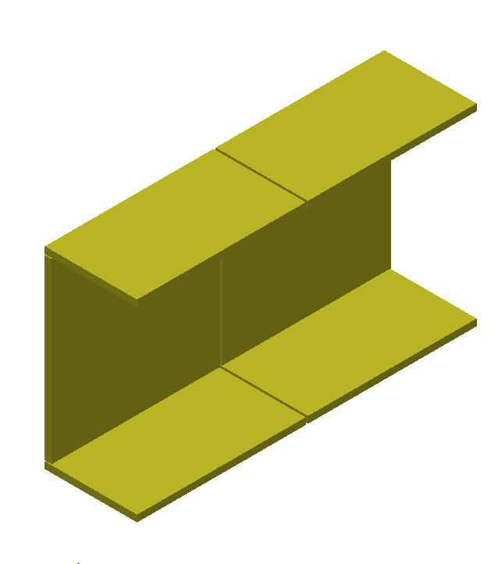
Electromagnetic Calorimeter
4π coverage gives
excellent neutral
pion identification
and containment
ECal designed to identify electrons and photons – critical for measuring neutral pion background
Sandwich of lead and plastic scintillator
Downstream ECal has 58 layers of 1.75mm lead with scintillator bars of 2.5cmx0.5cm profile (4m long)
The Barrel ECal (shown at left) and Upstream ECal have 3.5mm of lead
Total lead mass is 110 tons, scintillator mass is 35 tons

Slide 25
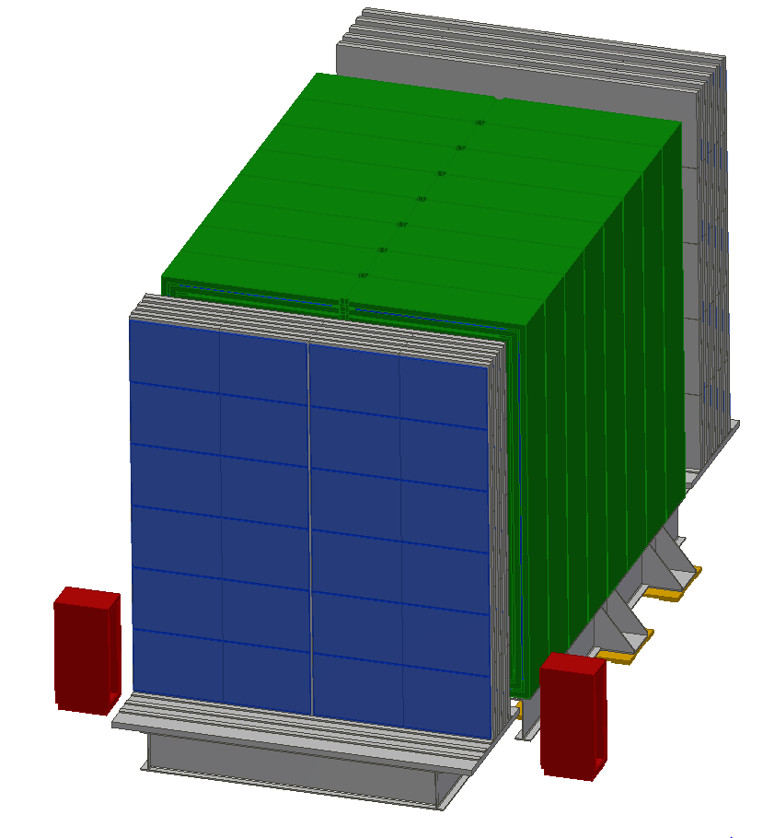
External Muon
Identifier
Steel interleaved with Resistive Plate Chambers
Identifies muons – separates muons and charged hadron (e.g. pions)

Slide 26
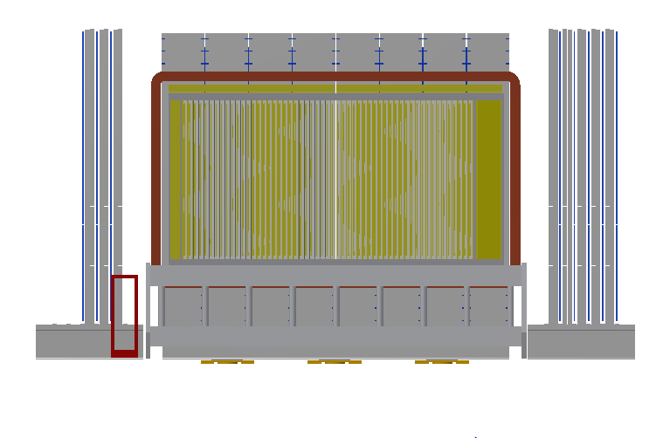
LBNE Near Neutrino Detector
Transition Radiation Detector
Radiator foils, argon gas targets, other
nuclear targets
UA1-style dipole magnet – 0.4 T
Muon identifier – also interleaved in magnet
Average density ~ 0.1 g/cm³

Slide 27
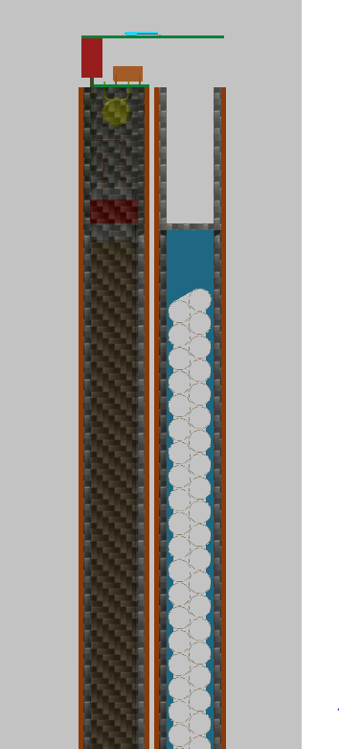
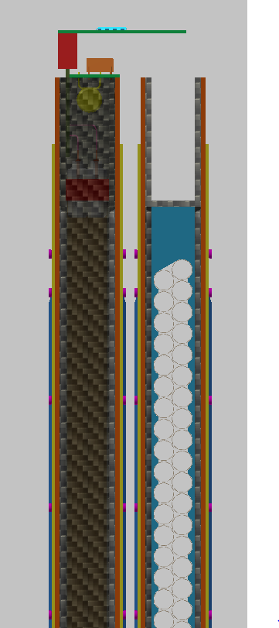
Strawtube Tracker
Module
XX YY Module
62mm thick leaving 18mm for a nuclear target module
TRD XX YY Module
76mm thick

Slide 28

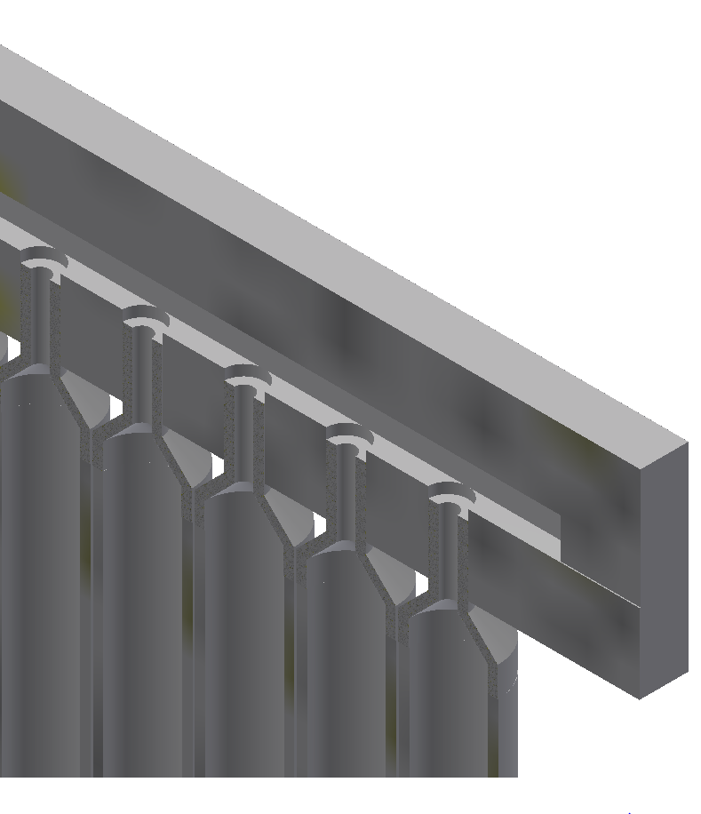
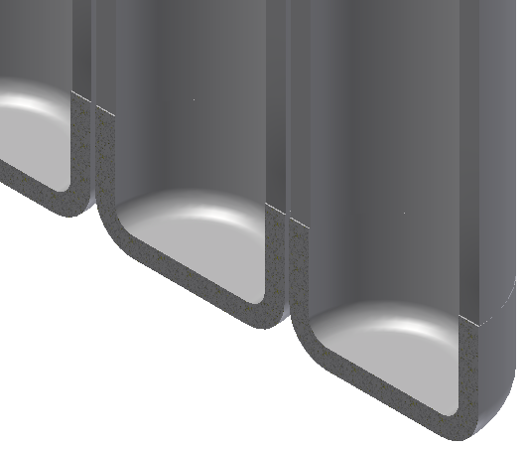
Argon Gas Target Assembly – SS Version
216 tube assemblies welded to manifold
SS Tube .625” OD x .065” wall butt welded to adapter and cap
SS Tube Adapter
Manifold Cover
Weld
Manifold
SS Tube Cap

Slide 29
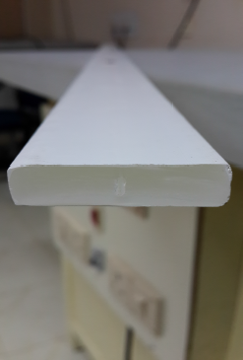
Basic Elements – Scintillator Bars
Scintillation peaks at 420nm, cuts off at 400nm
Collect scintillation light with wavelength shifting fiber – emission peak at 476 nm (green) – total internal reflection to end of bar
Maximize collection efficiency with a reflector around the outside of the bar
TO₂ reflecting material co-extruded with scintillator at FNAL
Wavelength shifter attenuation length > 3m, so long bars are possible
Versatile – used for tracking, ECal, Hcal
Useful in moderate density applications

Slide 30
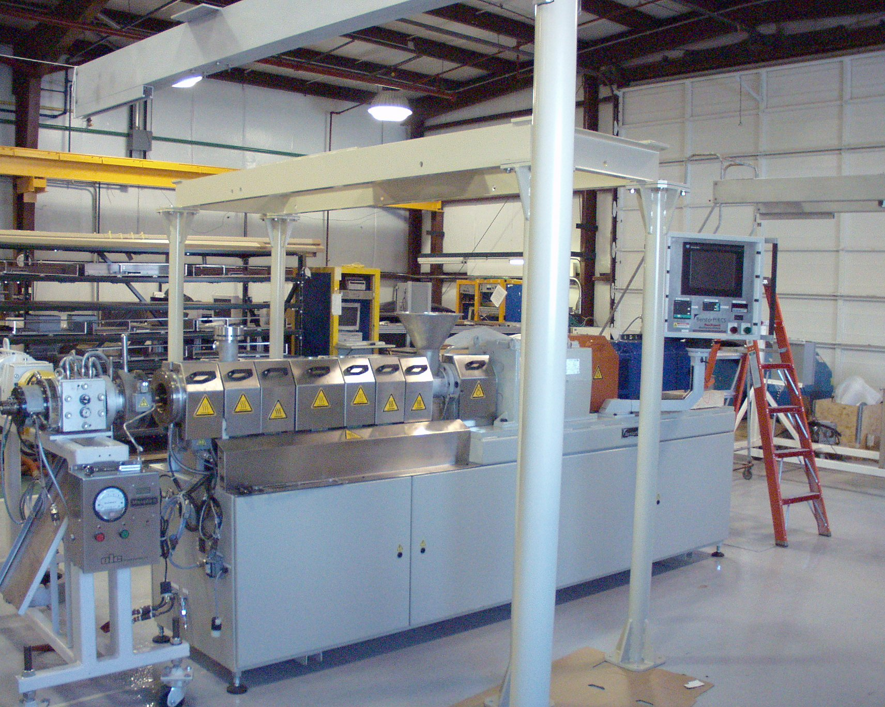
Basic Elements – Scintillator Bars
Lab 5 at FNAL, polystyrene scintillator extrusion
Co-extrusion with titanium dioxide successful, R&D on wavelength-shifting fiber co-extrusion

Slide 31
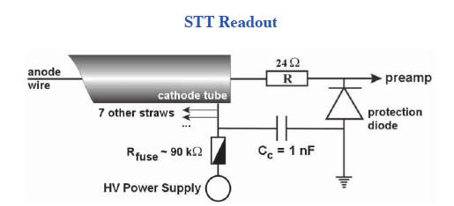
Basic Elements – Straw Tubes
Straws fabricated with conducting material (or coated with conducting material)
Anode wire threaded through the straw (which can be a few meters in length)
High electric field – especially near the anode results in electron multiplication
Excellent response to charged particles
Excellent in low-density applications
Charged particle
Ground
HV
Gas Volume
Ionization track

Slide 32
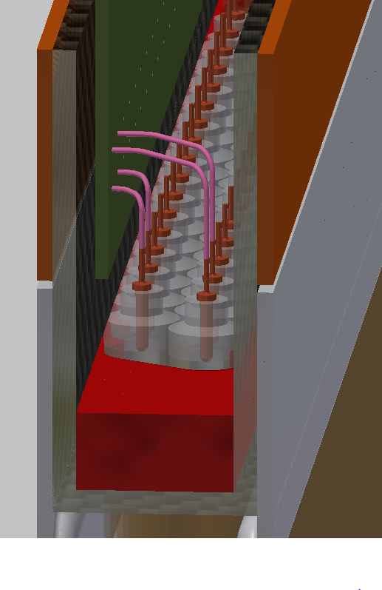
Straw Tubes
Anode wire: strong, good conductor, thin (gold-plated tungsten 30 microns)
Straw: kapton, coated with conducting material
Gas mixture: usually noble gas (argon) and damping gas (hydrocarbon)
Straw material can be the neutrino target
Wire Connections to IO Board
Straw Tube Pin
Straw Tube Insert

Slide 33
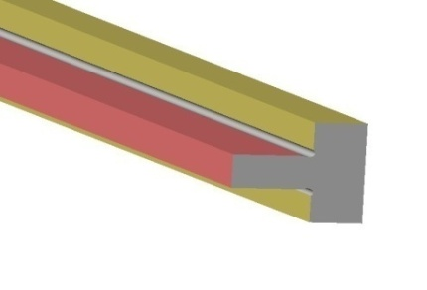
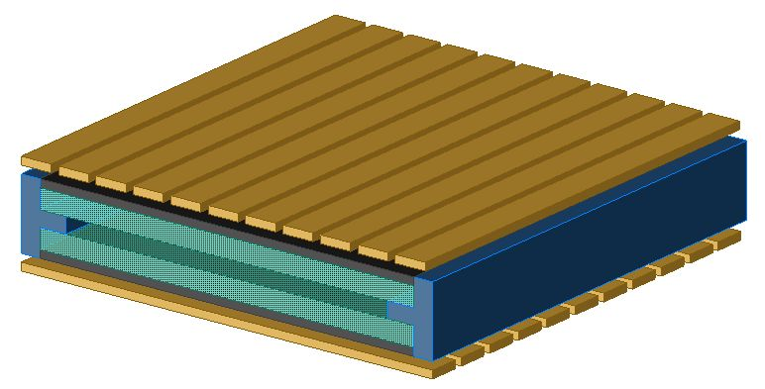
Construction of RPC
Two 2 mm thick float Glass
Separated by 2 mm spacer
2 mm thick spacer
Pickup strips
Glass plates
Resistive coating on the outer surfaces of glass
Naba Mondal
33
Notes:
33

Slide 34
Basic Elements – Resistive Plate Chambers
RPCs can be built with glass or plastic (bakelite)
Voltage drop across the plates (several kV)
Spacers used to keep the plates separated (few mm thick)
Charged particles induce a localized discharge
Good timing resolution (25 ns)
Enables inexpensive readout over a broad area

Slide 35
Gross Design Features - Tracking
How do we fit these together?
Next slides by Jan Boissevain (LBNE engineer)

Slide 36
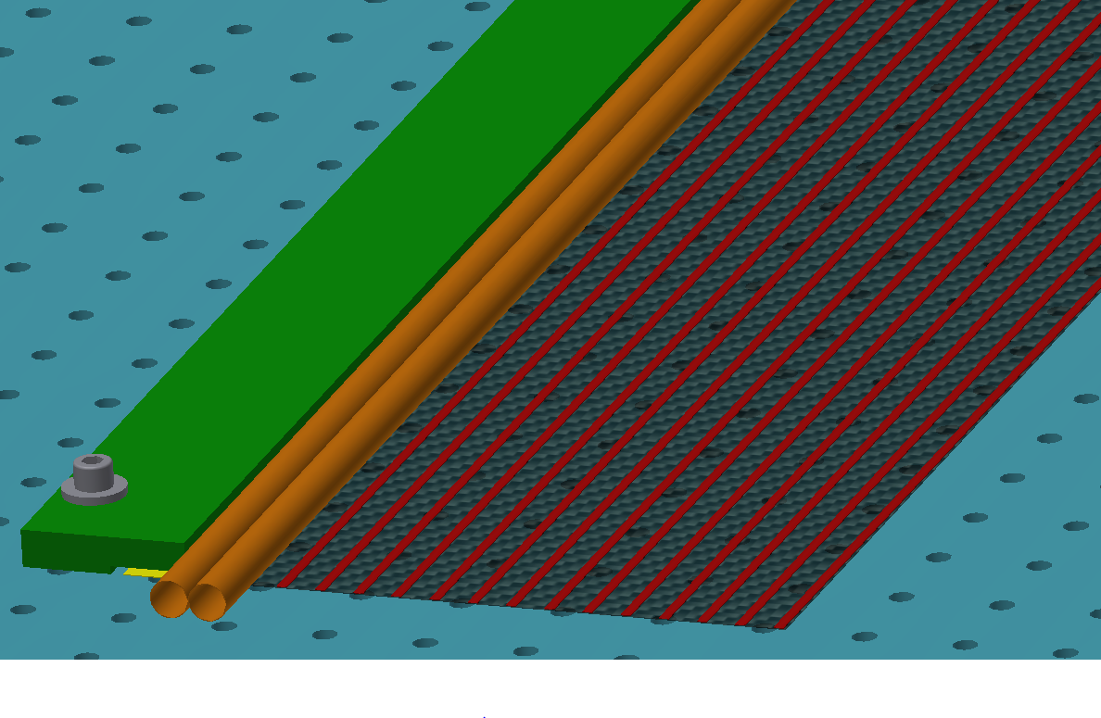
Place straws and fill with precision steel balls (.375”)
Straw Locator

Slide 37
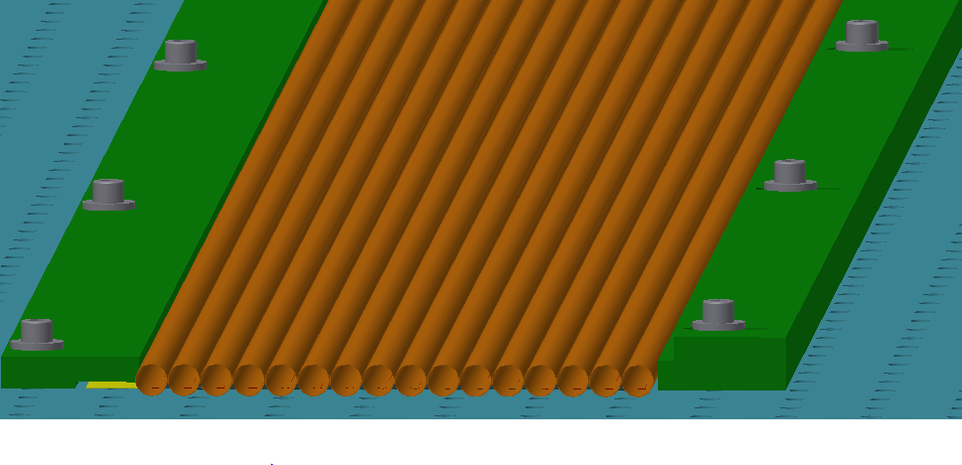
Complete straw placement for first row, add straw locator – all straws filled with precision steel balls

Slide 38
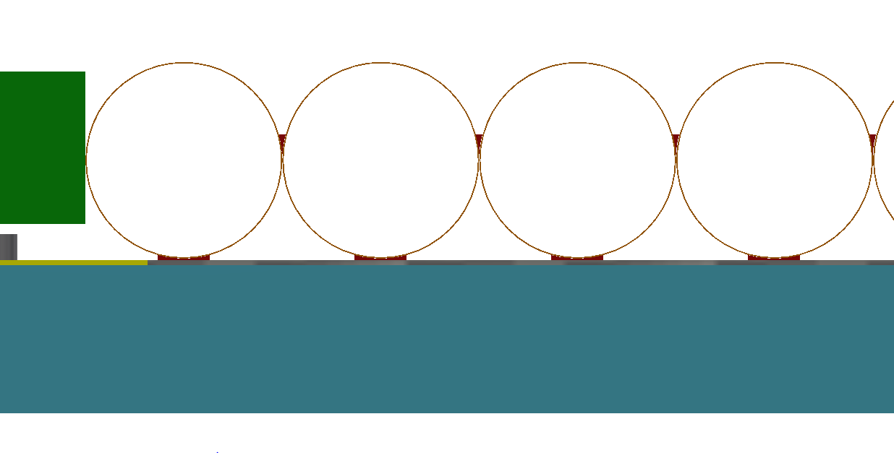
Apply glue between straws

Slide 39
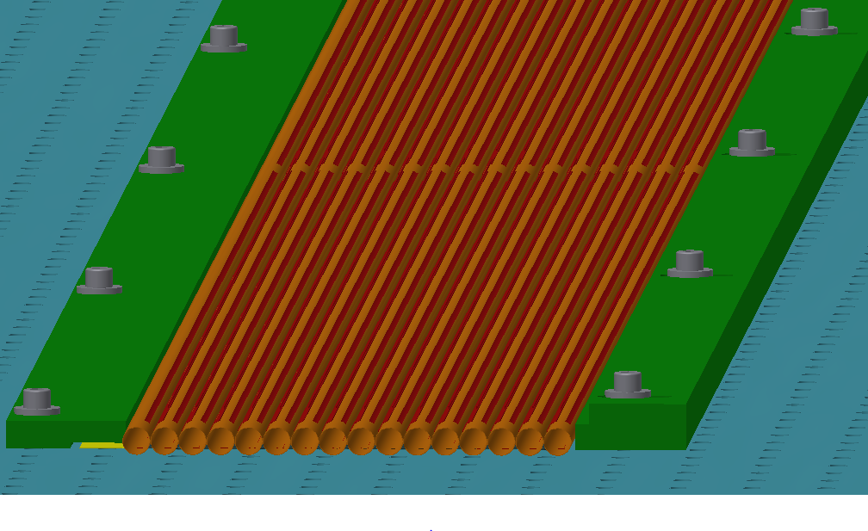
Apply glue in preparation for placement of 2nd row of straws

Slide 40
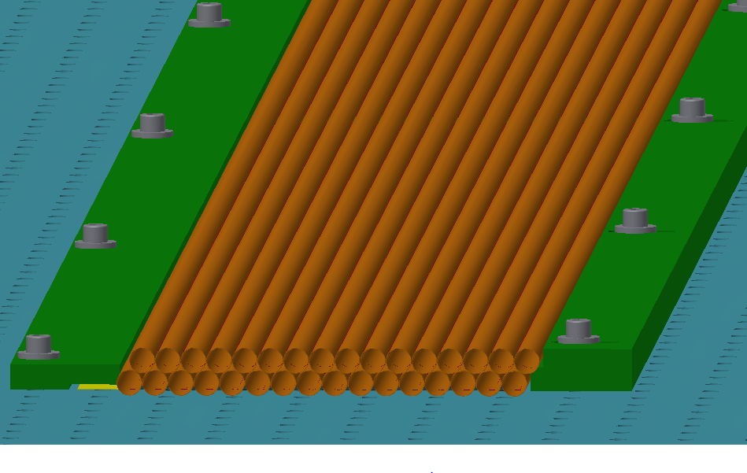
Add second row of straws, fill straws with precision steel balls – the bottom row of straws remain filled with steel balls

Slide 41
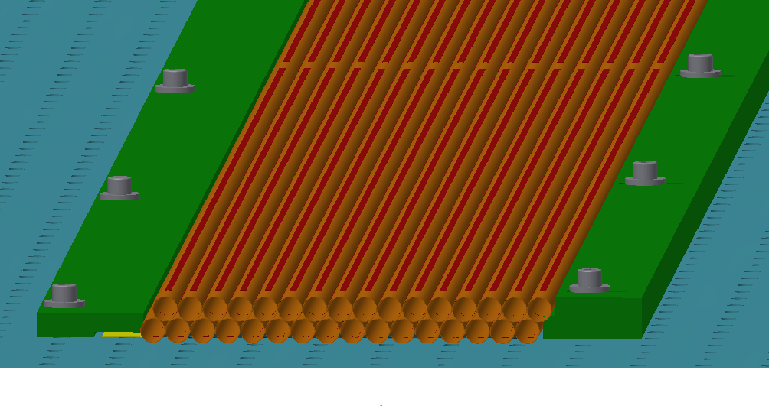
Add glue lines for top composite sheet

Slide 42
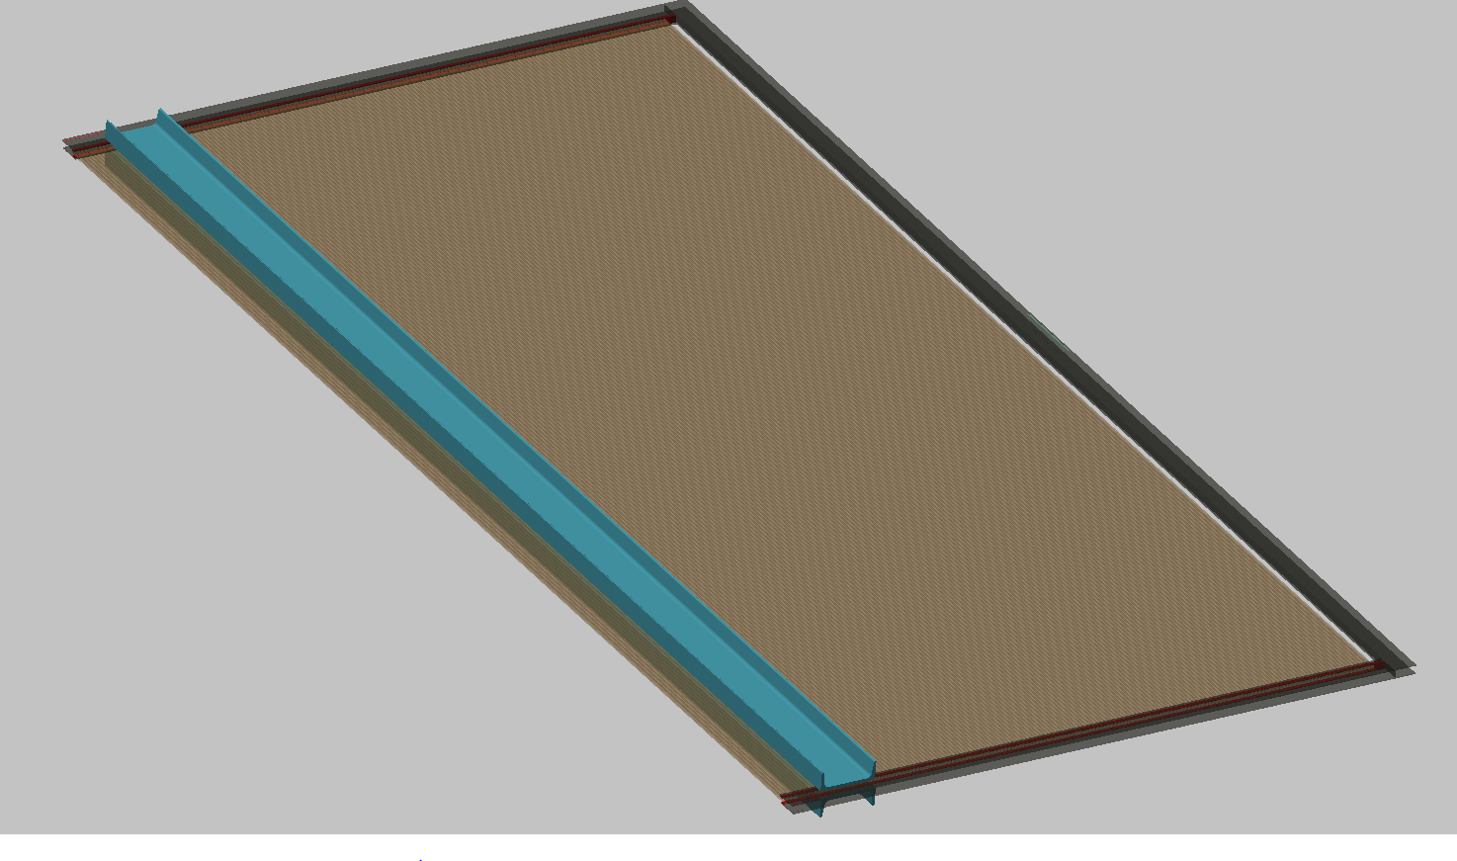
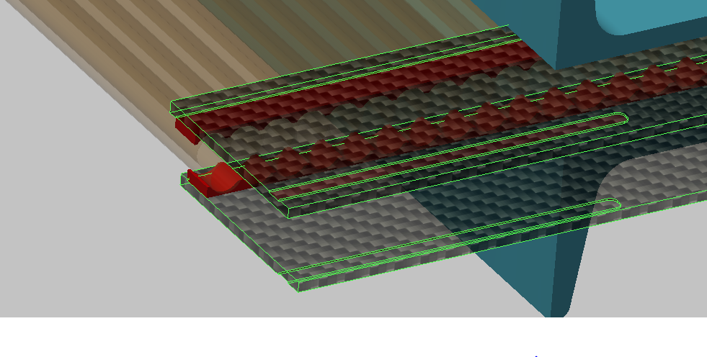
FGT Straw Tube Subassembly A with aluminum channels for shipping
Groove Feature for Indexing the Outer Frame during a glue operation

Slide 43
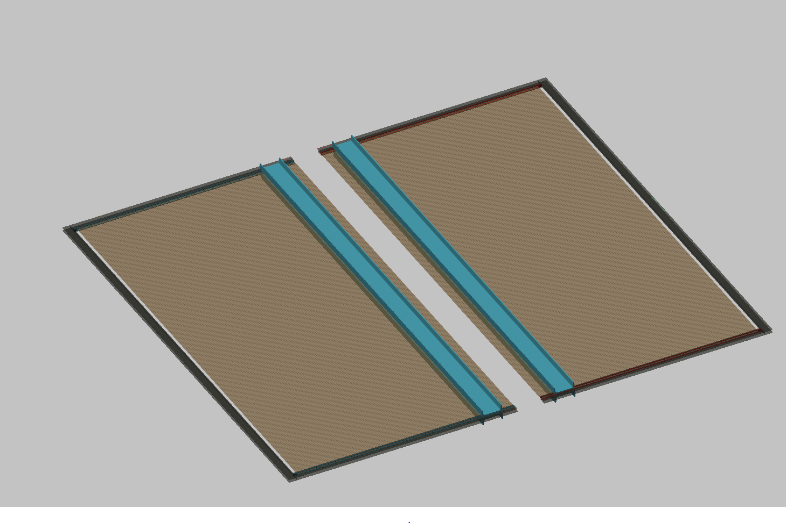
Prepare to mate the two halves
FGT Straw Tube Subassembly B
FGT Straw Tube Subassembly A

Slide 44
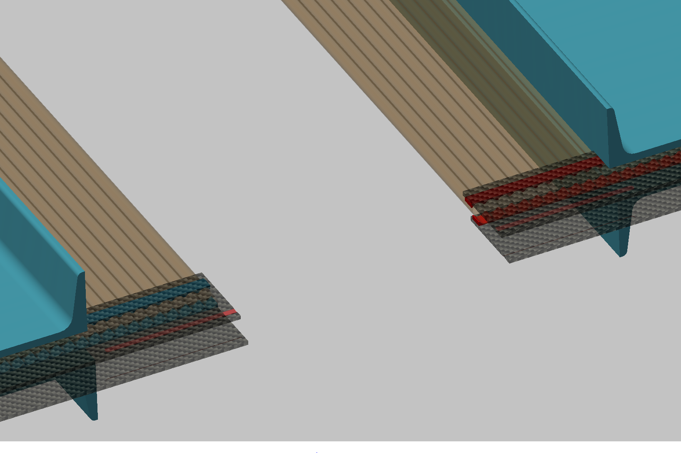

Slide 45
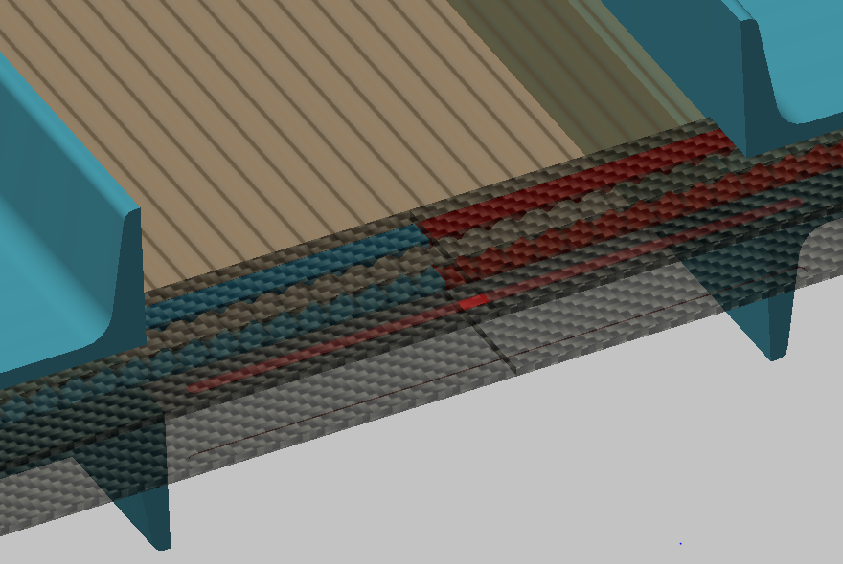
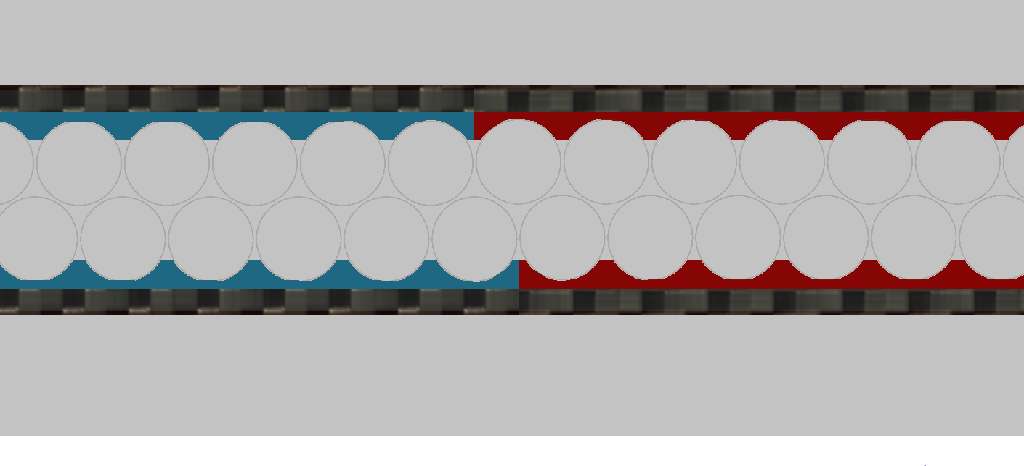

Slide 46
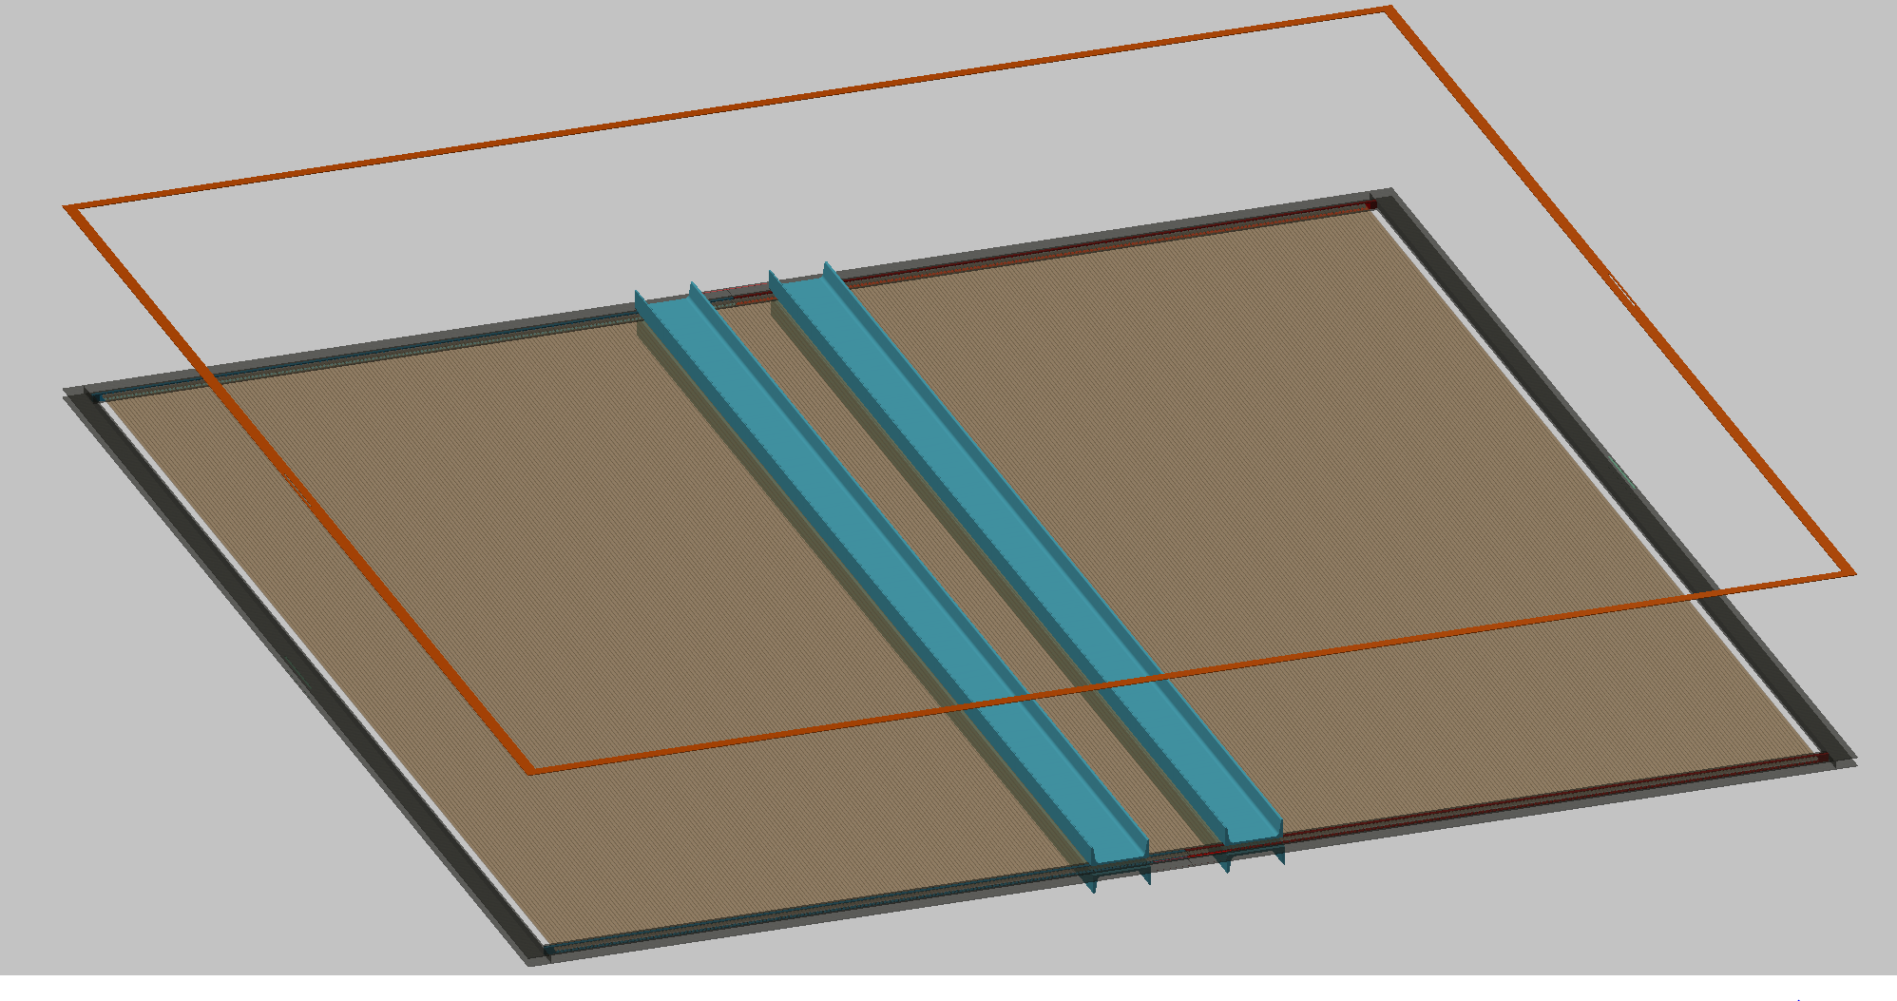
Position Outer Frame

Slide 47
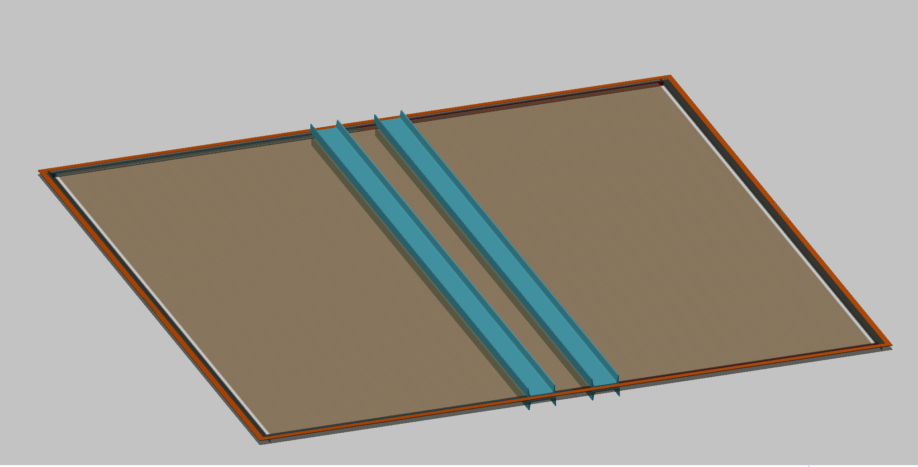
Glue Outer Frame In Place

Slide 48
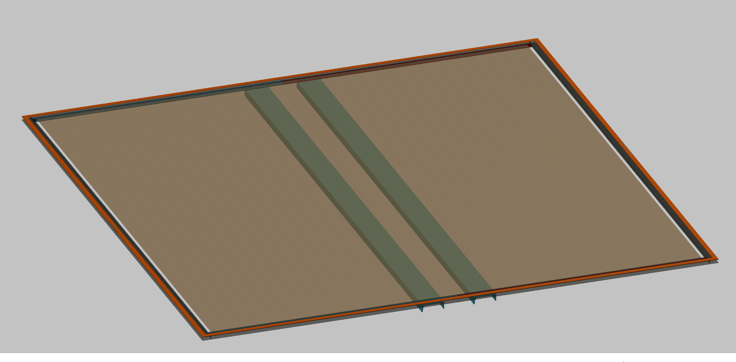
Glue Outer Frame to mated subassemblies A & B
Remove shipping fixtures

Slide 49
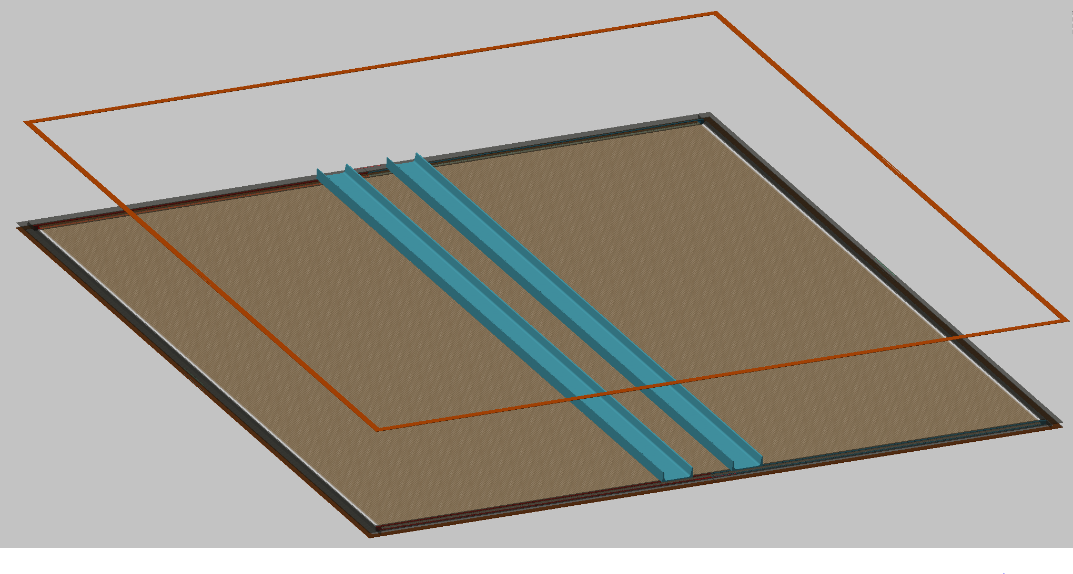

Slide 50
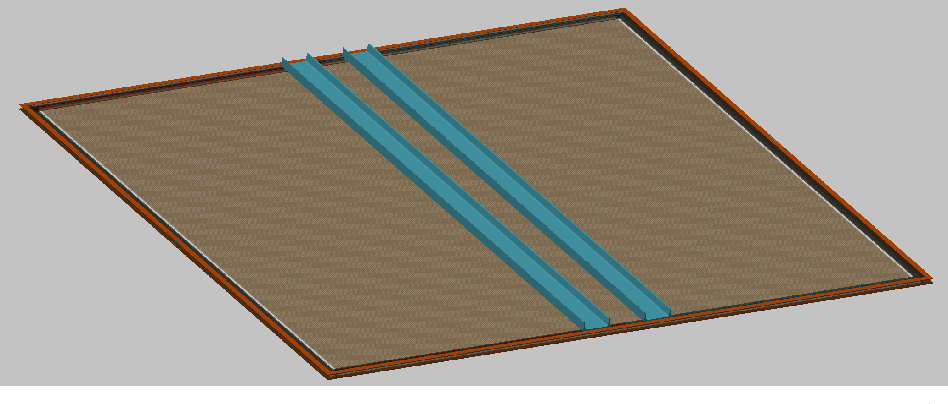
Turn assembly over and glue the second outer frame

Slide 51

Remove shipping fixtures
Result: XX straw tube plane assembly with 672 straws
3500mm x 3500mm x 30mm outside dimensions

Slide 52

Install Window Frames – window foil not shown

Slide 53

32 Channel I/O Board
Wire Connections to IO Board
Straw Tube Pin
Straw Tube Insert
Window Frame

Slide 54
Gross Design Features - Magnets
Magnetic field useful for charge separation and momentum measurements
Geometry of typical neutrino beams favors dipole configuration
Low-density trackers (e.g. straw tubes) can do electron-positron separation
Requires significant power – especially for cooling (few Mwatts)

Slide 55



UA1 magnet at CERN:
Yoke material: EN S235JRG2, a European low Carbon steel
Yoke sections assembled, tested
2 yoke sections on carriage, the total number of yoke sections is 16
Assembled magnet in hall

Slide 56

UA1 magnet at CERN:
Essential to have a continuous magnetic circuit in steel yoke -
Assembled yoke sections on carriage in UA1 experimental hall at CERN. Total magnet weight 850. tons.
Data taking started in November, 1981.
Operating properties: 10,000 amps, 576. V., resistance .0576Ω @ 40.º C. Cooling water flow 50. liters/sec.
Original yoke costs – 2,000,000.00 Euros in 1978.
Sondheim

Slide 57

Gross Design Features – Nuclear Targets
Geometry of typical fine-grained trackers such that planes of un-instrumented nuclear targets can be interspersed with tracking material
This allows good possibilities for neutrino-nucleus interaction studies. Targets can even be swapped out.
Care must be taken due to absorbed particles and side-going particles that will be missed.
Petti

Slide 58
Gross Design Features – Nuclear Targets
Some materials require specialized target containment – gases, liquids
In the case of liquid, liquid in, liquid out studies can be performed
In the case of gas, can vary the pressure continuously to enable efficiency studies
SS Tube .625” OD x .065” wall butt welded to adapter and cap
SS Tube Adapter
Manifold Cover
Weld
Manifold

Slide 59
Advantages and Disadvantages to Fine-Grained Trackers
Advantages
  exquisite reconstruction possible
  similarities to collider physics detectors
    share reconstruction tools, development costs, materials and component costs
  non-uniform: design flexibility
Disadvantages
  non-uniform, need to study efficiencies carefully
  dead space
  Issues of non-uniformity/dead space different from collider detectors since vertices happen anywhere
  cost scales like volume – not a problem for current and future experiments

Slide 60
Conclusions
Fine-grained trackers have a long history in neutrino physics.
FGTs benefit from similarities to detector systems in other communities (e.g. collider physics)
FGT designs can be tuned to the event rate, energy regime and background environment of a particular experiment
FGTs are optimal for high precision studies important for understanding neutrino interactions

