Slide 1
Advanced Group Policy Management

Slide 2
Advanced Group Policy Management
Key Features
Components
Workflow

Slide 3
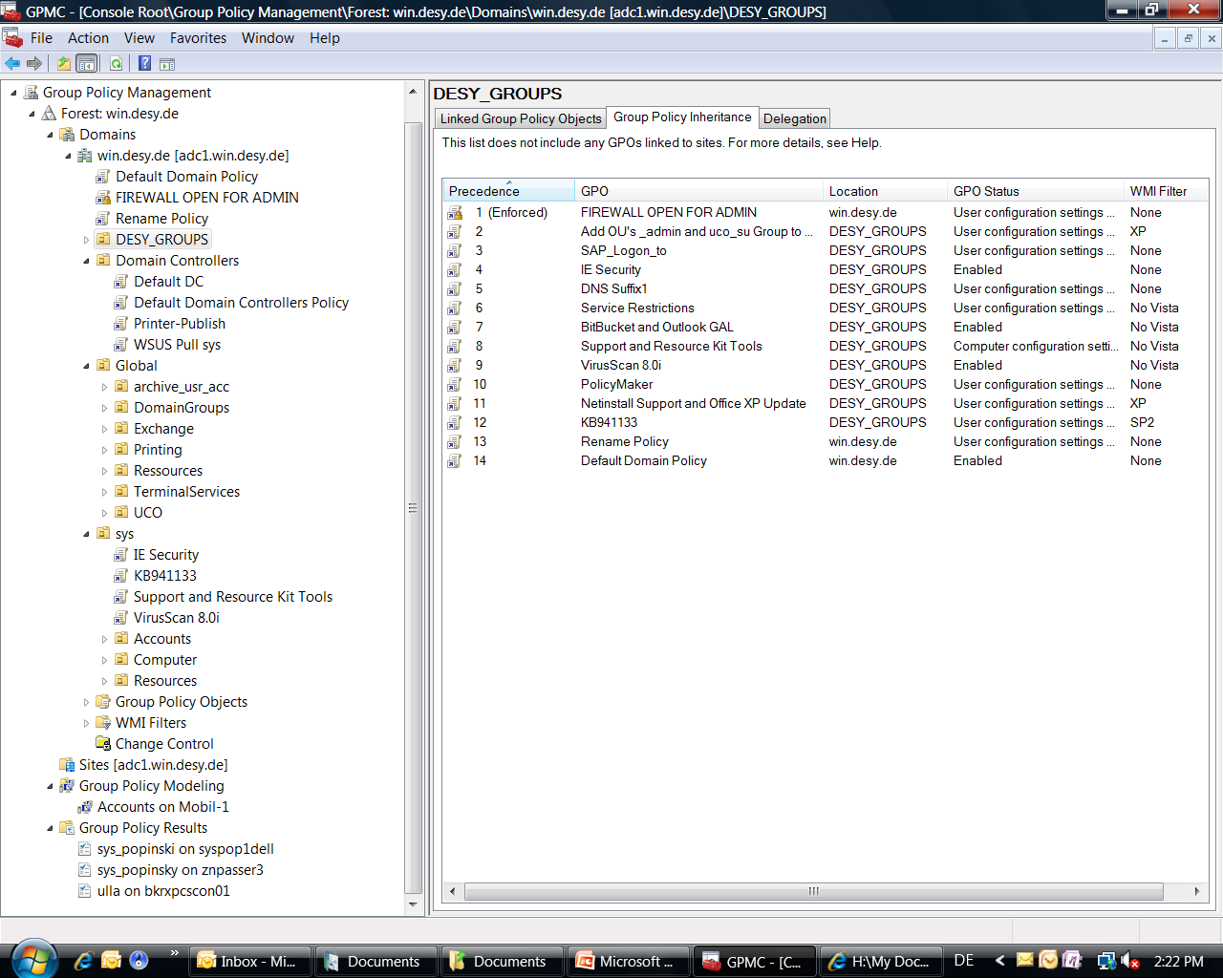
GPMC

Slide 4
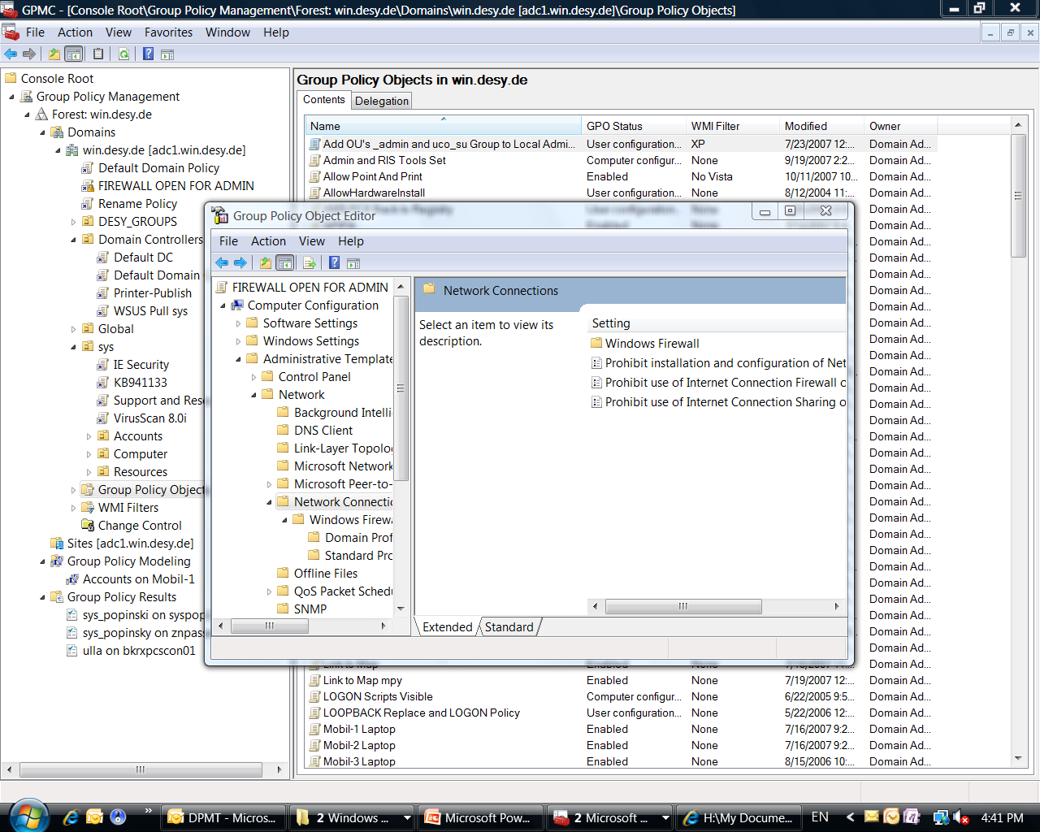
GPMC

Slide 5
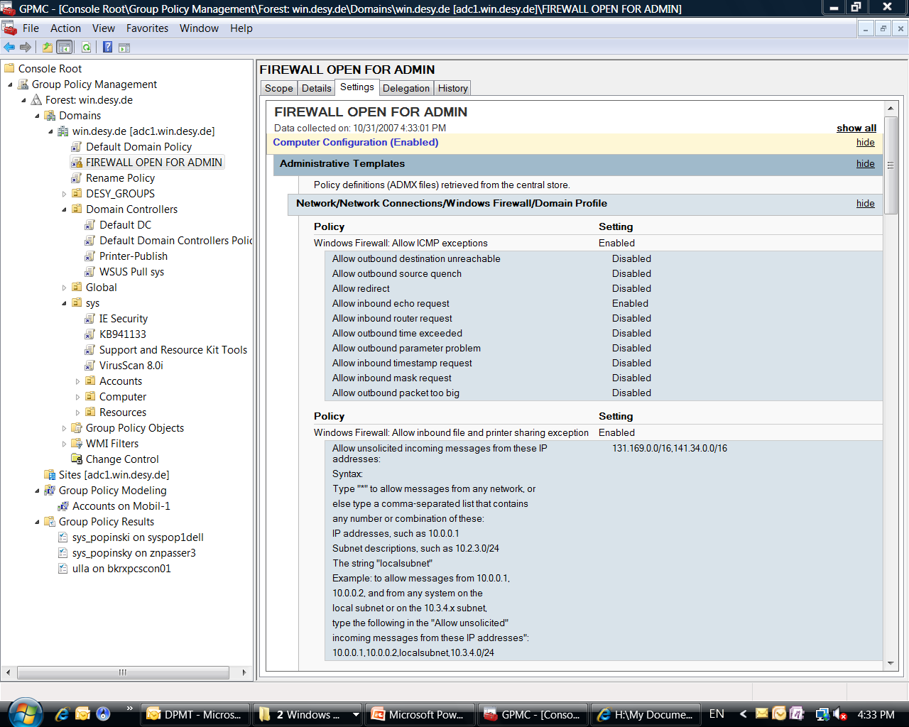
GPMC

Slide 6
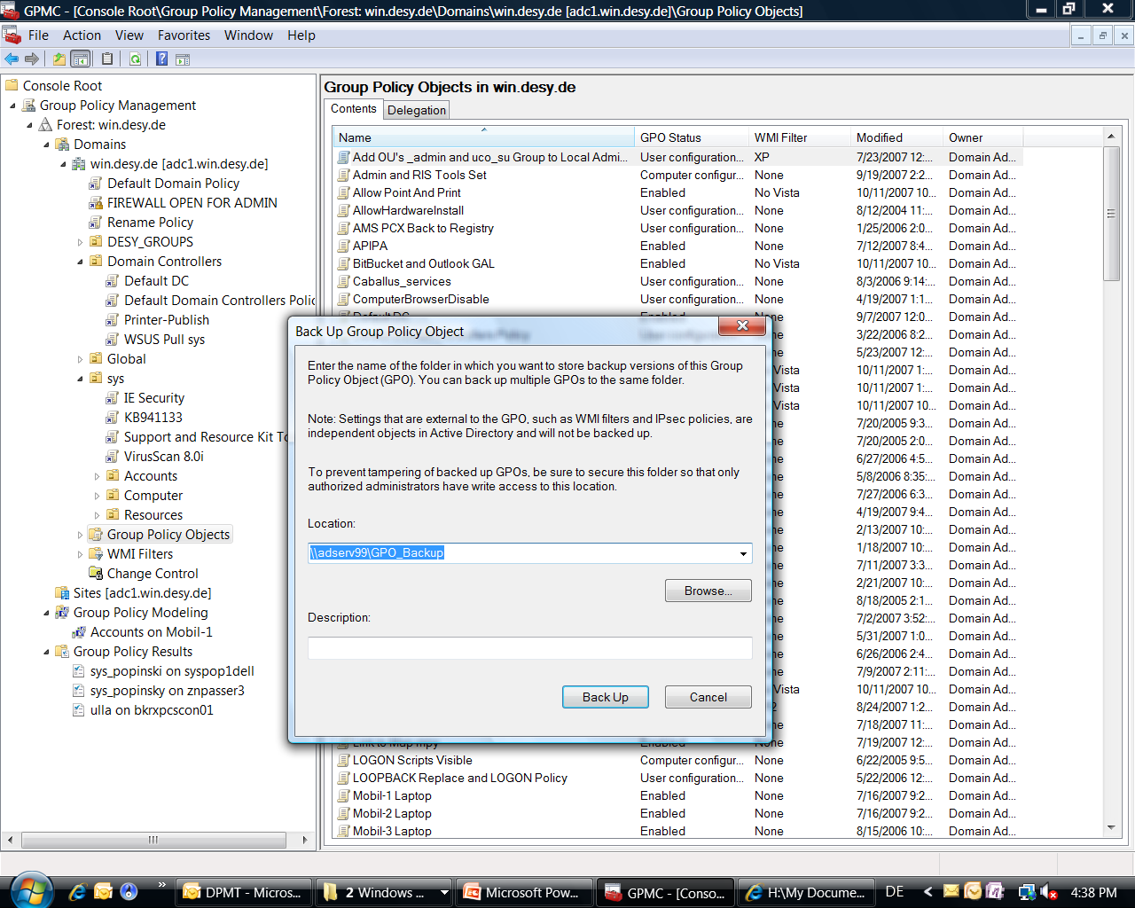
GPMC

Slide 7
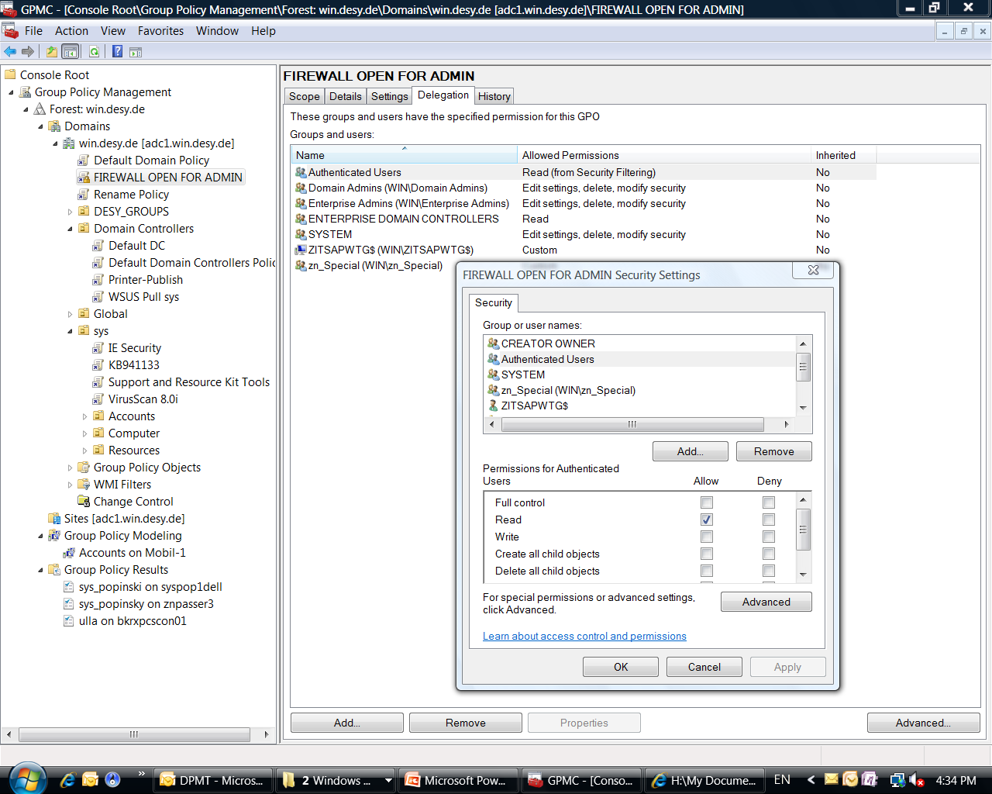
GPMC

Slide 8
GPMC

Slide 9
Advanced Group Policy Management
Key Features
Components
Workflow

Slide 10
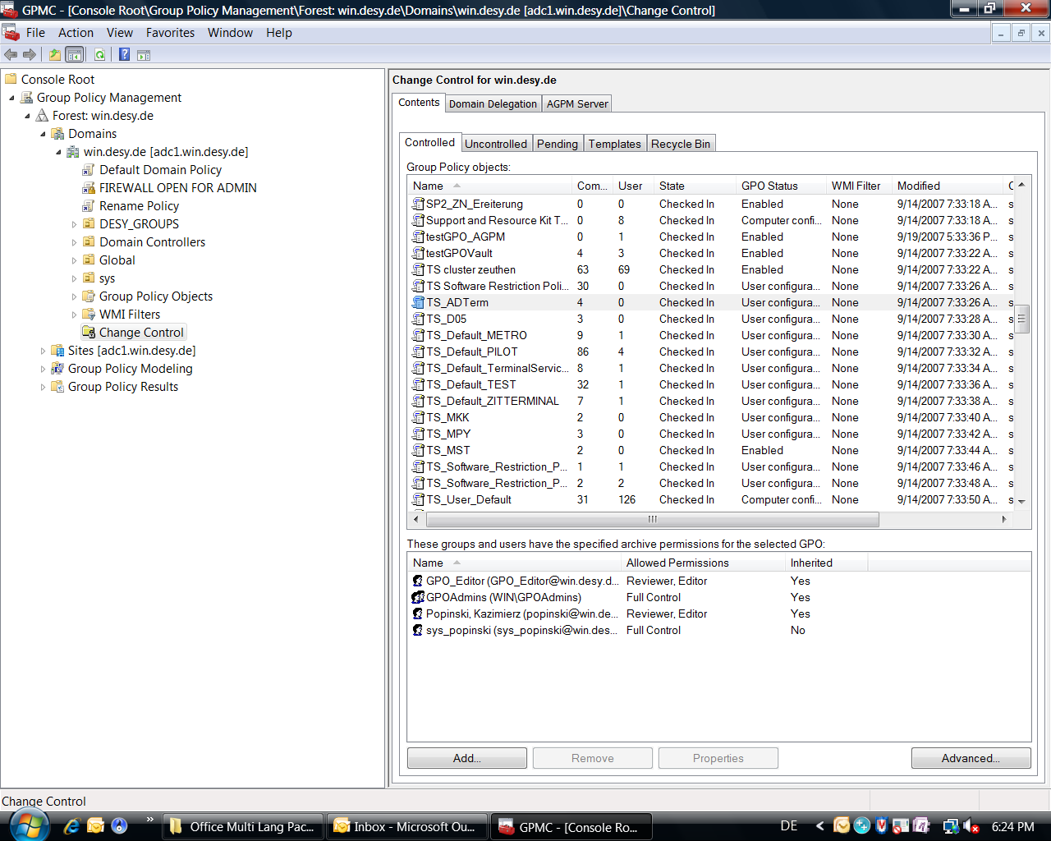
AGPM integration within GMPC

Slide 11
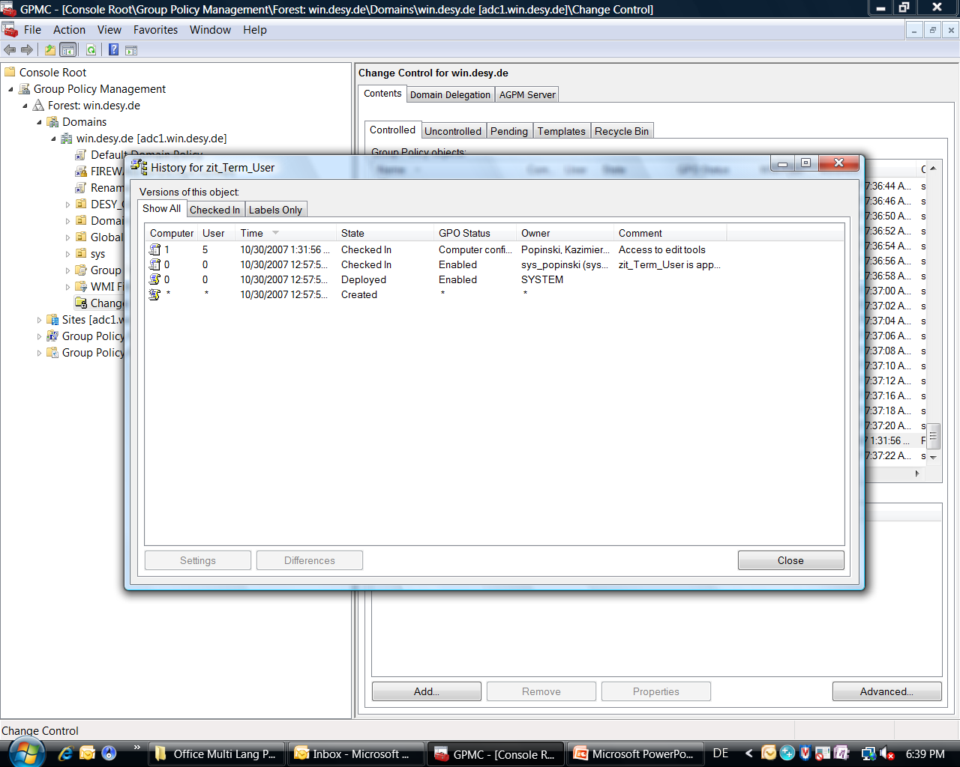
Change Control

Slide 12
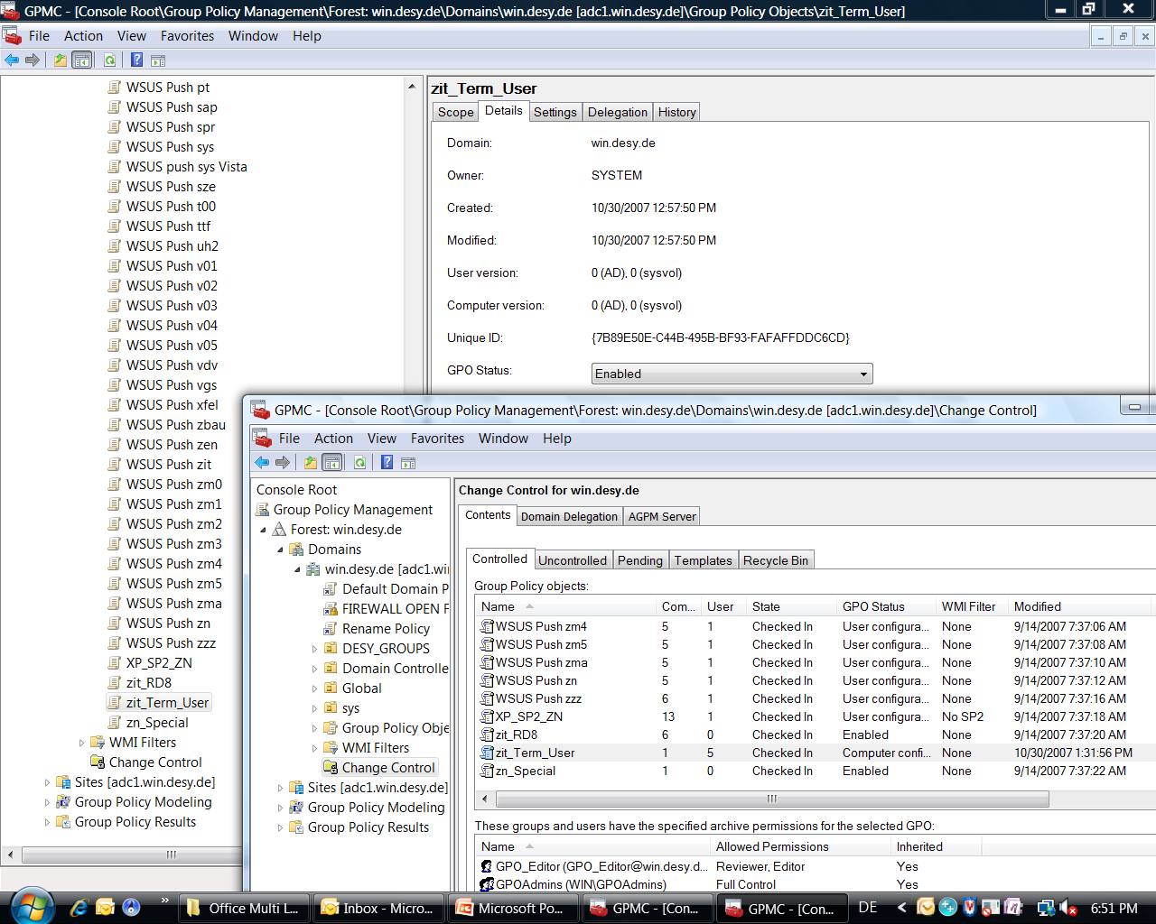
Offline Editing

Slide 13
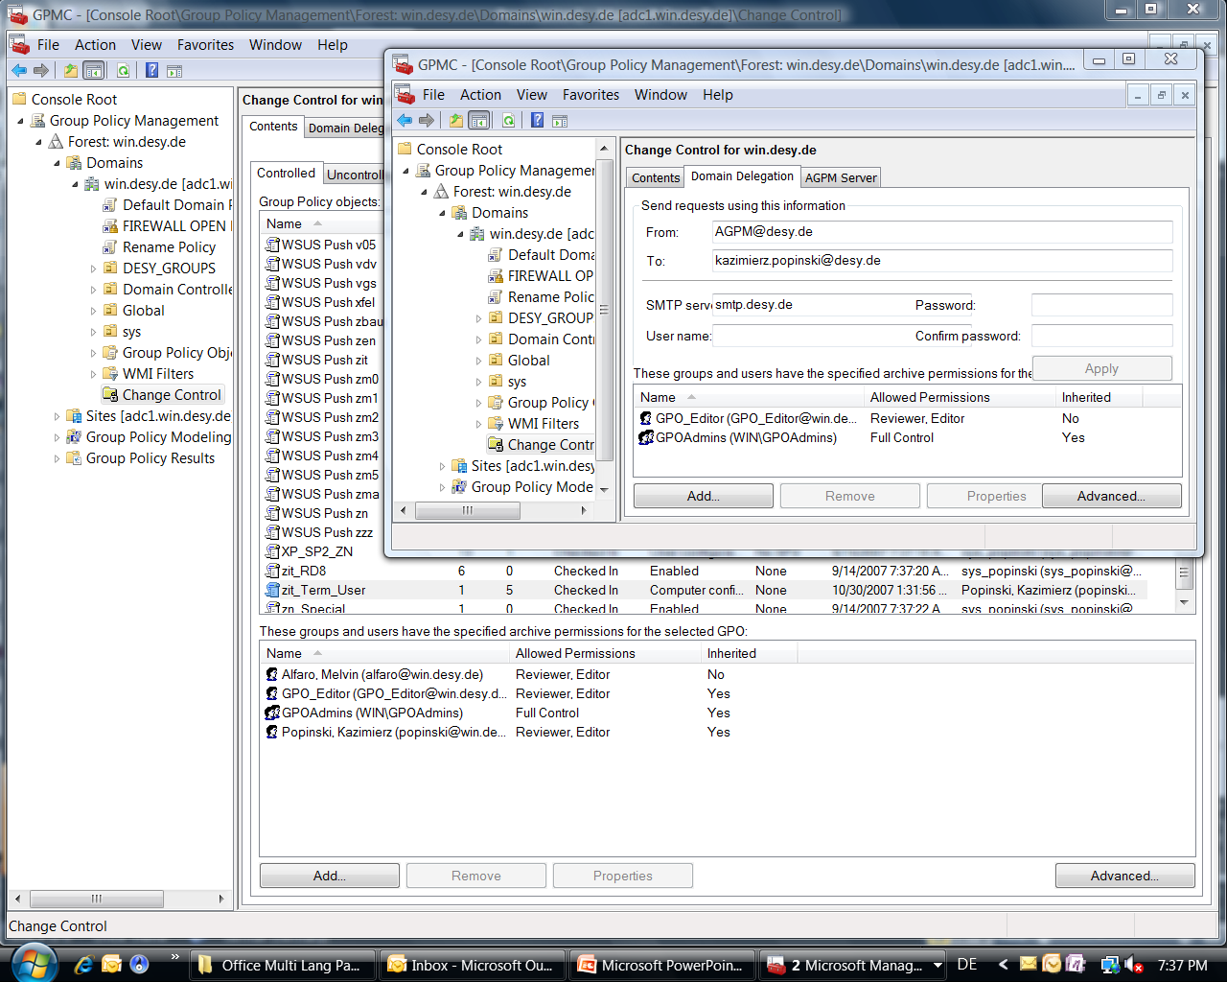
Role-Based Delegation

Slide 14
Advanced Group Policy Management
Key Features
Components
Workflow

Slide 15
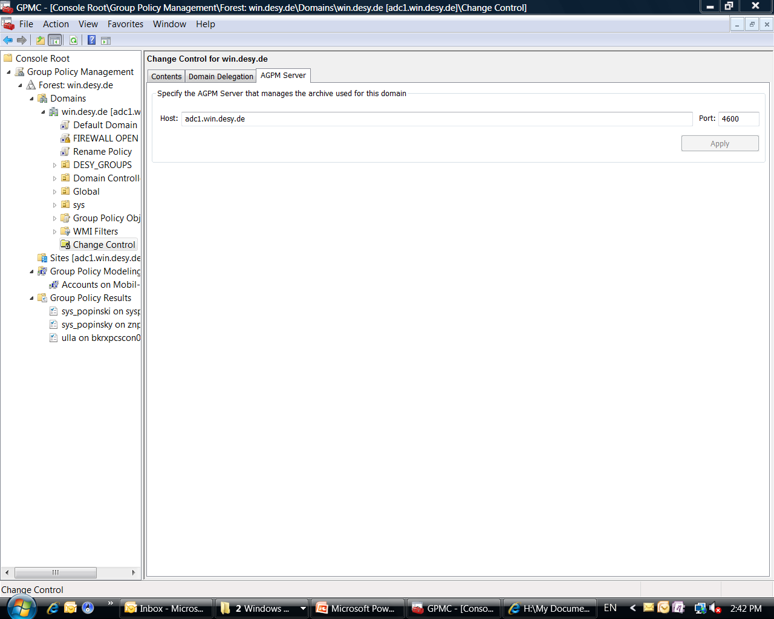
AGPM Service

Slide 16
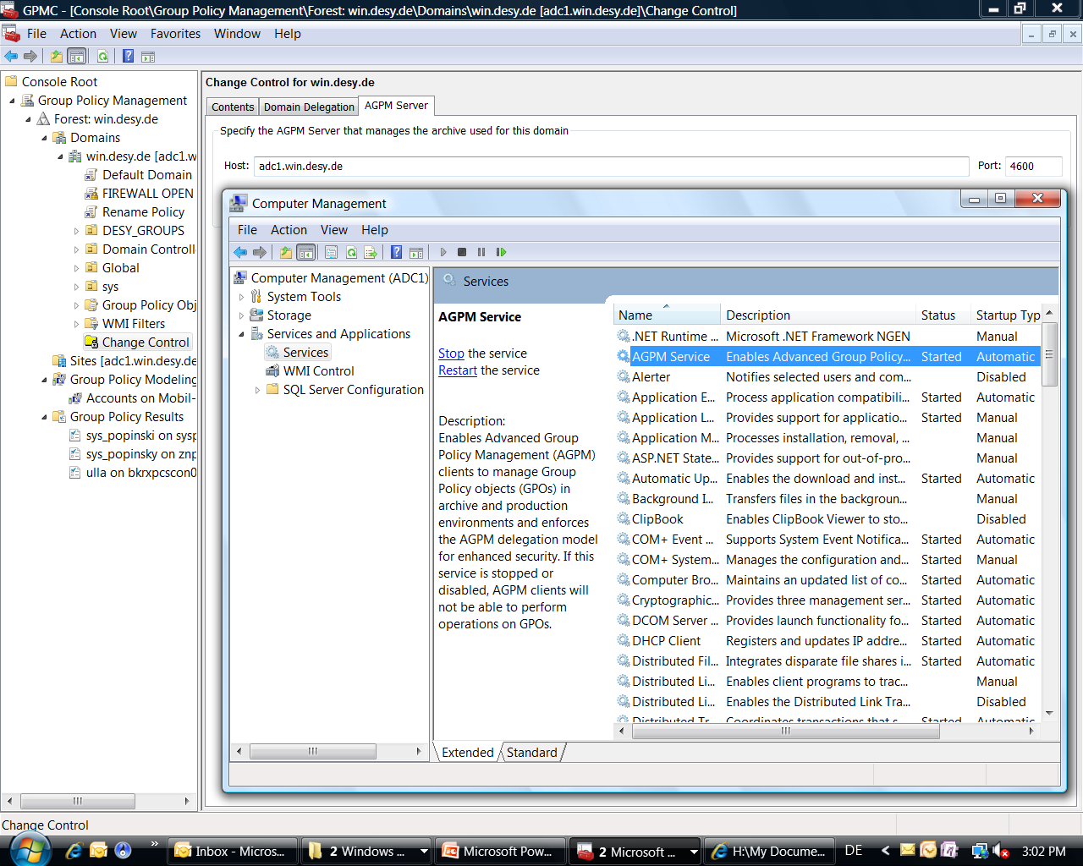
AGPM Service

Slide 17
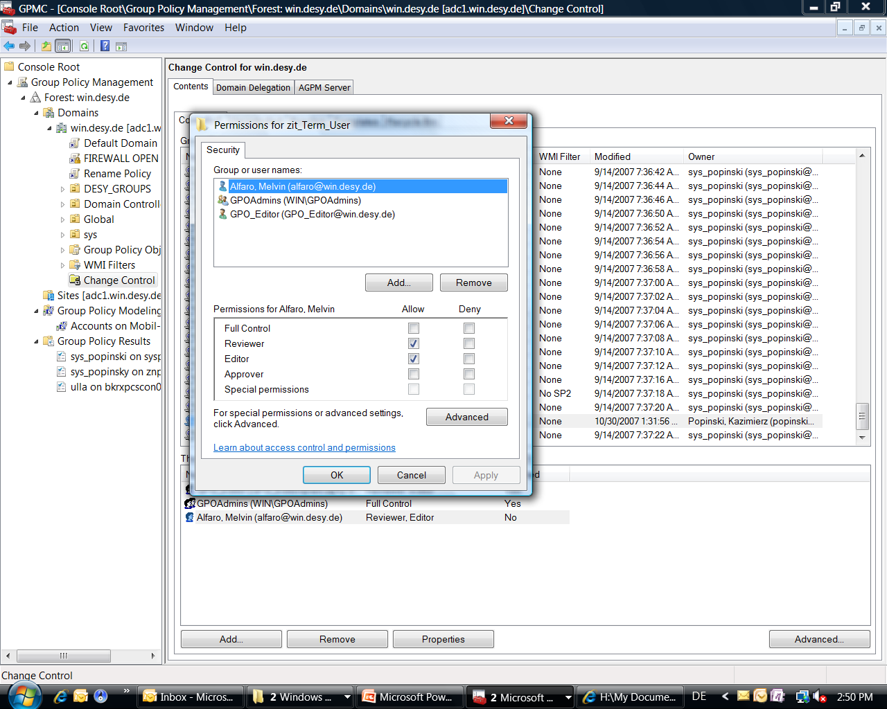
AGPM Service

Slide 18
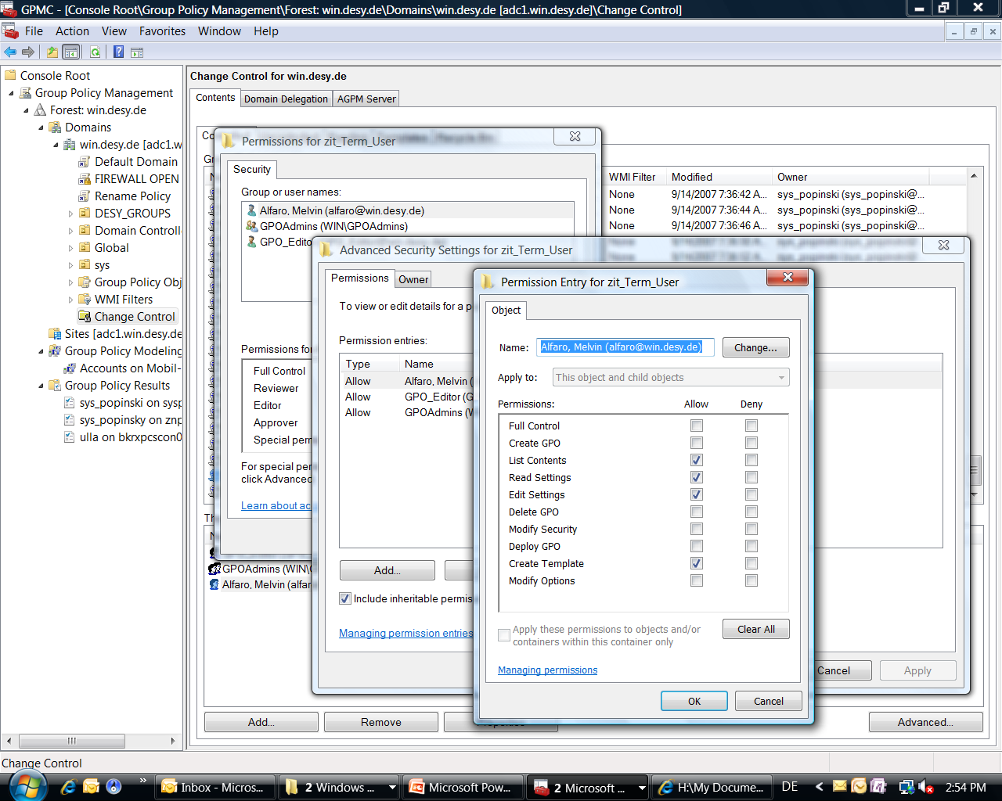
AGPM Service

Slide 19
Advanced Group Policy Management
Key Features
Components
Workflow

Slide 20
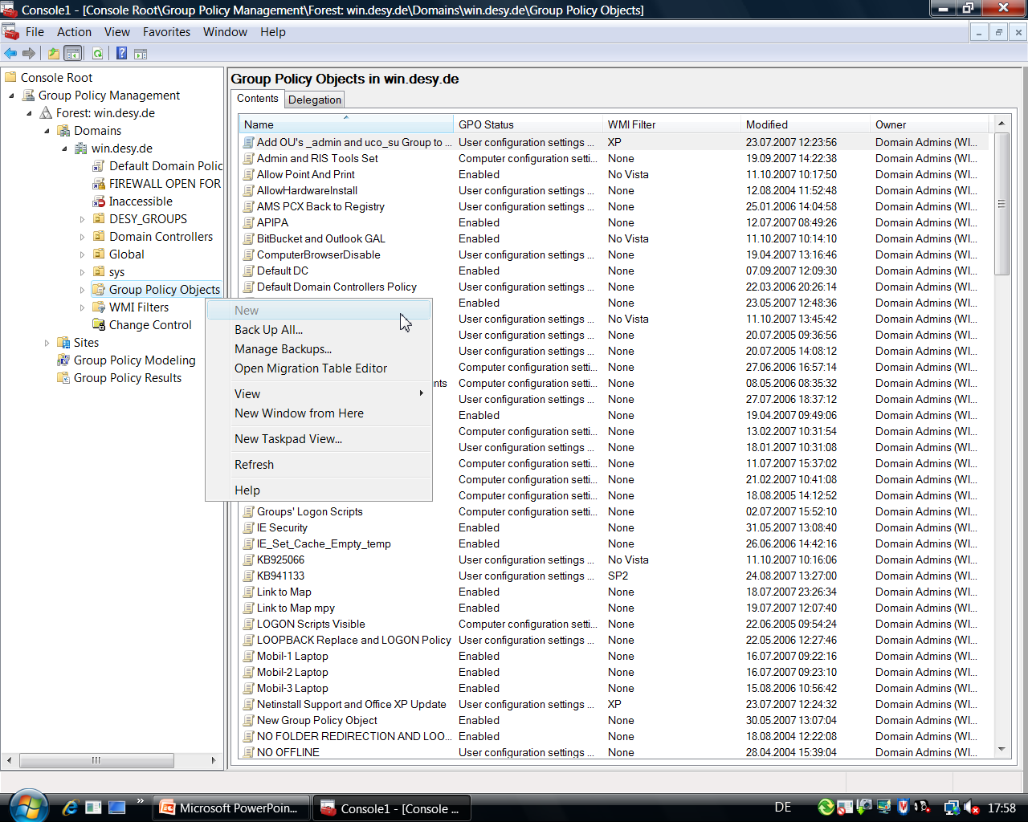
Workflow

Slide 21
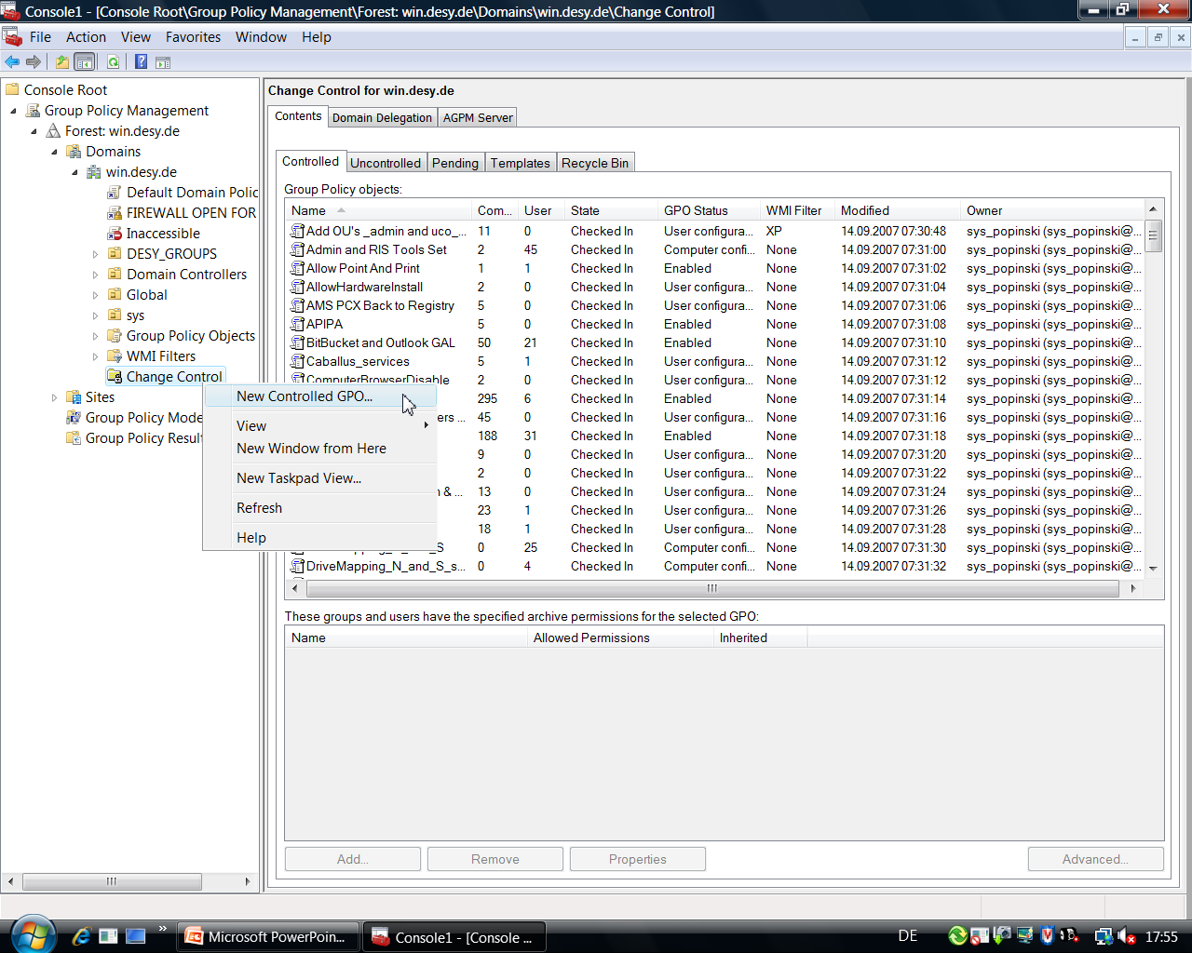
Workflow

Slide 22
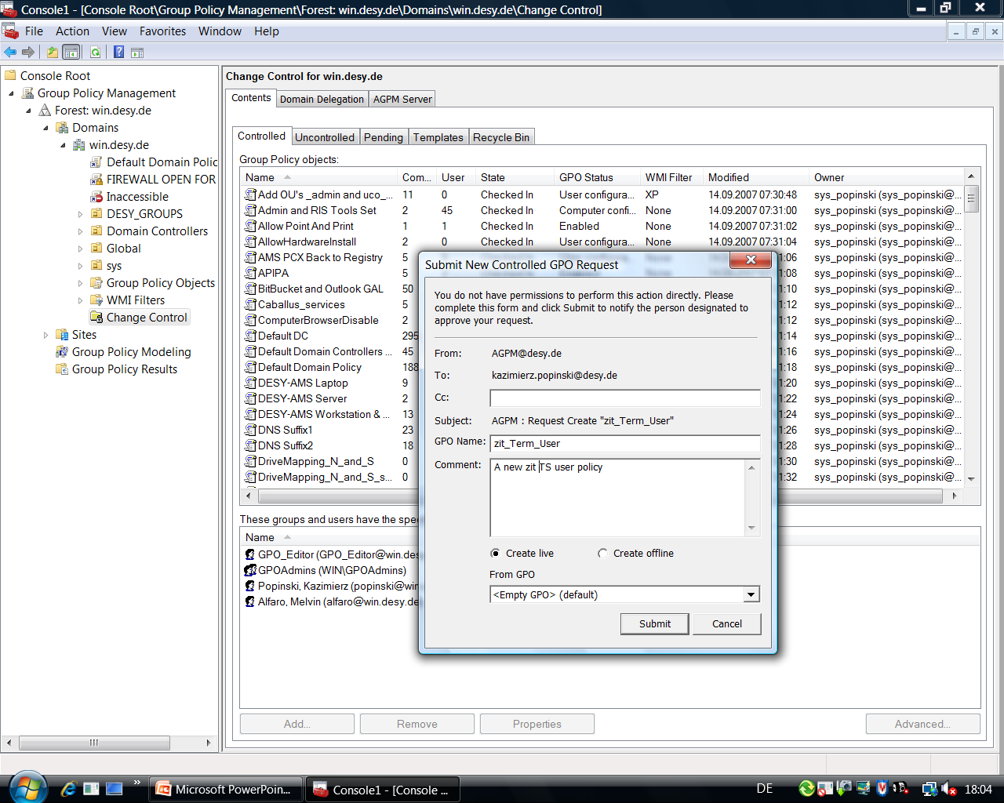
Workflow

Slide 23
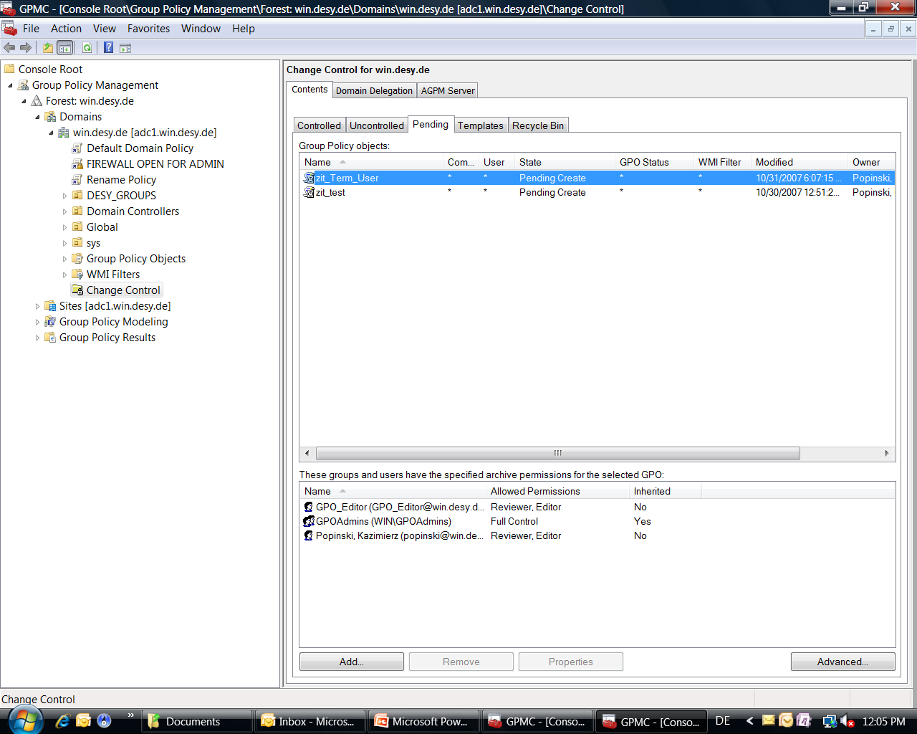
Workflow

Slide 24
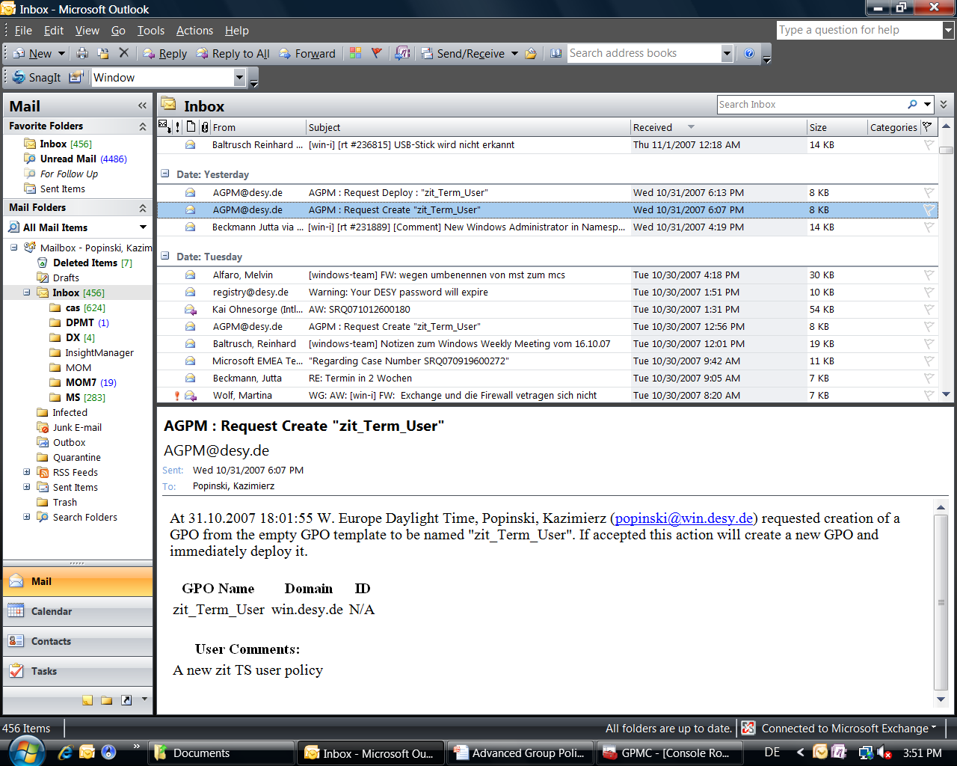
Workflow

Slide 25
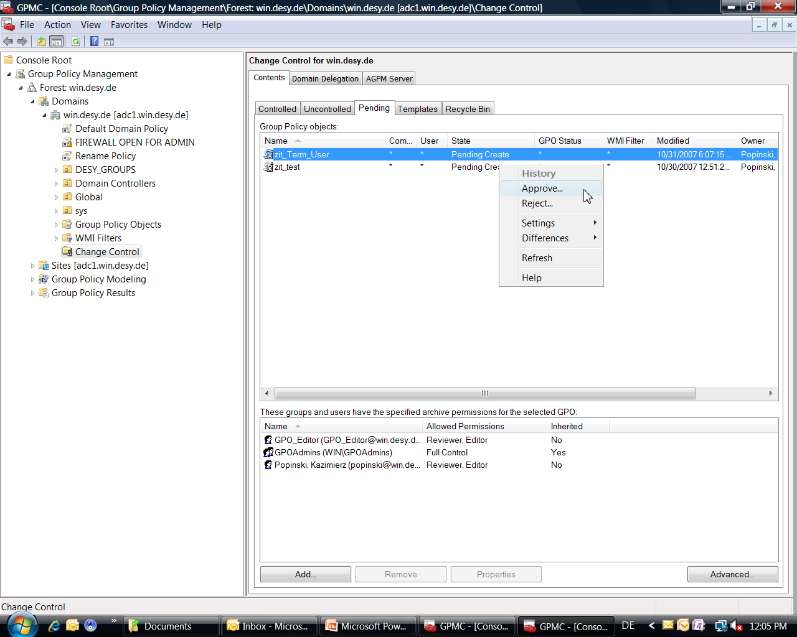
Workflow

Slide 26
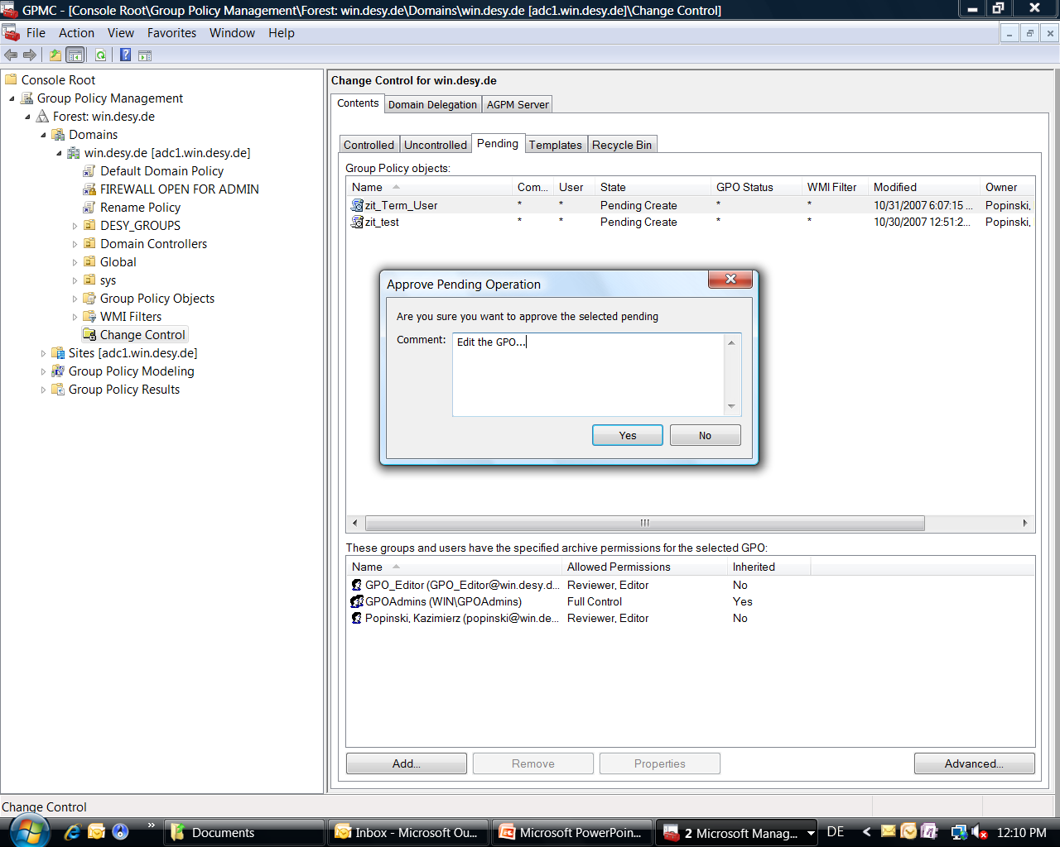
Workflow

Slide 27
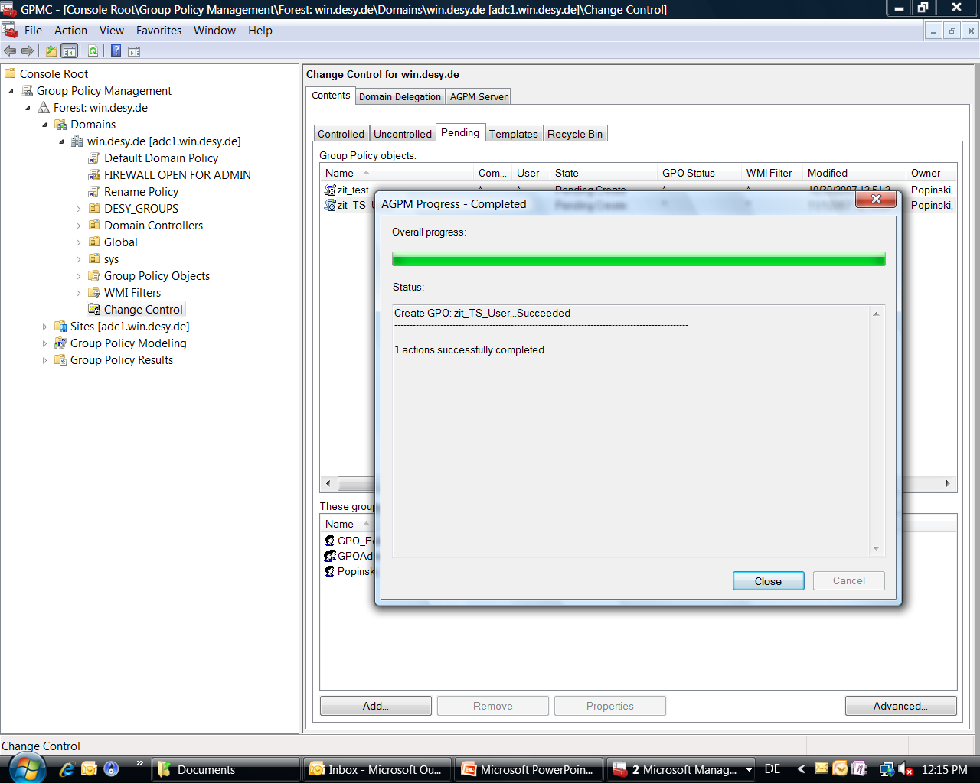
Workflow

Slide 28
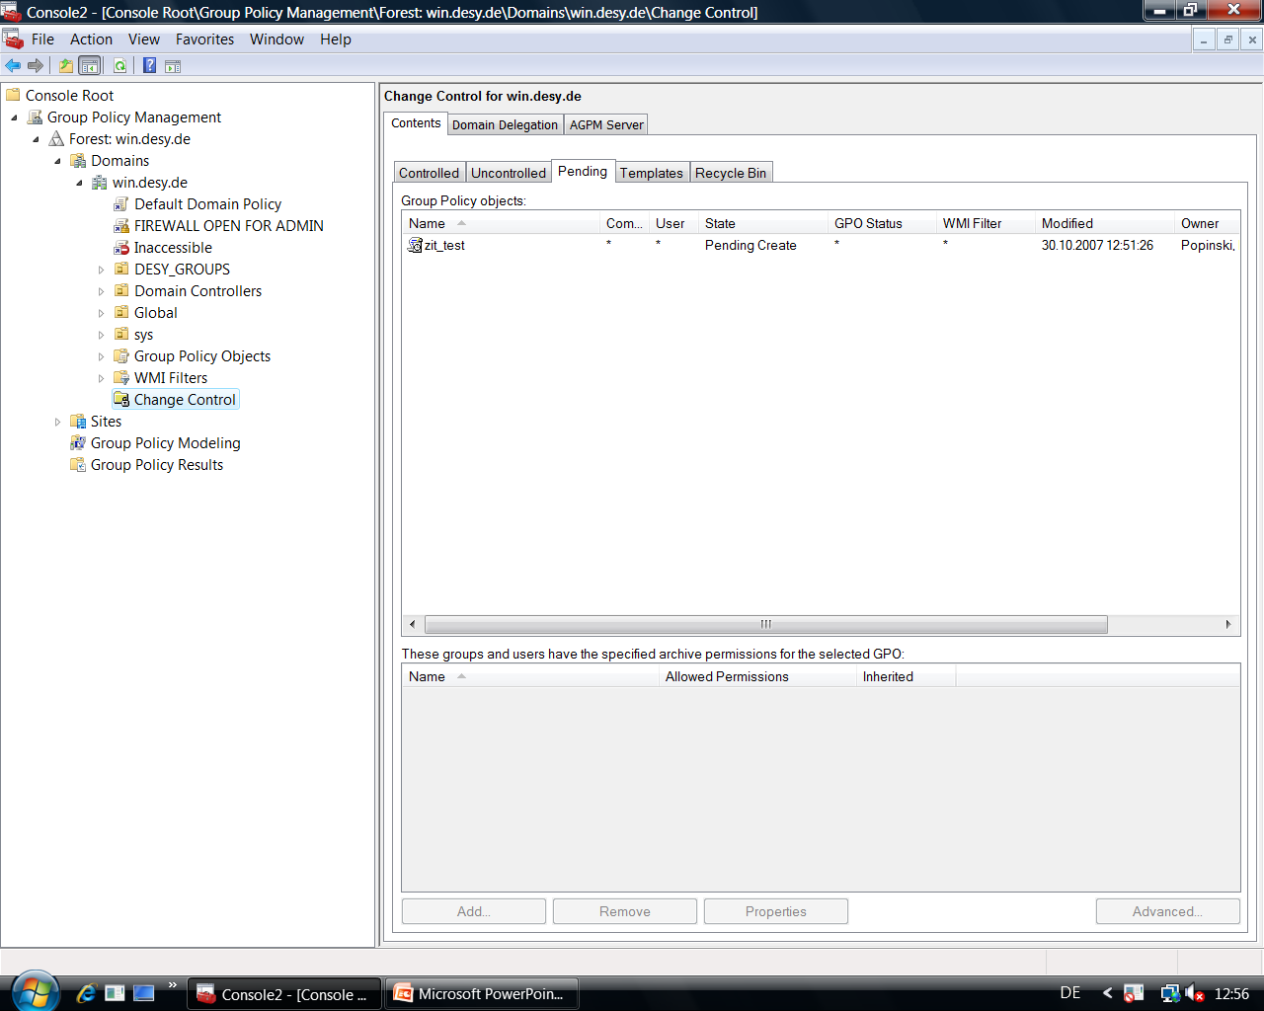
Workflow

Slide 29
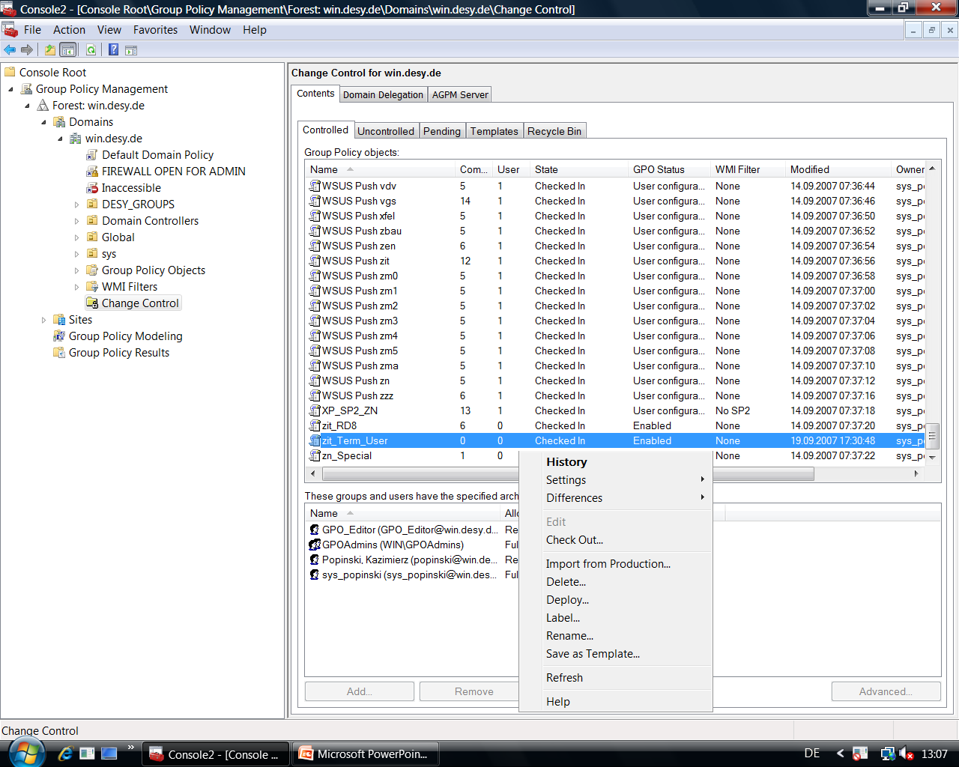
Workflow

Slide 30
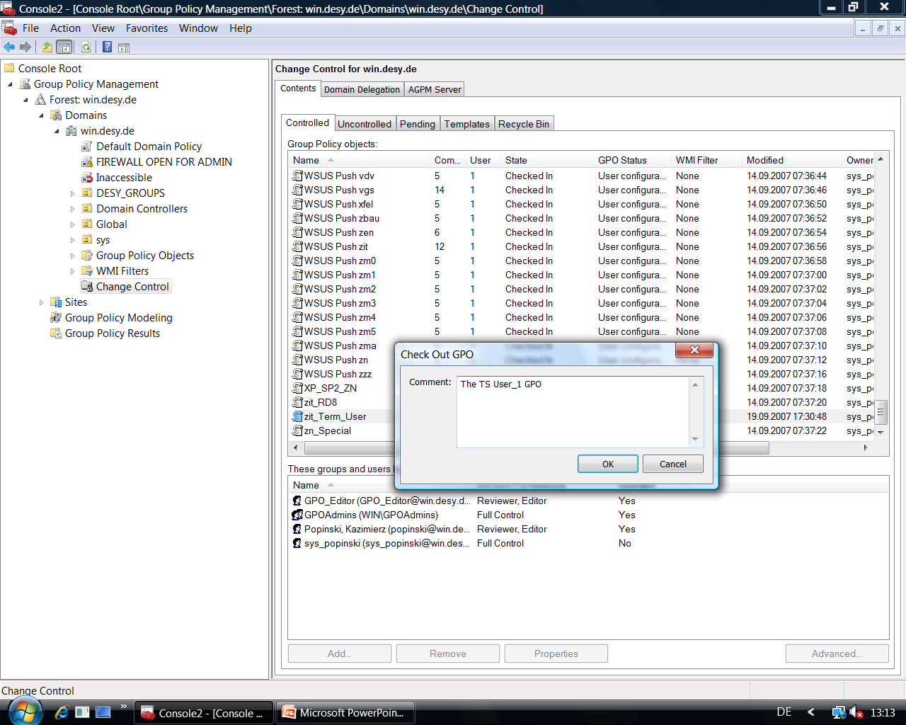
Workflow

Slide 31
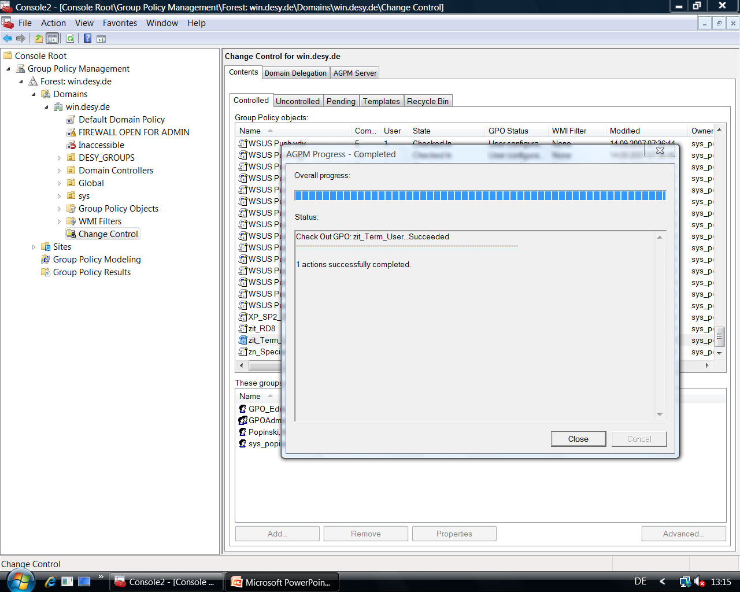
Workflow

Slide 32
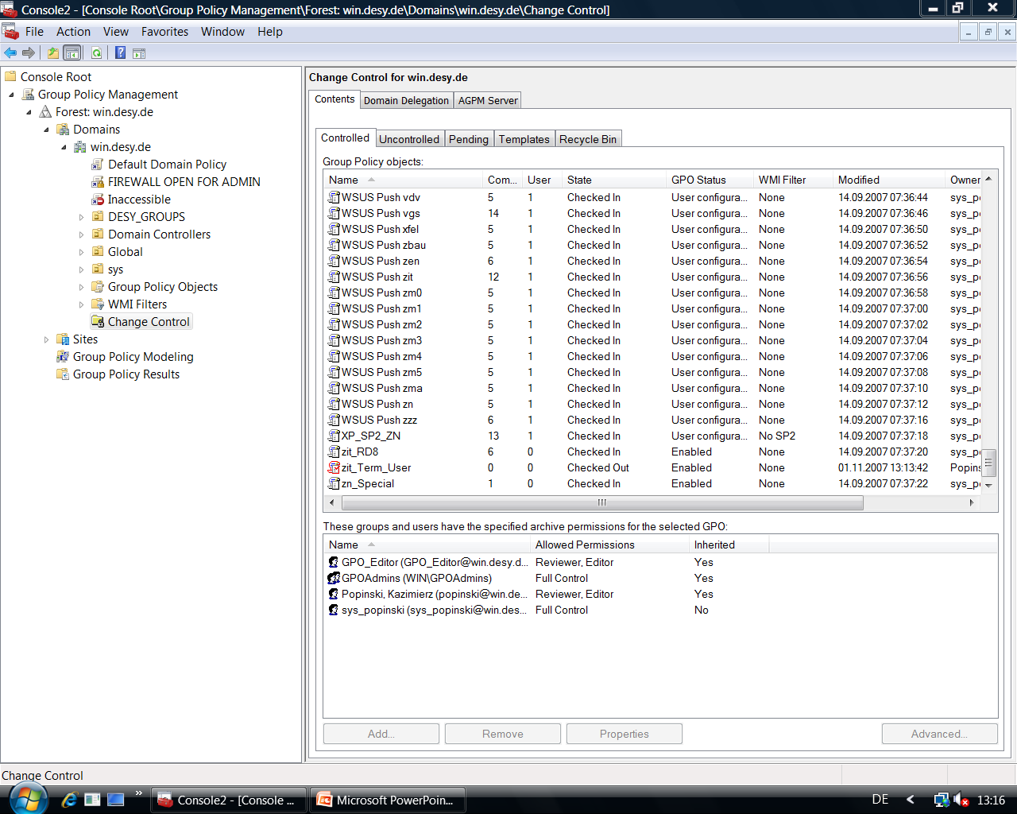
Workflow

Slide 33
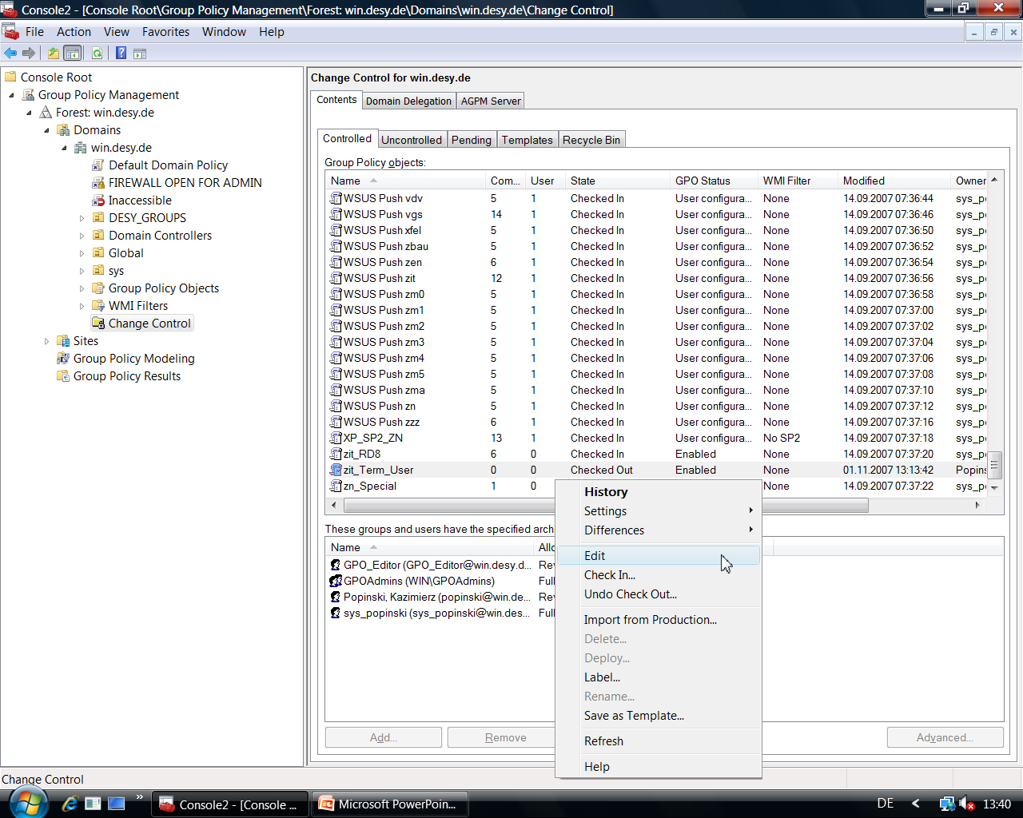
Workflow

Slide 34
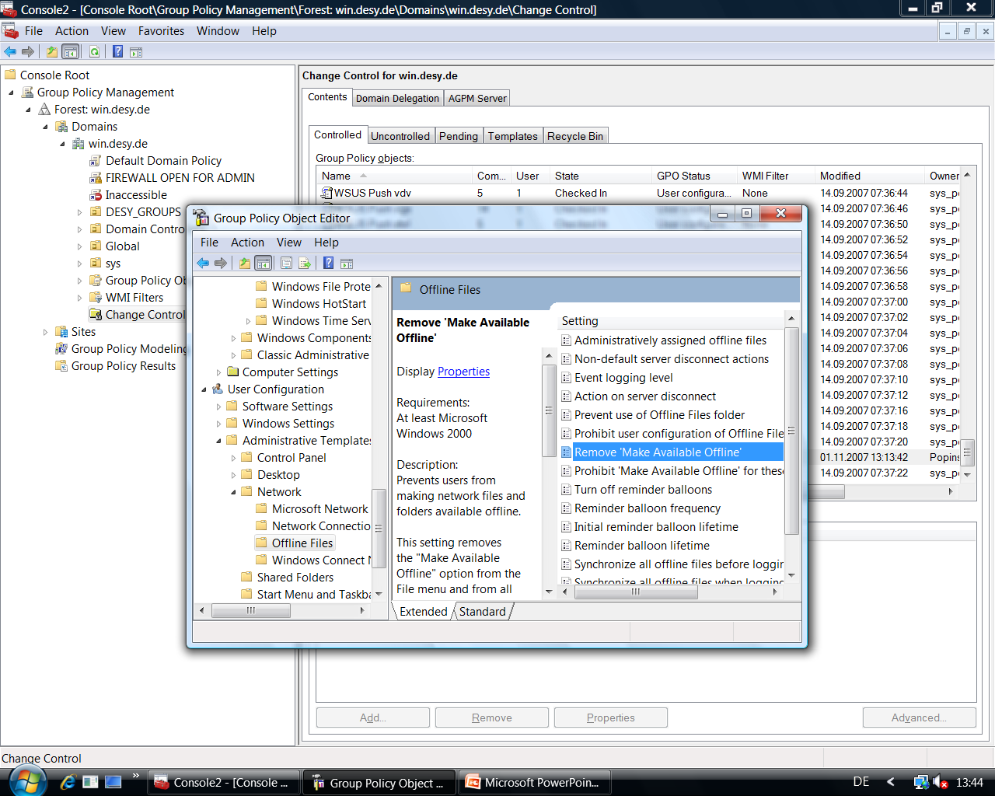
Workflow

Slide 35
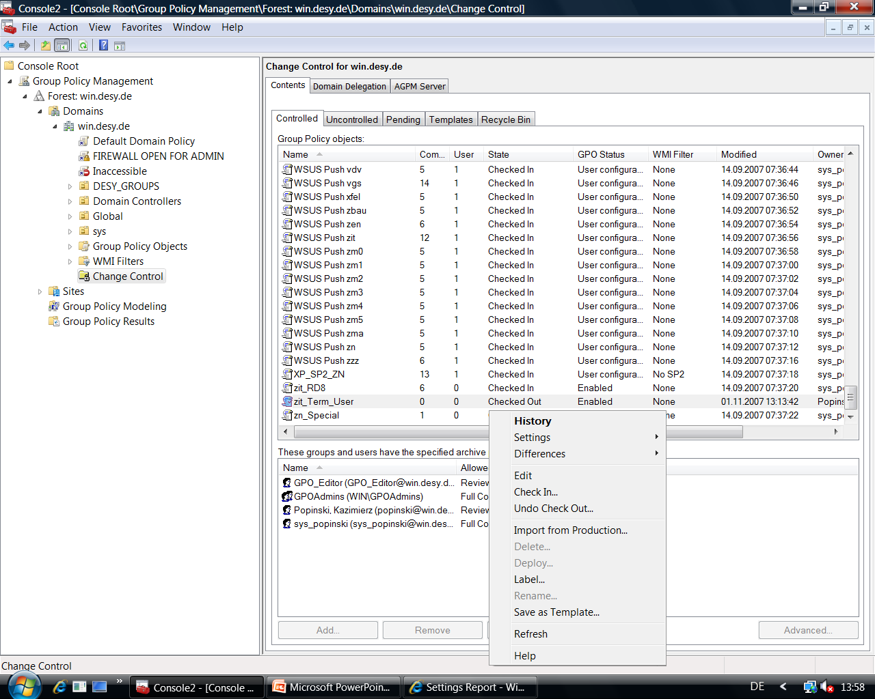
Workflow

Slide 36
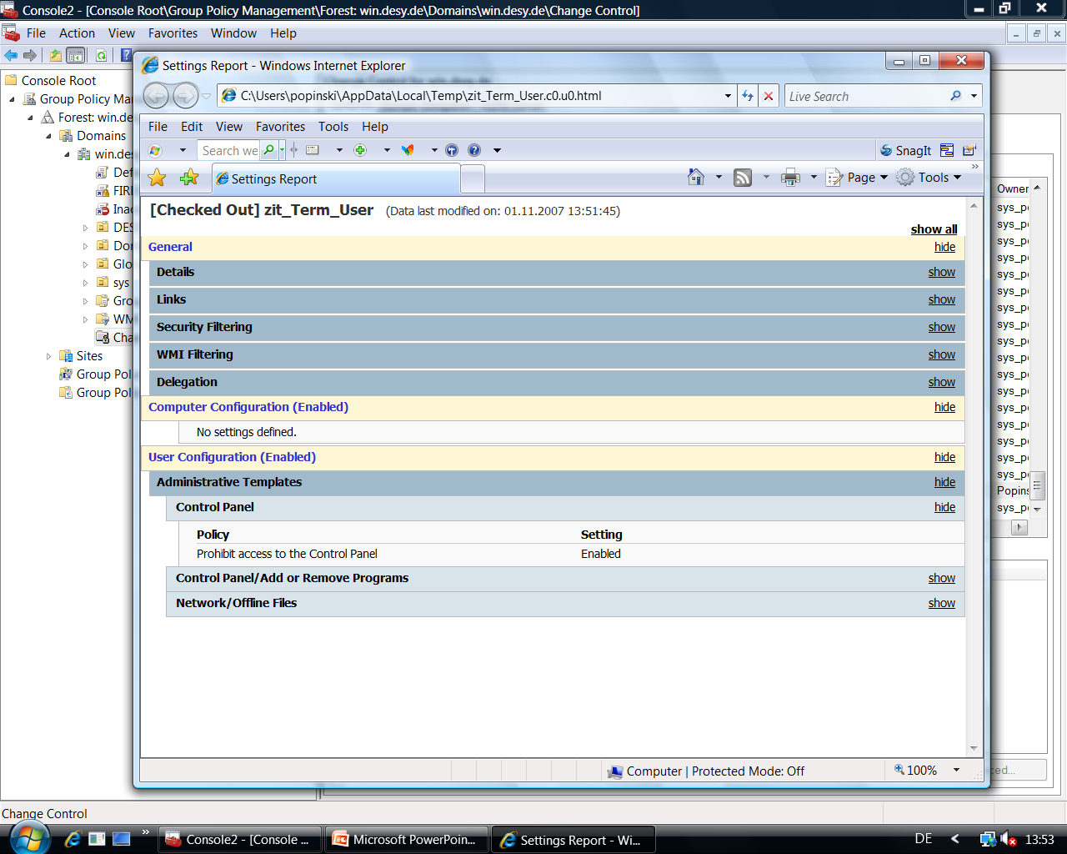
Workflow

Slide 37
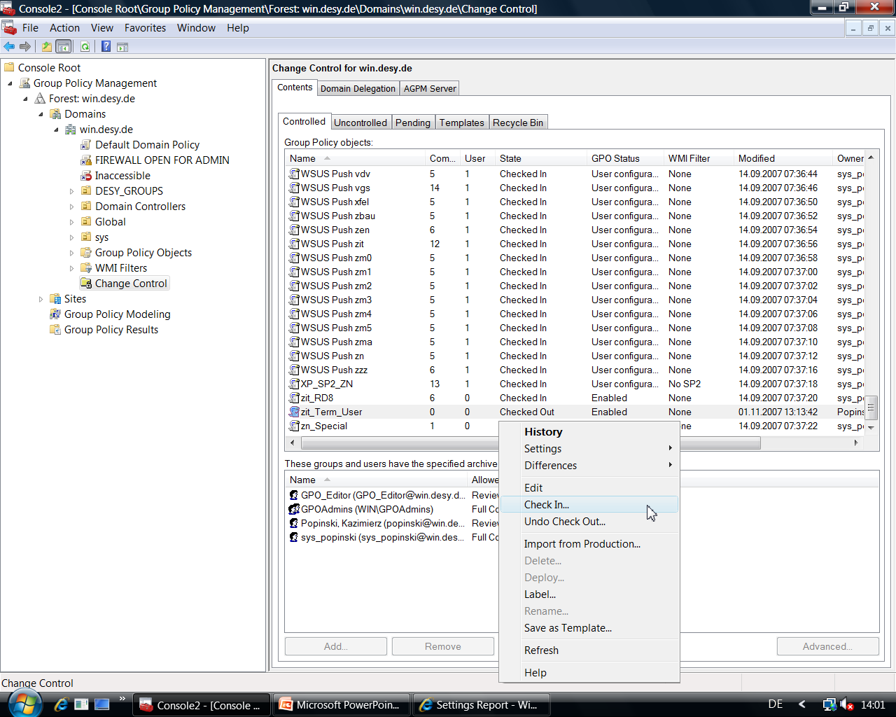
Workflow

Slide 38
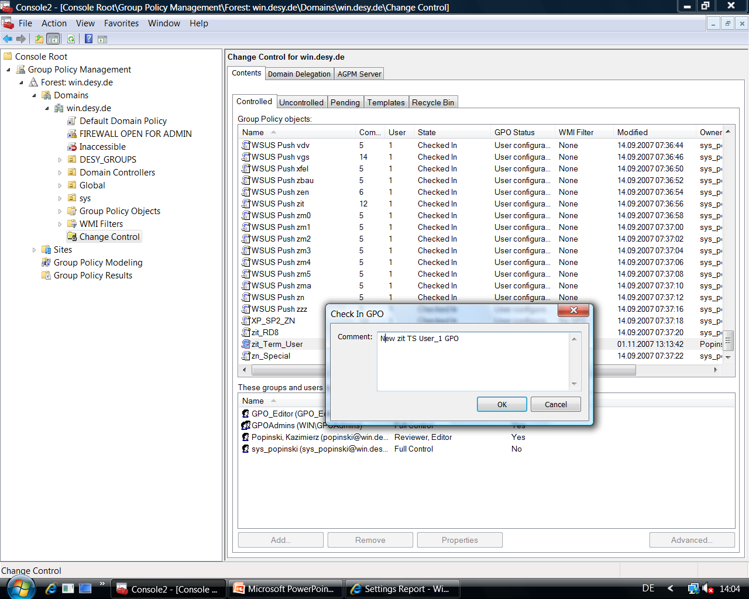
Workflow

Slide 39
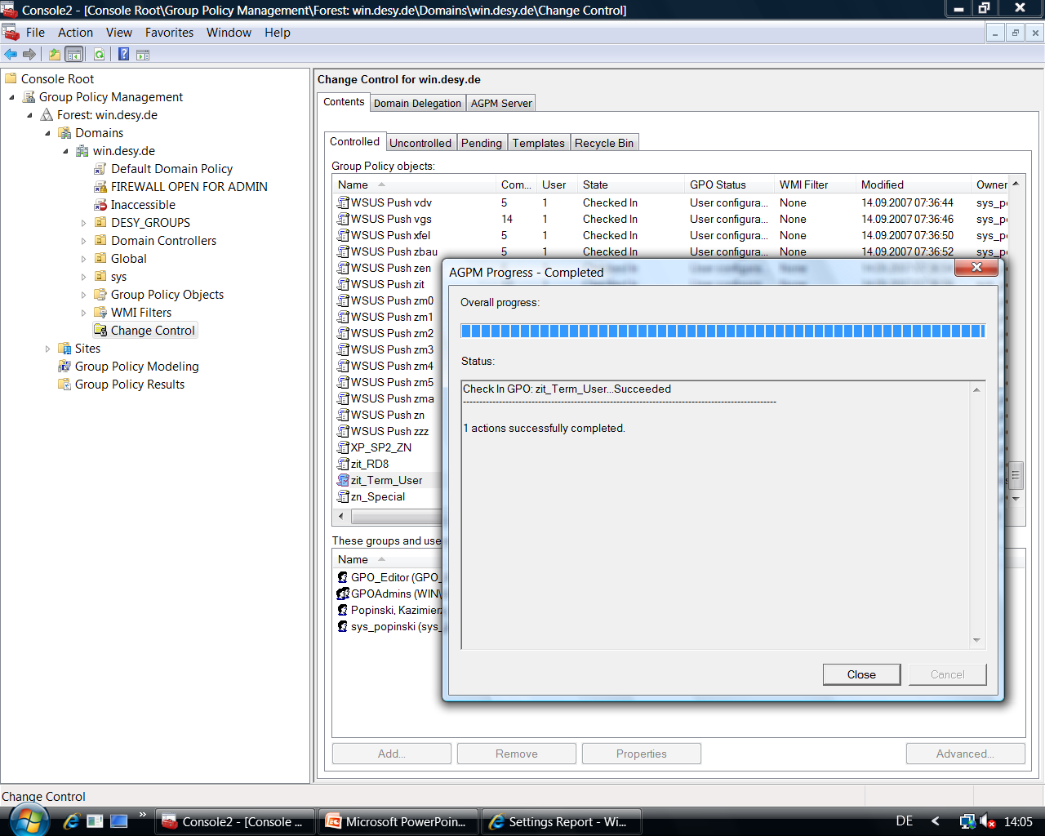
Workflow

Slide 40
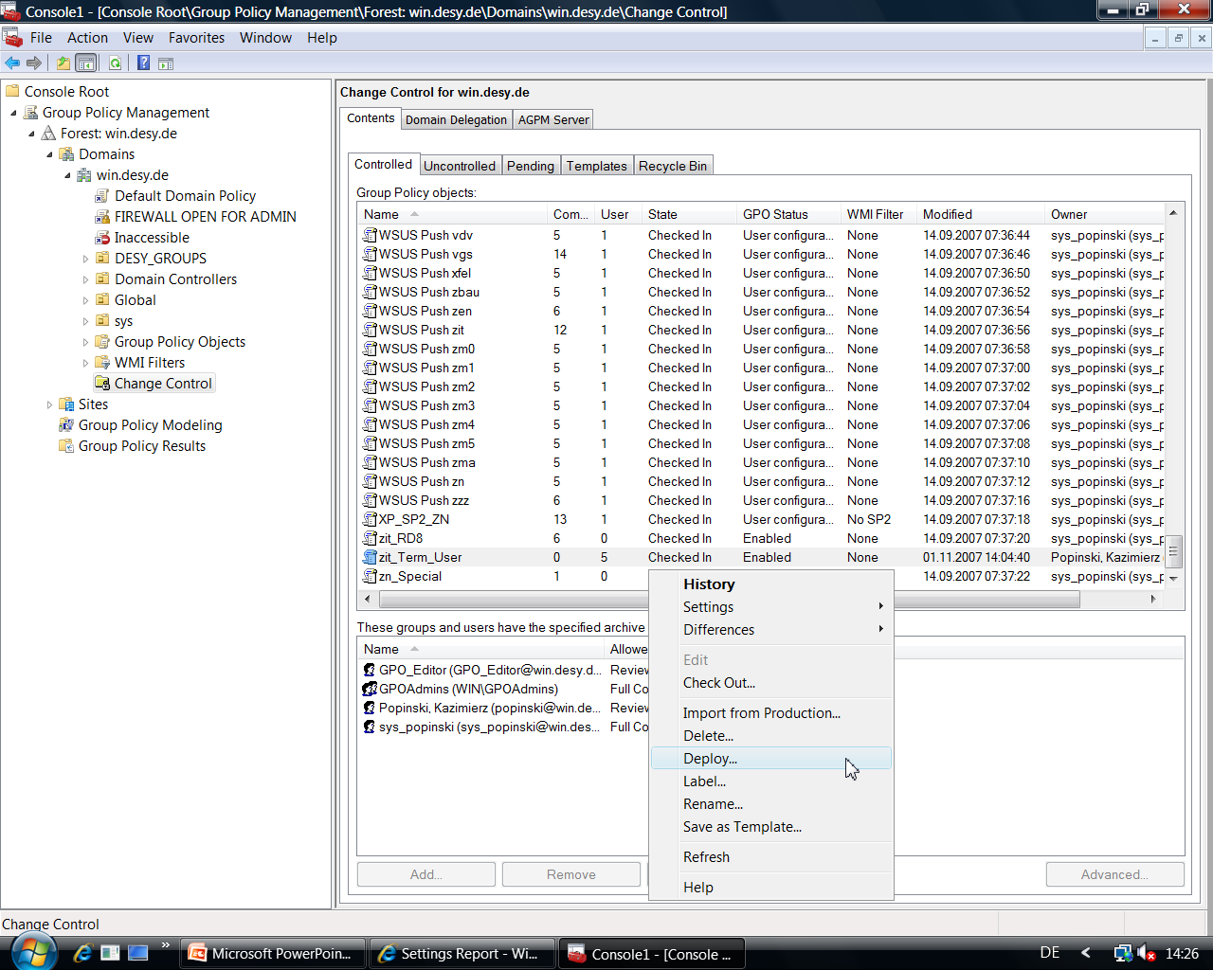
Workflow

Slide 41
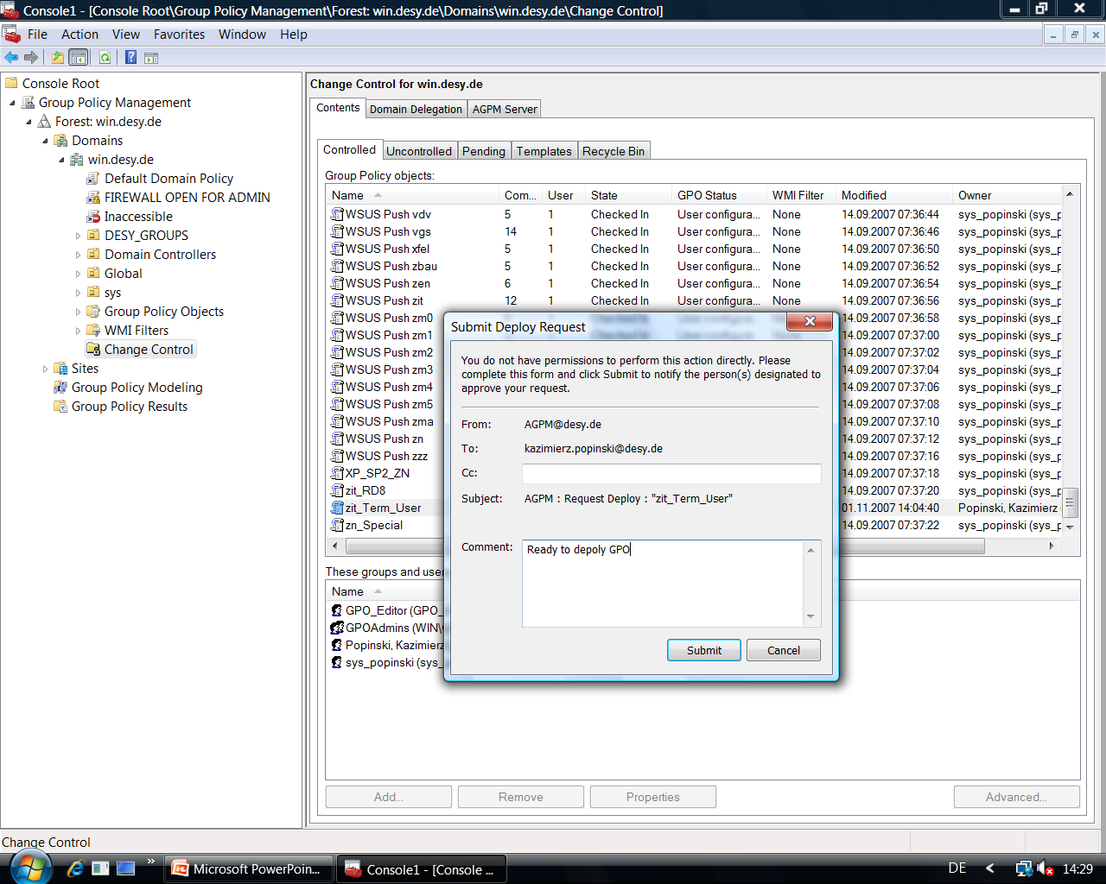
Workflow

Slide 42
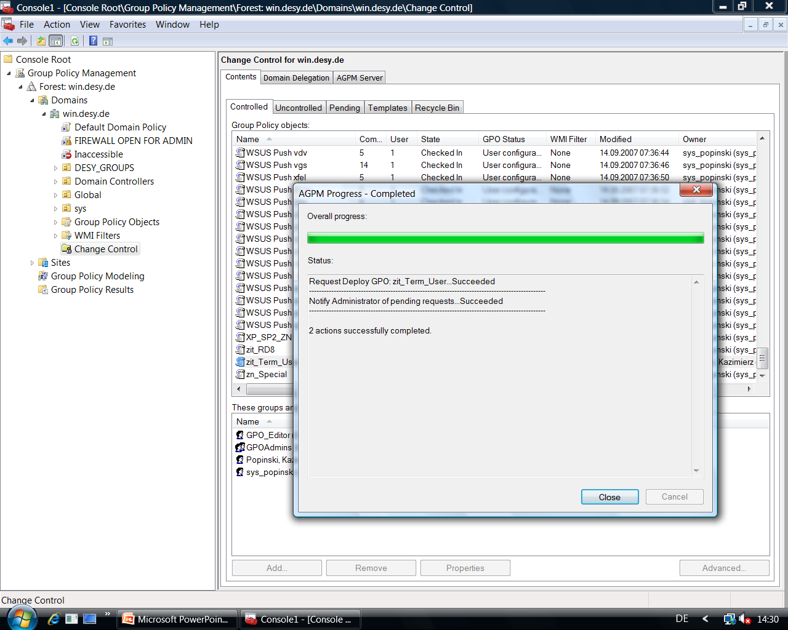
Workflow

Slide 43
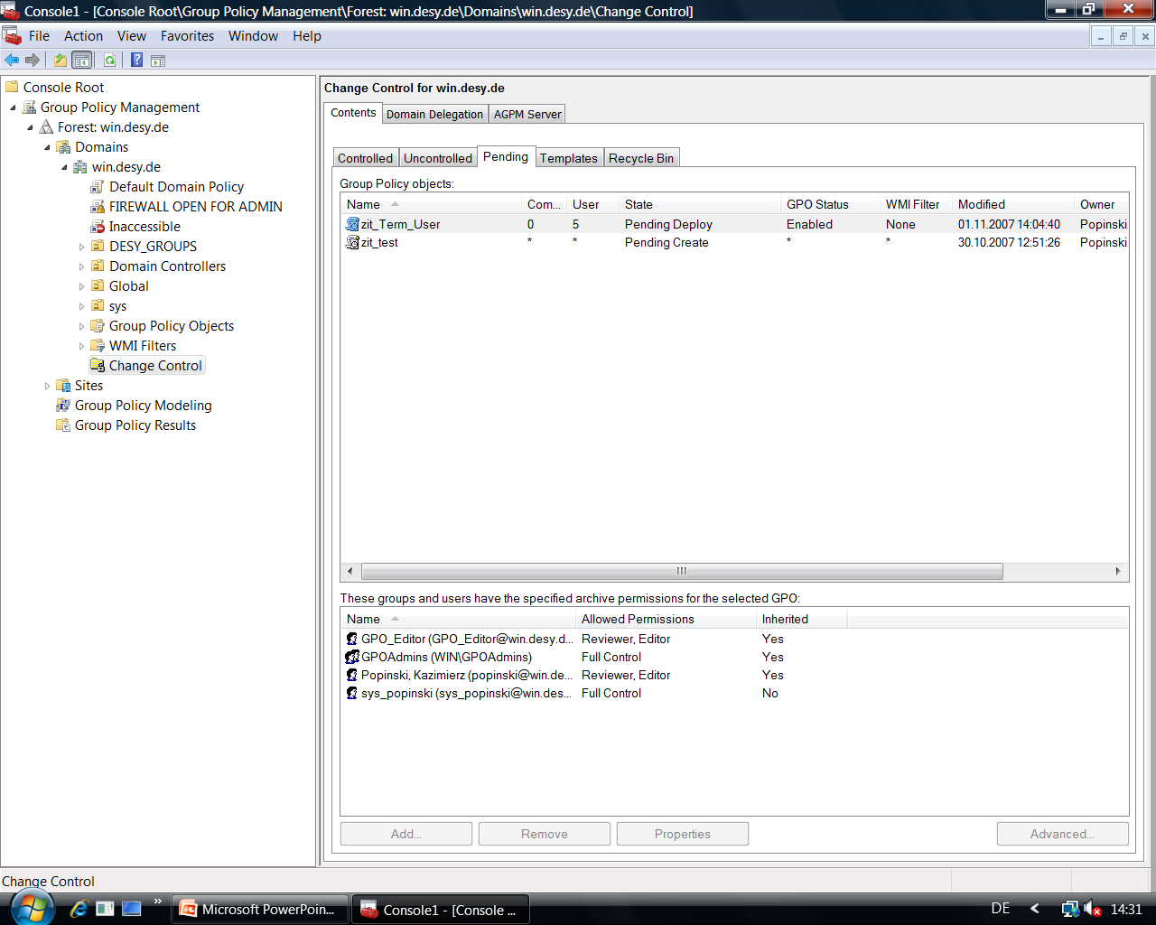
Workflow

Slide 44
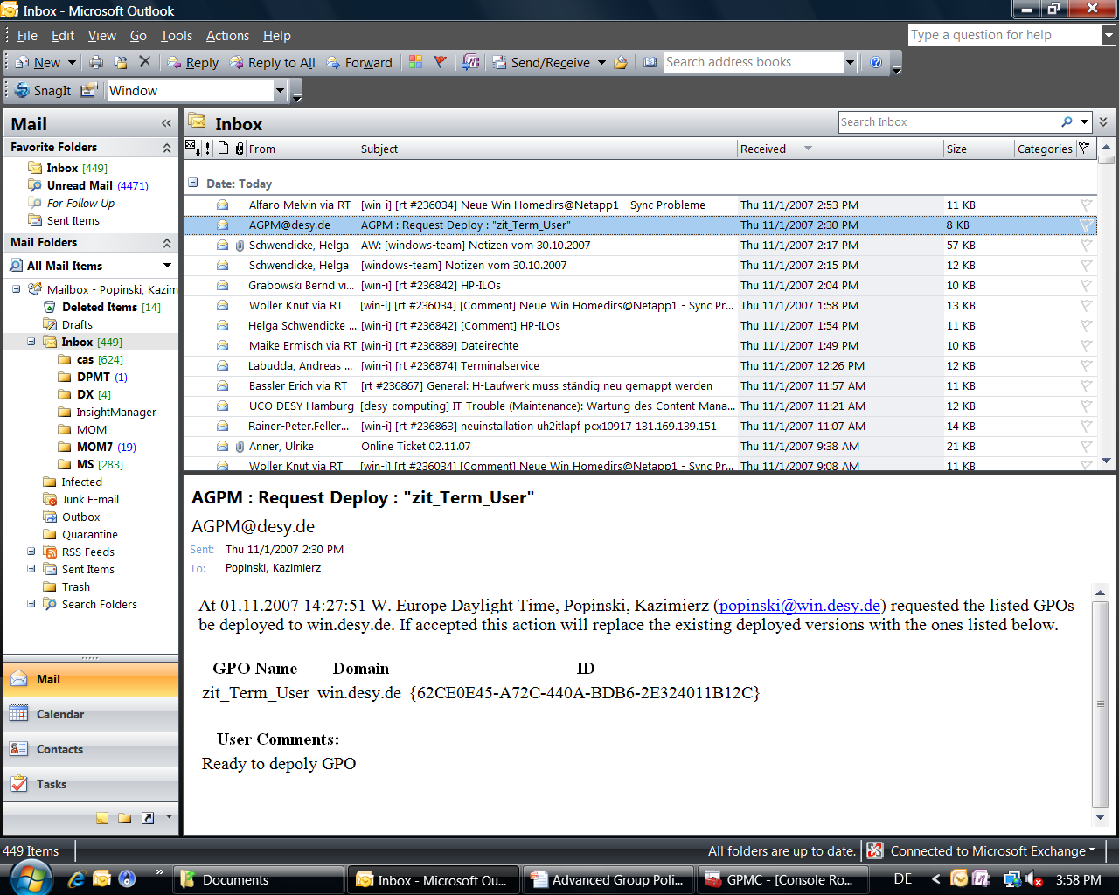
Workflow

Slide 45
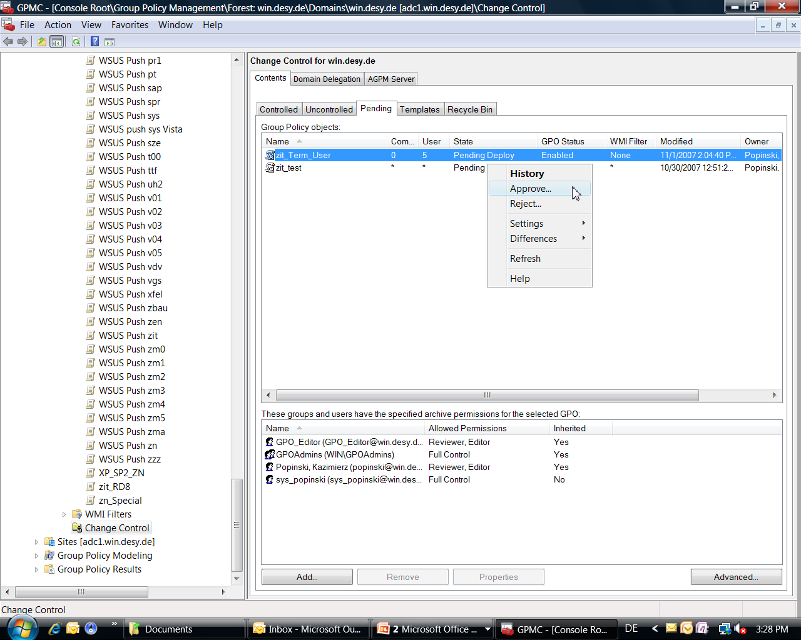
Workflow

Slide 46
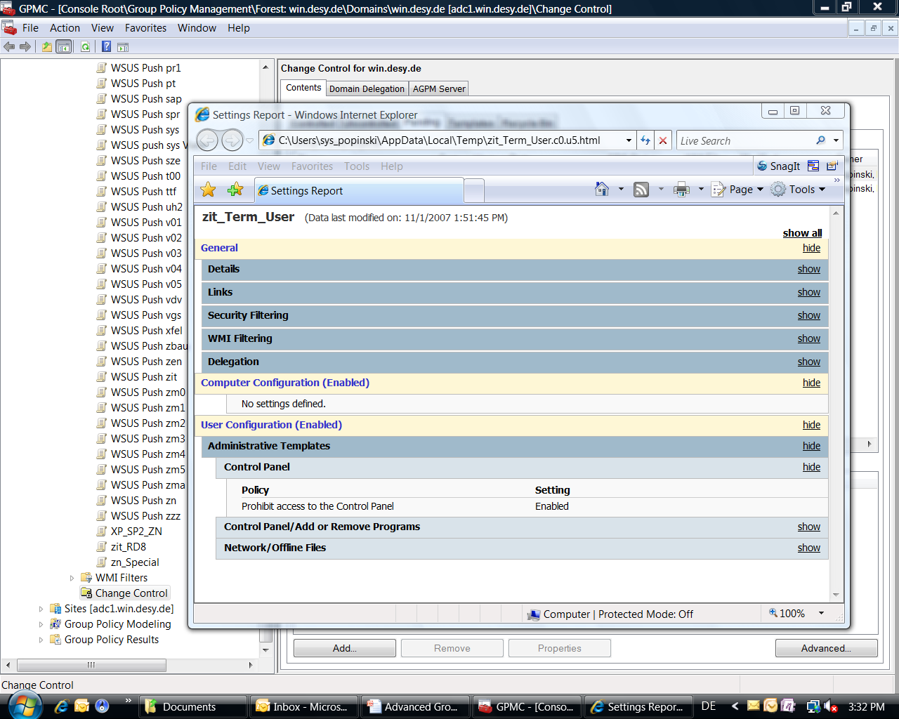
Workflow

Slide 47
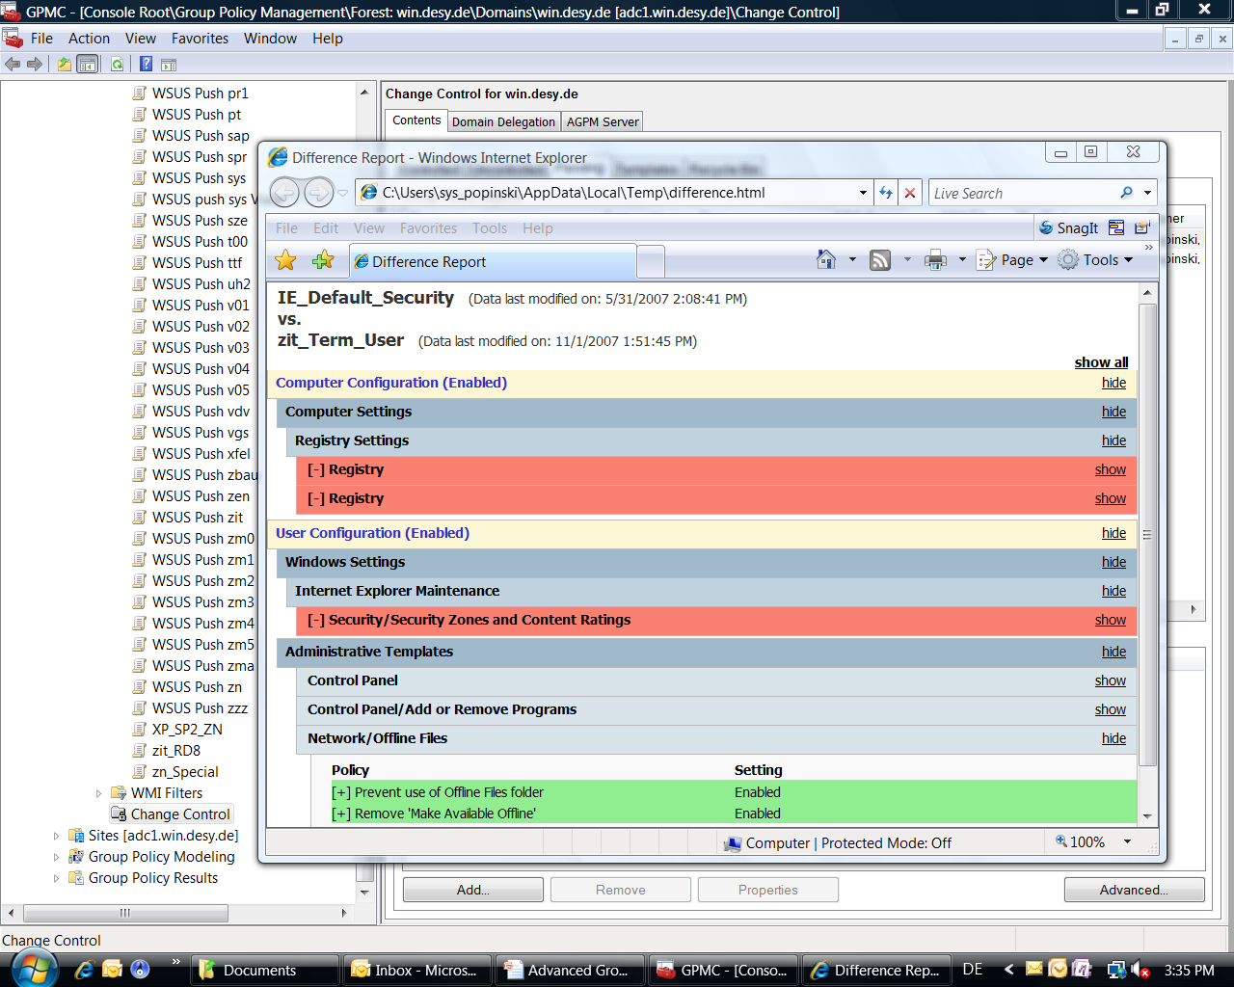
Workflow

Slide 48
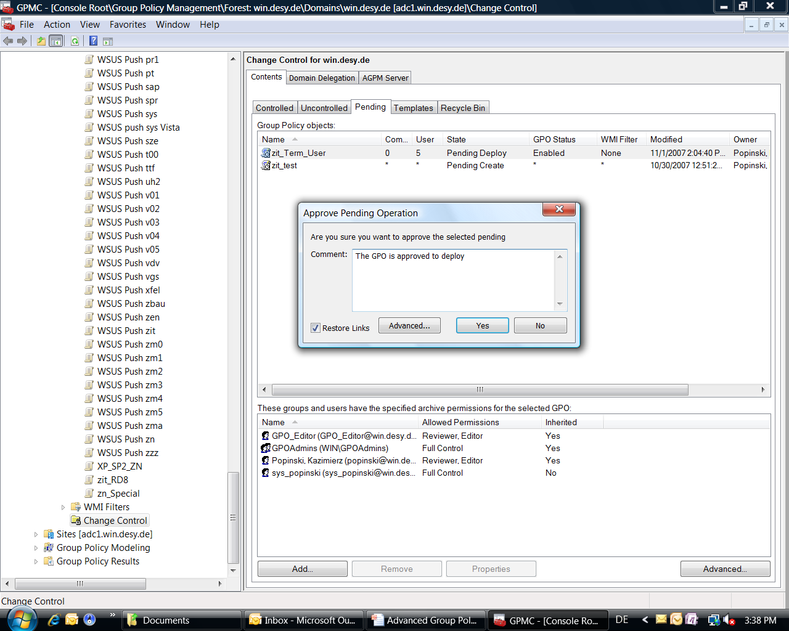
Workflow

Slide 49
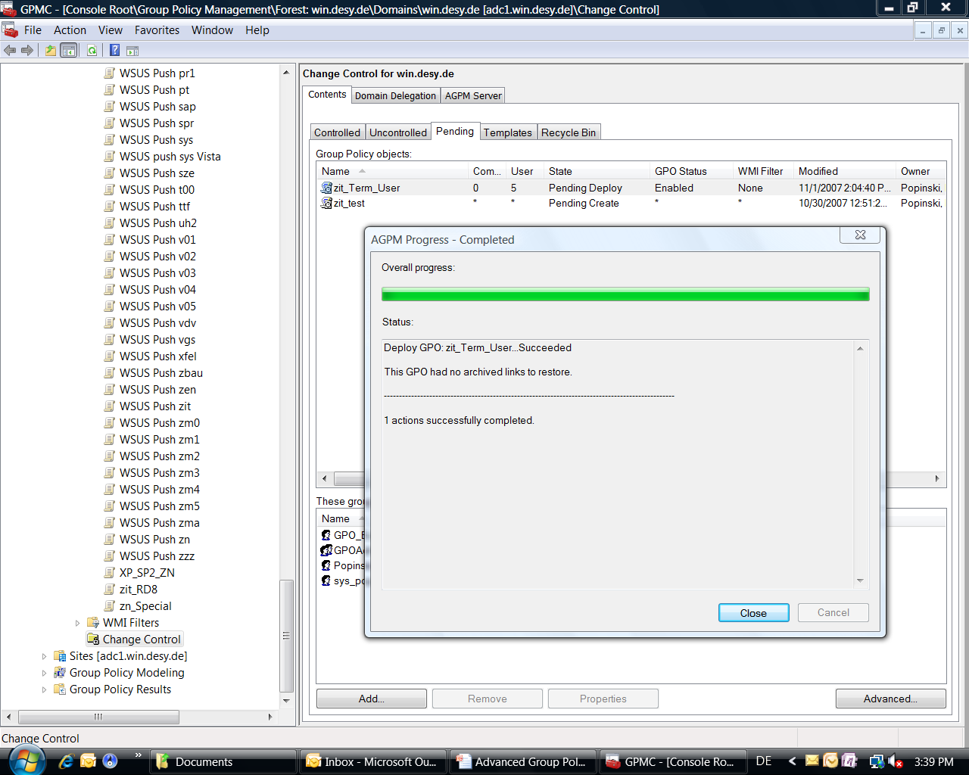
Workflow

Slide 50
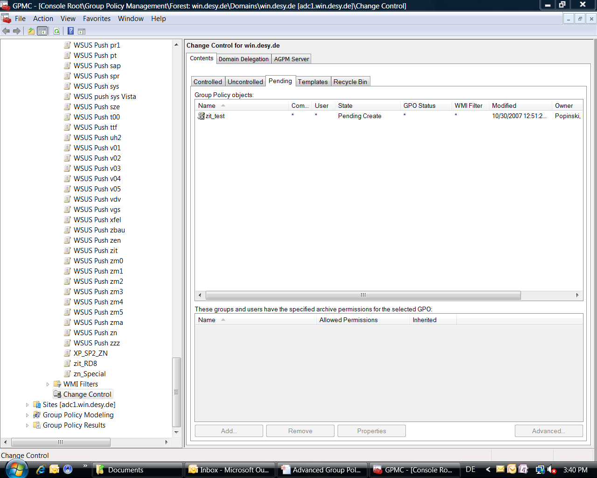
Workflow

Slide 51
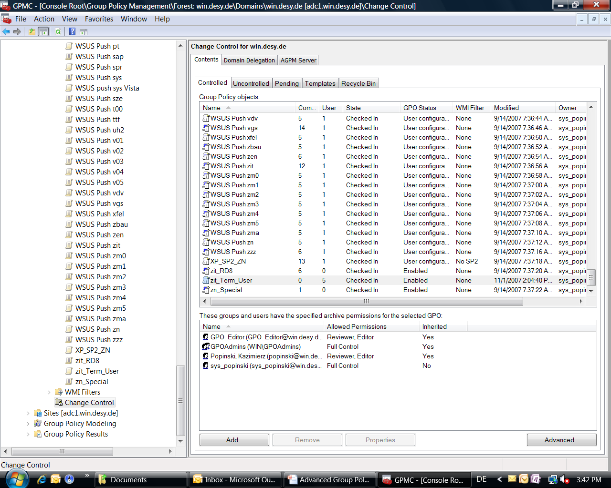
Workflow

Slide 52
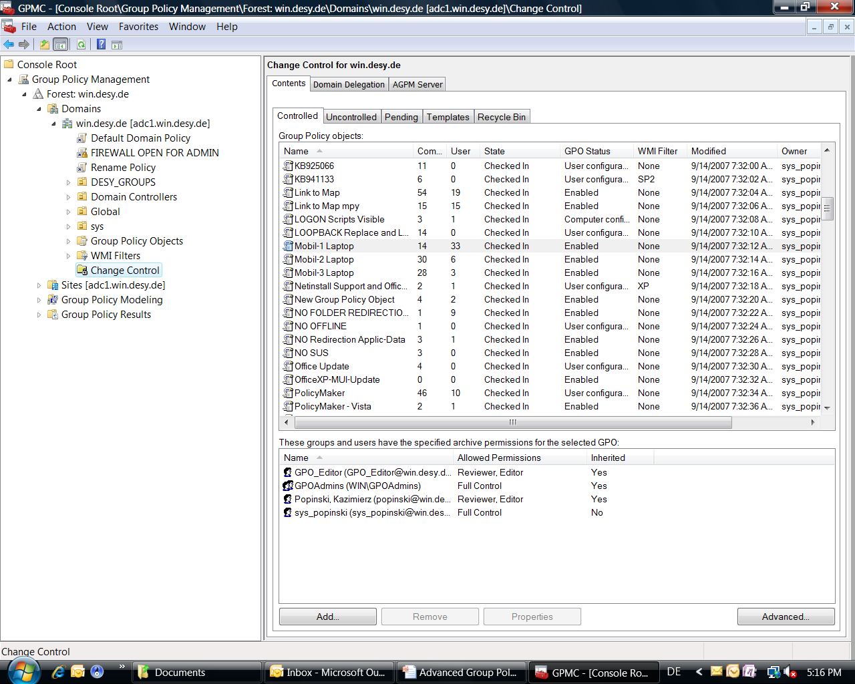
Workflow

Slide 53
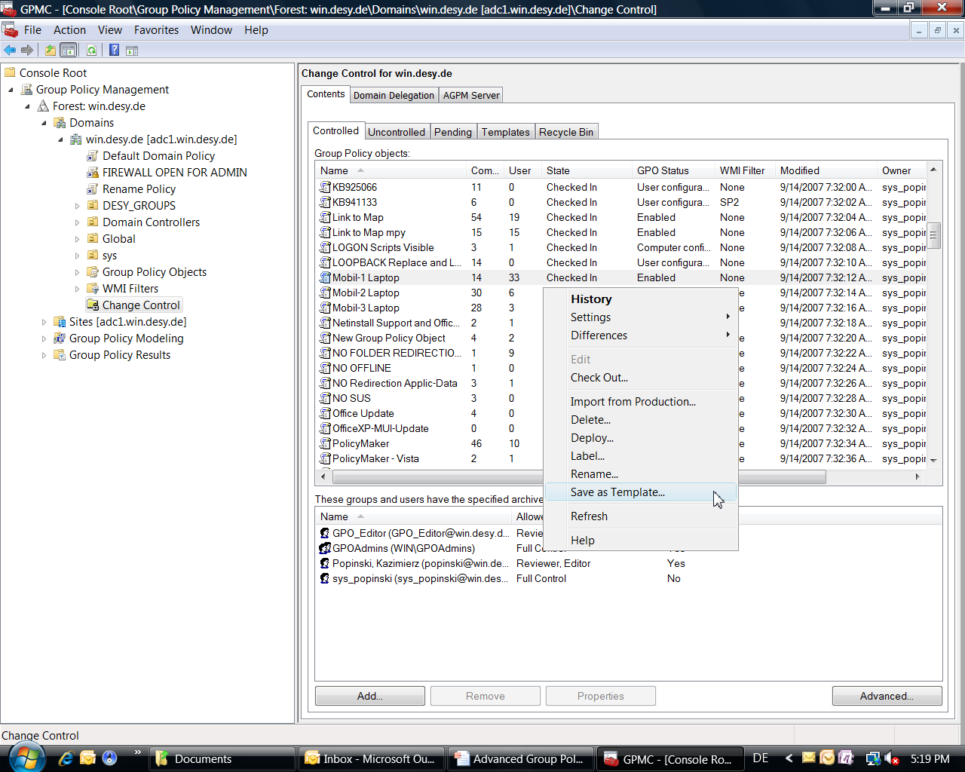
Workflow

Slide 54
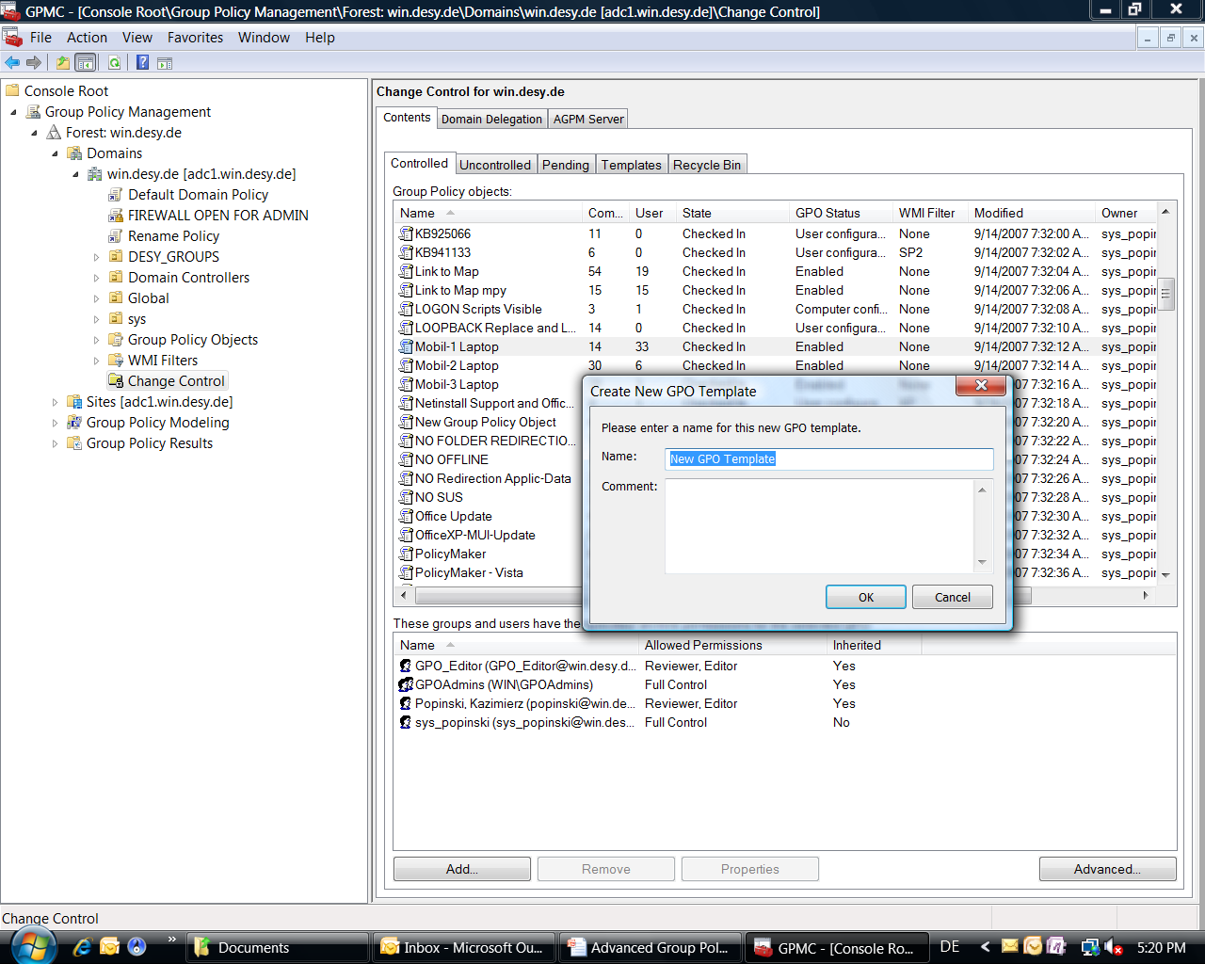
Workflow

Slide 55
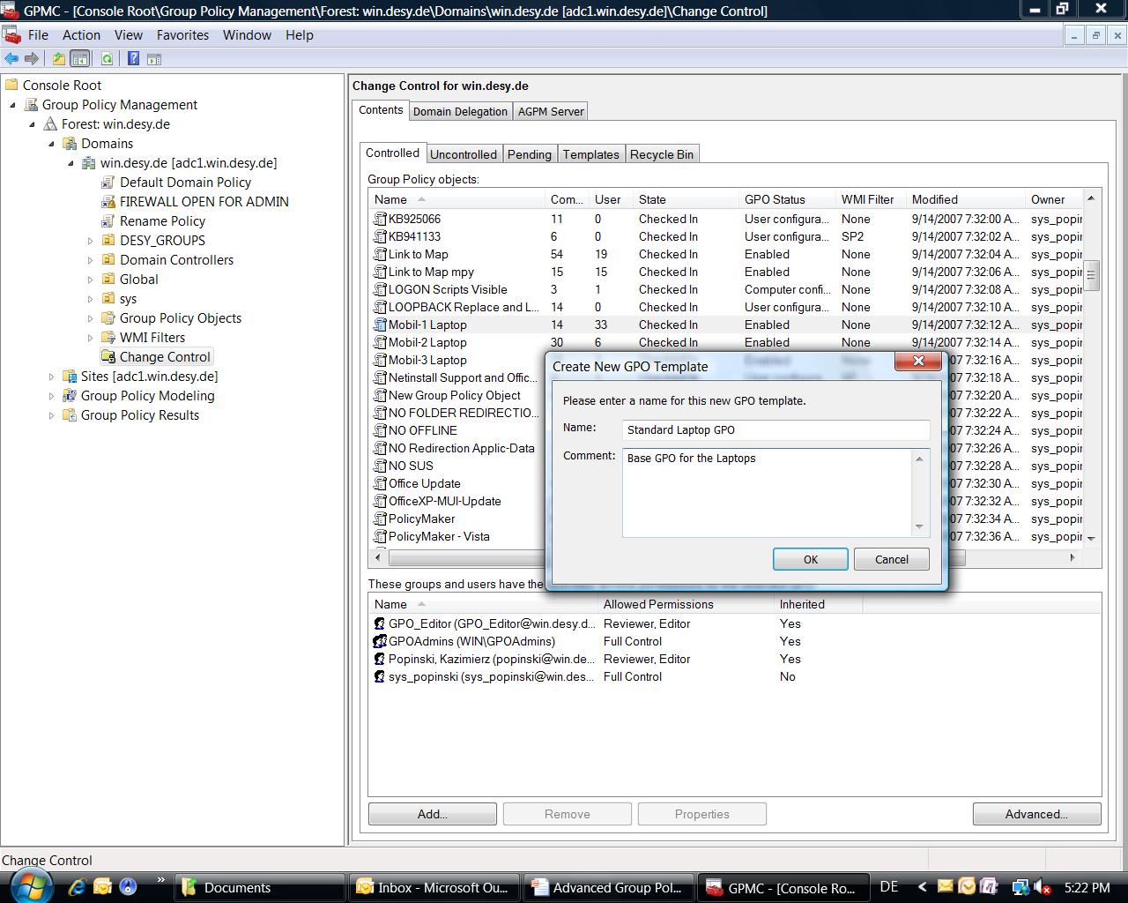
Workflow

Slide 56
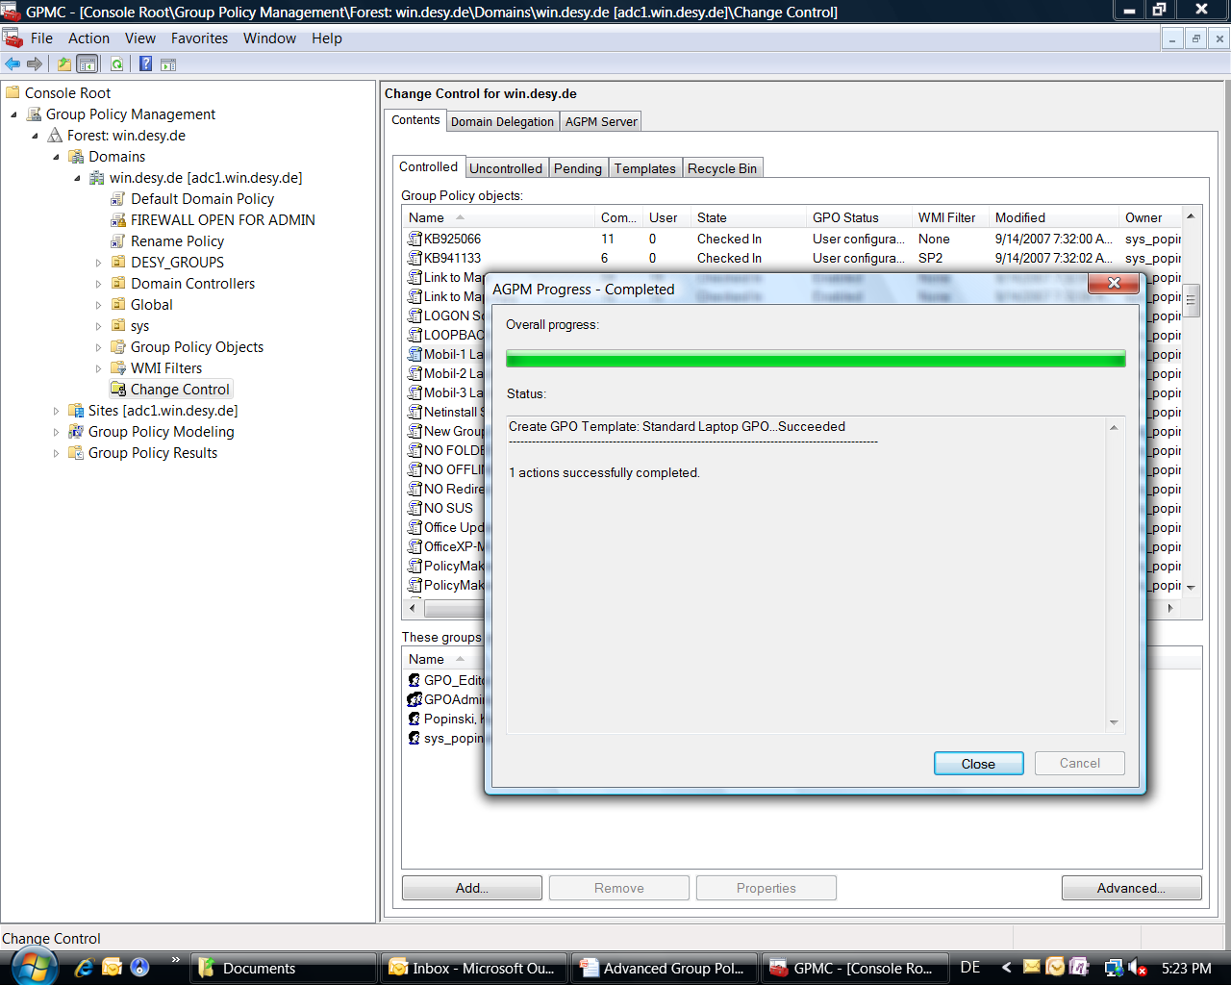
Workflow

Slide 57
Workflow

Slide 58
Workflow

Slide 59
Workflow

Slide 60
Workflow

Slide 61
Workflow

Slide 62
Workflow

Slide 63
Workflow

Slide 64
Workflow

Slide 65
Workflow

Slide 66
Workflow

Slide 67
Workflow

Slide 68
Workflow

Slide 69
Workflow

Slide 70
Workflow

Slide 71
Workflow

Slide 72
Workflow

Slide 73
Workflow

Slide 74
Workflow

Slide 75
Workflow

Slide 76
Advanced Group Policy Management
Integration with GMPC
Change Control
Offline Editing
Role-Based Delegation
Notes:
Microsoft provides the Group Policy Management Console (GPMC) as the main product for managing Group Policy in an enterprise.
Last year Microsoft aquisitioned DesktopStandard and set the it‘s AGPM technology on the top of the GPMC
Let‘s have a look at GPMC to understand why the extra functionality was needed
There are many benefits to the GPMC…

