Slide 1
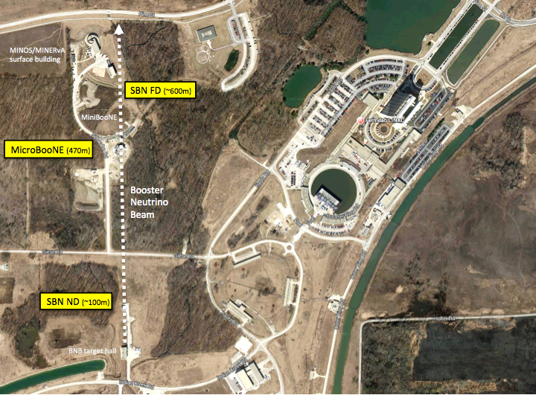

Future Short-Baseline Neutrino Experiments
47th Annual Fermilab Users Meeting
June 11-12, 2014 - Fermilab
David Schmitz

Slide 2
Outline
Why a Short-Baseline Neutrino (SBN) Program at Fermilab
A little history: recent proposals to expand the SBN program, address anomalies, and search for sterile neutrinos
The plan moving forward to build a world-leading accelerator-based short-baseline neutrino oscillation program on the FNAL Booster Neutrino Beam

Slide 3

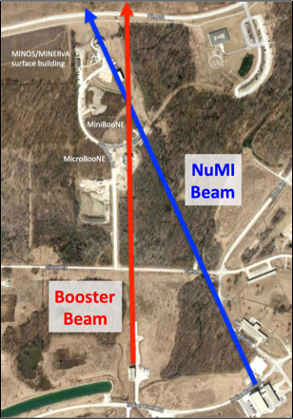
BNB Short-Baseline Neutrino Program
Fermilab makes an ideal host for a next generation short-baseline neutrino oscillation experimental program
  SBN Program builds upon existing capabilities and infrastructure, such as the Booster Neutrino Beam (BNB)
    The NuMI Beam is deep and aimed down toward Minnesota, but the BNB is shallow (~10 m detector hall depth at all baselines)
    BNB neutrino fluxes are well understood due to dedicated hadron production data (the HARP experiment @ CERN) and 10+ years of study by MiniBooNE and SciBooNE

Slide 4
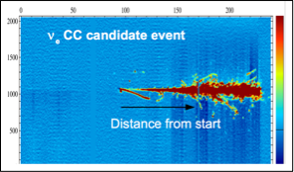
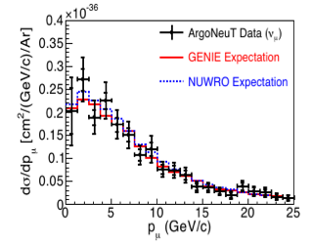
Synergy with the Long-Baseline Program
  SBN Program has important synergies with on-going lab efforts and the future long-baseline neutrino program
    Continued development of the Liquid Argon TPC technology for neutrino physics. SBN experiments offer a great opportunity for use of mid-scale detectors which will see large neutrino exposures.
      LArTPC technology development and prototyping
      Development and validation of LArTPC event reconstruction with large νμ ανδ νε data sets
      Measure important ν-Ar cross sections in GeV energy range
      Demonstrate sensitive νμ→νe appearance and disappearance oscillation measurements with LAr detectors
ArgoNeuT Data
νe
νμ
arXiv:1404.4809
≈1600 events

Slide 5
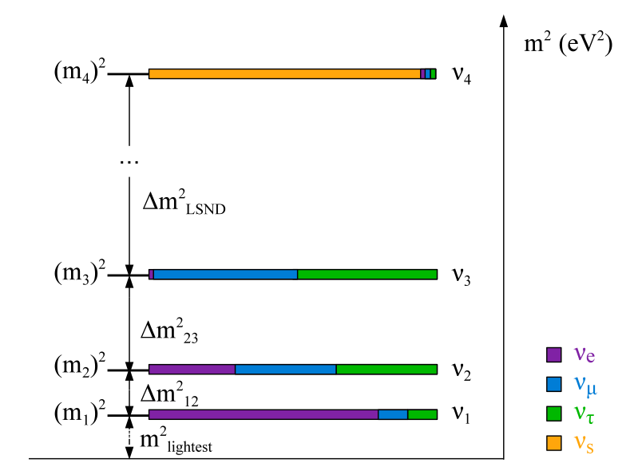




Expands the Laboratory’s Science Program
  SBN Program expands the science reach of the world-class neutrino physics program here at Fermilab
    While each of these measurements alone lack the significance to claim a discovery, together they could be hinting at important new physics
43
K. N. Abazajian et al. "Light Sterile Neutrinos: A Whitepaper", arXiv:1204.5379 [hep-ph], (2012)
One thing is certain…
The discovery of a light sterile neutrino would be monumental for particle physics as well as cosmology

Slide 6
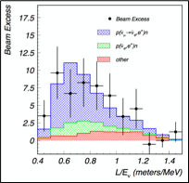

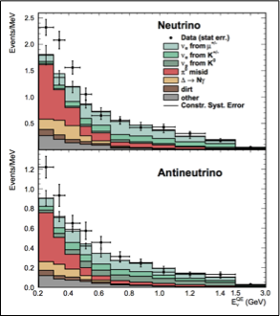

Accelerator-Based Anomalies
LSND
MiniBooNE

Slide 7
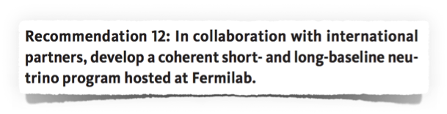
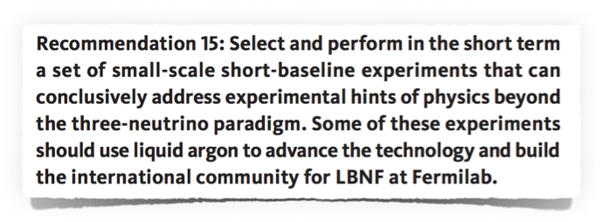
P5 Report Recommendations
ν

Slide 8
π Decay-In-Flight Experiments
DIF beam provides a rich oscillations program with a single facility:
  νμ → νe appearance
  νμ and νe disappearance
  both neutrinos and antineutrinos possible
  CC and NC interactions
Anomalies exist here (MiniBooNE neutrino and antineutrino) and these need to be addressed
However:
  Need detectors that can distinguish electrons from photons in order to reduce key backgrounds
  Multiple detectors at different baseline are key for reducing systematic uncertainties

Slide 9
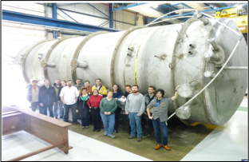
MicroBooNE
The first phase of the next generation SBN Program begins soon with MicroBooNE coming online later this year!

Slide 10
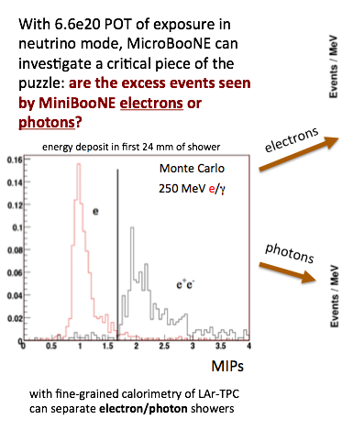
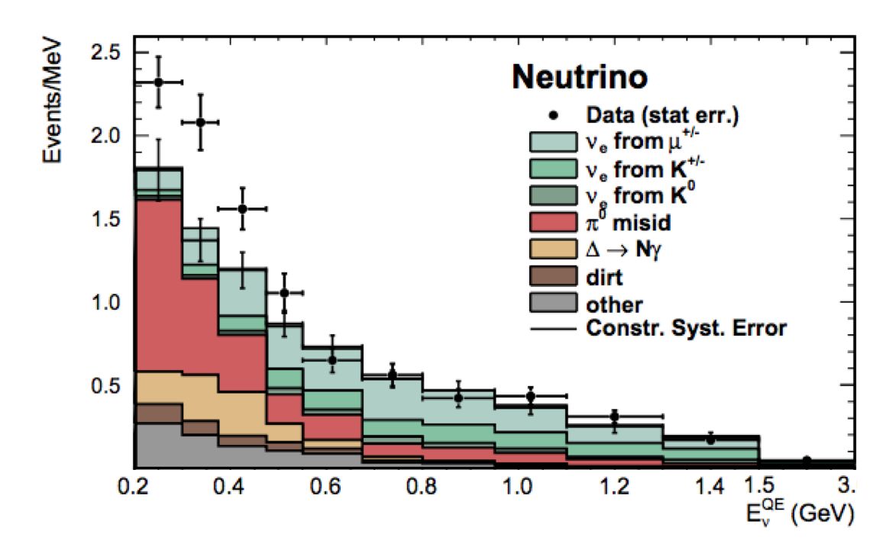
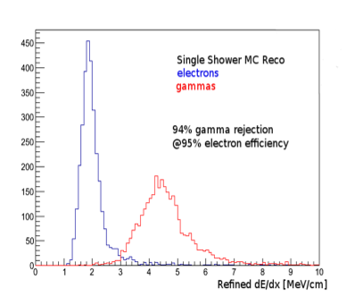
MicroBooNE and the MiniBooNE Excess
MicroBooNE
MiniBooNE
6.0 x 10²⁰ POT
>5σ statistical
e
LArTPC
OR…?
6.0 x 10²⁰ POT
γ
>4σ statistical
MicroBooNE can investigate a critical piece of the puzzle: are the excess events seen by MiniBooNE electrons or photons?

Slide 11
Some Recent History
MicroBooNE was not designed to explore the complete sterile neutrino oscillation parameter space on its own
Summer 2012, an LOI was submitted to the Fermilab PAC for the “LAr1” project. This was a 1-kton FV LArTPC, based on designs for LBNE, to serve as a second detector along with MicroBooNE. Estimated cost was $80M.

Slide 12
Some Recent History
MicroBooNE was not designed to explore the complete sterile neutrino oscillation parameter space on its own
Summer 2012, an LOI was submitted to the Fermilab PAC for the “LAr1” project. This was a 1-kton FV LArTPC, based on designs for LBNE, to serve as a second detector along with MicroBooNE. Estimated cost was $80M.
Fast forward to the January 2014 PAC where two new proposals were put forward:

Slide 13
Some Recent History
MicroBooNE was not designed to explore the complete sterile neutrino oscillation parameter space on its own
Summer 2012, an LOI was submitted to the Fermilab PAC for the “LAr1” project. This was a 1-kton FV LArTPC, based on designs for LBNE, to serve as a second detector along with MicroBooNE. Estimated cost was $80M.
Fast forward to the January 2014 PAC where two new proposals were put forward:
  P-1053: LAr1-ND
    Realizing the importance of a near detector to measure the unoscillated fluxes and the physics program enabled in a first phase with a ND + MicroBooNE, LAr1-ND was proposed as the next phase in the SBN program.
http://www.fnal.gov/directorate/program_planning/Jan2014PACPublic/LAr1ND_Proposal.pdf

Slide 14
Some Recent History
MicroBooNE was not designed to explore the complete sterile neutrino oscillation parameter space on its own
Summer 2012, an LOI was submitted to the Fermilab PAC for the “LAr1” project. This was a 1-kton FV LArTPC, based on designs for LBNE, to serve as a second detector along with MicroBooNE. Estimated cost was $80M.
Fast forward to the January 2014 PAC where two new proposals were put forward:
  P-1053: LAr1-ND
    Realizing the importance of a near detector to measure the unoscillated fluxes and the physics program enabled in a first phase with a ND + MicroBooNE, LAr1-ND was proposed as the next phase in the SBN program.
  P-1052: ICARUS@FNAL
    Was proposed to relocate the updated existing ICARUS T600 LArTPC detector (~450-ton FV) to the BNB and to construct a new one-fourth scale detector based on the same design to serve as a near detector for oscillation searches.
http://www.fnal.gov/directorate/program_planning/Jan2014PACPublic/LAr1ND_Proposal.pdf
http://www.fnal.gov/directorate/program_planning/Jan2014PACPublic/ICARUS.pdf

Slide 15
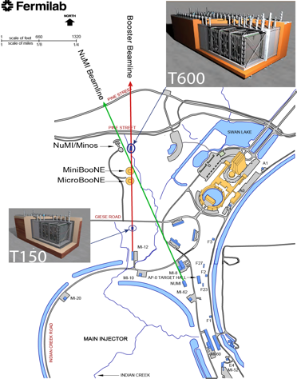
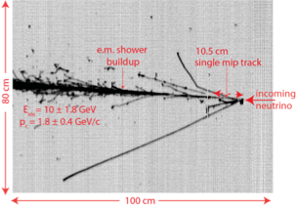
ICARUS@FNAL Proposal
ICARUS T600 detector to be located along the BNB at ~700 m from the target
A new T150 detector based on the ICARUS design to be located at about 150±50 m from the target
T600 would also receive ν’s from the off-axis NuMI neutrino beam peaked at ~2 GeV with an enriched νe flux
The dual presence of T600 and new T150 would extend the information coming from MicroBooNE
ICARUS data event with:
Evisible = 11.5 ± 1.8 GeV
Eelectron = 10 ± 1.8 GeV
ptransverse = 1.8 ± 0.4 GeV/c
http://www.fnal.gov/directorate/program_planning/Jan2014PACPublic/PAC_presentation.jan2014.F.pptx

Slide 16
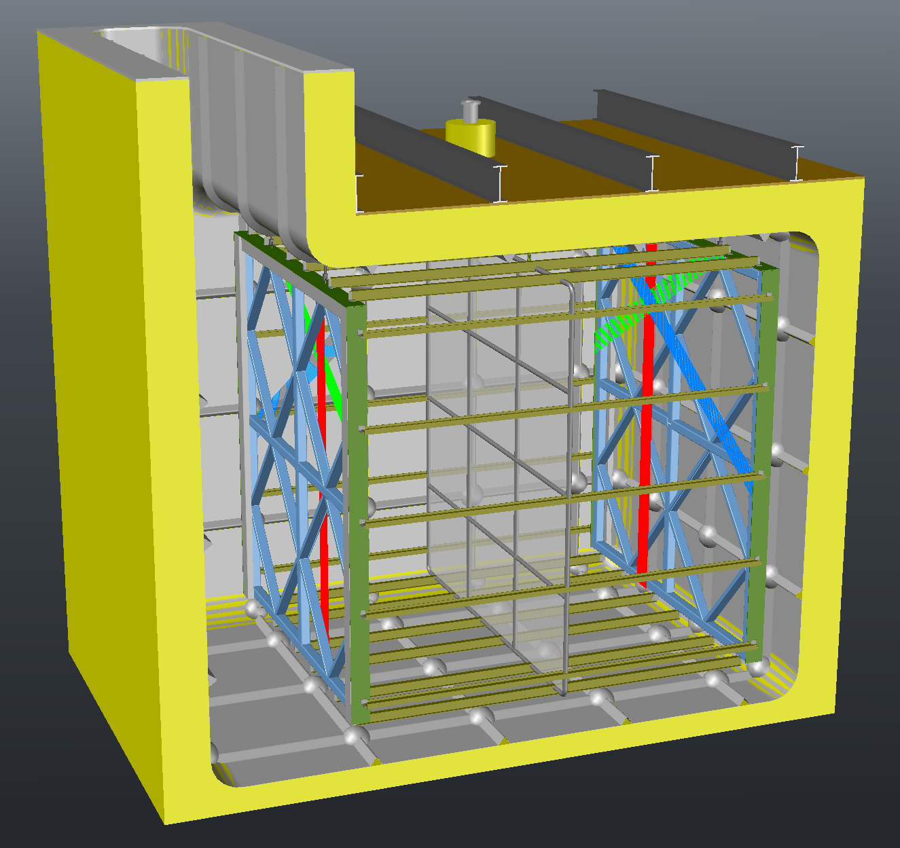
LAr1-ND Proposal
LAr1-ND detector design approach:
  utilize as many design elements developed for the LBNE Far Detector as feasible
  implement technology that builds upon experience from the T600, MicroBooNE and the 35-ton membrane cryostat prototype
  control project cost by reusing the empty SciBooNE detector hall at 100 m on the BNB
LAr-ND would provide high-statistics measurement of the intrinsic BNB content, enabling sensitive oscillation searches in combination with downstream detectors
Together with MicroBooNE, provide a complete interpretation of the MiniBooNE excess. Photons or electrons? Intrinsic to the beam or appearing?
Valuable “physics R&D” such as reconstruction development and GeV ν-Ar cross sections. ~1M νμ events per year, 6,000 νe per year!
BNB
100m
82 ton TPC
membrane
cryostat
design
http://www.fnal.gov/directorate/program_planning/Jan2014PACPublic/LAr1ND_PAC_2014_01_23_v3.pdf

Slide 17
SBN Program Development
Since the January PAC, proponents of the LAr1-ND and ICARUS proposals, members of the MicroBooNE collaboration, as well as representatives from Fermilab, INFN and CERN, have been working together to develop plans for a coherent SBN program on the BNB.
  An international team* is currently leading the preparation of a joint proposal to be submitted to the PAC for their next meeting in July.
  This proposal will include physics sensitivities for a multi-LArTPC detector program with a LAr1-ND type near detector at 100-150m, MicroBooNE at 470m, and the ICARUS T600 detector at 600m along the BNB.
  Three day workshop at FNAL in April with several members from each group
    Workshop included also the NESSIE collaboration who have proposed a muon spectrometer-based addition to the SBN experimental program at FNAL (arXiv:1404.2521)
*A. Guglielmi (INFN Padova/ICARUS), M. Nessi (CERN), D. Schmitz (Chicago/LAr1-ND), G. Zeller (FNAL/MicroBooNE),
and FNAL SBN Coordinator P. Wilson (FNAL SBN)

Slide 18
SBN Program Optimization
Feeding into the proposal are the on-going efforts of Working Groups with broad participation among the institutions and collaborations. Their charges are to address specific, key questions relating to the optimization of the experimental configuration.
  Cosmic backgrounds
    Impact of cosmic muons, neutrons and photons for surface detectors
  Neutrino Flux and Systematics
    Optimization of ND location, FD on-axis vs on surface
  Detector Buildings and Siting
    Cost and scheduling
  Cryostat and Cryogenic Systems

Slide 19
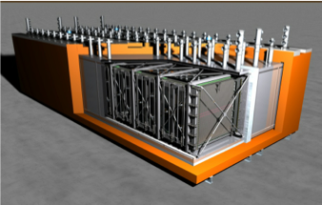

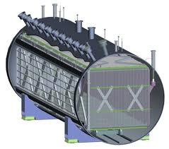


SBN@BNB
ICARUS T600
MicroBooNE
LAr1-ND

Slide 20
Sterile Neutrino Oscillations on the BNB
FD
FD
At peak BNB neutrino energy, E = 700 MeV

Slide 21
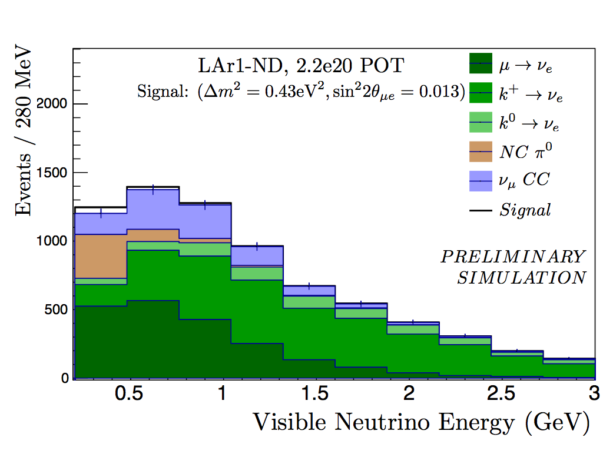
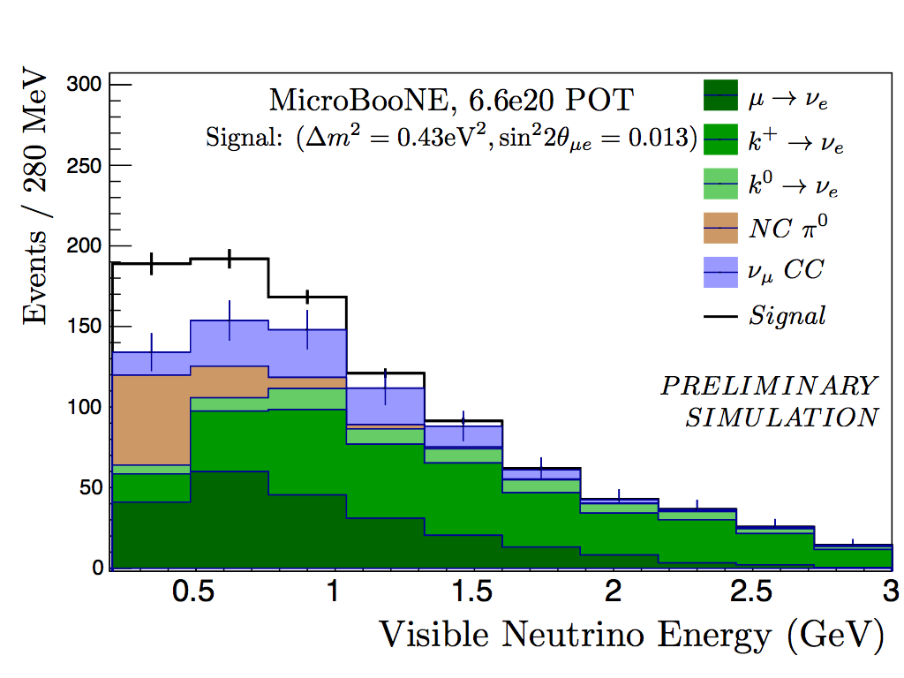
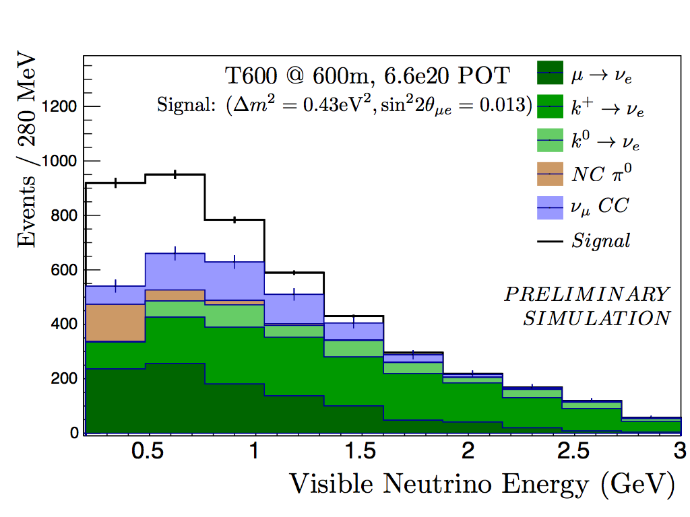


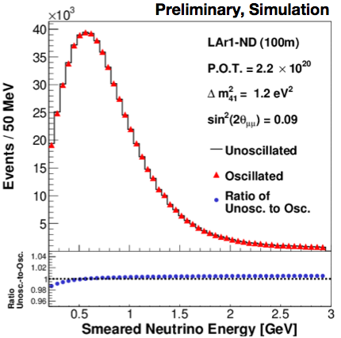
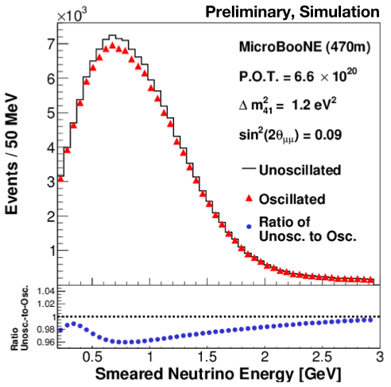
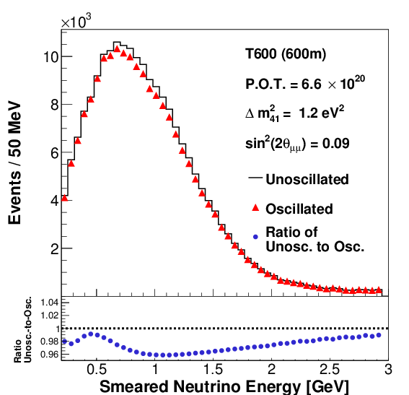
ND @ 100 m
MicroBooNE @ 470 m
ICARUS T600 @ 600 m
νe Appearance
νμ Disappearance

Slide 22
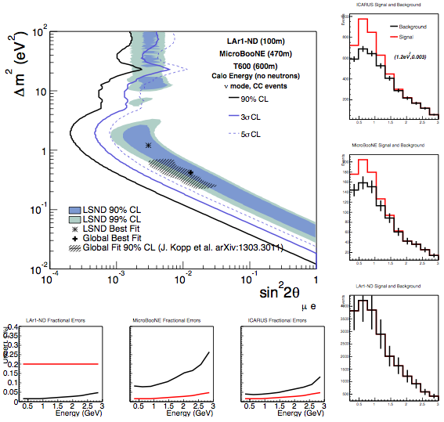
νμ → νe Appearance
MicroBooNE
uB statistical error
ND statistical error
fractional uncertainty
Statistical Uncertainty Limit
for 6.6e20 POT exposure
ICARUS T600
FD statistical error
ND statistical error
fractional uncertainty
4%

Slide 23
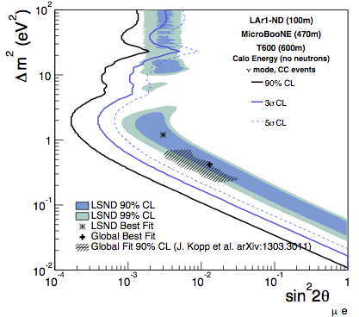


νμ → νe Appearance
Impact of increased exposure by 50%
Statistical Uncertainty Limit
for 10e20 POT exposure
Projecting integrated POT onto a time axis is clearly important and depends on proton economics after ~2018.
PIP-I/PIP-II goals very valuable to success of this program!

Slide 24
Make Every Proton Count
Possible BNB upgrades:
  New inner conductor design?
  New target design?
  Deploy 25m absorber?
  2nd focusing horn?
Beamline was optimized for MiniBooNE in 1990s
  Neutrino detector technology matters (S/B is the metric)
  Available hadron production data (from HARP expt.) means pion production off the target now better understood. Re-optimize focusing?
2 horns
1 horn

Slide 25
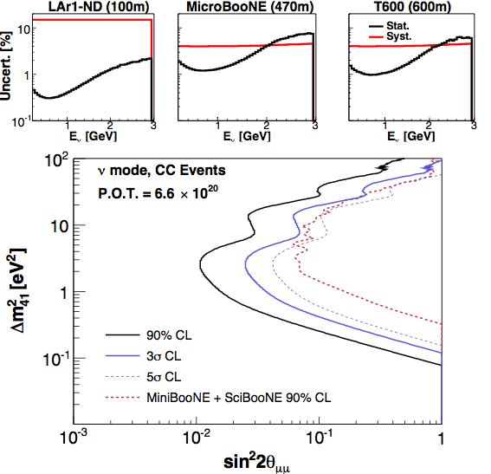
νμ Disappearance
νμ disappearance not a statistics limited search. Here shown with a 4% systematic uncertainty on the near to far extrapolation.
Previous limit at high Δm² limited by near and far detectors being different technologies

Slide 26
Summary
Fermilab is well positioned to play a key role in resolving the existing hints for new physics happening at short-baseline
A discovery would be revolutionary
A short-baseline program additionally provides opportunities for important physics measurements and detector R&D toward the future neutrino program
Such a program has been strongly endorsed by the recent P5 Report
An international group is currently developing a proposal to build a world-leading program here at Fermilab, utilizing the existing BNB. An optimization of this program, integrating recent proposals by the ICARUS and LAr1-ND collaborations, is under development for the summer PAC next month.

Slide 27

LAr1-ND Collaboration
10 US institutions
3 DOE National Laboratories
6 NSF institutions
7 European institutions
5 UK institutions
1 Swiss institution
CERN
11 institutions also on MicroBooNE.
Most also LBNE collaborators.
*Spokespersons

Slide 28
MicroBooNE Collaboration

Slide 29
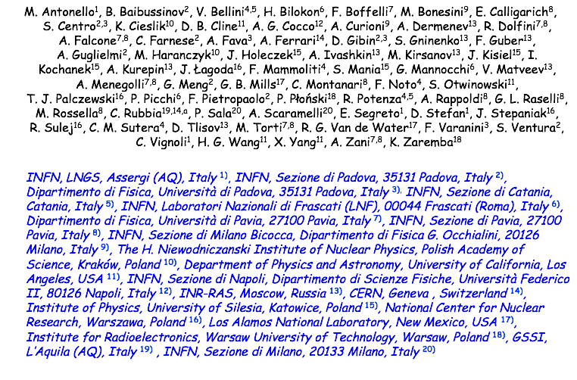
ICARUS Collaboration

