Slide 1
HEP P5 Response and Impacts
OFFICE OF SCIENCE
Jim Siegrist
Associate Director, Office of High Energy Physics
Office of Science, U.S. Department of Energy

Slide 2
Outline
HEP General Comments on P5
Elevator Speech
Executive Summary
Timeline
HEP Action Items
General recommendations and Major Changes
Other recommendations
Project-specific recommendations
Budget Impacts
Open Issues
Broader Impacts

Slide 3
Take-Away Messages
Recall Snowmass message from Moniz: “Get a plan. Get behind it.”
We have a plan. HEP supports the plan.
Community (and broader) reaction has been positive so far
Continued effort is needed to build support for the plan
We have several action items in progress to implement the P5 recommendations
Some can be done quickly, but many will take time
We will not know which budget scenario we are in until after the fact
We are using the excellent P5 plan and impact statements to argue for more robust budgets
Near-term appropriations (FY15, FY16) will be very important in setting the course for the future
There is a lot of work to do, on many fronts
Let’s get going!

Slide 4
HEP P5 RESPONSES

Slide 5
Our P5 Elevator Speech
This report represents a consensus vision developed bottom-up by the physics community with extensive consultation to identify the most exciting and productive areas of research and how we pursue them.
The report recognizes the reality of a challenging funding landscape, where choices have to be made and resources stewarded carefully, and confronts those challenges head on.
The promise/potential of high energy physics has never been greater – far from “settling” the big questions in high energy physics, the discovery of the Higgs boson and other recent milestones in physics have opened many more doors to exploring and understanding our universe.
Even given funding challenges, much important fundamental work can be accomplished and many tremendous scientific opportunities pursued, if we make the right strategic choices as a community.
This is a time of excitement and intellectual fervor that can engage young scientists and provide direction for a rewarding and fulfilling career.

Slide 6
P5: Executive Summary
We recommend a limited, prioritized and time-ordered list of experiments to optimally address these science drivers, with pieces covering small, medium and large investment scales that will produce results continuously throughout a twenty-year timeframe.
These derive directly from 5 Drivers
US contribution to big offshore projects (LHC, ILC) to be decided after consultations with international partners.
LBNE reconfigured as fully international project to achieve science goals.
Time-ordering makes it feasible in ~flat budget scenarios (see timeline)
Some additional project-specific details on following slides

Slide 7
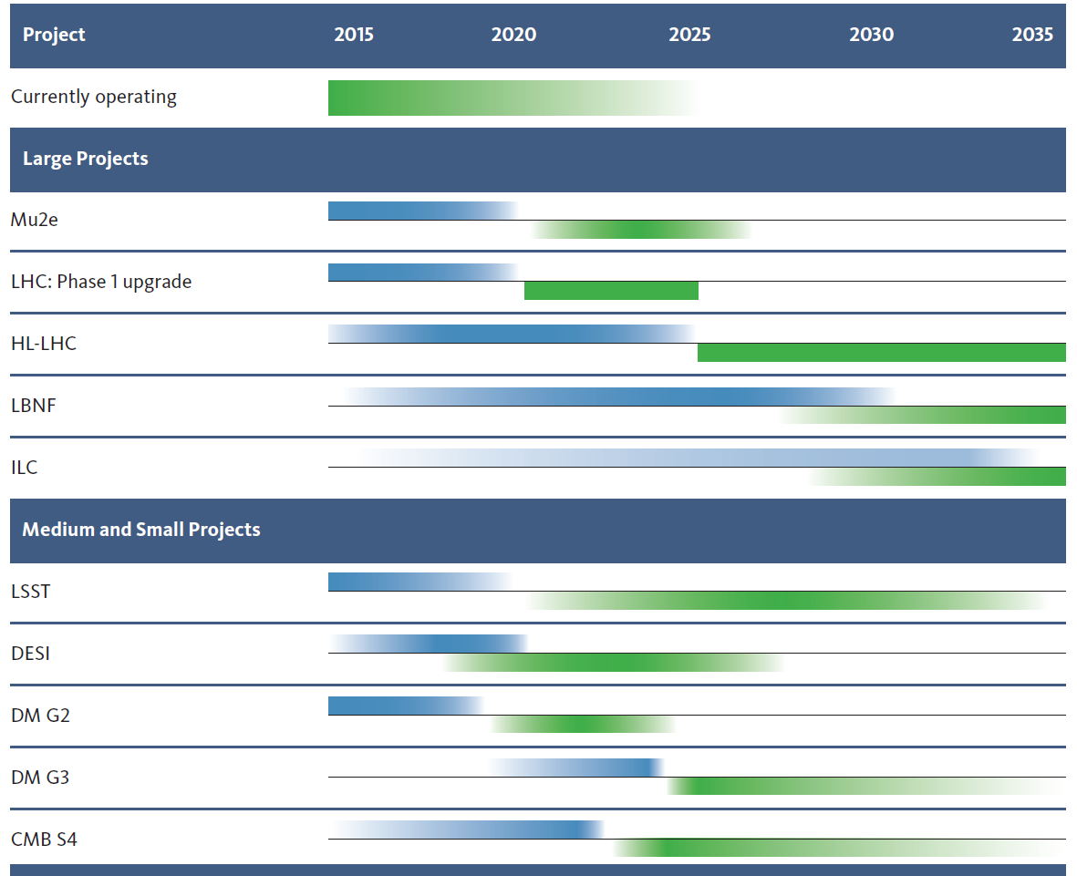
Construction and Physics Timeline

Slide 8
HEP P5 ACTION ITEMS

Slide 9
Near-Term Action Items : Big Picture
“Particle Physics is Global” [R1]*
Already have full-time program manager dedicated to International issues (+ a growing fraction of HEP management time).
This will require much work. International partners are interested but cautious given US history. We will engage DOE leadership to support the P5 plan and vigorously make the case with the rest of the Administration and Congress.
Many discussions with partners, SC international, State…
New/Updated int’l agreements in preparation (CERN, Italy, India)
Note formal agreements require State approval
Informal agreements (e.g. MOUs) require SC approval
Working on alignment and improving bi-directional nature of continuing int’l agreements (China, Japan)
Exploring possible options with other interested parties (Korea, UK)
The Five Drivers [R2]*
Can incorporate this concept fairly easily into HEP narrative justifications and other communications
We are not abandoning “Frontiers” basis for budget or internal program management
*Relevant P5 Recommendations referenced throughout with [R#]

Slide 10
The Science Drivers & The Frontiers
Higgs
Neutrinos
Dark Matter
Dark Energy / CMB
New particles
Energy Frontier
Intensity Frontier
Cosmic Frontier

Slide 11
Near-Term Action Items II : Major Changes
Increase new project construction to 20—25% of the program while university and laboratory research funding should not reduce below 40%. [We will use this guidance in budget formulation] [R5]
The long baseline neutrino program should be reformulated to be internationally coordinated and funded, with Fermilab as the host.[ Initial discussions with FNAL and partners have started] [R12, 13]
Invest in the Fermilab proton accelerator complex with the aim to provide substantial intensity beam (> 1 MW) at first operation of the new long baseline neutrino facility. [We concur. This is the current plan] [R14]
Increase investment in and immediately proceed with the next generation Dark Matter direct detection program. [Challenging w/current budgets. We are using this as a key argument to increase HEP budget] [R19, 20]
Substantially increase particle physics funding as part of the multiagency partnerships that support cosmic microwave background (CMB) research. [will convene the CMB community to (re)define the “S4” science plan] [R18]
Re-align accelerator R&D to focus on the latest assessment of our long-term needs, moving away from muon accelerator activities and towards capabilities that could dramatically improve the cost effectiveness of future accelerators. [charging new HEPAP subpanel to recommend plan][R24, 25, 26]

Slide 12
Other P5 Recommendations
[R3] Develop a mechanism to reassess the project priority at critical decision stages if costs and/or capabilities change substantively
Developing parameters for “National PAC” w/agency gatekeeper
Will also address new projects post-P5
[R24] Participate in global conceptual design studies and critical path R&D for future very high-energy proton-proton colliders. Continue to play a leadership role in superconducting magnet technology focused on the dual goals of increasing performance and decreasing costs.
Small R&D efforts for near-term
Will be prioritized as part of HEPAP accelerator R&D subpanel (other P5 Recommendations [R23, 25, 26] reference this as well)
Several recommendations on “balance”, diversity of program, and improving university-lab partnerships [R4, 6, 7, 28]
Note there is no specific “small project portfolio” in HEP
Discussion items for HEPAP

Slide 13
Other P5 Recommendations Continued
[R29] Strengthen the global cooperation among laboratories and universities to address computing and scientific software needs, and provide efficient training in next-generation hardware and data-science software relevant to particle physics.
Set up Forum for Computational Excellence to work with HEP to address this Recommendation

Slide 14
Project-Specific Comments
We note that the P5 recommendations, taken together, constitute a coherent HEP program, so one should not read too much into individual recommendations without context
That said, on the next few slides we address some DOE responses to recommendations concerning specific projects

Slide 15
Project Recommendations
[R10] Complete the LHC phase-I upgrades and collaborate in the high-luminosity upgrades of the accelerator and both general-purpose experiments (ATLAS and CMS). The LHC upgrades constitute our highest-priority near-term large project.
We concur. Phase-I accelerator upgrades underway (via LARP). Initial funding for Phase-I detector upgrades in FY15 Request.
The State Department is currently evaluating a DOE/NSF request to begin negotiations with CERN on an updated agreement between the US and CERN to provide the framework for the next stage
This agreement will be needed to seek approval of CD-0 for the HL-LHC projects.
High-luminosity (Phase-II) accelerator upgrades in advanced discussion stages with CERN
Phase-II detector upgrades in early discussion stage with international partners. Full scope of Phase-II detectors and US share will require an iterative process with CERN management and “scrutiny group”
Close DOE-NSF partnership will be necessary for success
We are working to better understand near-term R&D needs to prepare for the Phase-II detector projects.

Slide 16
Project Recommendations Continued
[R11] Motivated by the strong scientific importance of the ILC and the recent initiative in Japan to host it, the U.S. should engage in modest and appropriate levels of ILC accelerator and detector design in areas where the U.S. can contribute critical expertise. Consider higher levels of collaboration if ILC proceeds.
The meaning of “modest” will depend on the HEP budget
Initial support will be by redirection of effort
The meaning of “appropriate” will depend on the areas where Japan would like us to help
We believe the current priority is for site-specific accelerator R&D and design efforts
We await further discussions with the Japanese government

Slide 17
Project Recommendations Continued
General Observations on Recommended Neutrino Program:
There will need to be action on multiple levels to implement this plan.
Interested neutrino physicists from around the world will need develop a concept for the best neutrino program possible within fiscal constraints.
Funding agencies will need to develop appropriate arrangements to provide contributions to the US neutrino program to support the participation of their scientists
There will be high level meeting of interested funding agencies in Paris in late June to discuss cooperating on global program.
Fermilab is planning to invite prominent neutrino physicists from around the world this summer to meet and discuss how to bring together the needed collaboration(s)

Slide 18
Project Recommendations Continued
Short Baseline Neutrino Program [R12, 15]:
The Fermilab director has appointed a coordinator of the Short-Baseline Neutrino (SBN) program. The SBN coordinator has been charged with forging a plan to get a multi-detector SBN program at Fermilab operational by 2018 with two primary goals:
Make definitive measurements of the Liquid Scintillator Neutrino Detector (LSND) anomaly and the MiniBooNE low energy excess.
Further research and development of Liquid Argon Time Projection Chambers (LAr TPCs) and associated support systems to further the Long-Baseline Neutrino (LBN) program.
Various organizational efforts have already started. The intent is for a joint proposal to be reviewed at the July 2014 Fermilab PAC meeting.
Based on the Fermilab PAC report, and the Fermilab director’s recommendation, DOE will determine if the projects are ready to be considered for next-stage review and approval (eg CD-0).

Slide 19
LBNF Internationalization [Recommendation 13]
In order to attract foreign support, work needs to be done on two levels: (1) since funding agencies support the work of their PIs, we need PIs to be attracted to LBNF, and (2) we need to work out ‘rules of engagement’ between DOE and the other funding agencies
FNAL Director has to take the lead in attracting PIs to LBNF. A ‘summit’ meeting is planned for end of July for this purpose. We think the P5 plan should be quite attractive with PIP2 increasing power to >1MW and SURF and LBNE project development well along.
DOE, working with FNAL Director, has to take the lead in attracting foreign funding agencies to work with the US. The LHC management model will be followed as closely as possible. DOE SC project rules have the flexibility needed to do this. Proper oversight of the construction is important to SC; initial discussions with some foreign funding agency representatives indicate that a uniform (Lehman-style) review process may be desirable for all partners.
There is also much physics work to do! (see ICFA neutrino panel report: http://www.fnal.gov/directorate/icfa/files/ICFA-Neutrino-Panel-Rpt-1.pdf) . DOE (NP, HEP) and NSF (EPP, PA) are discussing modes of cooperation to support the neutrino program

Slide 20
Some Concerns Expressed on LBNF and DOE Response
The P5 version of LBNF is delayed relative to LBNE plans
LBNE CD1 featured 10kt on the surface. LBNF is at 4850’ with a minimum target mass defined by P5. LBNF as planned by P5 can be afforded by both the US program and its partners, by delaying the peak of spending relative to LHC. It is up to the LBNF collaboration, working with funding agencies, to collect resources globally to move as fast as it can.
This is an opportunity to enable the science the community wants to do
Other regions have their own plans, why would they participate?
P5 felt the impact of LBNF underground with a larger detector and more powerful beam was much more scientifically compelling than the DOE CD-1 version. Initial discussions with several potential European partners concur. We note the 2013 European HEP strategy explicitly called out the possibility of offshore collaboration on neutrino projects. Other (non-European) potential partners have also shown interest.

Slide 21
More LBNF FAQ
Does DOE plan to “re-open” LBNE CD-1?
No. We are re-evaluating total project cost for the revised LBNF plan (as required by CD process rules) but do not expect to re-open CD-1. That said, international negotiations may impact some of the design choices.
Is there any possibility for “early physics” before ~2025?
Yes. How much can be done depends on overall budget levels and readiness at the SURF site to begin construction of the far detector halls. It will be a high priority to get this going as fast as we can.
This is a long-term program. Is DOE committed to it, even in the face of possible delays, difficult negotiations, international competition, changing physics landscape?
HEP is committed now to try to make the full-scale LBNF happen, following the P5 plan. Note that DOE will have stuck with LHC for 20+ years if the upgrades happen as P5 envisions. No reason to believe the same cannot be done for LBNF. But the community must also maintain their commitment.

Slide 22
Other Recommended Projects
Project | P5 Recommendation | HEP action/comment
Mu2e | [R22] Yes in all scenarios. Reprofile? | In current budget plan. May adjust at CD-2.
LSST | [R17] Yes in all scenarios. | In current budget plan.
Dark Matter G2 | [R19] Yes in all scenarios. Joint DOE-NSF. Expand number of funded expt’s. | Expanded program challenging in current budget. No MIE in FY15 Request. Downselect announced asap.
Dark Matter G3 | [R20] Support one or more depending on G2 DM outcome. | Launching G2 DM is near-term priority. Scope TBD.
CMB S4 | [R18] Yes in all scenarios. DOE should get involved in next-gen large-scale expt’s. | Will discuss DOE role with other agencies (NSF, NASA) and CMB community
DESI | [R16] Yes in Scenario B, C. No in Scenario A. | Not in FY15 Request. Using DESI as argument for Scen. B CD-1 review by end FY2014.
g-2 | [R22] Yes in all scenarios | In current budget plan

Slide 23
Cosmic Frontier – Cherenkov Telescope Array (CTA) (P5 Recommendations, OHEP Response)
[R21] Invest in CTA as part of the small projects portfolio if the critical NSF Astronomy funding can be obtained.
CTA has a broad science reach that transcends fields, with the dark matter detection capabilities of direct importance to particle physics
Using P5 Criteria, a de-scoped US component should be shared by NSF-AST, NSF-PHY and DOE.
NSF-AST has said publicly that its budget is unable to accommodate this project as a strategic initiative; Only possibility is the competed mid-scale program.
➔HEP doesn’t plan to continue support of research or R&D efforts on CTA.
This could be re-considered if NSF moves forward on the project and requests a partnership with DOE, based on priorities, funding etc.

Slide 24
HEP Budget Impacts : FY15
Note HEP FY15 Request was developed before P5 Plan was announced, so there was little ammunition available to argue for higher budget levels
FY15 Request is slightly below P5 Scenario A level.
FY14 Appropriation is above Scenario B.
It is impossible at this stage to know which Scenario we are working in
But since we have already been working in this budget framework, only relatively small adjustments are needed for FY15 Request to “fit” P5 plans
We have communicated these adjustments to Congress at their request
We have also made the arguments for Scenario B funding levels
We expect House and Senate mark-ups to be released soon
We hope P5 plan + positive community reaction will help support more robust HEP budget generally
Users groups and DPF have been very active in supporting the plan
How much of the near-term plan can be achieved will depend largely on FY15 Appropriation

Slide 25
Open Issues
Advanced Technology R&D [R23, 24, 26, 27]
P5 suggested significant reduction/redirection here, as well as improving lab/university collaboration
How to do this and stay competitive in global program?
Impact of paradigm shifts? (e.g., “the end of Moore’s Law”?)
MAP/GARD redirection and transition [R25]
Need to understand core competencies that need to be preserved
Many details still to be worked out
HEP Computing R&D (including Trigger/DAQ) [R29]
US has been a world leader here but cost model may be breaking
P5 suggested exploring new partnerships and R&D modes
Impact of paradigm shifts? (as above)

Slide 26
P5 Rollout Timeline
Date | DOE/HEPAP effort | Date | Other effort
May 22-23 | HEPAP Meeting (incl press briefing, auxiliary mtgs) |  | Press releases; emails to community
Late May | Key stakeholder briefings | Late May | Letters from DPF exec, CERN
 | Request lab P5 responses | June 2 | Ritz community presentation
Early June | Lab SC briefings | June 4-6 | DPF Congressional visits, Senate Energy briefing
 |  | June 10 | House Science hearing
June 11-12 | FNAL User Meeting |  | (you are here)
June 16-17 | HEP PI Meeting (Rockville) | June 18 | PI Congressional visits
June 23-24 | Funding Agency Mtg (Paris)
Mid-July | HEP lab meeting (DC) |  | DPF Capitol Hill event “Future of US particle physics”
August | FY15 initial fin plan |  | Congressional visits (in home districts)

Slide 27
HEP Science & Technology Connections
The strength of the US S&T enterprise in which US HEP is embedded is a significant technical advantage for US HEP relative to competing regions
Only relevant if HEP community systematically takes advantage of the technical opportunities presented by our sister sciences
Need to identify and develop community support around those connections areas with largest promise for impact either in HEP or the allied field.
Important to remember that Connections are cyclic
Innovations developed in particle physics move outwards and evolve – while science and technology advances elsewhere help us
Better planning, cooperation, and organizing may help strengthen connections and accelerate S&T gains
P5 has also noted the importance of our Benefits and Connections to Society

Slide 28
Particle Physics Connections with Other Disciplines
Science Connections - to other Science Disciplines via synergies in the underlying physical systems and/or theoretical, mathematical, or computational frameworks that describe their behavior.
Technology Connections - via similar tools and techniques useful in pursuing science priorities of individual programs.
HEP recently charged Two Task Forces to explore some of the
connections of Particle Physics with other
basic sciences and beyond, and identify
science opportunities at the interfaces.
http://science.energy.gov/hep/news-and-resources/reports/
http://science.energy.gov/~/media/hep/hepap/pdf/201403/Kachru_HEPAP.pdf
This follows a prior 1998 NAS report on such intersections.
Particle Physics
CMP
AMO
Maths and computing
Nuclear Physics
Astrophysics

Slide 29
Paths Forward
HEP invites nominations for a Connections Core Working Group
Nominees : expected to be leaders in our field with established interdisciplinary credentials and contacts.
Connections Core Group will work with HEP and the Community to identify opportunities and move forward along the most promising ones.
The Core Working Group may suggest additional studies in consultation with DOE and potential partner disciplines
Please send your Nominations to Lali Chatterjee at HEP lali.chatterjee@science.doe.gov
In the meantime, HEP is contacting potential partner programs and agencies
Suggestions welcome…

Slide 30
Take-Away Messages
Recall Snowmass message from Moniz: “Get a plan. Get behind it.”
We have a plan. HEP supports the plan.
Community (and broader) reaction has been positive so far
Continued effort is needed to build support for the plan
We have several action items in progress to implement the P5 recommendations
Some can be done quickly, but many will take time
We will not know which budget scenario we are in until after the fact
We are using the excellent P5 plan and impact statements to argue for more robust budgets
Near-term appropriations (FY15, FY16) will be very important in setting the course for the future
There is a lot of work to do, on many fronts
Let’s get going!

Slide 31
BACKUP

Slide 32
Prioritization for Large Projects

Slide 33
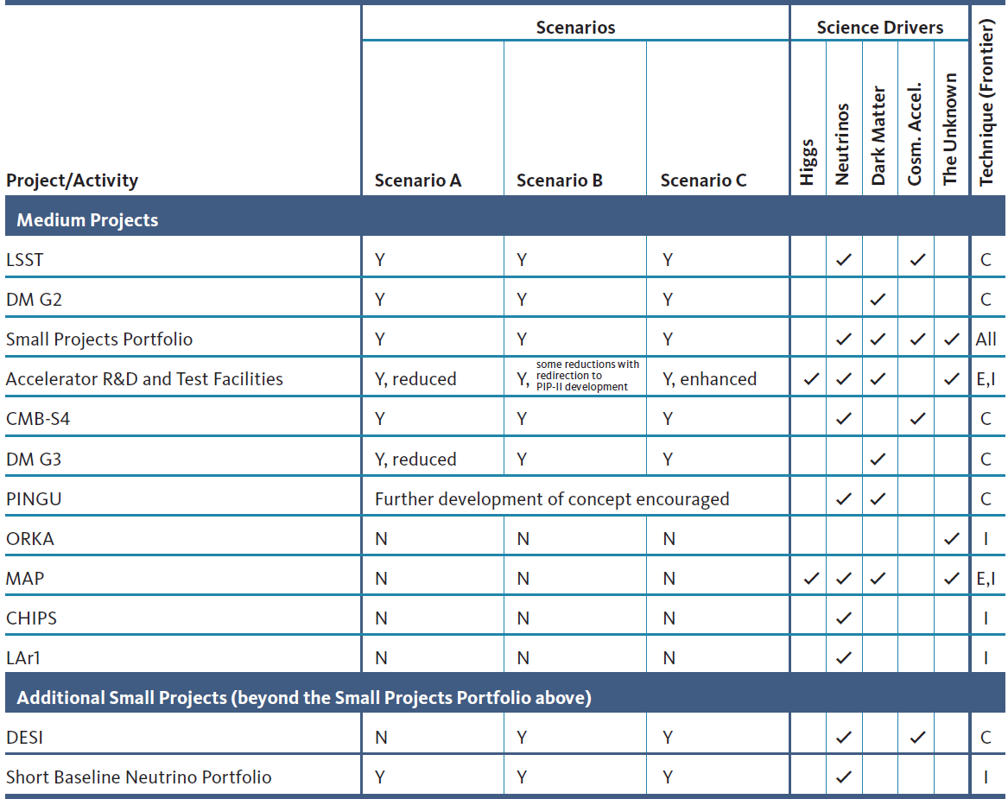
Prioritization for Medium and Small Projects

Slide 34
P5: Executive Summary
Particle physics is a discovery-driven science. Investments have rewarded us with fundamental discoveries and current opportunities will push into new territory.
Particle physics is global. Successfully addressing urgent scientific questions requires the U.S. to both host world-class facilities and act as reliable international partner with the worldwide community.
Choices are required. The U.S. must invest purposefully among many excellent ideas in order to have the biggest impact and make the most efficient use of resources over the coming decade.
Five intertwined scientific drivers were distilled from the results of a yearlong community-wide study:
Use the Higgs boson as a new tool for discovery [→ LHC + upgrades; ILC]
Pursue the physics associated with neutrino mass [→ FNAL nu program]
Identify the new physics of Dark Matter [→ direct detection + LHC, ILC]
Understand cosmic acceleration: Dark Energy and Inflation [→ LSST, DESI, CMB next-gen expt’s]
Explore the unknown: new particles, interactions, and physical principles. [→ Mu2e + LHC, ILC and most other recommended IF projects]
This will require much work. International partners are interested but cautious given US history. We will engage DOE leadership to support the P5 plan and vigorously make the case with the rest of the Administration and Congress.

Slide 35
Funding Stability and Investment Opportunities
Small changes in yearly budgets have large impacts on the timeline and capability of the U.S. particle physics program. Opportunities are identified where small limited-time funding increments would yield substantial returns. [→ This is the core of the argument “why HEP budget should be ~Scenario B”]
The lowest budget scenario is detrimental to the long-term health of particle physics: the U.S. would lose its position as a global leader in this field, and highly productive international relationships would be fundamentally altered.[→ This is the core of the impact statement for “what if you are stuck in Scenario A budgets”]
Three high-priority activities are identified for additional investments beyond our constrained scenarios: [ie, Scenario C. These will need additional development to become compelling arguments]
Expansion of accelerator R&D that would enable very high-energy future machines and likely provide benefits beyond particle physics. [New HEPAP accelerator R&D subpanel will address the case for such an expansion, and what investments would be recommended]
Play world-leading roles in the ILC detector and accelerator programs.
Host a large water-based neutrino detector to unify the global long-baseline neutrino community around the world’s highest intensity neutrino beam provided by Fermilab.

Slide 36
Recommendations
Global recommendations
Recommendation 1: Pursue the most important opportunities wherever they are, and host unique, world-class facilities that engage the global scientific community.
Recommendation 2: Pursue a program to address the five science Drivers.
Recommendation 3: Develop a mechanism to reassess the project priority at critical decision stages if costs and/or capabilities change substantively.
Recommendation 4: Maintain a program of projects of all scales, from the largest international projects to mid- and small-scale projects.

Slide 37
Recommendations
Program budget allocation
Recommendation 5: Increase the budget fraction invested in construction of projects to the 20%–25% range.
Recommendation 6: In the research program, a balance should be found between providing enough resources to reap the full and timely science benefits from major projects and maintaining the flexibility to support, at a reasonable level, new ideas and developments outside approved projects.
Recommendation 7: Any further reduction in level of effort for research should be planned with care, including assessment of potential damage in addition to alignment with the P5 vision.
Recommendation 8: As with the research program and construction projects, facility and laboratory operations budgets should be evaluated to ensure alignment with the P5 vision.

Slide 38
Recommendations
Project prioritization (part 1)
Recommendation 9: Funding for participation of U.S. particle physicists in experiments hosted by other fields and other countries is appropriate and important, but should be evaluated in the context of the Drivers and the P5 Criteria and should not compromise the success of prioritized and approved particle physics experiments.
Recommendation 10: Complete the LHC phase-I upgrades and collaborate in the high-luminosity upgrades of the accelerator and both general-purpose experiments (ATLAS and CMS). The LHC upgrades constitute our highest-priority near-term large project.
Recommendation 11: Motivated by the strong scientific importance of the ILC and the recent initiative in Japan to host it, the U.S. should engage in modest and appropriate levels of ILC accelerator and detector design in areas where the U.S. can contribute critical expertise. Consider higher levels of collaboration if ILC proceeds.

Slide 39
Recommendations
Project prioritization (part 2)
Recommendation 12: In collaboration with international partners, develop a coherent short- and long-baseline neutrino program hosted at Fermilab.
The minimum requirements to proceed are the identified capability to reach an exposure of at least 120 kt*MW*yr by the 2035 timeframe, the far detector situated underground with cavern space for expansion to at least 40kt LAr fiducial, and >1.2MW beam upgradable to higher beam power. The experiment should have the demonstrated capability to search for SN bursts and proton decay, providing a significant improvement in discovery sensitivity over current experiments for the proton lifetime.
To address even the minimum requirements specified above, the expertise and resources of the international neutrino community are needed. A change in approach is therefore required.
Recommendation 13: Form a new international collaboration to design and execute a highly capable Long-Baseline Neutrino facility (LBNF) hosted by the U.S. To proceed, a project plan and identified resources must exist to meet the minimum requirements in the text. LBNF is the highest-priority large project in its timeframe.
Recommendation 14: Upgrade the Fermilab proton accelerator complex to produce higher intensity beams. R&D for the Proton Improvement Plan II (PIP-II) should proceed immediately, followed by construction, to provide proton beams of >1 MW by the time of first operation of the new long-baseline neutrino facility.
Recommendation 15: Select and perform in the short term a set of small-scale short baseline experiments that can conclusively address experimental hints of physics beyond the three-neutrino paradigm. Some of these experiments should use liquid argon to advance the technology and build the international community for LBNF at Fermilab.

Slide 40
Recommendations
Project prioritization (part 3)
Recommendation 16: Build DESI as a major step forward in dark energy science, if funding permits (see Scenarios discussion below).
Recommendation 17: Complete LSST as planned.
Recommendation 18: Support CMB experiments as part of the core particle physics program. The multidisciplinary nature of the science warrants continued multiagency support.
Recommendation 19: Proceed immediately with a broad second-generation (G2) dark matter direct detection program with capabilities described in the text. Invest in this program at a level significantly above that called for in the 2012 joint agency announcement of opportunity.
Recommendation 20: Support one or more third generation (G3) direct detection experiments, guided by the results of the preceding searches. Seek a globally complementary program and increased international partnership in G3 experiments.
Recommendation 21: Invest in CTA as part of the small projects portfolio if the critical NSF Astronomy funding can be obtained.
Recommendation 22: Complete the Mu2e and muon g-2 projects.

Slide 41
Recommendations
Advanced technology R&D and computing
Recommendation 23: Support the discipline of accelerator science through advanced accelerator facilities and through funding for university programs. Strengthen national laboratory-university R&D partnerships, leveraging their diverse expertise and facilities.
Recommendation 24: Participate in global conceptual design studies and critical path R&D for future very high-energy proton-proton colliders. Continue to play a leadership role in superconducting magnet technology focused on the dual goals of increasing performance and decreasing costs.
Recommendation 25: Pursue accelerator R&D with high priority at levels consistent with budget constraints. Align the present R&D program with the P5 priorities and long-term vision, with an appropriate balance among general R&D, directed R&D, and accelerator test facilities and among short, medium, and long term efforts. Focus on outcomes and capabilities that will dramatically improve cost effectiveness for mid-term and far-term accelerators.
Recommendation 26: Focus resources toward directed instrumentation R&D in the near-term for high-priority projects. As the technical challenges of current high
priority projects are met, restore to the extent possible a balanced mix of short-term and long-term R&D.
Recommendation 27: Strengthen university-national laboratory partnerships in instrumentation R&D through investment in instrumentation at universities. Encourage graduate programs with a focus on instrumentation education at HEP supported universities and labs, and fully exploit the unique capabilities and facilities offered at each.
Recommendation 28: Strengthen the global cooperation between laboratories and universities to address computing and scientific software needs, and provide efficient training in next-generation hardware and data-science software relevant to particle physics. Investigate models for the development and maintenance of major software within and across research areas, including long-term data and software preservation.

Slide 42
Changes in Direction
Several of these recommendations represent significant changes in direction, which we highlight here:
Increase to 20%–25% the fraction of the budget devoted to construction, and plan with care any further reductions in real funding levels for research. In our budget exercises, we adopted an internal guideline of >40% for research.
A change in approach is required for the long-baseline neutrino program. The activity should be reformulated as an internationally coordinated and internationally funded program, with Fermilab as the host, to reach the science driver goals specified in the text. A new international collaboration should be formed.
Upgrade the Fermilab proton accelerator complex to produce higher intensity beams, redirecting some of the existing accelerator R&D and former Project-X activities at Fermilab toward this effort. R&D for PIP-II should proceed immediately, followed by construction, to provide proton beams of >1 MW by the time of first operation of the new long-baseline neutrino facility.
Proceed immediately with a broad second-generation (G2) dark matter direct detection program with capabilities described in the text. Invest in this program at a level significantly above that called for in the 2012 joint agency announcement of opportunity.
Provide substantially increased particle physics funding of CMB research and projects, as part of the core particle physics program, in the context of continued multiagency partnerships.
Re-align activities in accelerator R&D, which is critical to our future, based on new physics information and long-term needs. Specifically, reassess the Muon Accelerator Program (MAP), incorporating into the general accelerator R&D program those activities that are of broad importance to accelerator R&D, and consult with our international partners on the early termination of MICE. In addition, in the general accelerator R&D program, focus on outcomes and capabilities that will dramatically improve cost effectiveness for mid- and far-term accelerators.

Slide 43
Scenario A and Scenario B
Scenario A is much more challenging [than Scenario B].
The reduction relative to Scenario B, which is approximately $30M per year until FY2018 and then grows over time to $95M in 2024, would have very large impacts:
DESI would not be possible
Accelerator R&D and advanced detector R&D would be reduced substantially
Extension of flat-flat research program funding would result in further personnel reductions and loss of research capability
Ramp up of funding for LBNF would be delayed relative to Scenario B (preliminary work would proceed immediately in both scenarios)
A small change in the funding profile of Mu2e may be required.
DESI should be the last project to be cut if moving from Scenario B toward Scenario A. A small, limited-time increment above Scenario A would make this very important small project possible.
Scenario A is precarious.
It is close to the point beyond which hosting a large project (>$0.5B) in the U.S. would not be possible while maintaining the other elements necessary for mission success, particularly a minimal research program and our strong leadership position in a small number of core, near-term projects, which produce a steady stream of important new physics results. Without the capability to host a large project, the U.S. would lose its position as a global leader in this field, and the international relationships that have been so productive would be fundamentally altered.
The return on the investment of the relatively small increment from Scenario A to Scenario B is large.

Slide 44
Scenario C
Our vision for Scenario C is not a long list of projects. Instead, we focus on a few high-priority opportunities:
The U.S. could move boldly toward development of transformational accelerator R&D.
A detailed vision and roadmap should be articulated by the upcoming HEPAP sub-panel on accelerator research.
As work proceeds worldwide on far-future vision accelerator concepts, the U.S. should be counted among the potential host nations.
Experience suggests this effort will also have large, positive impacts beyond particle physics.
The interest expressed in Japan of hosting the International Linear Collider (ILC), a 500 GeV e⁺e⁻ accelerator upgradable to 1 TeV, is an exciting development.
Should the ILC go forward, Scenario C would enable the U.S. to play world-leading roles in the detector program as well as provide critical accelerator components.
It could be possible for the U.S. to offer to host a large water Cherenkov experiment, unifying the global long-baseline neutrino community to take full advantage of the world’s highest intensity neutrino beam.
The placement of the water and LAr detectors would be optimized for complementarity. This approach would be an excellent example of global cooperation and planning.

