Slide 1
Illinois Accelerator Research Center
Bob Kephart
FNAL Users Meeting
11 June 2014

Slide 2
What is IARC?
The Illinois Accelerator Research Center (IARC) is a new facility currently under construction at Fermilab
IARC will provide a state-of-the-art facility for testing high power accelerators and unique expertise for research, development and industrialization of particle accelerator technology.
A major focus of IARC will be to develop partnerships with private industry for the commercial and industrial application of accelerator technology for energy and the environment, medicine, industry, national security and discovery science.
IARC will also serve as the portal for industry into the larger accelerator infrastructure and capabilities at Fermilab

Slide 3
Why do this? Growing use of Accelerators
About 30,000 accelerators are in use in the world
Sales > $ 2 B/yr and growing, touch $ 500B/yr in products
Health and environment: medical accelerators for cancer treatment, medical isotopes, electron microscopes, etc.
Digital electronics: all computers, cell phones, televisions, etc. use accelerators to implant ions to make IC’s
Industrial fabrication: Electron beam welders used for auto fuel injectors, transmissions, to harden gears, & in aircraft construction
Industrial Processes: Radial tires are cured and your car under hood wiring is made heat resistant with accelerators, the ink on food packaging can be “instantly” cured with an electron beam (25 feet per second!)
Sterilization: medical supplies & instruments
Food industry: shrink wrap on your turkey, preservation of army field rations & Omaha steaks, irradiation of seeds to induce new variants, sterilize bee hives (to prevent colony collapse disorder )

Slide 4
Many future uses of accelerators are envisioned Some examples
Preservation of the Environment
Coal: removal of NOx and SOx from flue gas
Municipal waste: sterilization transforms sludge into Nitrogen/Phosphorus rich solid fertilizers vs hazardous land fill.
Waste water: accelerators can destroy pathogens, and pharmaceuticals in municipal waste water allowing its use liquid fertilizers vs algae blooms in rivers (volume➔ cost challenge)
Nuclear: Destruction of long-lived nuclear waste via ADS
Oil and Gas: Conversion of natural gas to liquid hydrocarbons $ 30 B/yr of natural gas flamed at well heads worldwide!
Defense: FEL based ship board missile defense

Slide 5
Many future uses of accelerators are envisioned
New Sources of Carbon Free Energy
Nuclear: Accelerator Driven systems that burn Thorium and other new fissile materials (Safer, cleaner, more abundant )
Wind: SC generators based on accelerator magnet tech
Medicine
Improved cancer treatment ( reduce cost of Proton/Carbon ion beams )
Medical Isotopes like Moly 99 created locally at hospitals, without reactors, enriched uranium, or nuclear chemistry
New industrial process applications (many!)
Conversion of natural gas to liquid fuels for transportation
Energy storage and carbon reuse:
CO₂ + CH₄ + 2H₂O +(accel) → 2CH₃OH + O₂
Next generation(13.5 nm) euv light source for chip foundries
Extension of the lifetime of highways

Slide 6
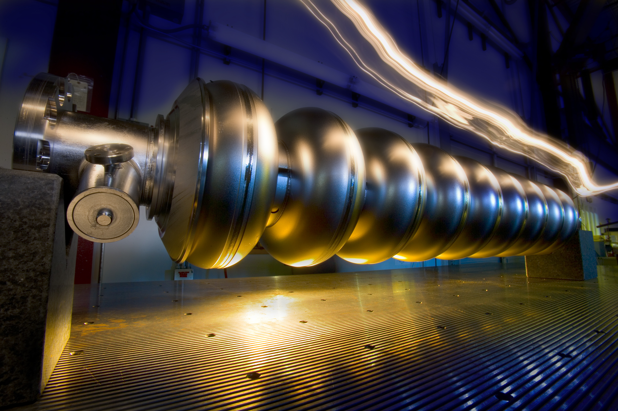
IARC Mission and Vision
Mission
Partner with industry to exploit technology developed in the pursuit of science to create the next generation of industrial accelerators, products, and new applications.
Vision
IARC will be the preeminent national enabler of accelerator based products and services serving as the seed for industry growth.

Slide 7
Strategies
Partner with small and medium sized industries to commercialize accelerator technology based products
Joint Development with large strategic partners to develop new industrial applications
Harvest and market mature Fermilab IP and spin off new products and companies
Invest in IP maturation to attract private investment
Enable the program through State, Federal, and Private Partnerships

Slide 8
Role of IARC at Fermilab
Fermilab
Research Hub
Basic Science/Discovery Mission
IARC
Development Hub
U.S. Competitiveness Mission
Funds Out (Procurements)
Funds In: federal and state programs, private industry, venture
Publish
Patent/Copyright
Relevance to Scientific Community
Relevance to General Public & Elected Officials
Single Program
Multi-Program
Agile, industry friendly
Inflexible processes

Slide 9
The Need for a Business Entity at IARC
A market survey by University of Chicago Booth Business School indicates strong interest in access to FNAL accelerator expertise and infrastructure from U.S. industry.
A key concern: DOE bureaucracy (e.g complex/rigid rules; slow decisions)
A business entity can in principle be more agile and handle interactions with the lab and DOE via blanket WFO/CRADA agreements
Can market and monetize IP created at the Lab creating license revenue
Can receive external funds in the form of grants or funds from private industry
Can use advice from the business community via a board to make solid business decisions on which projects to take on.
Can spin off new entrepreneurial companies
The business entity by agreement would feed profits or license fees back to Fermilab with the goal of achieving IARC sustainability in 6 yrs
Sustainablility = no new State or Federal seed funds required for operations

Slide 10
IARC: Physical Plant
The State of Illinois, Department of Commerce and Economic Opportunity (DCEO) provided a $ 20 M grant for the construction of a new building (Grant work complete in May)
DOE/OHEP committed to $ 13 M for site prep and to outfit the new space (networks, partitions, furniture, etc. in progress) and a refurbished $ 38 M heavy assembly building at Fermilab
Creating a $ 70 M complex to enable the IARC mission
Status:
Building outfitting in progress, (partitions, IT networks, furniture)
CDF D&D ~ complete. (Huge Job by PPD … > 3000 T of equip)
Refurbishment of HAB has started (paced by available DOE funds)

Slide 11
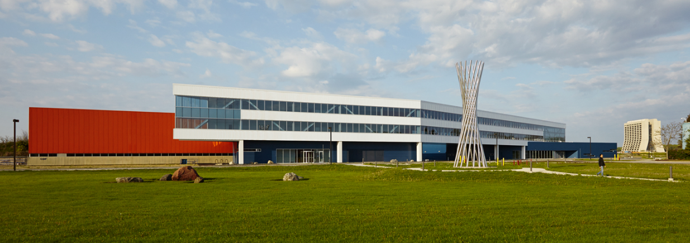
Illinois Accelerator Research Center
Construction Status
New State funded addition (white) is complete, now outfitting it with partitions, furniture, etc.
A New U.S. Center for Accelerator Applications
under construction at Fermilab

Slide 12
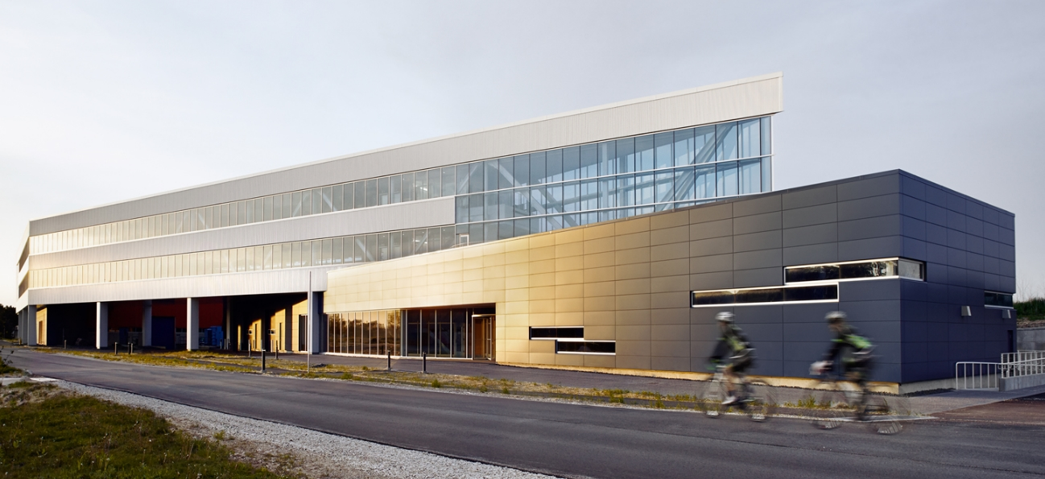
Illinois Accelerator Research Center
Modern Design: Architects = Ross Barney
LEED Gold: Designed for Energy Efficiency

Slide 13
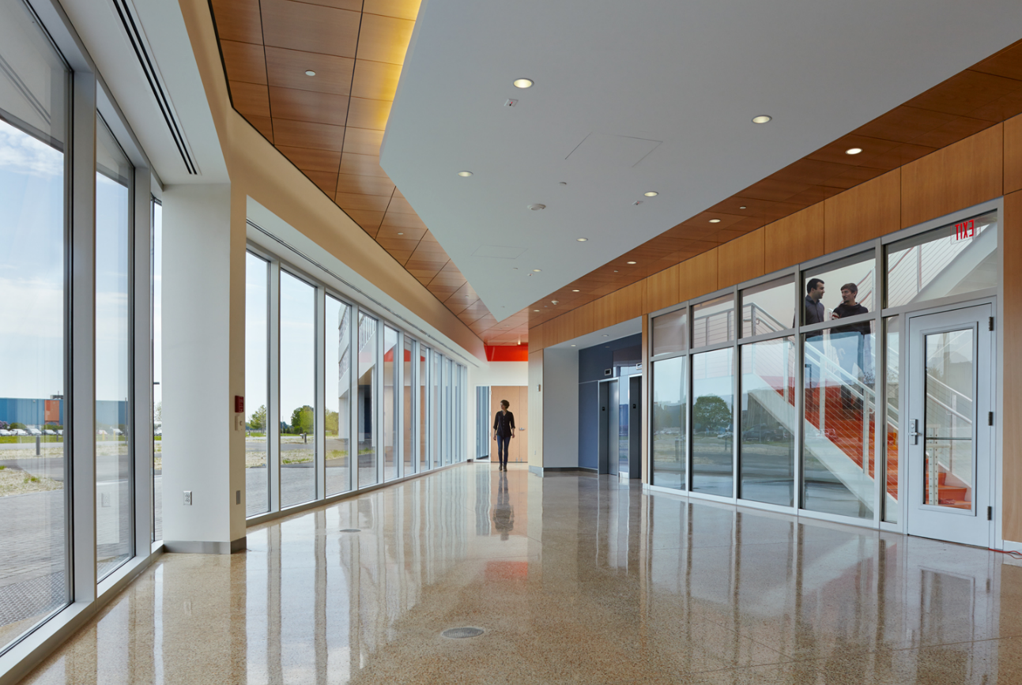
IARC: State funded building addition
48,000 gross square feet (lobby view)
13

Slide 14
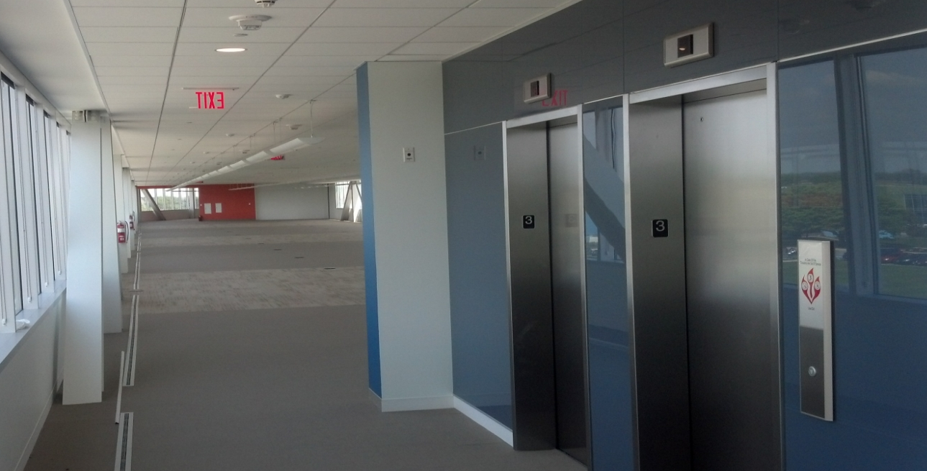
IARC: State funded building addition
One of two floors like this
~120 Offices total, Partitions, networks, furniture = DOE funds
14

Slide 15
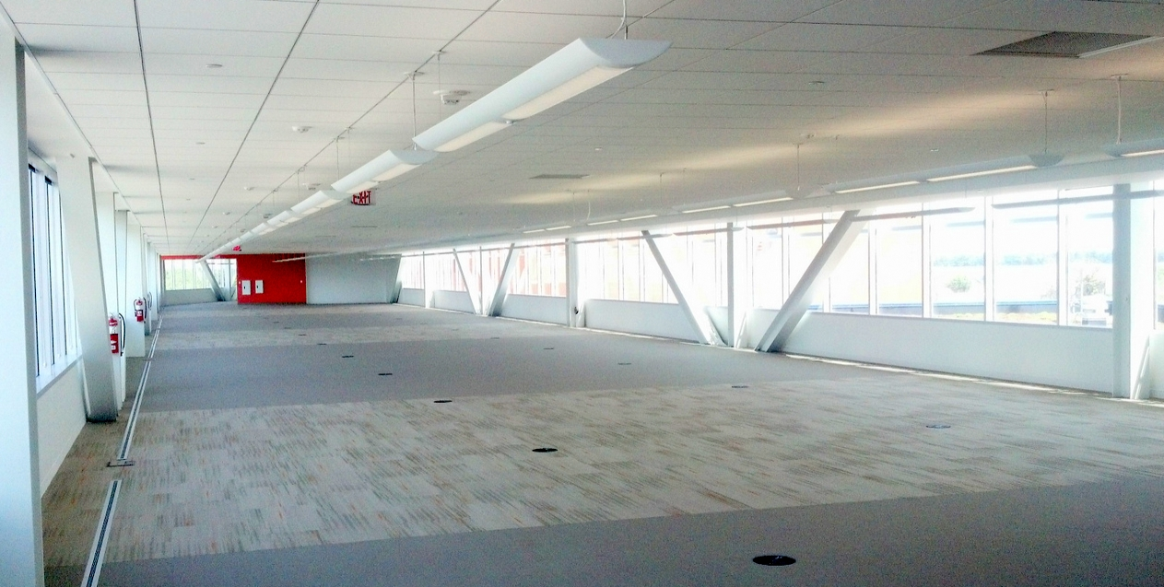
IARC: State funded building addition
Designed for IP protection ( e.g. zoned IT networks, key card access)
Next step is underfloor network and wiring to allow glass partition installation
15

Slide 16
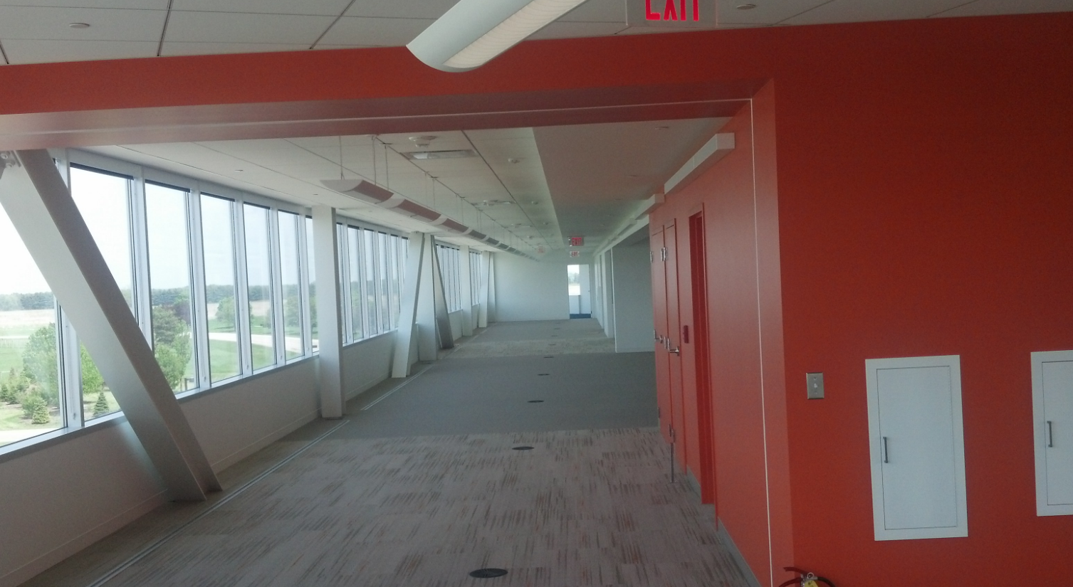
IARC: State funded building addition
One of two floors like this
16

Slide 17
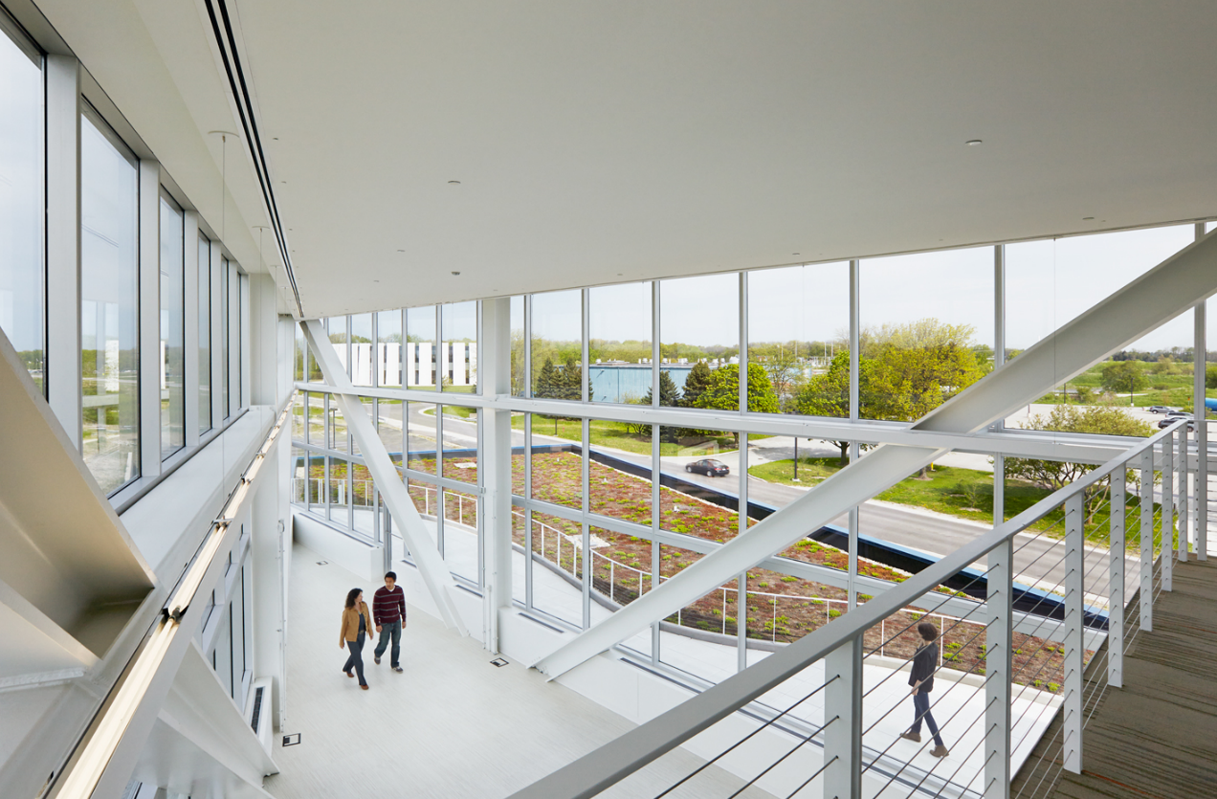
IARC: State funded building addition
Common space for coffee or lunch
17

Slide 18
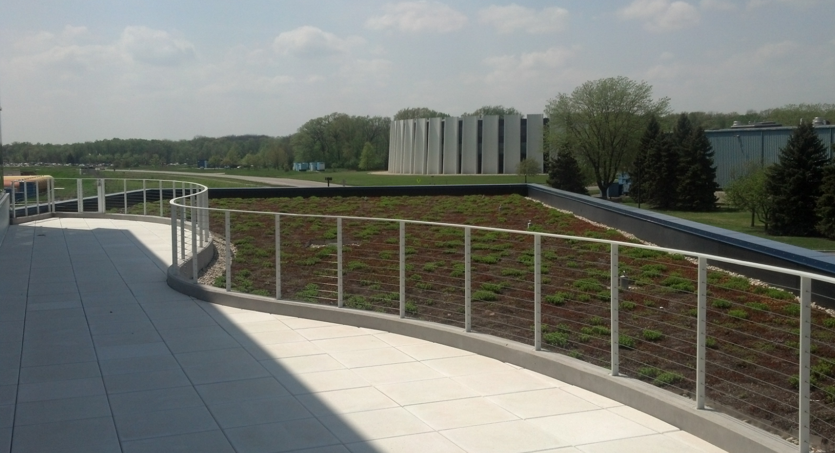
IARC: State funded building addition
Green Roof, outdoor spaces , geothermal wells, lots of natural light, etc.
Extensive of local and recycled materials
18

Slide 19
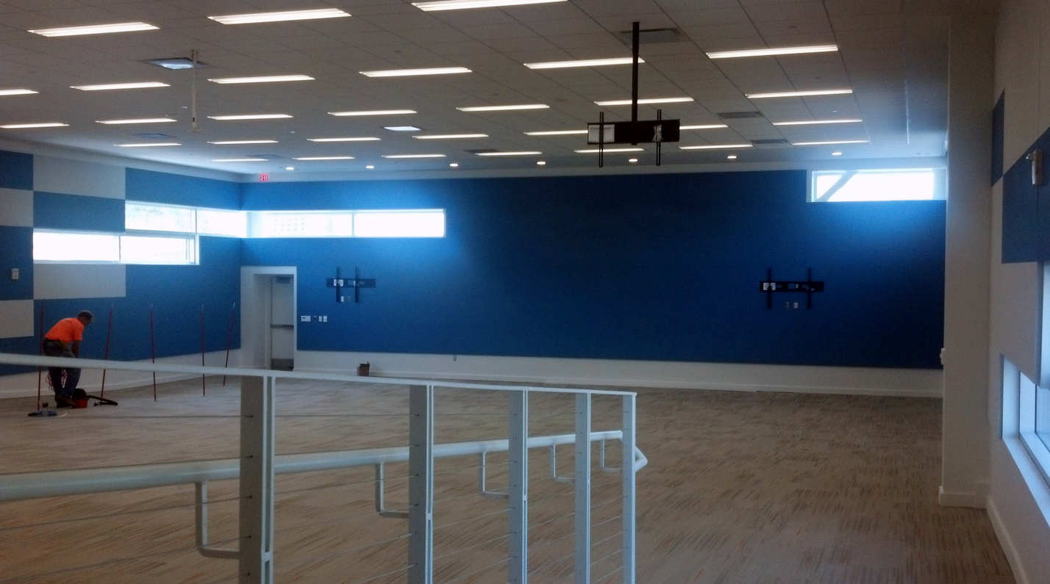
IARC: State funded building addition
175 seat meeting room, (Strategy maximize bricks and mortar!)
19

Slide 20
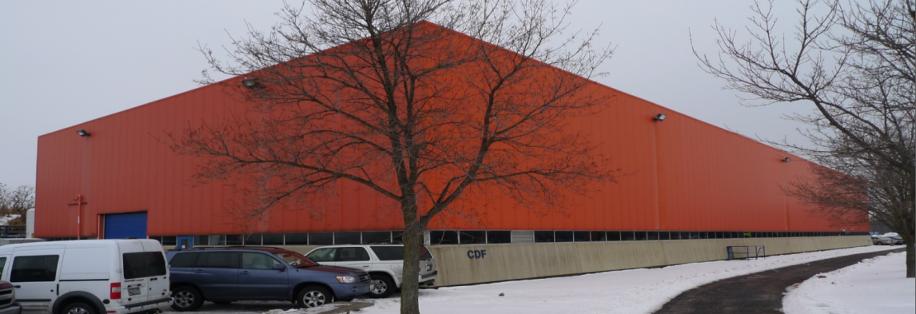
Heavy Assembly Building
Used for the construction of the CDF experiment (42,000 sq ft)
50 T crane; 10 T crane
Deep pit ideal for radiation shielding of high power accelerators;
1.5 MW of installed electrical Power (upgradeable)
2.0 MW of industrial, Low conductivity, and chilled water systems
600 W @ 4 K cryogenic refrigerator (upgradeable)
Light tech space, machine shop, 40 offices, high speed IT network
20

Slide 21
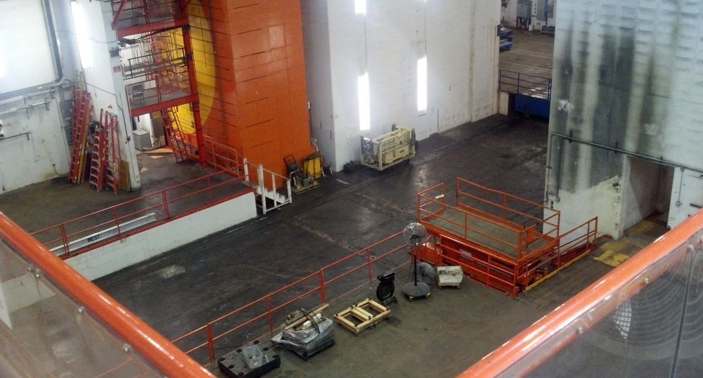
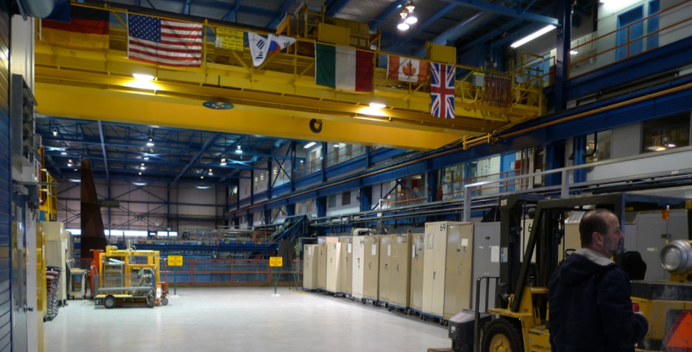
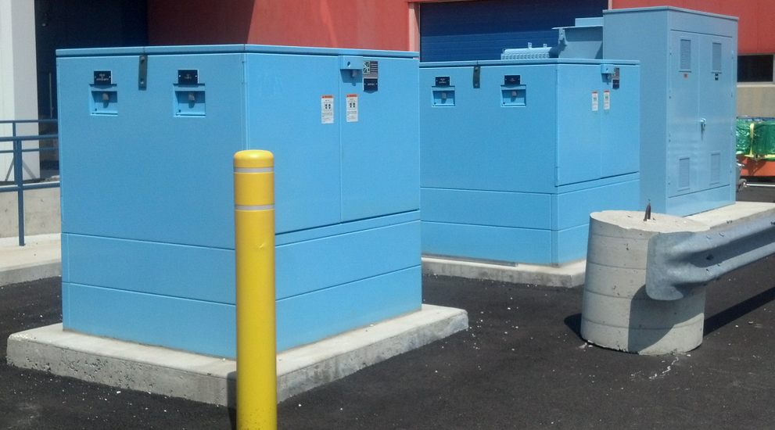
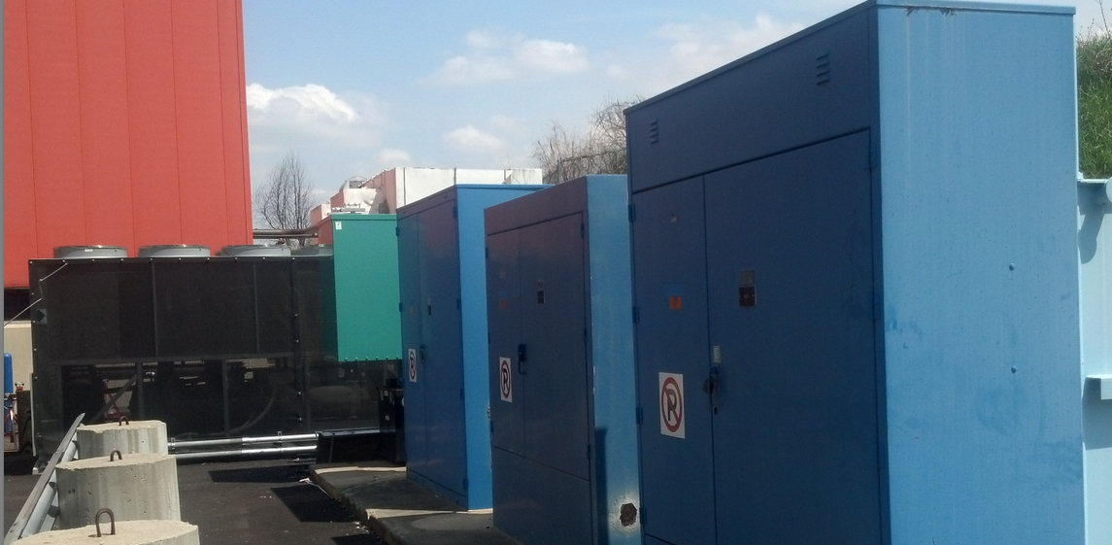
What Industry Really Gets Excited About
CDF D&D nearly complete, Great job by PPD!
Building refurbishment just starting
21

Slide 22
IARC - Some Examples of Big Opportunities
EBFGT: Partnership with PAVAC to develop accelerator based EB flue gas treatment; market is many hundreds of millions per yr to outfit coal fired plants to meet new EPA regulations
euvL: Create a consortium of labs (LBNL,ANL,SLAC), universities,and priviate industry to partner with chip industry (Sematech, etc), to create next generation 13.5 nm light source derived from SRF linac based FEL: Market: ~40 euv light sources at $500 M each and follow-on service
Highways: Partner with industry to extend life of asphalt highways with accelerator based polymerization of bitumen; Market scale is few % of ~ $ 80 B annual cost of U.S. asphalt road const & repair
Gas to Liquids: Partner with oil industry to convert $ 30 B of methane flared annually at well heads to liquid fuels using accelerators
Municipal Waste: Partner with industry to sterilize effluent water and sludge from municipal waste treatment plants allowing water reuse and creating fertilizer; Market is hundreds of millions per year

Slide 23
Valley of Death for Accelerator Applications
Feasibility
Prototype
Development
Early
Growth
Maturity
Research -
Development
Commercialization
Product
Launch
Successful
Product
SBIR/STTR
Grants
Venture Capital
Established
Business
Profit
IARC Program
Loss
Successful
Business
Valley of Death

Slide 24
So What Happens Next ?
Outfit new building with IT networks, partitions, IP control, and furniture… 1st Occupants ~ Nov 2014
Refurbish Heavy Assembly building… in process…high bay available in FY15, complete in FY16 (funds limited)
Complete and gain approval for IARC business model by the end of FY14
Launch first Projects in FY15
Some HEP base program activity (PIP-II HQ, PIP-II SSR1 CM, mu2e coils)
Accel projects selected based upon business case

Slide 25
Summary
Exciting new opportunity for FNAL & Industry
Steady Progress on the IARC physical plant
Working with DOE to converge on the business model, business entity, funding, & “rules”
Interesting challenges as we try to invent successful approach to the IARC program within the DOE systems…but strong support from FNAL Director, DOE, and Congress
Even without a “formal” IARC program announcement there is lots of interest from Industry. To learn more or submit an EOI…
For more on Accelerator Applications watch for an upcoming APT seminar (to be scheduled)
Check out the Web site IARC.fnal.gov

Slide 26
extras

Slide 27
What is the Problem?
New applications of accelerator technology seem to die for one of several reasons
Feasibility not proven: Inadequate resources: (financial, personnel, infrastructure) in industry, universities, or labs to demonstrate the basic feasibility of an idea
During transition from small scale technology demonstration to a commercial product (may require large investments & infrastructure)
Judged not economically viable reliability of technology, capital investment required, or operating costs are not demonstrated vs other approaches
Lack of acceptance of the new technology by potential customers that is cured only by large scale demonstrations that lower perceived risk and demonstrate costs
IARC is intended to lower the barriers for new accelerator applications by providing both a facility for testing accelerators and access to Fermilab’s accelerator experts and infrastructure
27

Slide 28
IARC Background
FNAL realized that accelerator technology developed in the pursuit of science has an increasing economic impact
$ 2 B/yr in accelerator sales, touches $ 500 B/yr in products
2007: Proposal to the State of Illinois and DOE
State DCEO realized they could leverage expertise at Fermilab to create high tech jobs and industry in Illinois
DOE realized this could contribute to US competitiveness
2009: Accelerators for Americas Future symposium hosted by the DOE. Report: http://www.acceleratorsamerica.org/
Provided strong support: Bottom line =
Accelerators already important to our economy but …
Many future Accelerator applications could be realized or commercialized in the future
2010: IARC Construction funded by the State

Slide 29
IARC Background
2011 First DOE const. funding (extends through FY15)
2011: President emphasizes important of tech transfer from Federal Research to U.S. Industry
2012 Senate Water and Energy bill language
Requests Accelerator stewardship plan from OHEP
2014 Draft Senate Legislation
Acting on recommendations from the report “Turning the page, Reimagining the National Labs in the 21st century innovation Economy”
Part of Lab mission = technology that drives the economy
FY14 HEP Stewardship Program launched
1st “new” Stewardship funding in FY15
RFI: Accelerator Applications for Energy and Environment
➔ IARC is well Aligned with National and HEP Priorities

Slide 30
IARC: The Opportunity for Fermilab & DOE
Opportunity to put substance behind the claim that HEP is the developer/steward of accelerator technology within the Office of Science
Opportunity to function as a center for accelerator based projects in the Office of Science and to partner with industry and labs (e.g. nearby ANL) on new accelerator applications
Opportunity to increase our role in accelerator technology education
Opportunity to establish additional funding sources outside DOE-HEP or with industry to create intellectual property (patents, royalties)
Opportunity to develop technologies that benefit society bringing recognition to the DOE SC laboratories and to Fermilab creating support for our basic science mission
30

Slide 31
IARC: The Opportunity for Industry
Fermilab has:
a world-leading accelerator engineering and scientific staff that have the potential to make an impact beyond the field of high-energy physics. (with addition resources at nearby ANL)
core capabilities and infrastructure that are unique, and that can be used for applications beyond the field of high-energy physics.
the IARC physical plant and the largest concentration of Accelerator Scientist and engineers in the world
Strong State support (DCEO) with incentives to encourage high tech businesses to locate in Illinois; growing support from DOE
Industry can leverage these assets to create new accelerator based products and capabilities
31

Slide 32
IARC: The Opportunity for Entrepreneurs (you!)
FNAL Office of Partnerships and Tech Transfer now exists, new lab and DOE encouragement to connect with businesses and create/capture IP
IARC will have a strong connections to the University of Chicago Booth Business school:
UofC grants and soon FNAL LDRD funds will become available to demonstrate feasibility of new ideas
Chicago Innovation Fund provides grants for financial support for startups from the UofC, ANL, FNAL community
UChicagoTech provides business advice from experienced & successful entrepreneurs (to launch companies)
Provides connections to angel investors
University and lab entrepreneurs will be encouraged to leverage these assets to create new products, capabilities, and/or to launch new businesses
32

Slide 33
Who is interested in using IARC ?
Even in the absence of an official announcements, many partners have contacted me about working at IARC (red = IARC EOI, SBIR, WFO, proposal)
ACSI.……………..SRF linac booster on existing Medical Accelerator
AES, UC Irvine……SBIR’s, Water Treatment with accelerators
Euclid……………..SBIR phase II’s several ,including PX SRF cavities
Faraday……………SBIR continued joint work on bipolar EP
Highways…………..FNAL IP, exploration with IdeOn, EBTech
LLNL……………....test accelerators funded by DTRA and/or DARPA
Muons Inc………...SBIR/STTR’s, Muon Collider/ADS R&D, ion implanter
National Instr……..accelerator instrumentation and controls
Niowave…………..SBIR phase II for medical isotope machine, LHC crab CM
Northwestern………Electronic and Detector development center in IARC
NIU: ……………....Source Development, SBIR/STTR, new RF sources, education
Omega-P………....SBIR Phase II: MB klystron for Project X
PAVAC…………....Flue gas test accelerator, Several SRF based SBIR ideas
Radiabeam……….SBIR, euv light source for chip foundry
RUSH spinoff…….Medical imaging
Tandell systems….accelerator reliability, integration, and simulation
UC Irvine………… Water treatment with accelerators
Walter Reed, UTSW, Mayo, etc ..Carbon ion medical accelerator
Varian Medical……test cell for medical machines, water treatment ?
Recurrent theme: funding, clear program rules, IP protection, predictable schedule and processes, access to deep pit & infra to test accelerators!
33

Slide 34
IARC-NewCo Relationships
DOE
FRA
FRA
board
NewCO
board
Fermilab
Director
IARC
The
Place
IARC
Director
Advisory
Office of Science
Base work
WFO
CRADA
NewCo
LLC
Fermilab
IARC the place is a center at Fermilab
NewCo is a not-for-profit LLC housed at IARC
DOE LABS
Industry
Partners
Spinoffs

