Slide 1
DØ International Cooperation
John Womersley
DØ collaboration meeting
10 June 2014

Slide 2
DØ has always been an international collaboration
Saclay group signed the original TDR
But the nature of that collaboration has changed dramatically through our history

Slide 3
DØ author list, by date of publication
Run I
Construction
Run II
1984
1989
1994
1999
2003
2008
2013
TDR

Slide 4
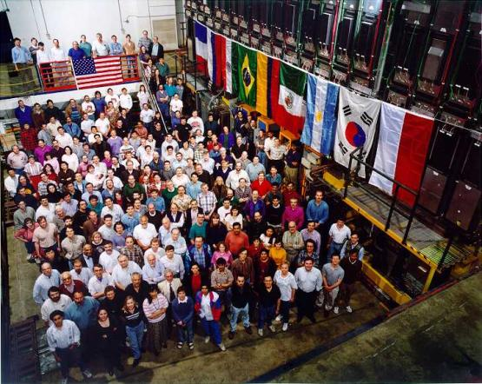
1996

Slide 5
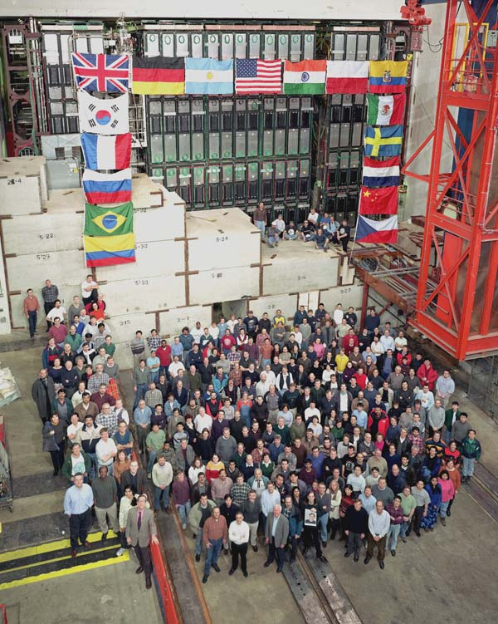
2001

Slide 6
2014

Slide 7
Countries which have been part of DØ
Argentina
Brazil
Canada
China
Colombia
Czech Republic
Ecuador
France
Germany
India
Ireland
Korea
Mexico
Netherlands
Poland
Russia
Spain
Sweden
Switzerland
Ukraine
UK
USA

Slide 8
Internationalisation
Original participants: France, Russia (originally Soviet Union)
Hardware contributions
Latin American Countries and Asia
Networks
Leon Lederman
DØ alumni
Importantly:
Experiment management made a deliberate effort to target new groups in Europe and Canada for Run II
Bring in new manpower and expertise

Slide 9
Case Study I - UK
LEP operations ending – ideas forming around CDF and DØ
Approach by Paul Grannis, visit to London
Imperial and Manchester (Hassard, Wyatt) pitched to PPESP
Request for a tiny amount – cut back even more, but accepted
Why?
UK expertise in hadron colliders small and dwindling (UA1, UA2)
need to refresh, re-educate, prepare for LHC
Consciously decided not to sell it as “fun” or “physics” – would not have gone down well with colleagues “slaving away” on ATLAS
Bottom-up, scientist driven
Not from strategy committees – in fact initially opposed by them
Some evidence that there was opposition ‘higher up”

Slide 10
Case Study I - UK
Took many years for perceptions to change
But from a very small start built up to one of the larger experimental efforts in the UK
For a while, CDF and DØ alumni dominated the jobs market in Europe (as groups prepared for LHC)

Slide 11
Case Study II - Germany
Original plan was to transition direct from LEP to LHC
In about 1999, started to think of Tevatron
Many groups just e⁺e⁻ in past
Need physics, training for young people, experience in operation of a detector
Jakobs, Zeitnitz, Schaile
Tom Ferbel played a big role in persuading – Liquid Argon technology, good fit with ATLAS and Saclay
Visited Fermilab – found DØ very welcoming (CDF “more arrogant”)
Plus DØ didn’t ask for too much money
Funding agency policy was that it didn’t support experiments at Fermilab
Didn’t want to embark on an additional long-term project – so DØ was always funded under the ATLAS funding line

Slide 12
Case Study II - Germany
Funding agencies gradually came around
Never big money, but easier as time went on
Computing contributions became quite important
Those who worked in DØ benefited a lot when they transitioned to ATLAS
E.g. understanding minbias events; SUSY searches
But the non-Tevatron people caught up fast!
The information flow was not just one-way
DØ Higgs searches benefited a lot from contact with LHC: e.g. H → WW channel

Slide 13
Ferminews 2004

Slide 14
Was Fermilab an easy place to work?
Yes - if based at the lab
Much harder if based in Europe – very different from working at CERN
International groups needed a full-time presence
Consortium working

Slide 15
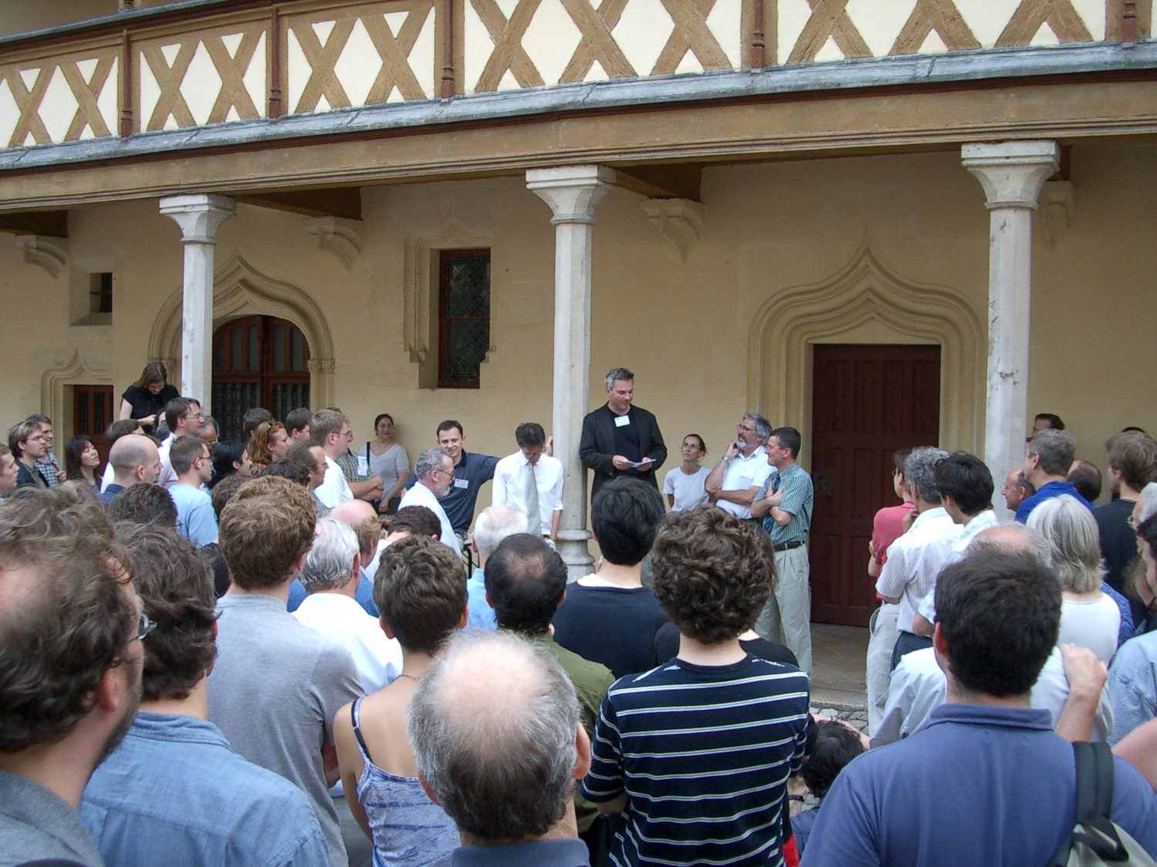
Beaune 2003

Slide 16
Was this all a good thing?
It benefited everyone involved
DØ
Fermilab
The individial international collaborators
Their groups
Their national programmes
High Energy Physics as a whole

Slide 17
What lessons for today?
The world is very different now
HEP is much more global in outlook e.g. CERN strategy contains 4 strands, two at CERN and two overseas
At one level, this makes international initiatives easier – they are more naturally part of the strategy
But
Funding pressures everywhere
It is still hard to start smaller, bottom-up efforts at international laboratories (e.g. UK group wanted to work on COMET at JPARC)
Conflict remains between prioritisation and breadth of programme
Still need to provide smaller, riskier opportunities for younger scientists

Slide 18
In the context of P5
Even in the US, there can be no such thing as a ‘national’ HEP program
Internationalisation of the future FNAL program is critical for the lab, and for the rest of the world
P5 is right to highlight this
Targeted intervention to attract groups to DØ worked well because US funding for Run II was (largely) sufficient; it was manpower that was lacking
Unfortunately this is not the case for LBNE!
Also – “cost free” European participation in Tevatron experiments may have created the perception in DOE that US groups could freely use CERN…

Slide 19
Global collaboration in HEP
Tevatron experiments were pioneers in establishing a genuine partnership between US, Japan and Europe
We need this approach again now
CERN Council European Strategy Process
US P5 report
Japanese roadmap under development
Building on recent discoveries
Higgs, θ₁₃, precision cosmology
opportunity to shape a science-driven strategy

Slide 20
Global collaboration in HEP
Needs to be a global strategy
Complementary pathways through a common landscape
CERN’s focus will be on energy frontier at LHC
Main questions: how (and where) to progress neutrino physics, precision measurements and astroparticle physics?
I hope other regions will see the scientific logic and political importance of supporting a strong US program in these areas

Slide 21
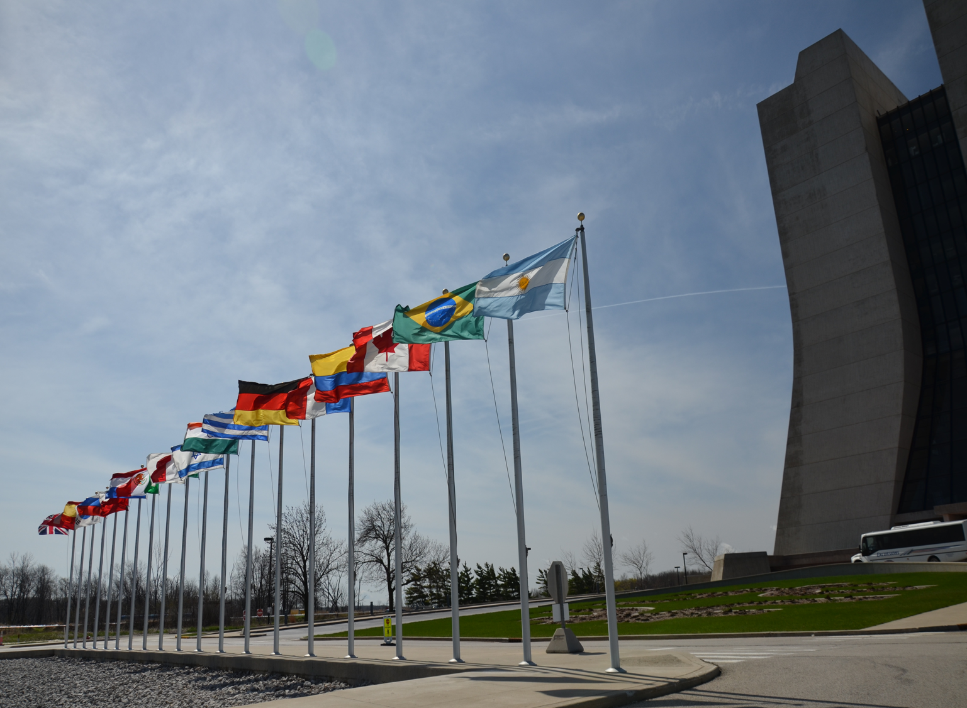
Discussion

