Slide 1
Vacuum and alignment in Run 1
Peter Winter

Slide 2
Overview
Vacuum chamber:
Chamber configuration, vacuum issues and performance
Detector alignment
Detector and lead configuration
Alignment measurements

Slide 3
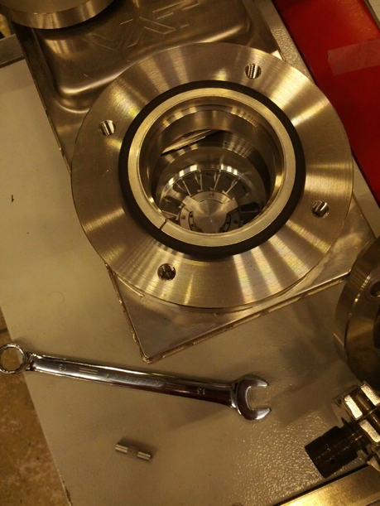
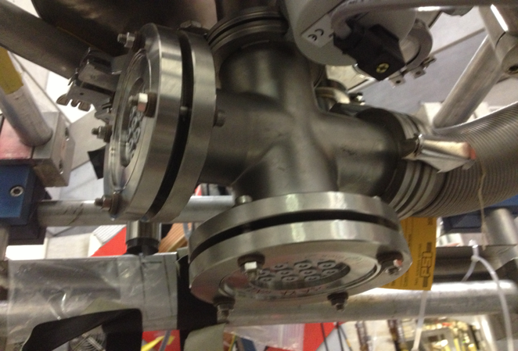
Vacuum system setup
Vacuum setup was quite some journey
Started out with the pump station at the port below the chamber
Not a good place due to falling pieces from work in chamber (lucky that LEMO connector did not destroy sensitive fins of turbo)
First change: Use side port for pump connection

Slide 4
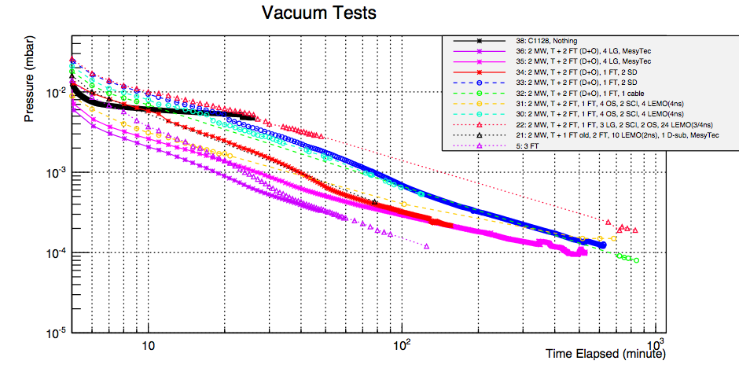
Lots of time was spent to eliminate leaks
We had a long series of various tests
Several leaks that were fixed
Many configuration changes took a long time to get it finally good enough for our needs
Lots of help from the vacuum group!

Slide 5
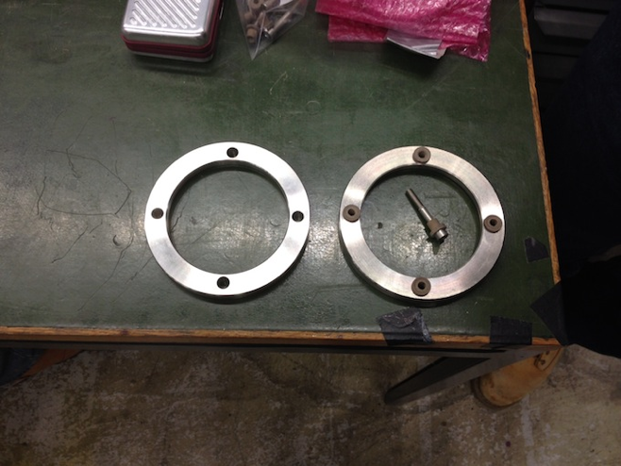
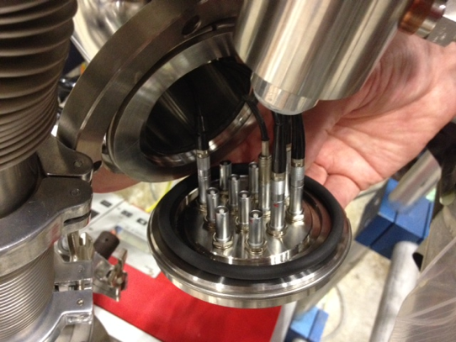
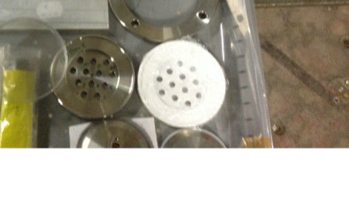
Leak tests of feedthroughs
We had 3 main types of feedthroughs: AccuGlas, metal Osaka with electrical isolation, Osaka teflon. They all were no problem concerning the vacuum

Slide 6
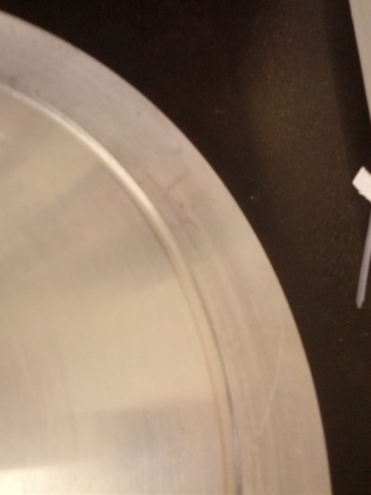
Leak tests: Top flange
The top flange is a general source for bad vacuum
It is not planar with the vacuum top (from welding?)
It scratches easily when mounted (since it is heavy) or when put aside with vacuum side down
Ended up using 6 clamps instead of typically 3-4
Needs to be handled carefully to maintain well polished surface
Scratches easily

Slide 7
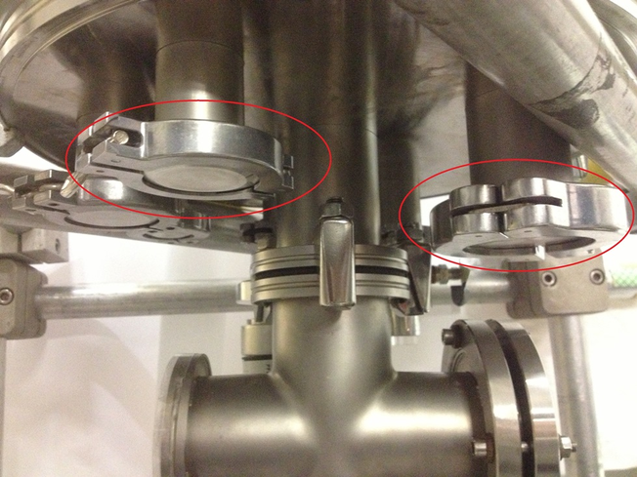
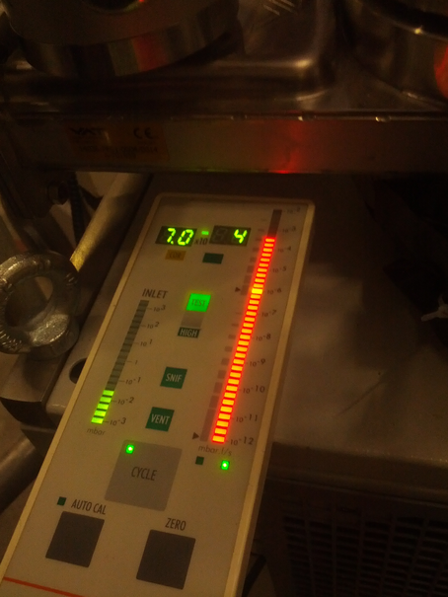
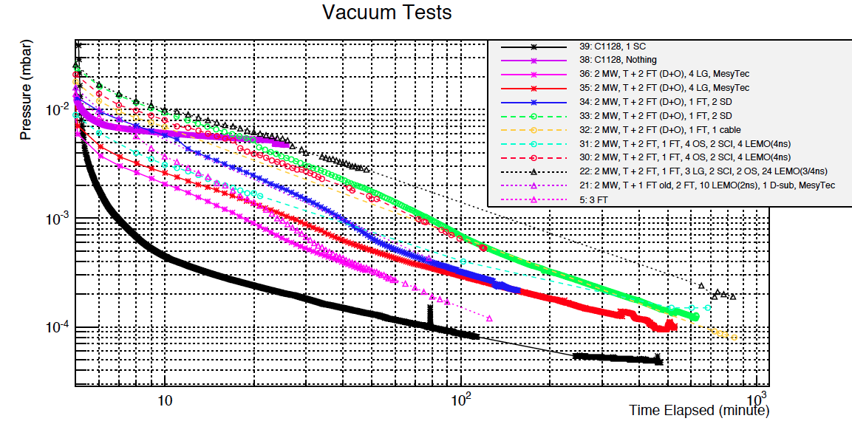
Leak tests: Light guides
Bad vacuum with light guides in place (huge signal with Helium leak tester)
Removal of light guide feedthroughs gives good vacuum quickly
He leak tester

Slide 8
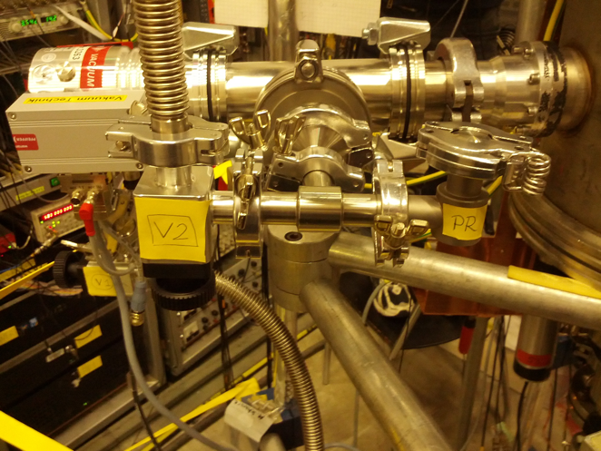
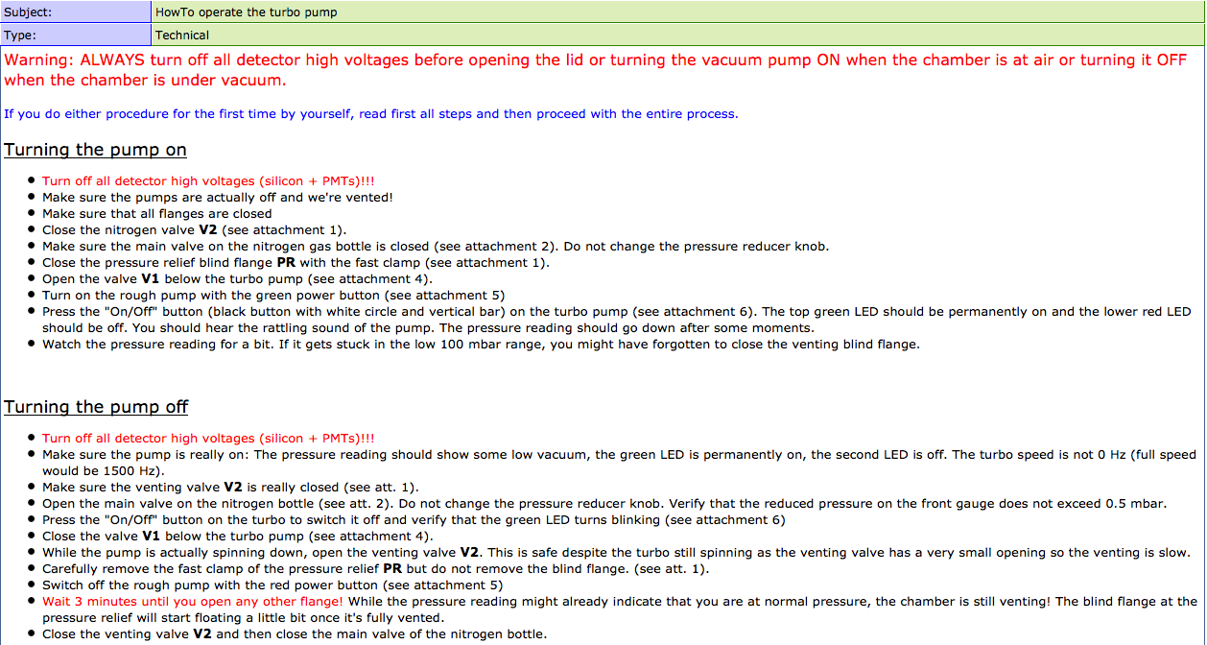
Final setup
Pump connected via solid T to chamber
Side port of T is for venting and dry N₂
Many steps but finally worked well (reaching 3E-4 mbar within ~1.5h)
Instructions in elog:74, reference for Run2

Slide 9
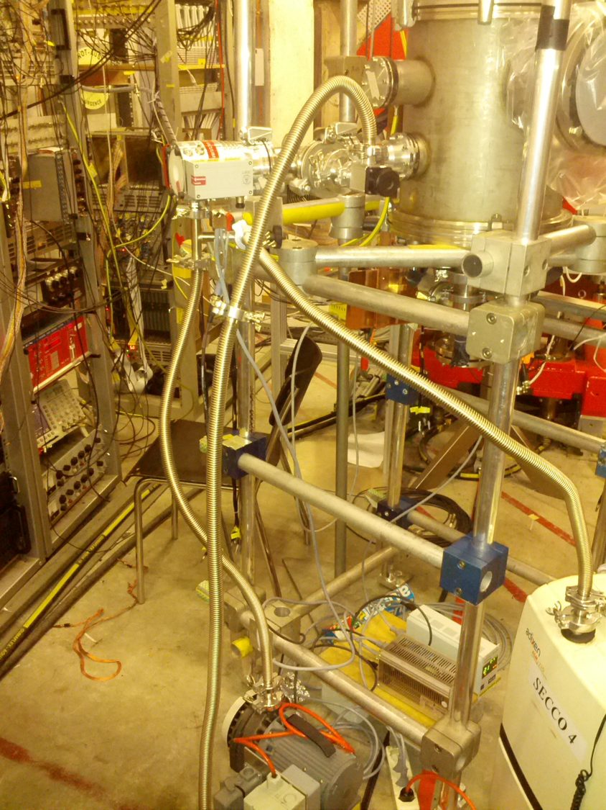
Final setup
Pump connected via solid T to chamber
Side port of T is for venting and dry nitrogen
Many steps but worked well
Instructions in elog:74, reference for Run2

Slide 10
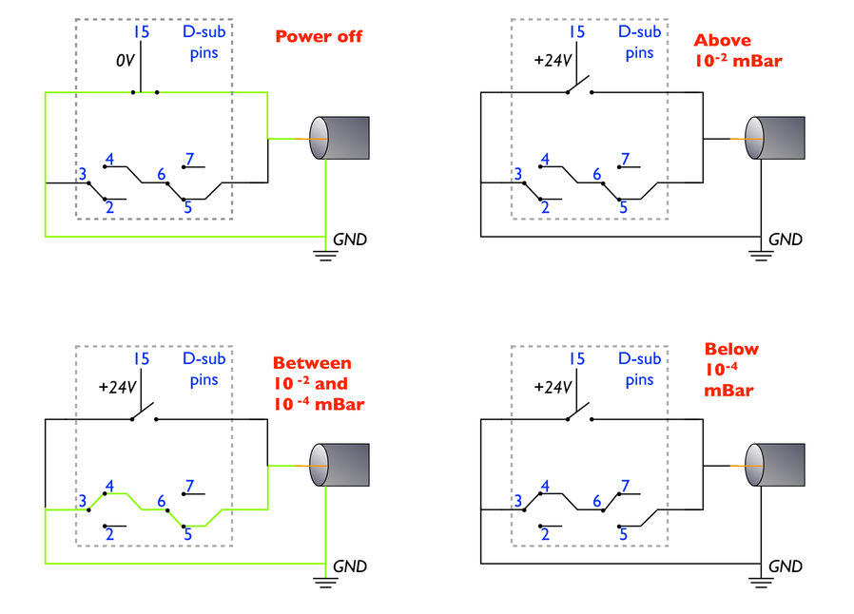
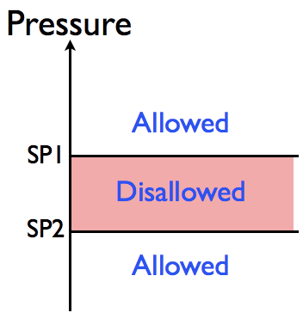
Vacuum interlock
We want to automatically disable the Si HV when vacuum in dangerous intermediate range

Slide 11
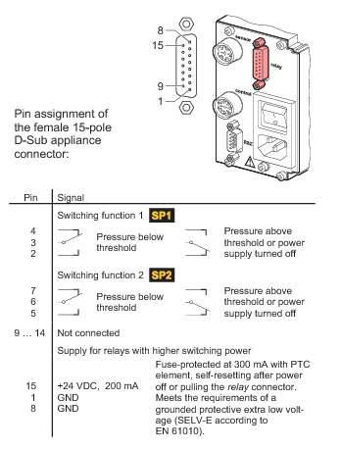
Vacuum interlock
The pump control has usually set points for such an interlock on the output serial connector
Reference for setting this up next year in elog:56 and replies.
Final set points were
Enable: P > 300 mBar
Disable: 300mBar > P > 3E-4 mBar
Enable: P < 3E-4 mBar

Slide 12
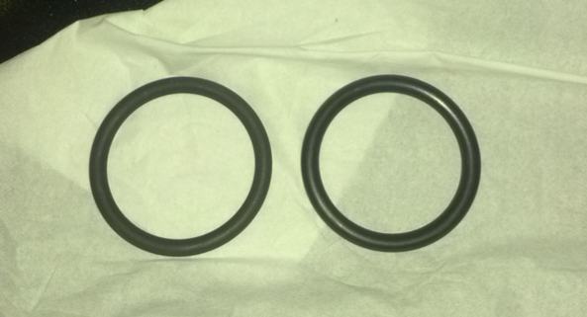
Vacuum lessons for next run
We should start with the final setup from Run 1
Always use the PSI oil free o-rings, ports and tubes
Vacuum interlock should be in place for detector HV
We should involve the PSI vacuum group and use their knowledge rather than do it ourself as they are experts
Flanges, o-rings need careful handling as little scratches can lead to time consuming leak search (especially heavy top flange)
Dull = GOOD
Shiny = BAD

Slide 13
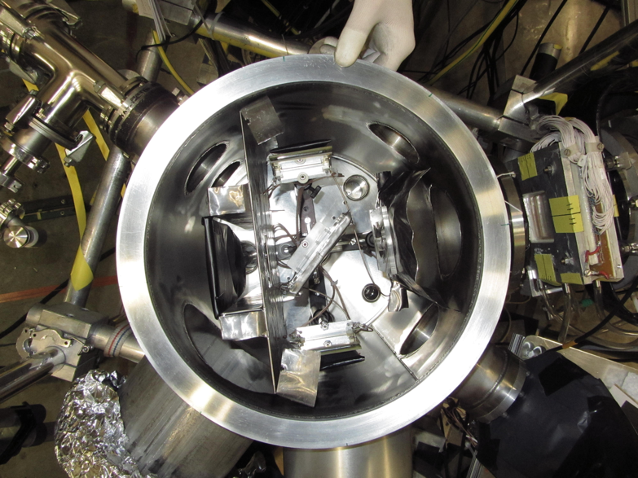
The vacuum chamber
The vacuum chamber contains many items
Collimator with lead at the entrance
Target holder with 45 degree angle
Si detectors with scintillator on either side at 90 degrees
Lead shield and veto scintillator

Slide 14
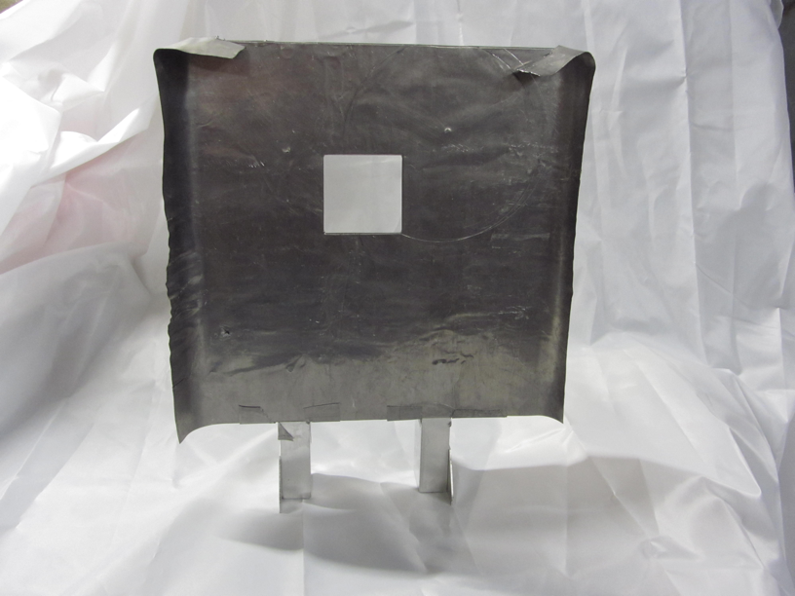
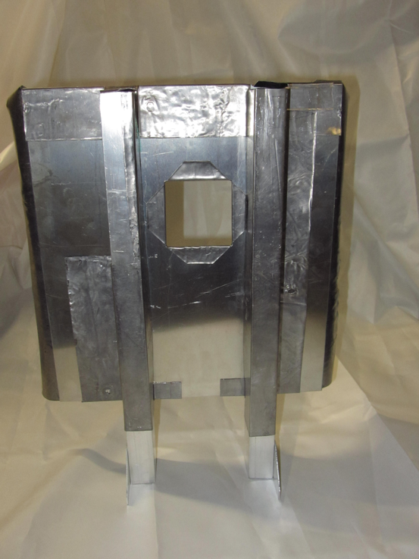
The lead shielding
Aim: Cover all possible locations of stopped muons with lead
Last minute development since it was missing to start production data. Master work of Volodya from 11pm – 5am!

Slide 15
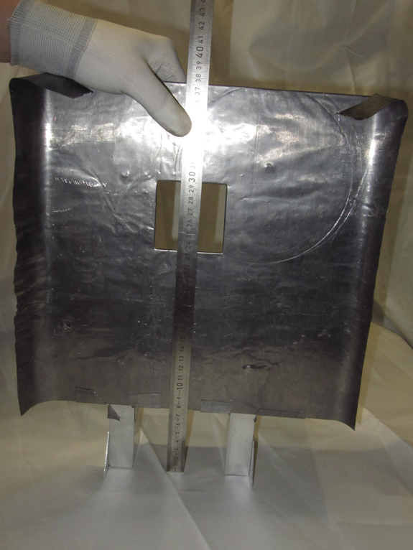
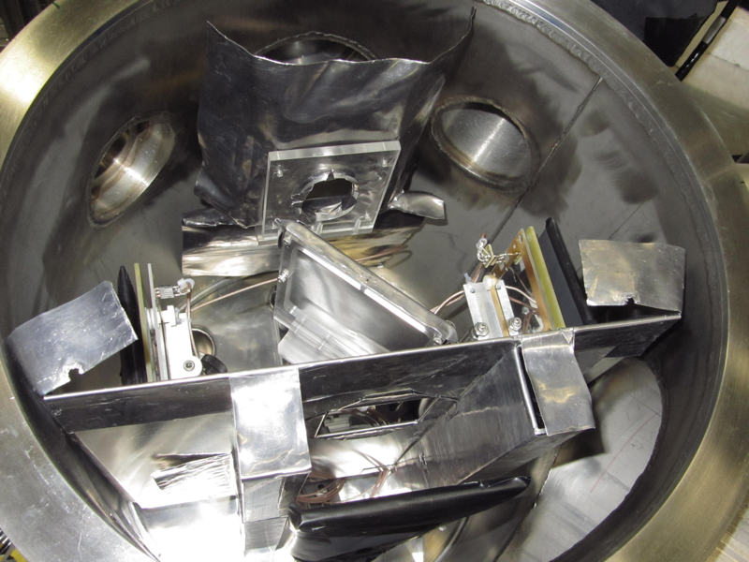
How was the size of the opening determined?
Opening is 6 cm x 6 cm, no physics / Monte Carlo driven dimension
We even considered closing it entirely
Size was to make it small to minimize muons possibly stopping in low-Z material

Slide 16
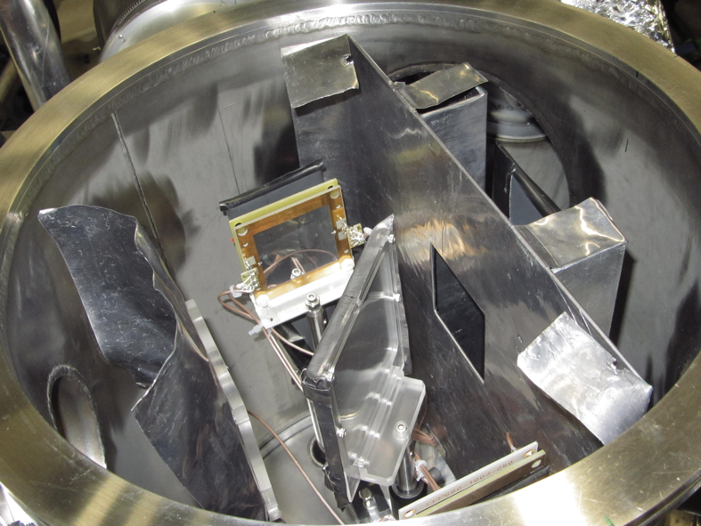
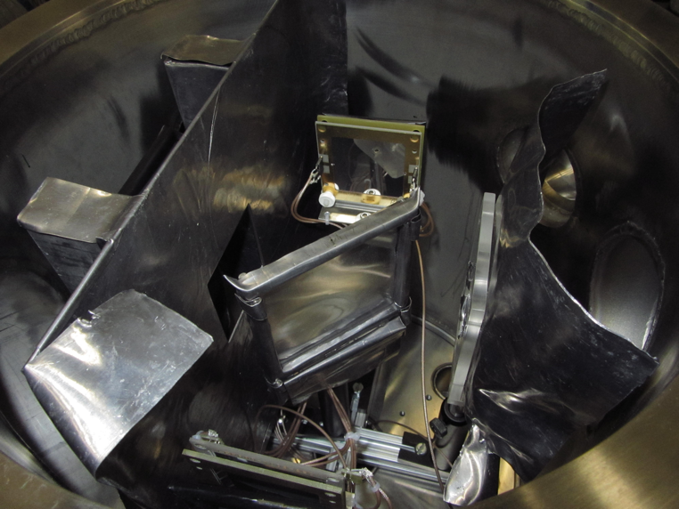
Some more pictures of the lead shield

Slide 17
The vacuum chamber alignment
Collimator, detector and target alignment is tricky because
no real alignment mechanism and difficult to measure inside chamber
sensitive objects require to be careful

Slide 18
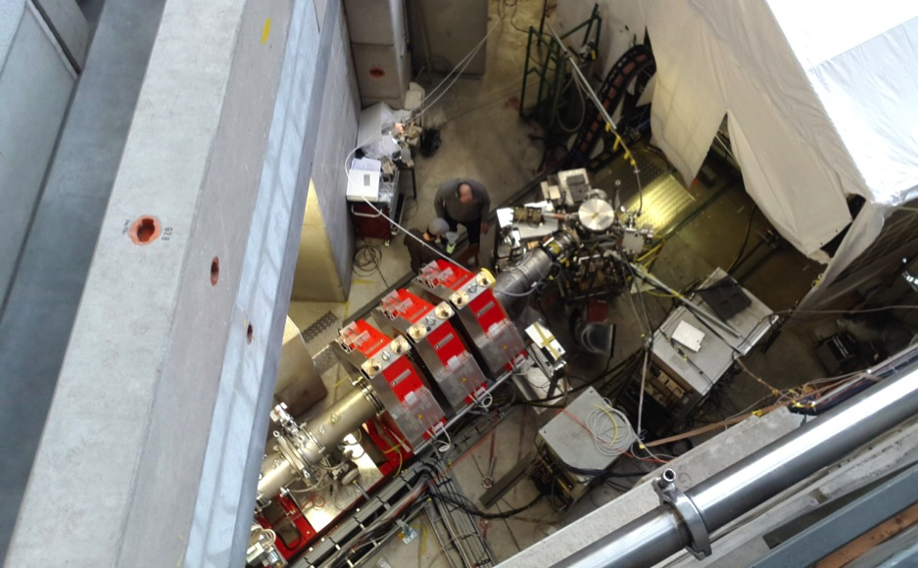
Alignment strategy
Want to align the collimator, target and detectors relative to the nominal beam axis and in height relative to the muon entrance chamber
We used a laser parallel to the nominal beam axis to center / align objects
Metrology group at PSI brought a device with a view point with a center mark inside
The marker of this device was aligned with the nominal beam axis, allowed to verify our alignment of objects relative to beam axis with laser
Height of detectors was measured with ruler (will describe)
Location of
tripod with
special view
port and mark
Location of
laser

Slide 19
Vacuum chamber alignment with laser
The laser was mounted centered on the last quad on a camera tripod
Installed an elevated cross bar downstream of chamber with plumb bob aligned to nominal beam axis on the floor
Align laser beam with string of the plumb bob to generate a vertical laser plane on the beam axis
elevated cross bar
with plumb bob
vacuum chamber
laser beam aligned
with beam axis
beam axis marker on floor
(exaggerated in thickness)
last quad with
laser on top

Slide 20
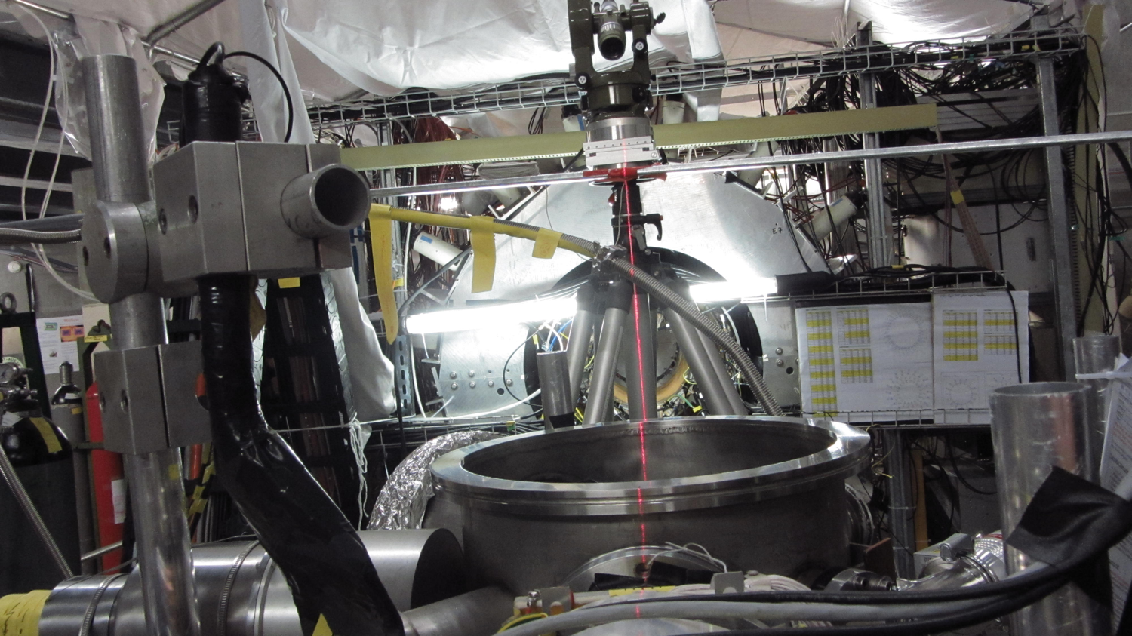
Vacuum chamber alignment

Slide 21
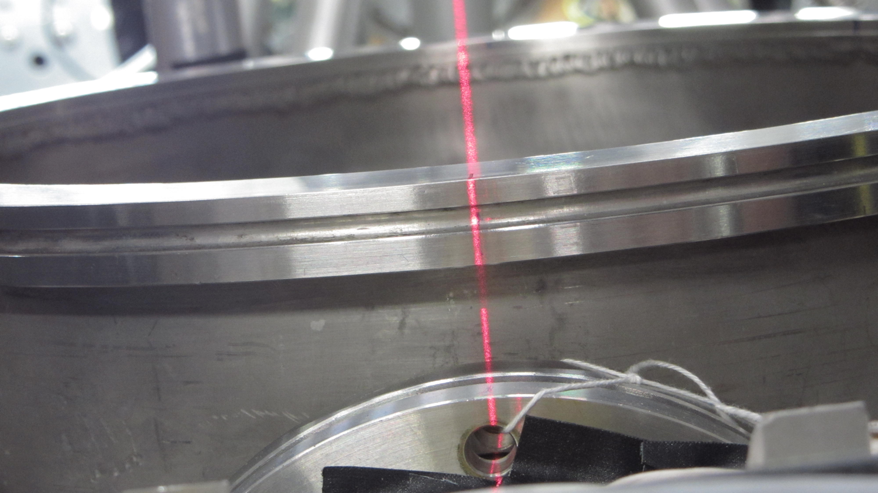
Vacuum chamber alignment

Slide 22
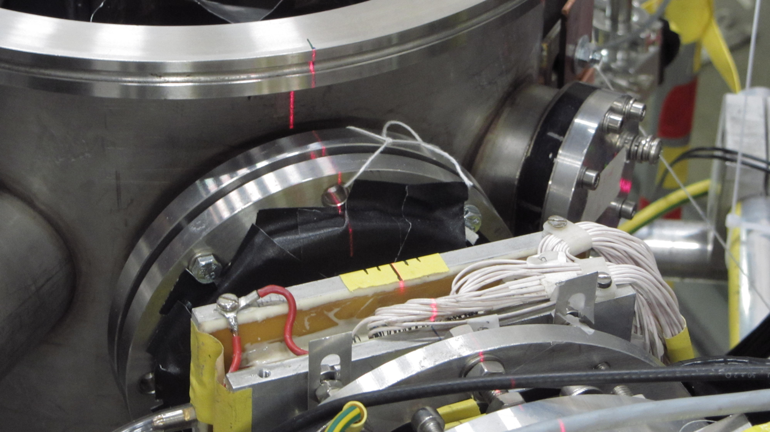
Vacuum chamber alignment with laser
Added marks on the top surface of the vacuum vessel at 0 (beam entrance) and 180 degrees (beam exit)
Use laser to center the vacuum chamber relative to beam axis (muPC well centered, too)

Slide 23
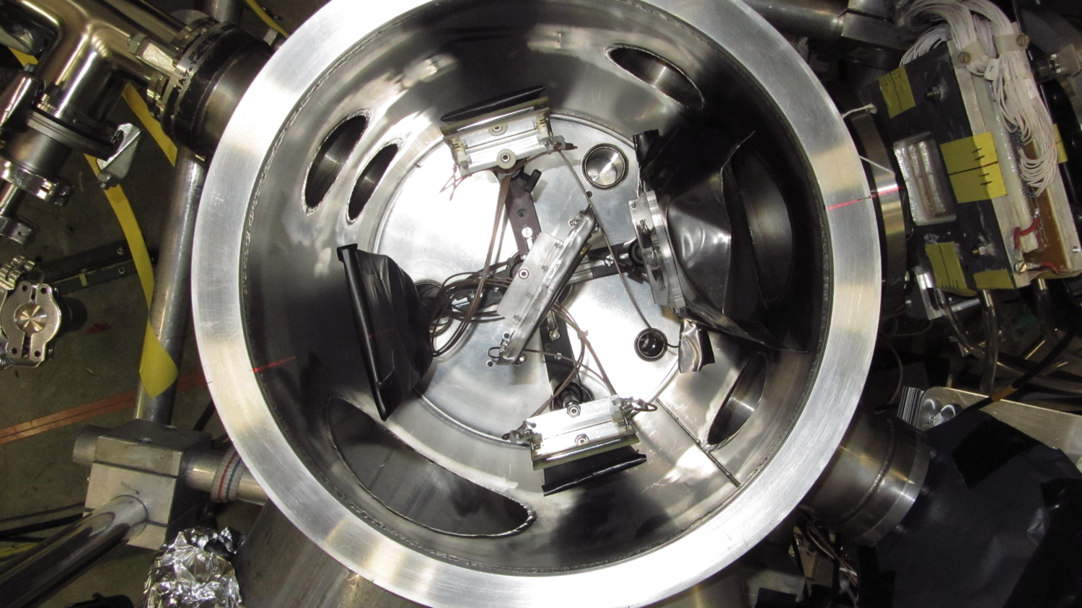
Vacuum chamber alignment with laser

Slide 24
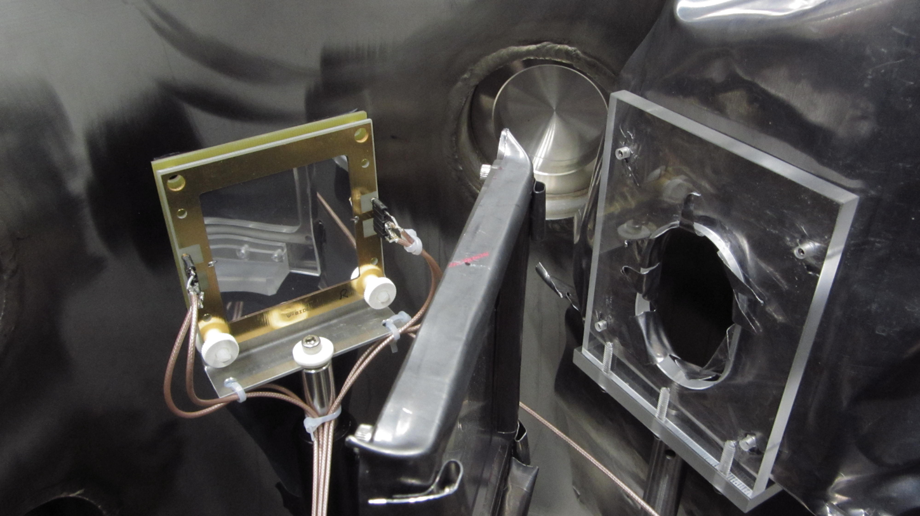
Target alignment
Aligning target on beam axis and at 45 degrees was trickier since it has two rotation centers
Maybe one can think of an improvement for next run?

Slide 25
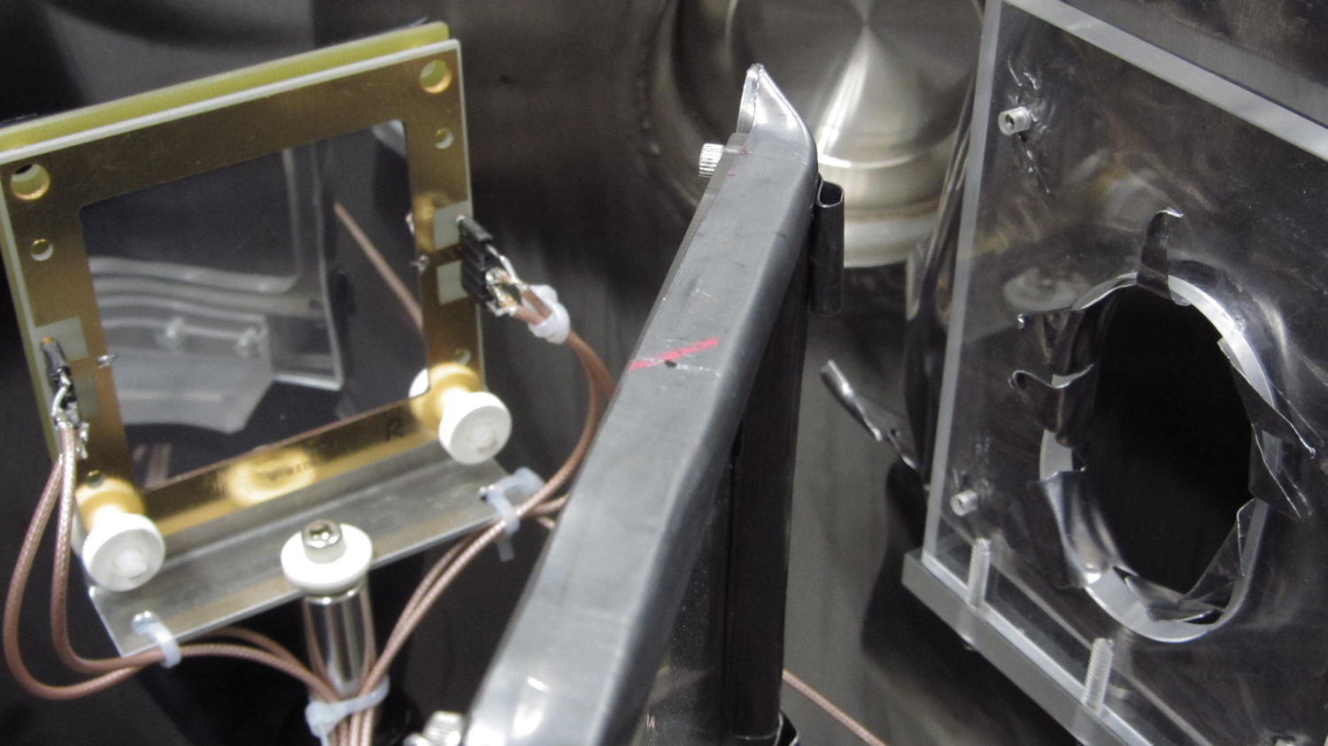
Target alignment

Slide 26
Target alignment
45 degree alignment with long ruler along 45 degree marks on chamber top (similar to beam axis marks used with the laser)
Precision for angle 1-2 degrees at best

Slide 27
Silicon and scintillator alignment at 90 degrees
Use perpendicular rulers and beam axis marks to align symmetrically around target center
Angular alginment of detectors to bem axis again with 1-2 degree precision

Slide 28
Height alignment of all components
Height alignment inside the chamber performed relative to the muPC center
Method: Ruler on top of chamber and one perpendicular to measure top and bottom of object to calculate its center and adjust relative to muPC
Aligned collimator, target, Si detectors and veto counter to ±5mm precision
Ruler
Ruler on top
Measurement
points for
vertical
alignment of
all objects
Target
Vacuum chamber side view

Slide 29
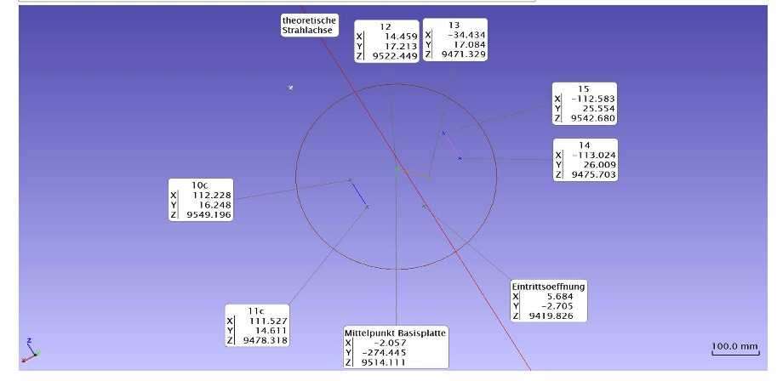
Vacuum chamber survey by PSI
Document in elog:19
Not sure that relative position to beam axis should be taken serious since this is after the run and the chamber was most likely moved during shutdown
Measurement precision 2-3mm due to shaky chamber holder

Slide 30
Alignment summary
Alignment of objects relative to beam axis with estimated ±2mm precision
Angles of objects aligned to ±2 degrees
Height adjusted relative to muPC with ±5 mm
Some of these measurements can be cross checked from PSI survey report (at least relative alignment of objects, maybe not the absolut relative to the beam axis)
We might want to think about a way to improve alignment of objects for Run2 as this was tedious and not very precise
Marks / grid on the bottom plate
Laser mounted above the chamber to produce required pattern via mask
...?

