Slide 1
AlCap Overview and Goals
Peter Kammel
WP1: Charged Particle emission after Muon Capture
Kammel (Washington) and Kuno (Osaka)
Rate and spectrum with precision 5-10% down to 2.5 MeV
Dominant rate in tracker for Mu2e and COMET I
WP2: X-ray and Gamma Emission after Muon Capture
Miller (Boston)
X-ray and gamma ray for normalization (by Ge detector), radiative muon decay (by NaI detector)
WP3: Neutron Emission after Muon Capture
Hungerford (Houston) and Winter (ANL)
Rate and spectrum from 1 MeV up to 10 MeV
BG for calorimeters and cosmic-ray veto, damage to electronics
Software Czar

Slide 2
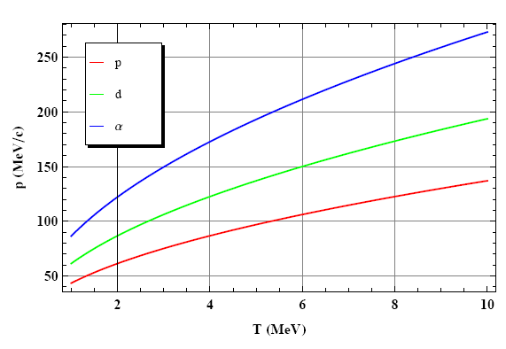
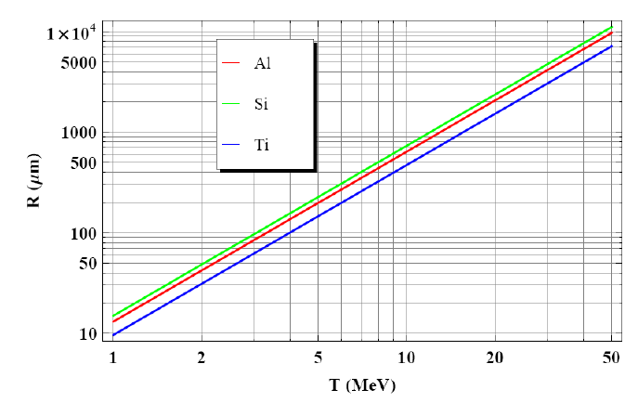
Relevance for Mu2e and COMET
accepted by tracker

Slide 3
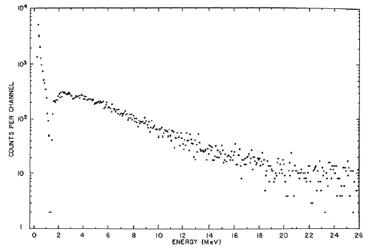
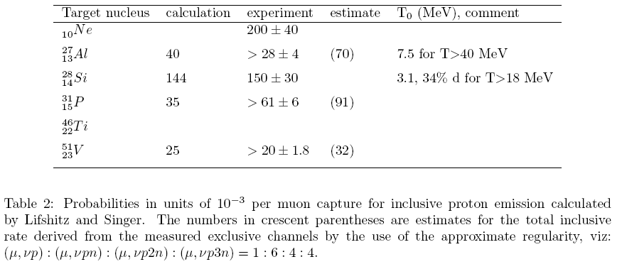
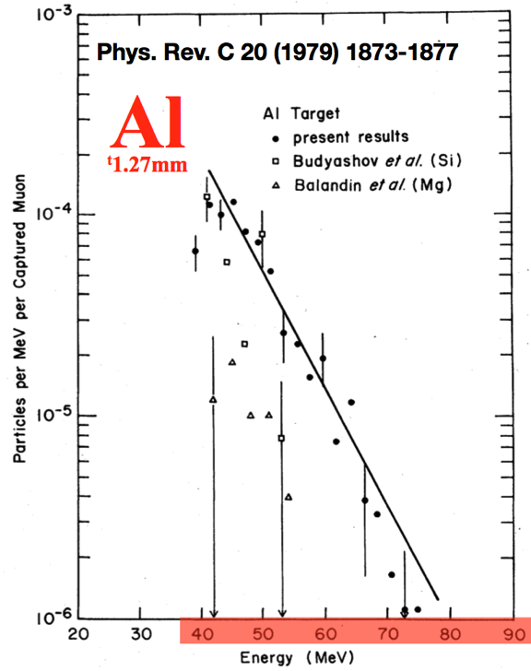
Present Knowledge
Active Si target
Activation analysis incomplete
no relevant Al data
no energy spectrum
no p:d:t ratio
only 1968 Si data
same situation for Ti
insufficient for serious
design optimization
Phys. Rev. Lett., 20(12):596 (1968)
only high energies, 1.27 mm target

Slide 4
Goals WP1
Measure spectrum dΛ/dE = f(E) for p,d,t emitted after mu-capture
5% absolute, 5% relative, 2.5<E<12 MeV
for Al, Ti and Si (important systematic cross check)
Method (proton case)
response function
μ in target
emission probability

Slide 5
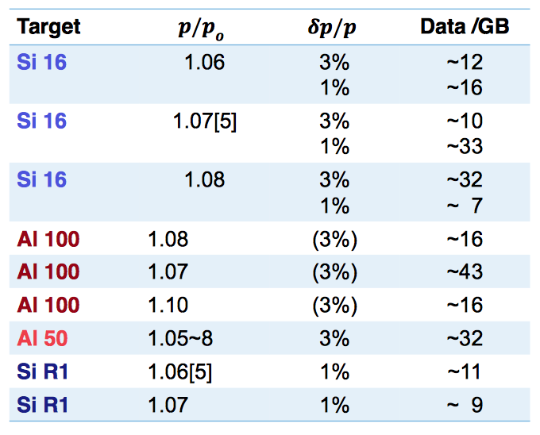
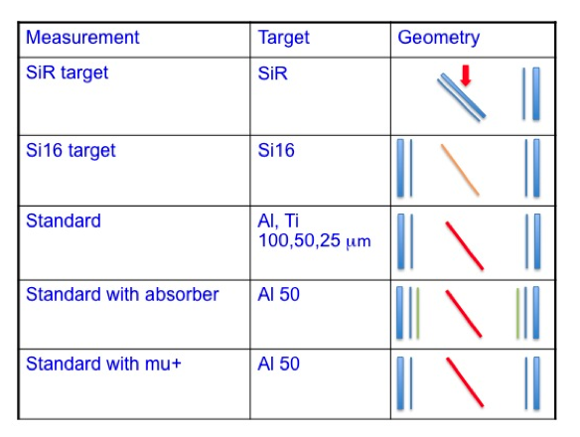
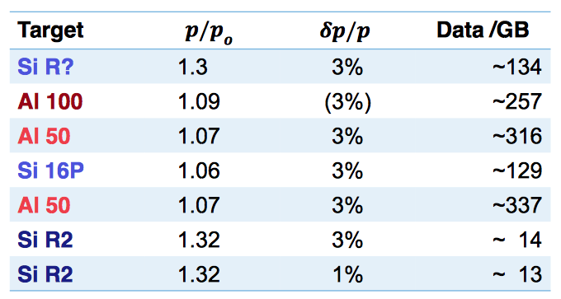
Measurements
Key ingredients
Beam
Si detector packages 65 μm
1500 μm
straggling
from Andy, Phill

Slide 6
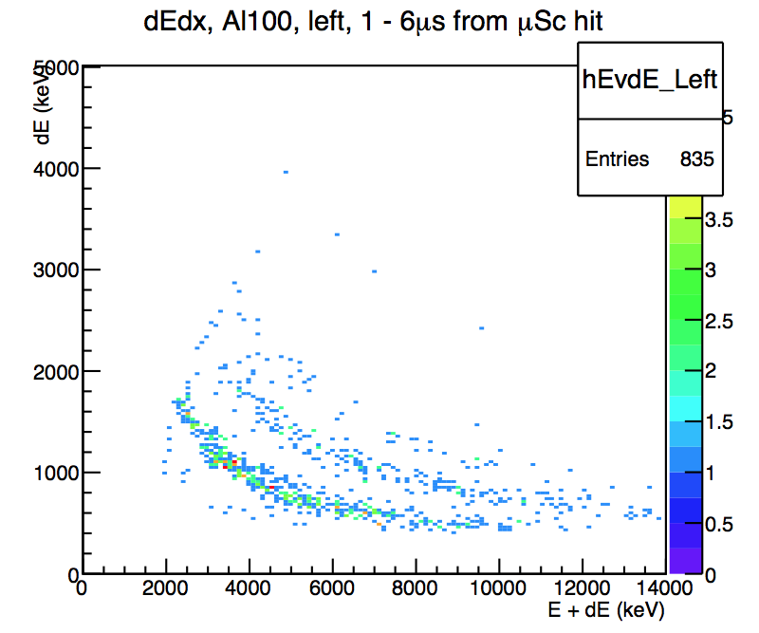
Systematics WP1
Absolute calibration
Muon stops in target
Proton detection efficiency
Deconvolution
Reconstruction of original f(E)
PID, very promising
Background
Target
Electrons
Neutrons
Wall
Protons
Thresholds and noise unstable
Si1, Si2 fast threshold effect on spectra
check with Ef x Es histograms
noise, threshold run history
Geometry, detector, electronics changes, position uncertainty
t
d
p
Si1 only?
6

Slide 7
Absolute Calibration
Charged particle efficiency
MC, study sensitivity to beam properties, mPC: x,y Turtle: x’,y’
Is thin SiR active/passive target emission consistent with measured f(E) in thick Si
energy calibration with Am-241, resolution, threshold quality
X-ray efficiency
γ sources
Si active target X-rays, consistent?
Consistent with calculated stopping fraction from E(SiR) vs p measurements ? Use range-energy and MC. Geometry documented?
Electrons
Try lifetime fit ?
Should work for thick Si target, questionable for thin targets
Use for roughly determining stopping fractions

Slide 8
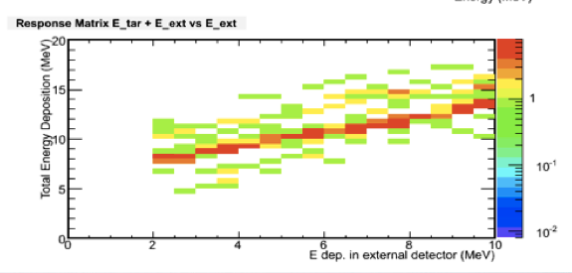
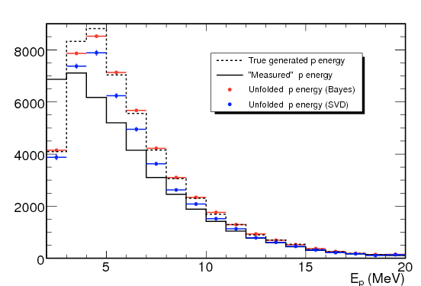
Deconvolution
Response matrix from
MC, input:
μ range distribution in target from thick Si
transverse distribution from mPC, MC eventually measure with Si16
Thick/thin Si target direct measurement
Yoshi: correct for capture recoil
Unfolding Methods
Nam
Vadim 2009*
Singular Value Decomposition
Bayesian
consistency different target thickness
Measured
Original
2009 run 1.5mm Si
* http://www-cdf.fnal.gov/~vrusu/psi/psi/Blog/Entries/2009/4/2_Unfolding_studies.html

Slide 9
Background
Target
Michel electrons: MIPS ΔE~40 keV in 100 μm
Cuts: ΔE vs E
Si veto scintillator
μ+ bg study
Neutrons
Cuts: ΔE vs E
Absorber bg study
Charged particles from wall + windows
Study time spectra, lifetimes
Active target analysis, explained next
Consistency with MC
Direct stops in Si counters
Study prompt correlations
Beam electrons

Slide 10
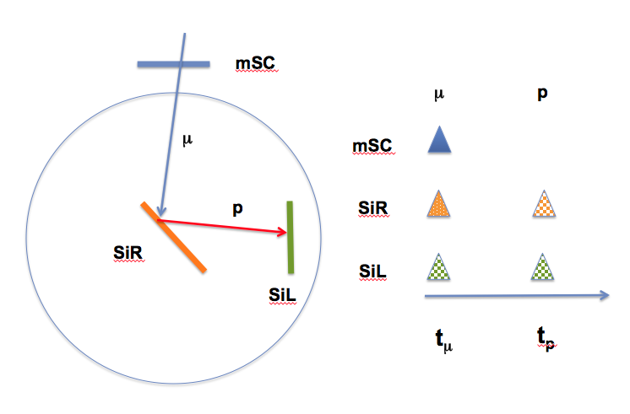
Active Target Analysis: Surface
Surface stop. Applicable to thin Si or surface stop in thick Si
Measure f(T) Si and confirm bg under control (see Michael’s talk)
initial cut mSC x !mSCa x mPC x !mV x PP
standard muon cut + prompt SiL veto
+SiR muon coinc
with cut 1
E(SiL), with delayed time cut
t(SiL), prompt peak ?
with cut 2
E(SiL), with delayed time time cut
t(SiL), lifetime ok ?
with cut 3
E(SiL) should be identical to above
t(SiL) if that’s the case, f(t) is clean
Spectra:
E(SiR) x t(SiR), time cuts on SiR-f
E(SiL) x t(SiL), time cuts on SiL-f
t(SiR) – t(SiL), E x t with coinc

Slide 11
Active Target Analysis: Center
Center stop. Determine f(E) Si.
standard muon cut + mu in SiR (defines normalization) compare mu SiR/mSC ratio to MC.
fast pulse analysis E x t SiR, time distribution, E spectra ?
can we do that with TFA undershoot ?
slow pulse analysis, only accept delayed, well separated pulses, pile up correction for slow pulses, improved energy resolution
MC corrections for escaped p, E<7 MeV should be save

Slide 12
AnalysisTopics
Thick silicon analysis
Active target analysis: surface
Active target analysis: center
Thin silicon analysis
passive like Al
Active target analysis: surface
Al measurements
standard muon cut
fast pulse analysis E x t
slow pulse analysis E x t
only one fast pulse
just use slow pulses, if double pulse prob small, lower, well defined threshold
consistency SiL/SiR
background estimation/subtraction
consistency f(t) different target thickness
X ray calibration
Response matrix k
thick/thin active target to determine k
Monte Carlo for k
Unfolding methods
Muon beam
measure p x E in SiR
MC predict stopping fractions, range distribution and compare to X-rays

Slide 13
mSC
μ
p
μ
mSC
SiR
SiL
p
SiR
SiL
t_{μ}
t_{p}

